Slide 1
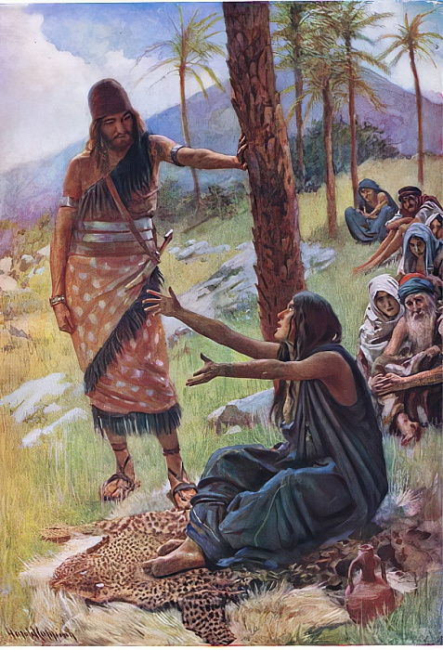
Deborah & barak
Radical action
Perth EOYS 2020

Slide 2
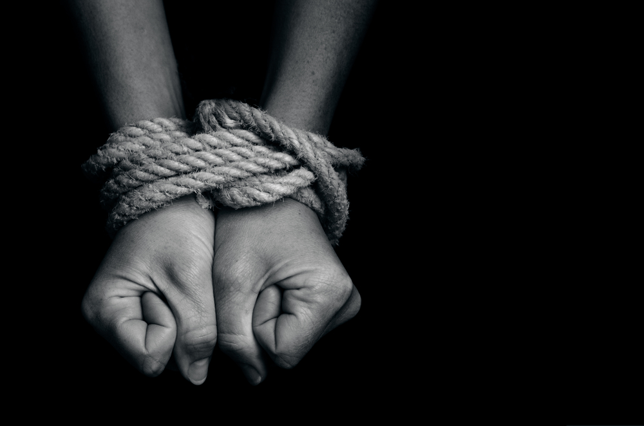
Rom 7v14
For we know that the law is spiritual, but I am of the flesh, sold under sin.

Slide 3
SoW
Deborah
Barak
Naphtali
Zebulun
Jael
SoS
Jabin
Sisera
Heber
Canaan
vs

Slide 4
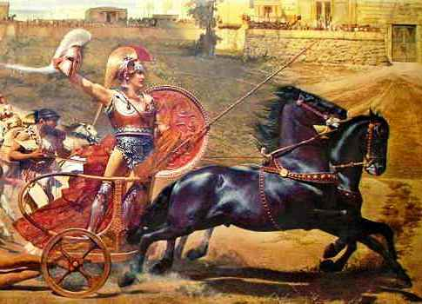
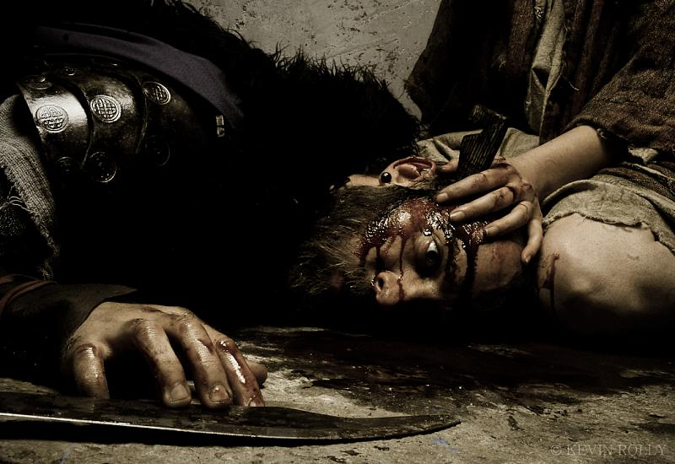
Who do you see?
or

Slide 5
SoW
Deborah
Barak
Naphtali
Zebulun
Jael
SoS
Jabin
Sisera
Heber
Canaan
vs

Slide 6
Barak: seed of the woman
Judg 5v12 Arise, Barak, lead away your captives…
Psa 68v19 The chariots of God are twice ten thousand, thousands upon thousands; the Lord is among them; v18 You ascended on high, leading a host of captives in your train and receiving gifts among men … God is our salvation. Selah. v21 But God will strike the heads of his enemies…
Eph 4v7 But grace was given to each one of us according to the measure of Christ's gift. v8 Therefore it says, “When he ascended on high he led a host of captives, and he gave gifts to men.”

Slide 7
SoW
Deborah
Barak
Naphtali
Zebulun
Jael
SoS
Jabin
Sisera
Heber
Canaan
vs

Slide 8
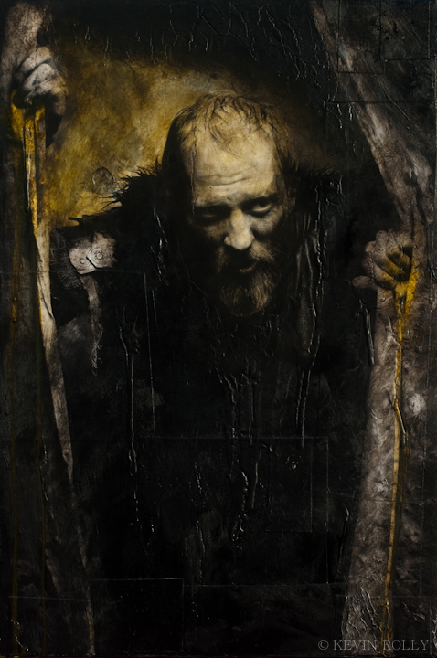

Slide 9
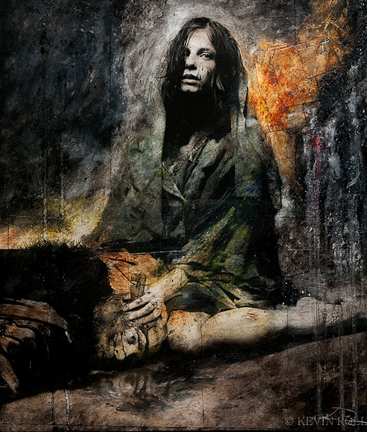

Slide 10
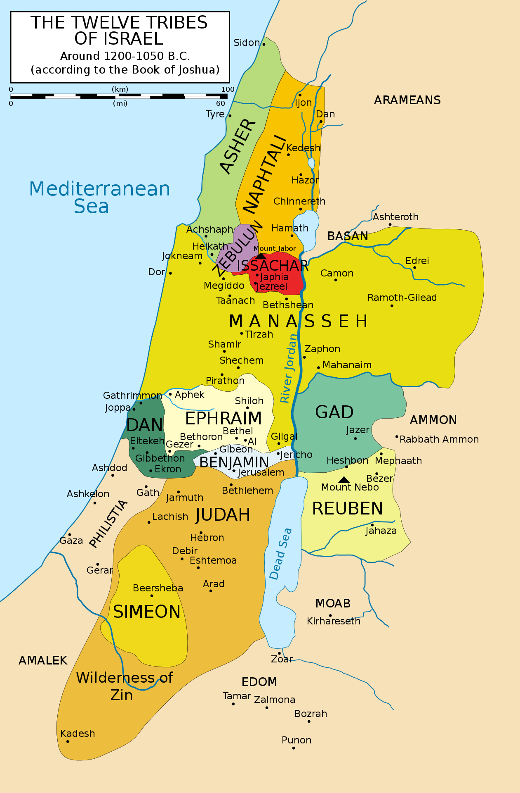
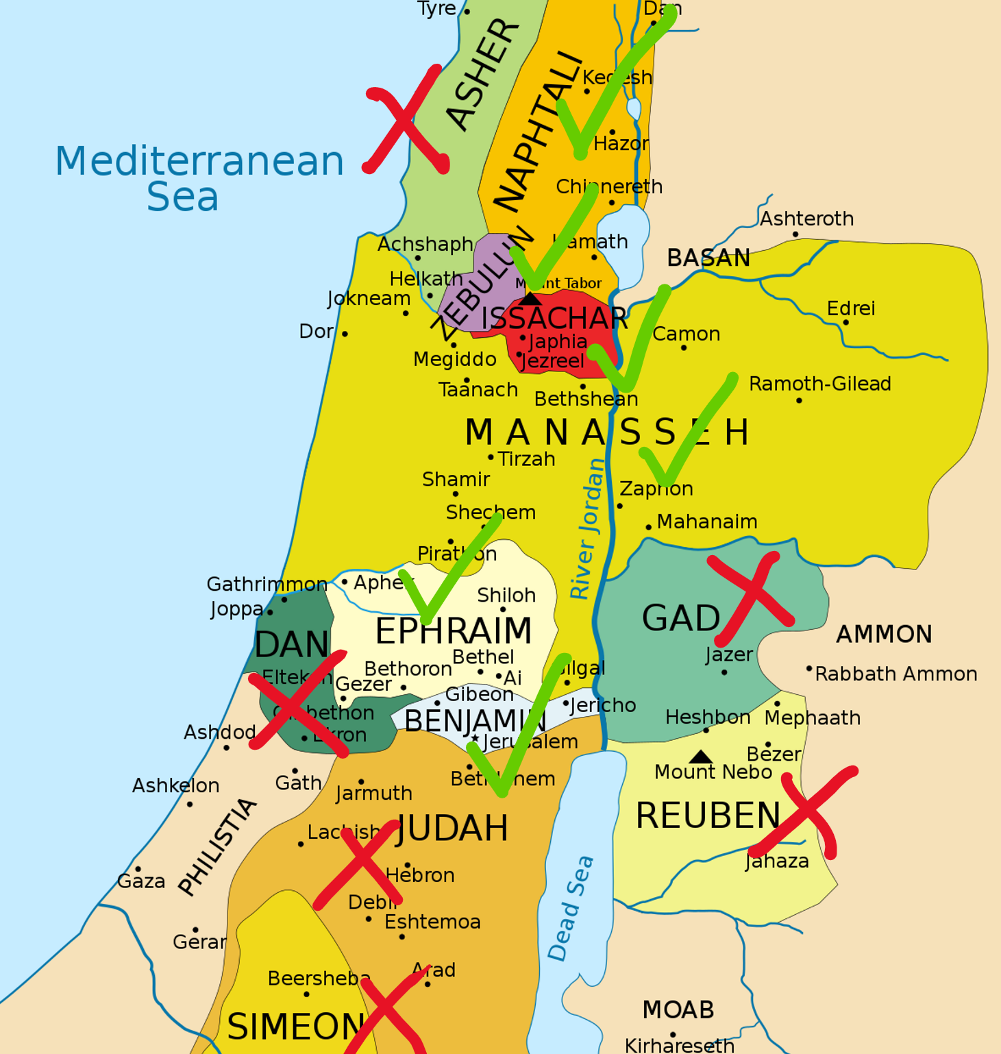
Acts 2v7 And they were amazed and astonished, saying, “Are not all these who are speaking Galileans?

Slide 11
which tribe are you?
Isa 9v1 But there will be no gloom for her who was in anguish. In the former time he brought into contempt the land of Zebulun and the land of Naphtali, but in the latter time he has made glorious the way of the sea, the land beyond the Jordan, Galilee of the nations.
2 The people who walked in darkness have seen a great light; those who dwelt in a land of deep darkness, on them has light shone.
Matt 4v12-17
1 Cor 1v26 For consider your calling, brothers: not many of you were wise according to worldly standards, not many were powerful, not many were of noble birth. 27 But God chose what is foolish in the world to shame the wise; God chose what is weak in the world to shame the strong; 28 God chose what is low and despised in the world, even things that are not, to bring to nothing things that are,

