Slide 1

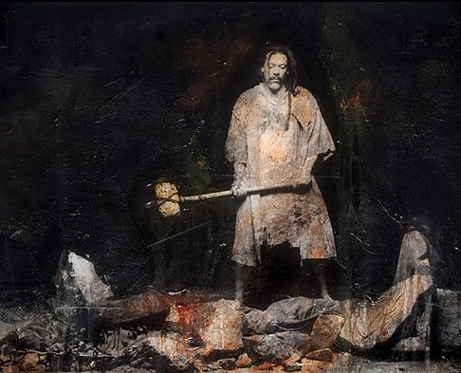
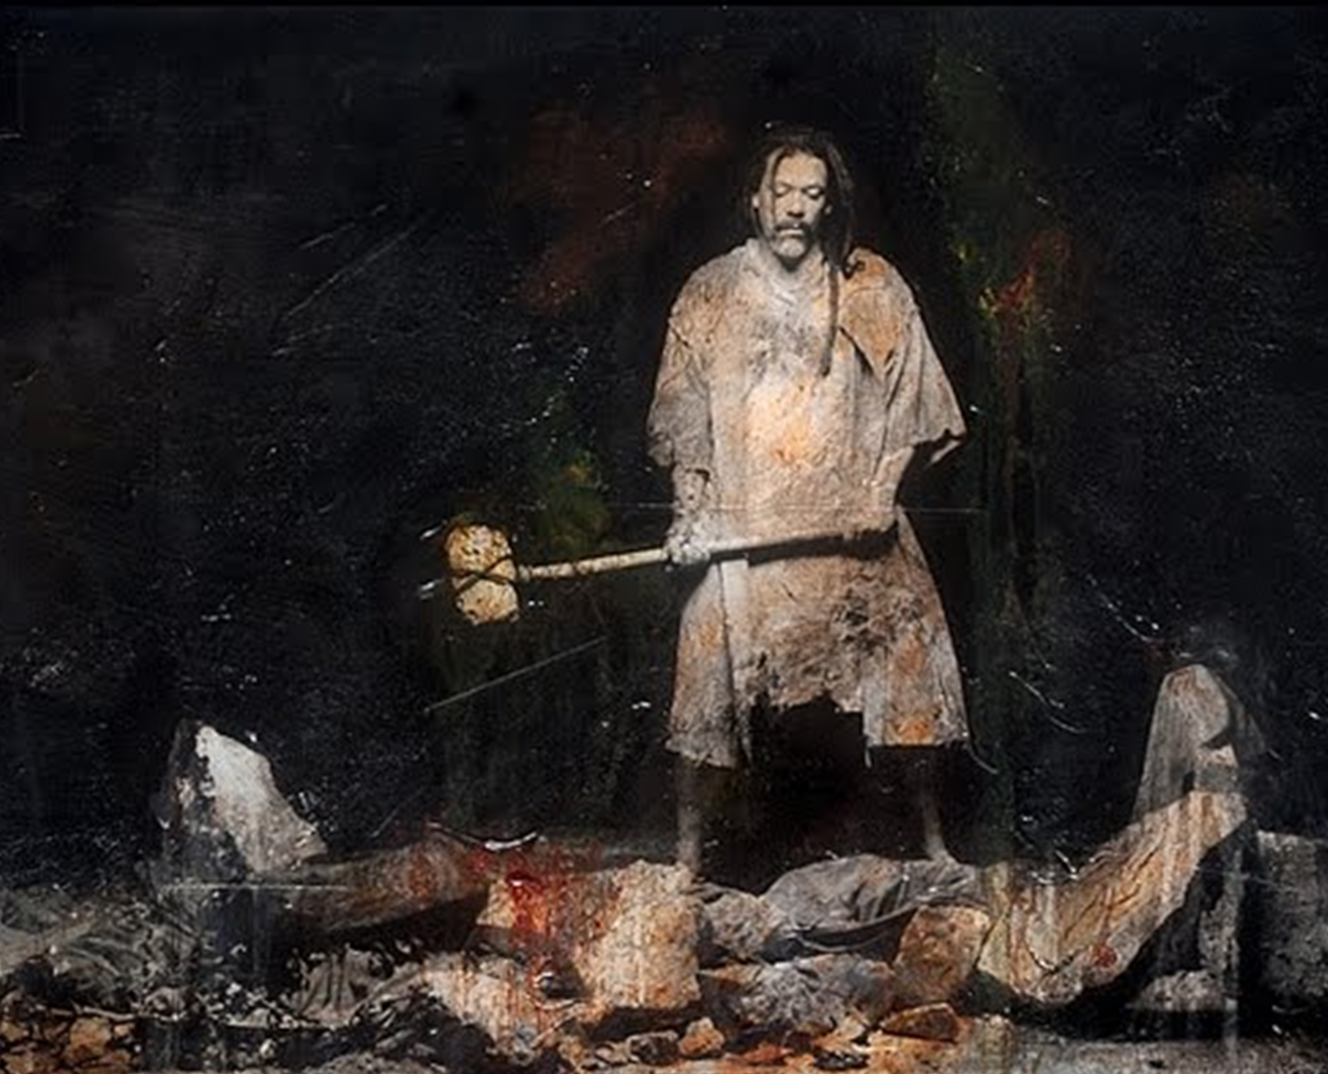
Gideon
Radical action
Perth EOYS 2020

Slide 2
The Oppressor
    6v4 & 5 And they encamped against them and destroyed the increase of the earth (Corrupted)
    For they (people, cattle, camels and tents) were without number and cam into the land to destroy it.
    Gan 6:12 Man corrupted the earth
    Ex 32:7 Israel corrupted themselves
    Duet 4:16 Warning by God they would be corrupted if they didn’t drive out the inhabitants

Slide 3
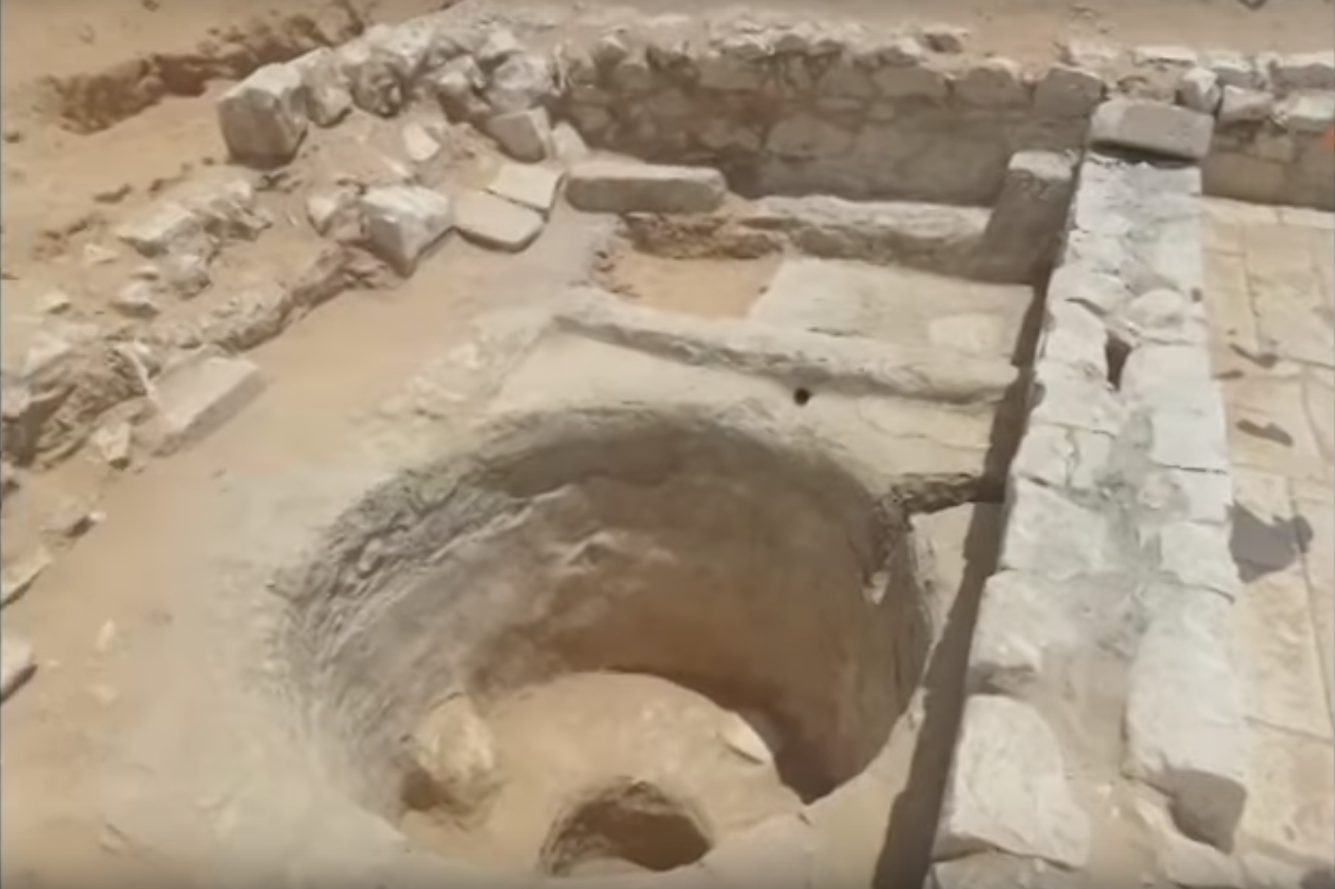
Mighty Man of Valour
Hiding in a Winepress
v6 - Impoverished: Feeble, dried up, emptied
v11 - threshed wheat in the winepress to hide from the Midianites.

Slide 4
Exodus 34:12-15
    Take care, lest you make a covenant with the inhabitants of the land to which you go, lest it become a snare in your midst. You shall tear down their altars and break their pillars and cut down their Asherim (for you shall worship no other god, for the Lord, whose name is Jealous, is a jealous God), lest you make a covenant with the inhabitants of the land, and when they whore after their gods and sacrifice to their gods and you are invited, you eat of his sacrifice.

Slide 5
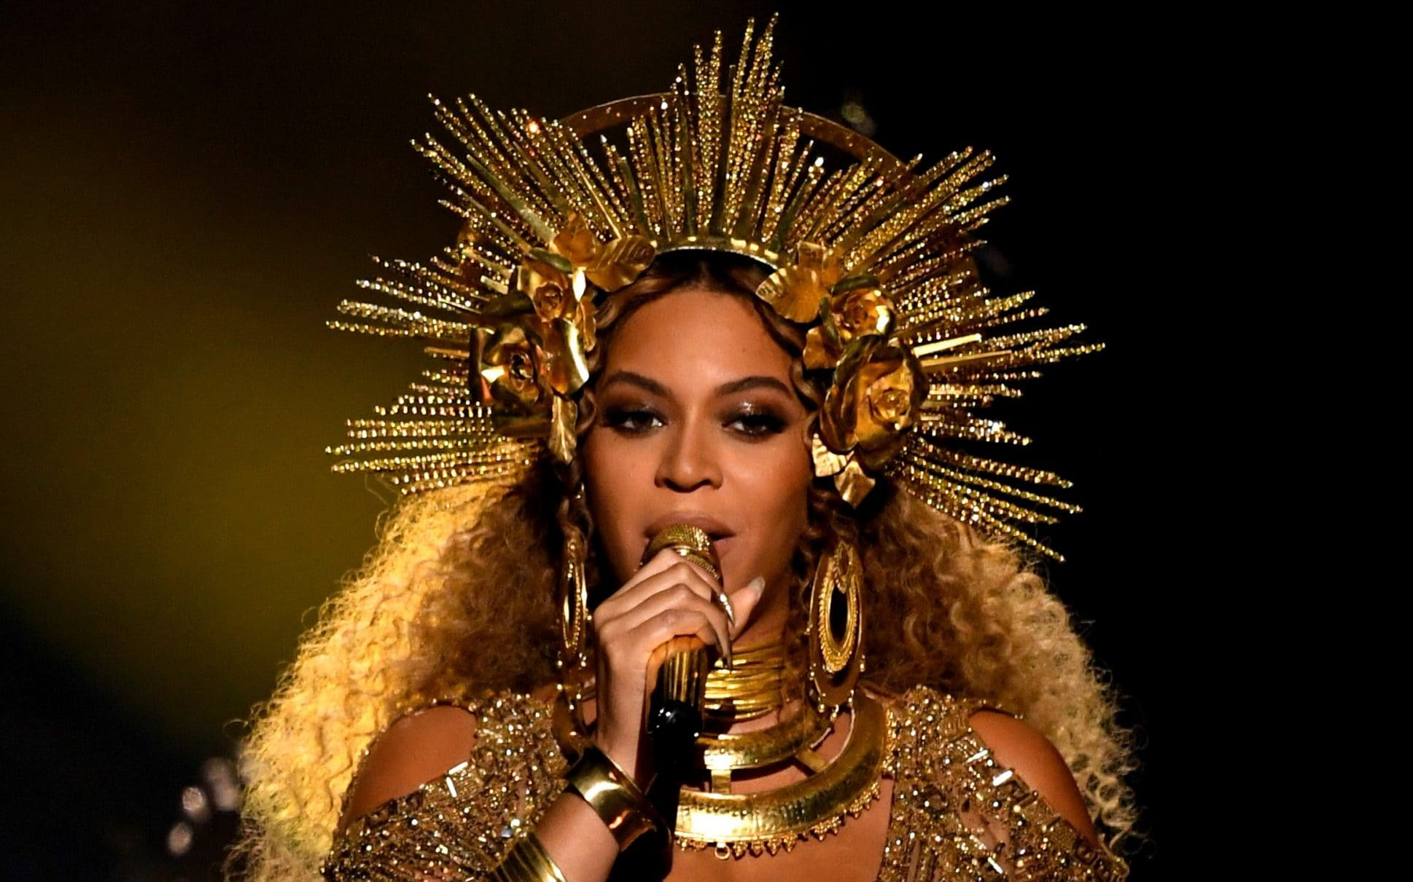
Baal and Ashteroth
Mobile Devices Social Media
You Tube Sports
Music Movies
Clothes Travel
Dining (Foodies) Career
Any worldly vice (addiction)

Slide 6

Abiezer v34
ten servants v27
Gideon v27
Joash v31
All Manasseh, Asher, Zebulun amd Naphtali v35

Slide 7
GOD
Christ
New Smart Phone
Netflix Account
Latest Fashions
Broadway Production
Video Games
Immorality
US

Slide 8
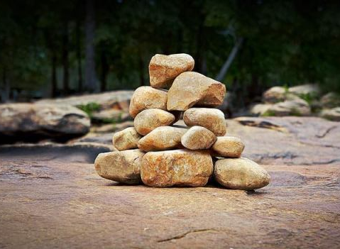
Building your altar
Verses and Quotes
Spiritual Pictures
Kids Sunday School Craft
Memorials in Our Yards
Signs on Our Walls, Doors & Gates
Quotes on Our Devices
Music in the House
Memories (Camps, Holy Days, etc…)

Slide 9
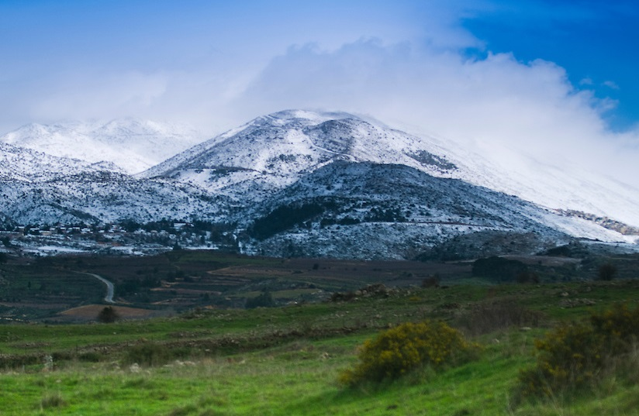
DEW
It is like the dew of Hermon, which falls on the mountains of Zion! For there the Lord has commanded the blessing, life forevermore.
Psalm 133:3

Slide 10
DEW
Is 26:19 Your dead shall live, their bodies shall rise. You who dwell in the dust awake and sing for Joy! For thy dew is the dew of light, and the earth will give birth to the dead.
Hos 14:5 I will be like the dew to Israel; he shall blossom like the lily; he shall take root like the trees of Lebanon; (Israel’s return to God and regeneration)
Further References; Duet 33:28-29, Micah 5:7, Zech 8:12-13,

Slide 11
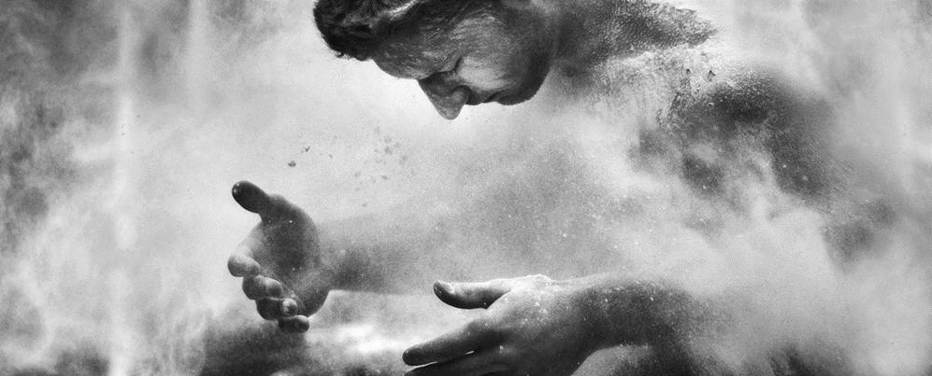
Dust
And the LORD God formed man of the dust of the ground and breathed into his nostrils the breath of life; and man became a living soul.
Gen 2:7

Slide 12
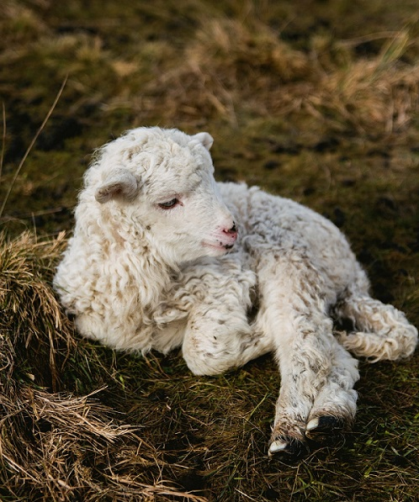
Fleece
“Behold, the Lamb of God, who takes away the sin of the world!
John 1:29

