Slide 1
Samuel
Radical Repentance
Radical action
Perth EOYS 2020

Slide 2
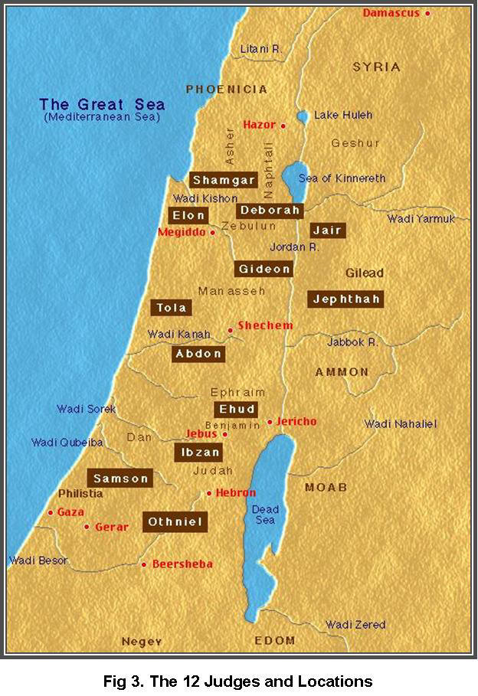

Slide 3
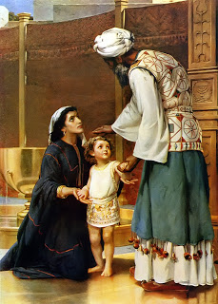

Slide 4
Syncretism

Slide 5
SEcuLAR Idolatry

Slide 6
Radical repentance

