Slide 1

HOW
PRESENT THE DEATH OF JESUS

Slide 2
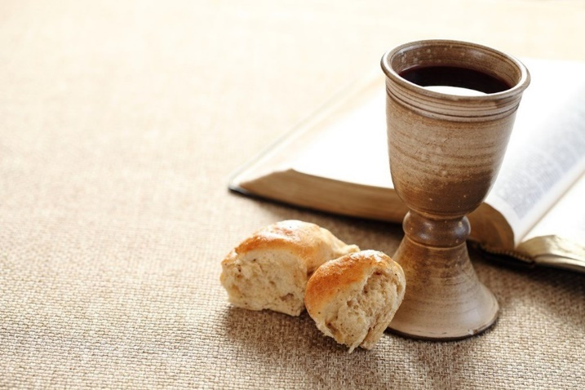
What Death do we proclaim when we eat bread & drink wine?
1Cor 11: 26 For as often as you eat this bread and drink this cup, you proclaim the Lord's death till He comes.
John 6: 53 Then Jesus said to them, "Most assuredly, I say to you, unless you eat the flesh of the Son of Man and drink His blood, you have no life in you. 54 Whoever eats My flesh and drinks My blood has eternal life, and I will raise him up at the last day. 55 For My flesh is food indeed, and My blood is drink indeed. 56 He who eats My flesh and drinks My blood abides in Me, and I in him.
This death has the power to change our lives!

Slide 3

Things to look for in the Gospel Record
Jesus & his Father are in this together – He is on the way to his Father
Jesus completely trusts God is in control
Jesus tries to help and protect his followers
No anger or vengeance from Jesus
Jesus doesn’t allow the devil in him to surface – he really does destroy the devil in himself
Jesus agrees with God’s decision that our nature is rightly related to death because it’s so prone to sin
“and the two of them went together” (Gen 22:6,8)

Slide 4
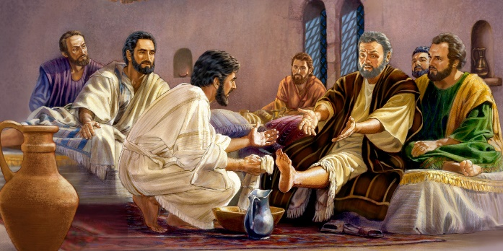
Jesus is focused on helping the Disciples
Lk 22:15 With fervent desire I have desired to eat this Passover [not the actual Passover] with you before I suffer
Jn 13 washes their feet, gives new commandment
Jn 14 I go to prepare a place for you, I will send the Helper
Jn 15 I am the true vine – abide in me
Jn 16 I have spoken to you so you won’t stumble
Jn 17 Prays for disciples & all who will believe
Even though he is facing crucifixion, Jesus focused on helping others

Slide 5

John 13:1
Jesus knows coming events would be terrible, but he focused on his commitment that this was the pathway to his Father
Now before the Feast of the Passover, when Jesus knew that His hour had come that He should depart from this world to the Father, having loved His own who were in the world, He loved them to the end.
We must have Jesus’ commitment that the events of this life are the training pathway to our future life in God’s family

Slide 6
Matthew 26:47-50
Judas betrays Jesus
47 And while He was still speaking, behold, Judas, one of the twelve, with a great multitude with swords and clubs, came from the chief priests and elders of the people.
48 Now His betrayer had given them a sign, saying, "Whomever I kiss, He is the One; seize Him." 49 Immediately he went up to Jesus and said, "Greetings, Rabbi!" and kissed Him.
50 But Jesus said to him, "Friend, why have you come?"
Then they came and laid hands on Jesus and took Him.
No anger or vengeance towards Judas

Slide 7
John 18:4-9
Jesus steps forward
4 Jesus therefore, knowing all things that would come upon Him, went forward and said to them, "Whom are you seeking?"
5 They answered Him, "Jesus of Nazareth."
Jesus said to them, "I am He." And Judas, who betrayed Him, also stood with them. 6 Now when He said to them, "I am He," they drew back and fell to the ground.
7 Then He asked them again, "Whom are you seeking?"
And they said, "Jesus of Nazareth."
8 Jesus answered, "I have told you that I am He. Therefore, if you seek Me, let these go their way," 9 that the saying might be fulfilled which He spoke, "Of those whom You gave Me I have lost none."
His focus was on protecting his disciples and growing their faith

Slide 8
John 18:10-11
Jesus heals Malchus
10 Then Simon Peter, having a sword, drew it and struck the high priest's servant, and cut off his right ear. The servant's name was Malchus.
11 So Jesus said to Peter, "Put your sword into the sheath. Shall I not drink the cup which My Father has given Me?"
Luke 22:49-51
49 When those around Him saw what was going to happen, they said to Him, "Lord, shall we strike with the sword?" 50 And one of them struck the servant of the high priest and cut off his right ear.
51 But Jesus answered and said, "Permit even this." And He touched his ear and healed him. [note the danger of a belief in a god of evil]
Healing unbelievers while being arrested

Slide 9
Matthew 26:52-56
Put your sword in its place
52 But Jesus said to him, "Put your sword in its place, for all who take the sword will perish by the sword. 53 Or do you think that I cannot now pray to My Father, and He will provide Me with more than twelve legions of angels? 54 How then could the Scriptures be fulfilled, that it must happen thus?"
55 In that hour Jesus said to the multitudes, "Have you come out, as against a robber, with swords and clubs to take Me? I sat daily with you, teaching in the temple, and you did not seize Me. 56 But all this was done that the Scriptures of the prophets might be fulfilled."
Then all the disciples forsook Him and fled.
All his friends left him, but Jesus trusted his Father’s pathway.

Slide 10
Luke 22:54-62
Peter denies knowing Jesus
54 Having arrested Him, they led Him and brought Him into the high priest's house. But Peter followed at a distance. 55 Now when they had kindled a fire in the midst of the courtyard and sat down together, Peter sat among them. 56 And a certain servant girl, seeing him as he sat by the fire, looked intently at him and said, "This man was also with Him."
57 But he denied Him, saying, "Woman, I do not know Him."
58 And after a little while another saw him and said, "You also are of them.“ But Peter said, "Man, I am not!"
59 Then after about an hour had passed, another confidently affirmed, saying, "Surely this fellow also was with Him, for he is a Galilean."
60 But Peter said, "Man, I do not know what you are saying!“ Immediately, while he was still speaking, the rooster crowed. 61 And the Lord turned and looked at Peter. Then Peter remembered the word of the Lord, how He had said to him, "Before the rooster crows, you will deny Me three times." 62 So Peter went out and wept bitterly.
Jesus had compassion even towards those who denied him

Slide 11
John 18:19-24
Jesus’ behavior before Annas
19 The high priest then asked Jesus about His disciples and His doctrine.
20 Jesus answered him, "I spoke openly to the world. I always taught in synagogues and in the temple, where the Jews always meet, and in secret I have said nothing. 21 Why do you ask Me? Ask those who have heard Me what I said to them. Indeed they know what I said."
22 And when He had said these things, one of the officers who stood by struck Jesus with the palm of his hand, saying, "Do You answer the high priest like that?"
23 Jesus answered him, "If I have spoken evil, bear witness of the evil; but if well, why do you strike Me?"
24 Then Annas sent Him bound to Caiaphas the high priest.
No threats, no verbal retaliation

Slide 12
Matthew 26:57-61
Jesus before Caiaphas & Sanhedrin
57 And those who had laid hold of Jesus led Him away to Caiaphas the high priest, where the scribes and the elders were assembled. 58 But Peter followed Him at a distance to the high priest's courtyard. And he went in and sat with the servants to see the end.
59 Now the chief priests, the elders, and all the council sought false testimony against Jesus to put Him to death, 60 but found none. Even though many false witnesses came forward, they found none. But at last two false witnesses came forward 61 and said, "This fellow said, 'I am able to destroy the temple of God and to build it in three days.'"
Jesus had to endure false witnesses, but doesn’t threaten them

Slide 13
Matthew 26:62-67
Jesus questioned by Caiaphas
62 And the high priest arose and said to Him, "Do You answer nothing? What is it these men testify against You?" 63 But Jesus kept silent. And the high priest answered and said to Him, "I put You under oath by the living God: Tell us if You are the Christ, the Son of God!"
64 Jesus said to him, "It is as you said. Nevertheless, I say to you, hereafter you will see the Son of Man sitting at the right hand of the Power, and coming on the clouds of heaven."
65 Then the high priest tore his clothes, saying, "He has spoken blasphemy! What further need do we have of witnesses? Look, now you have heard His blasphemy! 66 What do you think?"
They answered and said, "He is deserving of death."
67 Then they spat in His face and beat Him; and others struck Him with the palms of their hands, 68 saying, "Prophesy to us, Christ! Who is the one who struck You?"
Jesus was silent, then confessed he was the Christ

Slide 14
Luke 23:1-5
Jesus before Pilate
1 Then the whole multitude of them arose and led Him to Pilate. 2 And they began to accuse Him, saying, "We found this fellow perverting the nation, and forbidding to pay taxes to Caesar, saying that He Himself is Christ, a King."
3 Then Pilate asked Him, saying, "Are You the King of the Jews?"
He answered him and said, "It is as you say."
4 So Pilate said to the chief priests and the crowd, "I find no fault in this Man."
5 But they were the more fierce, saying, "He stirs up the people, teaching throughout all Judea, beginning from Galilee to this place."
Jesus endured all the false accusations, but confessed he was the King of the Jews

Slide 15
Luke 23:8-11
Jesus before Herod
8 Now when Herod [who killed John] saw Jesus, he was exceedingly glad; for he had desired for a long time to see Him, because he had heard many things about Him, and he hoped to see some miracle done by Him. 9 Then he questioned Him with many words, but He answered him nothing. 10 And the chief priests and scribes stood and vehemently accused Him. 11 Then Herod, with his men of war, treated Him with contempt and mocked Him, arrayed Him in a gorgeous robe, and sent Him back to Pilate.
Jesus didn’t revile or threaten

Slide 16
Luke 23:13-17
Pilate admits “nothing deserving of death”
13 Then Pilate, when he had called together the chief priests, the rulers, and the people, 14 said to them, "You have brought this Man to me, as one who misleads the people. And indeed, having examined Him in your presence, I have found no fault in this Man concerning those things of which you accuse Him; 15 no, neither did Herod, for I sent you back to him; and indeed nothing deserving of death has been done by Him. 16 I will therefore chastise Him and release Him" 17 (for it was necessary for him to release one to them at the feast).
Pilate admits Jesus’ innocence as Jesus silently endures

Slide 17
John 19:1-4
Pilate finds no fault in Jesus
1 So then Pilate took Jesus and scourged Him. 2 And the soldiers twisted a crown of thorns and put it on His head, and they put on Him a purple robe. 3 Then they said, "Hail, King of the Jews!" And they struck Him with their hands.
4 Pilate then went out again, and said to them, "Behold, I am bringing Him out to you, that you may know that I find no fault in Him."
Jesus endures scourging, beating, humiliation – but he doesn’t complain

Slide 18
Luke 23:18-25
The crowd demands he be crucified
18 And they all cried out at once, saying, "Away with this Man, and release to us Barabbas" — 19 who had been thrown into prison for a certain rebellion made in the city, and for murder.
20 Pilate, therefore, wishing to release Jesus, again called out to them. 21 But they shouted, saying, "Crucify Him, crucify Him!"
22 Then he said to them the third time, "Why, what evil has He done? I have found no reason for death in Him. I will therefore chastise Him and let Him go."
23 But they were insistent, demanding with loud voices that He be crucified. And the voices of these men and of the chief priests prevailed. 24 So Pilate gave sentence that it should be as they requested. 25 And he released to them the one they requested, who for rebellion and murder had been thrown into prison; but he delivered Jesus to their will.
Jesus didn’t verbally retaliate, but trusted his Father

Slide 19
Luke 23:27-31, 34
Jesus still had compassion
27 And a great multitude of the people followed Him, and women who also mourned and lamented Him. 28 But Jesus, turning to them, said, "Daughters of Jerusalem, do not weep for Me, but weep for yourselves and for your children. 29 For indeed the days are coming in which they will say, 'Blessed are the barren, wombs that never bore, and breasts which never nursed!' 30 Then they will begin 'to say to the mountains, "Fall on us!" and to the hills, "Cover us!"' 31 For if they do these things in the green wood, what will be done in the dry?"
34 Then Jesus said, "Father, forgive them, for they do not know what they do."
Jesus knew God would raise him, but felt sorry for those who were facing terrible persecution

Slide 20
Matthew 27:35
They crucified Him
35 Then they crucified Him, and divided His garments, casting lots,
Mark 15:24
24 And when they crucified Him, they divided His garments,
Luke 23:33
when they had come to the place called Calvary, there they crucified Him,
John 19:23
Then the soldiers, when they had crucified Jesus, took His garments and made four parts,
No mention of the pain or agony

Slide 21
Mark 15:27-28
Crucified with criminals
27 With Him they also crucified two robbers, one on His right and the other on His left. 28 So the Scripture was fulfilled which says, "And He was numbered with the transgressors."
Innocent Jesus was associated with criminals, but he did not attempt to justify himself or retaliate against his false accusers

Slide 22
Mark 15:29-32
Everyone mocked & reviled Jesus
29 And those who passed by blasphemed Him, wagging their heads and saying, "Aha! You who destroy the temple and build it in three days, 30 save Yourself, and come down from the cross!"
31 Likewise the chief priests also, mocking among themselves with the scribes, said, "He saved others; Himself He cannot save. 32 Let the Christ, the King of Israel, descend now from the cross, that we may see and believe."
Even those who were crucified with Him reviled Him.
Jesus trusted God & accepted it all

Slide 23
John 19:25-27
Jesus cares for Mary
25 Now there stood by the cross of Jesus His mother, and His mother's sister, Mary the wife of Clopas, and Mary Magdalene. 26 When Jesus therefore saw His mother, and the disciple whom He loved standing by, He said to His mother, "Woman, behold your son!" 27 Then He said to the disciple, "Behold your mother!" And from that hour that disciple took her to his own home.
Caring for others while suffering himself

Slide 24
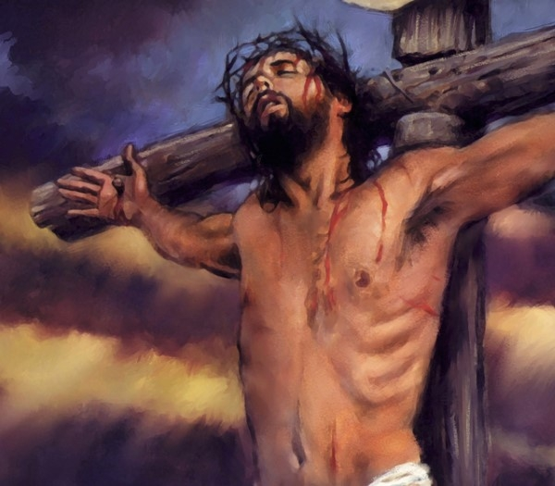
What’s missing from the gospel records of the crucifixion of Jesus that we would have recorded?
Detailed descriptions of the violence and torture done to Jesus before he was crucified – you would expect to read this if Jesus was being punished instead of you or paying for your sins
The horrible pain he felt as the nails were driven into him and the pole was dropped into the ground.
Graphic depictions of the agony Jesus experiences during the hours he hung on the cross.
Timeline of the energy being drained from Jesus as he suffered and endured.
That’s not what God wants us to remember and not what motivates us to join him in a death like his

Slide 25

Warning: God cannot save us by having…
Jesus die instead of us
Jesus be tortured for us
Jesus be punished for our sins
Jesus show us what sinners deserve
This is not the righteousness of God and lacks the power needed to fight Sin and destroy the devil

Slide 26
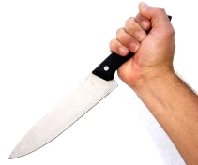

Christ’s Death was to Destroy Sin
Heb 2:14 that through death He might destroy him who had the power of death, that is, the devil,
1 Jn 3:5 He was manifested to take away our sins
1 Jn 3:8 For this purpose the Son of God was manifested, that He might destroy the works of the devil.
Heb 9:26 He has appeared to put away sin by the sacrifice of Himself.
Jn 1:29 The Lamb of God who takes away the sin of the world!
1 Pet 2:24 who Himself bore our sins in His own body on the tree
No matter what, Jesus never gave in to Sin

Slide 27
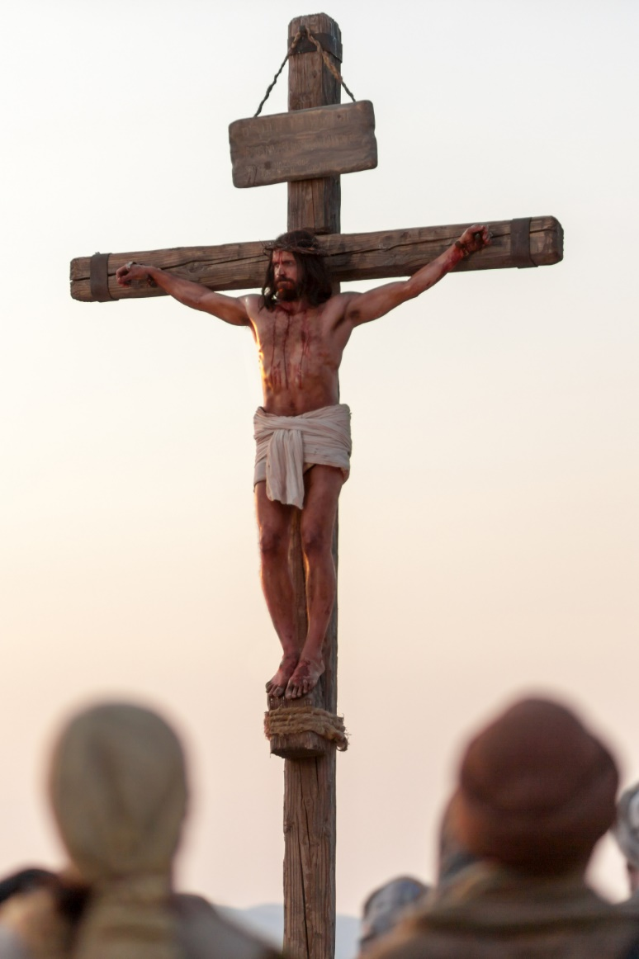
We must have the right perspective
Which one pleased God?
God wants us to see that Jesus killed the Devil (the power of Sin) to show us God’s right way to live
The Romans and Jews tortured & killed Jesus because they thought he deserved it
Which one has the power to change your life?

Slide 28
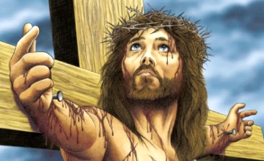
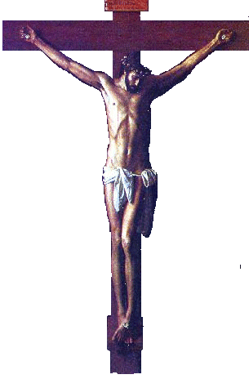
On the Cross….
Christ was not suffering some other person’s punishment
Christ was not illustrating the punishment sinners deserve
Christ did not deserve the cross because he had human nature
Christ was not going through a ritual or ceremony to save us
Christ showed us how to live the righteousness of God in our daily lives: “die to sin” and “live to righteousness”

Slide 29
Jesus Christ is our Representative
Substitution
1. Jesus died in my place as my substitute, instead of me
2. Jesus took my place and suffered the punishment I deserve
3. Therefore, I can escape punishment since all my sins (past, present and future) have been borne away by Christ
Representation:
1. Jesus died to redeem himself, as my representative (as one of us)
2. Jesus was not suffering anyone’s punishment. He willingly died to show me that Sin must be conquered and put to death to do God’s will.
3. Therefore, I must follow Christ’s example, put to death my evil desires, and live for God. God will forgive my sins because I am in Christ, walking with him.
Representation motivates us to join Christ in a death like his

Slide 30
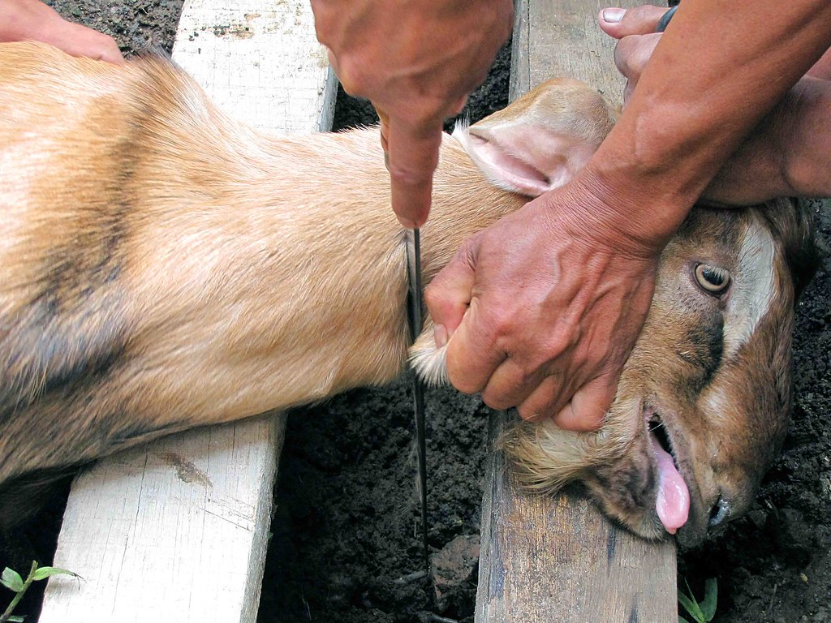
Animal Sacrifice
Identify with Christ, and commit to join him in a death like his. The animal died to show us how we should live!
God tried to get worshippers to join Messiah in a death like his

Slide 31
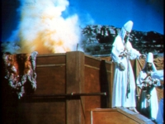
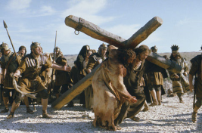
Misconceptions about animal sacrifice
The animal died instead of me
The animal died to show me what I deserve – a violent death!
Remember: The animal represented sinless Jesus Christ! He died to show us the way back to God – put Sin to death & do God’s will

Slide 32
1 Peter 2:20-24
Jesus died to show us how to live
But when you do good and suffer, if you take it patiently, this is commendable before God. 21 For to this you were called, because Christ also suffered for us, leaving us an example, that you should follow His steps:
22 "Who committed no sin, Nor was deceit found in His mouth";
23 who, when He was reviled, did not revile in return; when He suffered, He did not threaten, but committed Himself to Him who judges righteously; 24 who Himself bore our sins in His own body on the tree, that we, having died to sins, might live for righteousness — by whose stripes you were healed.
We must take up our cross daily & follow him

Slide 33
Romans 6:3-7
Join Christ in his death to Sin
Or do you not know that as many of us as were baptized into Christ Jesus were baptized into His death? 4 Therefore we were buried with Him through baptism into death, that just as Christ was raised from the dead by the glory of the Father, even so we also should walk in newness of life.
5 For if we have been united together in the likeness of His death, certainly we also shall be in the likeness of His resurrection, 6 knowing this, that our old man was crucified with Him, that the body of sin might be done away with, that we should no longer be slaves of sin.
We must walk in newness of life

Slide 34
2 Cor 4:7-12
Our new life is all of God
7 But we have this treasure in earthen vessels, that the excellence of the power may be of God and not of us. 8 We are hard-pressed on every side, yet not crushed; we are perplexed, but not in despair; 9 persecuted, but not forsaken; struck down, but not destroyed — 10 always carrying about in the body the dying of the Lord Jesus, that the life of Jesus also may be manifested in our body. 11 For we who live are always delivered to death for Jesus' sake, that the life of Jesus also may be manifested in our mortal flesh. 12 So then death is working in us, but life in you.
We must manifest the life of Jesus

Slide 35
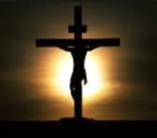
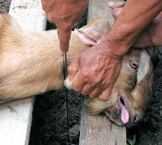
Jesus didn’t need a sacrifice – he was the reality that was shadowed by sacrifice!
In Hebrews, Paul uses the language of the Law to show the Jews that even their Law predicted “better sacrifices”
In Romans, Paul deals with these same issues, but confronts them without the language of sacrifices and offerings. “united together in the likeness of his death
Remember: Jesus is the reality, the sacrifices of the Law were only shadows.
Don’t make Jesus fit the shadows!

Slide 36

The message of the cross is the power of God for those who are being saved (1 Cor 1:18)
In God’s love & wisdom He provided
Jesus declared God right for requiring us to put to Sin to death
The death of Jesus demonstrated God’s love for us – how far God was willing to go – to save us into His family forever. [Love based, not fear!]
This has power to motivate us to join with Christ in a death like his (Rom 6:5) – his death to Sin
This is the strongest motivation God has provided

Slide 37
What Death do we proclaim when we eat bread & drink wine?
1Cor 11: 26 For as often as you eat this bread and drink this cup, you proclaim the Lord's death till He comes.
John 6: 53 Then Jesus said to them, "Most assuredly, I say to you, unless you eat the flesh of the Son of Man and drink His blood, you have no life in you. 54 Whoever eats My flesh and drinks My blood has eternal life, and I will raise him up at the last day. 55 For My flesh is food indeed, and My blood is drink indeed. 56 He who eats My flesh and drinks My blood abides in Me, and I in him.
This death has the power to change our lives!

Slide 38
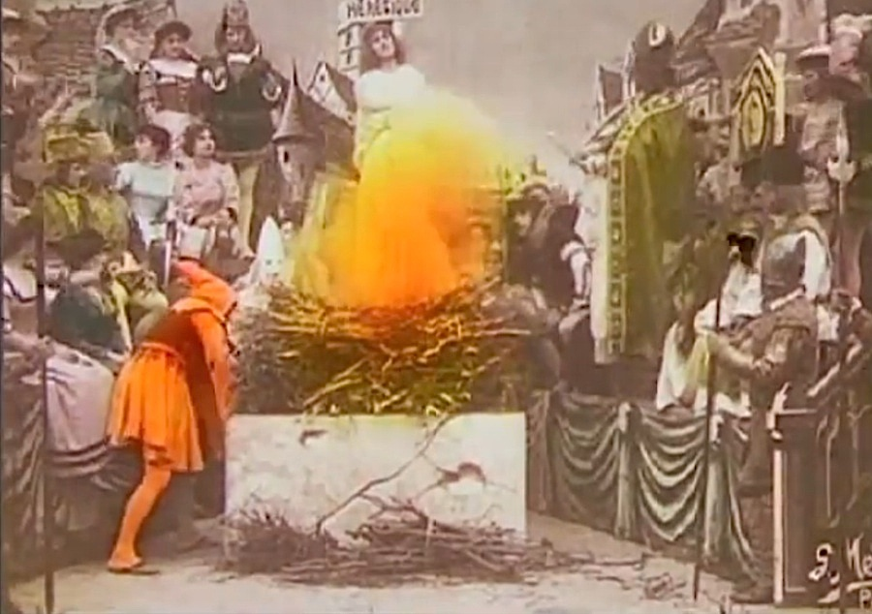
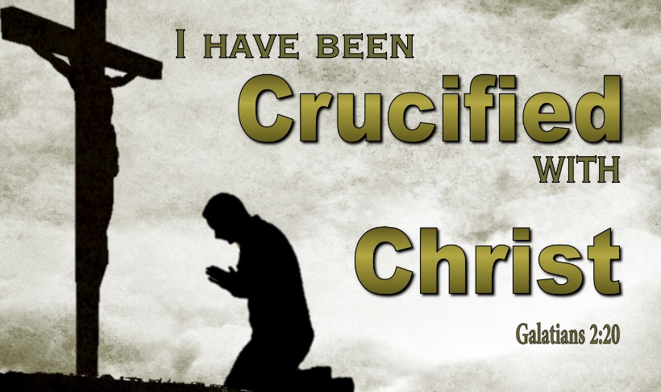
This class in no way minimizes the suffering Jesus went through for us!
But many humans have suffered torturous painful deaths, and they cannot save anyone!
When we join Christ in his death to Sin, God will give us eternal life

Slide 39
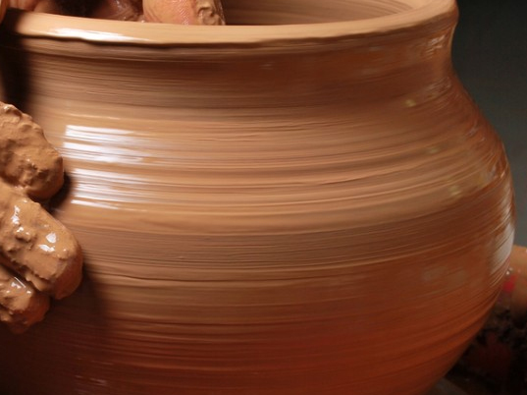
If we trust God, He will shape us into the image of Christ…
the same way He shaped His Son into His own image

Slide 40
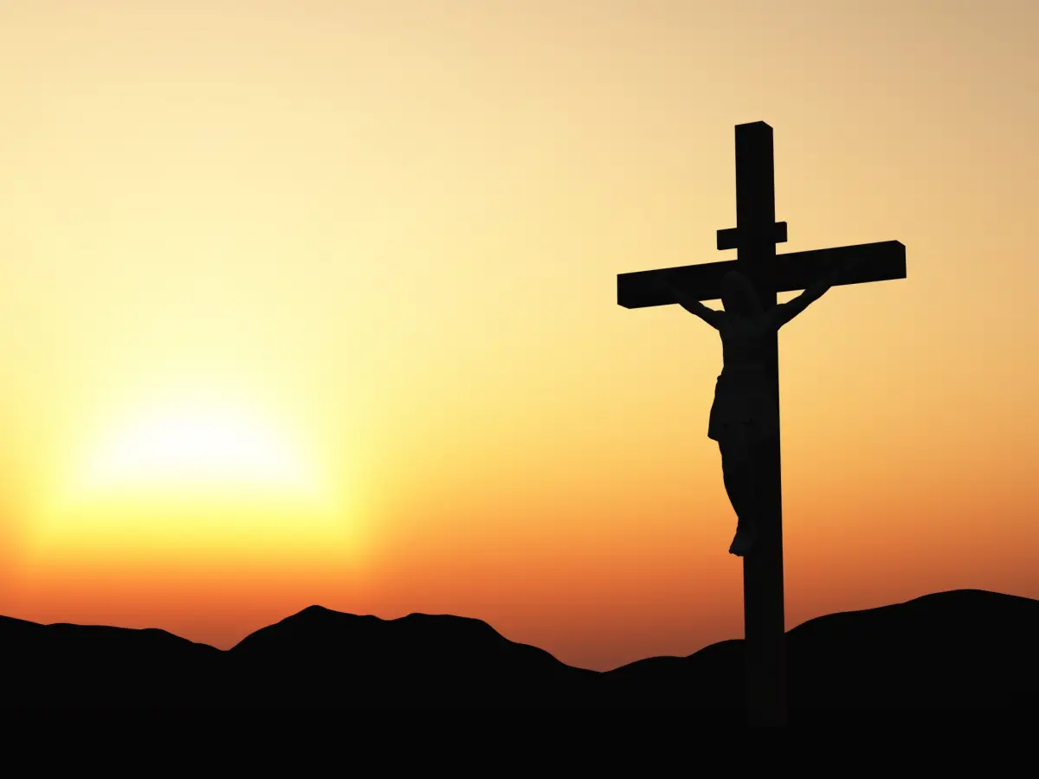
Let God’s power – through the power of the cross – motivate us to die daily to Sin, and live to God, like Jesus Christ our Lord – for we are “saved by his life”

