Slide 1
HISTORY OF CHRISTIANITY
Why should this topic be of interest to us?
It can provide us with a better understanding of prophecy (fulfilled and fulfilling)
It can provide us with a better understanding of the background of present circumstances
It reminds us about the importance of God’s word
It reminds us that God seeks to perfect his children through trials

Slide 2
HISTORY OF CHRISTIANITY - Part I
The First Century
- the spread of the Gospel
- the emergence of false Christianity
- the emergence of persecution
The Second and Third Century
- the growth of false Christianity
- persecution intensifies
The Fourth Century
- false Christianity is enthroned
- false Christianity flourishes & persecutes

Slide 3
1st Century Warning about the Apostasy
Let no one in any way deceive you, for it will not come unless the apostasy comes first, and the man of lawlessness is revealed, the son of destruction, who opposes and exalts himself above every so-called god or object of worship, so that he takes his seat in the temple of God, displaying himself as being God. Do you not remember that while I was still with you, I was telling you these things? And you know what restrains him now, so that in his time he may be revealed. For the mystery of lawlessness is already at work; only he who now restrains will do so until he is taken out of the way. And then that lawless one will be revealed whom the Lord will slay with the breath of His mouth and bring to an end by the appearance of His coming;
(2 Thess 2:3-8 NAS)

Slide 4
1st Century Warning about the Apostasy
Let no man deceive you by any means: for that day shall not come, except there come a falling away first, and that man of sin be revealed, the son of perdition; Who opposeth and exalteth himself above all that is called God, or that is worshipped; so that he as God sitteth in the temple of God, shewing himself that he is God. Remember ye not, that, when I was yet with you, I told you these things? And now ye know what withholdeth that he might be revealed in his time. For the mystery of iniquity doth already work: only he who now letteth will let, until he be taken out of the way. And then shall that Wicked be revealed, whom the Lord shall consume with the spirit of his mouth, and shall destroy with the brightness of his coming
( 2 Thess 2:3-8 KJV)

Slide 5
The Son of Perdition
Let no man deceive you by any means: for that day shall not come, except there come a falling away first, and that man of sin be revealed, the son of perdition; Who opposeth and exalteth himself above all that is called God, or that is worshipped; so that he as God sitteth in the temple of God, shewing himself that he is God. ( 2 Thess 2:3-8 KJV)
While I was with them in the world, I kept them in thy name: those that thou gavest me I have kept, and none of them is lost, but the son of perdition; that the scripture might be fulfilled. (John 17:12)

Slide 6
The Restraining Power
Peter: “Be sober, be vigilant; because your adversary the devil, as a roaring lion, walketh about, seeking whom he may devour” (1 Pet 5:8)
Paul: “I was delivered out of the mouth of the lion” (2 Tim 4:17)
Jesus: “behold, the devil shall cast some of you into prison, that ye may be tried; and ye shall have tribulation ten days” (Rev 2:10)
“I know thy works, and where thou dwellest, even where Satan's seat is” (Rev 2:13)
Restraining Power = Pagan Roman Authorities

Slide 7
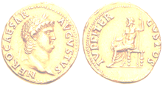
Persecution under Nero (54-68)
“Nero substituted as culprits, and punished with the utmost refinements of cruelty, a class of men, loathed for their vices, whom the crowd styled Christians…”
(Tacitus, Annals)

Slide 8
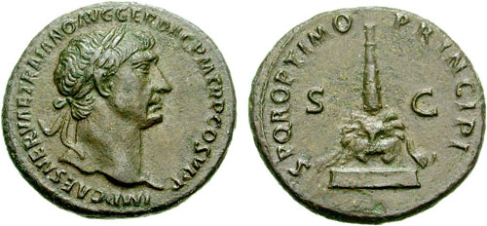
Persecution under Trajan (98-117)
“I asked at their own lips whether they were Christians, and if they confessed, I asked them a second and third time with threats of punishment. If they kept to it, I ordered them for execution.”
(Pliny to Trajan)

Slide 9
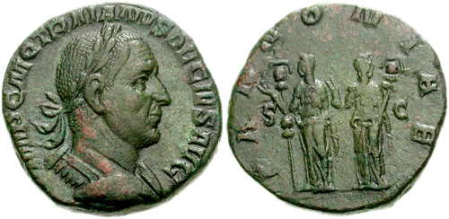
Persecution under Decius (249-51)
“The requirement was for all free inhabitants of the Empire, men, women and children, to sacrifice to the gods of the Empire, pour a libation, and taste sacrificial meat. The penalty for refusal was death.”
(W.H.C. Frend, Martyrdom and Persecution, p.407)

Slide 10
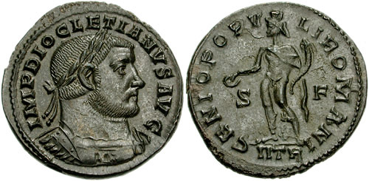
Persecution under Diocletian (303-12)
‘The Great Persecution’
“Imperial edicts were published everywhere ordering that the churches be razed to the ground, that the Scriptures be destroyed by fire, that those holding office be deposed and they of the household be deprived of freedom, if they persisted in the profession of Christianity.”
(Eusebius, Ecclesiastical History, IX.x.8)

Slide 11
False Teaching in the 2nd Century
Clement (150-215)
“Clement held that large elements in Greek philosophic thought were true, and that a Christian who combined them with his faith was a more perfect, well-equipped Christian than an uneducated one who had his faith only, and the more perfect Christian he did not shrink from calling a ‘Gnostic’. He loved his Plato as well as his New Testament, and declared that for the Greeks philosophy had been the tutor leading to Christ, as Paul said that the Law had been for the Jews.”
(Bevan, History of Christianity, p.75-6)

Slide 12
False Teaching in the 3rd Century
Origen (185-253)
“Origen…was the principal moulder of thought all over the Christian world in succeeding generations. He believed in reincarnation, and held that all souls, angels, men and devils, had originally existed in a state of absolute equality in heaven; from the state they had fallen individually to different levels. Of course, in his voluminous works there was a great deal which subsequent Christian teachers felt they could appropriate, so that the actual influence of Origen in the shaping of Christian theology was immense.”
(Bevan, History of Christianity, p.76-7)

Slide 13
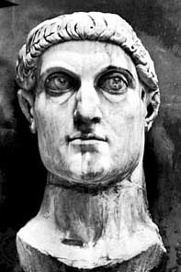
False Christianity is Enthroned Constantine - The First “Christian” Emperor
“Constantine is, of course, best known as the first Christian emperor, and it is predominantly for his conversion of the Roman imperial state to Christianity that he became famous”.
(Michael Grant, Constantine the Great, p. 221)

Slide 14
A Great Earthquake
And I beheld when he had opened the sixth seal, and, lo, there was a great earthquake; and the sun became black as sackcloth of hair, and the moon became as blood;
And the stars of heaven fell unto the earth, even as a fig tree casteth her untimely figs, when she is shaken of a mighty wind.
And the heaven departed as a scroll when it is rolled together; and every mountain and island were moved out of their places. (Rev 6:12-13)

Slide 15
Sun, Moon, and Stars in Heaven
And God made two great lights; the greater light to rule the day, and the lesser light to rule the night: he made the stars also.
And God set them in the firmament of the heaven to give light upon the earth,
And to rule over the day and over the night, and to divide the light from the darkness: and God saw that it was good.
(Genesis 1:16-18)

Slide 16
Constantine’s Revolution
“The reign of Constantine the Great forms one of the epochs in the history of the world. It is the era of the dissolution of the Roman Empire; the commencement, or rather consolidation, of a kind of Eastern despotism, with a new capital, a new patriciate, a new constitution, a new financial system, a new, though as yet imperfect, jurisprudence, and, finally, a new religion.”
(H.H. Milman, The History of Christianity, v. 2, p. 241)

Slide 17
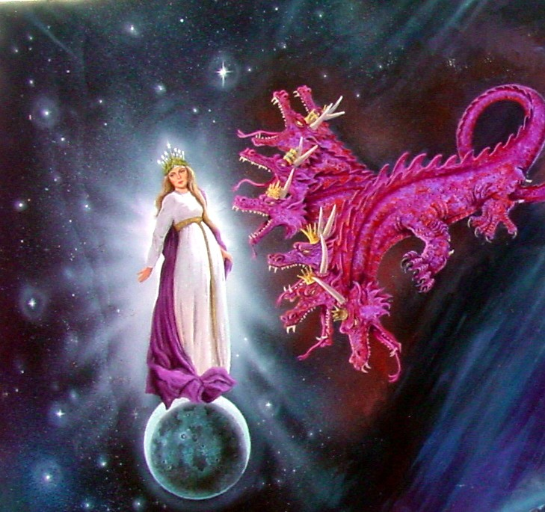
The Vision of the Woman & the Dragon
Revelation 12

Slide 18
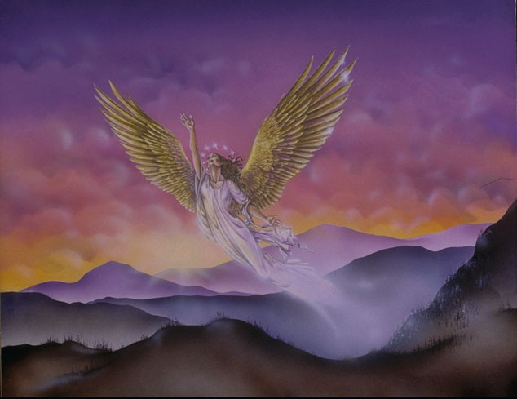
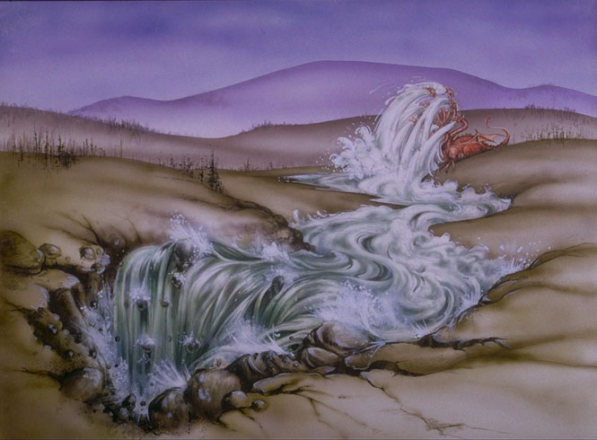
The Vision of the Woman & the Dragon

Slide 19
The Vision of the Woman & the Dragon
Heaven = Exalted status, political power
Woman with child = Corrupted Church
For I am jealous over you with godly jealousy: for I have espoused you to one husband, that I may present you as a chaste virgin to Christ.
But I fear, lest by any means, as the serpent beguiled Eve through his subtilty, so your minds should be corrupted from the simplicity that is in Christ.
(2 Cor 11:2-3)

Slide 20
The Vision of the Woman & the Dragon
Crown = Victory
Know ye not that they which run in a race run all, but one receiveth the prize? So run, that ye may obtain.
And every man that striveth for the mastery is temperate in all things. Now they do it to obtain a corruptible crown; but we an incorruptible.
(1 Cor 9:24-25)

Slide 21
The Vision of the Woman & the Dragon
Great Red Dragon = Roman Imperial Power
After this I saw in the night visions, and behold a fourth beast, dreadful and terrible, and strong exceedingly; and it had great iron teeth: it devoured and brake in pieces, and stamped the residue with the feet of it: and it was diverse from all the beasts that were before it; and it had ten horns.
(Dan 7:7)

Slide 22
The Vision of the Woman & the Dragon
Man child = Saviour, Deliverer
For unto you is born this day in the city of David
a Saviour, which is Christ the Lord.
(Luke 2:11)

Slide 23
Interpretation of the Vision
Heaven = Position of strength and authority
The Woman = Corrupt Christianity
The Dragon = Roman Imperial Power
Man child / Michael = Constantine
“travailing in birth” = 10 days before birth
10 years of persecution under Diocletian (303-312)
“a man child” = 280 days = 280 yrs
33 AD + 280 yrs = 313 AD

Slide 24
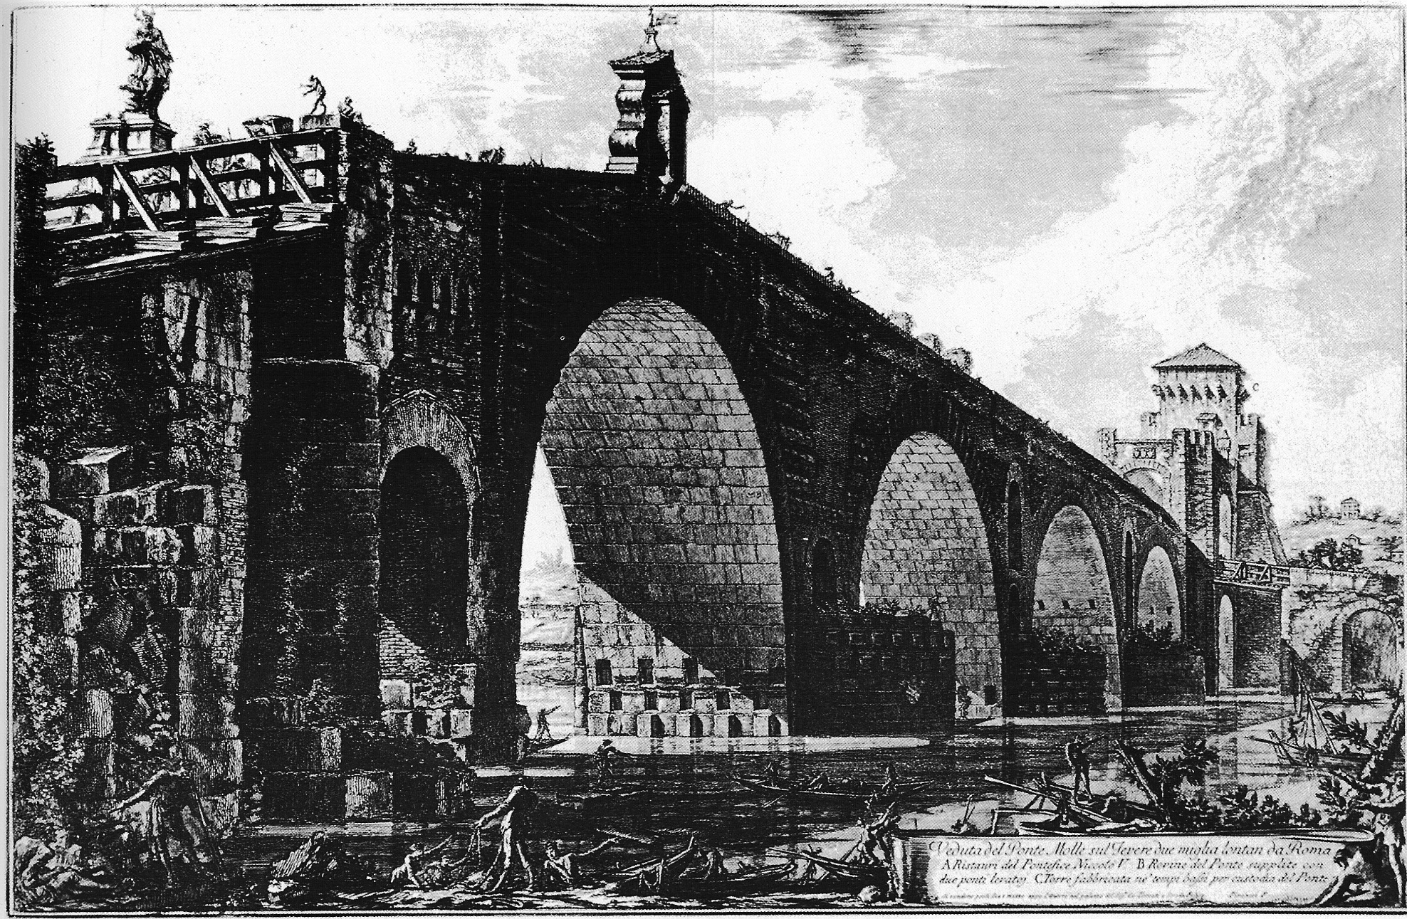

Battle of Milvian Bridge (AD 312)

Slide 25
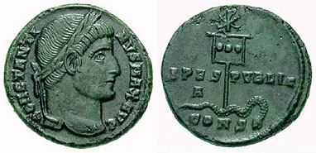
Constantine’s Kingdom
“Constantine, at his new capital Constantinople. The standard, bearing the letters XP (Christos) and inscribed ‘The National Hope’, crushes the serpent of evil”.
(Michael Grant, The Climax of Rome, plate 51)

Slide 26
The First “Christian” Emperor
“It was Constantine who made Christianity the official religion of the empire, and founded the new imperial capital of Constantinople. There is certainly no reason to doubt that Constantine was a man of sincere religious conviction. But he was also an able propagandist, a gifted military commander, and an unscrupulous and determined manipulator”.
(C. Scarre, Chronicle of the Roman Emperors, p. 213)

Slide 27
The First “Christian”Emperor
Constantine is converted to Christianity (312)
Co-emperor with Licinius (313)
Issues the Edict of Milan (313)
  grants complete religious toleration
  restores church property previously confiscated
Eliminates Licinius and rules as sole Emperor (324)
  founds Constantinople as his new capital
Represses Pagans and Christian ‘heretics’
Baptized on his death bed (337)

Slide 28
Constantine’s Kingdom
“When men commend my services, which owe their origin to the inspiration of Heaven, do they not clearly establish the truth that God is the cause of the exploits I have performed? Assuredly they do, for it belongs to God to do whatever is best, and to man, to perform the commands of God”.
(Constantine, To the Assembly of the Saints)
Eusebius – His biographer

Slide 29
Constantine’s Kingdom
“Constantine’s conversion, which had prompted [the Christian revolution], was seen by Petrarch in the fourteenth century as the great dividing line between antiquity and the ages that lay ahead; and, indeed, he had brought a whole new world into being. Constantine himself was profoundly aware of the vastness and holiness of this task: he saw himself as the thirteenth apostle of Jesus and God’s Messianic regent upon earth”.
(Michael Grant, History of Rome, p.412)

Slide 30
Constantine’s Kingdom
“These things were foretold in words long ago, and set down in sacred books; but the fulfilment has reached us no longer by hearsay but in fact.”
“It looked like the very image of the kingdom of Christ; and was altogether more like a dream than a reality.”
(Eusebius, History of the Church)

Slide 31
Constantine’s Kingdom
“The doctrine of Christ’s reign upon earth was at first treated as a profound allegory, was considered by degrees as a doubtful and useless opinion, and was at length rejected as the absurd invention of heresy and fanaticism”
(Gibbon, Decline & Fall of the Roman Empire)

Slide 32
Constantine the Persecutor
“The new position which Christianity had acquired in the world made a greater difference to the character of Christianity than it did to the character of the world.
Almost immediately after having undergone persecution itself, the Church began to instigate the rulers of the world to persecute on its behalf.”
(Bevan, History of Christianity, p.107)

