Slide 1
HISTORY OF CHRISTIANITY - PART IV
SUMMARY OF 7th to 13th Centuries
Schism between Eastern and Western Churches
Papacy protected by the Frankish kings
Franks “return” Italian territory to the Pope
Pope claims and exerts authority over kings
Gregory VII grasps at temporal supremacy
Innocent III changes temporal laws
Boniface VIII pronounces threats against ‘heretics’
Medieval Doctrines

Slide 2
Part IV
The punishment of heretics & dissenters
The Inquisition
The 14th to 16th Centuries
Early Protesters
Reformers
Later Protesters

Slide 3
The Little Horn (Daniel 7)
8 I considered the horns, and, behold, there came up among them another little horn, before whom there were three of the first horns plucked up by the roots: and, behold, in this horn were eyes like the eyes of man, and a mouth speaking great things.
20 And of the ten horns that were in his head, and of the other which came up, and before whom three fell; even of that horn that had eyes, and a mouth that spake very great things, whose look was more stout than his fellows.
21 I beheld, and the same horn made war with the saints, and prevailed against them;
25 And he shall speak great words against the most High, and shall wear out the saints of the most High, and think to change times and laws: and they shall be given into his hand until a time and times and the dividing of time.

Slide 4
The Punishment of Heretics & Dissenters
The Inquisition
Decrees if the Fourth Lateran Council [Innocent III – 1215]
“Convicted heretics shall be handed over for due punishment to their secular superiors, or the latter’s bailiffs…The goods of the laymen thus convicted shall be confiscated…If a temporal lord neglects to fulfill the demand of the Church that he shall purge his land of this contamination of heresy, he shall be excommunicated…If he fails to make amends within a year, it shall be reported to the supreme pontiff, who shall pronounce his vassals absolved from fealty to him and offer his land to catholics. The latter shall exterminate the heretics, possess the land without dispute and keep it in the true faith.”

Slide 5
The Inquisition
“Saint” Thomas Acquinas (1225-1274)
“Whether heretics should be tolerated.
“There is the sin, whereby they deserve not only to be separated from the Church by excommunication, but also to be shut off from the world by death. For it is a much more serious matter to corrupt faith…than to forge money…Hence if forgers of money…are straightway justly put to death by secular princes, with much more justice can heretics, immediately upon conviction, be not only excommunicated but also put to death.”
(Documents of the Chr. Church, Ed. Bettenson, p.186-187)

Slide 6
The Inquisition
Bernard Gui - Inquisitor in Toulouse, France (1307-1324)
“…bit by bit, [the heretics] tear to pieces and abuse all the sacraments of the Church, especially that of the Eucharist saying that the body of Christ is not there, for, if it were as large as a great mountain, Christians would already have eaten it all.
“Again, they say that confession made to priests of the Roman Church…is valueless.
“Again, they say that the cross of Christ should not be adored or reverenced, because no one adores the gibbet on which his father or relative or friend was hanged.”
(Select Documents of European History, Ed. Laffan, p.187-189)

Slide 7
Inquisition Policy regarding the Scriptures
The Council of Toulouse (1229), Canon 14:
“We prohibit also that the laity should be permitted to have the books of the Old or New Testament; unless anyone from motive of devotion should wish to have the Psalter or the Breviary for divine offices or the hours of the blessed Virgin; but we most strictly forbid their having any translation of these books.”
The Council of Tarragona of 1234, Canon 2:
"No one may possess the books of the Old and New Testaments in the Romance language, and if anyone possesses them he must turn them over to the local bishop within eight days after promulgation of this decree, so that they may be burned lest, be he a cleric or a layman, he be suspected until he is cleared of all suspicion."

Slide 8
The Word of God
Ps 119:103-105
103 How sweet are thy words unto my taste! yea, sweeter than honey to my mouth!
104 Through thy precepts I get understanding: therefore I hate every false way.
105 Thy word is a lamp unto my feet, and a light unto my path.
Rom 10:17
17 So then faith cometh by hearing, and hearing by the word of God.
2 Tim 3:15-17
15 And that from a child thou hast known the holy scriptures, which are able to make thee wise unto salvation through faith which is in Christ Jesus.
16 All scripture is given by inspiration of God, and is profitable for doctrine, for reproof, for correction, for instruction in righteousness:
17 That the man of God may be perfect, throughly furnished unto all good works.

Slide 9
Early Protesters
Heretics & Dissenters
The Donatists (312 onwards)
Defied Constantine from N. Africa
Critical of those who had lapsed and returned
The Albigenses (1167 onwards)
Predominant in Southern France
Eastern-based, belief in Good god and a Bad god
The Waldenses (1176 onwards)
Predominant initially in Southern France
Bible-based, rejected Roman Catholic doctrines

Slide 10
The Waldenses
Originating in France (12th Century) and spreading to Austria, Germany and Italy
Associated with Peter Waldo, an itinerant preacher
Focused on daily conduct, the authority of the Scriptures, and preaching
Translated parts of Scripture into common vernacular
In 1545, 22 villages inhabited by French Waldenses were pillaged and burnt by order of the parliament of Provence.

Slide 11
The Waldenses (cont’d)
“The Waldenses, leaning upon the Scriptures, sought to revive the simple precepts of the Apostolic age. They were the strictly biblical sect of the Middle Ages. They present a rare spectacle of the survival of a body of believers which has come up out of great tribulation.”
“They were charged with pronouncing the Roman Church as the Babylonian harlot, and calling it a house of lies.”
(History of the Chistian Church, Schaff, v.5, p.493, 505)

Slide 12
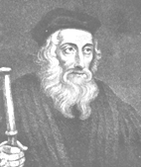
John Wycliffe (1320-1384)
A theological academic, politically active
Translated the Bible into English from the Latin
Protested against the Catholic Church and Papacy
- transubstantiation
- relics
- celibacy
Condemned posthumously (1415), his remains were exhumed, burned and thrown into the River Swift

Slide 13
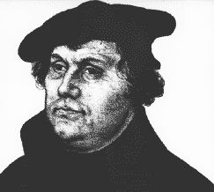
Reformers
Martin Luther (1483-1546)
A German priest, outraged by corruption in Church
95 Theses against the Sale of Indulgences by Leo X
Excommunicated in 1520 and writings burned
- Every man is a priest
- Roman Church void of faith
- Ceremony is a means not an end
Supported by German princes and commoners
Translated OT and Greek NT into German (1534)
Accepted things not contrary to Scripture

Slide 14
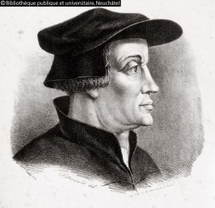
Zwingli (1484-1531)
A Swiss priest, outraged by corruption in Church
“Scripture only” as basis for doctrine and discipline
- Against Images, Mass, Monasteries
- Emphasis on preaching
Rejected anything not proved by Scripture
As Priest of Zurich, brutally condemned and killed Anabaptists

Slide 15
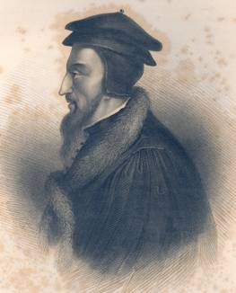
John Calvin (1509-1564)
A French academic, wrote against Roman system
Wrote ‘Institutes’
- Predetestination
- Obsessed over details of private life
Attempted to transform Geneva into a Calvinist State
- “Punished delinquents with appalling severity”
“Protestant Inquisition” against non-conformists
- Burned Michael Servetus, antitrinitarian

Slide 16
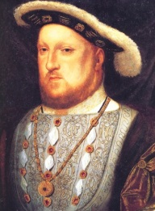
King Henry VIII (1491-1547)
An English king, who was a reformer for purely selfish reasons:
- Split with Rome to gain an annulment for his marriage and to seize Catholic wealth
Maintained Orthodoxy, but was anti-papal
More liberal in granting access to the Scriptures
Ruthless with his political and religious opponents
Set Britain on a different course than Europe

Slide 17
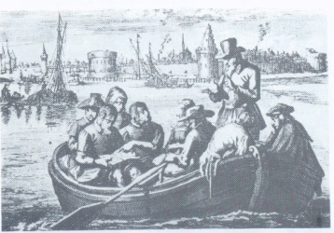
Later Protesters
Conrad Grebel (1498-1526)
Felix Manz (1498-1527)
Georg Blaurock (149X-1529)
Bathasar Hubmaier (1481-1528)
Swiss & German students who split with Zwingli
“Scripture only” approach to belief and conduct
- Against infant baptism (“Anabaptists” = re-baptizers)
Condemned by Zwingli and imprisoned
- some were drowned, others were burned
- Grebel died of the Plague

Slide 18
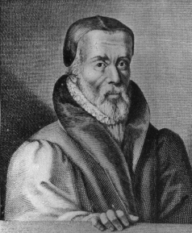
William Tyndale (1494-1536)
An English clergyman who favoured reform
Translated Hebrew OT and Greek NT into English
Bibles printed in Europe and smuggled into England
Hunted, imprisoned, strangled and burned
His version illegal but the basis of later ‘authorized’ versions, including the 1611 King James Version

Slide 19
William Tyndale (cont’d)
“ If God spare my life ere many years, I will cause the boy that drives the plow to know more of the scriptures than you”.
(If God Spare My Life, Moynahan)
“I wish that the husbandmen may sing parts of them at his plough, that the weaver may warble them at his shuttle, that the traveler may with their narratives beguile the weariness of the way”.
(Wide as the Waters, Bobrick)
“Faith is a sure confidence of things which are hoped for, and a certainty of things which are not seen”
(Tyndale’s New Testament, Daniell)

Slide 20
Summary of Protesters & Witnesses
The Huguenots – A Case Study
A representative class of religious and political dissenters against the Church and the Papacy (Protestants/Calvinists)
In August 1572, over 8,000 Huguenots were killed in Paris by command of the King of France. Thousands were killed elsewhere throughout France. This was known as the St. Bartholomew Massacre.
Thirty years of wars ensued in an attempt to exterminate the Huguenots. The wars ceased in 1598 with the Edict of Nantes and the Huguenots were afforded relief and certain rights.
This policy was reversed in 1685 when the Edict was revoked by King Louis XIV and the Huguenots were all but exterminated.
The Edict of Toleration in 1787 and the National Assembly in 1789 restored certain religious and political rights to the remaining Huguenots.

Slide 21
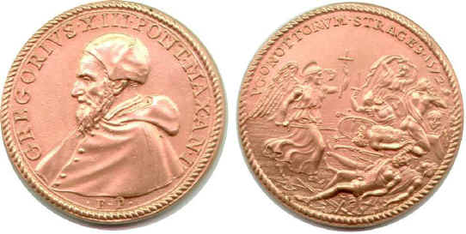
The Huguenots
On learning of the massacre in 1572, Pope Gregory XIII celebrated and had a medal struck to commemorate the event as a victory over heresy.
The medal shows an angel with a cross and sword standing over dead bodies.
In France, the King ordered that the event be publicly commemorated every August.

Slide 22
The Temple & Two Witnesses
Rev 11:1-3
“1 And there was given me a reed like unto a rod: and the angel stood, saying, Rise, and measure the temple of God, and the altar, and them that worship therein
2 But the court which is without the temple leave out, and measure it not; for it is given unto the Gentiles: and the holy city shall they tread under foot forty and two months.
3 And I will give power unto my two witnesses, and they shall prophesy a thousand two hundred and threescore days, clothed in sackcloth.”

Slide 23
The Temple & Two Witnesses
Rev 11:7-13
“7 And when they shall have finished their testimony, the beast that ascendeth out of the bottomless pit shall make war against them, and shall overcome them, and kill them.
11 And after three days and an half the Spirit of life from God entered into them, and they stood upon their feet; and great fear fell upon them which saw them.
12 And they heard a great voice from heaven saying unto them, Come up hither. And they ascended up to heaven in a cloud; and their enemies beheld them.
13 And the same hour was there a great earthquake…”

Slide 24
The Temple & Two Witnesses
Symbol | Interpretation
Rod | Chastisement & Suffering
The Temple | True Believers – the Saints
The Court Without | Nominal Christianity
Gentiles…they | Nominal Christians as Persecutors
Two Witnesses | Political & Religious Protesters
Sackcloth | Affliction
Ascended to Heaven | Political Resurrection & Elevation
Great Earthquake | Political Revolution

