Slide 1
HISTORY OF CHRISTIANITY - PART V
SUMMARY OF Part IV
Early Protesters (14th Century)
Reformers (15th/16th Century)
Later Protesters (15th/16th Century)
The “Two Witnesses”
- Religious Protesters: Authentic & False
- Political Protesters

Slide 2
The Protesters
“Perhaps the greatest contribution made by the Dissenters was the continuous testimony they bore, by their very existence, to the character of Christianity as a society to which men adhere by individual conversion and choice, not by birth.”

Slide 3
The Reformers
“If these Protestants have rejected a great part of the Catholic tradition, what they retain is sufficiently remarkable…the Protestantism which had rejected so much of Catholicism, but which still held fast to the old Catholic creeds…”
(Bevan, History of Chr., p.197, 201, 203)

Slide 4
Prophetic Time Periods
Scripture Ref. | Symbol | Time Period | Issue
Dan 7:25 | Time, times, half a time | 1260 yrs | Treading Down Saints
Rev 11:2-3 | 42 months 1260 days | 1260 yrs | Treading Down Holy City Witnessing
Rev 12:6,14 | 1260 days Time, times, half a time | 1260 yrs | Witnessing
Rev 13:5 | 42 months | 1260 yrs | War Against Saints

Slide 5
Prophetic Time Periods
Starting Event | Start Date | Time Period | End Date | Ending Event
False Teachers in 1st Century | 32 | 280 | 312 | Birth of Man Child
Donatist Witness Begins | 312 | 1260 | 1572 | Massacre of Huguenot Witnesses
2nd Persecution of Huguenots | 1685 | 105 | 1790 | French Revolution
Justinian’s Decree | 533 | 1260 | 1793 | French Revolution
Phocas’ Decree | 608/ 610 | 1260 | 1868/ 1870 | Papal Loss of Temporal Power

Slide 6
Part V (Conclusion)
Revolution in Europe (18th & 19th Century)
The Papacy Transformed (18th to 20th Century)

Slide 7
The Vials of the Wrath of God
Judgment of the Papacy
Rev 16:1 And I heard a great voice out of the temple saying to the seven angels, Go your ways, and pour out the vials of the wrath of God upon the earth. 2 And the first went, and poured out his vial upon the earth; and there fell a noisome and grievous sore upon the men which had the mark of the beast, and upon them which worshipped his image. 6 For they have shed the blood of saints and prophets, and thou hast given them blood to drink; for they are worthy.
10 And the fifth angel poured out his vial upon the seat of the beast; and his kingdom was full of darkness; and they gnawed their tongues for pain, 11 And blasphemed the God of heaven because of their pains and their sores, and repented not of their deeds.

Slide 8
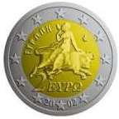
Mother of Harlots
Rev 17:3-6 So he carried me away in the spirit into the wilderness: and I saw a woman sit upon a scarlet coloured beast, full of names of blasphemy, having seven heads and ten horns.
4 And the woman was arrayed in purple and scarlet colour, and decked with gold and precious stones and pearls, having a golden cup in her hand full of abominations and filthiness of her fornication:
5 And upon her forehead was a name written, MYSTERY, BABYLON THE GREAT, THE MOTHER OF HARLOTS AND ABOMINATIONS OF THE EARTH.
6 And I saw the woman drunken with the blood of the saints, and with the blood of the martyrs of Jesus.
16 And the ten horns which thou sawest upon the beast, these shall hate the whore, and shall make her desolate and naked, and shall eat her flesh, and burn her with fire.

Slide 9
The Phases of the Beast
Daniel’s 4th Beast | Red Dragon | Beast of the Sea | Scarlet Beast
Dan 7 | Rev 12 | Rev 13 | Rev 17
One Head | Seven Heads | Seven Heads | Seven Heads
Ten Horns | Ten Horns | Ten Horns | Ten Horns
 | Crowns on Heads | Crowns on Horns
Mouth Speaks against God |  | Names of Blasphemy | Names of Blasphemy
Wars with the Saints | Wars with the Remnant | Wars with the Saints | Wars with the Lamb

Slide 10
The French Revolution
“But when the Revolution did come, the Church was identified with aristocracy and suffered accordingly. The first attack was naturally upon the enormous property held by ecclesiastical institutions. Talleyrand paid the deficit in the Treasury from the clerical revenues. In 1789 the Assembly confiscated ecclesiastical property and reduced the clergy to the position of servants of the State. The next year this was fixed by the Civil Constitution of the Clergy. The religious Orders were suppressed and the hundred and fifty bishoprics were reduced to eighty-three; and both the bishops and parochial clergy were to be elected by the people.”
(History of the Modern Church, Wand, p.197f)

Slide 11
The French Revolution (1789-1790)
Declaration of the Rights of Man:
“Article 1. Men are born and remain free and they are equal in rights.
3. No body or individual can exercise authority that does not emanate from the nation.
4. Liberty consists of the right to do anything which does not injure anybody else.
10. No one may be molested for his opinions, even for his religious opinions, provided that their manifestation does not disturb the public order by law established.”
(Select Documents of European History, v .III, Butterfield, p.68)

Slide 12
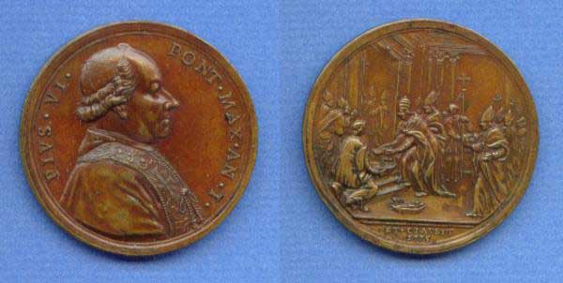
Pope Pius VI (1775-1799)
Pius VI condemns the principles of the French Revolution:
“But what could be more senseless than to establish among men equality and this unbridled freedom which seems to quench reason…”
(How to Read Church History, v.2, Comby & MacCulloch, p.113)

Slide 13
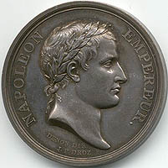
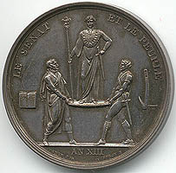
Napoleon Bonaparte (1769-1821)
Less than 10 years after the French Revolution, Napoleon inflicted war on most of Western (Catholic) Europe
Reigned as ruler of France (1799-1804)
Reigned as Emperor of France and King of Italy (1804-1814)

Slide 14
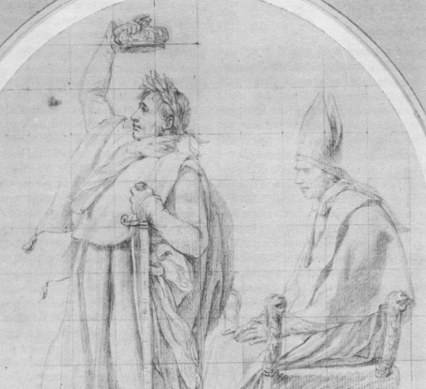
Napoleon Bonaparte
In December 1804, in the presence of Pope Pius VII, Napoleon crowned himself as Emperor, and then crowned his wife Josephine.

Slide 15
The Papacy Transformed
The Revolution and the Papacy
“French and European Catholicism came out of the Revolution greatly changed. For the most part, the wealth of the church had passed into the hands of the laity…By the control of a civil state, the stages of human life escaped from the control of the church”
(How to Read Church History, v.2, Comby & MacCulloch, p.119)

Slide 16
The Loss of Temporal Power (1870)
“With the political upheavals that followed the creation of the Roman republic in 1849 and then the kingdom of Italy in 1860, which incorporated Rome as its capital in 1870, the temporal princedom of the papacy shrank to the Vatican and its immediate environs, and thus it has remained ever since. The popes had returned to their roots (perforce, it is true), and the way was now clear for the office to exercise a purely spiritual authority unencumbered by the claims of secular government.”
(Chronicle of the Popes, Maxwell-Stuart, p.218)

Slide 17
Papal Loss of Temporal Power
1790 French Revolution
1797 Papal States invaded and occupied
Pope Pius VI flees
1804 Pope Pius VII watches Napoleon’s self-coronation
1809 Papal States annexed to France
Pius VII excommunicates Napoleon
Napoleon imprisons Pius VII
1814 Napoleon defeated and exiled
Pius VII returns to Rome
1815 Papal States returned to Papacy
1848 Pope Pius IX flees unrest in Rome
1849 Roman republic declared
1850 French troops restore Pius IX
1860 Papal States annexed to Kingdom of Italy
1870 Rome annexed to Kingdom of Italy
Pope Pius IX a “prisoner of the Vatican”

Slide 18
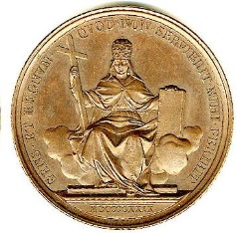
Mother of Harlots
Rev 18:6 Reward her even as she rewarded you, and double unto her double according to her works: in the cup which she hath filled fill to her double.
7 How much she hath glorified herself, and lived deliciously, so much torment and sorrow give her: for she saith in her heart, I sit a queen, and am no widow, and shall see no sorrow.
8 Therefore shall her plagues come in one day, death, and mourning, and famine; and she shall be utterly burned with fire: for strong is the Lord God who judgeth her.

Slide 19
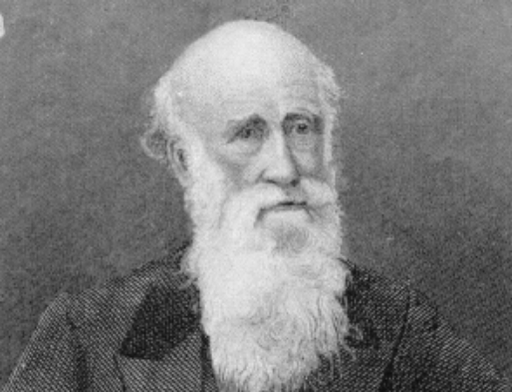
John Thomas (1805-1871)
“Shall such a thing as a temporal and spiritual dominion, under a supreme pontiff, claiming to be the Vicar of Christ, exist at all in Rome, or anywhere else? Who can settle this question? The will of man cannot determine it. The dominion exists, and has afflicted the earth with its accursed presence for quite 1,335 years from its constitutional inception, and 1,260 from its confirmation; but there is not power in the universe which can extinguish it, save that of the Eternal Himself… She will revive again, and by her Babylonian Mouth, rejoice in the discomfiture of the Terrorists, “saying in her heart, I sit a Queen, and am not a widow, and shall see no sorrow” (Rev. 18:7).”
(The Roman Question, c.1867)

Slide 20
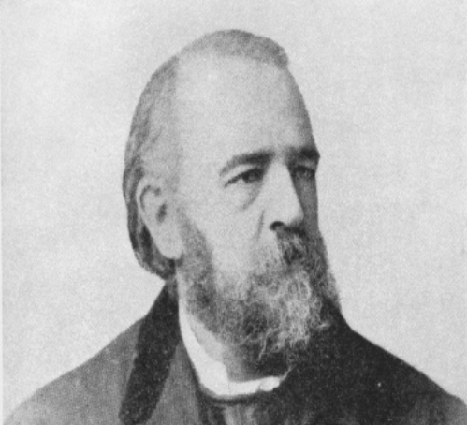
Robert Roberts (1839-1898)
“Before the days of the French Revolution, the Church possessed nearly a third of the lands of Europe: now she has but very little. The Church has been hated of the governments; her flesh has been nearly eaten off her bones, and they have burnt her with the fire of war. But a re-action in her favour may be looked for as the end approaches. When Christ appears on the scene, the powers rally round her; for the false prophet is found in their camp, as their inspirer and ecclesiastical leader. But her “last end will be worse than the first; for Christ himself confronts her as the avenger of the slaughtered saints, and there will be no recovery from the perdition which he will bring upon her.”
(Thirteen Lectures, p. 174)

Slide 21
The False Prophet
Papal Infallibility (1870)
“We teach and define as dogma divinely revealed: That the Roman Pontiff, when he speaks ex cathedra - that is, when fulfilling the office of Pastor and Teacher of all Christians, on his supreme Apostolical authority, he defines a doctrine concerning faith or morals to be held by the Universal Church - through the divine assistance promised him in blessed Peter, is endowed with that infallibility, with which the Divine Redeemer has willed that His Church – defining doctrine concerning faith or morals – should be equipped: and therefore, that such definitions of the Roman Pontiff of themselves…are irreformable.”
(Documents of the Christian Church, Bettenson, p.381f)

Slide 22
The False Prophet
“The papacy has long experience in adapting herself to new circumstances, and overcoming new enemies. After suffering, complaining, and resisting through the first half of the 19th century, she saw that the new forces of the revolution were permanently established, and there could be no going back to the Old Order; in the second half of the century she began slowly to adapt herself to the new spirit and power of the masses.
(Dragon and the Lamb, Houlton & Pearce, p. 62f – circa 1965)

Slide 23
The False Prophet
Rev 16:13 And I saw three unclean spirits like frogs come out of the mouth of the dragon, and out of the mouth of the beast, and out of the mouth of the false prophet.
14 For they are the spirits of devils, working miracles, which go forth unto the kings of the earth and of the whole world, to gather them to the battle of that great day of God Almighty.

Slide 24
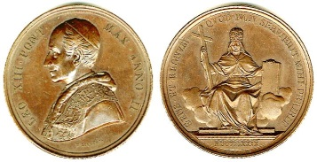
Pope Leo XIII (1878-1903)
“We are persuaded that it is necessary by prompt and effective measures to come to the aid of people of the lower classes, since for the most part they are in a situation of misfortune and undeserved misery…Rapacious usury has added to the evil. To all this must be added the concentration of industry and commerce in the hands of a few…who impose an almost servile yoke on the infinite multitude of the proletariat.”
(Church History, Comby & McCulloch, p. 193)

Slide 25
Vatican II
“The Vatican Council declares that the human person has a right to religious freedom. Freedom of this kind means that all men should be immune from coercion on the part of individuals, social groups and every human power so that, within due limits, nobody is forced to act against his convictions nor is anyone to be restrained from acting in accordance with his convictions in religious matters. This right of the human person to religious freedom must be given such recognition in the constitutional order of society as will make it a civil right.”
(Church History, Comby & McCulloch, p. 228)

Slide 26
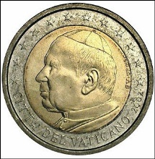
Pope John Paul II (1978-2005)
“Few countries have not received a papal visit, and indeed he has traveled almost frantically in an effort to fulfill what he called at the start of his reign ‘our universal pastoral ministry’. Perhaps his greatest contribution is to have played a major role in the downfall of Communism and the consequent changes of regime in many European countries – Poland in particular.”
(Chronicle of the Popes, Maxwell-Stuart, p.231f)

Slide 27
Pope John Paul II (1978-2005)
“In recalling this patrimony, the Holy See and all the Christian Churches have urged those drawing up the future Constitutional Treaty of the European Union to include a reference to Churches and religious institutions. We believe it desirable that, in full respect of the secular state, three complementary elements should be recognized: religious freedom not only in its individual and ritual aspects, but also in its social and corporative dimensions.” (John Paul II, 2003 )
"Through the new life which Christ has bestowed on us, we can recognize one another as brothers and sisters, despite every difference of language, nationality and culture. In a word, by sharing in the one bread and the one cup, we come to realize that we are "God's family" and that together we can make our own effective contribution to building a world based on the values of justice, freedom and peace.”
(John Paul II, 2004)

Slide 28
The Return of Christ
Rev 16:15 Behold I come as a thief. Blessed is he that watcheth, and keepeth his garments, lest he walk naked, and they see his shame.

Slide 29
The Glorified Saints
Rev 20:4 And I saw thrones, and they sat upon them, and judgment was given unto them: and I saw the souls of them that were beheaded for the witness of Jesus, and for the word of God, and which had not worshipped the beast, neither his image, neither had received his mark upon their foreheads, or in their hands; and they lived and reigned with Christ a thousand years.

Slide 30
War with the Lamb
Rev 17:14 These shall make war with the Lamb, and the Lamb shall overcome them: for he is Lord of lords, and King of kings: and they that are with him are called, and chosen, and faithful.

Slide 31
The Destruction of the False Prophet
2 Th 2:8 And then shall that Wicked be revealed, whom the Lord shall consume with the spirit of his mouth, and shall destroy with the brightness of his coming:
Rev 19:20 And the beast was taken, and with him the false prophet that wrought miracles before him, with which he deceived them that had received the mark of the beast, and them that worshipped his image. These both were cast alive into a lake of fire burning with brimstone.

Slide 32
The Honor of the Saints
Ps 149:5 Let the saints be joyful in glory: let them sing aloud upon their beds.
6 Let the high praises of God be in their mouth, and a two edged sword in their hand;
7 To execute vengeance upon the heathen, and punishments upon the people;
8 To bind their kings with chains, and their nobles with fetters of iron;
9 To execute upon them the judgment written: this honour have all his saints. Praise ye the LORD.

