Slide 1
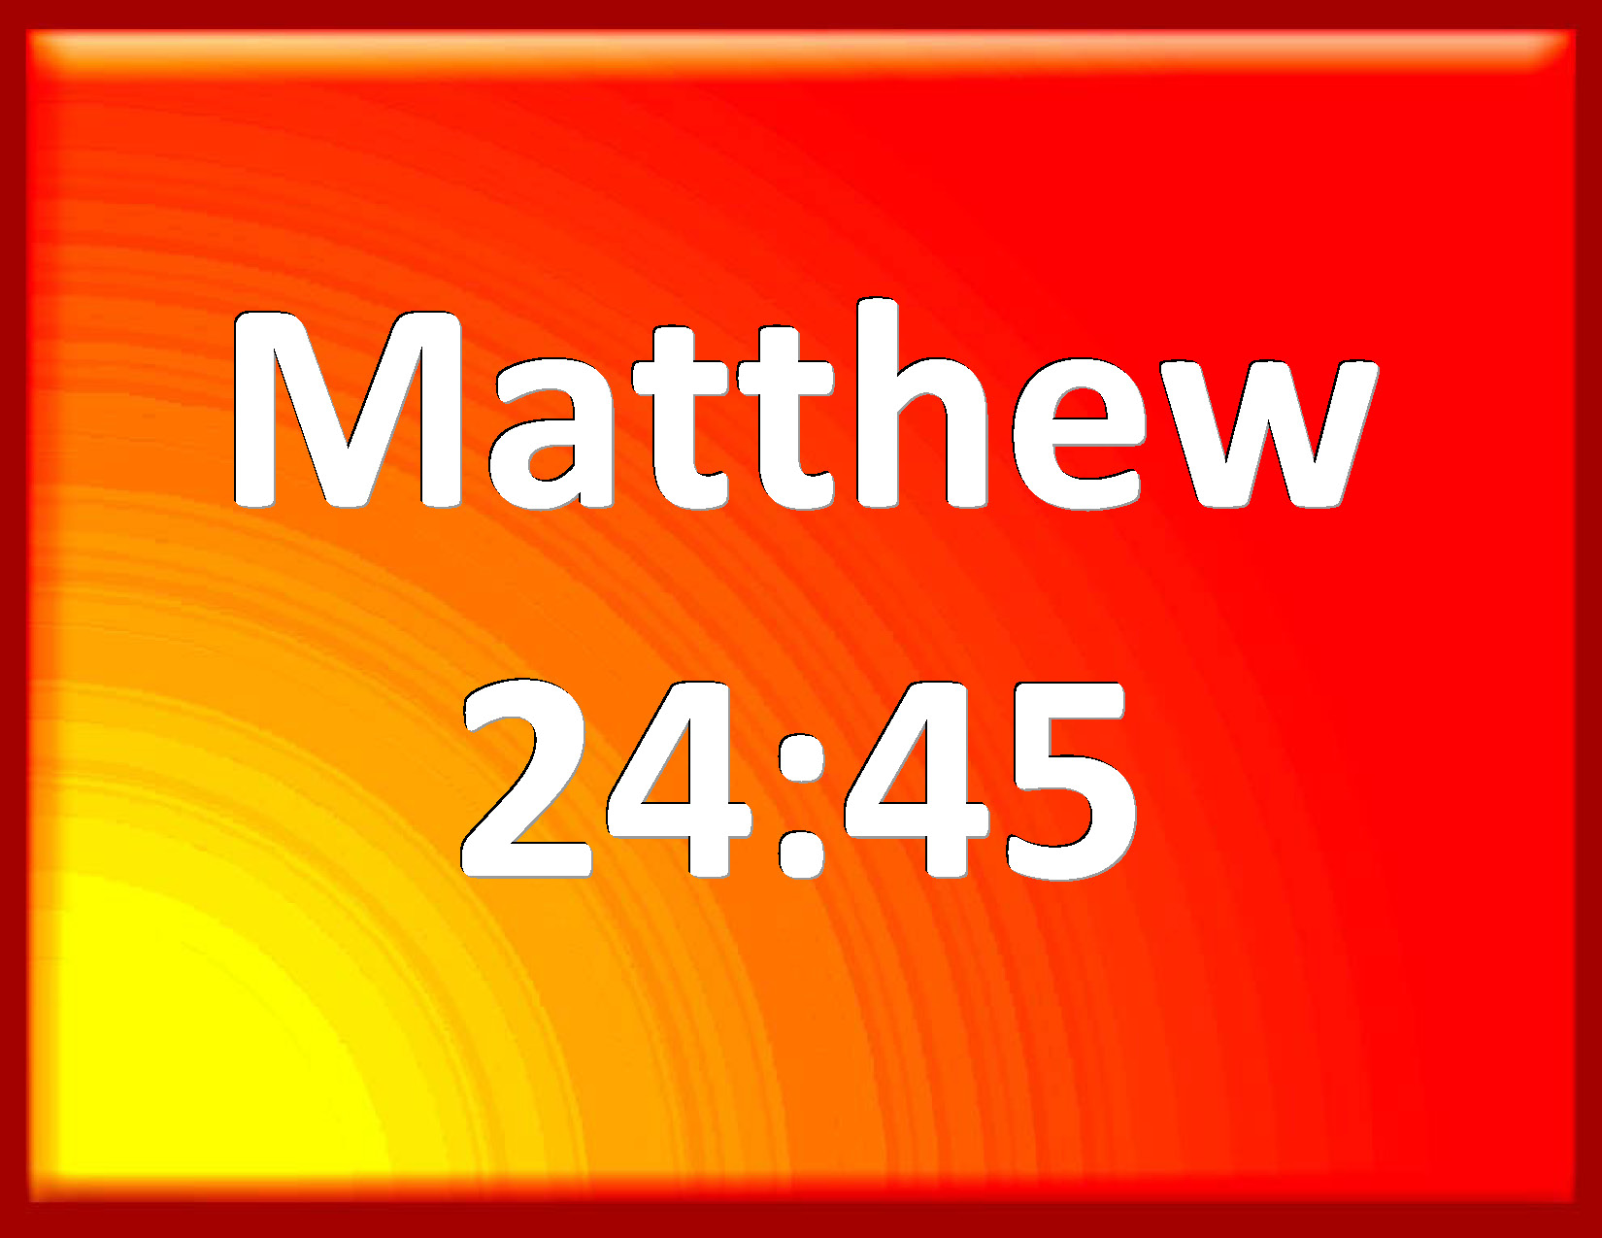

Slide 2
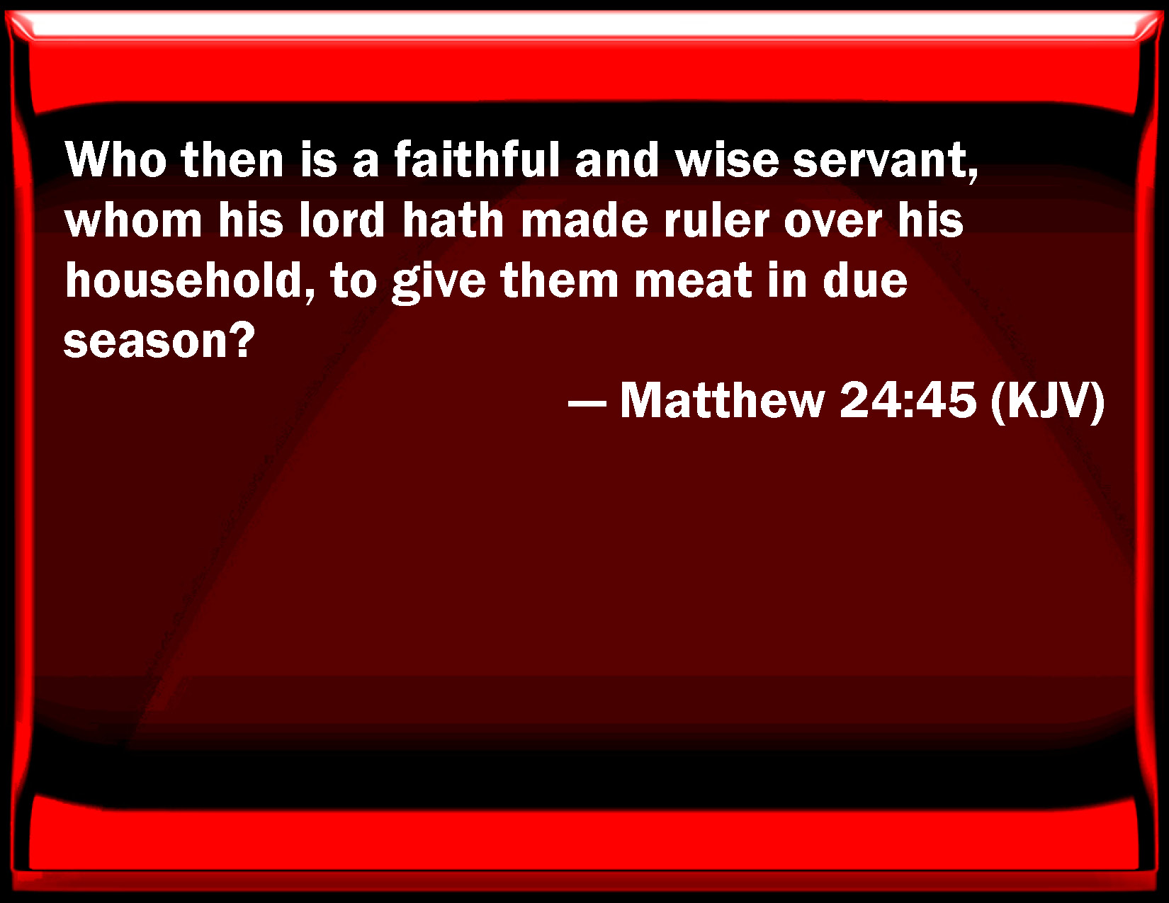

Slide 3
Preliminary Comments
An article by Bro John Marshall in ‘The Christadelphian’ on the 3 parables in Matthew Ch 25:
10 Virgins .. Judgment on the Household
The Servants .. Judgment on Israel
Sheep and Goats .. Judgment on the nations
-------------------------------------------------------------
1 Peter 4:17 ... Judgment to begin at the house of God
Matt Ch 3 … John Baptist … wheat into barn, chaff into fire
Isa 60:12 … Nations that will not serve thee shall be utterly wasted and perish.

Slide 4
Wikipedia
The chapter and verse divisions did not appear in the original texts.
Since the early 13th century, most copies and editions of the Bible present all but the shortest of these books with divisions into chapters.
Since the mid-16th century (eg The Geneva Bible) editors have further subdivided each chapter into verses.
------------------------------
The chapter break between Matt 24:51 and 25:1 is particularly unhelpful.

Slide 5
Preliminary Comments
Two books published in 2004/2005:
“John’s Creation – A Model for understanding the Gospel of John” by Bro John Pople (USA).
“Come and See – The Gospel of John Revisited” by Bro David Nightingale (UK).
The Word of God is like a beautiful tapestry with many strands and themes. (Bro Harry Tennant, UK)
--------------------------------------------------
Handouts available at the end of the session.

Slide 6
Matthew’s Gospel : Features
Characterised by sermons on mountain tops
Chs 5-7 .. The Sermon on the Mount
Ch:15:29 .. Miracles of Healing and Feeding
Chs 24-25 .. The Olivet Prophecy
Ch 28:16-20 .. The Great Commission
(Cp. Luke 6:17-49 .. The Sermon on the Plain)
Why this unique emphasis in Matthew?

Slide 7
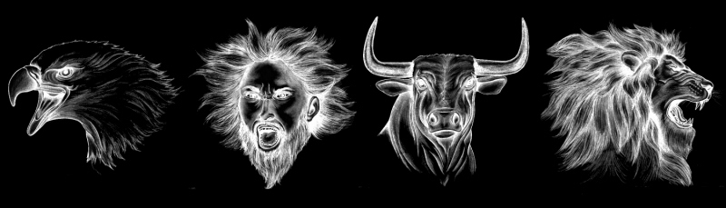
Answer ?
Ezekiel Ch 1 – The four faces of the Cherubim representing the glory of God.

Slide 8
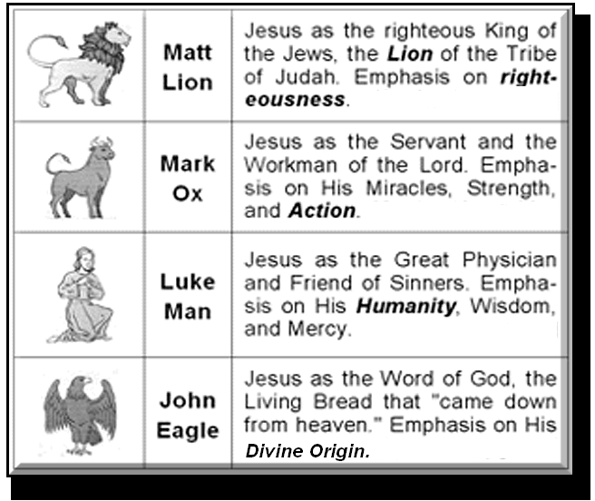
Replicated in the 4 Gospels

Slide 9
Matthew’s Gospel : Other Features
The ministry of the Lord begins and ends in the same way.
Begins: Matt 4:23-25 + 5:1-2
Ends: Matt 23:1, 37-39 + 24:3
Why ?

Slide 10
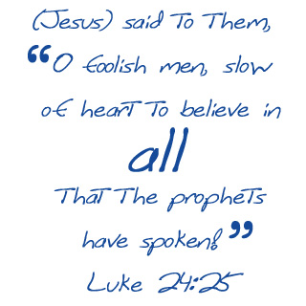

Slide 11
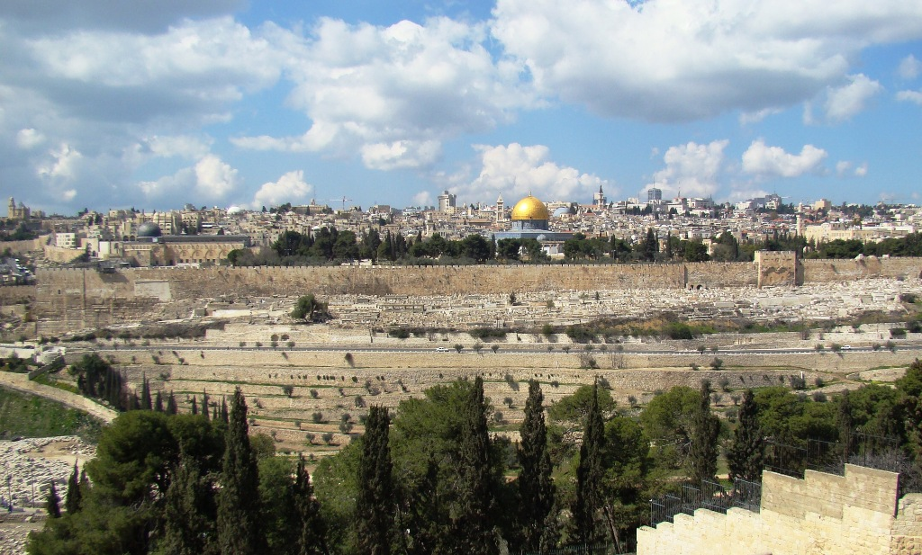
The Olivet Prophecy

Slide 12
The Prophecy in Outline
The disciples ask three questions : Mt 24:3
Jesus answers : Mt 24:4-44
The disciples emphasis seems to be misdirected (see Luke 17:20-21)
The crucial question : Mt 24:45
Jesus answers the question in four parables – Mt 24:45-51; 25:1-13; 25:14-30; 25:31-46

Slide 13

Parable of the Household
Matthew 24:45-51

Slide 14
Three Key Points
“Household” = “therapeia” (Gk) translated ‘healing’ 2x and ‘household’ 2x
O.T. source: “faithful and wise servant” ? Genesis Chs 39, 41 & 47
O.T. source: “evil servants” ? Exodus Ch 32

Slide 15
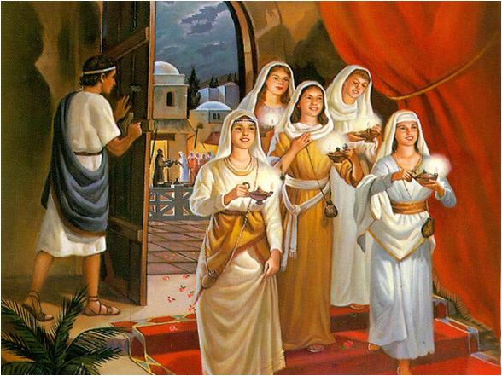
Parable of the 10 Virgins
Matthew 25:1-13

Slide 16
Important Points
Significance of the oil ? .. Proverbs 6:23; Psalm 119:105
Its production is labour intensive.
To be of use it must be in the lamps and ignited. (Read the manual, check the job description.)
Are the wise virgins selfish in not sharing?
No – Knowledge can be shared, but spiritual preparation is an individual matter (Psa 49:7).

Slide 17
Interesting Points
Note the link with the days of Noah (vs 10) -- Genesis 7:16
OT source of the “oil” and its value -- Proverbs 21:20
The ‘proportion’ problem –
50% in, 50% out ??

Slide 18
“Lord, are there few that be saved?”
“Enter ye in at the strait gate: for wide is the gate, and broad is the way, that leadeth to destruction, and many there be which go in thereat:
Because strait is the gate, and narrow is the way, which leadeth unto life, and few there be that find it.” (Matthew 7:13-14)

Slide 19
5 Virgin Daughters of Zelophehad
Numbers 27:1-11
Mahlah, Noah, Hoglah, Milcah and Tirzah.
Seriously concerned for their inheritance in the Land of Promise.
Provision was made in the Law of Moses to cover all similar situations (vs 8-11).
----------------------
The underlying exhortation for ourselves: We should be seriously concerned for our spiritual inheritance.

Slide 20
An additional problem
If the girls married out of the tribe to which they belonged their inheritance would be lost to Manasseh – (Numbers 36:3-4)
The LORD commanded: “Let them marry whom they think best, but only within their father’s tribe” – (36:6-9)
The exhortation is for us also. Marry in the Faith.

Slide 21
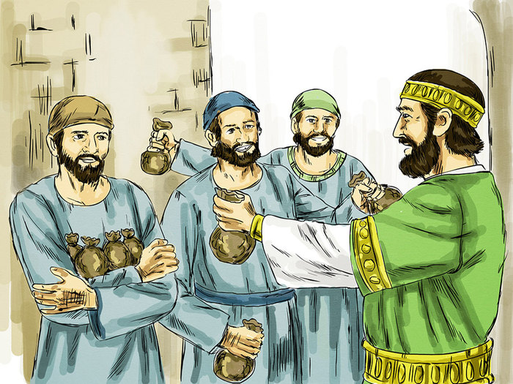
Parable of the Servants
Matthew 25:14-30

Slide 22
Important Points
Each servant given responsibilities according to his natural ability (v15).
What are the “master’s goods” ?
Everything we incorporate in the new life in Christ : the Word of God, our families, ecclesial duties, pastoral care, outreach, etc.

Slide 23
Important Points
Diligent servants rewarded : Vs 21 & 23
Is there perhaps an element of surprise in vs 20 & 22 ? (“behold”)
The lazy servant condemned : Vs 26-30
Why is he also described as “wicked”? (Malachi 3:17-18)
Key phrases: “thou knewest” (v26) .. “therefore thou oughtest” (v27)

Slide 24
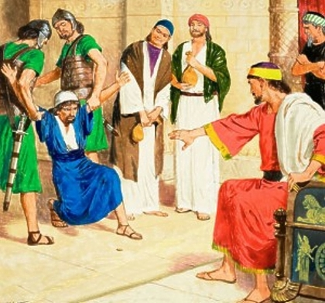
“Cast the unprofitable servant into outer darkness …”

Slide 25
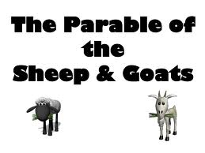
Matthew 25:31-46

Slide 26
Important Points
The use of the phrase “all nations” surely has the same meaning as in Gal 3:8 & Rev 5:9.
The qualities of care, concern and compassion are praised : Vs 35-36.
All the activities in v 35-36 have both a literal and figurative meaning.
We have an interesting exposition of what it means to “trade with the Master’s goods”.

Slide 27
Important Points
Slothfulness, selfishness and sin are condemned : Vs 41-43.
It would seem that to neglect the least is to wound Christ the most : Vs 45.
Vs 35 & 36 are a portrait of the King himself – Matthew 4:23-25; Luke 4:18-21.
Our Lord never asks us to do anything he has not done himself, by showing us the way and setting the example.

Slide 28
Conclusions
Note the progression of thought and ideas in the four parables :
(1) faithful and wise servants are sought;
(2) this requires thorough preparation;
(3) then diligent application;
(4) in a spirit of care, concern and compassion.

Slide 29
Conclusions
Note the change in emphasis from personal qualities in the Sermon on the Mount at the beginning of the ministry (Matthew Chs 5-7) to ecclesial responsibilities in the four parables in Matthew Chs 24 & 25.
Why ? Because the ecclesia is about to be born as a result of the sacrificial death and glorious resurrection of the Lord Jesus Christ.

Slide 30
