Slide 1
“Naming Names”

Slide 2
Goals of this Study
Review what Names are
&
their function and use in scripture
& thus
understand this context for the Name and Titles of Jesus Christ

Slide 3
What is a Name?

Slide 4
Names today, perform two broad functions:
1) A label
2) An identity
Consider:
The base piece of “unique” identifying data
The first thing we share when we meet
We hang everything we come to know about that person on their name
Their Name becomes their identity and reputation

Slide 5
What are the Three Words you would use to Describe
Yourself – who are you – what is your “Name”?
 | I think my name is: | Others think my name is: | Jesus Christ thinks my name is:
1
2
3

Slide 6
3 Keys to
Bible
Names

Slide 7
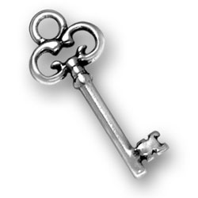
Key ONE
A BIBLE NAME is an IDENTITY
(as well as
a label)
1) Starts with your Birth
2) Your Character
3) Your Behaviour
Together these make an Identity
And define Your NAME
And thus your Memory and Memorial

Slide 8
Typical Summary of the Kings/Chronicles:
  A Name
  Lineage
  Actions and Words
  Did right/evil before the LORD
  All the acts which he did
  Died and Buried
  Their Label and Identity

Slide 9
Key TWO
Bible Names have a Thematic Rationale
A Bible NAME
Exists within a Context
Which is
Related to A ROLE/Purpose
And conforms with
the Bibles
Typological Framework

Slide 10
Names have meanings:
  Adam = Earth
  Eve = Living
  Noah = Rest
  Abraham = Father of a Multitude
  Isaac = Laughter
  Israel = Prince with El
  David = Beloved
  Samuel = Heard of God
  Mary = Bitter
  Simon = Hearer
  Paul = Little
  etc

Slide 11
Adam the earthy
Abel the murdered seed
Noah the builder of the Ark
Abraham the Father
Melchizedek – King Priest
Isaac the promised seed
Israel –Prince with God
Joseph the rejected Saviour
Moses the leader out of Egypt
Aaron the High Priest
Joshua the conqueror
Samson destroyer of Philistines
Gideon the destroyer of idolatry
Samuel – the seer
David the King
David the Captain
Solomon the peaceful
Solomon the wise
Job the intercessor
Ezekiel – Son of Man
Etc etc
The Christ – The Son of God
A “Mosaic”

Slide 12
Ruth – Friend of “Naomi”
Leah – The forgotten one
Esther – Queen- saves her people
Sarah – Mother of the seed
Eve – Mother of living
Mary – in Bitterness bears the son
Dorcas – Good works
Lydia – Seller of purple
Bathsheba –
Rebekah -
Martha –
New Jerusalem –
etc
The Woman – Mother of Living

Slide 13

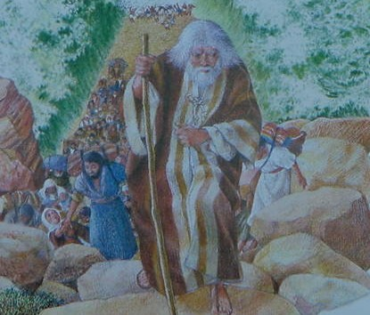
All Types have AN Idea in the middle
“Is Like”
Moses
Drawn
Christ
“Both are Leaders out of Egypt”
And the sense in which the Christ is a Leader is greater and grander

Slide 14
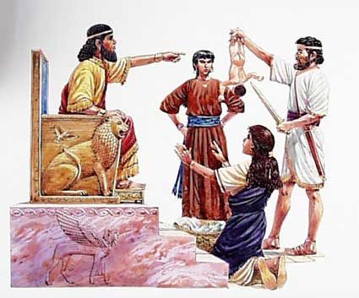

All Types have AN Idea in the middle
“Is Like”
Christ
Solomon
Peace
“Both are Kings of Peace”
And the sense in which the Christ is
a King of Peace is greater and grander

Slide 15
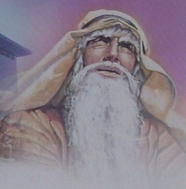
All Types have AN Idea in the middle
“Is Like”
Isaac
Laughter
Christ
“Both are the Seed of promise”
And the sense in which the Christ is
a Seed of Promise is greater and grander

Slide 16
Summary
IDENTITY
A LABEL
TYPOLOGY
Birth
Characteristics
Circumstance
Role/Purpose
Meaning
Behaviours/Reputation

Slide 17
KEY THREE

Slide 18
KEY THREE
Names are related to a Biblical Template
A Voice | God | Jesus | We | Shepherd
Calls | Calls | Calls | Call | Calls
A Name | By Name | By Name | The Name | By Name
Known | Known | Known | Known | Known
Respond | Respond | Respond | Respond | Followed

Slide 19
Believing in the Name
3 Key Terms Define our Relationship with his Name
Jesus |  | We
John 10:27, 2 Tim 2:19, Rev 7 Ecclesias | Know the Name | John 10:4,14
John 10:3 1 Sam 3:10 | Call the Name | Rom 10:12-13 1 Cor 1:2
Rev 3:5, Matt7:23, 25:12 | Confess the Name | Matt 10:32-33 Phil 2:5-11

Slide 20
Confession
“Homo-Logeo”
“To say the same thing”
The Same LOGOS
Done Before Witnesses
With the Mouth
The Antithesis of Denial
1 Tim 6:12-13
Matt 10:32-33
Romans 10:9-10
Hebrews 11:13-14

Slide 21
Believing in the Name
3 Key Terms Define our Relationship with his Name
Jesus |  | We
John 10:27, 2 Tim 2:19, Rev 7 Ecclesias | Know the Name | John 10:4,14
John 10:3 1 Sam 3:10 | Call the Name | Rom 10:12-13 1 Cor 1:2
Rev 3:5, Matt7:23, 25:12 | Confess the Name | Matt 10:32-33 Phil 2:5-11

Slide 22
Joh 10:2 But he that entereth in by the door is the shepherd of the sheep.
Joh 10:3 To him the porter openeth; and the sheep hear his voice: and he calleth his own sheep by name, and leadeth them out.
Joh 10:4 And when he putteth forth his own sheep, he goeth before them, and the sheep follow him: for they know his voice.
Joh 10:14 I am the good shepherd, and know my sheep, and am known of mine.
Joh 10:26 But ye believe not, because ye are not of my sheep, as I said unto you.
Joh 10:27 My sheep hear my voice, and I know them, and they follow me:

Slide 23
The Name is both a Label and an entire Identity
The Name and Titles will Build the Bibles thematic structure based in his Role(s) and Purpose
The Name relates to an important thematic patten and process:
A Call – A Hearing – A Knowing – A Response
The Name and Titles are about a relationship…. His and ours….. And the active terms between us are Call – Know – Confess.

Slide 24
“Naming Names”

