Slide 1
“To Know... Jesus Christ, whom thou Hast Sent”
The Name and Titles of Jesus Christ
“The Lord”

Slide 2
The Name and Titles of Jesus...........
Approximate Number of Occurrences from NT
Title | Approx Number of Occurrences
Lord | 700x
Christ/Messiah | 570x
Master/Disciple | 350x
Son of Man | 85x
Son of God | 45x
Son of David | 16x
King of the Jews | 17x
The Name of JESUS | 940x

Slide 3
Goals of this Study
Scripturally Define the Role and Title of “Lord”
&
Show the pivotal relationship between Lord and Servant
&
Do the sweep of Scripture

Slide 4
My Lord
Write down what you mean when you say this

Slide 5
It is very difficult for us
to comprehend what Lordship is about

Slide 6
Rev 19:15 And out of his mouth goeth a sharp sword, that with it he should smite the nations: and he shall rule them with a rod of iron: and he treadeth the winepress of the fierceness and wrath of Almighty God.
Rev 19:16 And he hath on his vesture and on his thigh a name written, KING OF KINGS, AND LORD OF LORDS.
Rev 2:26 And he that overcometh, and keepeth my works unto the end, to him will I give power over the nations:
Rev 2:27 And he shall rule them with a rod of iron; as the vessels of a potter shall they be broken to shivers: even as I received of my Father.

Slide 7
Worship.......
Rev 15:4 Who shall not fear thee, O Lord, and glorify thy name for thou only art holy: for all nations shall come and worship before thee; for thy judgments are made manifest.

Slide 8
Worship.......
G4352
pros-koo-neh'-o
.....a derivative of G2965 (meaning to kiss, like a dog licking his master’s hand); to fawn or crouch to, that is, (literally or figuratively) prostrate oneself in homage
G2965
Κύων kuōn koo'-ohn
A primary word; a dog (“hound”), (literally or figuratively): - dog.

Slide 9
Understanding Terms.......
Old test Hebrew - Adon.......
H113
'âdôn
From an unused root (meaning to rule); sovereign, that is, controller (human or divine):
New test Greek - Kurios.......
G2962
Kurios
(supremacy); supreme in authority, that is, (as noun) controller;

Slide 10
The Essential Principle.......
Lord and Servant/Slave go together
Lord | Slave
Adon Ot | Obed Ot
Kurios Nt | Doolos Nt
Command | Obey/do the Work
Matt 10:24
Matt 18:26-27
Matt 24:45-46
John 15:15
James 1:1

Slide 11
Mat 10:24 The disciple is not above his master, nor the servant above his lord.
Mat 10:25 It is enough for the disciple that he be as his master, and the servant as his lord.

Slide 12
2Ti 2:24 And the servant of the Lord must not strive; but be gentle unto all men, apt to teach, patient,

Slide 13
Understanding Terms.......
Old test Hebrew - Obed....... The Servant
H5650
‛ebed eh'-bed
From H5647; a servant: - X bondage, bondman, [bond-] servant, (man-) servant.
H5647
‛âbad aw-bad'
A primitive root; to work (in any sense); by implication to serve, till,

Slide 14
Understanding Terms.......
New test Greek - Doolos.......
G1401
doo'-los
From G1210; a slave (literally or figuratively, involuntarily or voluntarily;
G1210
deō deh'-o
A primary verb; to bind (in various applications, literally or figuratively): - bind, be in bonds, knit, tie, wind

Slide 15
Let’s Summarise
A Lord: Commands, Rules, has Authority
A Servant: Obeys, Submits, Serves, Does
A Lord and Servant go together
The Role is inherently relationship based
Lord
Kurios
Servant
Doolos

Slide 16
The Lord (Adon)........... And the Servant (Obed)
The Adon | The Obed
The Adamah (Dirt) | Adam | Genesis 3
Abraham | Sarah | Gen
Abraham | Eleazar | Gen 24
Potiphar | Joseph | Gen 39
Joseph | Brethren | Gen 42-45
Pharoah | Israel | Gen
Esau | Jacob | Gen 33
Saul | David
David | Uriah | 2 Sam 11
David | Abigail | 1 Sam 25
Yahweh | Any Prophet | Deut 18:18
Yahweh | Jacob | Is 41-53
The Father | The Son | NT
The Lord Jesus Christ | His Servants | NT
Death | All Flesh | NT Rom
The Law | Those under Law | NT- Rom

Slide 17
A Prophet is a Servant
A Prophet is inherently a Servant of a Lord because they obey a command
Because Yahweh as Adon commands a prophet and they do, the two key elements of a Lord/Servant relationship define this role:
The Lord Commands and the Servant does (in a prophets case... Usually speaks)
Moses was a prophet and the “Servant of Yahweh”.
Because the Lord spake and Moses did, it was the defining characteristic of the relationship (note the making of the tabernacle).Moses broke this Lord/Servant relationship once (that is recorded).

Slide 18
Amo 3:7 Surely the Lord GOD will do nothing, but he revealeth his secret unto his servants the prophets.
Rev 10:7 But in the days of the voice of the seventh angel, when he shall begin to sound, the mystery of God should be finished, as he hath declared to his servants the prophets.
Rev 22:6 And he said unto me, These sayings are faithful and true: and the Lord God of the holy prophets sent his angel to show unto his servants the things which must shortly be done.

Slide 19
Luk 6:46 And why call ye me, Lord, Lord, and do not the things which I say?
Luk 6:47 Whosoever cometh to me, and heareth my sayings, and doeth them, I will show you to whom he is like:
Luk 6:48 He is like a man which built a house, and digged deep, and laid the foundation on a rock: and when the flood arose, the stream beat vehemently upon that house, and could not shake it: for it was founded upon a rock.

Slide 20
The essential principle when we use the title “Lord”
Is
Doing..... The keeping of the Command
Luke 6:46-48
Mat 7:21-24
Mat 25:11-12

Slide 21
The essential Qualifier and Adjective is
Faithful to the Lord
Mat 24:42-51 – The Faithful Servant
Mat 25:21-25 – The Faithful Servant

Slide 22
SUMMARY

Slide 23
Gen 3:23 Therefore the LORD God sent him forth from the garden of Eden, to till the ground from whence he was taken.
H5647
‛âbad
BDB Definition:
1) to work, serve
Gen 3:23 Jehovah God sendeth him forth from the garden of Eden to serve the ground from which he hath been taken; YLT

Slide 24
Adam is a: “till the ground” – Gen 3:23
“Obed” (servant) – “Adamah”(ground)
Cain is a: “tiller of the ground” – Gen 4:2
“Obed” (servant) – “Adamah”(ground)
Noah is a: “husbandman” – Gen 9:20
“Ish” (man) – “Adamah”(ground)

Slide 25
The Lord from Heaven –”That which is above”
The Heaven
The Spirit
Righteous
Life
The Law of God
Liberty
1Co 15:47 The first man is of the earth, earthy: the second man is the Lord from heaven.
Joh 3:31 He that cometh from above is above all: he that is of the earth is earthly,
and speaketh of the earth: he that cometh from heaven is above all.
The Dominion of the Earth –”That which is beneath”
The Earth
The Flesh
Sin
Death
The Law of Sin
Bondage
Gen 3:23 sendeth him forth from the garden of Eden to serve the ground from which he hath been taken;
Rom 7:25 “with the mind I myself serve the law of God; but with the flesh the law of sin.”
Rom 6:6 .... that henceforth we should not serve sin. V14 For sin shall not have dominion over you
Rom 6:9 Knowing that Christ being raised from the dead dieth no more; death hath no more dominion over him.
Rom 7:1 Know ye not, brethren, ......how that the law hath dominion over a man as long as he liveth?
Rom 8:2 For the law of the Spirit of life in Christ Jesus hath made me free from the law of sin and death.

Slide 26
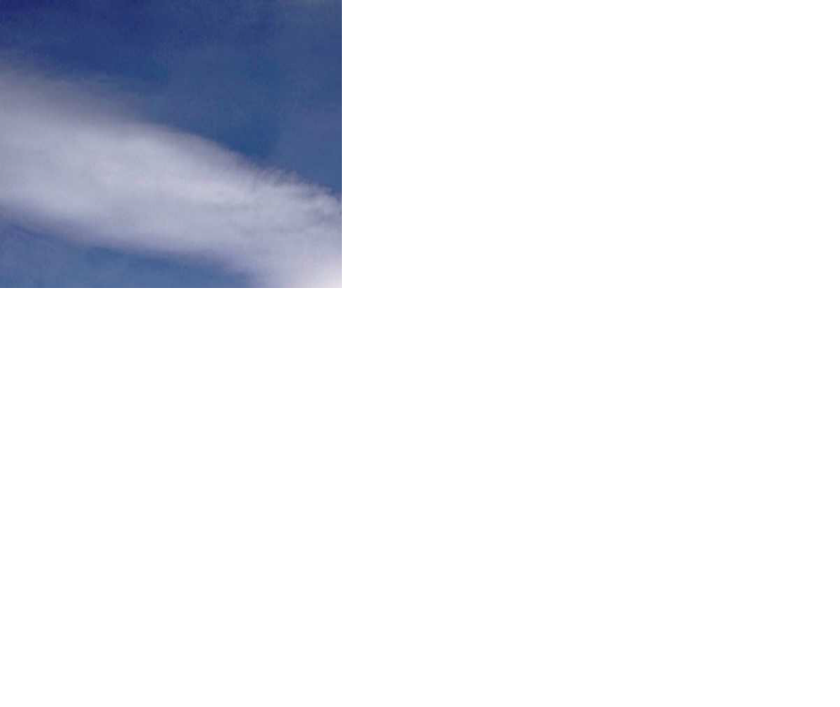
The Lord from Heaven
The Heaven
The Spirit
Righteous
Life
The Law of God
Liberty
The Dominion of the Earth
The Earth
The Flesh
Sin
Death
The Law of Sin
Bondage
The Sea

Slide 27
Let’s Summarise....again
A Lord: Commands, Rules, has Authority
A Servant: Obeys, Submits, Serves, Does
A Lord and Servant go together as a relationship
Faithfulness in doing is the sought quality in a servant
The Role of Lordship is presented as the “Lord from heaven”
he is Lord because he has Dominion over earth/sin/death/flesh
Joh 3:31 “He that cometh from above is above all: he that is of the earth is earthly,
and speaketh of the earth: he that cometh from heaven is above all.”

Slide 28
The Command
Of
The Lord

Slide 29
Joh 15:12 This is my commandment, That ye love one another, as I have loved you.

Slide 30
This is my commandment,
That ye love one another,
as I have loved you.
How?
that a man lay down his life for his friends.

Slide 31
“To Know... Jesus Christ, whom thou Hast Sent”
The Name and Titles of Jesus
“The Lord”

Slide 32
Rev 15:3 And they sing the song of Moses the servant of God, and the song of the Lamb, saying, Great and marvelous are thy works, Lord God Almighty; just and true are thy ways, thou King of saints.
Rev 15:4 Who shall not fear thee, O Lord, and glorify thy name for thou only art holy: for all nations shall come and worship (kiss thy hand) before thee; for thy judgments are made manifest.

Slide 33
The Servant & Prophet of the Lord Yahweh
The Lord from Heaven
The Heaven
The Spirit
Righteous
Life
The Law of God
Liberty
Joh 6:38 For I came down from heaven, not to do mine own will, but the will of him that sent me.
Heb 5:8 Though he were a Son, yet learned he obedience by the things which he suffered;
Php 2:8 And being found in fashion as a man, he humbled himself, and became obedient unto death, even the death of the cross.
The Dominion of the Earth
The Earth
The Flesh
Sin
Death
The Law of Sin
Bondage

Slide 34
Obed Edom – Obed Adamah
“The Servant of the Earth”
The “Adamah” - Ground
The “Adam” - Man
“Edom” – Man (adam)
“Edom” – which is Esau

Slide 35
Obed Edom – Obed Adamah
The Servant of Edom/Esau/Adamah
“The Servant of the Earth”
Obadiah – The end of Esau/Edom
Isaiah Servant – Jacob the Servant of Yahweh Is 41-53
“The Elder Shall Serve the Younger”
2 Sam 6 – The House of Obed Edom
Jacob the Servant of Lord Esau Gen 33
“Thou shalt break his yoke from off thy neck”
“Jacob” – The catcher of Esau’s Heel gen 27,25:23
Adam – Cain – Noah – Ish adam, Obed adam

