Slide 1
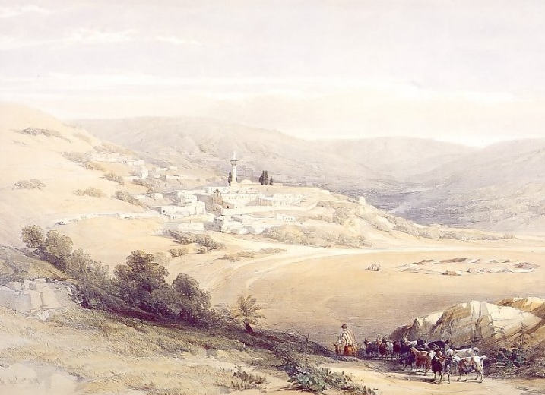
Thou Shalt Call his Name
Jesus

Slide 2
What are the first two things you Think about when you hear their Name?

Slide 3

What Emotional response does their name
Trigger in you?

Slide 4
What are the first two things you Think about when you hear the name
Jesus?

Slide 5
What Emotional response does the name
JESUS
Trigger in you?

Slide 6
The Name and Major Titles of Jesus........... In the NT
Title | Approx Number of Occurrences
Lord | 700x
Christ/Messiah | 570x
Master/Disciple | 350x
Son of Man | 85x
Son of God | 45x
Son of David | 16x
King of the Jews | 17x
The Name of JESUS | 940x

Slide 7
Goals of this Study
1. Understand how Names work in The Bible
&
2. Establish a foundation for an
Intellectual, Emotional and Moral connection with the Name “Jesus”

Slide 8
Principle ONE- A BIBLE NAME is a
Label for an IDENTITY
Principle TWO – Bible Names have a
Thematic rationale
1) Starts with your Birth
2) Your Character
A Bible NAME
Exists within a Context
Which is
Related to A ROLE/Purpose
And conforms with
the Bibles
Typological Frameworks
3) Your Behaviour
Together these make an Identity
And define Your NAME
And thus your Memory and Memorial

Slide 9
The Name of Jesus
A Label
An Identity
Birth
Characteristics
Circumstance
Role/Purpose
Typology
Behaviours/Reputation
This makes an Identity
And defines Existence
And thus Memory and Memorial

Slide 10
The Name of Jesus IS:
His Naming
His Purpose and Reason
His Character
Actions & Words

Slide 11
He Shall Save
His People
From
Their Sins

Slide 12

The Name of Jesus IS:
His Naming
His Purpose and Reason
His Character
Actions & Words

Slide 13

The Captain of Salvation
THE CAPTAIN that Saves by Overcoming
Based on the principle of conquest
&
Based on the thematic of “The Enmity” (Gen 3:15)
Title of the Lion of Judah that Saves by Destroying the enemy
Rev 5:5
Heb 2:9-15
Eph 4:8
Rom7:23
2 Cor 10:5
1 Cor 15:54-57

Slide 14
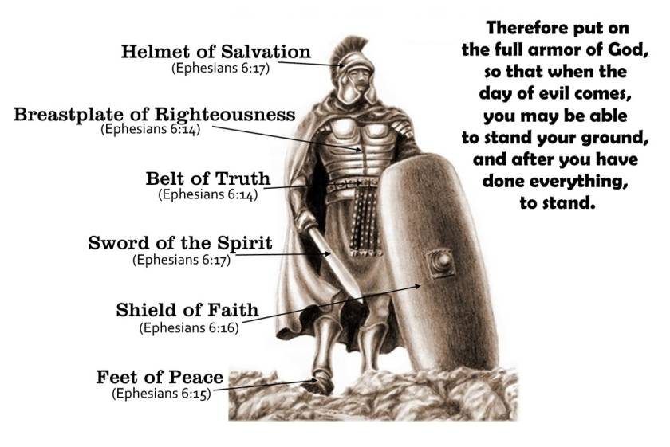
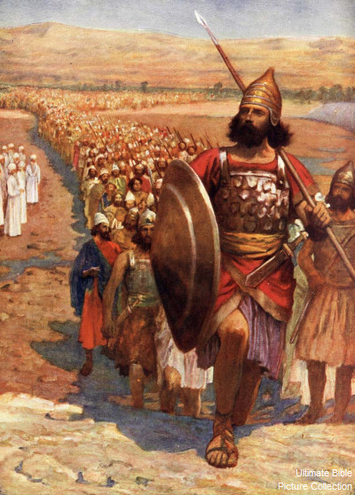
Joshua – A Captain

Slide 15

Eph 4:8 Wherefore he saith, When he (Jesus) ascended up on high, he led captivity captive, and gave gifts (the spoil) unto men.

Slide 16
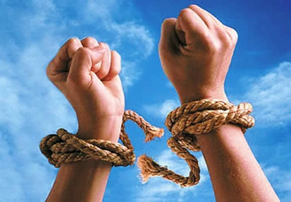
Rom 7:23 But I see another law in my members, warring against the law of my mind, and bringing me into captivity to the law of sin which is in my members.
Rom 7:24 O wretched man that I am! who shall deliver me from the body of this death?
Rom 7:25 I thank God through Jesus Christ our Lord.

Slide 17
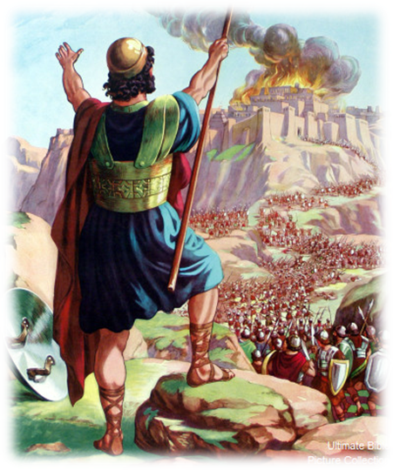
Co 10:3 For though we walk in the flesh, we do not war after the flesh:
2Co 10:4 (For the weapons of our warfare are not carnal, but mighty through God to the pulling down of strong holds;)
2Co 10:5 Casting down imaginations, and every high thing that exalteth itself against the knowledge of God, and bringing into captivity every thought to the obedience of Christ;

Slide 18
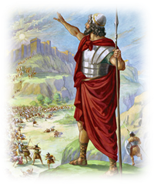
Heb 2:9 But we see Jesus, who was made a little lower than the angels for the suffering of death, crowned with glory and honor; that he by the grace of God should taste death for every man.
Heb 2:10 For it became him, for whom are all things, and by whom are all things, in bringing many sons unto glory, to make the captain of their salvation perfect through sufferings.
Heb 2:14 Forasmuch then as the children are partakers of flesh and blood, he also himself likewise took part of the same; that through death he might destroy him that had the power of death, that is, the devil; (Dia – Bolis – the accuser)
Heb 2:15 And deliver them who through fear of death were all their lifetime subject to bondage.

Slide 19
Overcome:
G3529 νίκη nikē
a primary word; conquest that is, the means of success: - victory.
G3528 νικά nikaō
From G3529; to subdue: - conquer, overcome, prevail, get the victory.
1Jn 5:4 For whatsoever is born of God overcometh the world: and this is the victory that overcometh the world, even our faith.
1Jn 5:5 Who is he that overcometh the world, but he that believeth that Jesus is the Son of God?

Slide 20
Rev 2-3 –To those who overcome:
will I give to eat of the tree of life
shall not be hurt of the second death
will I give to eat of the hidden manna,
I will give him a white stone, and in the stone a new name
the same shall be clothed in white raiment;
I will confess his name before my Father, and before his angels.
will I give power over the nations:
I will give him the morning star.
will I make a pillar in the temple of my God,
I will write upon him the name of my God,
will I grant to sit with me in my throne,
Rev 21:7 He that overcometh shall inherit all things; and I will be his God, and he shall be my son.

Slide 21
Overcome:
G3529 νίκη nikē
a primary word; conquest that is, the means of success: - victory.
G3528 νικά nikaō
From G3529; to subdue: - conquer, overcome, prevail, get the victory.
Rev 5:5 And one of the elders said to me, “Weep no more; behold, the Lion of the tribe of Judah, the Root of David, has conquered, so that he can open the scroll and its seven seals.” ESV

Slide 22
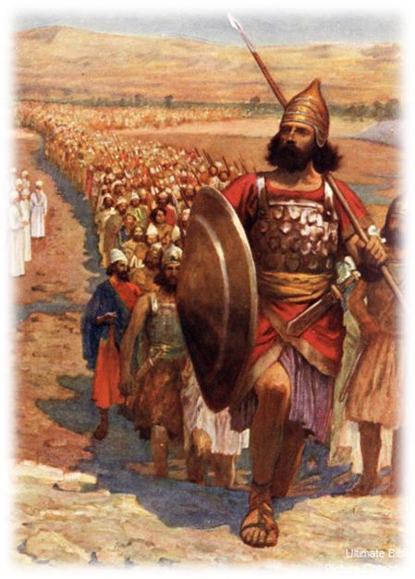
The Captain of Salvation
THE CAPTAIN that Saves by Overcoming
Based on the principle of conquest
&
Based on the thematic of “The Enmity” (Gen 3:15)
Title of the Lion of Judah that Saves by Destroying the enemy
Rev 5:5
Heb 2:9-15
Eph 4:8
Rom7:23
2 Cor 10:5
1 Cor 15:54-57

Slide 23
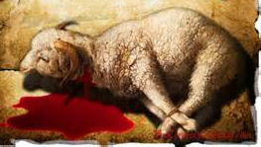
The Lamb

Slide 24
Joh 1:29 The next day John seeth Jesus coming unto him, and saith, Behold the Lamb of God, which taketh away the sin of the world.

Slide 25
Three Key “Sub” Symbols used to Describe the Saving Blood of the Lamb.....................
The Blood of the New Covenant
Matt 26:27 -28
Heb 10:29, Heb 12:24, Heb 13:20
Rom 3:25
The Blood of Cleansing
Rev 1:5
Rev 7:14
1 Jhn 1:7
Heb 9:14
The Blood of Redemption
Rev 5:9-10
1 Pet 1:18-19
Acts 20:28
Heb 9:12
You are
Forgiven
You are
Cleansed
You are
Bought

Slide 26
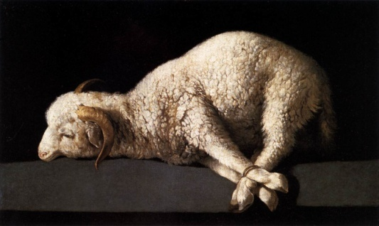
There are two main Symbolic representations of Jesus Christ the Saviour...........
THE LAMB that Saves
Based on the principle of Sacrifice
(But also using secondary symbols of Washing and Purchase)
And
Based (mostly) on the thematics of the Law
The Lamb that Saves by Taking Away their Sins
“Forgiveness”
THE CAPTAIN that Saves
Based on the principle of conquest
And
Based on the thematic of “The Enmity”
Title of the Lion of Judah that Saves by Destroying the enemy
“Overcoming”
Matt 26:28
John 1:29
Rom 3:25, 5:9
Eph 1:7
Col 1:14
Heb 9:22, 10:1
Rev 5:5
Heb 2:9-15
Eph 4:8
Rom7:23
2 Cor 10:5
1 Cor 15:54-57

Slide 27
The Name of Jesus IS:
His Naming
His Purpose and Reason
His Character
Actions & Words

Slide 28
Grace and Truth

Slide 29
The Child Jesus of Nazareth
Luk 2:40 And the child grew, and waxed strong in spirit, filled with wisdom (sophia): and the grace (charis)of God was upon him.
Note: Mk 10:14

Slide 30
The Teenager Jesus of Nazareth
Luk 2:51 ……..and came to Nazareth, and was subject unto them: ………
Luk 2:52 And Jesus increased in wisdom (sophia) and stature, and in favour (charis) with God and man.
Prov 2:1-9 - Prov 7:1-4, Luke 2:51, Isa 50:4 &
Is 11:1-51, Sam 3:10, John 8:28-29, 7:15

Slide 31
GRACE and TRUTH

Slide 32
Think of the best and most successful relationship you have ever had
Were the words and actions that define this relationship about:
Mutual Kindness?
Mutual Truthfulness?
Think of the worst and least successful relationship you have ever had
Had Kindness and Trust broken down?

Slide 33
GRACE Is:
A CAUSE - The compassion and kindness of The Fathers Love,
THE ACTION - expressed in words or actions towards Us
THE REACTION - that generates a feeling of appreciation, pleasure & cheer both in the giver and the recipient.

Slide 34
These words or actions may be in
everyday provision, 2 Cor 9:8,
or a specific blessing or need, Rom 12:6, Heb 4:16
or the overall work of salvation and purpose in Jesus Christ. 2 Tim 1:9, Tit 2:11, 1 Pet 1:10
So that
The Gospel word of God is a called the word of Grace. Acts 14:3 20:32
His salvation in Christ is called being saved by Grace, Eph 2:5-8
his everyday care for us – his Grace. Heb 4:16, 2 Cor 9:8

Slide 35
GRACE in the Fathers Children Is:
A CAUSE - The compassion and kindness of OUR Love,
THE ACTION - expressed in words or actions towards OTHERS
THE REACTION - that generates a feeling of appreciation, pleasure & cheer both in the giver and the recipient.

Slide 36
GRACE and TRUTH

Slide 37
G225
alētheia
From G227; truth:
NOT
HIDDEN - Lanthano
G227
alēthēs
From G1 and G2990; true (as not concealing)

Slide 38
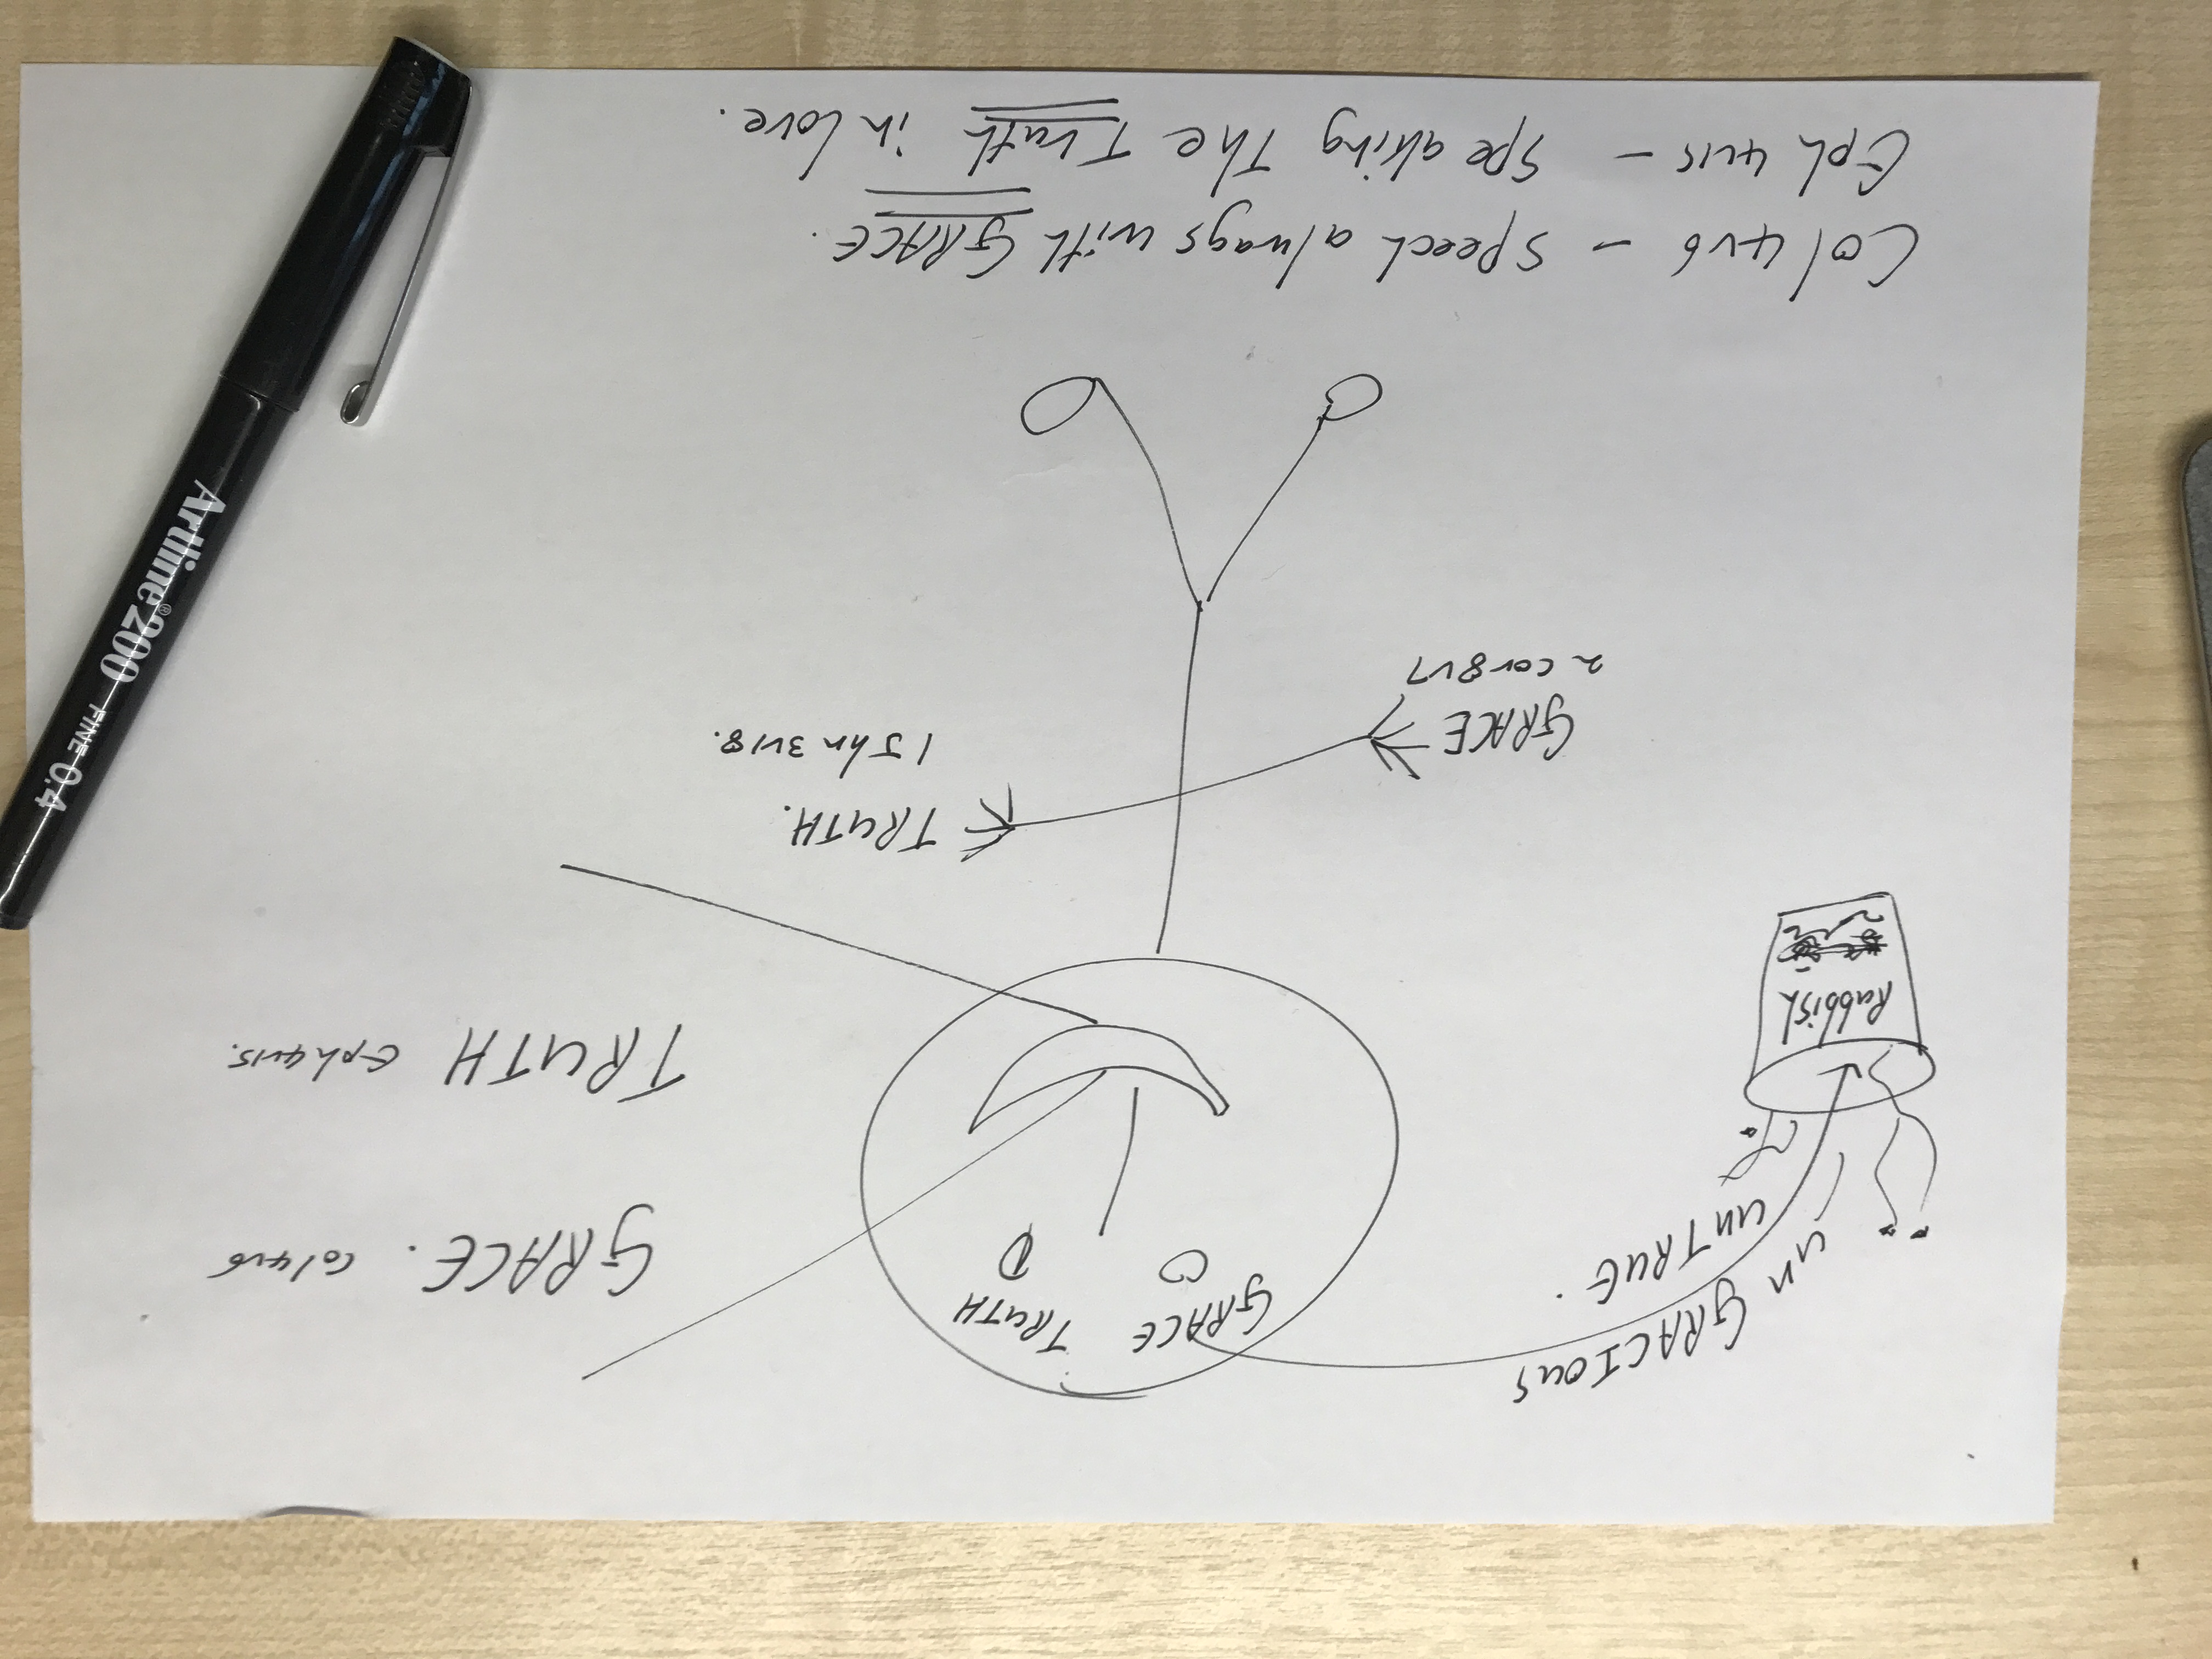
Think
Speak
Do

Slide 39
The Name of Jesus IS:
His Naming
His Purpose and Reason
His Character
Actions & Words

Slide 40
PREACHING
TEACHING
HEALING

Slide 41
This is what he said
This is what he did
Mat 4:23 And Jesus went about all Galilee, teaching in their synagogues, and preaching the gospel of the kingdom, and healing all manner of sickness and all manner of disease among the people.
Mat 4:24 And his fame went throughout all Syria: and they brought unto him all sick people that were taken with divers diseases and torments, and those which were possessed with devils, and those which were lunatic, and those that had the palsy; and he healed them.

Slide 42
Thou Shalt Call His Name
Jesus

