Slide 1
Put Ye On The Whole Armour of God

Slide 2
Put Ye On The Whole Armour of God
Your Loins Girt About with Truth

Slide 3
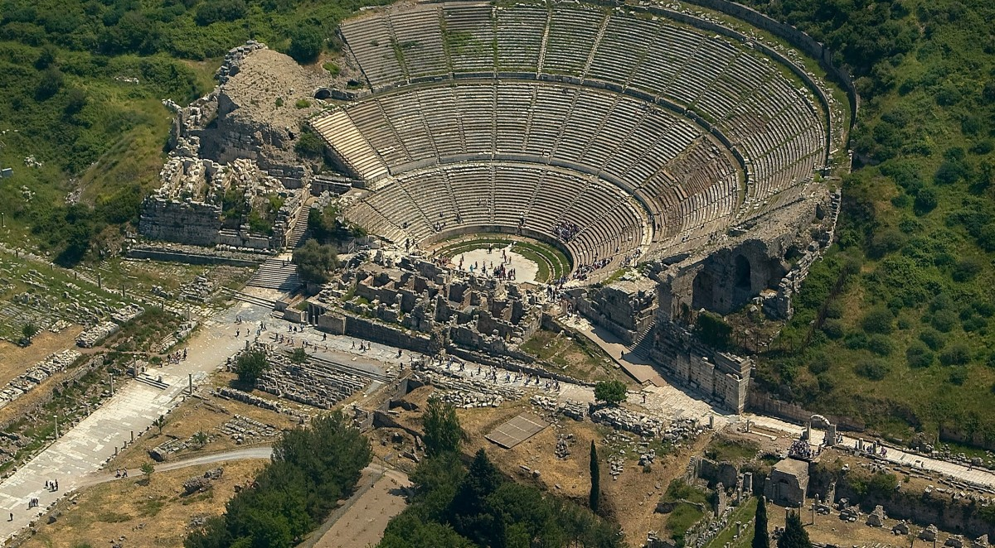

Slide 4
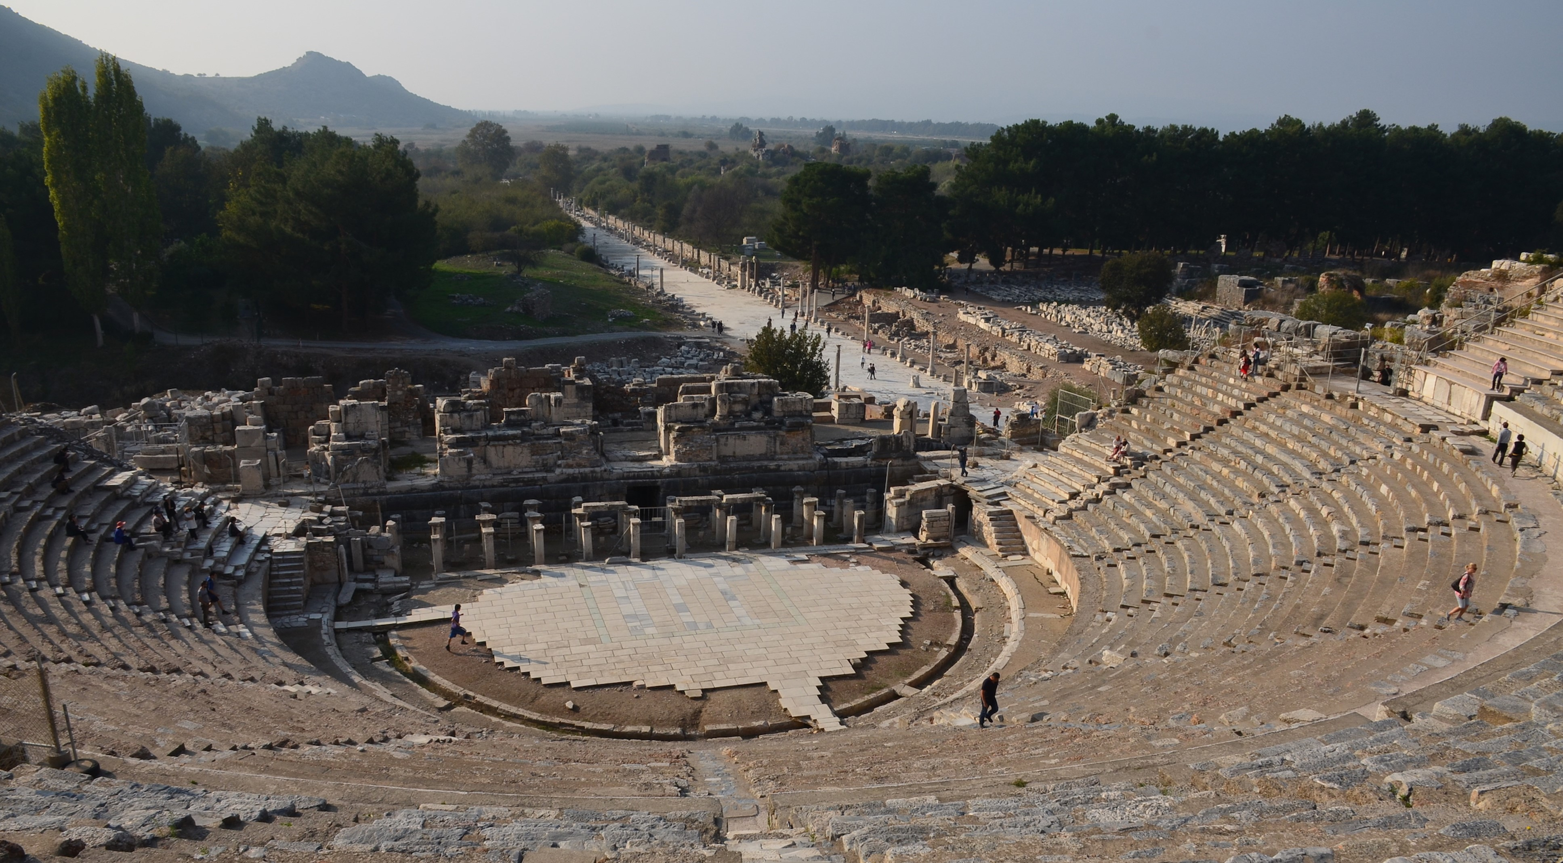
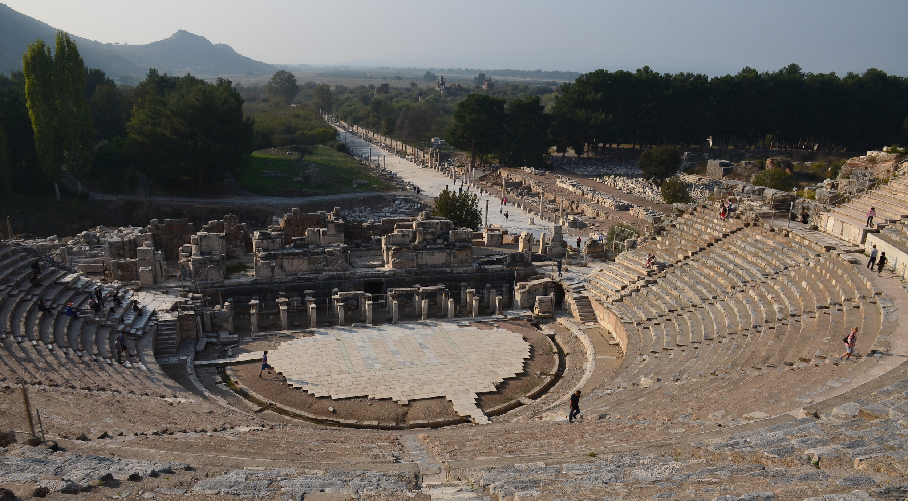
This Photo by Unknown Author is licensed unr CC BY-NC-ND

Slide 5
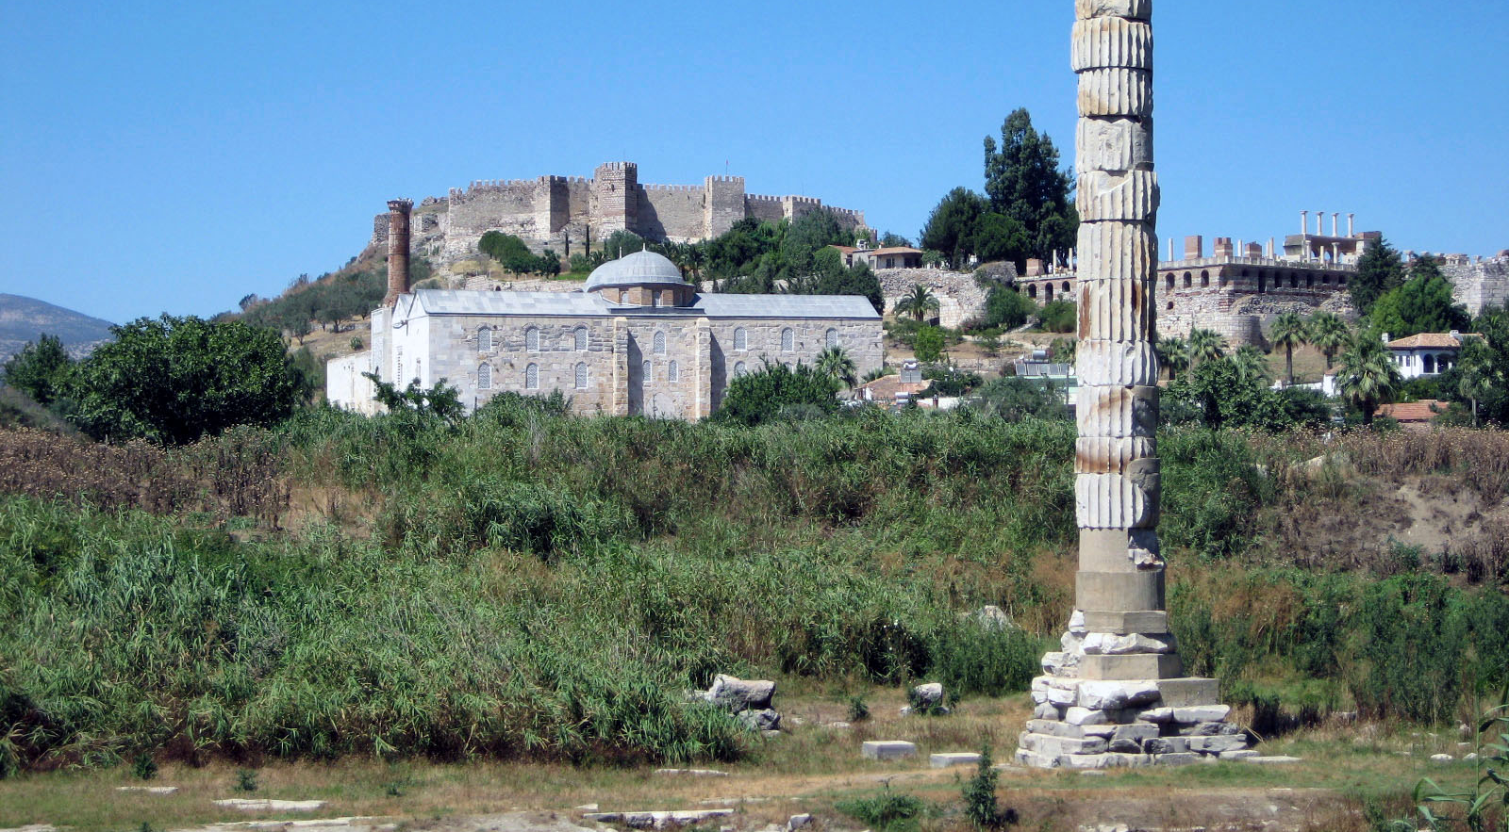
This Photo by Unknown Author is licensed under CC BY-NC-ND

Slide 6
1 Kings 18:46 And the hand of the LORD was on Elijah; and he girded up his loins, and ran before Ahab to the entrance of Jezreel.
2 Kings 4:29 Then he said to Gehazi, Gird up thy loins, and take my staff in thine hand, and go thy way: if thou meet any man, salute him not; and if any salute thee, answer him not again: and lay my staff upon the face of the child
2 Kings 9:1 And Elisha the prophet called one of the children of the prophets, and said unto him, Gird up thy loins, and take this box of oil in thine hand, and go to Ramothgilead

Slide 7
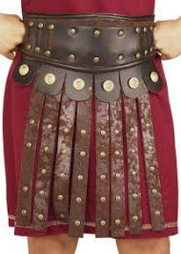
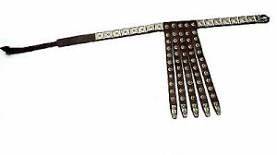
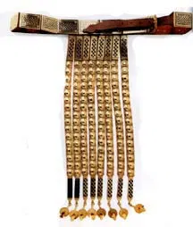

Slide 8
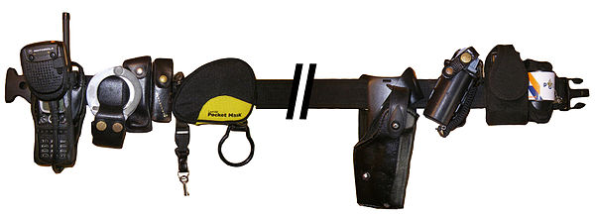
This Photo by Unknown Author is licensed under CC BY-SA

Slide 10
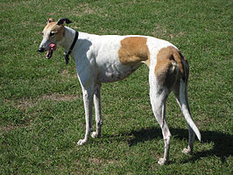
Loins:- Strongs H 4975 mothen = ‘to be slender’
Proverbs 30:29
There be three things which go well, yea, four are comely in going:
A lion which is strongest among beasts, and turneth not away for any;
A greyhound (mothen) ; an he goat also; and a king, against whom there is no rising up.
This Photo by Unknown Author is licensed under CC BY-SA

Slide 11
Isaiah 11:2 And the spirit of the LORD shall rest upon him, the spirit of wisdom and understanding, the spirit of counsel and might, the spirit of knowledge and of the fear of the LORD;
11:3 And shall make him of quick understanding in the fear of the LORD: and he shall not judge after the sight of his eyes, neither reprove after the hearing of his ears:
11:4 But with righteousness shall he judge the poor, and reprove with equity for the meek of the earth: and he shall smite the earth with the rod of his mouth, and with the breath of his lips shall he slay the wicked.
11:5 And righteousness shall be the girdle of his loins, and faithfulness the girdle of his reins.

Slide 12
Isaiah 41:4
Who hath wrought and done it, calling the generations from the beginning? I the LORD, the first, and with the last; I am he.
Eureka vol 1. (Letter to Smyrna)
‘These things saith the First and Last, who was dead and lived’.
The ‘Lord the Spirit’, the ‘First’ was dead and lived by resurrection.
When all the saints shall have been begotten, they will constitute ‘the Last, or ‘the Last Ones ,’ according to Isaiah

Slide 13
Ephesians 4 v 24
And that ye put on the new man, which after God is created in righteousness and true holiness.
English Revised Version
And put on the new man, which after God hath been created in righteousness and holiness of truth

Slide 14
1 John 1:6
If we say that we have fellowship with him, and walk in darkness, we lie, and do not the truth

Slide 15
1 John 1:6
If we say that we have fellowship with him, and walk in darkness, we lie, and do not the truth
1 John 3:18
My little children, let us not love in word, neither in tongue; but in deed and in truth
The New Living translation:-
‘but let us show the truth by our actions

Slide 16
1 John 1:6
If we say that we have fellowship with him, and walk in darkness, we lie, and do not the truth
1 John 3:18
My little children, let us not love in word, neither in tongue; but in deed and in truth
The New Living translation:-
‘but let us show the truth by our actions
John 3:21
But he that doeth truth cometh to the light, that his deeds may be made manifest, that they are wrought in God.

