Slide 1
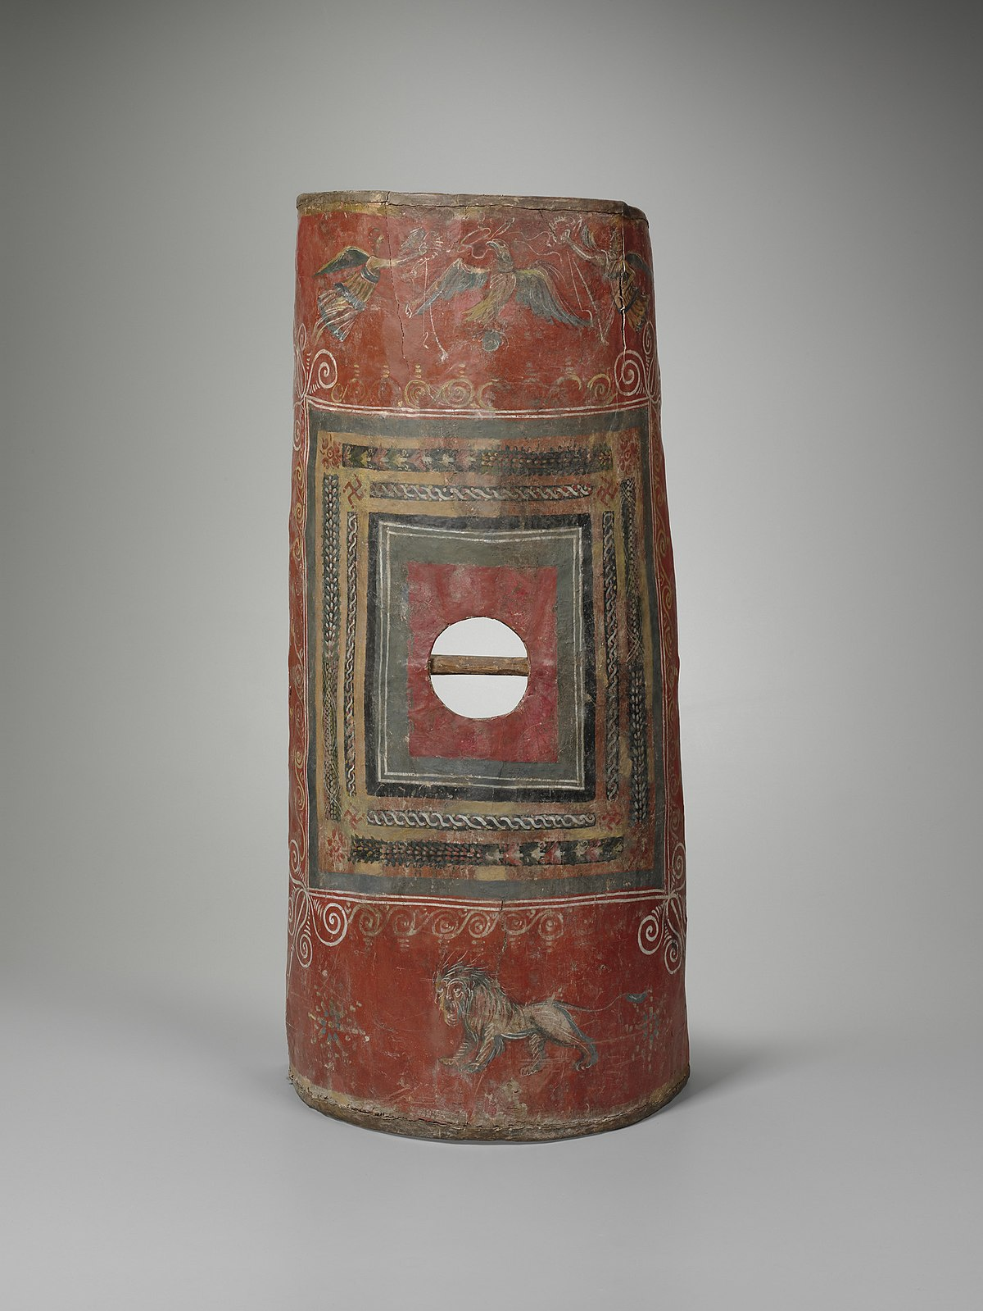
The Shield of Faith
This Photo by Unknown Author is licensed under CC BY-SA

Slide 2
Ephesians 6.16
‘Above all’
Weymouth:- And besides all these take the great shield of faith……
NIV :- In addition to all this take up the shield of faith……..

Slide 3
The Shield of Faith v 16
Greek = THUREOS
Thayer:-
‘a large oblong, four cornered shield’
Strongs ( G2374):-
‘A large shield (as door shaped)’
This Photo by Unknown Author is licensed under CC BY-SA

Slide 4
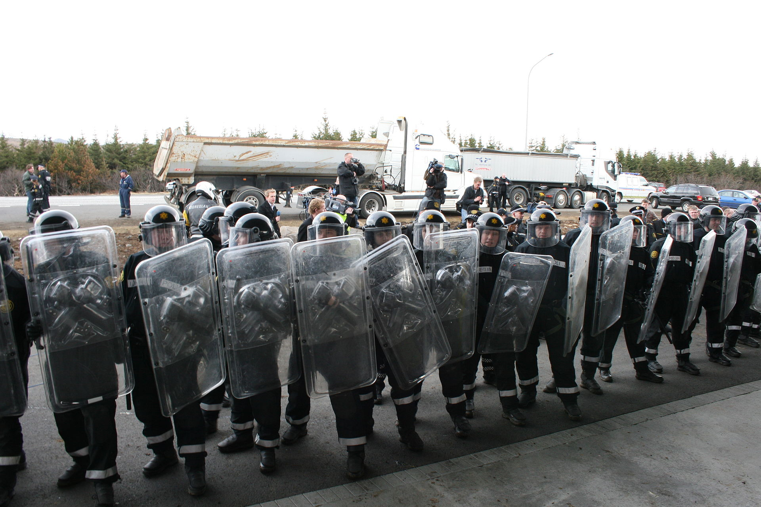
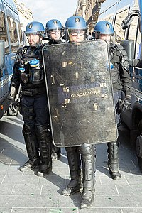
This Photo by Unknown Author is licensed under CC BY-SA
This Photo by Unknown Author is licensed under CC BY-SA

Slide 5
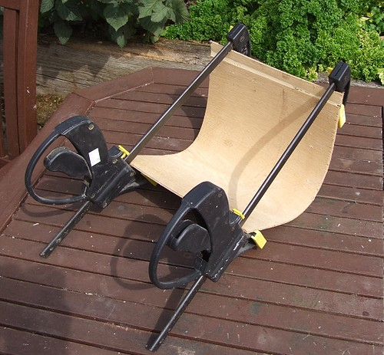
This Photo by Unknown Author is licensed under CC BY

Slide 6
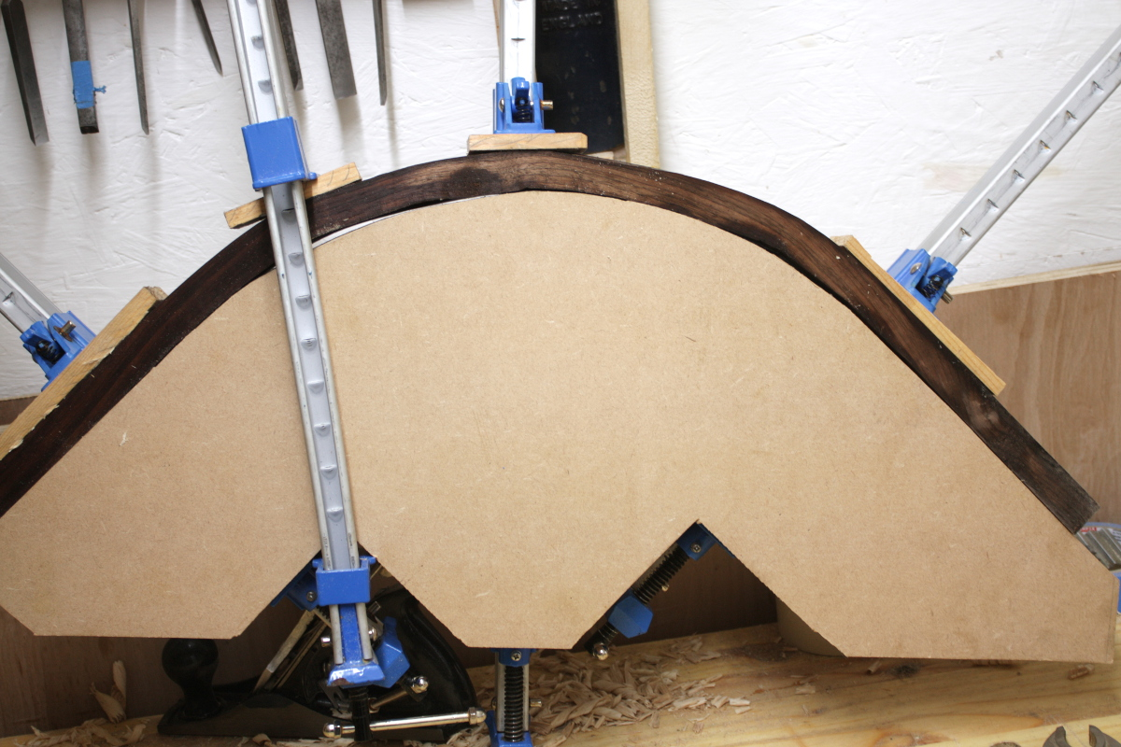
This Photo by Unknown Author is licensed under CC BY-SA

Slide 7
The Covering of the Shield
KJV. Gen 3.21 Coats of skins
Rotherham. ‘Yahweh God made for the man and his wife tunics of skin and clothed them.
Hebrews 10.12 …this man(Jesus), after He had offered one sacrifice for sins for ever, sat down on the right hand of God.
Hebrews 10. 14 For by one offering he hath perfected for ever them that are sanctified

Slide 8
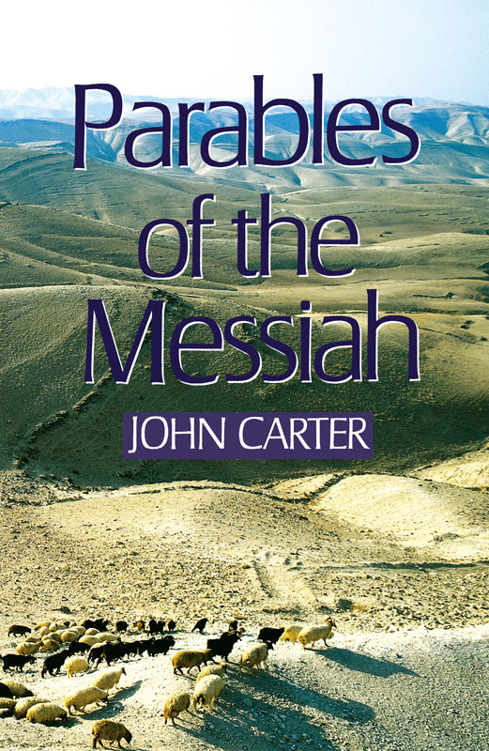
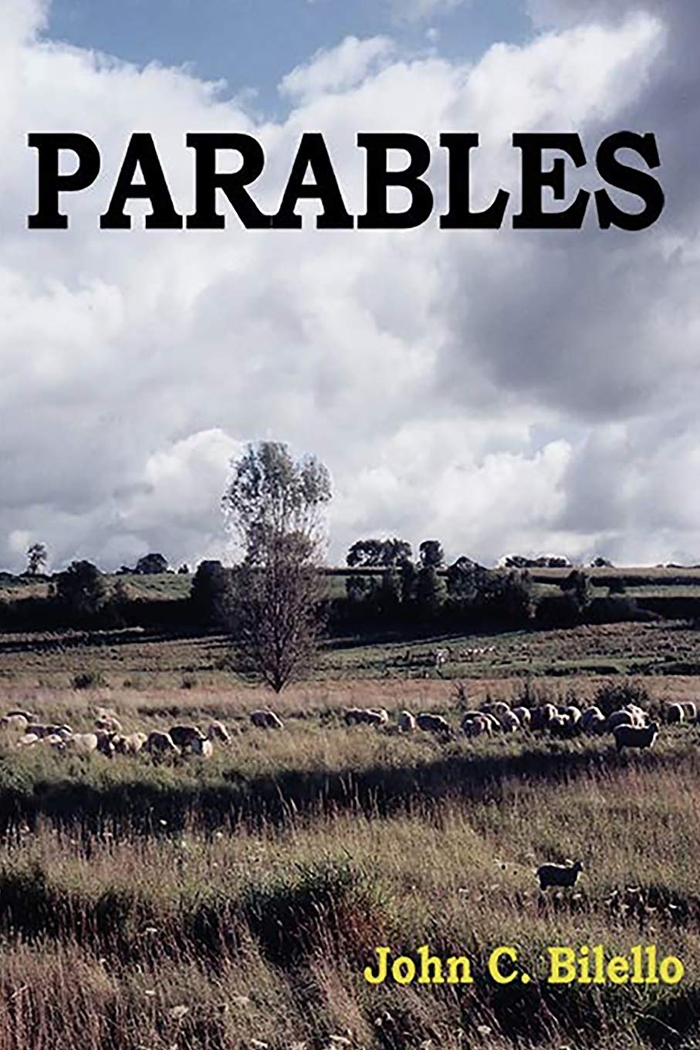
Page 177:- ‘Oil, which is the basis of light, can thus be regarded as the word of God. Without it there can be no preparation for Christ’.
Page 128:- Oil is the word of God…'oil stands for the internal energising power of that word…it is evident that the word of God must be continually replenished within us….’

Slide 9
Yahweh is our Shield
Deut 33.29
2 Sam 22.3
Psalm 28.7
Prov 30.5
Psalm 3.3
Psalm 33.20
Psalm 47.9
Psalm 59.11
Psalm 84.11
Psalm 144.2
Proverbs 2.7

Slide 10
METAL | WEIGHT PER CUBIC FOOT IN LBS | ORDER OF HARDNESS
IRON | 491 | 1
COPPER (BRASS) | 559 | 2
SILVER | 655 | 3
GOLD | 1206 | 4

Slide 11
1 Kings 10.16
And king Solomon made two hundred targets of beaten gold: six hundred shekels of gold went to one target.
And he made three hundred shields of beaten gold; three pound of gold went to one shield: and the king put them in the house of the forest of Lebanon.

Slide 12
2 Sam 8.1
2 Sam 8.1 And after this it came to pass, that David smote the Philistines, and subdued them: and David took Metheg-ammah out of the hand of the Philistine
Metheg-ammah = (RSV)
Bridle of the mother-city

Slide 13
2 Sam 8.1
2 Sam 8.1 And after this it came to pass, that David smote the Philistines, and subdued them: and David took Metheg-ammah out of the hand of the Philistine
1 Chron 18,1 Now after this it came to pass, that David smote the Philistines, and subdued them, and took Gath and her towns out of the hand of the Philistines.
Metheg-ammah = (RSV)
Bridle of the mother-city
Gath = winepress

Slide 14
2 Sam 8.1
2 Sam 8.1 And after this it came to pass, that David smote the Philistines, and subdued them: and David took Metheg-ammah out of the hand of the Philistine
1 Chron 18,1 Now after this it came to pass, that David smote the Philistines, and subdued them, and took Gath and her towns out of the hand of the Philistines.
1 Chron 18,1 Now after this it came to pass, that David smote the Philistines, and subdued them, and took Gath and her towns out of the hand of the Philistines.
Metheg-ammah = (RSV)
Bridle of the mother-city
Gath = winepress
Douay-Rheims Bible:- ‘They took away Geth and her daughters’
Catholic Public Domain Bible:- ‘David took Gath and her daughters’

Slide 15
2 Sam 8.3 Hadadezer.
Smiths Bible Dictionary:- Hadad ‘…originally the indigenous appellation of a deity among the Syrians (the Sun, according to Macrob…..)’
‘ezer’ means ‘helped’
Thus Hadad-ezer possibly means ‘Helped of the sun god’.

Slide 16
2 Samuel 8 (1 Chronicles 18) | Revelation
Metheg-ammah = Bridle of the mother city | 17.5 BABYLON THE GREAT, THE MOTHER…

Slide 17
2 Samuel 8 (1 Chronicles 18) | Revelation
Metheg-ammah = Bridle of the mother city | 17.5 BABYLON THE GREAT, THE MOTHER…
Gath = winepress | 14.20 ..blood came out of the winepress…

Slide 18
2 Samuel 8 (1 Chronicles 18) | Revelation
Metheg-ammah = Bridle of the mother city | 17.5 BABYLON THE GREAT, THE MOTHER…
Gath = winepress | 14.20 ..blood came out of the winepress…
Gath and her daughters | 17.5 THE MOTHER OF HARLOTS…

Slide 19
2 Samuel 8 (1 Chronicles 18) | Revelation
Metheg-ammah = Bridle of the mother city | 17.5 BABYLON THE GREAT, THE MOTHER…
Gath = winepress | 14.20 ..blood came out of the winepress…
Gath and her daughters | 17.5 THE MOTHER OF HARLOTS…
Hadadezer = helped of the sun god | 12.1 ..a woman clothed with the sun…

Slide 20
2 Samuel 8 (1 Chronicles 18) | Revelation
Metheg-ammah = Bridle of the mother city | 17.5 BABYLON THE GREAT, THE MOTHER…
Gath = winepress | 14.20 ..blood came out of the winepress…
Gath and her daughters | 17.5 THE MOTHER OF HARLOTS…
Hadadezer = helped of the sun god | 12.1 ..a woman clothed with the sun…
2 Sam 8.7 …shields of gold | 17.4 ..decked with gold… having a golden cup

