Slide 1


Slide 2
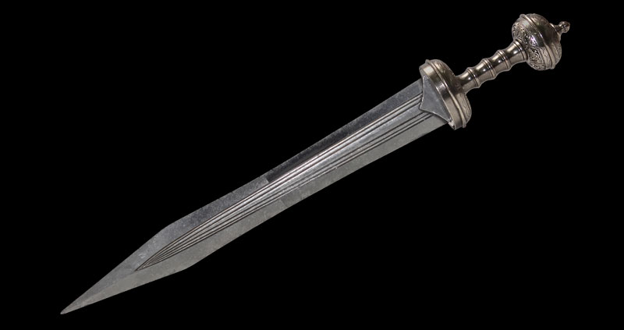
Psalm 44 vs 3:
For they got not the land in possession by their own sword, neither did their own arm save them: but thy right hand, and thine arm, and the light of thy countenance, because thou hadst a favour unto them.

Slide 3
Judges Chapter 3
Moab = ‘of his father’ (Seed of the Serpent)
Eglon = ‘calf-like’
Sin
Gera = ‘a grain’ (a single seed – of the woman)
Present = meal offering (see Ex 29 vs 41)
Roman Gladius | Ehud’s Dagger
Double Edged | Double Edged
18 inch blade (approx) | 18 inch blade (approx)
Kept on the right side | Kept on the right side
Salvation
Suffer
Dagger = ‘hereb’ the word for Sword
Seek
Ehud = ‘Union’ (The Unifier)
Benjamite = ‘a son of the right hand’

Slide 4
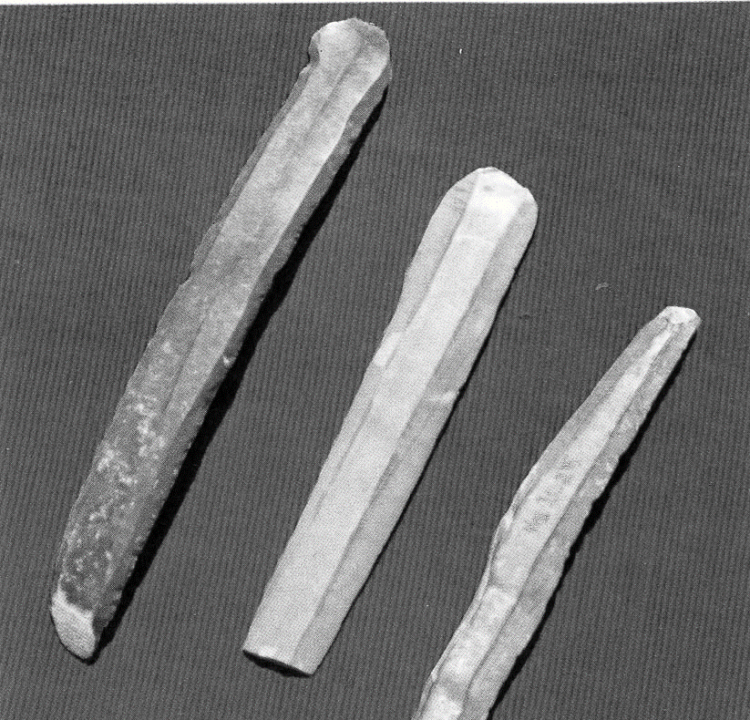
So what was Ehud’s sword made of?
Joshua 5 vs 3:
And Joshua made him sharp knives, and circumcised the children of Israel at the hill of the foreskins.
Deut 32 vs 4:
He is the Rock, his work is perfect: for all his ways are judgment: a God of truth and without iniquity, just and right is he.
The American Medical Association (AMA) has tested the sharpness of flint knives against today’s steel equivalent.
Their findings confirm the following:
Flint knives are 500 times sharper than steel scalpels.
Flint knives more cleanly through cells and tissue.

Slide 5
So what was Ehud’s sword made of?
Joshua 5 | Judges 3
Flint Knives - Vs 2 | Dagger / Sword made of flint? - Vs 16
(Made from the rock of their salvation) | (Made from the rock of their salvation)
Knives made to cut away the flesh - Vs 3 | Dagger made to slay a fleshly king – Vs 16
The people are at Gilgal - Vs 9 | Ehud is at Gilgal – Vs 19
Joshua (the saviour) carries this out – Vs 3 | Ehud (the deliverer) carries this out – Vs 15
Reproach of Egypt was rolled away – Vs 9 | Reproach of Moab was removed – Vs 22
Phil 3 vs 18:
For many walk, of whom I have told you often, and now tell you even weeping, that they are the enemies of the cross of Christ: Whose end is destruction, whose God is their belly, and whose glory is in their shame, who mind earthly things.

Slide 6
Matt 10 vs 34-36
Think not that I am come to send peace on earth: I came not to send peace, but a sword. For I am come to set a man at variance against his father, and the daughter against her mother, and the daughter in law against her mother in law. And a man's foes shall be they of his own household.

Slide 7
Psalm 69 vs 9:
I am become a stranger unto my brethren, and an alien unto my mother's children. For the zeal of thine house hath eaten me up;

Slide 8
Psalm 69 vs 9:
I am become a stranger unto my brethren, and an alien unto my mother's children. For the zeal of thine house hath eaten me up;

Slide 9
Acts 1 vs 13-14:
And when they were come in, they went up into an upper room, where abode both Peter, and James, and John, and Andrew, Philip, and Thomas, Bartholomew, and Matthew, James the son of Alphaeus, and Simon Zelotes, and Judas the brother of James.
These all continued with one accord in prayer and supplication, with the women, and Mary the mother of Jesus, and with his brethren.

Slide 10
Proverbs 27 vs 17:
Iron sharpeneth iron, so a man sharpeneth the countenance of his friend.

