Slide 1
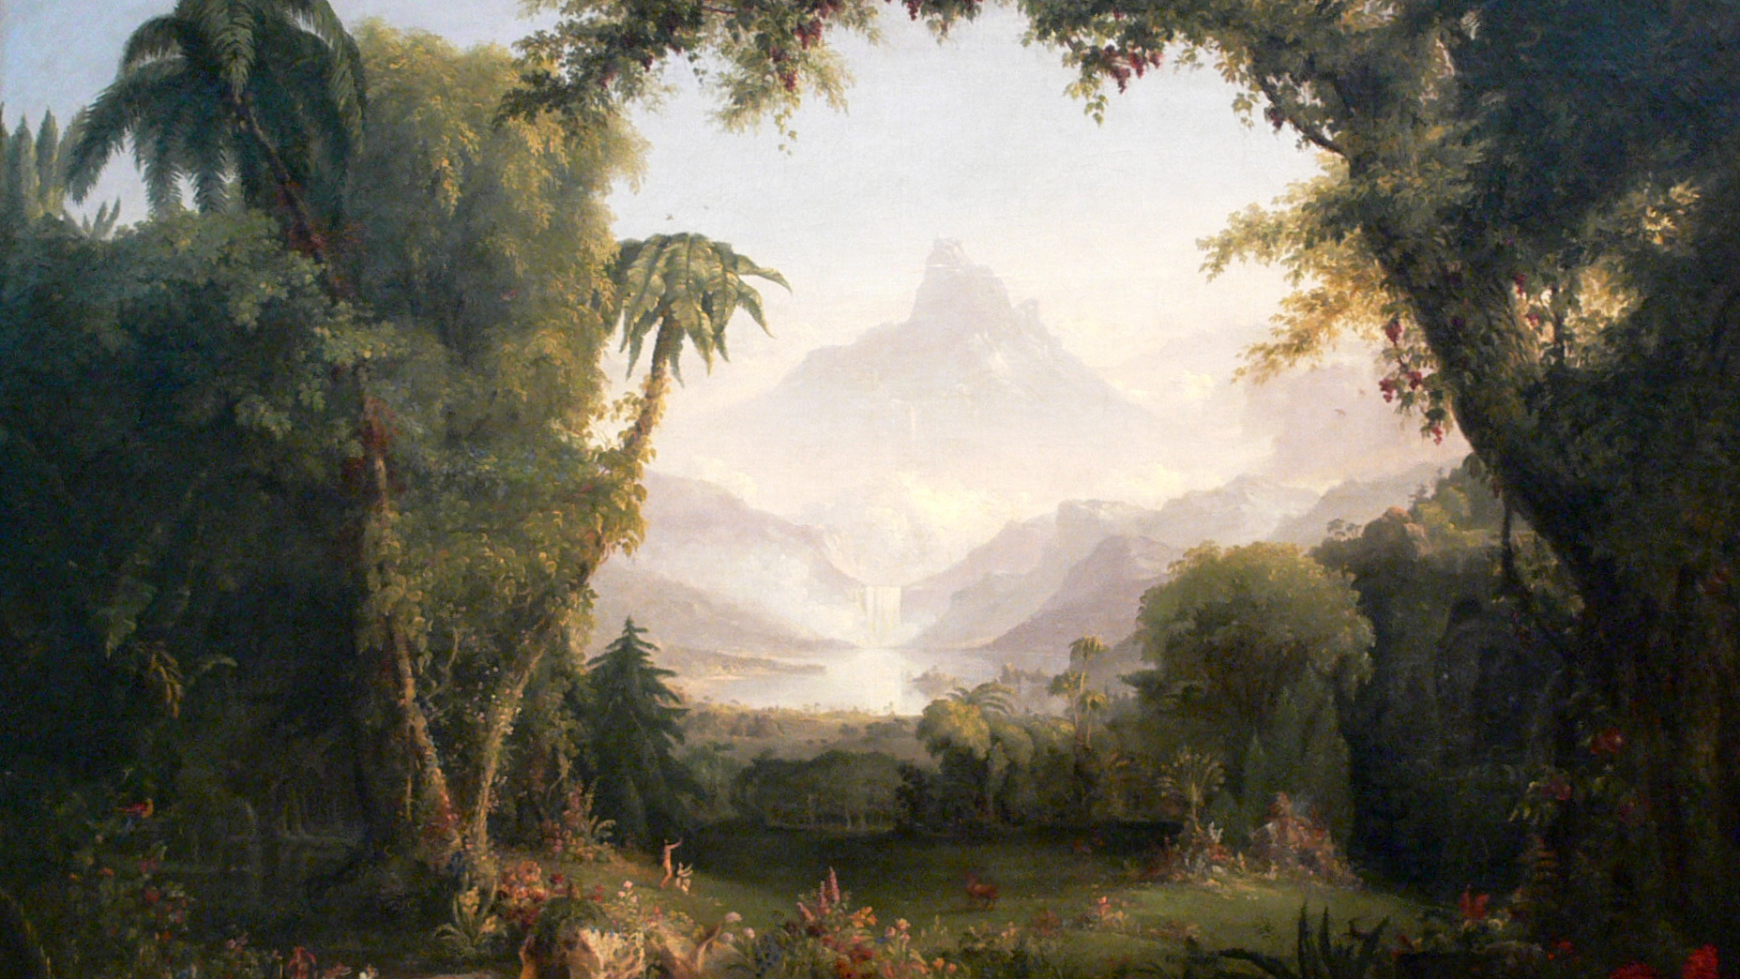
The Garden:
Its Revelation & Restoration
Class 1 – From Beast to Man

Slide 2
God’s Plan and Purpose
Numbers 14:21
“But as truly as I live, all the earth shall be filled with the glory of the LORD.”
Habakkuk 2:14
“For the earth shall be filled with the knowledge of the glory of the LORD, as the waters cover the sea.”

Slide 3
Timeline of God’s Plan
God reveals His plan
God executes His plan over 7000 years
God executes His plan
God unfolds the restoration of His plan
Man disrupts God’s plan

Slide 4
The Revelation in the Garden
God reveals His plan for the earth in Genesis 1
Vision
Man
Execution
Male & Female created in His Image
Blessing
Children in God's Image
Image and Likeness of God
Dominion
Dominion over every living thing

Slide 5
The Revelation in the Garden
Image
Pattern, form
Paul quotes 5x in his epistles
Likeness
Similitude from a root meaning to compare/think
Male & Female
Equal in God’s plan & purpose

Slide 6
”Image” interpreted by the Bible
“Have this mind among yourselves, which is yours in Christ Jesus, who, though he was in the form of God, did not count equality with God a thing to be grasped,” Philippians 2:5-6
“For God doth know that in the day ye eat thereof, then your eyes shall be opened, and ye shall be as gods, knowing good and evil. And when the woman saw that the tree was good for food, and that it was pleasant to the eyes, and a tree to be desired to make one wise, she took of the fruit thereof …” Genesis 3:5-6

Slide 7
“Image” interpreted by the Bible
“Who being the brightness of his glory, and the express image of his person, and upholding all things by the word of his power, when he had by himself purged our sins, sat down on the right hand of the Majesty on high;” Hebrews 1:3
Image <charakter> = character
Glory - “we beheld his glory, the glory as of the only begotten of the Father, full of grace and truth” John 1:14

Slide 8
“Image” interpreted by the Bible
“In whom the god of this world hath blinded the minds of them which believe not, lest the light of the glorious gospel of Christ, who is the image of God, should shine unto them.” II Corinthians 4:4
“For God, who commanded the light to shine out of darkness, hath shined in our hearts, to give the light of the knowledge of the glory of God in the face of Jesus Christ.” II Corinthians 4:6

Slide 9
“Image” interpreted by the Bible
“Who (God’s dear Son) is the image of the invisible God, the firstborn of every creature (of the new creation):” Colossians 1:15
“For it pleased the Father that in him should all fulness dwell” Colossians 1:19
Fulness? “And of his fulness have all we received … grace and truth came by Jesus Christ” John 1:16-17

Slide 10
“Image” interpreted by the Bible
Image = God’s Character or Glory
Likeness - “the verb assumes the meaning to compare, imagine, think, intend.” Theological Wordbook of the Old Testament
Likeness = Spiritual Discernment
  John 14:9
  I Corinthians 11:7
  II Corinthians 4:4
  Philippians 2:5-6
  Colossians 1:14
  Hebrews 1:3

Slide 11
“Likeness” interpreted by the Bible
“Therewith bless we God, even the Father; and therewith curse we men, which are made after the similitude of God. Out of the same mouth proceedeth blessing and cursing.” James 3:9
“For we have not an high priest which cannot be touched with the feeling of our infirmities; but was in all points tempted like as we are, yet without sin.” Hebrews 4:15

Slide 12
“Likeness” interpreted by the Bible
Likeness - “the verb assumes the meaning “to compare, imagine, think, intend.”” Theological Wordbook of the Old Testament
James 3:9 - being in the likeness of God, we ought to choose to bless rather than curse.
Hebrews 4:15 - in our likeness Jesus tempted but always chose life
Likeness = Spiritual Discernment

Slide 13
God’s Plan Revealed
“And did not he make one? Yet had he the residue of the spirit. And wherefore one? That he might seek a godly seed.” Malachi 2:15
  When God said, “Be fruitful and multiply and fill the earth”, His intent was that they would fill the earth with a people manifesting His character and exercising spiritual discernment.
God’s plan from Genesis 1:26-28 was to fill the earth with His Glory!

Slide 14
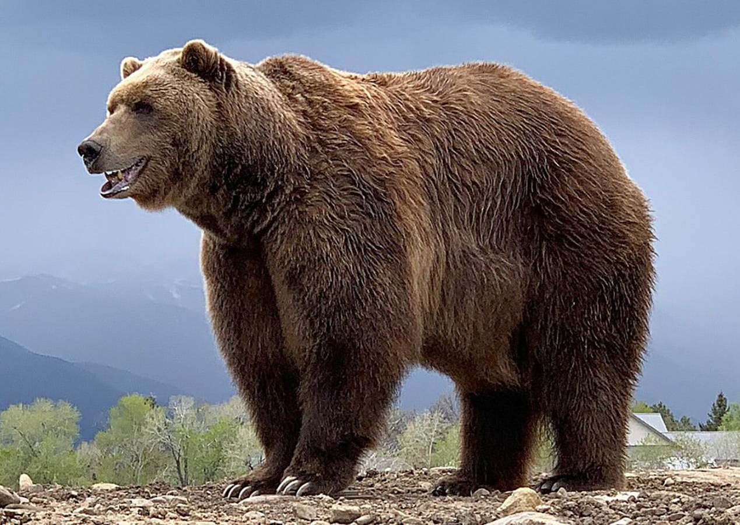
Character of a Beast
Instincts
  No Divine character
Without morals (no absolute right and wrong)
  No spiritual discernment

Slide 15
When image and likeness are absent
“Nevertheless man being in honour abideth not: he is like the beasts that perish.” Psalm 49:12
“Man that is in honour, and understandeth not, is like the beasts that perish” Psalm 49:20
  Understandeth = Discerning – Likeness
“Like sheep they are laid in the grave; death shall feed on them; and the upright shall have dominion over them … God will redeem my soul from the power of the grave” Psalm 49:14-15

Slide 17
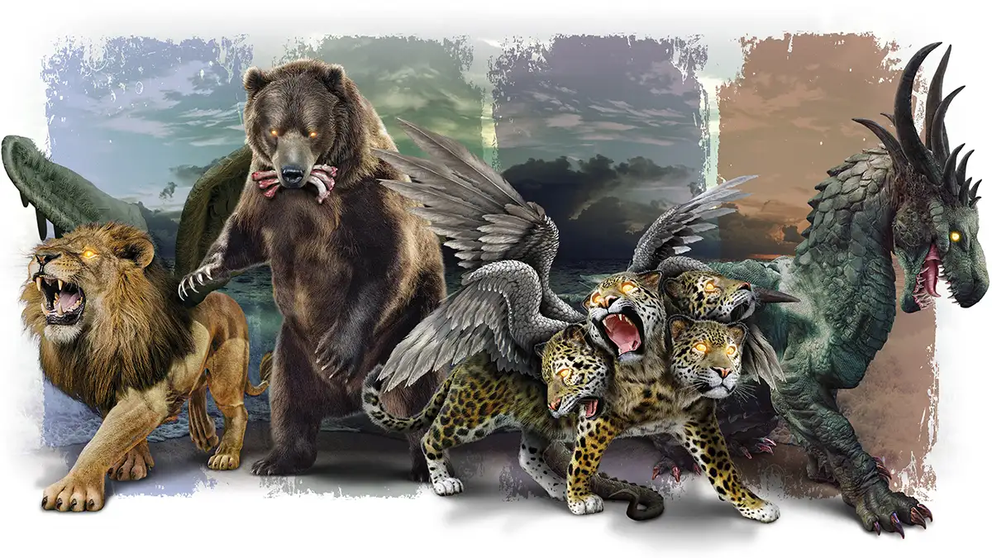
Nations without God’s Character or Spiritual Discernment

Slide 18
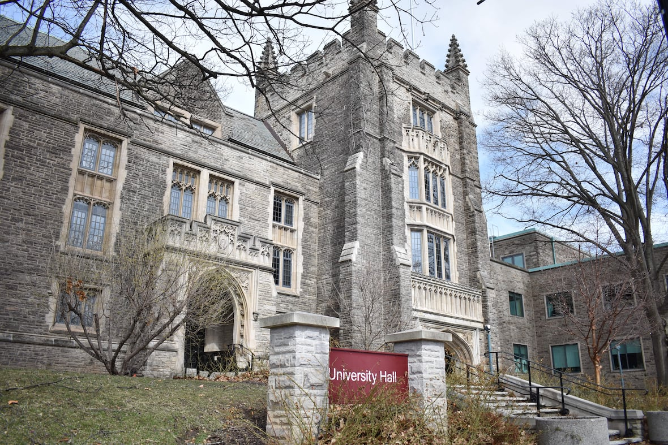
Influence of the Beast
University
Mandatory prerequisite for all students
Diversity (D) - Learning Objectives
Guide and prompt students to evaluate the diversity of human experience, behavior, and thought, in order to better understand ourselves and others, to respond to the roots of inequality that undermines social justice, while developing awareness regarding diversity in culture, ethnicity, race, gender/gender expression, religion, age, social class, sexual orientation, or abilities.

Slide 19


Influence of the Beast
Social Media, News Media
Airwaves, television, internet
  Anything but Christianity is celebrated
  Alternative lifestyles promoted as the norm
  Conservative values labeled oppressive and disruptive.

Slide 20
Notable Beasts in the Bible
Daniel 7
Revelation 13
Revelation 17
Revelation 19
the kingdom of men depicted as 4 beasts coinciding with Babylon, Medes & Persians, Greece, and Rome
the kingdom of men depicted as a beast of the sea and beast of the earth
the harlot of the Apocalypse rides on a beast
the beast attacks Christ and the saints and is destroyed forever (cast into a lake of fire)

Slide 21
The Revelation in the Garden
God reveals His plan for the earth in Genesis 1
Vision
Man
Execution
Male & Female created in His Image
Blessing
Children in God's Image
Image and Likeness of God
Dominion
Dominion over every living thing

Slide 22
Carrying on the Work of God
“And on the seventh day God ended his work which he had made; and he rested on the seventh day from all his work which he had made. And God blessed the seventh day, and sanctified it: because that in it he had rested from all his work which God created and made.” Genesis 2:2-3

Slide 23
The Revelation in the Garden
God elaborates His plan for the earth in Genesis 2
Yahweh Elohim
Generations
Fathered creation
Dominion

Slide 24
Yahweh Elohim - Father of Creation
“These are the generations of the heavens and the earth, when they were created, in the day that the LORD God made the earth and the heavens.”
LORD God
Yahweh Elohim introduced - name that declares His purpose
Generations
From a root word meaning “to give birth”
To become a Father (“Adam, which was the son of God”)
Translated “begat” in Genesis 4v18
“I will be” ... “mighty ones”

Slide 25
Revelation of the Garden
God’s plan revealed in the garden
About God
About God's Plan and Purpose
Through the creation of man and woman, God will fill the earth with His glory
Given dominion over creation
He wants us to share in His work
God will be manifest in a host of mighty men and women
He desires to be a Father to His creation

