Slide 1
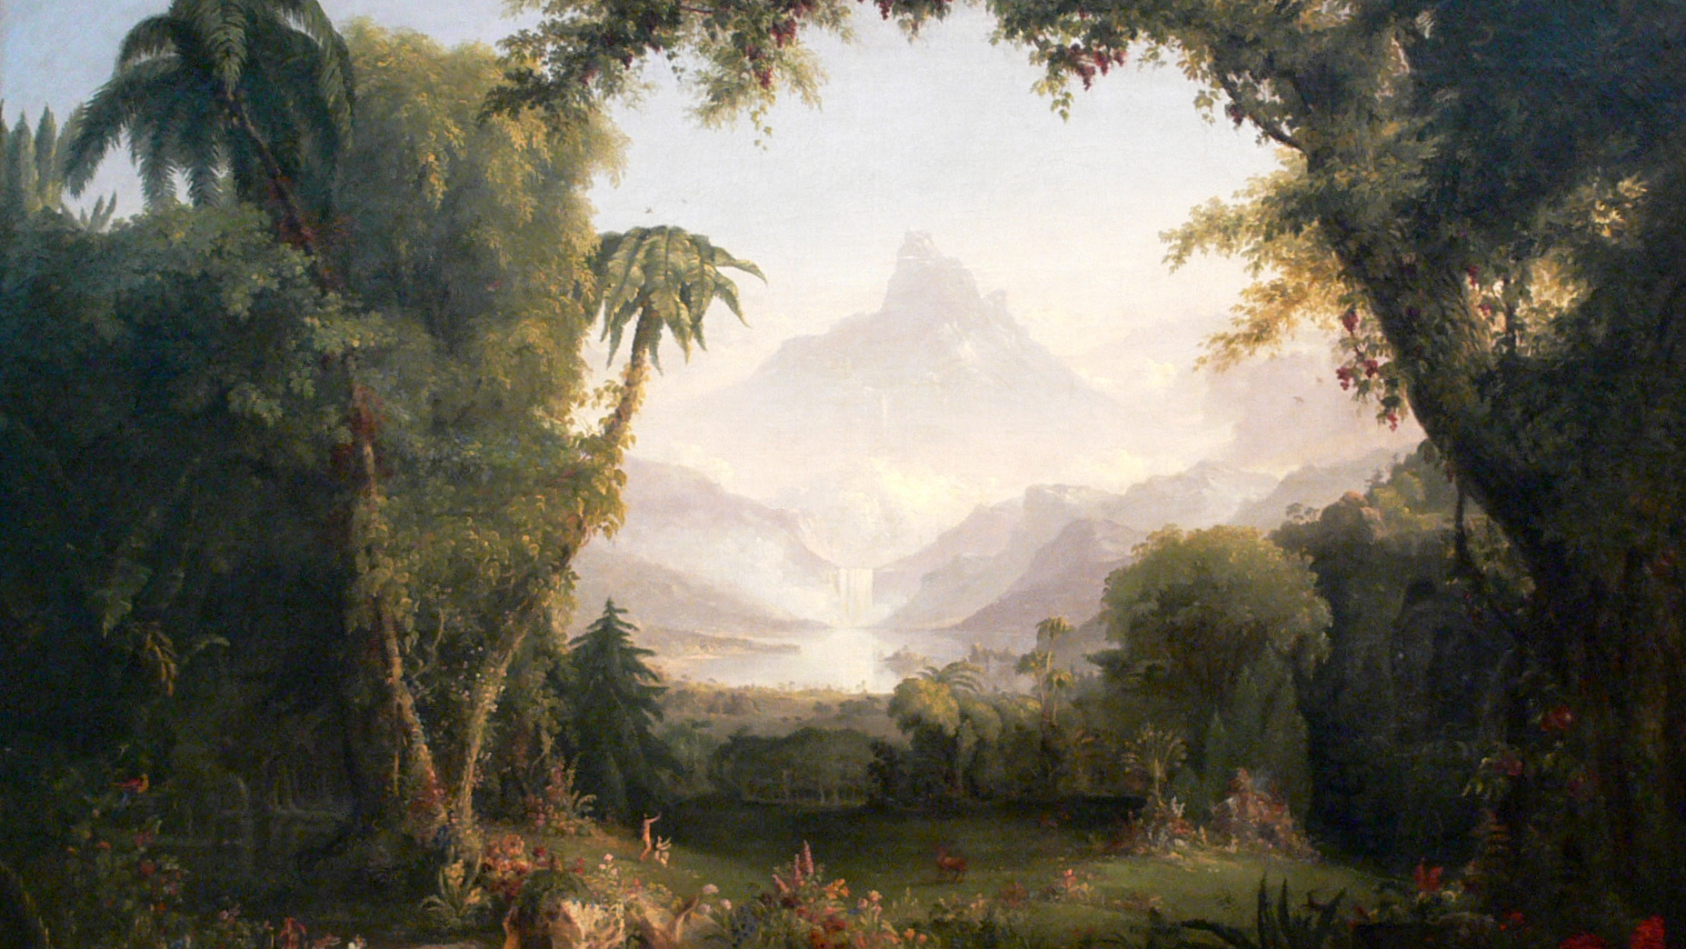
The Garden:
Its Revelation & Restoration
Class 2 – Mystery of the Four Rivers

Slide 2
Timeline of God’s Plan
God reveals His plan
God executes His plan over 7000 years
God executes His plan
God unfolds the restoration of His plan
Man disrupts God’s plan

Slide 3
The Revelation in the Garden
God reveals His plan for the earth in Genesis 1
Vision
Man
Execution
Male & Female created in His Image
Blessing
Children in God's Image
Image and Likeness of God
Dominion
Dominion over every living thing

Slide 4
Yahweh Elohim - Father of Creation
“These are the generations of the heavens and the earth, when they were created, in the day that the LORD God made the earth and the heavens.”
LORD God
Yahweh Elohim introduced - name that declares His purpose
Generations
From a root word meaning “to give birth”
To become a Father (“Adam, which was the son of God”)
Translated “begat” in Genesis 4v18
“I will be” ... “mighty ones”

Slide 5
Revelation of the Garden
God’s plan revealed in the garden
About God
He desires to be a Father to His creation
About God's Plan and Purpose
Through the creation of man and woman, God will fill the earth with His glory
Given dominion over creation
He wants us to share in His work
God will be manifest in a host of mighty men and women

Slide 6
The Revelation in the Garden
God elaborates His plan for the earth in Genesis 2
Yahweh Elohim
Eden
Generations
Fathered creation
Dominion
God planted a garden eastward in Eden
A river into 4 heads

Slide 7
Eden
“And the LORD God planted a garden eastward in Eden;”
Garden - to cover over and shield from danger
Eastward denotes an idyllic state - ancient or antiquity
Eden = a place of delights and pleasantness; paradise
Garden of God - Isaiah 51:3, Ezekiel 28:13, 31:8-9

Slide 8
Eden
Speaking of the regathering of Israel in the land: “This land that was desolate is become like the garden of Eden;” Ezekiel 36:35
Comparing pharaoh of Egypt to the demise of Assyria: “and all the trees of Eden, the choice and best of Lebanon,” Ezekiel 31:8-9,16
Speaking to the king of Tyrus of the area of Jerusalem: “Thou hast been in Eden the garden of God;” Ezekiel 28:13

Slide 9
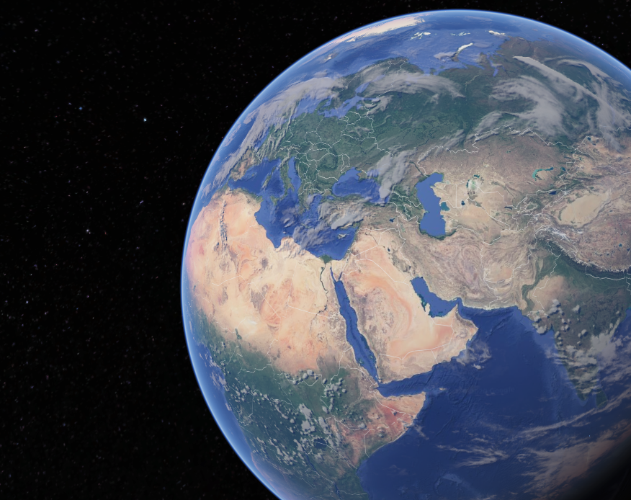
Eden

Slide 10
Mystery of the Four Rivers
“And a river went out of Eden to water the garden; and from thence it was parted, and became into four heads. The name of the first is Pison: that is it which compasseth the whole land of Havilah, where there is gold; and the gold of that land is good: there is bdellium and the onyx stone. And the name of the second river is Gihon: the same is it that compasseth the whole land of Ethiopia. And the name of the third river is Hiddekel: that is it which goeth toward the east of Assyria. And the fourth river is Euphrates.” Genesis 2:10-14

Slide 11
Mystery of the Four Rivers
“And a river went out of Eden to water the garden; and from thence it was parted, and became into four heads. The name of the first is Pison: that is it which compasseth the whole land of Havilah, where there is gold; and the gold of that land is good: there is bdellium and the onyx stone. And the name of the second river is Gihon: the same is it that compasseth the whole land of Ethiopia. And the name of the third river is Hiddekel: that is it which goeth toward the east of Assyria. And the fourth river is Euphrates.” Genesis 2:10-14

Slide 12
Mystery of the Four Rivers
“And a river went out of Eden to water the garden; and from thence it was parted, and became into four heads. The name of the first is Pison: that is it which compasseth the whole land of Havilah, where there is gold; and the gold of that land is good: there is bdellium and the onyx stone. And the name of the second river is Gihon: the same is it that compasseth the whole land of Ethiopia. And the name of the third river is Hiddekel: that is it which goeth toward the east of Assyria. And the fourth river is Euphrates.” Genesis 2:10-14

Slide 13
Mystery of the Four Rivers
“And a river went out of Eden to water the garden; and from thence it was parted, and became into four heads. The name of the first is Pison: that is it which compasseth the whole land of Havilah, where there is gold; and the gold of that land is good: there is bdellium and the onyx stone. And the name of the second river is Gihon: the same is it that compasseth the whole land of Ethiopia. And the name of the third river is Hiddekel: that is it which goeth toward the east of Assyria. And the fourth river is Euphrates.” Genesis 2:10-14

Slide 14
Mystery of the Four Rivers
“And a river went out of Eden to water the garden; and from thence it was parted, and became into four heads. The name of the first is Pison: that is it which compasseth the whole land of Havilah, where there is gold; and the gold of that land is good: there is bdellium and the onyx stone. And the name of the second river is Gihon: the same is it that compasseth the whole land of Ethiopia. And the name of the third river is Hiddekel: that is it which goeth toward the east of Assyria. And the fourth river is Euphrates.” Genesis 2:10-14

Slide 15
Mystery of the Four Rivers
Pison = spread or scattered
Nahum 3:18 - Assyria’s army scattered
Habakkuk 1:8; Jeremiah 50:11 - Babylon’s army judged
Malachi 4:2 - Christ’s army scatters
Compasses = to march about, encircle
Havilah = to travail, to writhe in pain, to travail in birth
Gold, Bdellium and Onyx
Gold = tried faith
Bdellium = colour of the manna | from root ‘divide or separate’
Onyx = vain or emptiness
Area settled by Ishmaelites (Saudi Arabia) - Gen. 25:18; I Sam. 15:7

Slide 16
Mystery of the Four Rivers
Gihon = to burst or break forth
As in to be born (Psa. 22:9)
Compasses = to march about, encircle
Ethiopia = Cush - the father Nimrod who built Assyria and Babylon

Slide 17
Mystery of the Four Rivers
Hiddekel = rapids in a river
Daniel says “as I was by the side of the great river, which is Hiddekel” = Tigris river
Euphrates = to break forth, fruitfulness
“Goeth towards Ethiopia” (Cush - Assyrio-Babylon) - Isa. 18:1 w. Isa. 8:8

Slide 18
Eden
Territory of Eden is from Euphrates in the North, Mediterranean in the West, Arabian Peninsula in the South, and Arabian Sea in the East

Slide 19
Mystery of the Four Rivers
“And a river went out of Eden to water the garden; and from thence it was parted, and became into four heads.”
River
From verb to flow - verb found 3 times in the OT

Slide 20
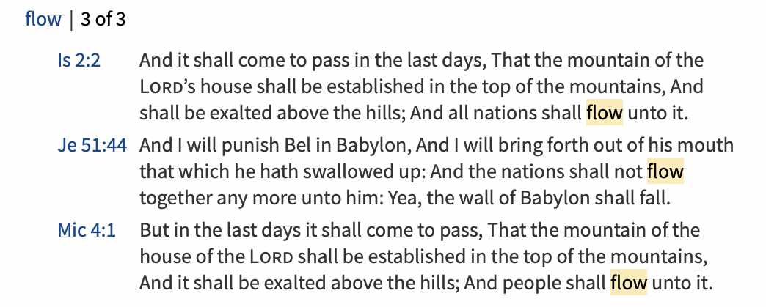

Slide 21
Mystery of the Four Rivers
“And a river went out of Eden to water the garden; and from thence it was parted, and became into four heads.”
River
From verb to flow - verb found 3 times in the OT
Jeremiah 51:44 - in the day of her judgment nations will no longer flow to Babylon
Isaiah 2:2, Micah 4:1 - after the day of judgment, all nations will flow to Zion
Four
Divine government
Heads
Rosh - chief; masculine of "beginning" in Genesis 1:1
Jesus is the head … the beginning … has the pre-eminence (Colossians 1:18)

Slide 22
Mystery of the Four Rivers
Armies of Christ Victorious over Babylon | Waiting for the Appearing of the Saints
Pison speaks of the armies of Assyrio-Babylon being judged and Jesus Christ’s victorious army Gihon encompasses Cush - Father of Nimrod, settler of Assyria and Babylon Euphrates & Tigris are rivers of Babylon | Havilah speaks of travailing like a woman Gihon speaks of bringing forth a child
Divine Government | All nations flow to Zion
FOUR speaks of divine government in the Garden of Eden where Jesus Christ is the chief ruler | River speaks of nations no longer flowing to Babylon but flowing to Zion

Slide 23
“For the anxious longing of the creation waits eagerly for the revealing of the sons of God.
For the creation was subjected to futility, not willingly, but because of Him who subjected it, in hope that the creation itself also will be set free from its slavery to corruption into the freedom of the glory of the children of God.
For we know that the whole creation groans and suffers the pains of childbirth together until now.”
Romans 8:19-22

Slide 24
Mystery of the Four Rivers
Armies of Christ Victorious over Babylon | Waiting for the Appearing of the Saints
Pison speaks of the armies of Assyrio-Babylon being judged and Jesus Christ’s victorious army Gihon encompasses Cush - Father of Nimrod, settler of Assyria and Babylon Euphrates & Tigris are rivers of Babylon | Havilah speaks of travailing like a woman Gihon speaks of bringing forth a child
Divine Government | All nations flow to Zion
FOUR speaks of divine government in the Garden of Eden where Jesus Christ is the HEAD chief ruler | River speaks of nations no longer flowing to Babylon but flowing to Zion

Slide 25
Mystery of the Four Rivers
All creation is groaning like a pregnant woman waiting to give birth. The birth is the return of the Lord Jesus Christ and his Saints who will subdue the armies of the nations and establish a new divine government. At that time, all nations will no longer flow to Babylon (the teaching of this world) but will flow to Zion (the teaching of God and Christ).

Slide 26
Revelation of the Garden
God’s plan revealed in the garden
About God
He desires to be a Father to His creation
About God's Plan and Purpose
Through the creation of man and woman, God will fill the earth with His glory
Given dominion over creation
He wants us to share in His work
Given a special land
God will be manifest in a host of mighty men and women

Slide 27
Revelation of the Garden
God’s plan revealed in the garden
About God
He desires to be a Father to His creation
About God's Plan and Purpose
Through the creation of man and woman, God will fill the earth with His glory
He desires to dwell with us
Given dominion over creation
He wants us to share in His work
Given a special land
God will be manifest in a host of mighty men and women
Given access to eternal life

