Slide 1
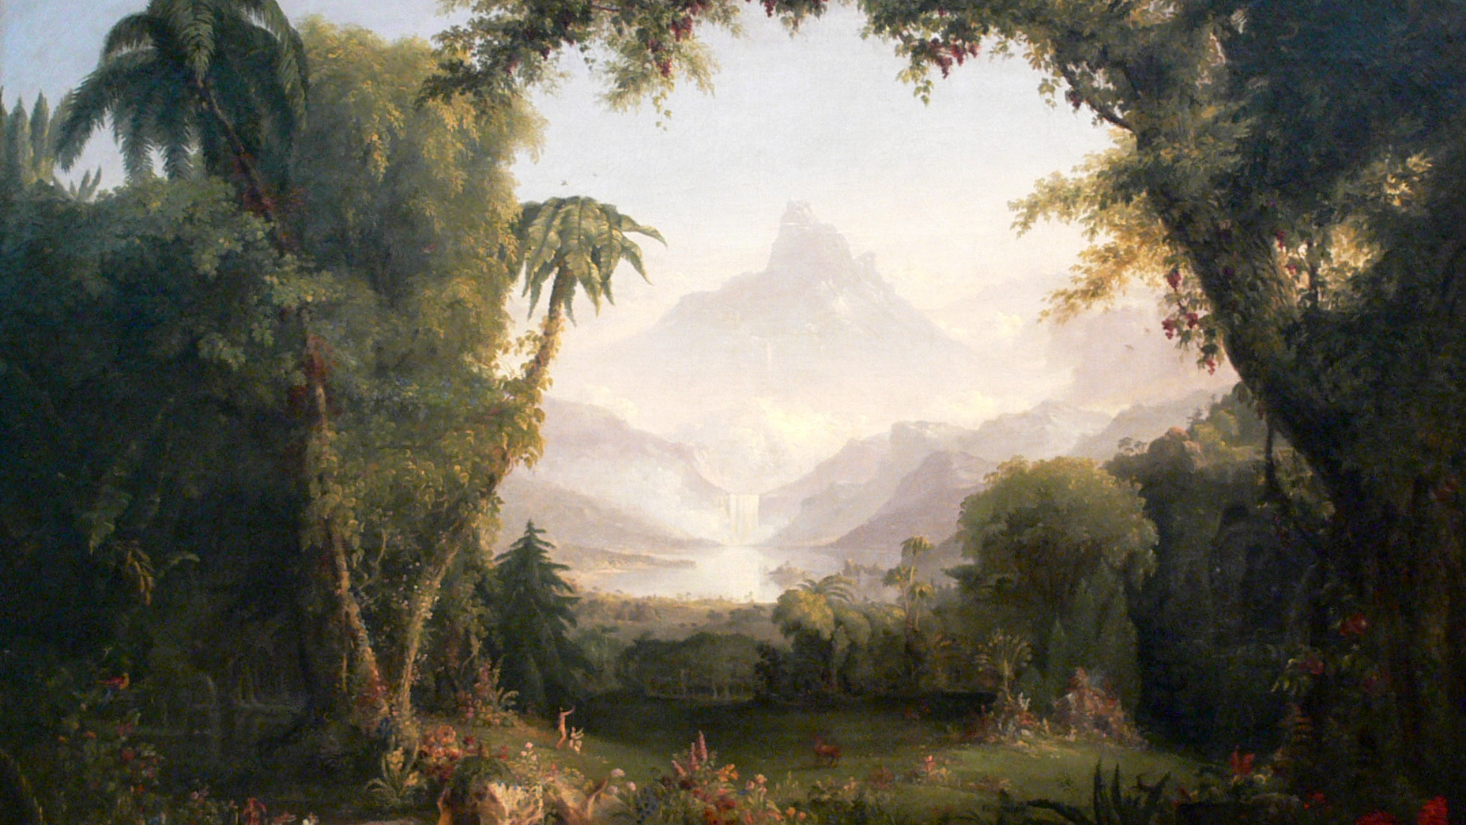
The Garden:
Its Revelation & Restoration
Class 3 – The Blessings Removed

Slide 2
Revelation of the Garden
God’s plan revealed in the garden
About God
He desires to be a Father to His creation
About God's Plan and Purpose
Through the creation of man and woman, God will fill the earth with His glory
Given dominion over creation
He wants us to share in His work
Given a special land
God will be manifest in a host of mighty men and women

Slide 3
Revelation of the Four Rivers
All creation is groaning like a pregnant woman waiting to give birth. The birth is the return of the Lord Jesus Christ and his Saints who will subdue the armies of the nations and establish a new divine government. At that time, all nations will no longer flow to Babylon (the teaching of this world) but will flow to Zion (the teaching of God and Christ).

Slide 4
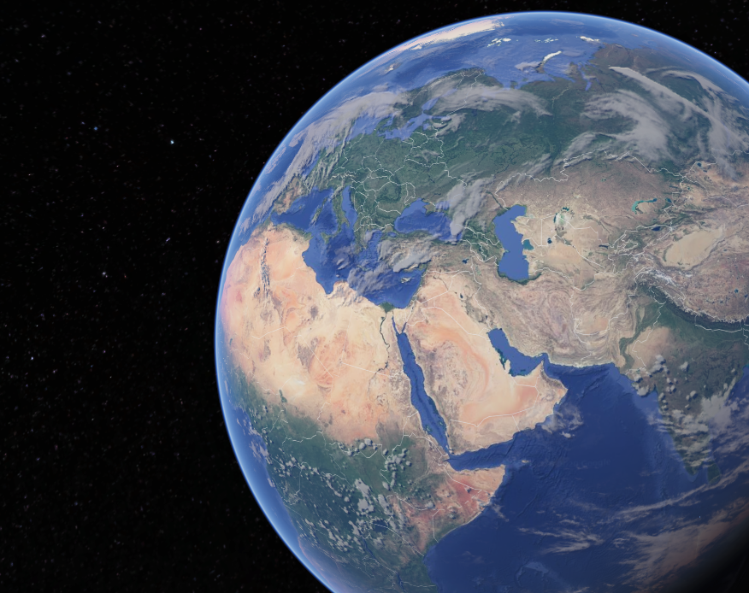
Eden
Territory of Eden is from Euphrates in the North, Mediterranean in the West, Arabian Peninsula in the South, and Arabian Sea in the East

Slide 5
The Revelation in the Garden
God elaborates His plan for the earth in Genesis 2
Yahweh Elohim
Generations
Eden
Life
The tree of life in the midst of the Garden
Fathered creation
Dominion
Based upon free will
God planted a garden eastward in Eden
A river into 4 heads

Slide 6
God’s plan and purpose revealed in Genesis 1:26-28
Man and woman created to reflect God’s glory and fill the earth with children reflecting the same; and to have dominion over all the earth.
Yahweh Elohim revealed a Father of all Creation in Genesis 2:4
Generations = He begot the heavens and the earth
Name ‘I will be manifest in a host of mighty ones’ revealed
Mystery of the 4 rivers revealed in Genesis 2:10-14
The kingdom of God will overcome the kingdom of Babylon
All nations will flow to Zion in that day and no longer to Babylon

Slide 7
The Blessings in Eden
Dominion
“let them have dominion”
Land
Eternal Life
“the tree of life also”
“planted a garden before Eden”

Slide 8
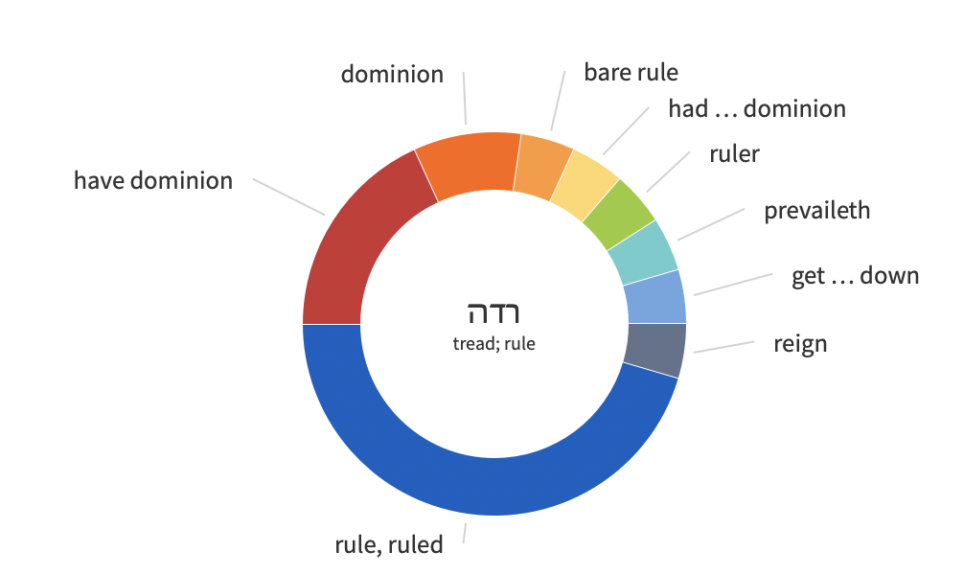
“Let them have dominion”
Dominion = Rule
“{the King} shall have dominion also from sea to sea, and from the river unto the ends of the earth.” Psalm 72:8
“The LORD shall send the rod of thy strength out of Zion: rule thou in the midst of thine enemies.” Psalm 110:2
“Put ye in the sickle, for the harvest is ripe: come, get you down; for the press is full, the fats overflow; for their wickedness is great.”Joel 3:13

Slide 9
“God planted a garden in Eden”
Eden = a place of delights and pleasantness; Paradise
Garden = to cover over and shield from danger
Well-watered everywhere (Gen. 13:10)
Every kind of tree grew there - cedars, fir, chestnut (Eze. 31:8-9)
In the middle of the garden were two special trees: the tree of life and the tree of knowledge of good and evil.

Slide 10

Garden Eastward in Eden
The noun qedem has either a geographical meaning, “east,” or a temporal notion “ancient time, aforetime.” This noun occurs sixty-one times. It denotes an idyllic state whereas ʿôlām, ʿad denote perpetuity, zāqēn, agedness, and riʾšôn primacy

Slide 11
God’s Garden
Garden of the LORD
  Isaiah 51:3
Garden of God
  Ezekiel 28:12-15; Ezekiel 31:8-18
King of Tyre had been in the Garden of God when he built the house of the LORD
“the voice of the LORD God walking in the garden in the cool of the day”
God dwelt with man in the garden

Slide 12
A Place for God to Dwell with His People
“I will dwell with the children of Israel”
Through the tabernacle - Exodus 29:45
”thou wentest forth before thy people”
First speaks of the pillar of cloud and fire in the wilderness but then of God with the saints that march from Sinai to Zion - Psalm 68:6-8
The LORD dwells in those who are ”poor and of a contrite spirit, and trembleth at my word”
Not in temples made with hands - Isaiah 66:1-2
“For the LORD hath chosen Zion; He hath desired it for his habitation.”
The LORD chose Zion to place His name in. Psalm 132:13

Slide 13
A Place for God to Dwell with His People
“I am the LORD your God dwelling in Zion”
In the kingdom God will dwell amongst His people in Zion - Joel 3:17
God always intended to dwell in us and to be a Father to us - II Corinthians 6:16-18
“the tabernacle of God is with men, and he will dwell with them”
With Eden restored God once again dwells with men and women - Revelation 21:3
“Ye are the temple of the living God”
Not in temples made with hands - Isaiah 66:1-2
The LORD dwells in those who are ”poor and of a contrite spirit, and trembleth at my word”

Slide 14
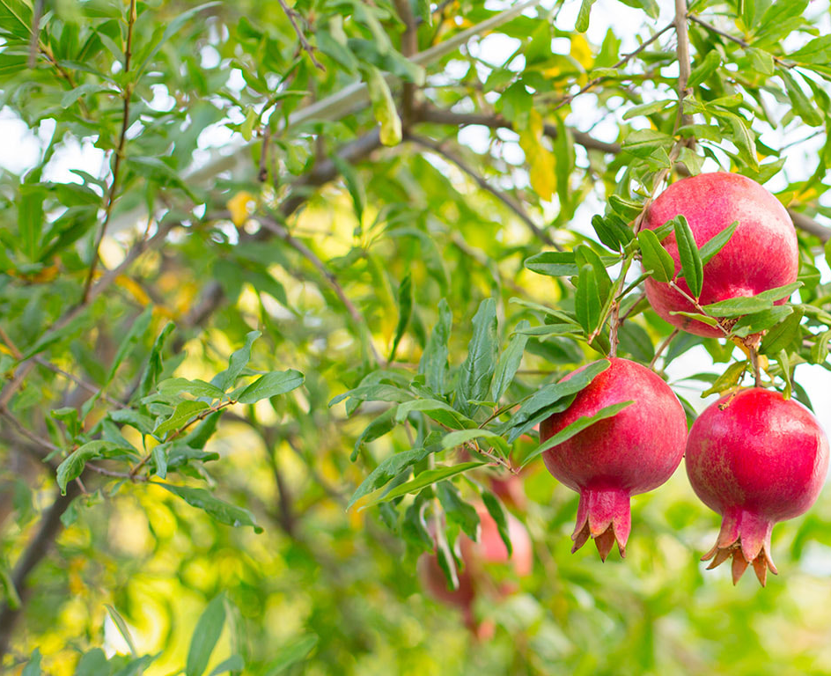
Tree of Life
“And out of the ground made the LORD God to grow every tree that is pleasant to the sight, and good for food; the tree of life also in the midst of the garden, and the tree of knowledge of good and evil.”
Tree of life = live forever
Tree of knowledge = death
CHOOSE BETWEEN LIFE AND DEATH

Slide 15
Blessings Bestowed in the Garden
Dominion over creation
Placed in a garden in Eden
Access to the tree of life

Slide 16
“Male & female made he them”
In the context of God’s plan and purpose with the earth, male and female are presented as one.
  Principle extended in Galatians 3:28 “there is neither male nor female: for ye are all one in Christ Jesus”
In Genesis 2, creation of male and female separated

Slide 17
A Bride From His Side
Adam
Deep sleep from God
From his side created a bride
Christ
Asleep in the Lord
From his side flowed blood and water from which a bride was formed
  Grasped after equality with God
  Sinned against God introducing the need for sacrifice
  Human nature and mortality passed on to his progeny
  Cast out of the garden away from the tree of life
  Did not grasp after equality with God
  Did not sin
  Sacrifice for sin opened the way for a change in nature
  Opened the way to the tree of life in the garden

Slide 18
“Male & Female made he them”
In the context of God’s plan and purpose with the earth, male and female are presented as one.
  Principle extended in Galatians 3:28 “there is neither male nor female: for ye are all one in Christ Jesus”
In Genesis 2, creation of male and female separated
  Divine Order - greater responsibility of the man
  “In any case, in the Lord woman is not independent of man, nor is man independent of woman. For just as woman came from man, so man comes through woman. But all things come from God.” I Corinthians 11:11-12 NET

Slide 19
The Wrong Choice
Created with the ability to reflect God’s character and to exercise spiritual discernment in making godly choices
Not enough: “a tree to be desired to make one wise”
  Jesus “did not count equality with God a thing to be grasped” though he perfectly reflected God’s character
“And they knew they were naked”
  No covering = Unreconciled sin
  They now knew evil - to disobey God

Slide 20
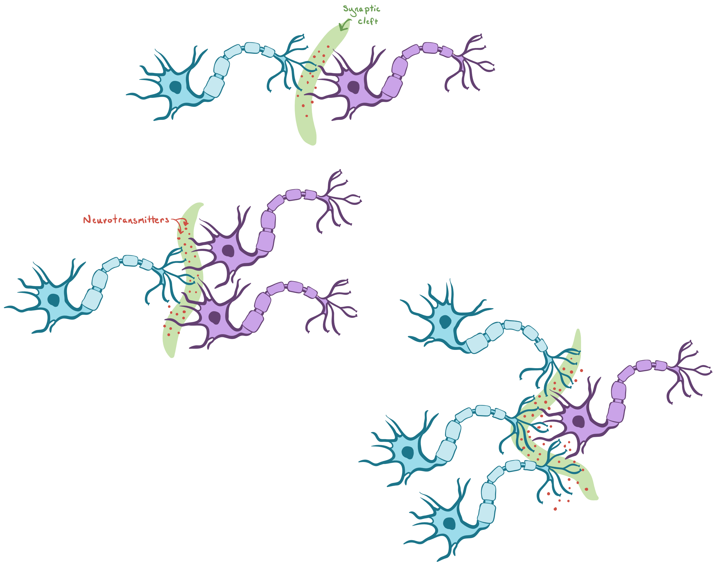
Our brain when excited

Slide 21
Consequences of the Fall
No more dominion over creation
Dominion over creation
Placed in a garden in Eden
Access to the tree of life
Sent forth from the garden in Eden
No more access to the tree of life

Slide 22
Cherubims: a Flaming Sword
Cherubim - speaks of the presence of God and God dwelling with men
Whereas Adam was to “keep” {watch and observe, have charge over, guard and protect} the garden, God now places this responsibility in the hand of the Cherubims “to keep the way to the tree of life”

Slide 23
Cherubims: a Flaming Sword
Cherubim - speaks of the presence of God and God dwelling with men
Genesis 3:24 | Keep the way to the tree of life
Exodus 25:30 | On top of the mercy seat
Numbers 7:89 | Voice of the LORD
II Samuel 6:2; II Kings 19:15; Psalm 80:1; Isaiah 37:6 | LORD of Hosts dwells in the cherubim
Exodus 26:1,31 | On the entrance to the most holy place
I Kings 6:29, 32; 7:29 | In the walls and doors of Solomon’s temple
Ezekiel 41:18-20, 25 | In the walls - A palm tree between 2 cherubs - man and lion
Ezekiel 1, 10; Revelation 4:6-8 | Describes the cherubim as living creatures with 4 faces

Slide 24
Revelation of the Garden
God’s plan revealed in the garden
About God
He desires to be a Father to His creation
About God's Plan and Purpose
Through the creation of man and woman, God will fill the earth with His glory
He desires to dwell with us
Given dominion over creation
He wants us to share in His work
Given a special land
God will be manifest in a host of mighty men and women
Given access to eternal life

Slide 25
Mercy of our Heavenly Father
Dominion over creation | No more dominion over creation
Placed in a garden in Eden | Sent forth from the garden in Eden
Access to the tree of life | No more access to the tree of life
Covenant to David
Covenant to Abraham
Covenant in Eden

