Slide 1
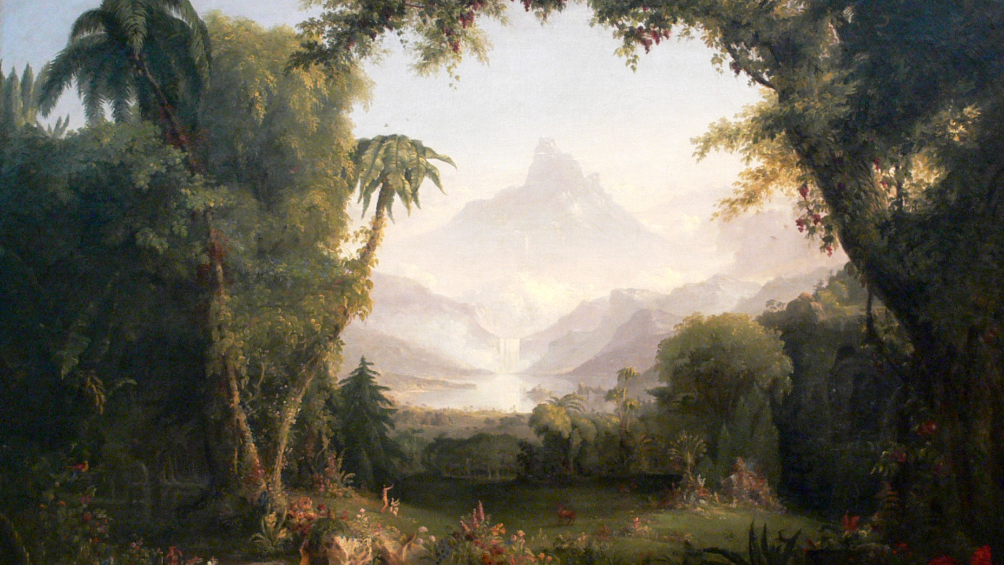
The Garden of Eden:
Its Revelation & Restoration
Class 4 – A Shared Vision

Slide 2
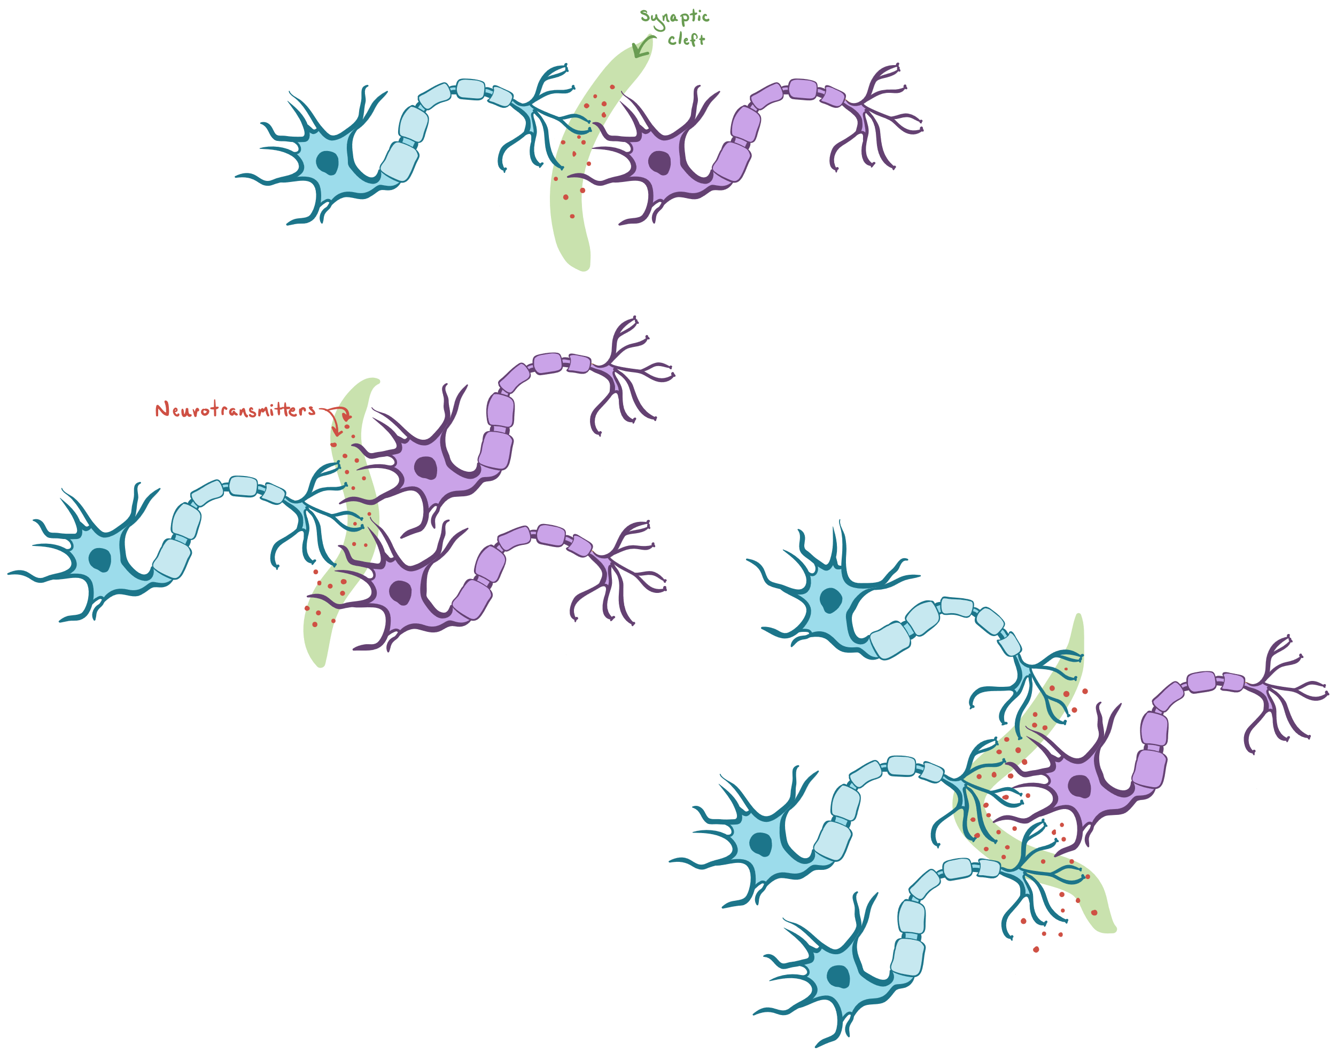
Our brain when excited

Slide 3
Consequences of the Fall
No more dominion over creation
Dominion over creation
Placed in a garden in Eden
Access to the tree of life
Sent forth from the garden in Eden
No more access to the tree of life

Slide 4
Cherubims: a Flaming Sword
Cherubim - speaks of the presence of God and God dwelling with men
Whereas Adam was to “keep” {watch and observe, have charge over, guard and protect} the garden, God now places this responsibility in the hand of the Cherubims “to keep the way to the tree of life”

Slide 5
Cherubims: a Flaming Sword
Cherubim - speaks of the presence of God and God dwelling with men
Genesis 3:24 | Keep the way to the tree of life
Exodus 25:30 | On top of the mercy seat
Numbers 7:89 | Voice of the LORD
II Samuel 6:2; II Kings 19:15; Psalm 80:1; Isaiah 37:6 | LORD of Hosts dwells in the cherubim
Exodus 26:1,31 | On the entrance to the most holy place
I Kings 6:29, 32; 7:29 | In the walls and doors of Solomon’s temple
Ezekiel 41:18-20, 25 | In the walls - A palm tree between 2 cherubs - man and lion
Ezekiel 1, 10; Revelation 4:6-8 | Describes the cherubim as living creatures with 4 faces

Slide 6
Revelation of the Garden
God’s plan revealed in the garden
About God
He desires to be a Father to His creation
About God's Plan and Purpose
Through the creation of man and woman, God will fill the earth with His glory
He desires to dwell with us
Given dominion over creation
He wants us to share in His work
Given a special land
God will be manifest in a host of mighty men and women
Given access to eternal life

Slide 7
Consequences of the Fall
Dominion over creation
Placed in a garden in Eden
Access to the tree of life
No more dominion over creation
Sent forth from the garden in Eden
No more access to the tree of life
Path of Restoration

Slide 8
Covenant in Eden
Covenant in Eden
Blessing of Adam & Eve
Transgression of Adam & Eve
Casting out of Adam & Eve

Slide 9
God’s Character
“The LORD, The LORD God, merciful and gracious, longsuffering, and abundant in goodness and truth, keeping mercy for thousands, forgiving iniquity and transgression and sin, and that will by no means clear the guilty; visiting the iniquity of the fathers upon the children, and upon the children’s children, unto the third and to the fourth generation.” Exodus 34v6-7
merciful
gracious
longsuffering
goodness and truth
mercy
forgiving
no means clear
the guilty
visiting the iniquity

Slide 10
Character of God Revealed
Genesis 3 Exodus 34
 | Longsuffering
 | By no means clear the guilty
“Between thy seed and her seed” | Visiting the iniquity of the fathers upon the children
“It shall bruise thy head, and thou shalt bruise his heel” | Goodness, Merciful and Gracious
“unto dust shalt thou return” | Truth
“make coats of skins, and clothed them” | forgiving iniquity and transgression and sin
“Where art thou?” “Who told thee?”
“Because thou has done this”

Slide 11
Forgiving Iniquity, Transgression and Sin
Knew they were naked
  Exposed and unforgiven sin
Sewed together fig leaves to make girdles
  Tried to cover their own sin
LORD God made coats of skins and clothed them
  God’s sacrifice
  To cover sin requires a blood sacrifice
    “To obey is better than sacrifice” I Sa 15:22
  “Lamb slain from the foundation of the world” Re 13:8

Slide 12
Covenant in Eden - Genesis 3:15
‘thee’ = The Serpent - reasoning that excludes God’s word | ‘and the woman’ = Eve - reasoning that seeks to defend God’s word
‘thy seed’ = Those who leave God’s word out of decision making | ‘and her seed’ = Those whose first response is to defend God’s word
‘thou (the serpent) shalt bruise his (the seed of the woman) heal’ = Jesus would spend 3 days in the grave due to his mortal nature | ‘it (the seed of the woman) shall bruise thy (the serpent) head’ = Victory over sin and death, when Jesus died sinless and was raised 3 days later

Slide 13
Cherubims: a Flaming Sword
Cherubim - speaks of the presence of God and God dwelling with men
Whereas Adam was to “keep” {watch and observe, have charge over, guard and protect} the garden, God now places this responsibility in the hand of the Cherubims “to keep the way to the tree of life”

Slide 14
Jesus is the Way
“In the beginning was the Word {Logos = purpose} … And the Word was made flesh, and dwelt among us, (and we beheld his glory, the glory as of the only begotten of the Father,) full of grace and truth.” Jn 1:1,14
“For God so loved the world, that he gave his only begotten Son… have everlasting life” Jn 3:16-17
“I am the way, the truth and the life: no man cometh unto the Father, but by me.” Jn 14:6

Slide 15
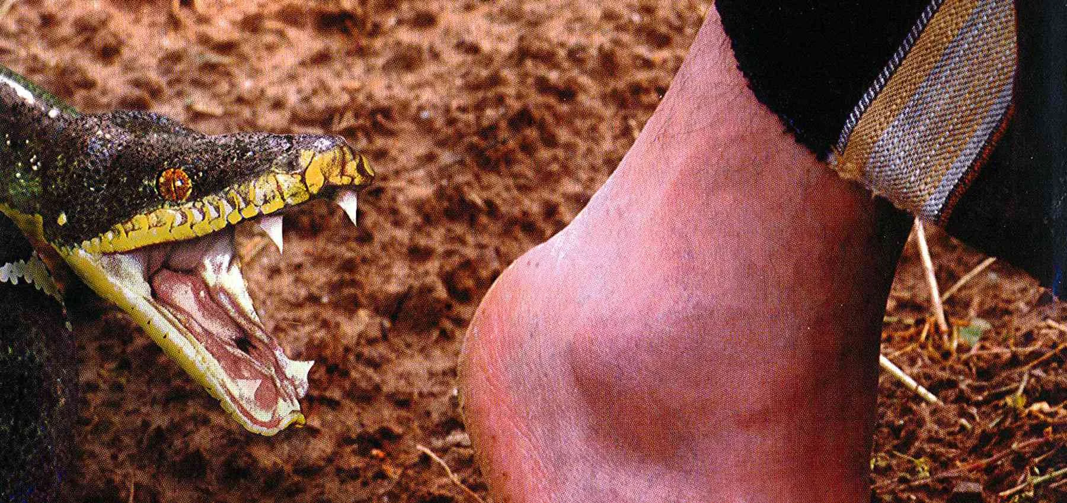
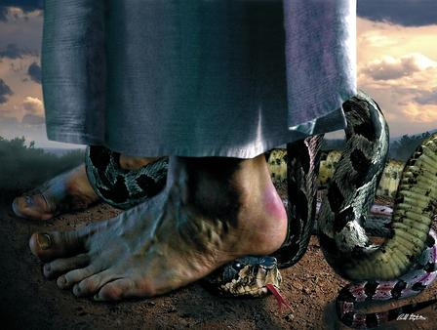
Jesus’ sacrifice is the way
“as Moses lifted up the serpent in the wilderness, even so must the Son of man be lifted up:” Jn 3:14
  “God sending His own Son in the likeness of sinful flesh” Rm 8:3
  Jesus said, ’It is finished” and bowed his head and died Jn 19:30
  Jesus Christ, a mortal with human nature died for 3 days - he was bruised in the heel
Jesus Christ “was in all points tempted like as we are, yet without sin”. He 4:15
  “thanks be to God, which giveth us the victory through our Lord Jesus Christ” I Co 15:57
  “When he ascended up on high, he led captivity captive” Ep 4:8
  Jesus Christ, a mortal man with human nature, died without ever succumbing to temptation – he bruised the serpent in the head.

Slide 16
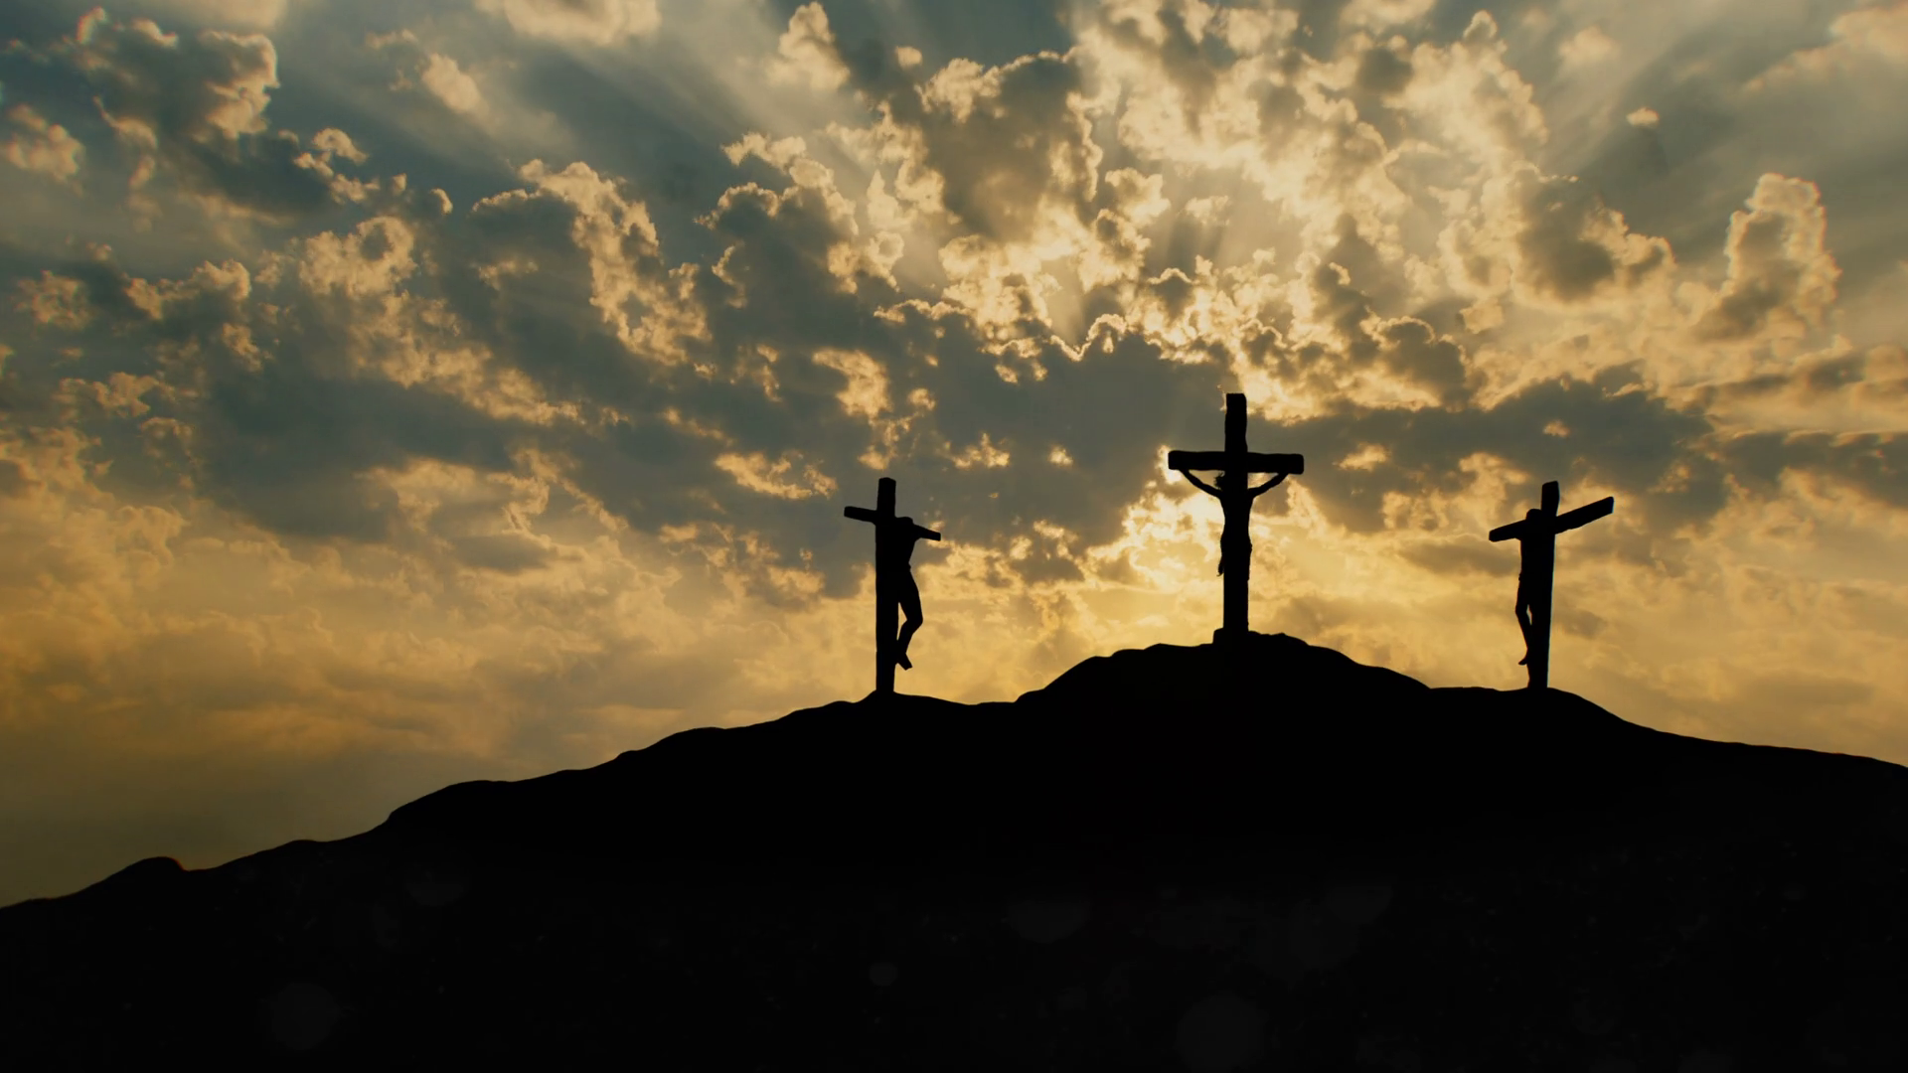
“Verily I say unto thee today thou shalt be with me in paradise {Eden}”
“To him that overcometh will I give to eat of the
tree of life, which is in the midst of the paradise of God.”

Slide 17
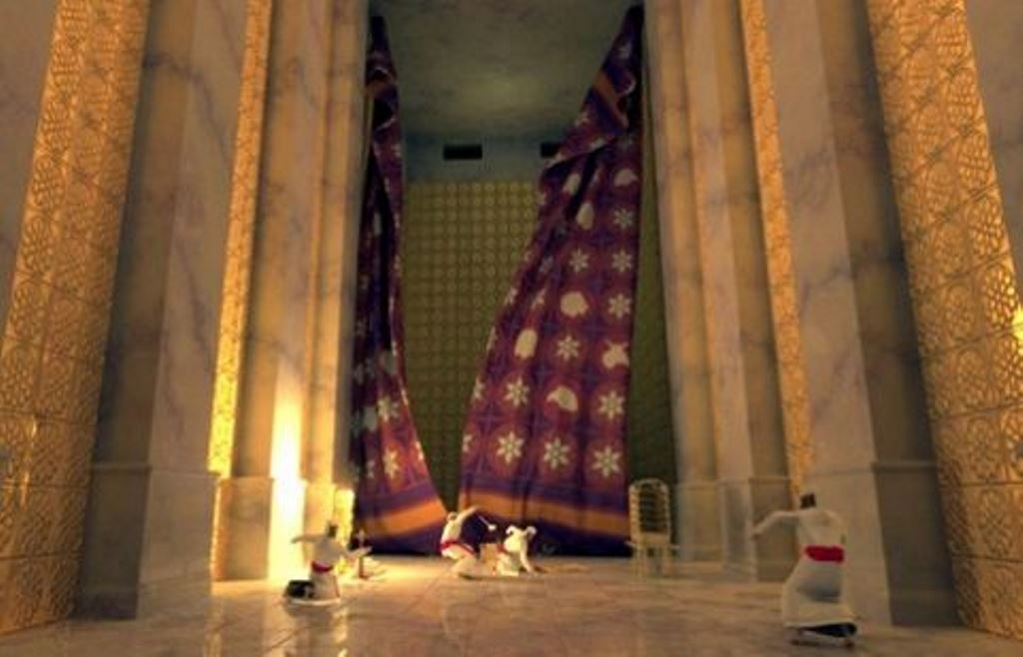
“And the sun was darkened, and the veil of the temple was rent in the midst.”

Slide 18
God’s Dwelling with Man
“the LORD of hosts that dwelleth between the cherubims.” II Samuel 6v2
“the LORD of hosts that dwelleth between the cherubims.” II Samuel 6v2
“Behold, a virgin shall be with child, and shall bring forth a son, and they shall call his name Emmanuel, which being interpreted is, God with us.” Matthew 1:23
“Whom God hath set forth to be a {Mercy Seat} through faith in his blood,” Romans 3:25

Slide 19


A Flaming Sword
“He placed at the east of the garden of Eden Cherubims, and a flaming sword which turned every way, to {guard and protect} the way of the tree of life.” Genesis 3:24
When Jesus Christ died on the cross, the veil was rent, and the sword was lowered. Jesus was the first mortal man to partake of the tree of life. Now Jesus dwells with God at His side.

Slide 20
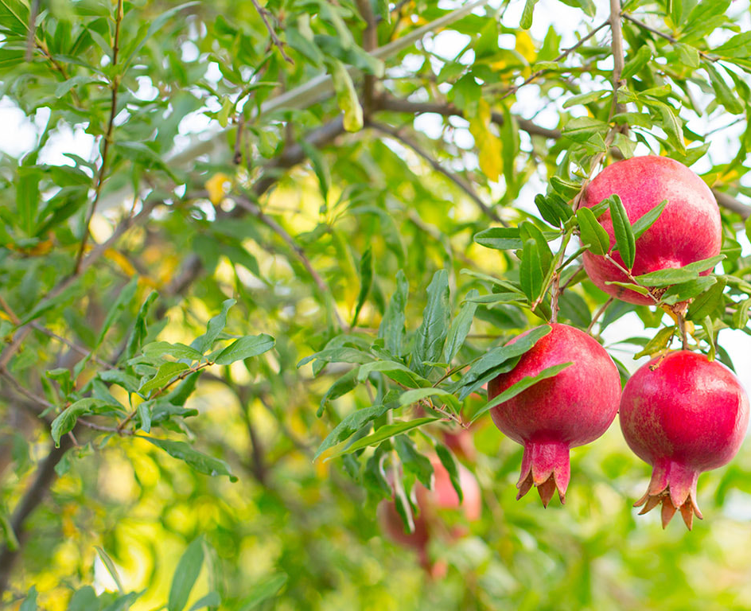
Restoration to the Tree of Life
“To him that overcometh will I give to eat of the tree of life, which is in the midst of the paradise of God.” Revelation 2:7
“Blessed are they that do his commandments, that they may have right to the tree of life, and may enter in through the gates into the city.” Revelation 22:14
“And he shewed me a pure river of water of life, clear as crystal, proceeding out of the throne of God and of the Lamb. In the midst of the street of it, and on either side of the river, was there the tree of life, which bare twelve manner of fruits, and yielded her fruit every month: and the leaves of the tree were for the healing of the nations. And there shall be no more curse:” Revelation 22:1-3

Slide 21
Restoration of eternal life
Dominion over creation
Placed in a garden in Eden
Access to the tree of life |  | Covenant of Eden
No more dominion over creation
Sent forth from the garden in Eden
No more access to the tree of life

Slide 22
Covenant with Abram
“I will make of thee a great nation, and I will bless thee, and make thy name great; and thou shalt be a blessing: and I will bless them that bless thee, and curse him that curseth thee: and in thee shall all families of the earth be blessed.” Genesis 12:2-3
Paul expounds “the scripture, foreseeing that God would justify {people} through faith, preached before the gospel unto Abraham, saying, In thee shall all nations be blessed.” Galatians 3:8

Slide 23
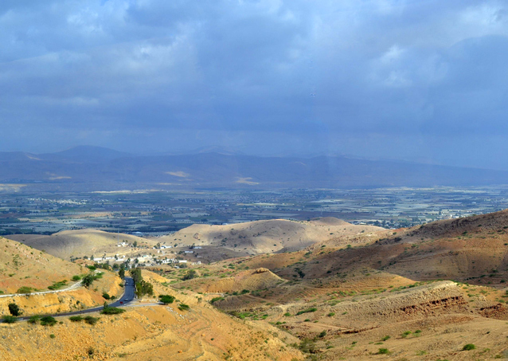
To thee and thy seed
“Lift up now thine eyes, and look from the place where thou art northward, and southward, and eastward, and westward: for all the land which thou seest, to thee will I give it, and to thy seed for ever.”
Genesis 13:14

Slide 24
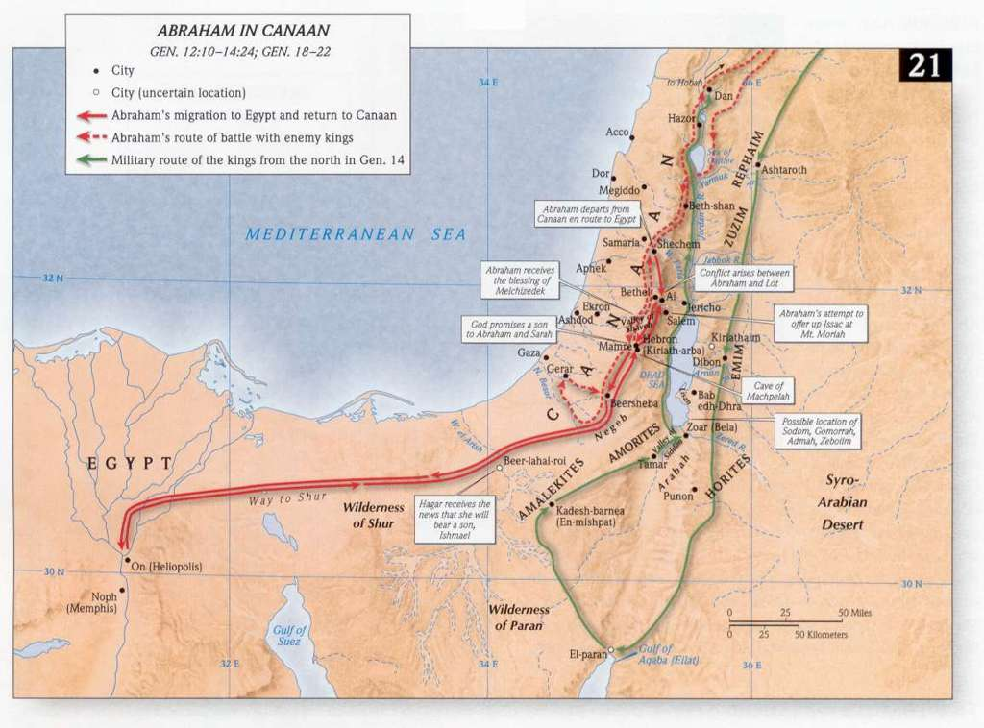
Territory given to Abraham’s Seed
“Arise, walk through the land in the length of it and in the breadth of it; for I will give it unto thee.” Genesis 13:17

Slide 25
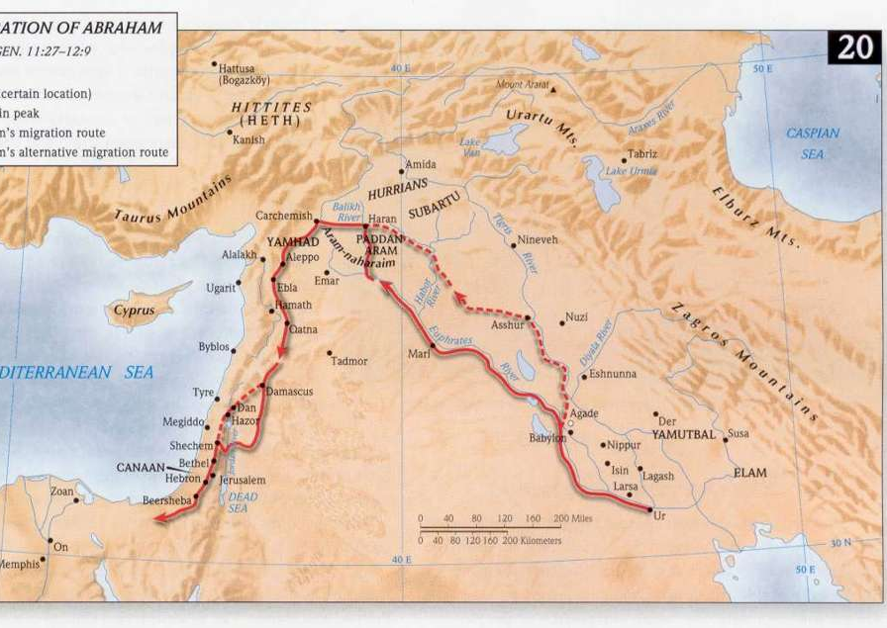
Territory given to Abraham’s Seed
But Abram had walked much broader than just in Canaan!

Slide 26
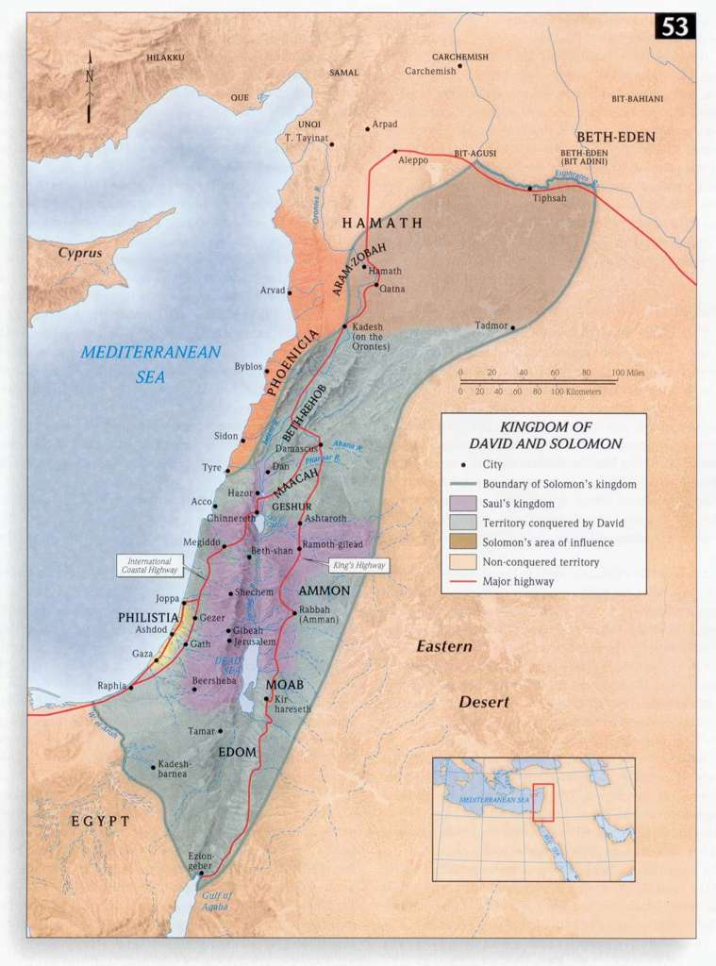
Kingdom of Israel
Israel’s settlements in the land under Moses and Joshua
Largest expanse under David and Solomon
A fulfillment of promises to Abraham
Only a partial fulfillment
  “All nations”
  Area of settlement

Slide 27
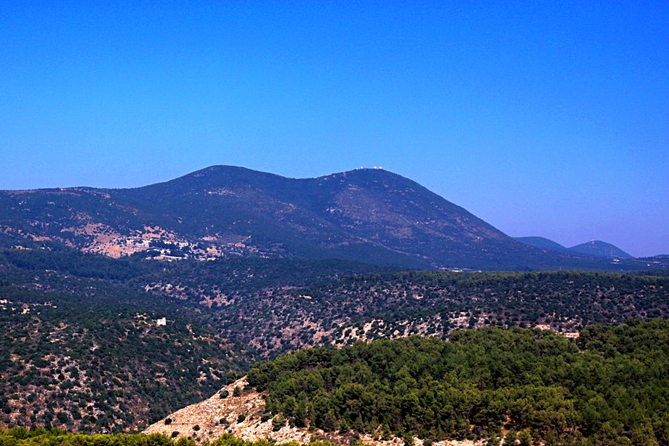
Territory given to Abraham’s Seed
“Unto thy seed have I given this land, from the river of Egypt unto the great river, the river Euphrates:”
Genesis 15:18

Slide 28
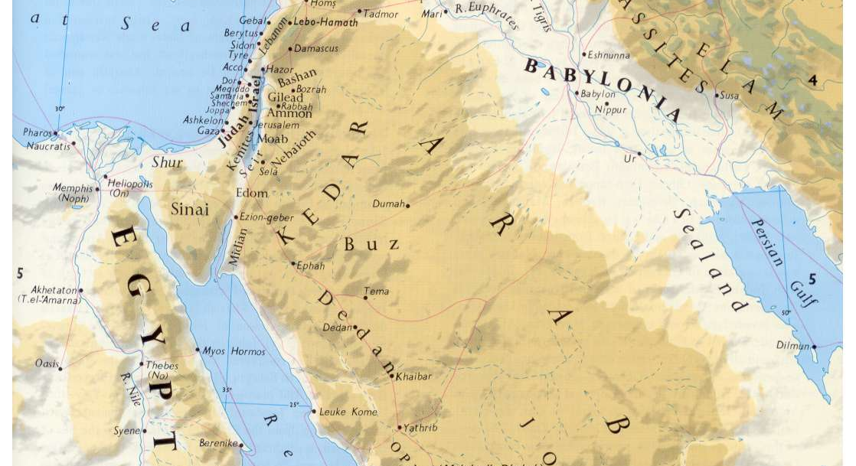
From the River of Egypt to the River Euphrates

Slide 29
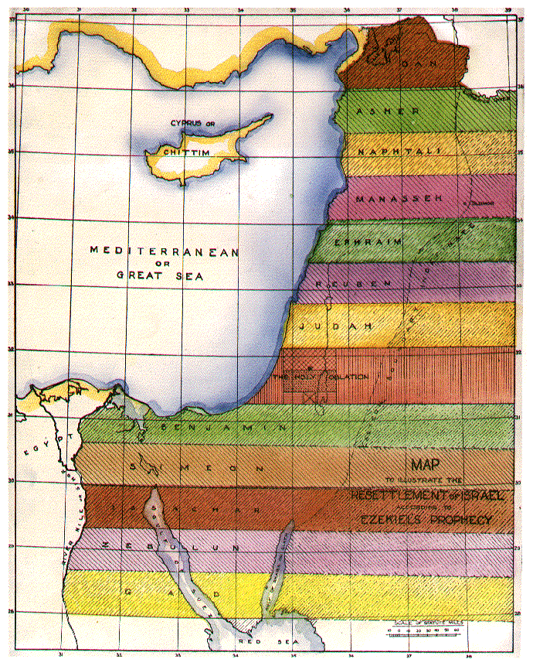
From River to River
Bro. Sulley provides this map of the future tribal allotment in ‘The Temple of Ezekiel’s Prophecy’

Slide 30
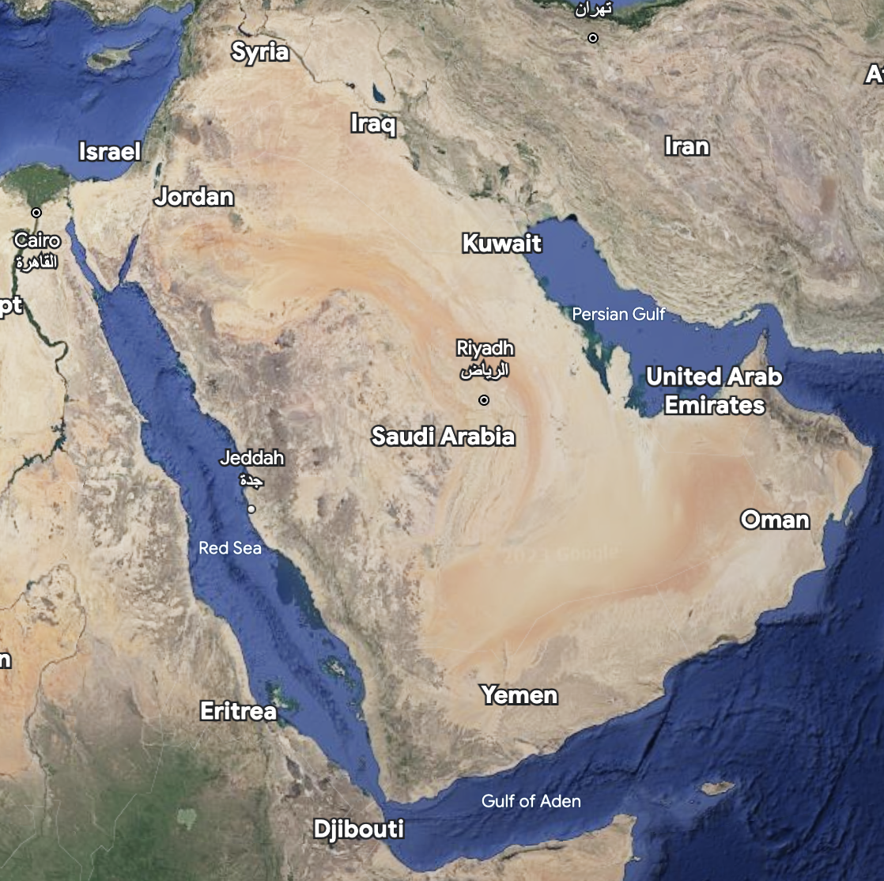
From the Nile to the Euphrates
“He shall have dominion also from sea to sea, and from the river unto the ends of the earth. They that dwell in the wilderness shall bow before him;” Psalm 72:8-9
Sea = ?
Sea = ?
The River = ?
Ends of the Earth = ?
Mediterranean Sea
Euphrates

Slide 31
Ends of the Earth
Ends <ehpec> - Ceasing, finality
Earth <erets> - “eretṣ designates either (a) “the earth” in a cosmological sense, or (b) “the land” in the sense of a specific territorial designation”
  Genesis 1:1 “In the beginning God created the heavens and the earth”
  Genesis 15:18 “Unto thy seed have I given this land, from the river of Egypt unto the great river, the river Euphrates:”

Slide 32
From the Nile to the Euphrates
“He shall have dominion also from sea to sea, and from the river unto the ends of the earth. They that dwell in the wilderness shall bow before him;”
Sea = ?
Sea = ?
The River = ?
Ends of the Earth = ?
Mediterranean Sea
Arabian Sea
Euphrates
Arabian
Peninsula

Slide 33
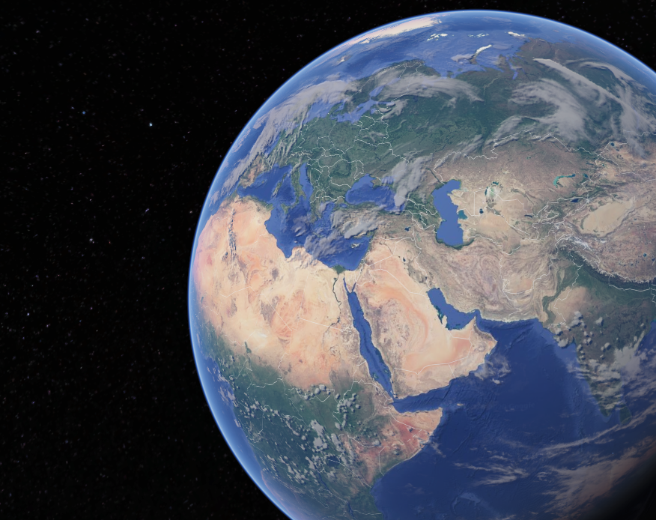
Territory promised to Abraham
= Eden
Territory of Eden is from Euphrates in the North, Mediterranean in the West, Arabian Peninsula in the South, and Arabian Sea in the East

Slide 34
Covenant with Abram
Paul expounds “the scripture, foreseeing that God would justify {people} through faith, preached before the gospel unto Abraham, saying, In thee shall all nations be blessed.” Galatians 3:8
“For as many of you as have been baptized into Christ have put on Christ. There is neither Jew nor Greek, there is neither bond nor free, there is neither male nor female: for ye are all one in Christ Jesus. And if ye be Christ’s, then are ye Abraham’s seed, and heirs according to the promise.” Galatians 3:27-29

Slide 35
Restoration of eternal life
Dominion over creation
Placed in a garden in Eden |  | Covenant of Abraham
Access to the tree of life |  | Covenant of Eden
No more dominion over creation
Sent forth from the garden in Eden

Slide 36
Revelation of the Garden
God’s plan revealed in the garden
About God
He desires to be a Father to His creation
About God's Plan and Purpose
Through the creation of man and woman, God will fill the earth with His glory
He desires to dwell with us
Given dominion over creation
He wants us to share in His work
Given a special land
God will be manifest in a host of mighty men and women
Given access to eternal life
God reveals His character in the context of the transgression

