Slide 1
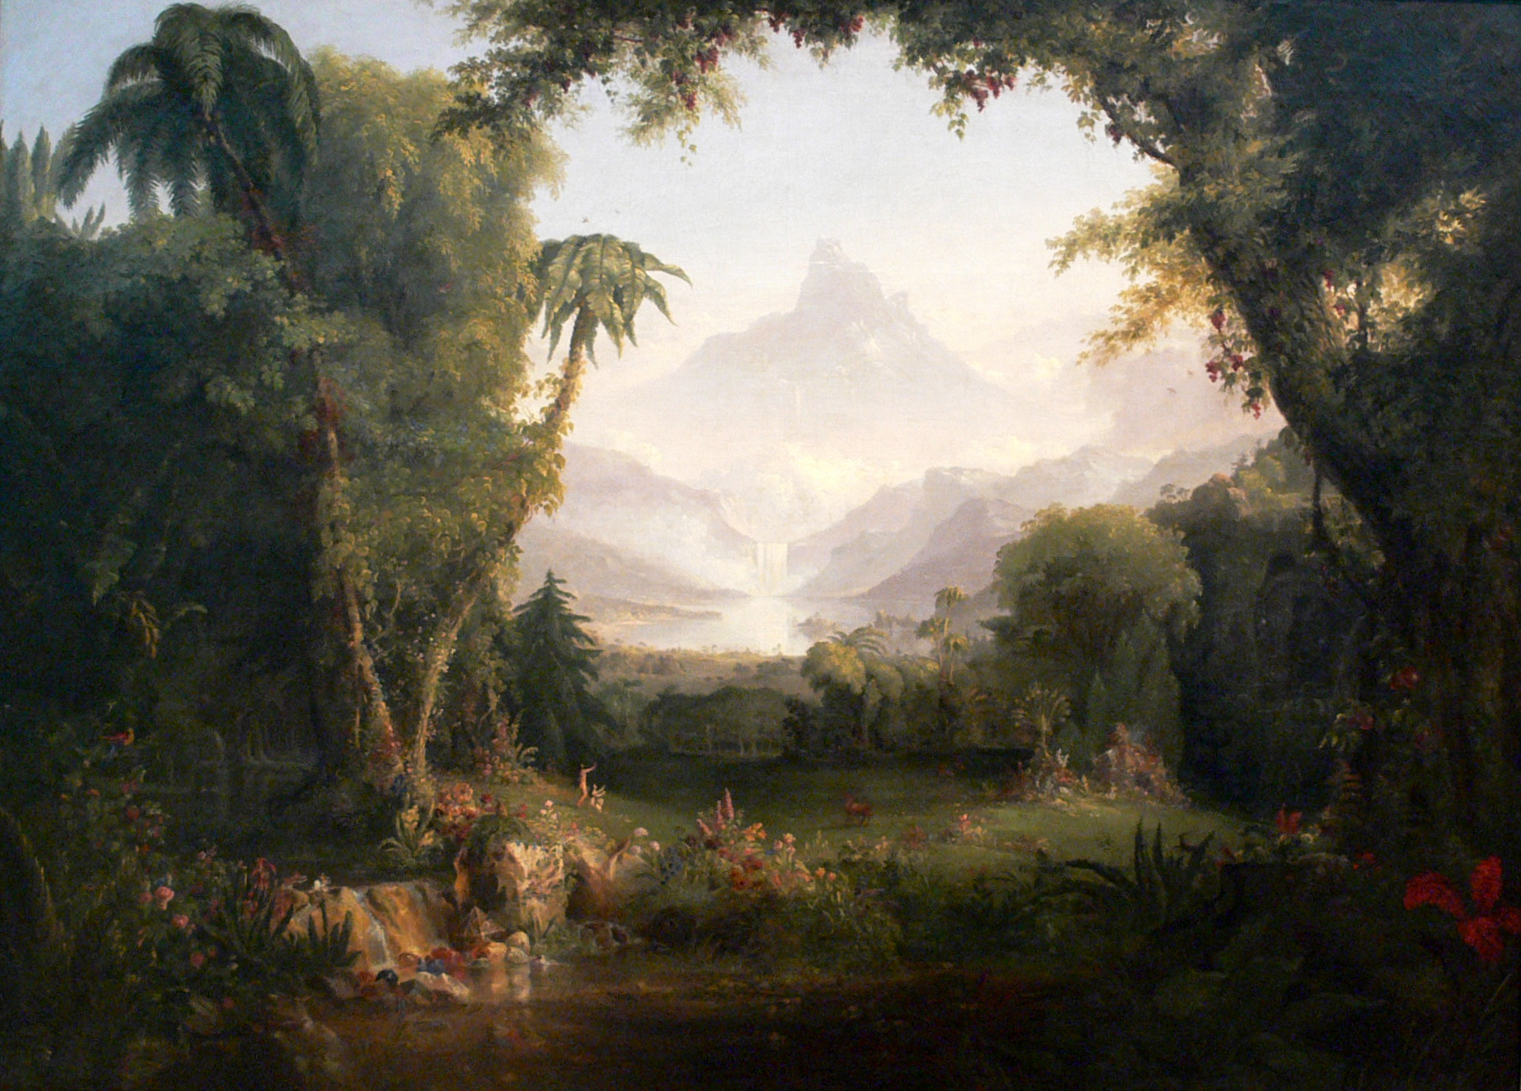
The Garden of Eden:
Its Revelation & Restoration
Class 5 – Garden Restored

Slide 2
Revelation of the Garden
God’s plan revealed in the garden
About God
He desires to be a Father to His creation
About God's Plan and Purpose
Through the creation of man and woman, God will fill the earth with His glory
He desires to dwell with us
Given dominion over creation
He wants us to share in His work
Given a special land
God will be manifest in a host of mighty men and women
Given access to eternal life
God reveals His character in the context of the transgression

Slide 3
Restoration of eternal life
Dominion over creation
Placed in a garden in Eden |  | Covenant of Abraham
Access to the tree of life |  | Covenant of Eden
No more dominion over creation
Sent forth from the garden in Eden
No more access to the tree of life
Path of Restoration

Slide 4
Covenant with David
“I will set up thy seed after thee, which shall proceed out of thy bowels, and I will establish his kingdom. He shall build an house for my name, and I will stablish the throne of his kingdom for ever. I will be his father, and he shall be my son.” II Samuel 7:12-14
Jesus shared the blessing and “And hath made us kings and priests unto God and his Father” Revelation 1:6

Slide 5
Thrones of Judgment
“I beheld, and the same horn made war with the saints, and prevailed against them; until the Ancient of days came, and judgment was given to the saints of the most High; and the time came that the saints possessed the kingdom.” Daniel 7:21-22
“To him that overcometh will I grant to sit with me in my throne, even as I also overcame, and am set down with my Father in his throne.” Revelation 3:21
“And I saw thrones, and they sat upon them, and judgment was given unto them:” Revelation 20:4

Slide 6
“He shall have dominion also from sea to sea, and from the river unto the ends of the earth. They that dwell in the wilderness shall bow before him;” Psalm 72:8-9

Slide 7
Ends of the Earth
Ends <ehpec> - Ceasing, finality
Earth <erets> - “eretṣ designates either (a) “the earth” in a cosmological sense, or (b) “the land” in the sense of a specific territorial designation”
  Genesis 1:1 “In the beginning God created the heavens and the earth”
  Genesis 15:18 “Unto thy seed have I given this land, from the river of Egypt unto the great river, the river Euphrates:”

Slide 8
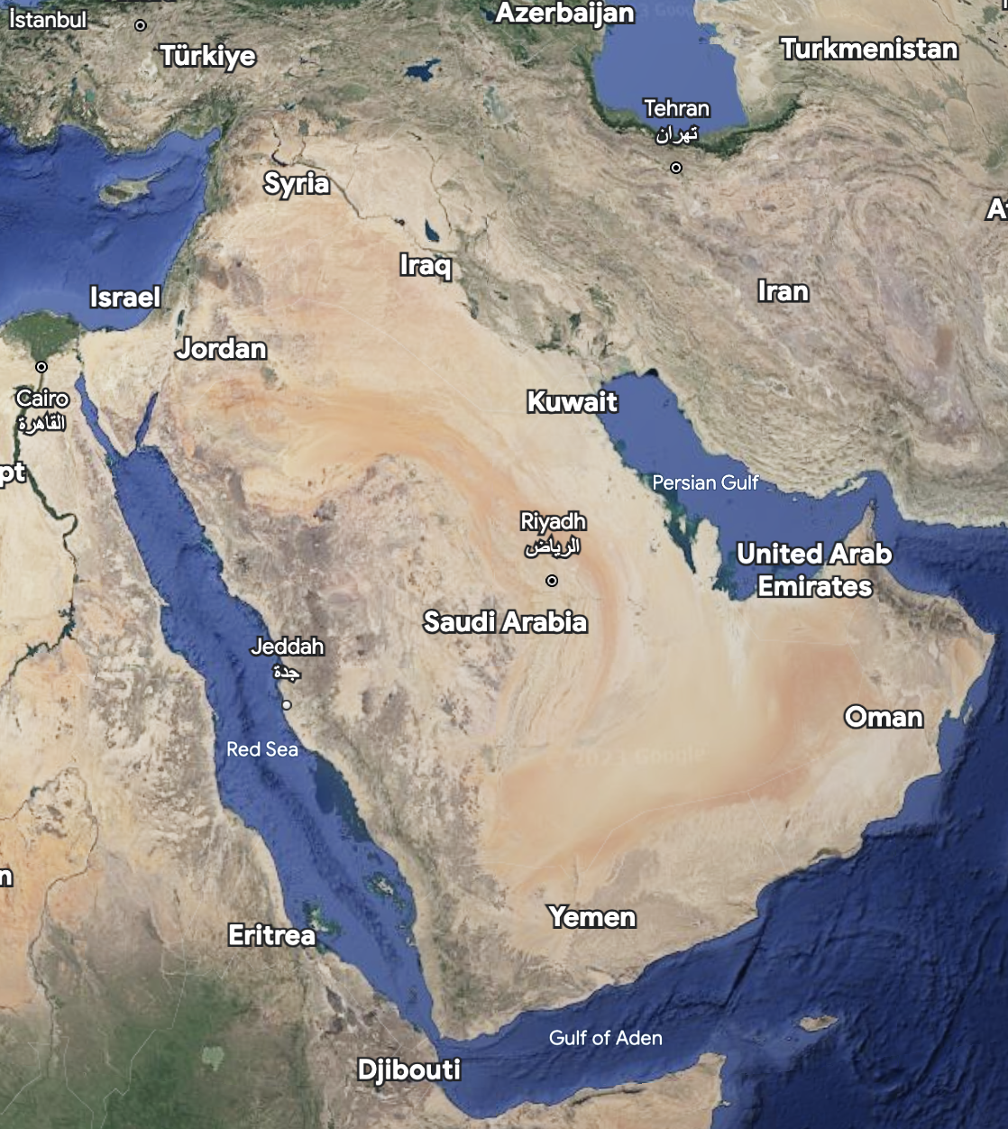
Dominion Restored
“He shall have dominion also from sea to sea, and from the river unto the ends of the earth. They that dwell in the wilderness shall bow before him;”

Slide 9
Dominion Restored
Good news that Jesus is King
Many reject submission
Saints sent to execute judgment
Revelation 14:7
Psalm 2:1-3
Psalm 149:4-9
New kings of the earth
Revelation 21:24
“and the kingdom, and the dominion, even the greatness of the kingdom under the whole heavens, is given to the people - the saints of the Most High, His kingdom is a kingdom age-during, and all dominions do serve and obey Him.” Daniel 7:27 YLT

Slide 10
Restoration of eternal life
Dominion over creation |  | Covenant of David
Placed in a garden in Eden |  | Covenant of Abraham
Access to the tree of life |  | Covenant of Eden
No more dominion over creation

Slide 11
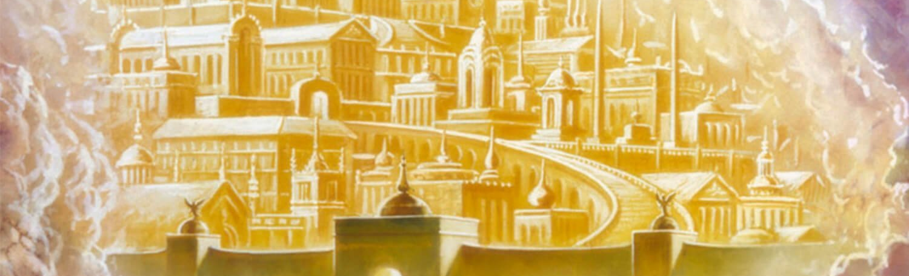
The Garden Restored
“I saw a new heaven and a new earth: for the first heaven and the first earth are passed away”. Revelation 21:1
What is the new heaven?
  New Jerusalem, coming down from heaven, as a bride
  New Government (heaven)
The tabernacle of God is with men, and He will dwell with them!

Slide 12
A New Creation
Revelation 3:14 Jesus calls himself “the beginning of the creation of God.”
Colossians 1:15-18
  Head of … the ecclesia
  Beginning
  Firstborn from the dead
  Preeminent
Genesis 1:1
“in the beginning” = <reshiyth>
  Best
  Beginning
  First
  Chief

Slide 13
Restoration of the Garden
“God shall wipe away all tears from their eyes; and there shall be no more death, neither sorrow, nor crying, neither shall there be any more pain (affliction): for the former things are passed away.” Revelation 21:4
  First occurrence of Death? Genesis 3:19
  First occurrence of Sorrow? Genesis 3:16
  First occurrence of Affliction? Genesis 3:16, 19
  First heaven and earth are passed away!

Slide 14
The Garden Restored
With the first things having passed away - the consequences of the transgression in Eden reversed
Revelation 22 - the garden restored
  River
  Dominion (throne)
  Tree of Life
  No more curse
  Face to face with God

Slide 15
The River
“a pure river of water of life, clear as crystal, proceeding out of the throne of God and of the Lamb.” Revelation 22:1
Psalm 46:5 - makes the city of God glad
Isaiah 48:18 - it will heal wilderness and dry land
Ezekiel 47:8 - heals the Dead (Salt) Sea
Joel 3:18 - describes its source as a fountain
Zechariah 14:8 - living waters

Slide 16
The River
“a pure river of the water of life, clear as crystal proceeding out of the throne of God and the Lamb”
John 4:14 - water from Jesus gives eternal life
John 6:63 - the words I speak are life
John 7:37-38 - whoever believes me..rivers of living water
“Come ye, and let us go up to the mountain of the LORD, to the house of the God of Jacob; and he will teach us of his ways, and we will walk in his paths: for out of Zion shall go forth the law, and the word of the LORD from Jerusalem.” Isaiah 2:3

Slide 17
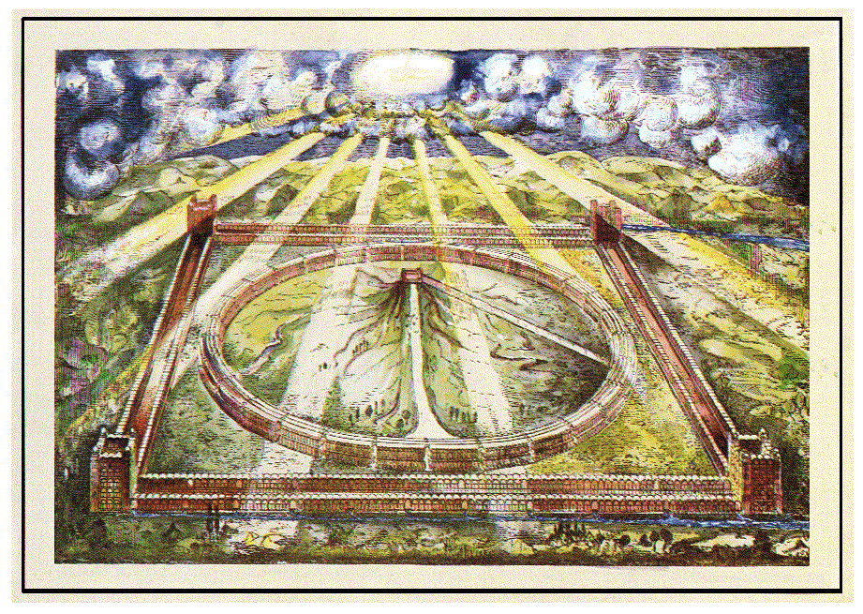
The Tabernacle of David
“After this I will return, and will build again the tabernacle of David, which is fallen down; and I will build again the ruins thereof, and I will set it up: that the residue of men might seek after the Lord, and all the Gentiles, upon whom my name is called,” Acts 15:16-17
“And in mercy shall the throne be established: and he shall sit upon it in truth in the tabernacle of David, judging, and seeking judgment, and hasting righteousness.” Isaiah 16:15

Slide 18
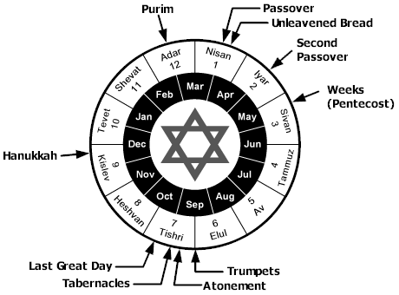
Celebrating Feasts in Zion
Feast of Tabernacles
“And it shall come to pass, that every one that is left of all the nations which came against Jerusalem shall even go up from year to year to worship the King, the Lord of hosts, and to keep the feast of tabernacles.” Zechariah 14:16
Passover
“In the first month, in the fourteenth day of the month, ye shall have the Passover, a feast of seven days; unleavened bread shall be eaten. And upon that day shall the prince prepare for himself and for all the people of the land a bullock for a sin offering.” Ezekiel 45:21-22

Slide 19
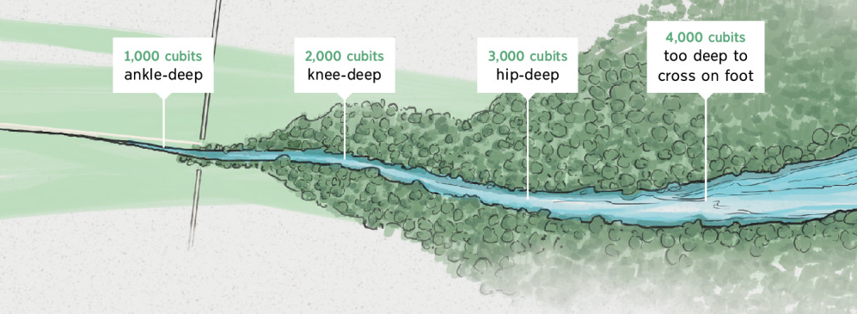
The River
“The man walked east, then took out his measuring stick and measured five hundred sixty yards downstream. He told me to wade through the stream there, and the water came up to my ankles. Then he measured another five hundred sixty yards downstream, and told me to wade through it there. The water came up to my knees. Another five hundred sixty yards downstream the water came up to my waist. Another five hundred sixty yards downstream, the stream had become a river that could be crossed only by swimming. The man said, “Ezekiel, son of man, pay attention to what you’ve seen.” “ Ezekiel 47:3-6

Slide 20
The Trees of Life
“And on this side of the river and on that was a tree of life bearing twelve crops of fruit, every several month yielding its fruit; and the leaves of the tree were for the healing of the nations.” | “And by the river upon the bank thereof, on this side and on that side, shall grow all trees for meat, whose leaf shall not fade, neither shall the fruit thereof be consumed: it shall bring forth new fruit according to his months, because their waters they issued out of the sanctuary: and the fruit thereof shall be for meat, and the leaf thereof for medicine.”
Revelation 22:2 (Rotherham’s) | Ezekiel 47:12

Slide 21

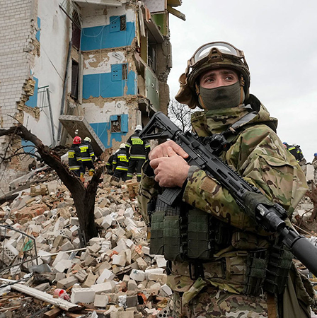
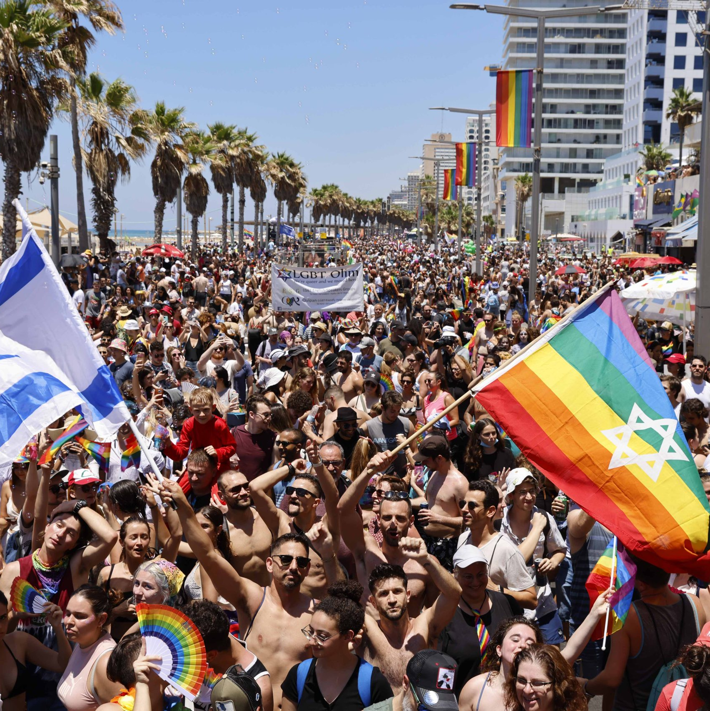
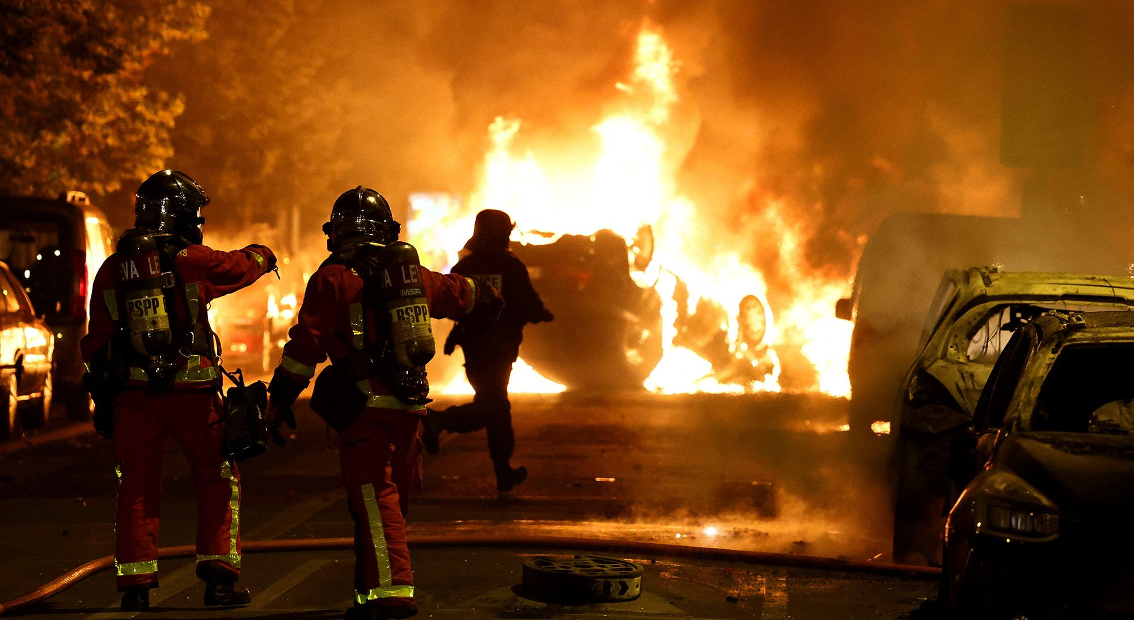
Medicine for a World gone Mad

Slide 22
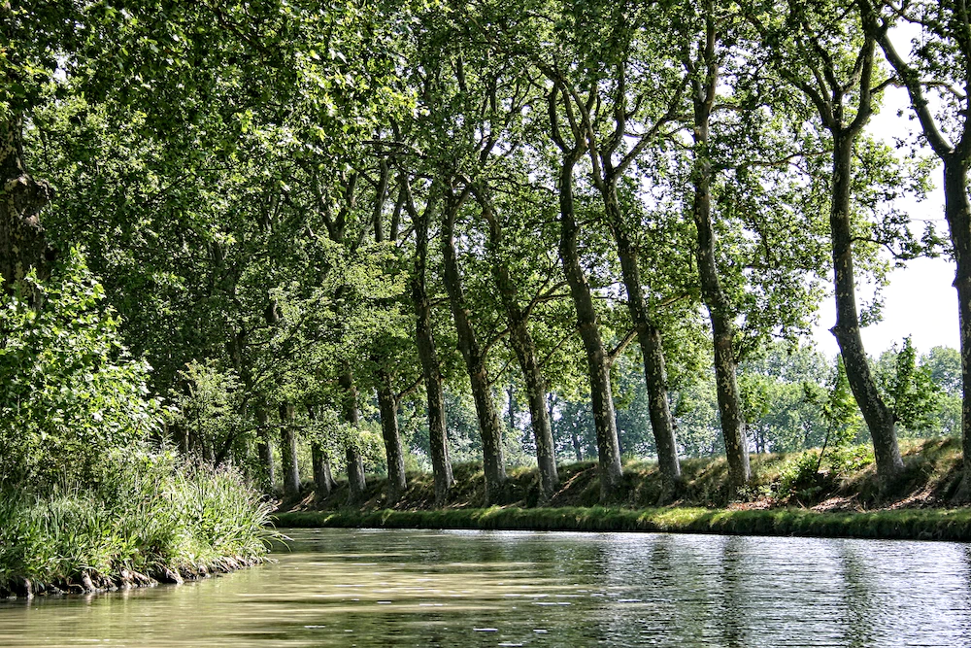
Trees of Life
Blessed is the man that walketh not in the counsel of the ungodly, nor standeth in the way of sinners, nor sitteth in the seat of the scornful. But his delight is in the law of the Lord; and in his law doth he meditate day and night. And he shall be like a tree planted by the rivers of water, that bringeth forth his fruit in his season; his leaf also shall not wither; and whatsoever he doeth shall prosper.
Psalm 1:1-3

Slide 23
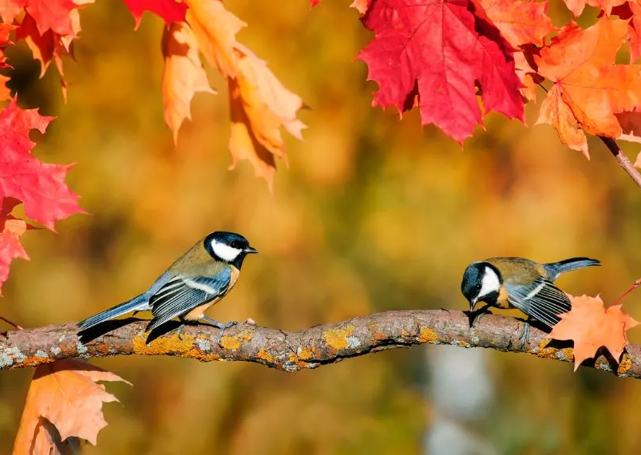
Tree of Life
Kingdom of Heaven is like a grain of mustard seed that becomes a tree that the birds of the air come and lodge in its branches.
Matthew 13:31-32

Slide 24
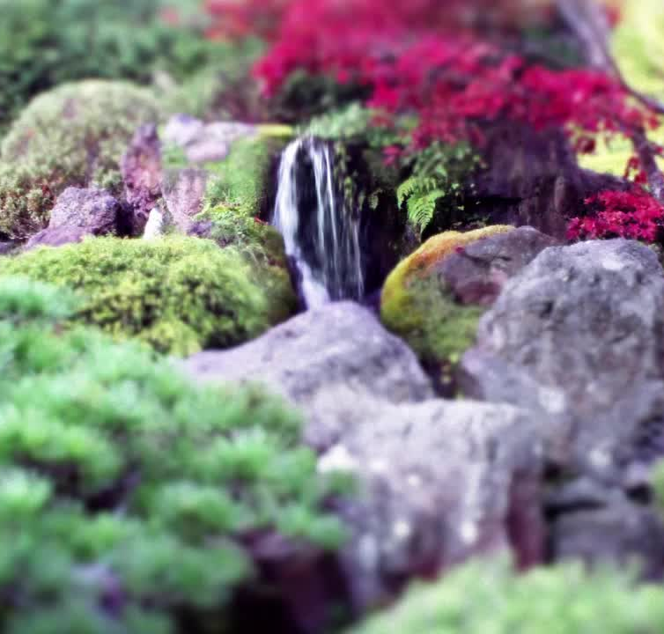
The Garden of Eden Restored
River = word of life flowing from God and Christ
Trees of Life = men and women who hearing the word of God believe and therein are made immortal Saints
Nations = mortals during the kingdom that receive the word from the Saints

Slide 25
Timeline of God’s Plan
God reveals His plan
God executes His plan over 7000 years
God executes His plan
God unfolds the restoration of His plan
Man disrupts God’s plan

Slide 26
Revelation of the Garden
God’s plan revealed in the garden
About God
He desires to be a Father to His creation
About God's Plan and Purpose
Through the creation of man and woman, God will fill the earth with His glory
He desires to dwell with us
Given dominion over creation
He wants us to share in His work
Given a special land
God will be manifest in a host of mighty men and women
Given access to eternal life
God reveals His character in the context of the transgression

Slide 27
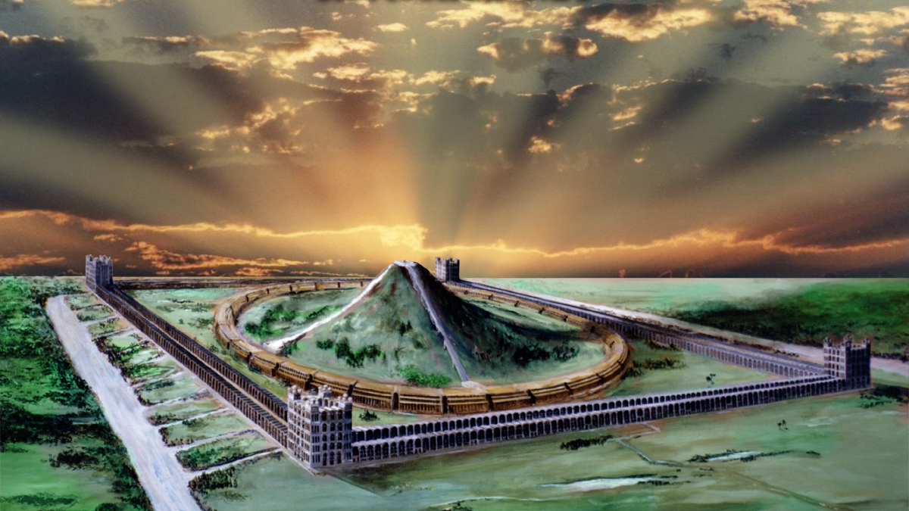
Even so, come, Lord Jesus.
The grace of our Lord Jesus Christ be with you all. Amen.

