Slide 1

“For the body is not one member, but many”
- Diversity In Discipleship -

Slide 2
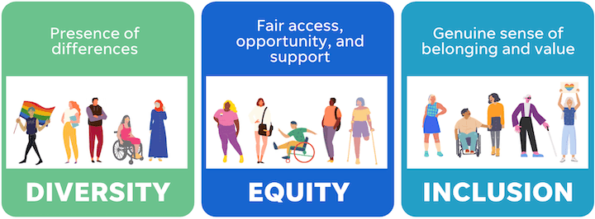
“For the body is not one member, but many”
- Diversity In Discipleship -

Slide 3
“For the body is not one member, but many”
^{Galatians 3}
²⁶ For ye are all the children of God by faith in Christ Jesus.
²⁷ For as many of you as have been baptized into Christ have put on Christ.
²⁸ There is neither Jew nor Greek, there is neither bond nor free, there is neither male nor female: for ye are all one in Christ Jesus.
- Diversity In Discipleship -

Slide 4
“For the body is not one member, but many”
^{Galatians 3}
²⁶ For ye are all the children of God by faith in Christ Jesus.
²⁷ For as many of you as have been baptized into Christ have put on Christ.
²⁸ There is neither Jew nor Greek, there is neither bond nor free, there is neither male nor female: for ye are all one in Christ Jesus.
- Diversity In Discipleship -

Slide 5


“For the body is not one member, but many”
- Diversity In Discipleship -

Slide 6

“For the body is not one member, but many”
Hebrews 1
God, who at sundry times and in divers manners spake in time past unto the fathers by the prophets,
² Hath in these last days spoken unto us by his Son, whom he hath appointed heir of all things, by whom also he made the worlds;
G4187
πολυτρόπως
polutropōs
pol-oot-rop'-oce
Adverb from a compound of G4183 and G5158; in many ways, that is, variously as to method or form: - in divers manners.
- Diversity In Discipleship -

Slide 7
“For the body is not one member, but many”
1 Corinthians 12
⁴ Now there are diversities of gifts, but the same Spirit.
⁵ And there are differences of administrations, but the same Lord.
⁶ And there are diversities of operations, but it is the same God which worketh all in all.
- Diversity In Discipleship -

Slide 8
“For the body is not one member, but many”
1 Corinthians 12
Now concerning spiritual gifts, brethren, I would not have you ignorant.
² Ye know that ye were Gentiles, carried away unto these dumb idols, even as ye were led.
³ Wherefore I give you to understand, that no man speaking by the Spirit of God calleth Jesus accursed: and that no man can say that Jesus is the Lord, but by the Holy Ghost.
⁴ Now there are diversities of gifts, but the same Spirit.
⁵ And there are differences of administrations, but the same Lord.
⁶ And there are diversities of operations, but it is the same God which worketh all in all.
- Diversity In Discipleship -

Slide 9
“For the body is not one member, but many”
1 Corinthians 12
Now concerning spiritual gifts, brethren, I would not have you ignorant.
² Ye know that ye were Gentiles, carried away unto these dumb idols, even as ye were led.
³ Wherefore I give you to understand, that no man speaking by the Spirit of God calleth Jesus accursed: and that no man can say that Jesus is the Lord, but by the Holy Ghost.
⁴ Now there are diversities of gifts, but the same Spirit.
⁵ And there are differences of administrations, but the same Lord.
⁶ And there are diversities of operations, but it is the same God which worketh all in all.
“Office & Roles”
- Diversity In Discipleship -

Slide 10
“For the body is not one member, but many”
1 Corinthians 12
Now concerning spiritual gifts, brethren, I would not have you ignorant.
² Ye know that ye were Gentiles, carried away unto these dumb idols, even as ye were led.
³ Wherefore I give you to understand, that no man speaking by the Spirit of God calleth Jesus accursed: and that no man can say that Jesus is the Lord, but by the Holy Ghost.
⁴ Now there are diversities of gifts, but the same Spirit.
⁵ And there are differences of administrations, but the same Lord.
⁶ And there are diversities of operations, but it is the same God which worketh all in all.
“Works & Services”
- Diversity In Discipleship -

Slide 11
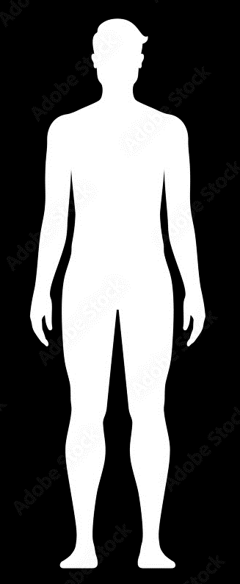
“For the body is not one member, but many”
^{1 Corinthians 12}
¹² For as the body is one, and hath many members, and all the members of that one body, being many, are one body: so also is Christ.
Ephesians 4
16 From whom the whole body fitly joined together and compacted by that which every joint supplieth, according to the effectual working in the measure of every part, maketh increase of the body unto the edifying of itself in love.
- Diversity In Discipleship -

Slide 12
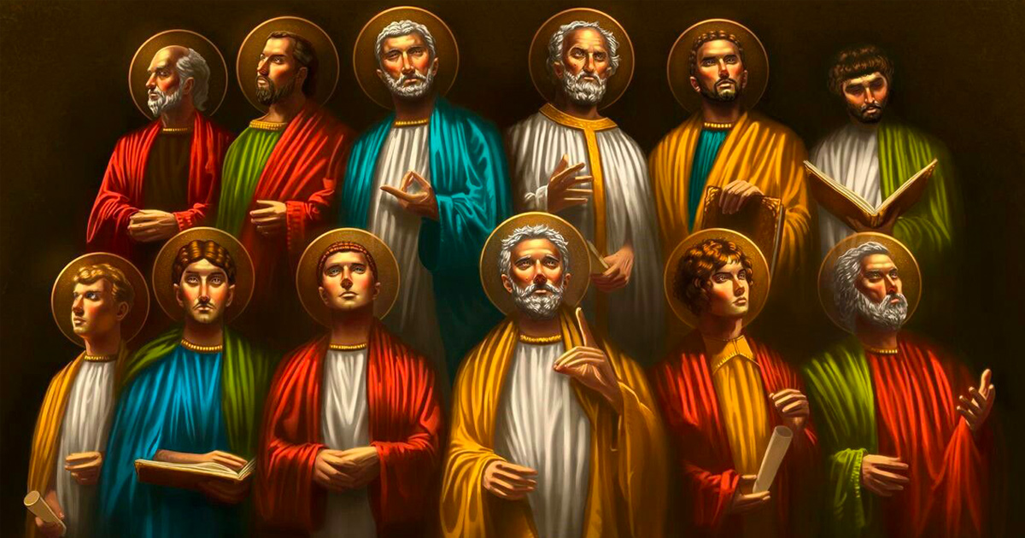
“For the body is not one member, but many”
The Twelve Disciples Of Jesus…
- Diversity In Discipleship -

Slide 13
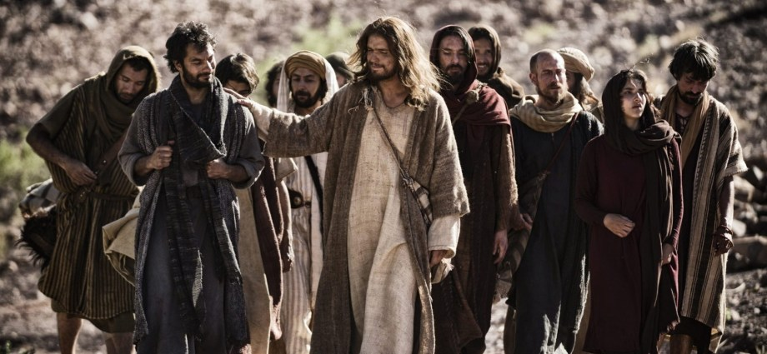
“For the body is not one member, but many”
The Twelve Disciples Of Jesus…
Peter & Andrew - James & John
Fishermen
Matthew
Worked With Romans
Simon the Zealot
Rebel Against Romans
Judas Iscariot
Cultured
- Diversity In Discipleship -

Slide 14
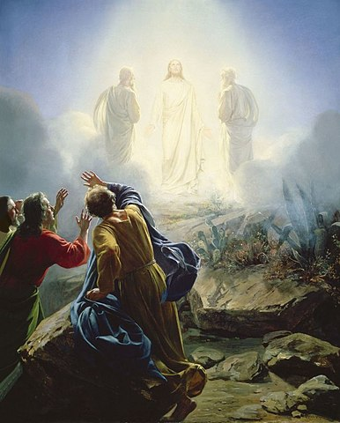
“For the body is not one member, but many”
Disputes Amongst The Twelve Disciples
^{Luke 9}
⁴⁶ Then there arose a reasoning among them, which of them should be greatest.
G1261
διαλογισμός
dialogismos
dee-al-og-is-mos'
From G1260; discussion, that is, (internal) consideration (by implication purpose), or (external) debate: - dispute, doubtful (-ing), imagination, reasoning, thought.
- Diversity In Discipleship -

Slide 15
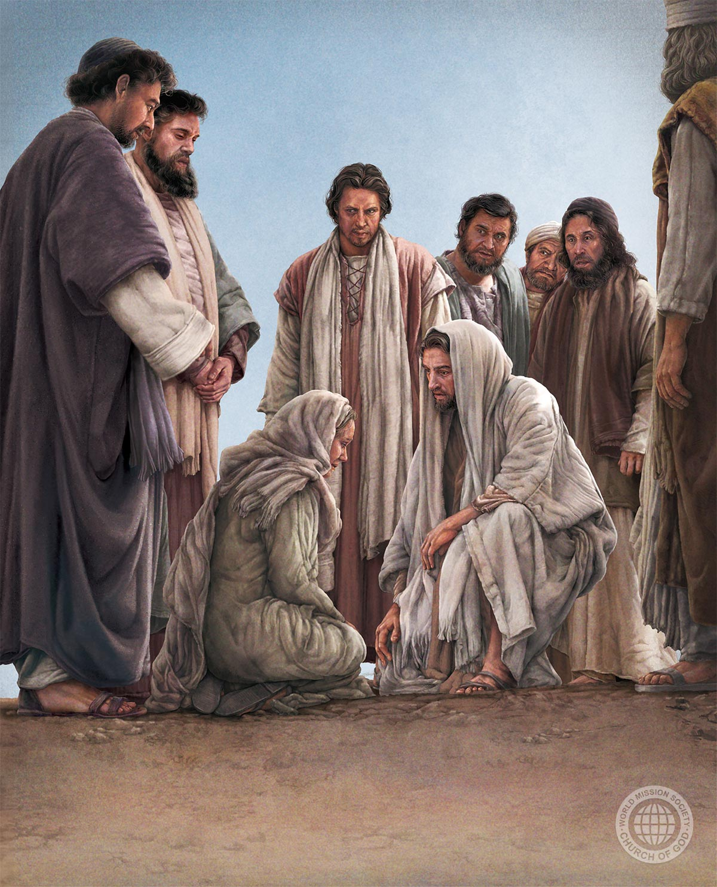
“For the body is not one member, but many”
Disputes Amongst The Twelve Disciples
^{Matthew 20}
²⁴ And when the ten heard it, they were moved with indignation against the two brethren.
- Diversity In Discipleship -

Slide 16
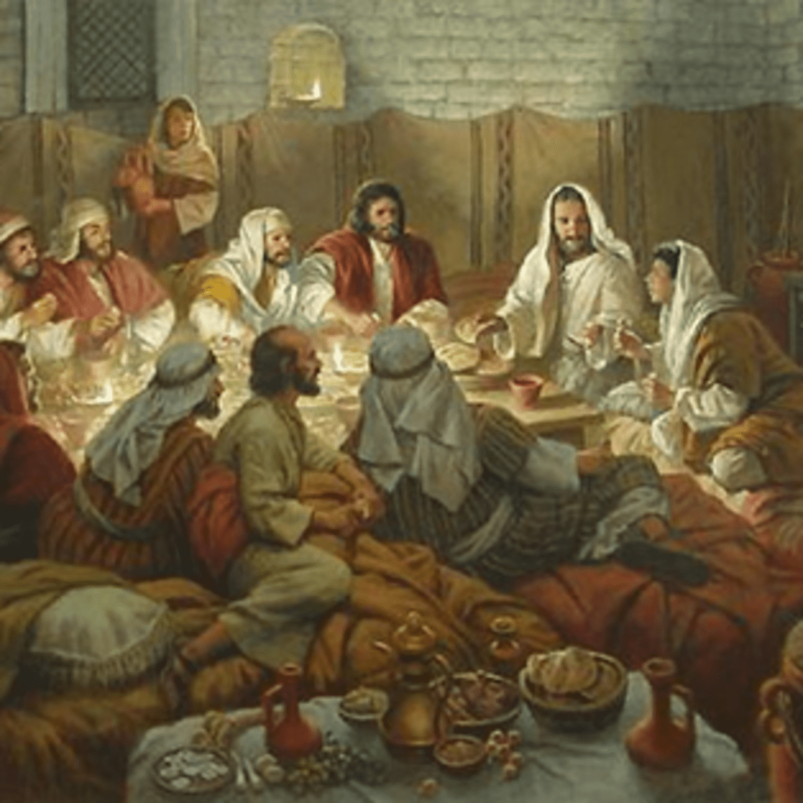
“For the body is not one member, but many”
Disputes Amongst The Twelve Disciples
^{Luke 22}
²⁴ And there was also a strife among them, which of them should be accounted the greatest.
G5379
φιλονεικία
philoneikia
fil-on-i-kee'-ah
From G5380; quarrelsomeness, that is, a dispute: - strife.
Total KJV occurrences: 1
- Diversity In Discipleship -

Slide 17
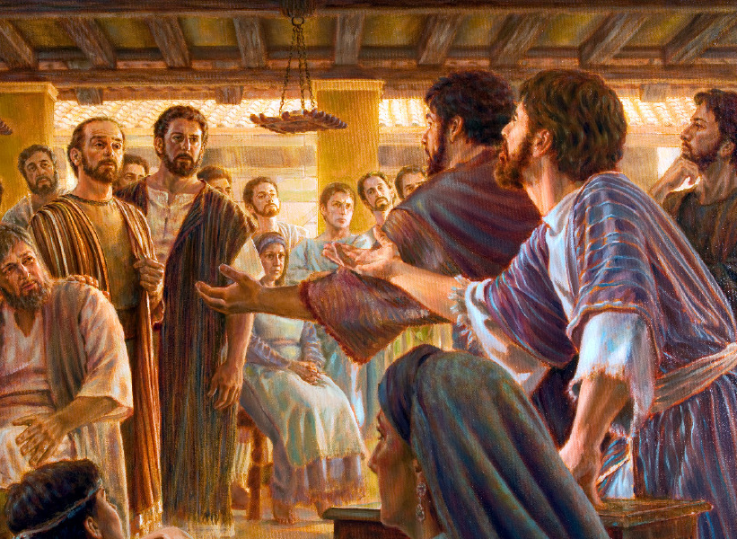
“For the body is not one member, but many”
Disputes Amongst The Apostles
^{Acts 15}
³⁹ And the contention was so sharp between them, that they departed asunder one from the other: and so Barnabas took Mark, and sailed unto Cyprus;
- Diversity In Discipleship -

Slide 18
“For the body is not one member, but many”
Character & Personality
Character is formed in the deep core beliefs and values of an individual
Personality is the outward expression of an individuals character in behaviour
Lead enthusiastically from the front…
Character of the Father – Exodus 34
…merciful and gracious, longsuffering, and abundant in goodness and truth,
Personality will determine…
Work quietly in the background…
- Diversity In Discipleship -

Slide 19
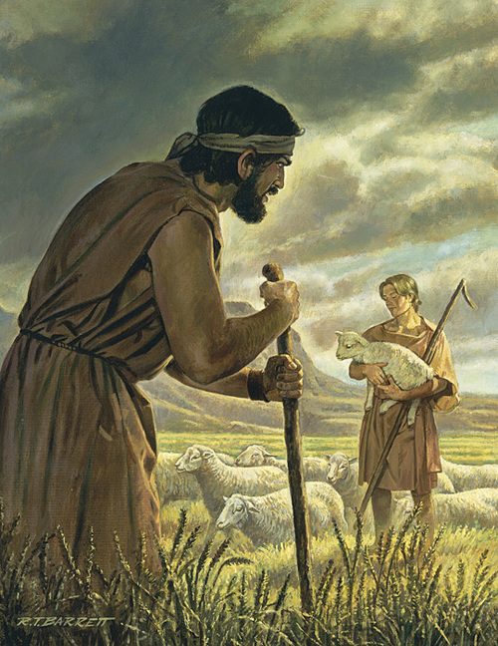
“For the body is not one member, but many”
Character & Personality
Genesis 4
And Adam knew Eve his wife; and she conceived, and bare Cain, and said, I have gotten a man from the Lord.
² And she again bare his brother Abel. And Abel was a keeper of sheep, but Cain was a tiller of the ground.
- Diversity In Discipleship -

Slide 20
“For the body is not one member, but many”
Character & Personality
Genesis 4
And Adam knew Eve his wife; and she conceived, and bare Cain, and said, I have gotten a man from the Lord.
² And she again bare his brother Abel. And Abel was a keeper of sheep, but Cain was a tiller of the ground.
H7462
רָעָה
râ‛âh
raw-aw'
A primitive root; to tend a flock, that is, pasture it; intransitively to graze (literally or figuratively); generally to rule; by extension to associate with (as a friend): - X break, companion, keep company with, devour, eat up, evil entreat, feed, use as a friend, make friendship with, herdman, keep [sheep] (-er), pastor, + shearing house, shepherd, wander, waste.
- Diversity In Discipleship -

Slide 21
“For the body is not one member, but many”
Character & Personality
Genesis 4
And Adam knew Eve his wife; and she conceived, and bare Cain, and said, I have gotten a man from the Lord.
² And she again bare his brother Abel. And Abel was a keeper of sheep, but Cain was a tiller of the ground.
H5647
עָבַד
‛âbad
aw-bad'
A primitive root; to work (in any sense); by implication to serve, till, (causatively) enslave, etc.: - X be, keep in bondage, be bondmen, bond-service, compel, do, dress, ear, execute, + husbandman, keep, labour (-ing man), bring to pass, (cause to, make to) serve (-ing, self), (be, become) servant (-s), do (use) service, till (-er), transgress [from margin], (set a) work, be wrought, worshipper.
- Diversity In Discipleship -

Slide 22
“For the body is not one member, but many”
Character & Personality
³ And in process of time it came to pass, that Cain brought of the fruit of the ground an offering unto the Lord.
⁴ And Abel, he also brought of the firstlings of his flock and of the fat thereof. And the Lord had respect unto Abel and to his offering:
⁵ But unto Cain and to his offering he had not respect. And Cain was very wroth, and his countenance fell.
^{Jude}
¹¹ Woe unto them! for they have gone in the way of Cain, and ran greedily after the error of Balaam for reward, and perished in the gainsaying of Core.
- Diversity In Discipleship -

Slide 23
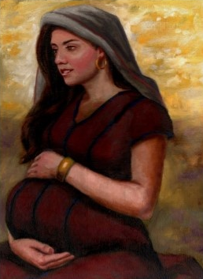
“For the body is not one member, but many”
Character & Personality
^{Genesis 25}
²³ And the Lord said unto her, Two nations are in thy womb, and two manner of people shall be separated from thy bowels; and the one people shall be stronger than the other people; and the elder shall serve the younger.
- Diversity In Discipleship -

Slide 24
“For the body is not one member, but many”
Character & Personality
^{Genesis 25}
²³ And the Lord said unto her, Two nations are in thy womb, and two manner of people shall be separated from thy bowels; and the one people shall be stronger than the other people; and the elder shall serve the younger.
- Diversity In Discipleship -

Slide 25
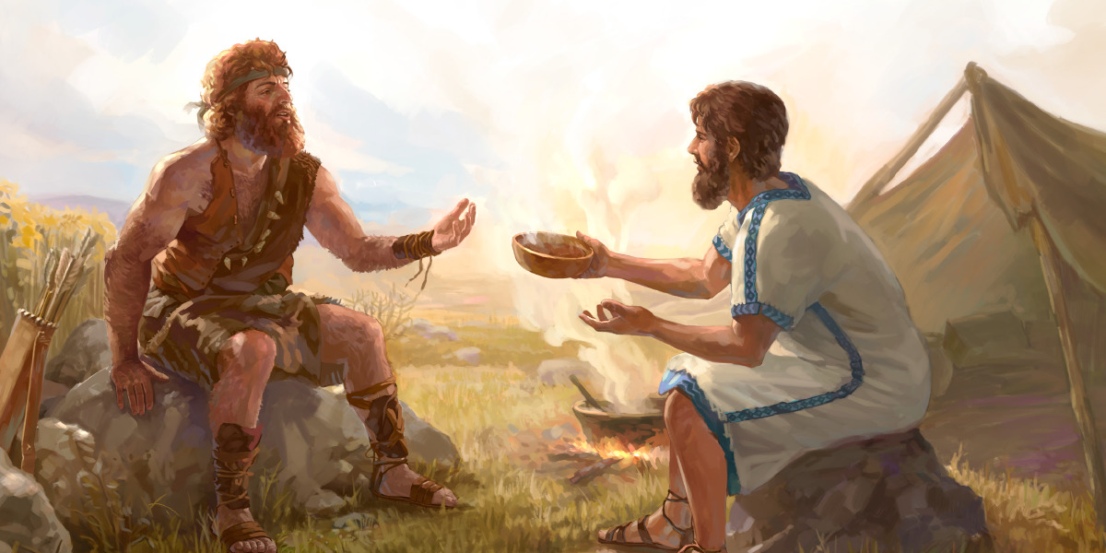
“For the body is not one member, but many”
Character & Personality
^{Genesis 25}
²⁷ And the boys grew: and Esau was a cunning hunter, a man of the field; and Jacob was a plain man, dwelling in tents.
- Diversity In Discipleship -

Slide 26
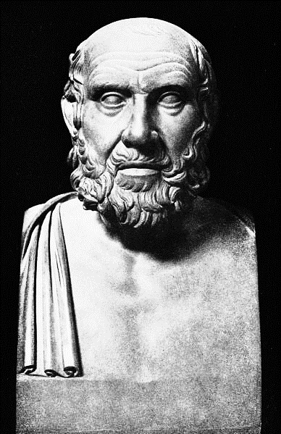
“For the body is not one member, but many”
Character & Personality
Hippocrates (460 – 370 BC)
‘Father of Medicine’
First to promote disease & health conditions were natural and not from the gods.
- Diversity In Discipleship -

Slide 27
“For the body is not one member, but many”
Character & Personality
Melancholic
Sanguine
Phlegmatic
Choleric
- Diversity In Discipleship -

Slide 28
“For the body is not one member, but many”
Character & Personality
Sociable
Charismatic
Optimistic
Melancholic
Sanguine
Impulsive
Shameless
Exaggerator
Phlegmatic
Choleric
- Diversity In Discipleship -

Slide 29
“For the body is not one member, but many”
Character & Personality
Melancholic
Sanguine
Ambitious
Passionate
Efficient
Phlegmatic
Choleric
Aggressive
Impatient
Argumentative
- Diversity In Discipleship -

Slide 30
“For the body is not one member, but many”
Character & Personality
Melancholic
Sanguine
Relaxed
Kind
Observant
Shy
Stubborn
Lazy
Phlegmatic
Choleric
- Diversity In Discipleship -

Slide 31
“For the body is not one member, but many”
Character & Personality
Thoughtful
Organized
Creative
Moody
Obsessive
Perfectionist
Melancholic
Sanguine
Phlegmatic
Choleric
- Diversity In Discipleship -

Slide 32
“For the body is not one member, but many”
Character & Personality
Melancholic
Sanguine
Phlegmatic
Choleric
- Diversity In Discipleship -

Slide 33
“For the body is not one member, but many”
Character & Personality
Melancholic
Sanguine
Choleric
- Diversity In Discipleship -

Slide 34

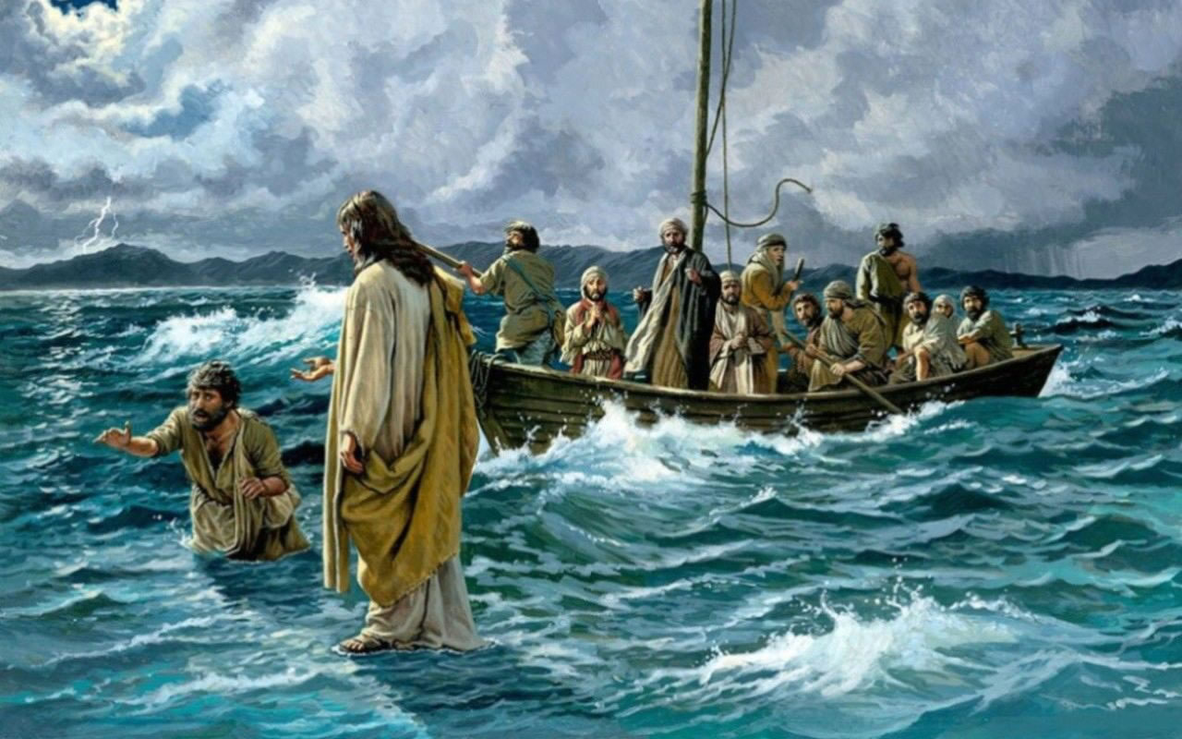
“For the body is not one member, but many”
Character & Personality
Sociable
Charismatic
Optimistic
Sanguine
Impulsive
Shameless
Exaggerator
PETER
- Diversity In Discipleship -

Slide 35
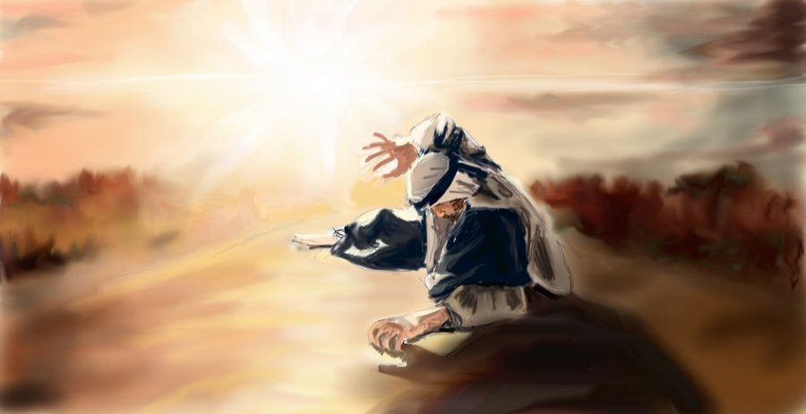
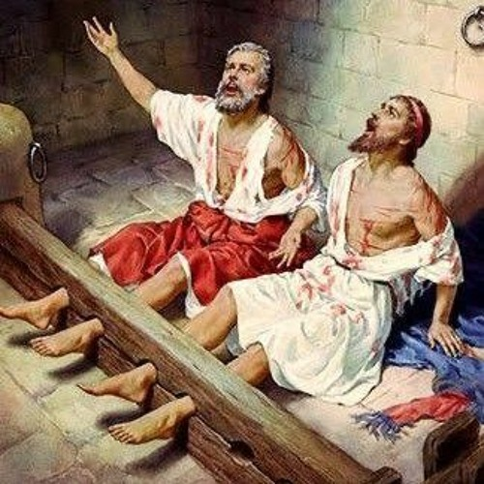
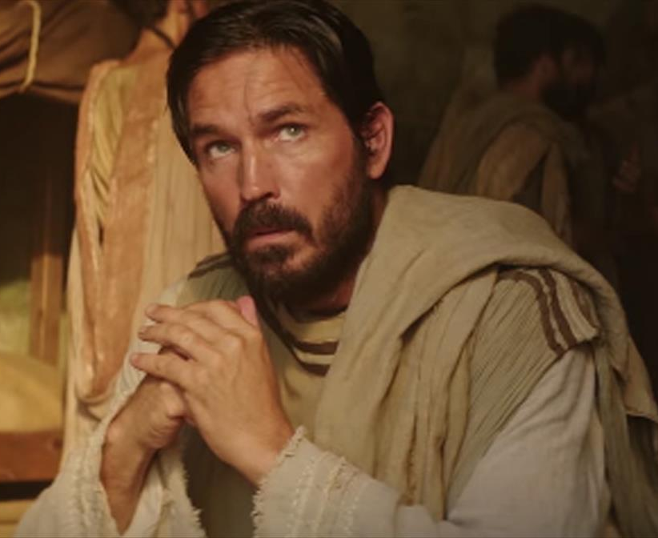
“For the body is not one member, but many”
Character & Personality
Ambitious
Passionate
Efficient
Choleric
Aggressive
Impatient
Argumentative
PAUL
- Diversity In Discipleship -

Slide 36
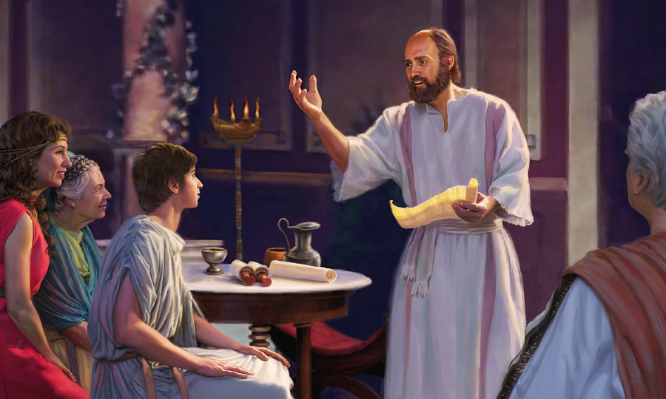
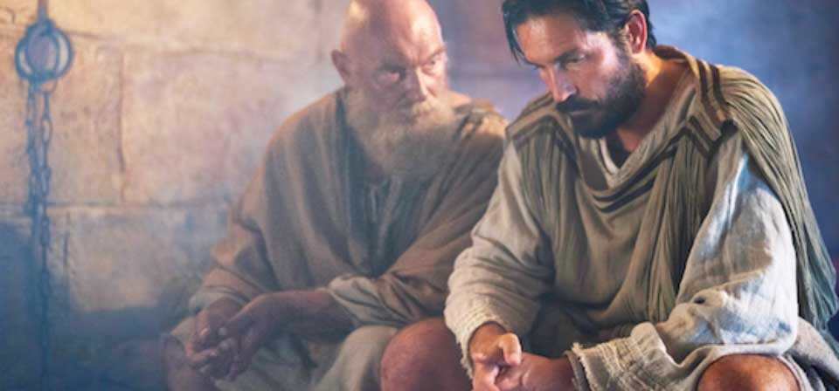
“For the body is not one member, but many”
Character & Personality
Relaxed
Kind
Observant
Phlegmatic
Shy
Stubborn
Lazy
TIMOTHY
- Diversity In Discipleship -

Slide 37
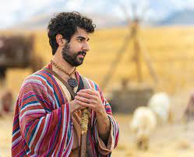
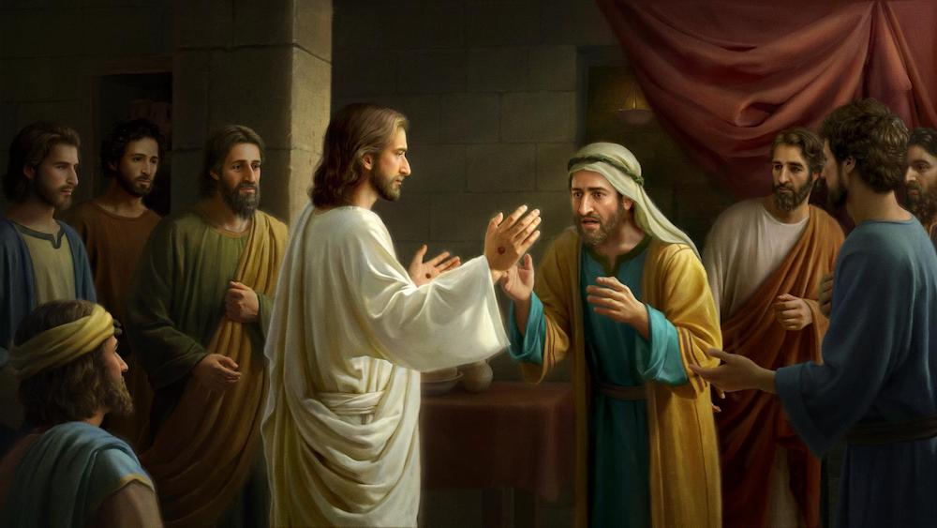
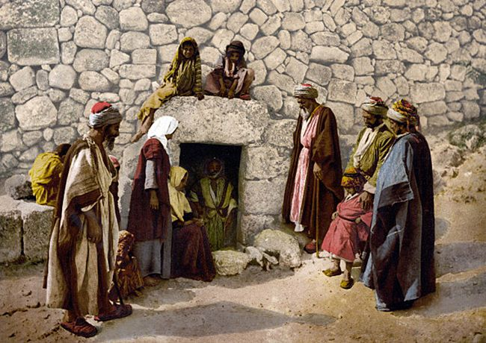
“For the body is not one member, but many”
Character & Personality
Thoughtful
Organized
Creative
Moody
Obsessive
Perfectionist
Melancholic
THOMAS
- Diversity In Discipleship -

Slide 38
“For the body is not one member, but many”
^{1 Corinthians 12}
²⁷ Now ye are the body of Christ, and members in particular.
Ecclesial Function
Preaching
Welfare
Youth
Finances
Fellowship
Teaching
Worship
Hall Maintenance
Catering
Transportation
IT & Communications
- Diversity In Discipleship -

Slide 39

“For the body is not one member, but many”
- Diversity In Discipleship -

Slide 40

“For the body is not one member, but many”
^{Matthew 19}
⁵ And said, For this cause shall a man leave father and mother, and shall cleave to his wife: and they twain shall be one flesh?
⁶ Wherefore they are no more twain, but one flesh. What therefore God hath joined together, let not man put asunder.
^{1 Corinthians 12}
¹⁸ But now hath God set the members every one of them in the body, as it hath pleased him.
NET - ”But in fact God has placed the parts in the body, every one of them, just as he wanted them to be”
- Diversity In Discipleship -

Slide 41
“For the body is not one member, but many”
^{1 Corinthians 12}
²⁴ For our comely parts have no need: but God hath tempered the body together, having given more abundant honour to that part which lacked.
- Diversity In Discipleship -

Slide 42
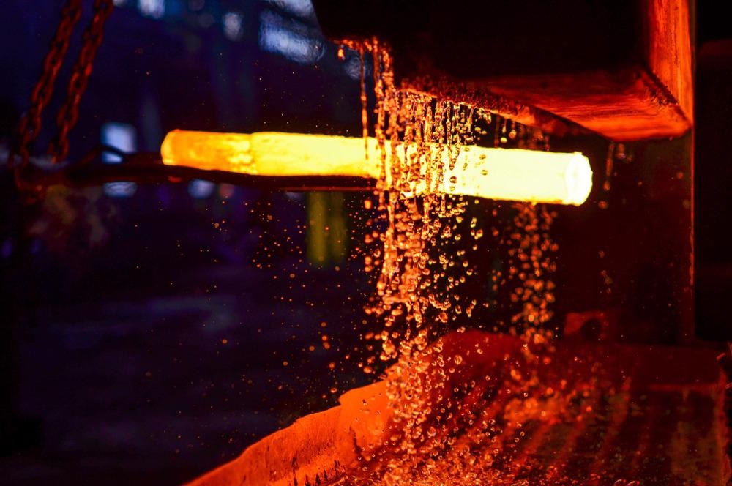
“For the body is not one member, but many”
^{1 Corinthians 12}
²⁴ For our comely parts have no need: but God hath tempered the body together, having given more abundant honour to that part which lacked.
- Diversity In Discipleship -

Slide 43
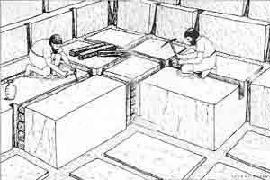
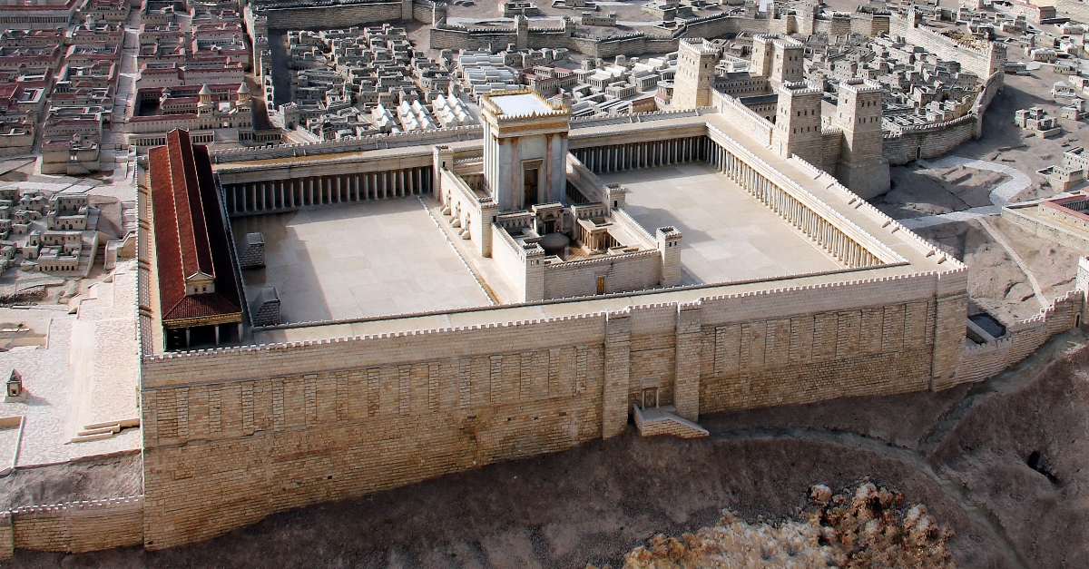
“For the body is not one member, but many”
^{1 Kings 5}
¹⁸ And Solomon's builders and Hiram's builders did hew them, and the stonesquarers: so they prepared timber and stones to build the house.
⁷ And the house, when it was in building, was built of stone made ready before it was brought thither: so that there was neither hammer nor axe nor any tool of iron heard in the house, while it was in building.
- Diversity In Discipleship -

Slide 44


“For the body is not one member, but many”
- Diversity In Discipleship -

Slide 45
“For the body is not one member, but many”
Character & Personality
Thoughtful
Organized
Creative
Sociable
Charismatic
Optimistic
Moody
Obsessive
Perfectionist
Melancholic
Sanguine
Impulsive
Shameless
Exaggerator
Relaxed
Kind
Observant
Ambitious
Passionate
Efficient
Phlegmatic
Choleric
Shy
Stubborn
Lazy
Aggressive
Impatient
Argumentative
- Diversity In Discipleship -

