Slide 1

“There is neither Jew nor Greek…”
- Diversity In Discipleship -

Slide 2
“For there is neither Jew nor Greek”
^{Galatians 3}
²⁶ For ye are all the children of God by faith in Christ Jesus.
²⁷ For as many of you as have been baptized into Christ have put on Christ.
²⁸ There is neither Jew nor Greek, there is neither bond nor free, there is neither male nor female: for ye are all one in Christ Jesus.
(But there is Jew and Greek!)
- Diversity In Discipleship -

Slide 3
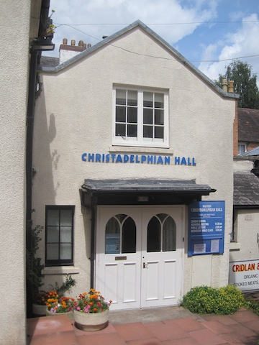
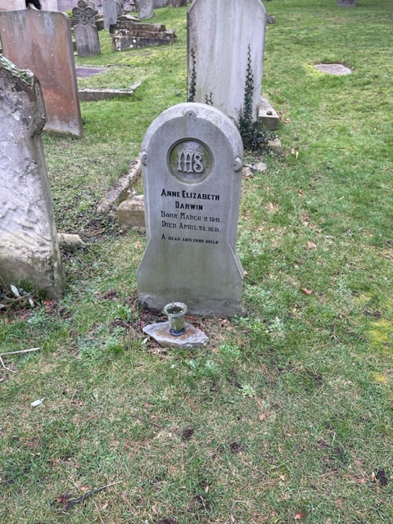
“There is neither Jew nor Greek…”
- Diversity In Discipleship -
Notes:
April 23 1851
Origin of Species November 24th 1859

Slide 4
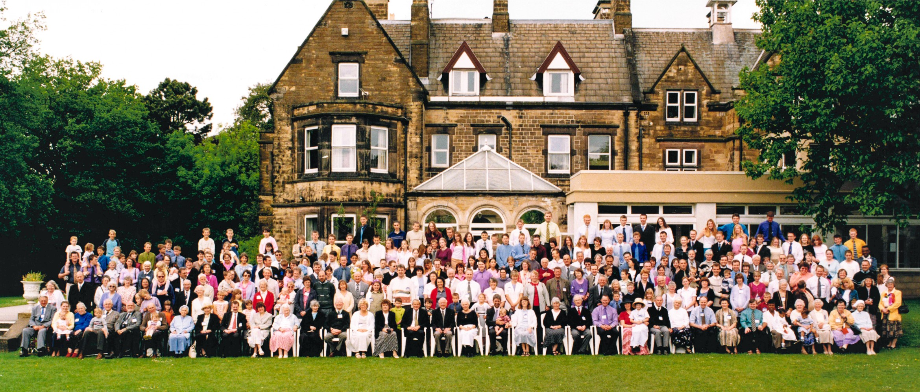
“There is neither Jew nor Greek…”
- Diversity In Discipleship -

Slide 5
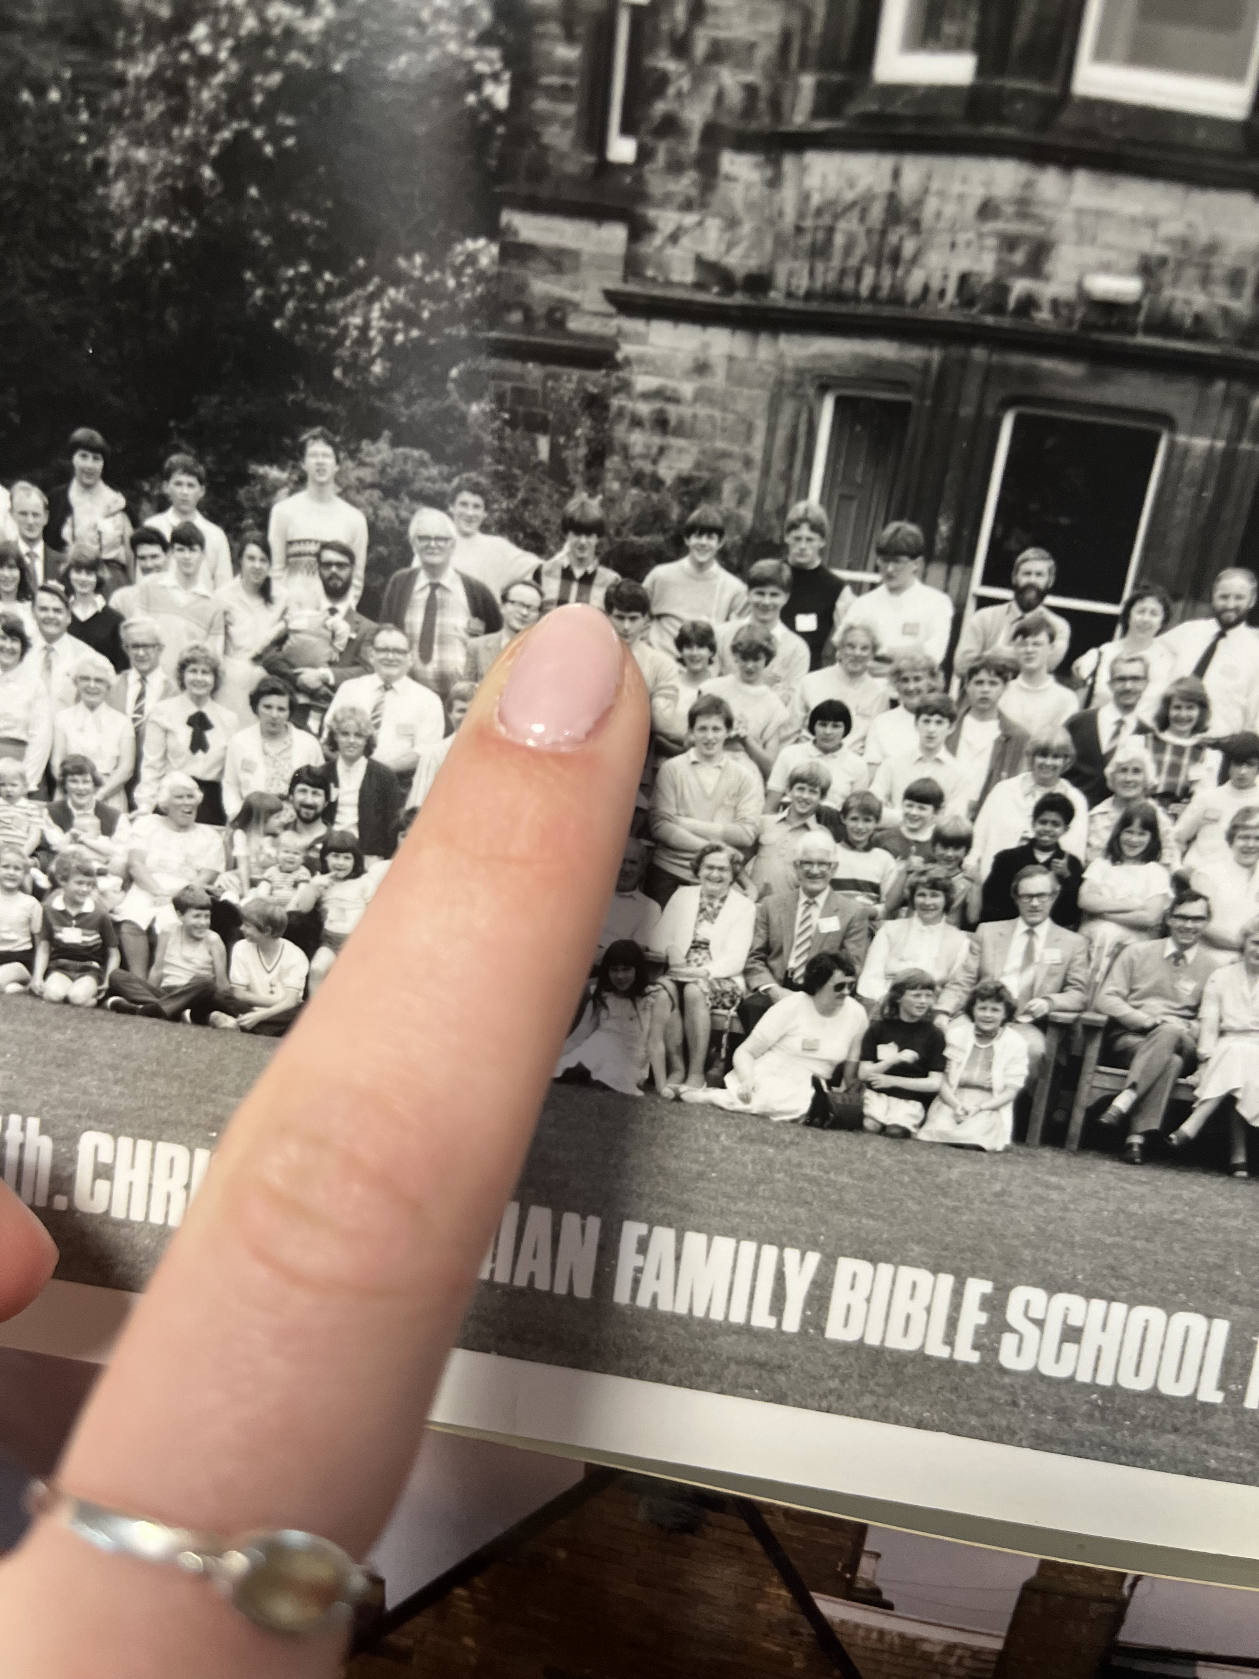
“There is neither Jew nor Greek…”
- Diversity In Discipleship -

Slide 6

“There is neither Jew nor Greek…”
- Diversity In Discipleship -

Slide 7
“There is neither Jew nor Greek…”
culture
^{[ kuhl-cher ]}
noun
the quality in a person or society that arises from a concern for what is regarded as excellent in arts, letters, manners, scholarly pursuits, etc.
a particular form or stage of civilization, as that of a certain nation or period:Greek culture.
development or improvement of the mind by education or training.
verb (used with object), cul·tured, cul·tur·ing.
to subject to culture; cultivate.
Biology.to grow (microorganisms, tissues, etc.) in or on a controlled or defined medium.
to introduce (living material) into a culture medium.
- Diversity In Discipleship -

Slide 8
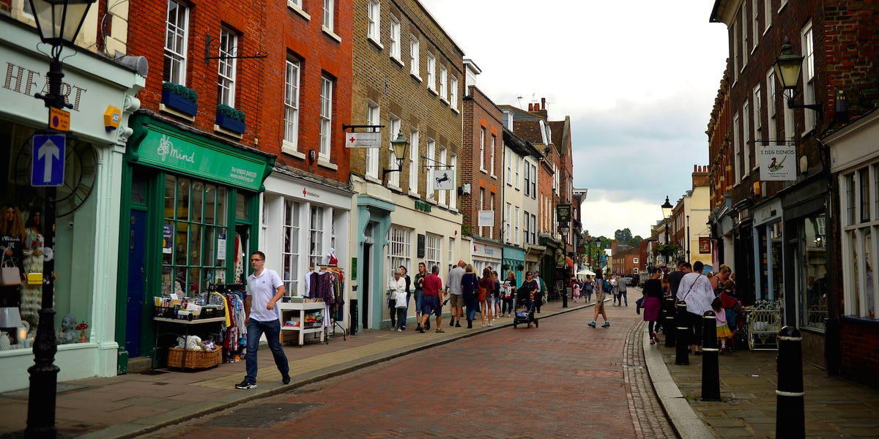
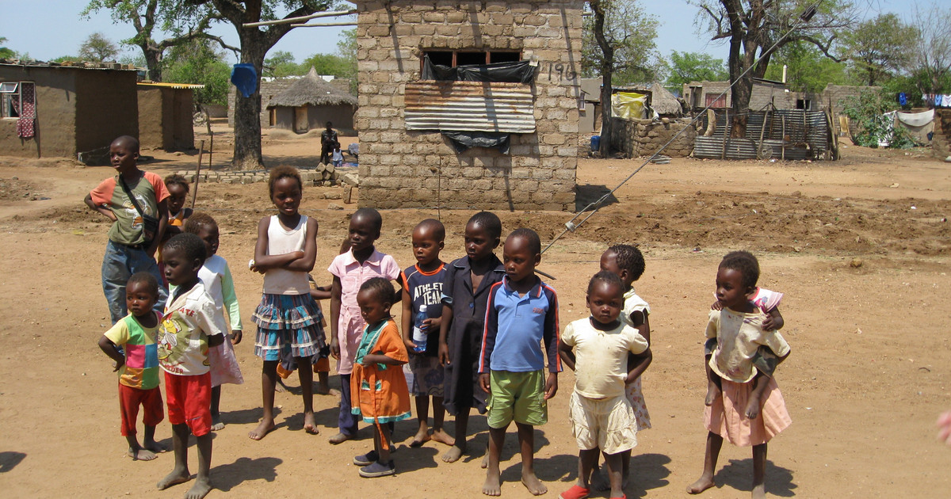

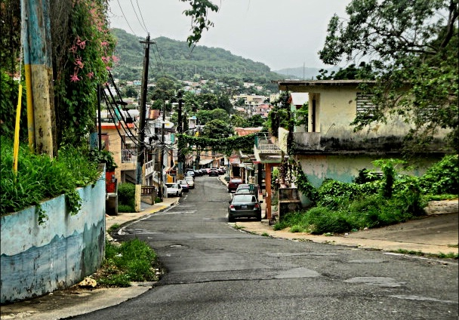

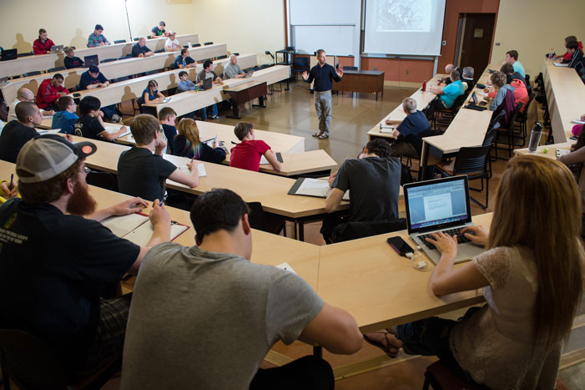

“There is neither Jew nor Greek…”
- Diversity In Discipleship -

Slide 9

“There is neither Jew nor Greek…”
- Diversity In Discipleship -

Slide 10
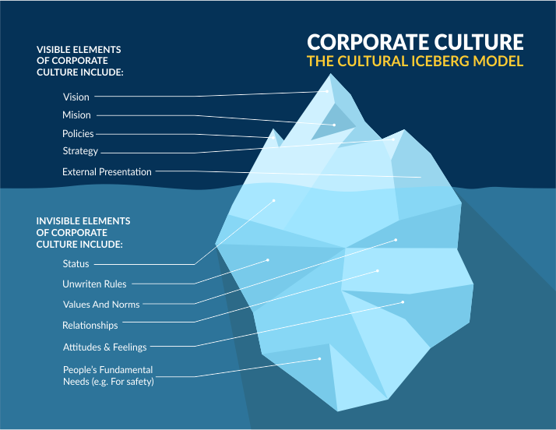
“There is neither Jew nor Greek…”
- Diversity In Discipleship -

Slide 11

“There is neither Jew nor Greek…”
- Diversity In Discipleship -

Slide 12
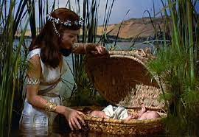
“There is neither Jew nor Greek…”
^{Acts 7 (Amplified Version)}
²² So Moses was educated in all the wisdom and culture of the Egyptians, and he was a man of power in words and deeds.
- Diversity In Discipleship -

Slide 13
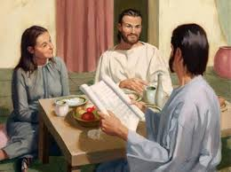
“There is neither Jew nor Greek…”
^{Acts 18}
²⁴ Now a Jew named Apollos, a native of Alexandria, came to Ephesus. He was an eloquent and cultured man, and well versed in the [Hebrew] Scriptures.
- Diversity In Discipleship -

Slide 14
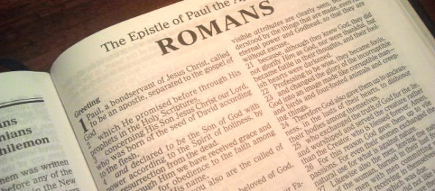
“There is neither Jew nor Greek…”
^{Romans 1}
¹⁴ I have a duty to perform and a debt to pay both to Greeks and to barbarians [the cultured and the uncultured], both to the wise and to the foolish.
- Diversity In Discipleship -

Slide 15
“There is neither Jew nor Greek…”
^{Genesis 4}
¹⁹ And Lamech took unto him two wives: the name of the one was Adah, and the name of the other Zillah.
²⁰ And Adah bare Jabal: he was the father of such as dwell in tents, and of such as have cattle.
²¹ And his brother's name was Jubal: he was the father of all such as handle the harp and organ.
²² And Zillah, she also bare Tubalcain, an instructer of every artificer in brass and iron: and the sister of Tubalcain was Naamah.
- Diversity In Discipleship -

Slide 16
“There is neither Jew nor Greek…”
^{Genesis 4}
¹⁹ And Lamech took unto him two wives: the name of the one was Adah, and the name of the other Zillah.
²⁰ And Adah bare Jabal: he was the father of such as dwell in tents, and of such as have cattle.
²¹ And his brother's name was Jubal: he was the father of all such as handle the harp and organ.
²² And Zillah, she also bare Tubalcain, an instructer of every artificer in brass and iron: and the sister of Tubalcain was Naamah.
- Diversity In Discipleship -

Slide 17
“There is neither Jew nor Greek…”
^{Genesis 4}
¹⁹ And Lamech took unto him two wives: the name of the one was Adah, and the name of the other Zillah.
²⁰ And Adah bare Jabal: he was the father of such as dwell in tents, and of such as have cattle.
²¹ And his brother's name was Jubal: he was the father of all such as handle the harp and organ.
²² And Zillah, she also bare Tubalcain, an instructer of every artificer in brass and iron: and the sister of Tubalcain was Naamah.
- Diversity In Discipleship -

Slide 18
“There is neither Jew nor Greek…”
Agriculture & Food Production
^{Genesis 4}
¹⁹ And Lamech took unto him two wives: the name of the one was Adah, and the name of the other Zillah.
²⁰ And Adah bare Jabal: he was the father of such as dwell in tents, and of such as have cattle.
²¹ And his brother's name was Jubal: he was the father of all such as handle the harp and organ.
²² And Zillah, she also bare Tubalcain, an instructer of every artificer in brass and iron: and the sister of Tubalcain was Naamah.
Industry & Manufacturing
Arts & Entertainment
- Diversity In Discipleship -

Slide 19
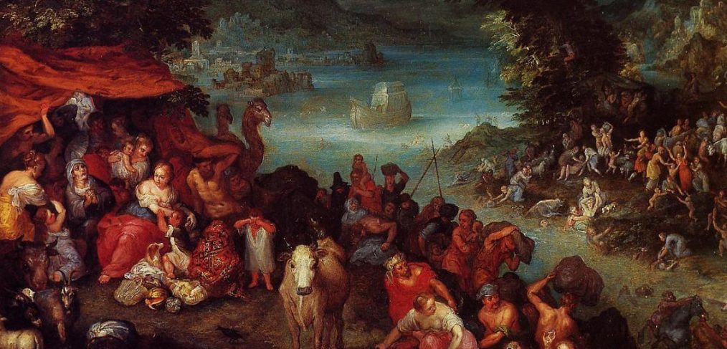
“There is neither Jew nor Greek…”
^{Matthew 24}
³⁷ But as the days of Noah were, so shall also the coming of the Son of man be.
³⁸ For as in the days that were before the flood they were eating and drinking, marrying and giving in marriage, until the day that Noe entered into the ark,
³⁹ And knew not until the flood came, and took them all away; so shall also the coming of the Son of man be.
- Diversity In Discipleship -

Slide 20
“There is neither Jew nor Greek…”
^{Genesis 6}
¹¹ The earth also was corrupt before God, and the earth was filled with violence.
¹² And God looked upon the earth, and, behold, it was corrupt; for all flesh had corrupted his way upon the earth.
¹³ And God said unto Noah, The end of all flesh is come before me; for the earth is filled with violence through them; and, behold, I will destroy them with the earth.
- Diversity In Discipleship -

Slide 21
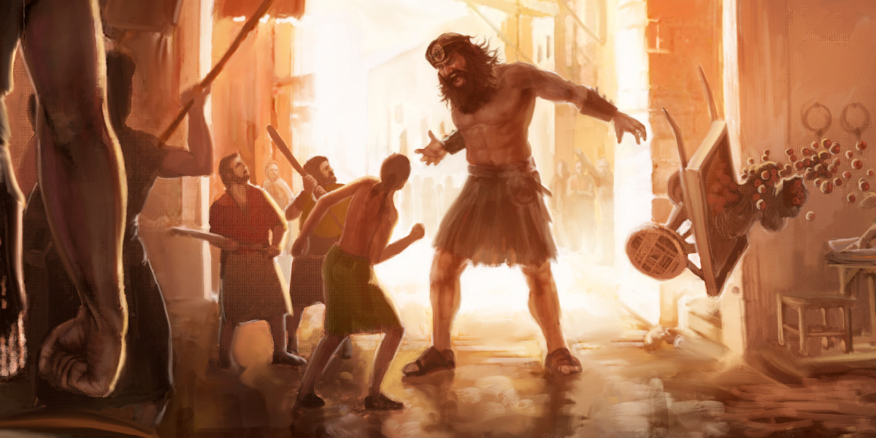
“There is neither Jew nor Greek…”
^{Genesis 6}
¹¹ The earth also was corrupt before God, and the earth was filled with violence.
¹² And God looked upon the earth, and, behold, it was corrupt; for all flesh had corrupted his way upon the earth.
¹³ And God said unto Noah, The end of all flesh is come before me; for the earth is filled with violence through them; and, behold, I will destroy them with the earth.
- Diversity In Discipleship -

Slide 22
“There is neither Jew nor Greek…”
^{Genesis 6 (Amplified Bible)}
¹¹ The [population of the] earth was corrupt [absolutely depraved—spiritually and morally putrid] in God’s sight, and the land was filled with violence [desecration, infringement, outrage, assault, and lust for power]. ¹² God looked on the earth and saw how debased and degenerate it was, for all humanity had corrupted their way on the earth and lost their true direction.
- Diversity In Discipleship -

Slide 23
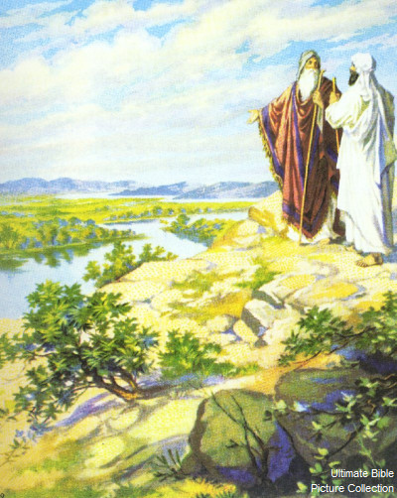
“There is neither Jew nor Greek…”
^{Genesis 13}
¹² Abram dwelled in the land of Canaan, and Lot dwelled in the cities of the plain, and pitched his tent toward Sodom.
¹³ But the men of Sodom were wicked and sinners before the Lord exceedingly.
- Diversity In Discipleship -

Slide 24
“There is neither Jew nor Greek…”
^{Acts 7 (Amplified Version)}
²² So Moses was educated in all the wisdom and culture of the Egyptians, and he was a man of power in words and deeds.
Exodus 2
18 And when they came to Reuel their father, he said, How is it that ye are come so soon to day?
19 And they said, An Egyptian delivered us out of the hand of the shepherds, and also drew water enough for us, and watered the flock
- Diversity In Discipleship -

Slide 25
“There is neither Jew nor Greek…”
^{Acts 7 (Amplified Version)}
²² So Moses was educated in all the wisdom and culture of the Egyptians, and he was a man of power in words and deeds.
Exodus 2
18 And when they came to Reuel their father, he said, How is it that ye are come so soon to day?
19 And they said, An Egyptian delivered us out of the hand of the shepherds, and also drew water enough for us, and watered the flock
- Diversity In Discipleship -

Slide 26
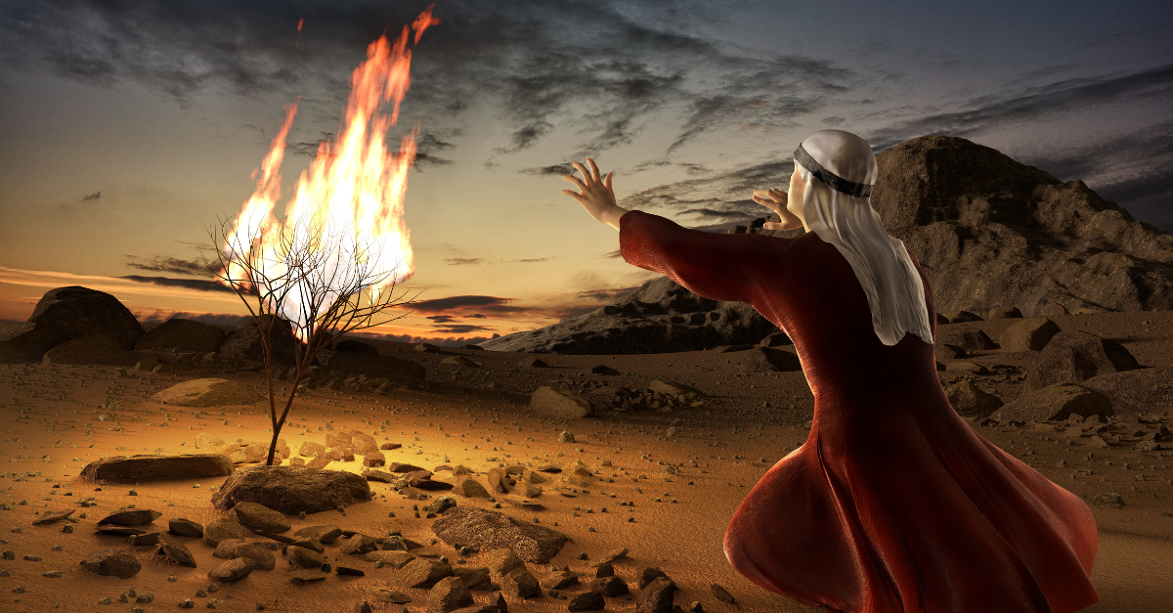
“There is neither Jew nor Greek…”
^{Exodus 3}
¹³ And Moses said unto God, Behold, when I come unto the children of Israel, and shall say unto them, The God of your fathers hath sent me unto you; and they shall say to me, What is his name? what shall I say unto them?
- Diversity In Discipleship -

Slide 27
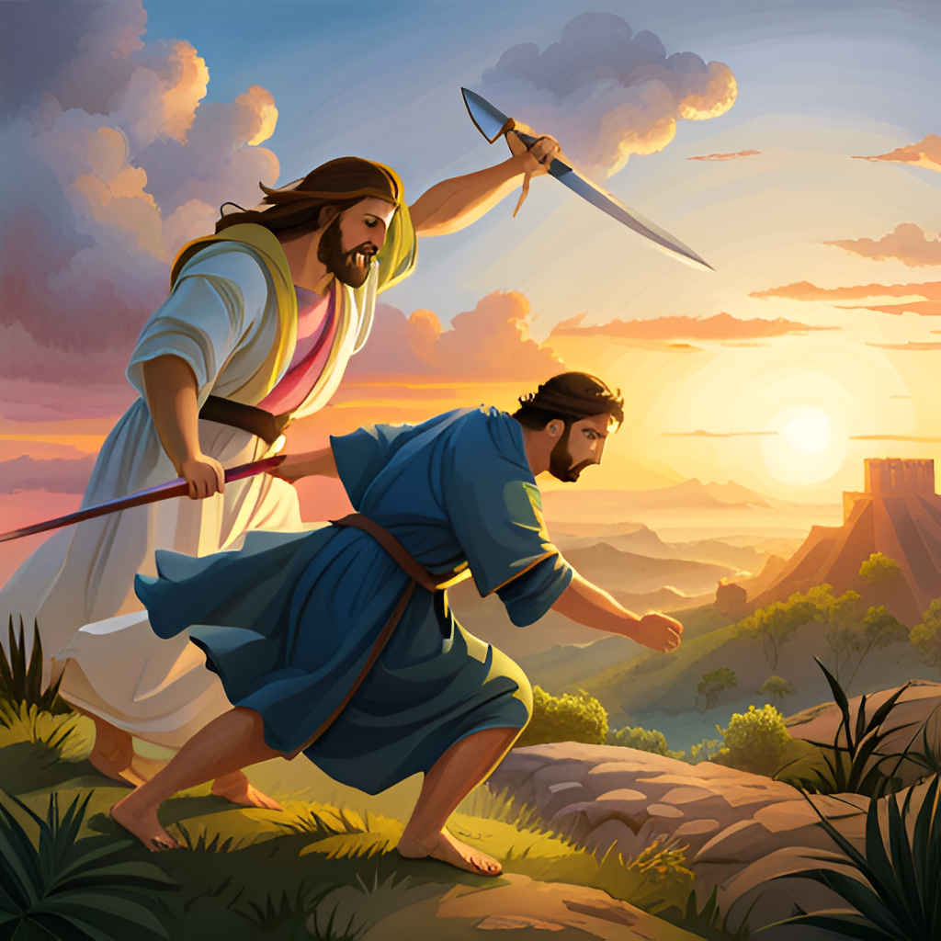
“There is neither Jew nor Greek…”
^{Exodus 4}
²⁴ And it came to pass by the way in the inn, that the Lord met him, and sought to kill him.
- Diversity In Discipleship -

Slide 28
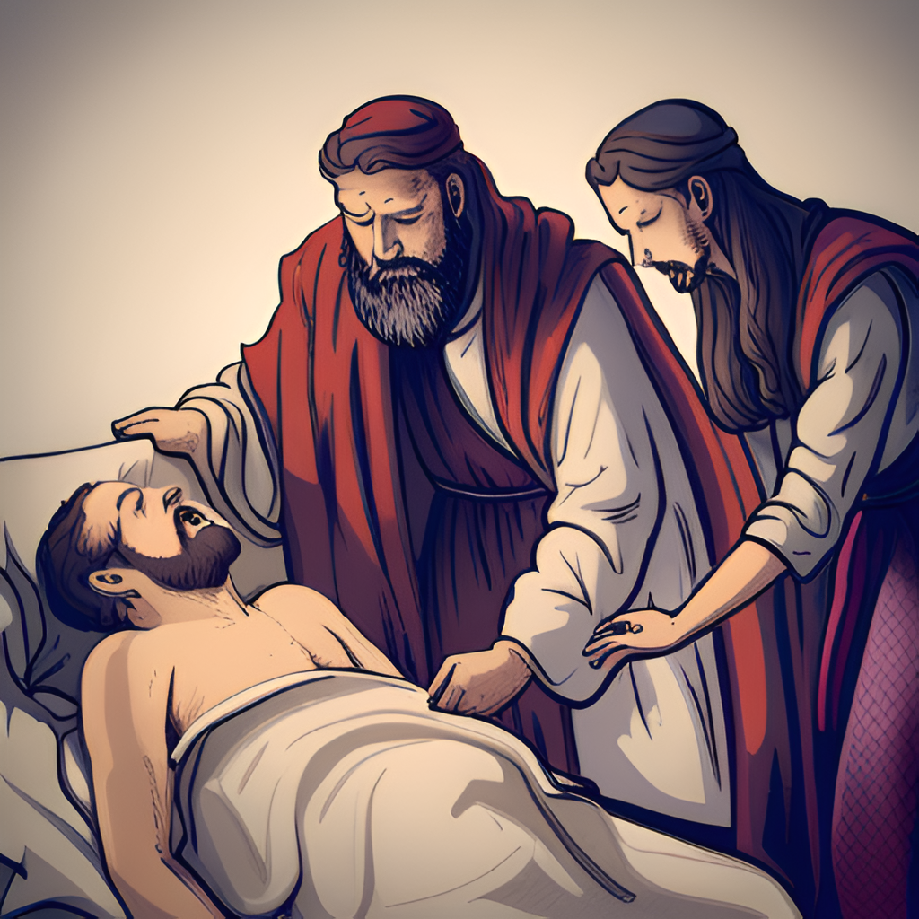
“There is neither Jew nor Greek…”
^{Exodus 4}
²⁴ And it came to pass by the way in the inn, that the Lord met him, and sought to kill him.
²⁵ Then Zipporah took a sharp stone, and cut off the foreskin of her son, and cast it at his feet, and said, Surely a bloody husband art thou to me.
²⁶ So he let him go: then she said, A bloody husband thou art, because of the circumcision
- Diversity In Discipleship -

Slide 29
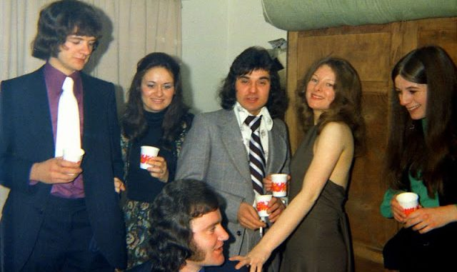
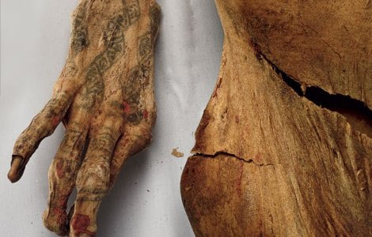
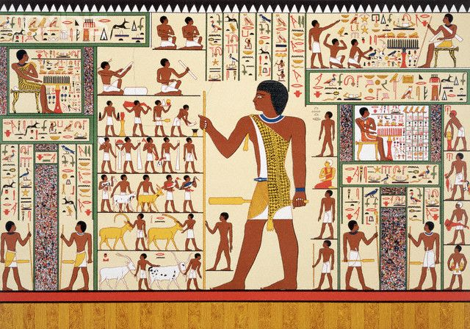
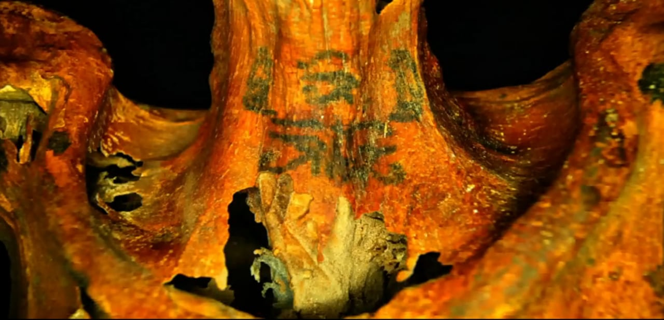
“There is neither Jew nor Greek…”
Leviticus 19
And the Lord spake unto Moses, saying,
² Speak unto all the congregation of the children of Israel, and say unto them, Ye shall be holy: for I the Lord your God am holy.
²⁷ Ye shall not round the corners of your heads, neither shalt thou mar the corners of thy beard.
²⁸ Ye shall not make any cuttings in your flesh for the dead, nor print any marks upon you: I am the Lord.
- Diversity In Discipleship -

Slide 30
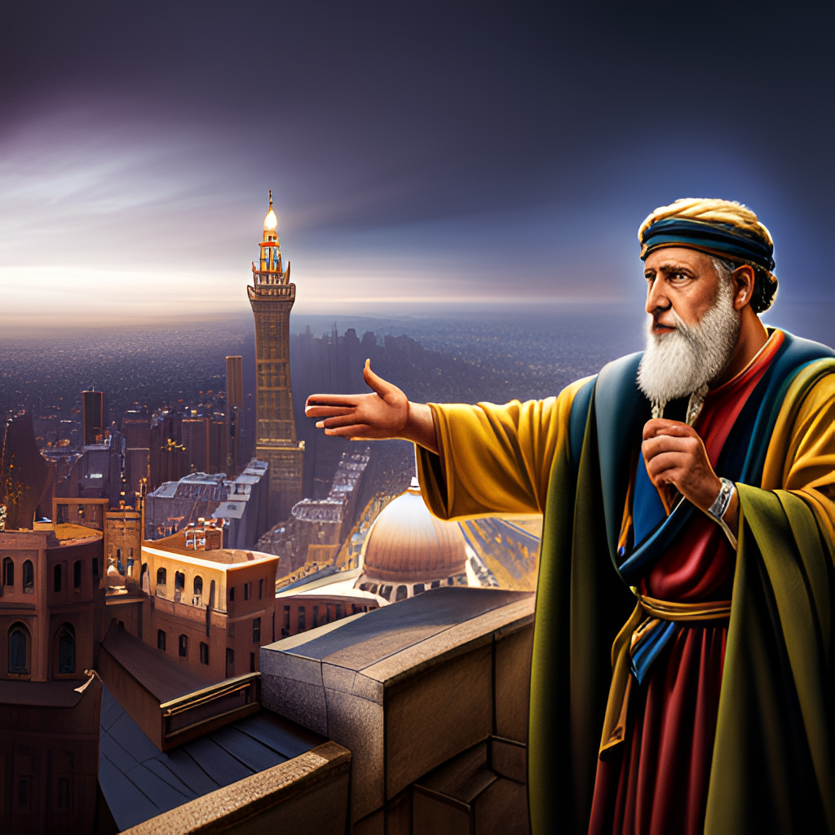
“There is neither Jew nor Greek…”
Jeremiah 29
4 Thus saith the LORD of hosts, the God of Israel, unto all that are carried away captives, whom I have caused to be carried away from Jerusalem unto Babylon;
5 Build ye houses, and dwell in them; and plant gardens, and eat the fruit of them;
6 Take ye wives, and beget sons and daughters; and take wives for your sons, and give your daughters to husbands, that they may bear sons and daughters; that ye may be increased there, and not diminished.
7 And seek the peace of the city whither I have caused you to be carried away captives, and pray unto the LORD for it: for in the peace thereof shall ye have peace.
- Diversity In Discipleship -

Slide 31
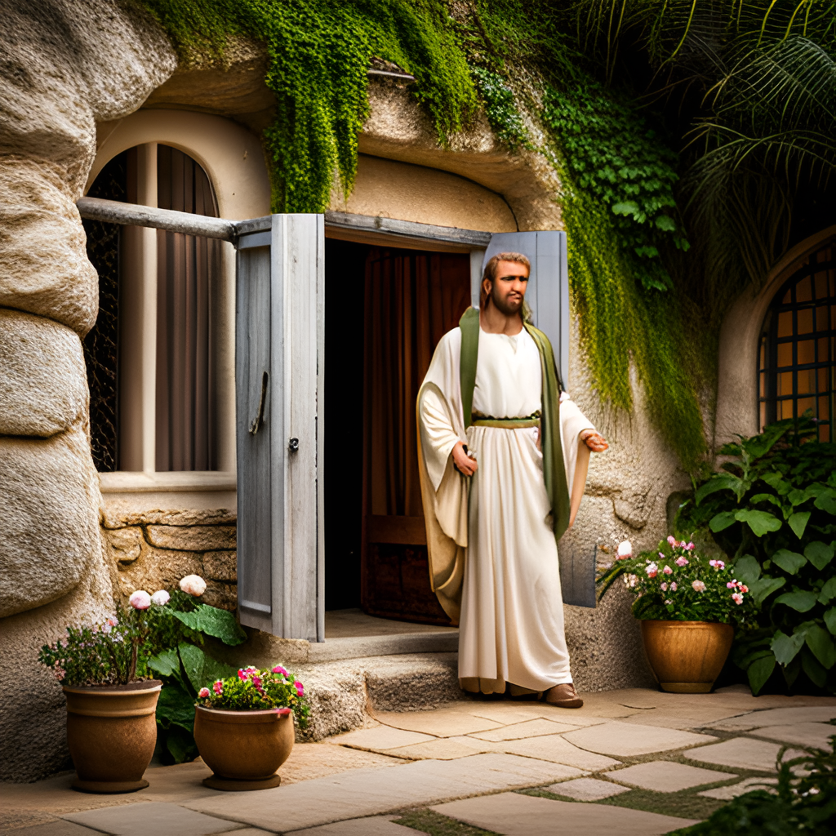
“There is neither Jew nor Greek…”
Haggai 1
4 Is it time for you, O ye, to dwell in your cieled houses, and this house lie waste?
5 Now therefore thus saith the LORD of hosts; Consider your ways.
H1870
דֶּרֶךְ
derek
deh'-rek
From H1869; a road (as trodden); figuratively a course of life or mode of action, often adverbially: - along, away, because of, + by, conversation, custom, [east-] ward, journey, manner, passenger, through, toward, [high-] [path-] way [-side], whither [-soever].
- Diversity In Discipleship -

Slide 32
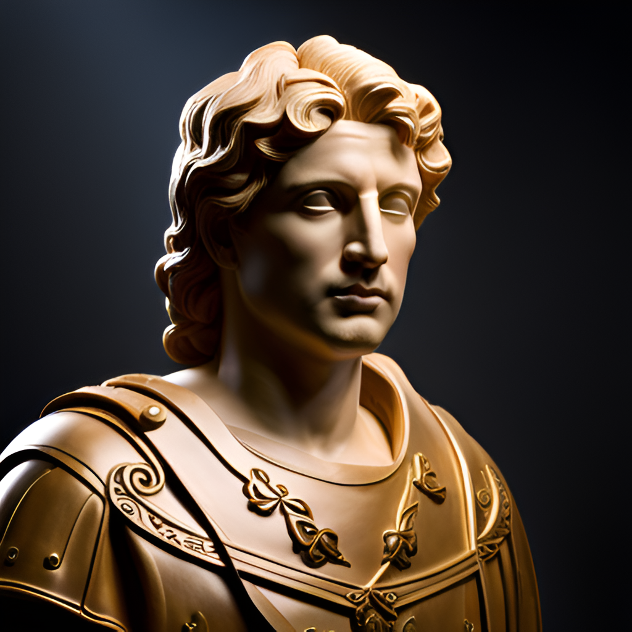
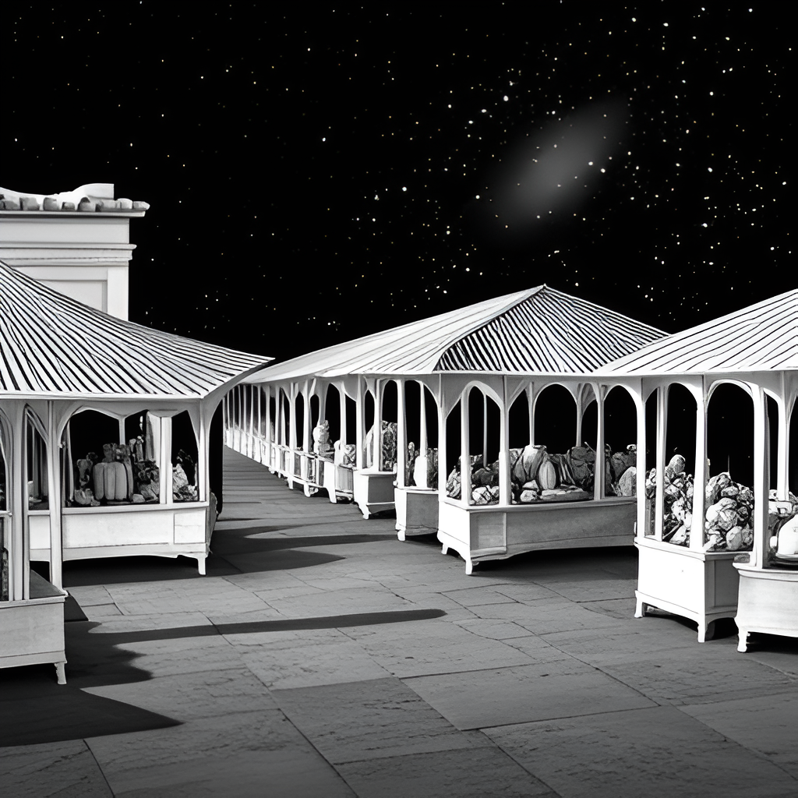

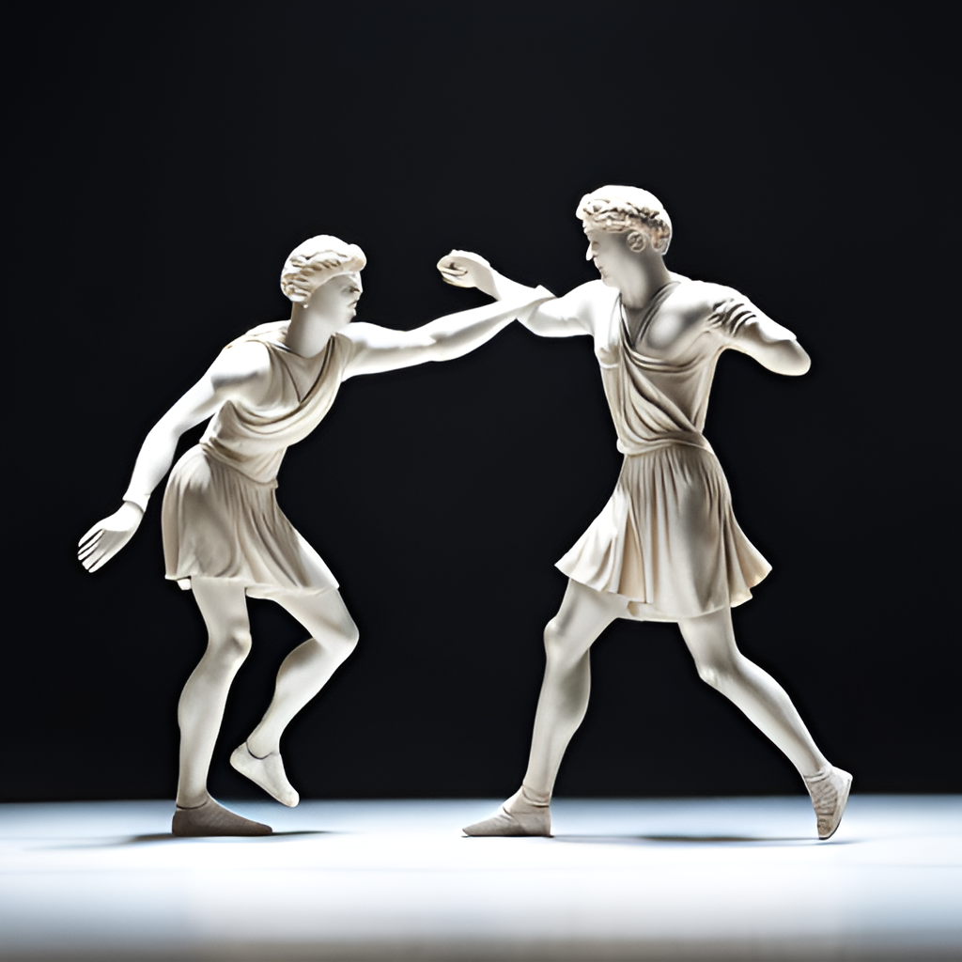
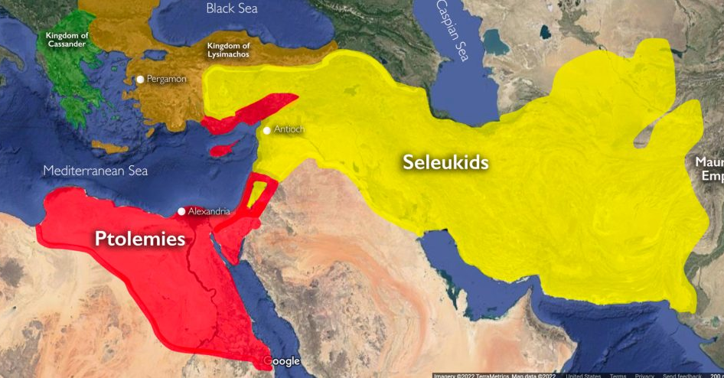
“There is neither Jew nor Greek…”
Influence of Greek Culture…
300BC
200BC
100BC
167BC - Jewish revolt against the Selucid Greeks led by Judas Maccabeaus. Successfully retake Jerusalem and cleanse the second Temple.
- Diversity In Discipleship -

Slide 33
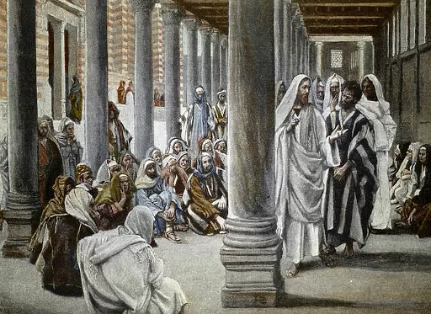
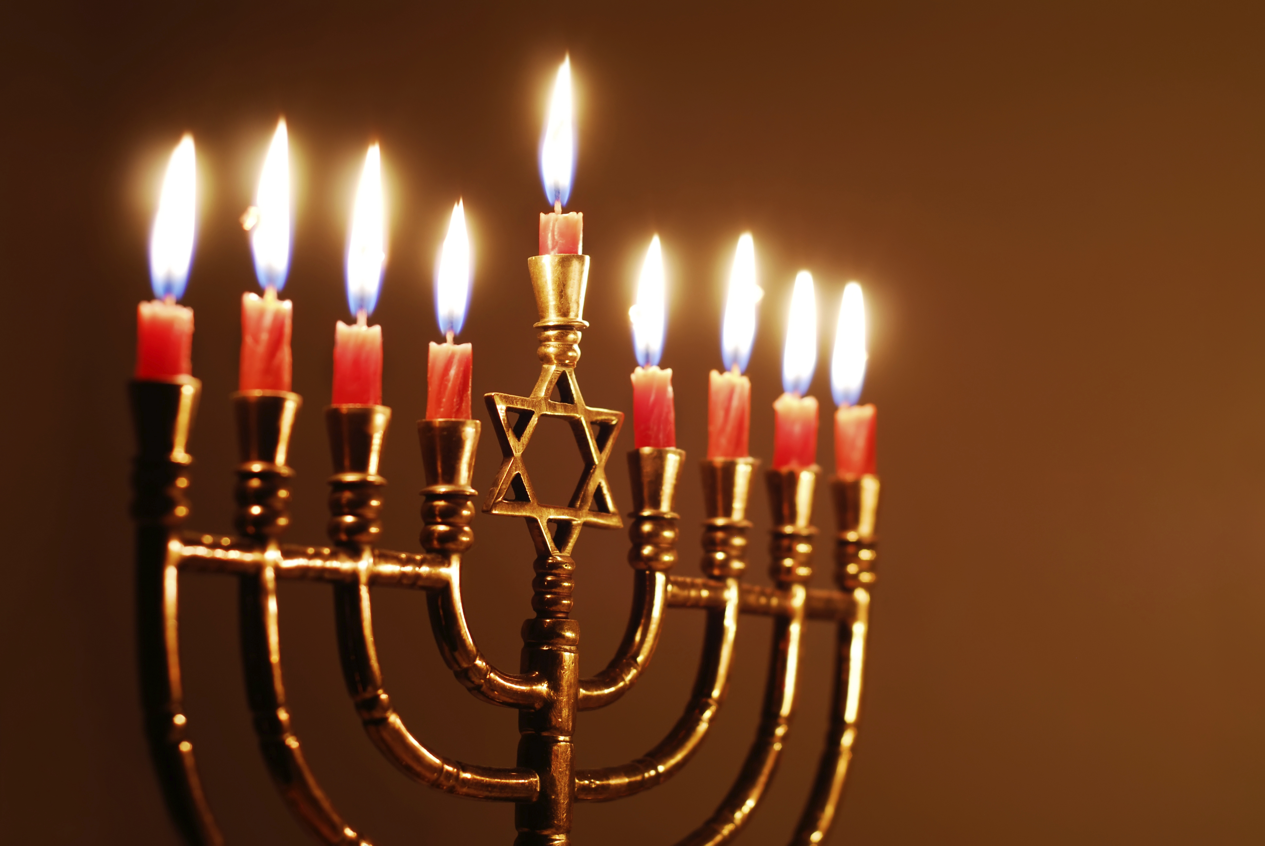
“There is neither Jew nor Greek…”
^{John 10}
²² And it was at Jerusalem the feast of the dedication, and it was winter.
²³ And Jesus walked in the temple in Solomon's porch.
- Diversity In Discipleship -

Slide 34

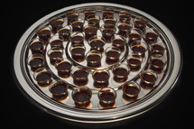
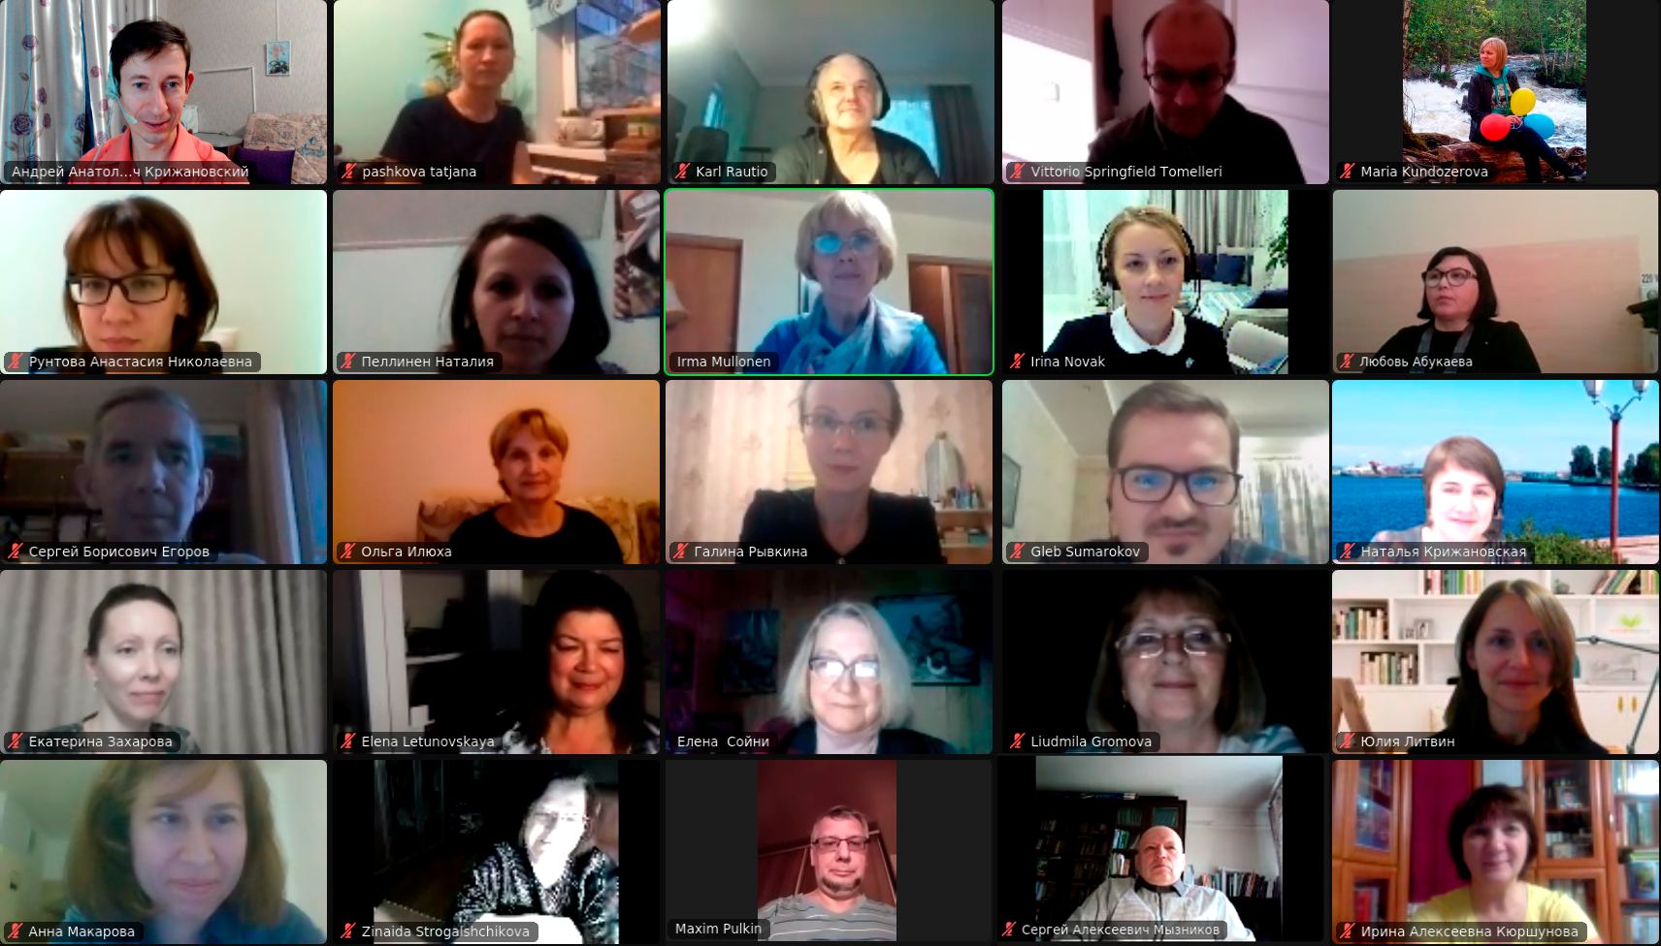
“There is neither Jew nor Greek…”
- Diversity In Discipleship -

Slide 35

“There is neither Jew nor Greek…”
- Diversity In Discipleship -

Slide 36
“There is neither Jew nor Greek…”
Influence of Greek Culture…
300BC
200BC
100BC
167BC - Jewish revolt against the Selucid Greeks led by Judas Maccabeaus. Successfully retake Jerusalem and cleanse the second Temple.
Ptolemy II Philadelpheus invites 72 Scholars to translate the Hebrew text into Greek for the library in Alexandria
- Diversity In Discipleship -

Slide 37

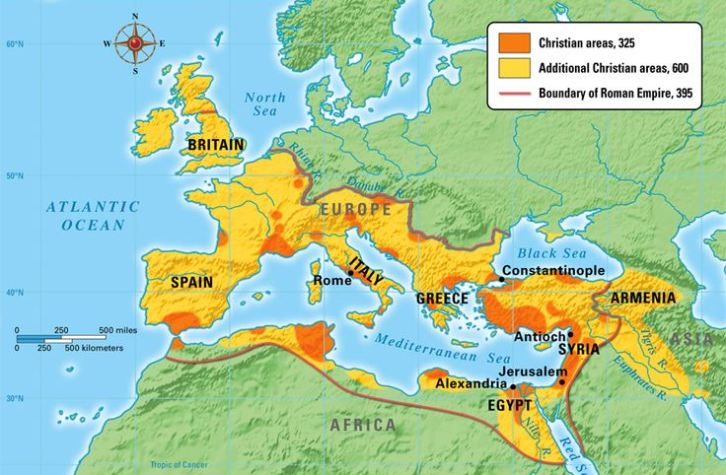
“There is neither Jew nor Greek…”
320 direct quotations
&
890 indirect quotations
Septuagint
English is Latin by origin
150,000 words in the English language have their origins from Greek.
That’s about 30%
- Diversity In Discipleship -

Slide 38
“There is neither Jew nor Greek…”
- Diversity In Discipleship -

Slide 39
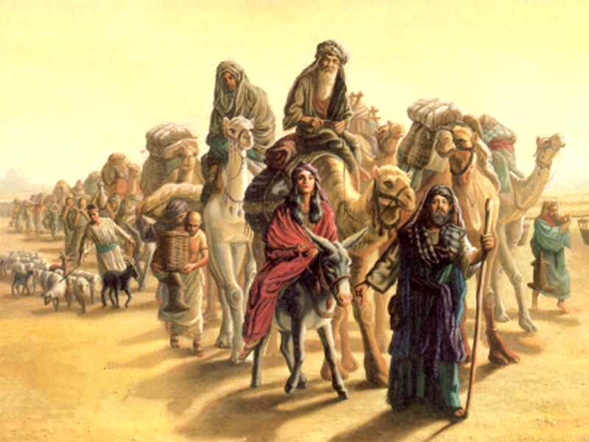
“There is neither Jew nor Greek…”
Genesis 12
Now the Lord had said unto Abram, Get thee out of thy country, and from thy kindred, and from thy father's house, unto a land that I will shew thee:
- Diversity In Discipleship -

Slide 40
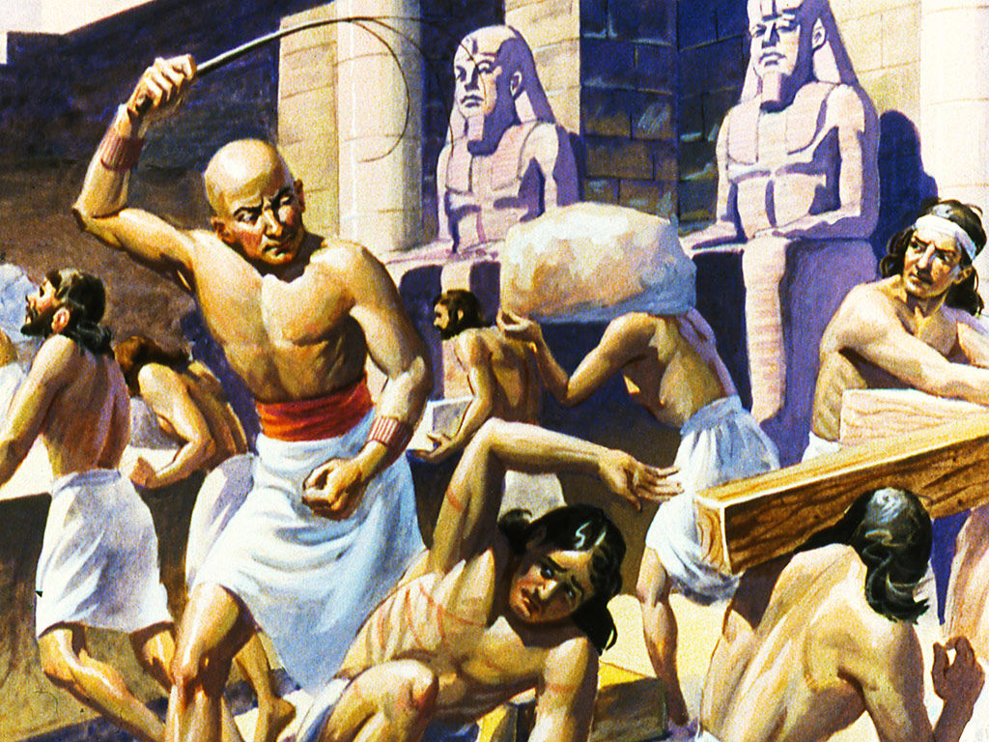
“There is neither Jew nor Greek…”
^{Exodus 3}
⁸ And I am come down to deliver them out of the hand of the Egyptians, and to bring them up out of that land unto a good land and a large, unto a land flowing with milk and honey; unto the place of the Canaanites, and the Hittites, and the Amorites, and the Perizzites, and the Hivites, and the Jebusites.
- Diversity In Discipleship -

Slide 41
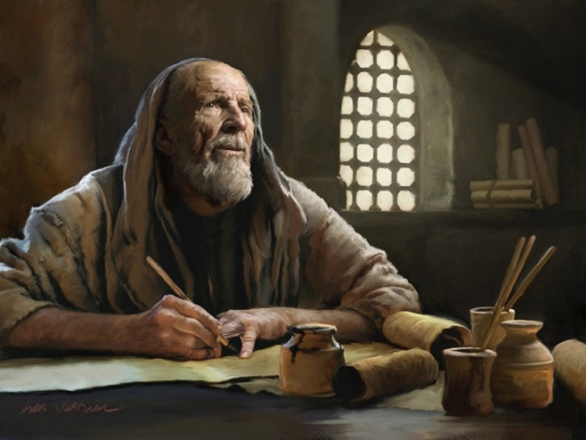
“There is neither Jew nor Greek…”
^{2 Corinthians 6}
¹⁷ Wherefore come out from among them, and be ye separate, saith the Lord, and touch not the unclean thing; and I will receive you.
- Diversity In Discipleship -

Slide 42
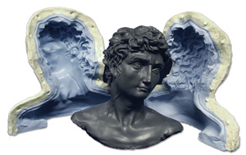
“There is neither Jew nor Greek…”
^{Romans 12}
² And be not conformed to this world: but be ye transformed by the renewing of your mind, that ye may prove what is that good, and acceptable, and perfect, will of God.
G4964
συσχηματίζω
suschēmatizō
soos-khay-mat-id'-zo
From G4862 and a derivative of G4976; to fashion alike, that is, conform to the same pattern (figuratively): - conform to, fashion self according to.
Total KJV occurrences: 2
- Diversity In Discipleship -

Slide 43
“There is neither Jew nor Greek…”
^{1 Peter 1}
¹³ Wherefore gird up the loins of your mind, be sober, and hope to the end for the grace that is to be brought unto you at the revelation of Jesus Christ;
¹⁴ As obedient children, not fashioning yourselves according to the former lusts in your ignorance:
- Diversity In Discipleship -

Slide 44
“There is neither Jew nor Greek…”
^{1 Peter 1}
¹³ Wherefore gird up the loins of your mind, be sober, and hope to the end for the grace that is to be brought unto you at the revelation of Jesus Christ;
¹⁴ As obedient children, not fashioning yourselves according to the former lusts in your ignorance:
- Diversity In Discipleship -

Slide 45

“There is neither Jew nor Greek…”
Glory of The Father
And the Word was made flesh, and dwelt among us, (and we beheld his glory, the glory as of the only begotten of the Father,) full of grace and truth. (John1:14)
Culture of Christ
Moved with compassion
Mercy
Grace
Longsuffering
Always about his Fathers business
Seeking to make whole
Speaking the truth in love
Zealous for the LORD’s House
- Diversity In Discipleship -

Slide 46
“There is neither Jew nor Greek…”
^{Exodus 11}
⁷ ….that ye may know how that the Lord doth put a difference between the Egyptians and Israel.
- Diversity In Discipleship -

