Slide 1

“…there is neither bond nor free…”
- Diversity In Discipleship -

Slide 2
“For there is neither Jew nor Greek”
^{Galatians 3}
²⁶ For ye are all the children of God by faith in Christ Jesus.
²⁷ For as many of you as have been baptized into Christ have put on Christ.
²⁸ There is neither Jew nor Greek, there is neither bond nor free, there is neither male nor female: for ye are all one in Christ Jesus.
- Diversity In Discipleship -

Slide 3
“For there is neither Jew nor Greek”
^{Galatians 3}
²⁶ For ye are all the children of God by faith in Christ Jesus.
²⁷ For as many of you as have been baptized into Christ have put on Christ.
²⁸ There is neither Jew nor Greek, there is neither bond nor free, there is neither male nor female: for ye are all one in Christ Jesus.
(But there is bond and free!)
- Diversity In Discipleship -

Slide 4
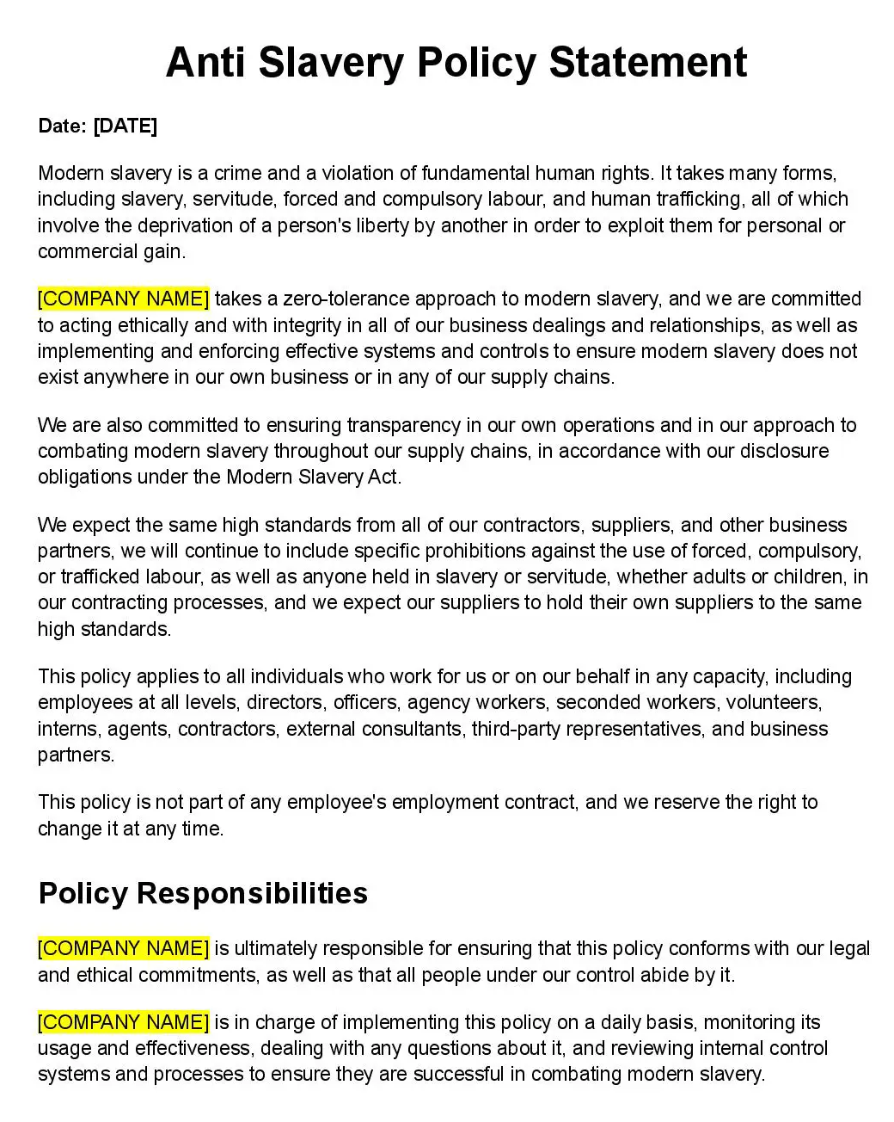
“…there is neither bond nor free…”
In 2023, it’s estimated that up to 50 Million people are living in a form of slavery…
- Diversity In Discipleship -

Slide 5
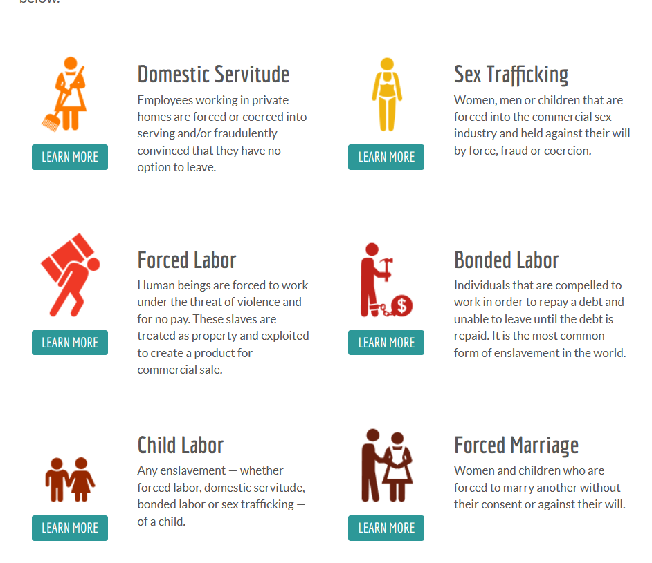

“…there is neither bond nor free…”
G20 Nations
Home to 50% of those living in slavery
Imports $468 Billion USD of ‘at risk products’
  USA is largest importer at $169 Billion USD
Electronics highest value at $243 Billion USD
Russia
1.9M
Türkiye
1.3M
China
5.8M
USA
1.1M
India
11M
Indonesia
1.8M
- Diversity In Discipleship -

Slide 6
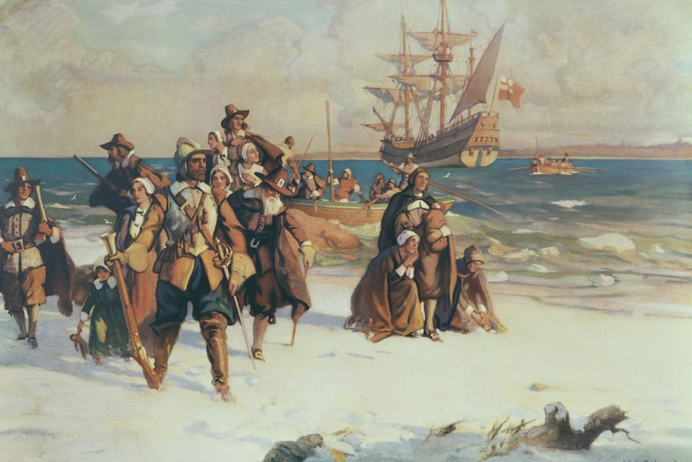
“…there is neither bond nor free…”
Indentured Servitude:
Indentured servitude is a form of labor in which a person is contracted to work without salary for a specific number of years. The contract, called an "indenture", may be entered "voluntarily" for purported eventual compensation or debt repayment, or it may be imposed "involuntarily" as a judicial punishment.
Result of Debt
- Diversity In Discipleship -

Slide 7
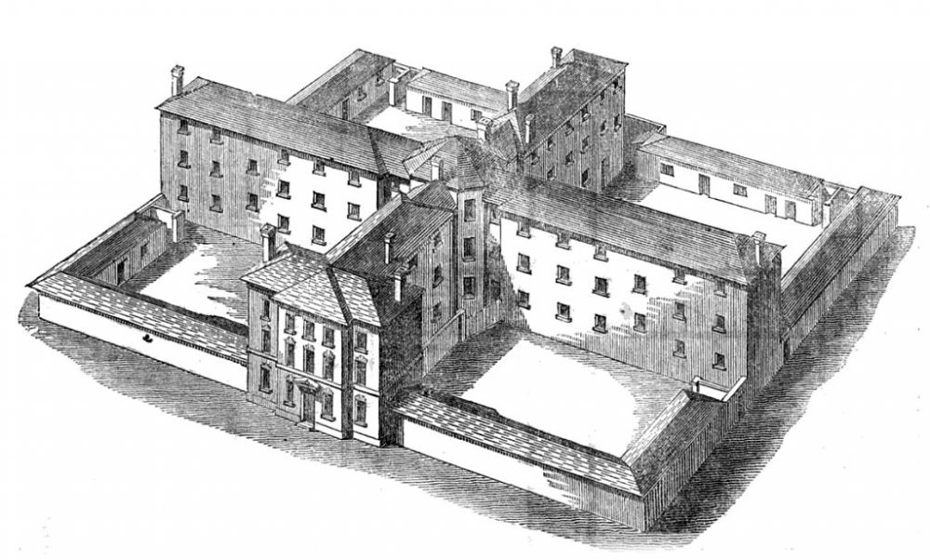
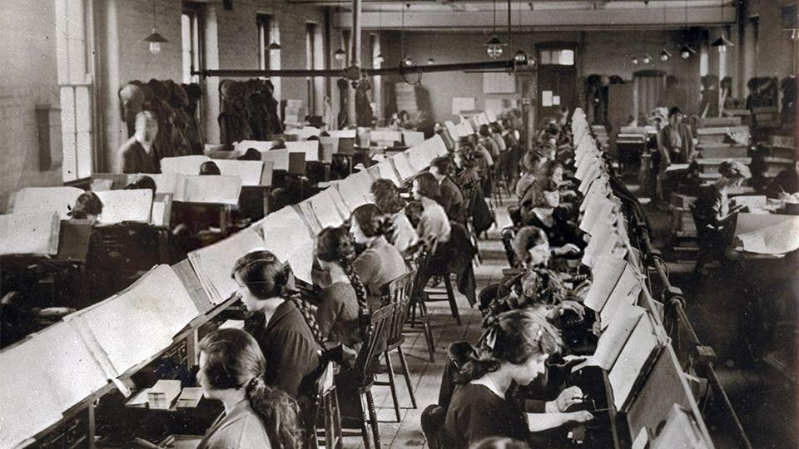
“…there is neither bond nor free…”
Indentured Servitude:
- Diversity In Discipleship -

Slide 8
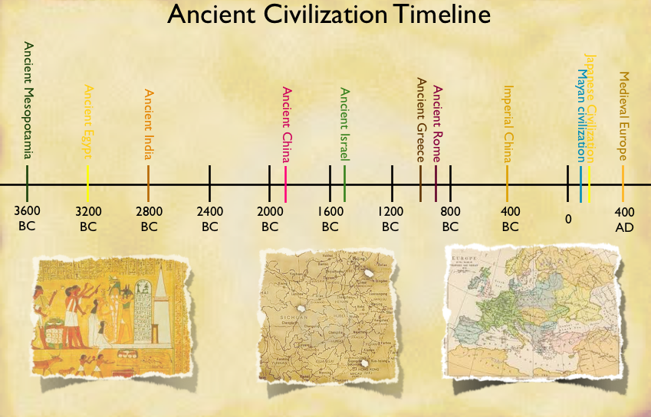
“…there is neither bond nor free…”
- Diversity In Discipleship -

Slide 9
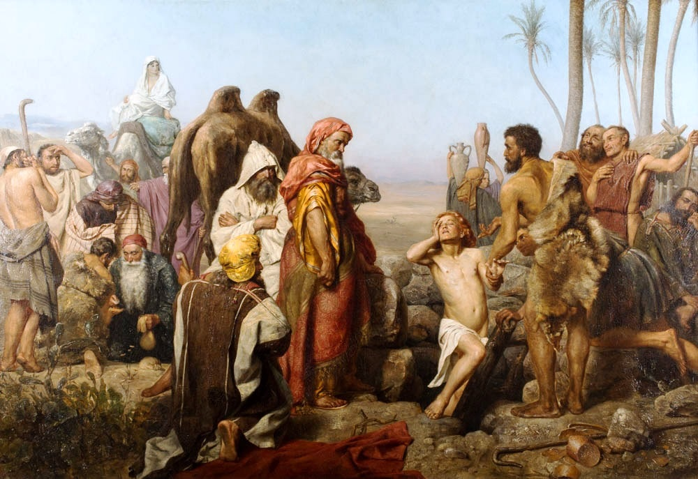
“…there is neither bond nor free…”
^{Genesis 37}
²⁶ And Judah said unto his brethren, What profit is it if we slay our brother, and conceal his blood?
²⁷ Come, and let us sell him to the Ishmeelites, and let not our hand be upon him; for he is our brother and our flesh. And his brethren were content.
²⁸ Then there passed by Midianites merchantmen; and they drew and lifted up Joseph out of the pit, and sold Joseph to the Ishmeelites for twenty pieces of silver: and they brought Joseph into Egypt.
- Diversity In Discipleship -

Slide 10
“…there is neither bond nor free…”
^{Genesis 37}
²⁶ And Judah said unto his brethren, What profit is it if we slay our brother, and conceal his blood?
²⁷ Come, and let us sell him to the Ishmeelites, and let not our hand be upon him; for he is our brother and our flesh. And his brethren were content.
²⁸ Then there passed by Midianites merchantmen; and they drew and lifted up Joseph out of the pit, and sold Joseph to the Ishmeelites for twenty pieces of silver: and they brought Joseph into Egypt.
- Diversity In Discipleship -

Slide 11
“…there is neither bond nor free…”
^{Genesis 37}
²⁶ And Judah said unto his brethren, What profit is it if we slay our brother, and conceal his blood?
²⁷ Come, and let us sell him to the Ishmeelites, and let not our hand be upon him; for he is our brother and our flesh. And his brethren were content.
²⁸ Then there passed by Midianites merchantmen; and they drew and lifted up Joseph out of the pit, and sold Joseph to the Ishmeelites for twenty pieces of silver: and they brought Joseph into Egypt.
- Diversity In Discipleship -

Slide 12
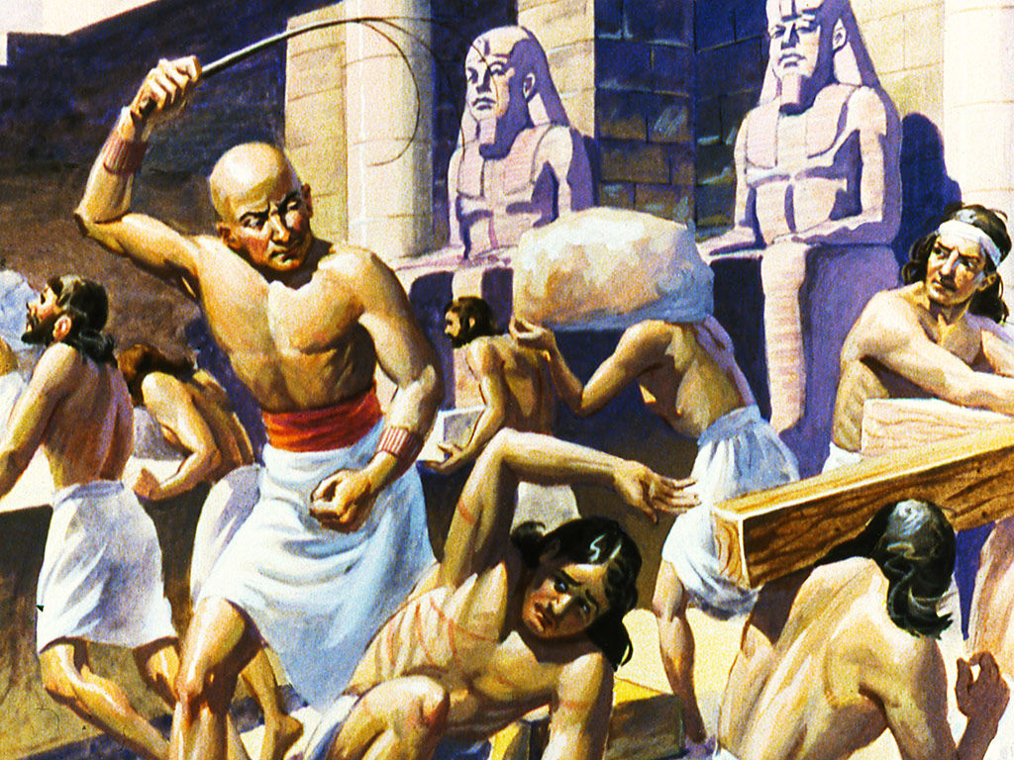
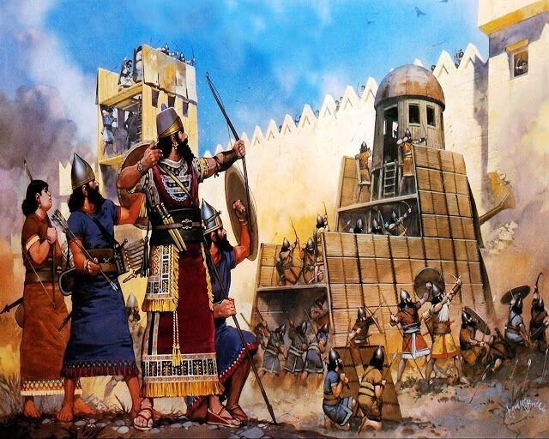
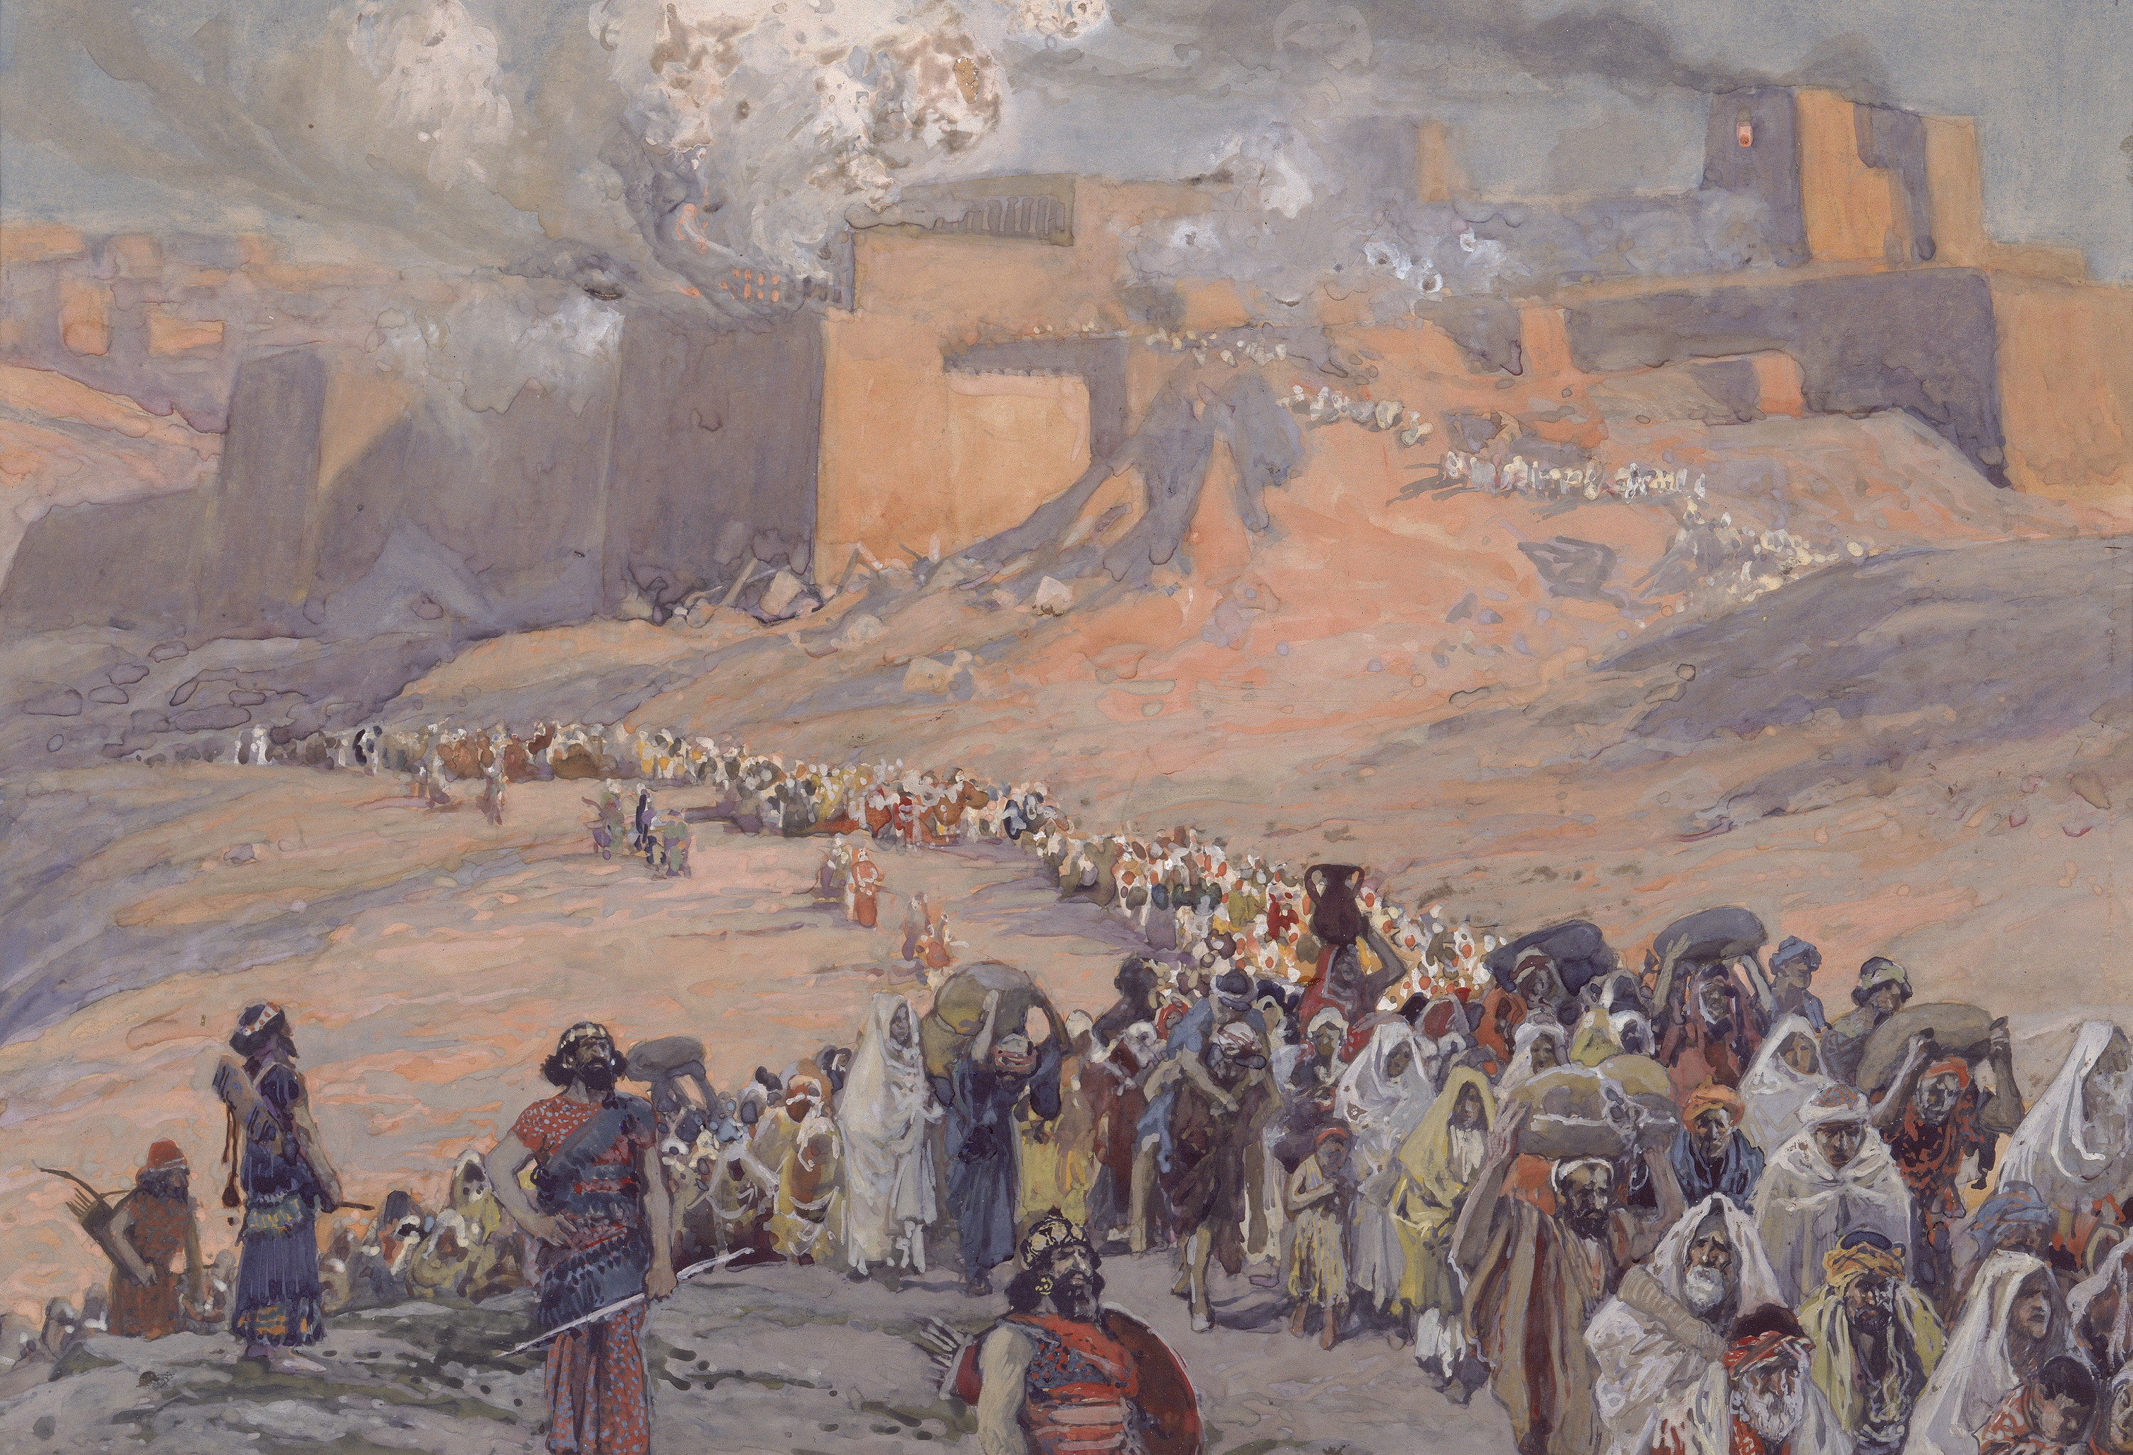
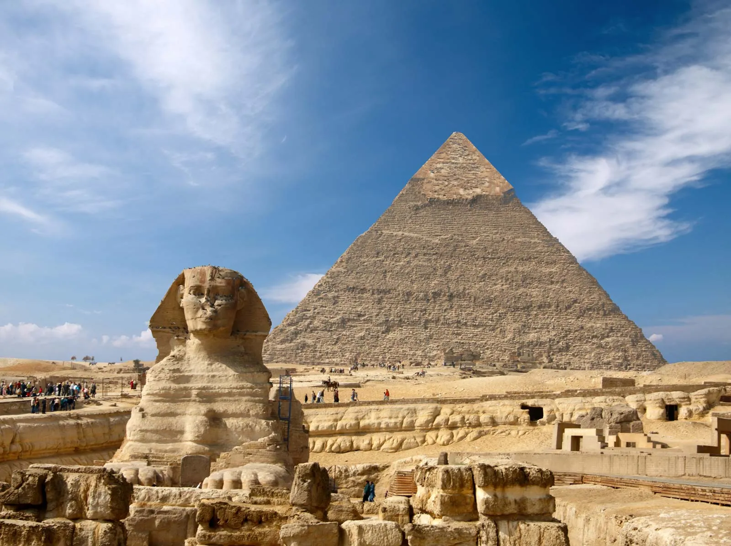
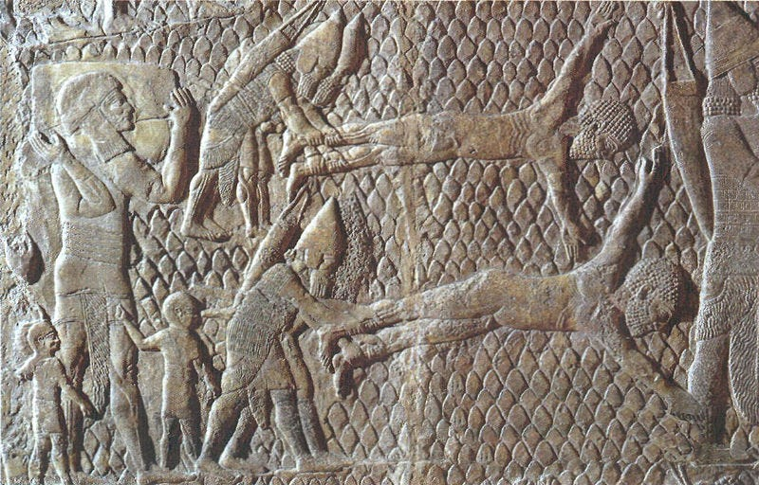

“…there is neither bond nor free…”
Egyptians
Assyrians
Babylonians
- Diversity In Discipleship -

Slide 13
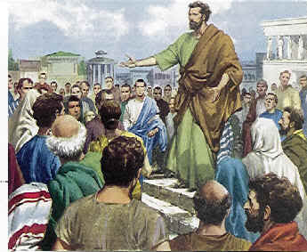
“…there is neither bond nor free…”
^{Acts 20}
⁴ And there accompanied him into Asia Sopater of Berea; and of the Thessalonians, Aristarchus and Secundus; and Gaius of Derbe, and Timotheus; and of Asia, Tychicus and Trophimus.
Second or Slave #2
- Diversity In Discipleship -

Slide 14
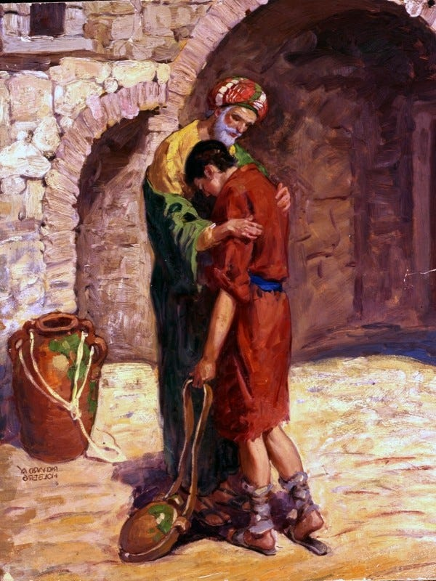
“…there is neither bond nor free…”
^{Philemon (NIV)}
¹⁵ Perhaps the reason he was separated from you for a little while was that you might have him back forever— ¹⁶ no longer as a slave, but better than a slave, as a dear brother. He is very dear to me but even dearer to you, both as a fellow man and as a brother in the Lord.
- Diversity In Discipleship -

Slide 15

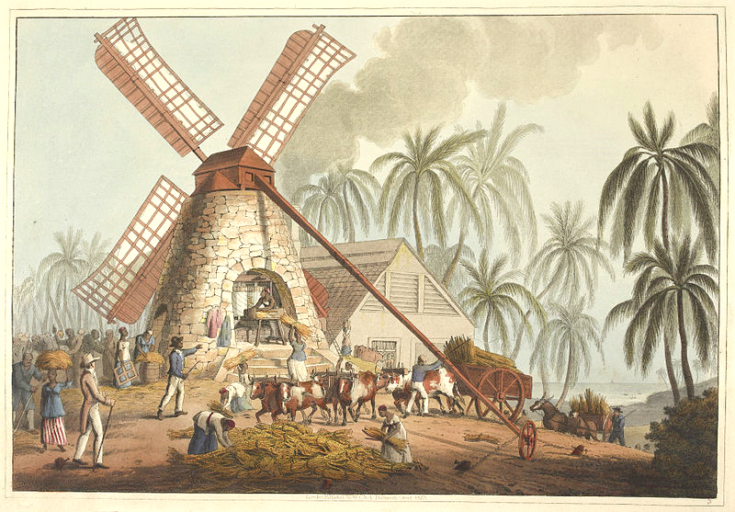
“…there is neither bond nor free…”
- Diversity In Discipleship -

Slide 16
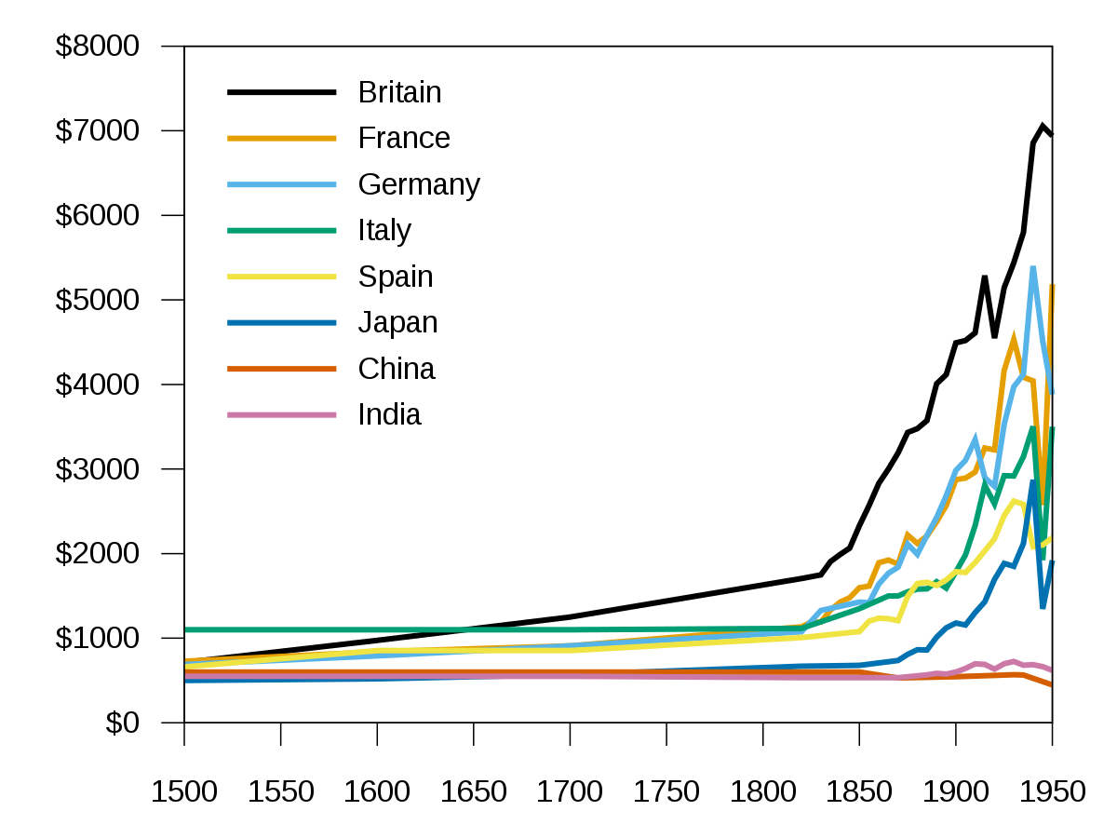
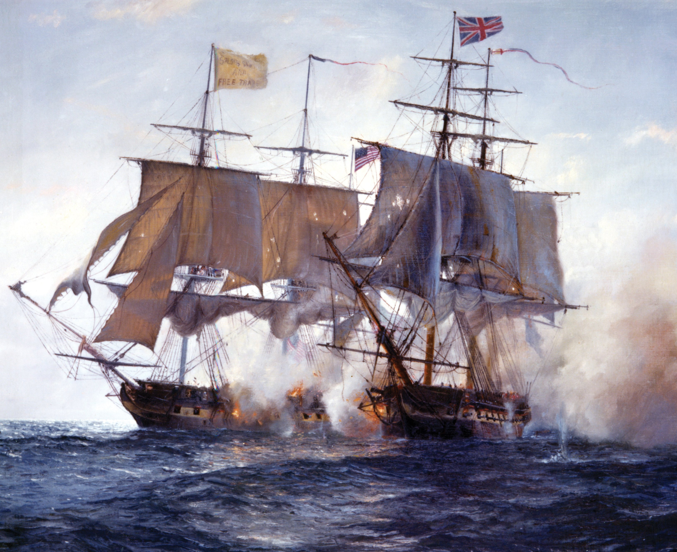
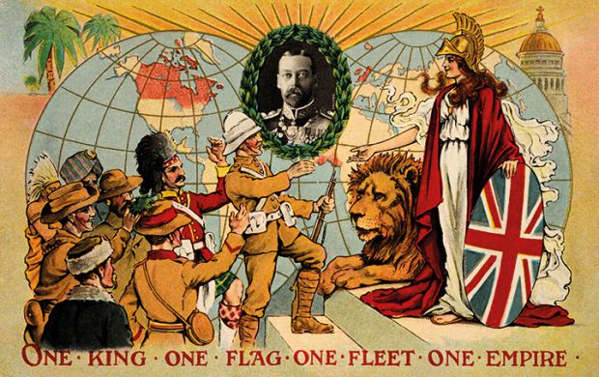
“…there is neither bond nor free…”
- Diversity In Discipleship -

Slide 17
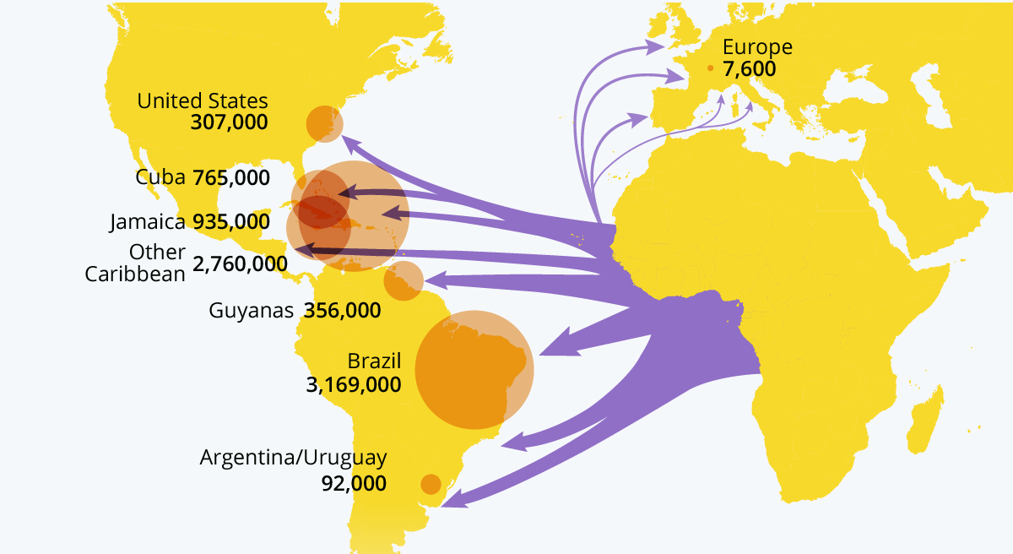
“…there is neither bond nor free…”
Number of enslaved Africans shipped across the Atlantic between 1514 - 1866
8.4M
- Diversity In Discipleship -

Slide 18
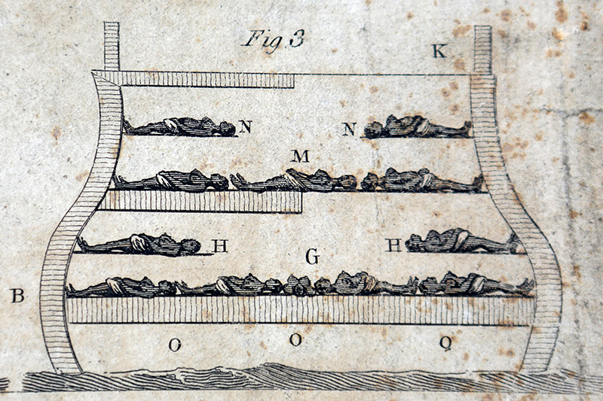
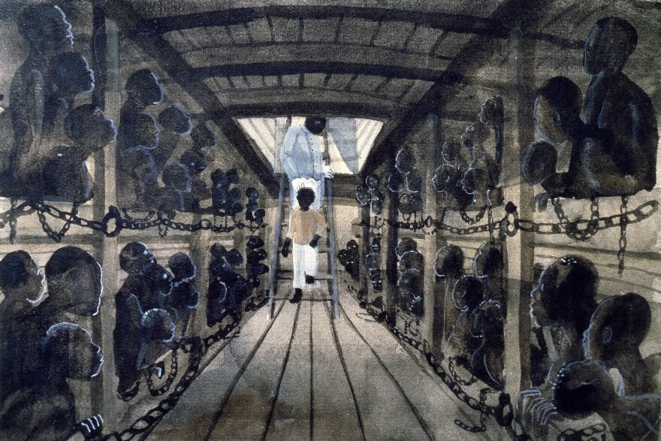
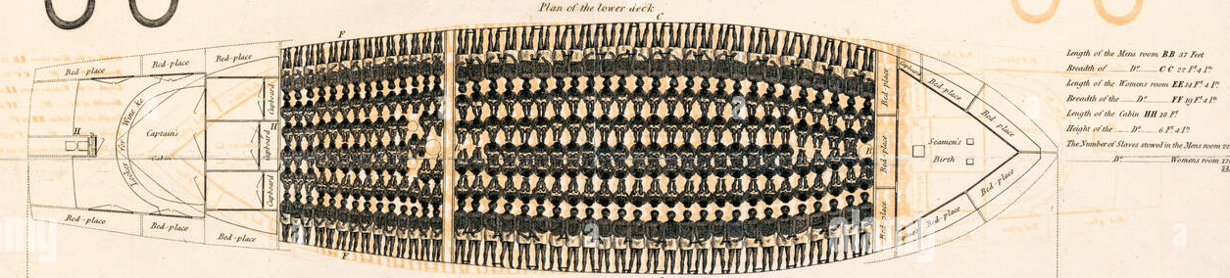
“…there is neither bond nor free…”
- Diversity In Discipleship -

Slide 19






“…there is neither bond nor free…”
- Diversity In Discipleship -

Slide 20
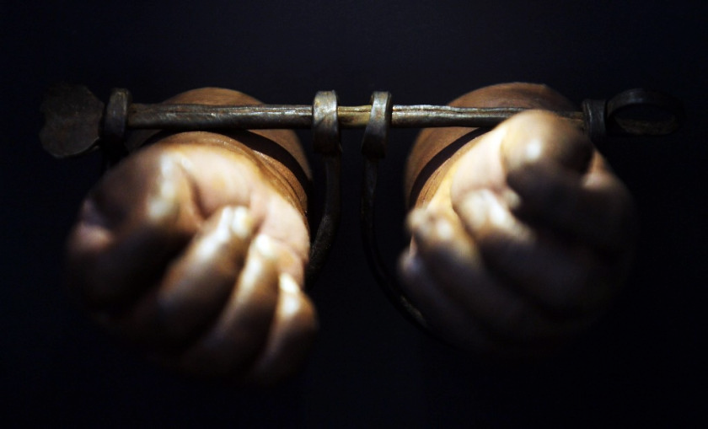
“…there is neither bond nor free…”
Why doesn’t God condemn slavery in the Bible?
- Diversity In Discipleship -

Slide 21
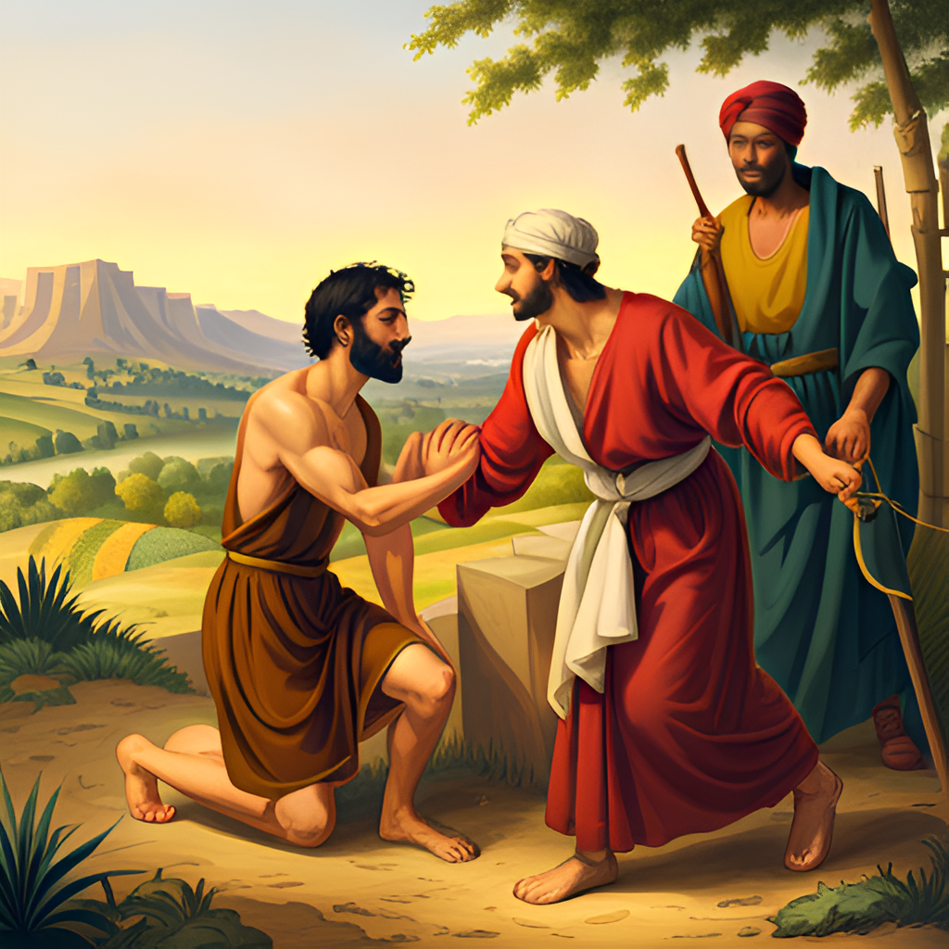
“…there is neither bond nor free…”
Exodus 21
Now these are the judgments which thou shalt set before them.
² If thou buy an Hebrew servant, six years he shall serve: and in the seventh he shall go out free for nothing.
³ If he came in by himself, he shall go out by himself: if he were married, then his wife shall go out with him.
⁴ If his master have given him a wife, and she have born him sons or daughters; the wife and her children shall be her master's, and he shall go out by himself.
- Diversity In Discipleship -

Slide 22
“…there is neither bond nor free…”
^{Leviticus 25}
⁸ I am the Lord your God, which brought you forth out of the land of Egypt, to give you the land of Canaan, and to be your God.
³⁹ And if thy brother that dwelleth by thee be waxen poor, and be sold unto thee; thou shalt not compel him to serve as a bondservant:
⁴⁰ But as an hired servant, and as a sojourner, he shall be with thee, and shall serve thee unto the year of jubile.
⁴¹ And then shall he depart from thee, both he and his children with him, and shall return unto his own family, and unto the possession of his fathers shall he return.
⁴² For they are my servants, which I brought forth out of the land of Egypt: they shall not be sold as bondmen.
⁴³ Thou shalt not rule over him with rigour; but shalt fear thy God.
- Diversity In Discipleship -

Slide 23
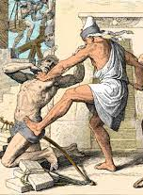
“…there is neither bond nor free…”
^{Leviticus 25}
⁸ I am the Lord your God, which brought you forth out of the land of Egypt, to give you the land of Canaan, and to be your God.
³⁹ And if thy brother that dwelleth by thee be waxen poor, and be sold unto thee; thou shalt not compel him to serve as a bondservant:
⁴⁰ But as an hired servant, and as a sojourner, he shall be with thee, and shall serve thee unto the year of jubile.
⁴¹ And then shall he depart from thee, both he and his children with him, and shall return unto his own family, and unto the possession of his fathers shall he return.
⁴² For they are my servants, which I brought forth out of the land of Egypt: they shall not be sold as bondmen.
⁴³ Thou shalt not rule over him with rigour; but shalt fear thy God.
- Diversity In Discipleship -

Slide 24
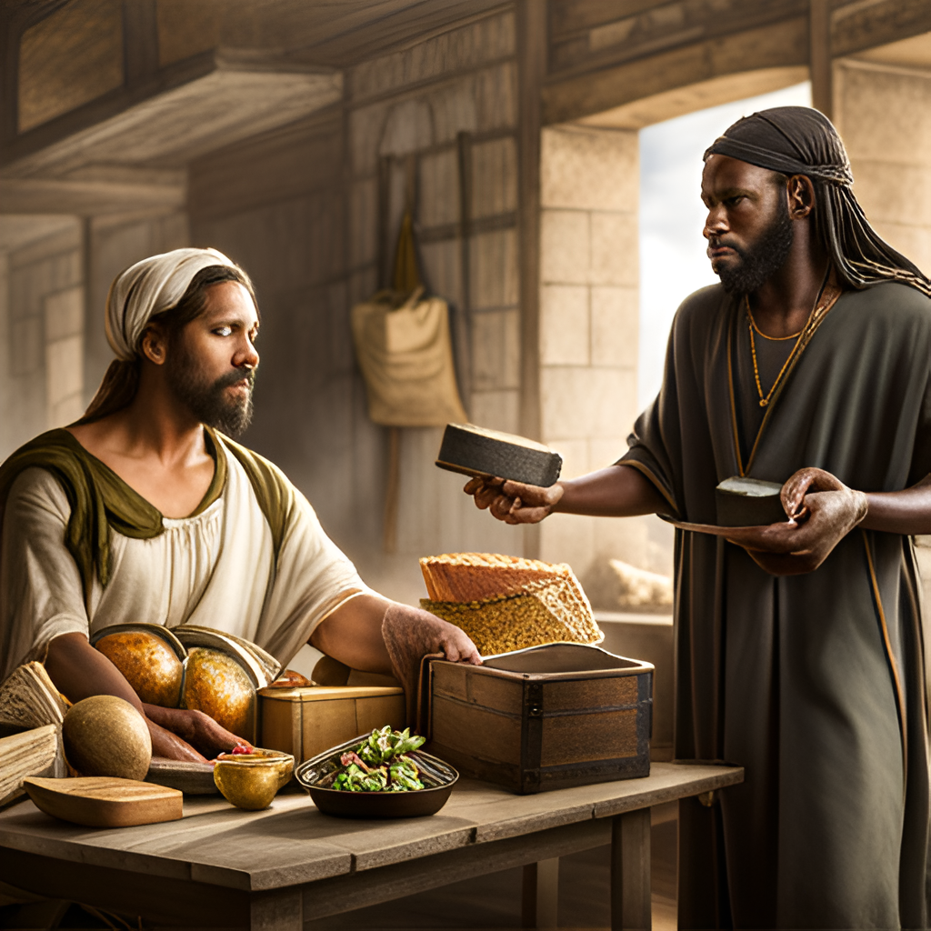
“…there is neither bond nor free…”
^{Deuteronomy 15}
¹² And if thy brother, an Hebrew man, or an Hebrew woman, be sold unto thee, and serve thee six years; then in the seventh year thou shalt let him go free from thee.
¹³ And when thou sendest him out free from thee, thou shalt not let him go away empty:
¹⁴ Thou shalt furnish him liberally out of thy flock, and out of thy floor, and out of thy winepress: of that wherewith the Lord thy God hath blessed thee thou shalt give unto him.
- Diversity In Discipleship -

Slide 25
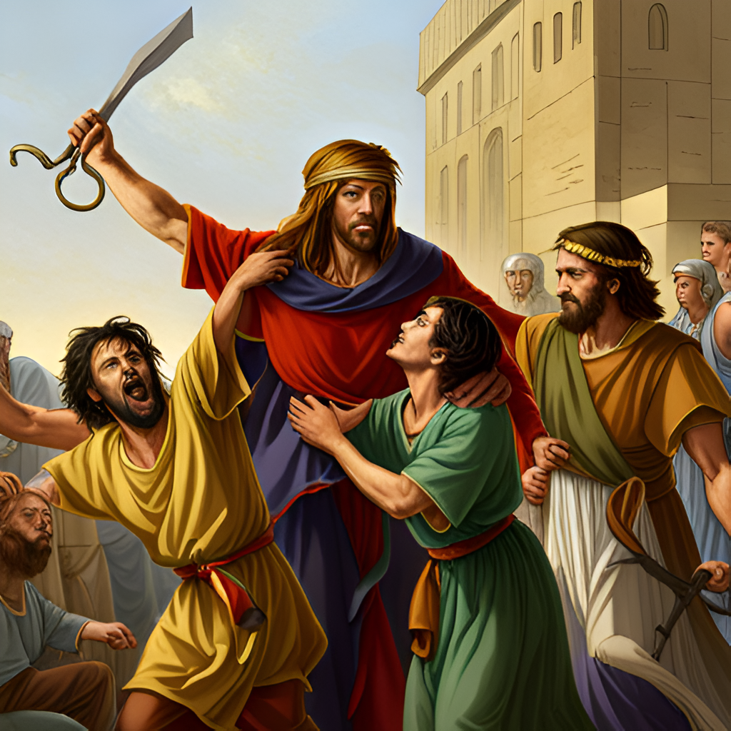
“…there is neither bond nor free…”
^{Exodus 21}
¹⁶ And he that stealeth a man, and selleth him, or if he be found in his hand, he shall surely be put to death.
^{Deuteronomy 24}
⁷ If a man be found stealing any of his brethren of the children of Israel, and maketh merchandise of him, or selleth him; then that thief shall die; and thou shalt put evil away from among you.
- Diversity In Discipleship -

Slide 26
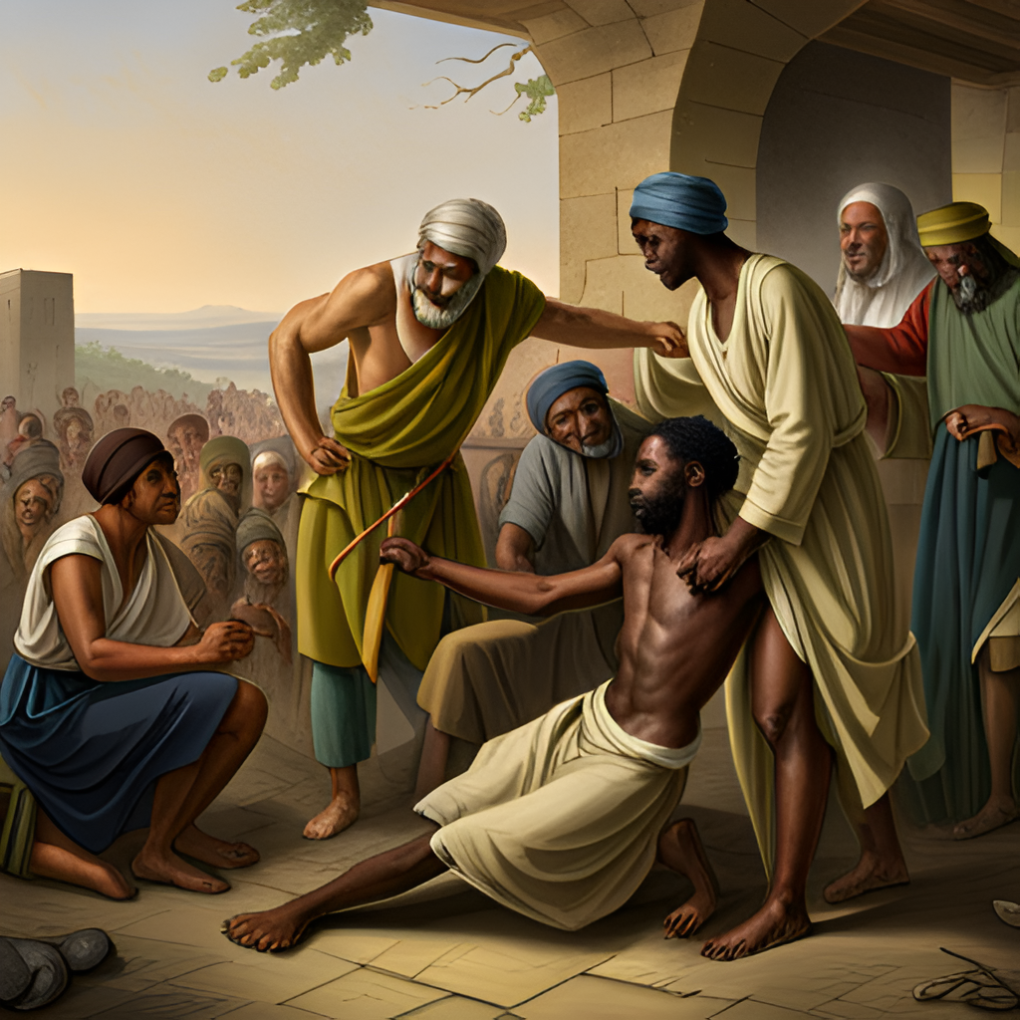
“…there is neither bond nor free…”
^{Exodus 21}
²⁶ And if a man smite the eye of his servant, or the eye of his maid, that it perish; he shall let him go free for his eye's sake.
²⁷ And if he smite out his manservant's tooth, or his maidservant's tooth; he shall let him go free for his tooth's sake.
- Diversity In Discipleship -

Slide 27
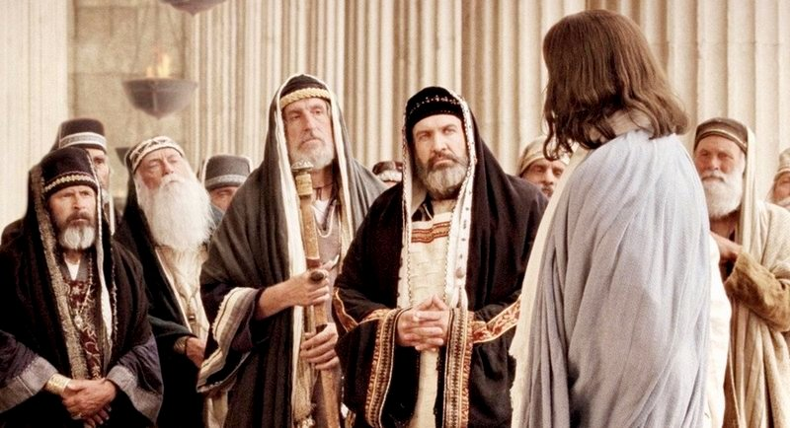
“…there is neither bond nor free…”
So…God accepts Slavery then…?
- Diversity In Discipleship -

Slide 28
“…there is neither bond nor free…”
Regulation does not mean approval!
^{Matthew 19}
³ The Pharisees also came unto him, tempting him, and saying unto him, Is it lawful for a man to put away his wife for every cause?
⁴ And he answered and said unto them, Have ye not read, that he which made them at the beginning made them male and female,
⁵ And said, For this cause shall a man leave father and mother, and shall cleave to his wife: and they twain shall be one flesh?
⁶ Wherefore they are no more twain, but one flesh. What therefore God hath joined together, let not man put asunder.
- Diversity In Discipleship -

Slide 29
“…there is neither bond nor free…”
Regulation does not mean approval!
^{Matthew 19}
⁷ They say unto him, Why did Moses then command to give a writing of divorcement, and to put her away?
⁸ He saith unto them, Moses because of the hardness of your hearts suffered you to put away your wives: but from the beginning it was not so.
- Diversity In Discipleship -

Slide 30
“…there is neither bond nor free…”
^{Leviticus 25}
⁴⁴ Both thy bondmen, and thy bondmaids, which thou shalt have, shall be of the heathen that are round about you; of them shall ye buy bondmen and bondmaids.
⁴⁵ Moreover of the children of the strangers that do sojourn among you, of them shall ye buy, and of their families that are with you, which they begat in your land: and they shall be your possession.
⁴⁶ And ye shall take them as an inheritance for your children after you, to inherit them for a possession; they shall be your bondmen for ever: but over your brethren the children of Israel, ye shall not rule one over another with rigour.
Galations 4 v 24
“Which things are an allegory:”
- Diversity In Discipleship -

Slide 31
“…there is neither bond nor free…”
( If we’re being honest here…we’re all slaves to something!)
- Diversity In Discipleship -

Slide 32
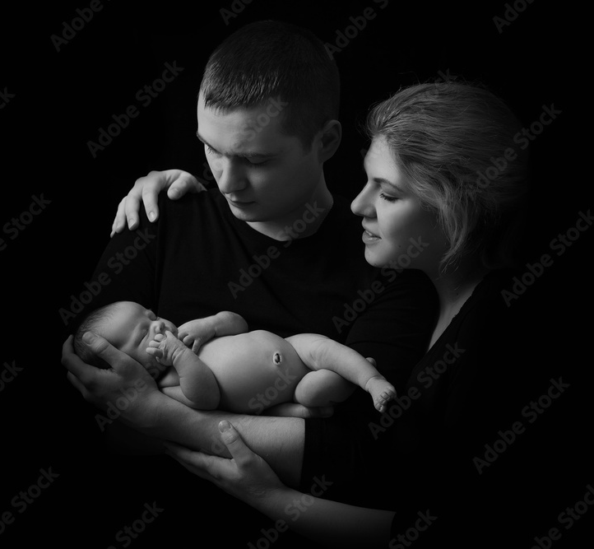
“…there is neither bond nor free…”
Work
Hobbies & Interests
Relative
Property
Ecclesia
- Diversity In Discipleship -

Slide 33
“…there is neither bond nor free…”
Servant or Slave?
- Diversity In Discipleship -

Slide 34
“…there is neither bond nor free…”
G1401
δοῦλος
doulos
doo'-los
From G1210; a slave (literally or figuratively, involuntarily or voluntarily; frequently therefore in a qualified sense of subjection or subserviency): - bond (-man), servant.
Total KJV occurrences: 125
- Diversity In Discipleship -

Slide 35
“…there is neither bond nor free…”
Matthew 13 – Parable of the Wheat & Tares…
Matthew 18 – Parable of the unforgiving servant…
Matthew 21 / Mark 12 / Luke 20 – Parable of the wicked husbandmen…
Matthew 22 – Parable of the Wedding feast…
Matthew 24 – “Who is that wise and faithful servant?”
Matthew 25 / Luke 19 – Parable of the talents…
Mark 10 – “Whosoever will be chief will be servant of all”
Mark 13 – House owner - Servants & Porter of the household to watch
Luke 12 – Parable of the goodman of the house…
Luke 14 – Parable of the great supper…
Luke 15 – Parable of the prodigal son…
Luke 17 – Parable of the master & servant…
John 8 – “whosoever committeth sin is the servant of sin”
John 13 – “The servant is not greater than his Lord”
John 15 – “Henceforth, I call you not servants…but friends”
59 Times
- Diversity In Discipleship -

Slide 36
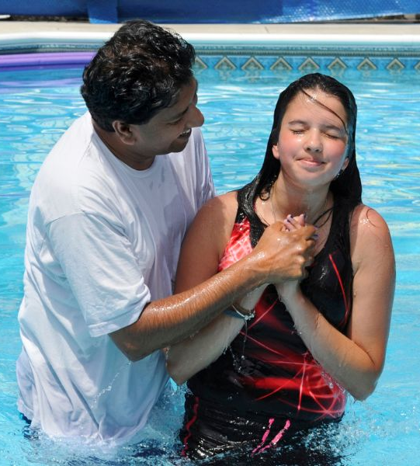
“…there is neither bond nor free…”
^{Romans 6}
⁴ Therefore we are buried with him by baptism into death: that like as Christ was raised up from the dead by the glory of the Father, even so we also should walk in newness of life.
⁵ For if we have been planted together in the likeness of his death, we shall be also in the likeness of his resurrection:
⁶ Knowing this, that our old man is crucified with him, that the body of sin might be destroyed, that henceforth we should not serve sin.
⁷ For he that is dead is freed from sin.
- Diversity In Discipleship -

Slide 37
“…there is neither bond nor free…”
^{Romans 6}
⁴ Therefore we are buried with him by baptism into death: that like as Christ was raised up from the dead by the glory of the Father, even so we also should walk in newness of life.
⁵ For if we have been planted together in the likeness of his death, we shall be also in the likeness of his resurrection:
⁶ Knowing this, that our old man is crucified with him, that the body of sin might be destroyed, that henceforth we should not serve sin.
⁷ For he that is dead is freed from sin.
- Diversity In Discipleship -

Slide 38
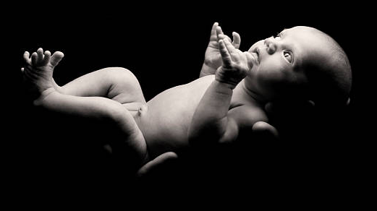
“…there is neither bond nor free…”
- Diversity In Discipleship -

Slide 39
“…there is neither bond nor free…”
G1401
δοῦλος
doulos
doo'-los
From G1210; a slave (literally or figuratively, involuntarily or voluntarily; frequently therefore in a qualified sense of subjection or subserviency): - bond (-man), servant.
Total KJV occurrences: 125
SLAVE
SERVANT
- Diversity In Discipleship -

Slide 40
“…there is neither bond nor free…”
^{Romans 6 KJV}
¹⁷ But God be thanked, that ye were the servants of sin, but ye have obeyed from the heart that form of doctrine which was delivered you.
¹⁸ Being then made free from sin, ye became the servants of righteousness.
^{Romans 6 (NIV)}
¹⁷ But thanks be to God that, though you used to be slaves to sin, you have come to obey from your heart the pattern of teaching that has now claimed your allegiance. ¹⁸ You have been set free from sin and have become slaves to righteousness.
- Diversity In Discipleship -

Slide 41

“…there is neither bond nor free…”
- Diversity In Discipleship -

Slide 42
“…there is neither bond nor free…”
13th Amendment
Passed by US Congress January 31st 1865
(Ratified on December 6th 1865)
- Diversity In Discipleship -

Slide 43
“…there is neither bond nor free…”
Romans 8
2 For the law of the Spirit of life in Christ Jesus hath made me free from the law of sin and death.
Galatians 5
1 Stand fast therefore in the liberty wherewith Christ hath made us free, and be not entangled again with the yoke of bondage.
- Diversity In Discipleship -

Slide 44
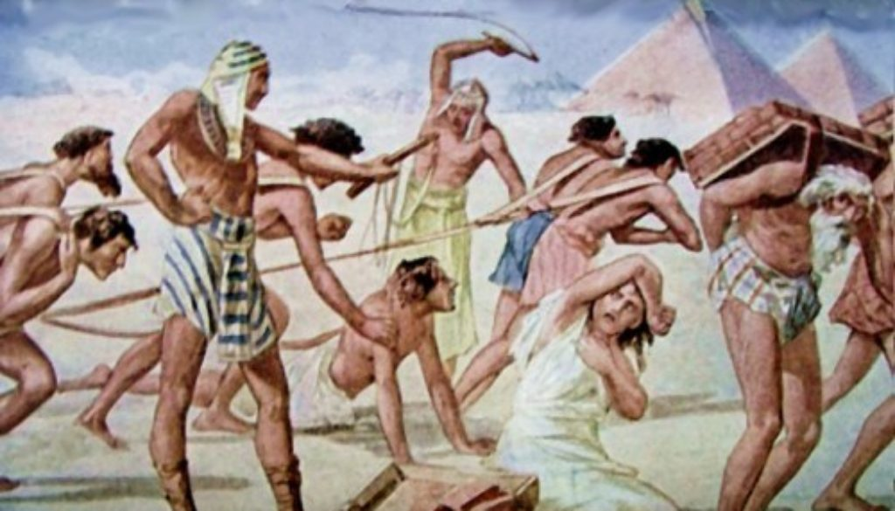
“…there is neither bond nor free…”
^{Deuteronomy 15}
¹⁵ And thou shalt remember that thou wast a bondman in the land of Egypt, and the Lord thy God redeemed thee:
- Diversity In Discipleship -

