Slide 1

“There is neither male nor female…”
(But there is male and female!)
- Diversity In Discipleship -

Slide 2

“There is neither male nor female…”
- Diversity In Discipleship -

Slide 3
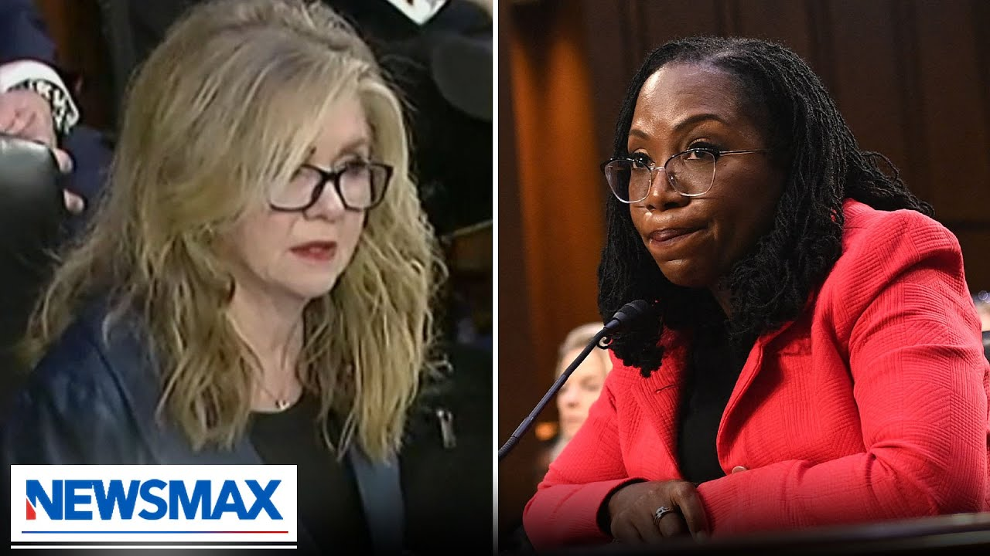
“There is neither male nor female…”
Senator Marsha Blackburn asked Supreme Court Nominee Judge Ketanji Brown, “can you define the word, Woman?
“No I can’t” answered Judge Ketanji Brown….
- Diversity In Discipleship -

Slide 4
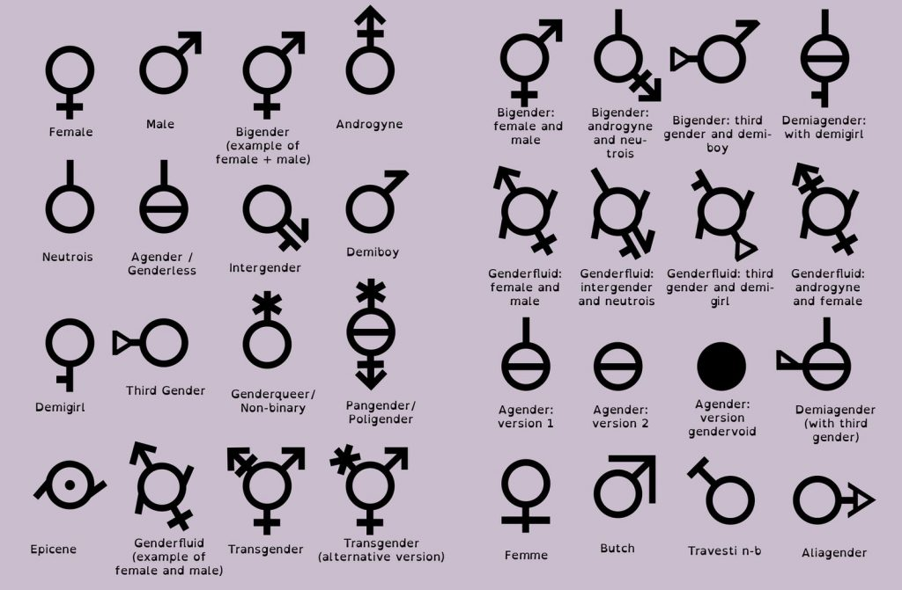
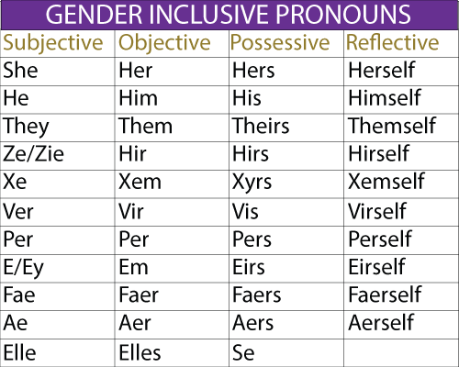
“There is neither male nor female…”
- Diversity In Discipleship -

Slide 5
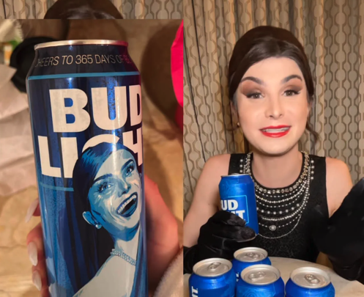
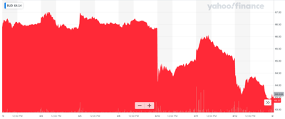
“There is neither male nor female…”
$6 Billion USD
- Diversity In Discipleship -

Slide 6
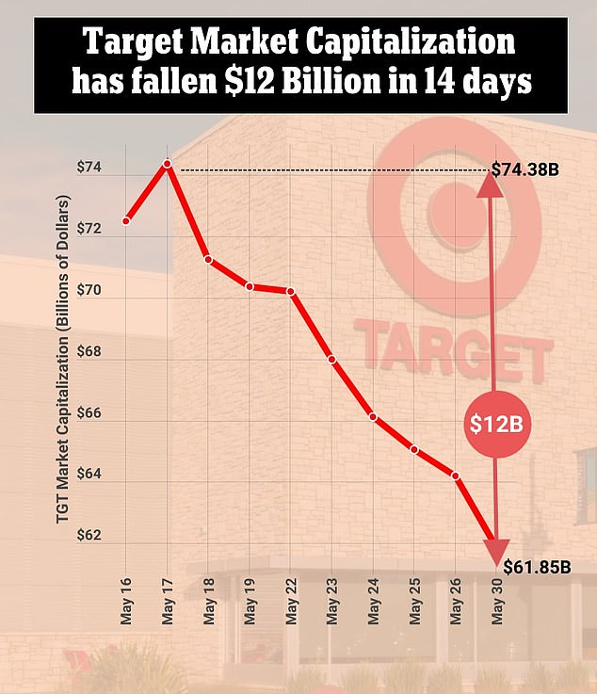
“There is neither male nor female…”
- Diversity In Discipleship -

Slide 7
“There is neither male nor female…”
^{Genesis 1}
²⁷ So God created man in his own image, in the image of God created he him; male and female created he them.
Male & Female
In General
Male & Female
In The Ecclesial Family
Male & Female
In Worship Together
- Diversity In Discipleship -

Slide 8
“There is neither male nor female…”
Titus 2
But speak thou the things which become sound doctrine:
- Diversity In Discipleship -

Slide 9
“There is neither male nor female…”
1
Male & Female In General…
- Diversity In Discipleship -

Slide 10
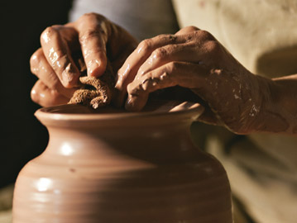
“There is neither male nor female…”
^{Genesis 2}
⁷ And the Lord God formed man of the dust of the ground, and breathed into his nostrils the breath of life; and man became a living soul.
⁸ And the Lord God planted a garden eastward in Eden; and there he put the man whom he had formed.
H3335
יָצַר
yâtsar
yaw-tsar'
probably identical with H3334 (through the squeezing into shape); (compare H3331); to mould into a form; especially as a potter; figuratively to determine (that is, form a resolution): - X earthen, fashion, form, frame, make (-r), potter, purpose.
- Diversity In Discipleship -

Slide 11

“There is neither male nor female…”
1
Creation of man…
2
Placed in the garden…
V15 “to dress it and to keep it…”
H5647
עָבַד
‛âbad
aw-bad'
A primitive root; to work (in any sense); by implication to serve, till, (causatively) enslave, etc., keep in bondage, be bondmen, bond-service, compel, do, dress, ear, execute, + husbandman, keep, labour (-ing man), bring to pass, (cause to, make to) serve (-ing, self), (be, become) servant (-s), do (use) service, till (-er), transgress [from margin], (set a) work, be wrought, worshipper.
H8104
שָׁמַר
shâmar
shaw-mar'
A primitive root; properly to hedge about (as with thorns), that is, guard; generally to protect, attend to, etc.: - beware, be circumspect, take heed (to self), keep (-er, self), mark, look narrowly, observe, preserve, regard, reserve, save (self), sure, (that lay) wait (for), watch (-man).
3
Given a Law / Commandment…
4
Divine statement of Adam’s situation…
- Diversity In Discipleship -

Slide 12
“There is neither male nor female…”
^{Genesis 2}
¹⁸ And the Lord God said, It is not good that the man should be alone; I will make him an help meet for him.
H5048
נֶגֶד
neged
neh'-ghed
From H5046; a front, that is, part opposite; specifically a counterpart, or mate; usually (adverbially, especially with preposition) over against or before: - about, (over) against, X aloof, X far (off), X from, over, presence, X other side, sight, X to view.
- Diversity In Discipleship -

Slide 13
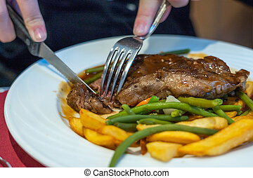
“There is neither male nor female…”
- Diversity In Discipleship -

Slide 14
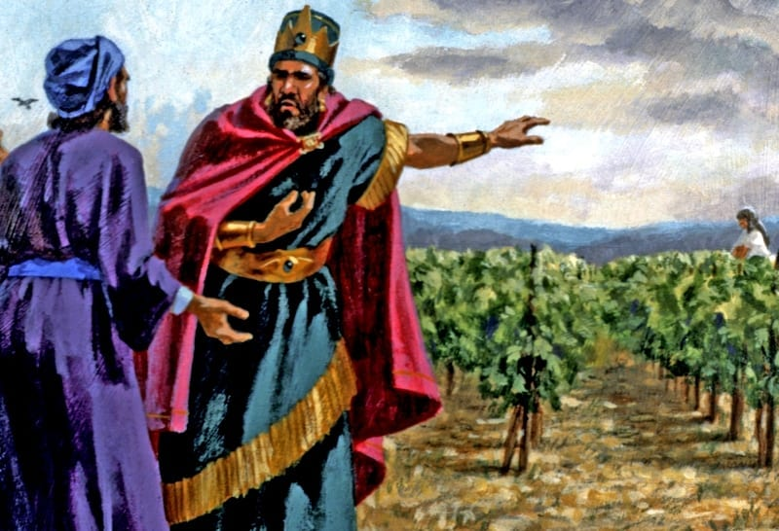
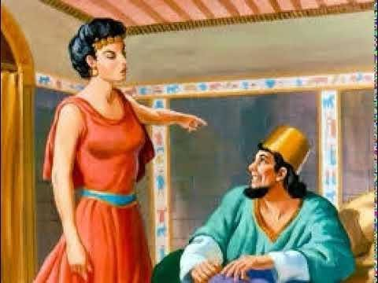
“There is neither male nor female…”
^{1 Kings 21}
²⁵ But there was none like unto Ahab, which did sell himself to work wickedness in the sight of the Lord, whom Jezebel his wife stirred up.
- Diversity In Discipleship -

Slide 15

“There is neither male nor female…”
- Diversity In Discipleship -

Slide 16
“There is neither male nor female…”
^{Genesis 2}
²² And the rib, which the Lord God had taken from man, made he a woman, and brought her unto the man.
²³ And Adam said, This is now bone of my bones, and flesh of my flesh: she shall be called Woman, because she was taken out of Man.
H1129
בָּנָה
bânâh
baw-naw'
A primitive root; to build (literally and figuratively): - (begin to) build (-er), obtain children, make, repair, set (up), X surely.
- Diversity In Discipleship -

Slide 17

“There is neither male nor female…”
Men:
Logical & react without empathy
Women:
Intuitive & react emotionally
- Diversity In Discipleship -

Slide 18
“There is neither male nor female…”
^{Genesis 3}
¹⁶ Unto the woman he said, I will greatly multiply thy sorrow and thy conception; in sorrow thou shalt bring forth children; and thy desire shall be to thy husband, and he shall rule over thee.
¹⁷ And unto Adam he said, Because thou hast hearkened unto the voice of thy wife, and hast eaten of the tree, of which I commanded thee, saying, Thou shalt not eat of it: cursed is the ground for thy sake; in sorrow shalt thou eat of it all the days of thy life;
- Diversity In Discipleship -

Slide 19
“There is neither male nor female…”
^{Genesis 3}
¹⁶ Unto the woman he said, I will greatly multiply thy sorrow and thy conception; in sorrow thou shalt bring forth children; and thy desire shall be to thy husband, and he shall rule over thee.
H6093
עִצָּבוֹן
‛itstsâbôn
its-tsaw-bone'
From H6087; worrisomeness, that is, labor or pain: - sorrow, toil.
¹⁷ And unto Adam he said, Because thou hast hearkened unto the voice of thy wife, and hast eaten of the tree, of which I commanded thee, saying, Thou shalt not eat of it: cursed is the ground for thy sake; in sorrow shalt thou eat of it all the days of thy life;
- Diversity In Discipleship -

Slide 20
“There is neither male nor female…”
2
Male & Female In The Ecclesial Family…
- Diversity In Discipleship -

Slide 21
“There is neither male nor female…”
^{Genesis 3}
¹⁷ And unto Adam he said, Because thou hast hearkened unto the voice of thy wife, and hast eaten of the tree…
^{Genesis 16}
¹ Now Sarai Abram's wife bare him no children: and she had an handmaid, an Egyptian, whose name was Hagar.
² And Sarai said unto Abram, Behold now, the LORD hath restrained me from bearing: I pray thee, go in unto my maid; it may be that I may obtain children by her. And Abram hearkened to the voice of Sarai.
- Diversity In Discipleship -

Slide 22
“There is neither male nor female…”
^{Genesis 21}
⁹ And Sarah saw the son of Hagar the Egyptian, which she had born unto Abraham, mocking.
¹⁰ Wherefore she said unto Abraham, Cast out this bondwoman and her son: for the son of this bondwoman shall not be heir with my son, even with Isaac.
¹¹ And the thing was very grievous in Abraham's sight because of his son.
¹² And God said unto Abraham, Let it not be grievous in thy sight because of the lad, and because of thy bondwoman; in all that Sarah hath said unto thee, hearken unto her voice; for in Isaac shall thy seed be called.
- Diversity In Discipleship -

Slide 23
“There is neither male nor female…”
^{1 Samuel 25}
³² And David said to Abigail, Blessed be the LORD God of Israel, which sent thee this day to meet me:
³³ And blessed be thy advice, and blessed be thou, which hast kept me this day from coming to shed blood, and from avenging myself with mine own hand.
H2940
טַעַם
ṭa‛am
tah'-am
From H2938; properly a taste, that is, (figuratively) perception; by implication intelligence; transitively a mandate: - advice, behaviour, decree, discretion, judgment, reason, taste, understanding.
- Diversity In Discipleship -

Slide 24
“There is neither male nor female…”
^{Proverbs 12}
⁴ A virtuous woman is a crown to her husband;
- Diversity In Discipleship -

Slide 25
“There is neither male nor female…”
3
Male & Female In Ecclesial Worship…
- Diversity In Discipleship -

Slide 26
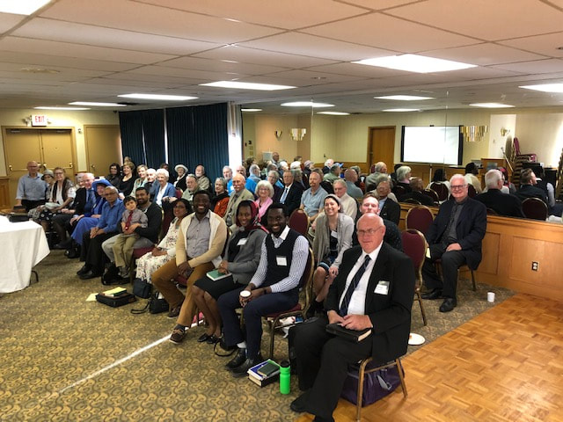
“There is neither male nor female…”
Our Worship As An Ecclesia
Formality in Worship
- Diversity In Discipleship -

Slide 27
“There is neither male nor female…”
1 Corinthians 11
² Now I praise you, brethren, that ye remember me in all things, and keep the ordinances, as I delivered them to you.
³ But I would have you know, that the head of every man is Christ; and the head of the woman is the man; and the head of Christ is God.
G3860
παραδίδωμι
paradidōmi
par-ad-id'-o-mee
From G3844 and G1325; to surrender, that is, yield up, intrust, transmit: - betray, bring forth, cast, commit, deliver (up), give (over, up), hazard, put in prison, recommend.
Total KJV occurrences: 121
- Diversity In Discipleship -

Slide 28
“There is neither male nor female…”
Ephesians 5
¹ Be ye therefore followers of God, as dear children;
² And walk in love, as Christ also hath loved us, and hath given himself for us an offering and a sacrifice to God for a sweetsmelling savour.
- Diversity In Discipleship -

Slide 29
“There is neither male nor female…”
1 Corinthians 11
² Now I praise you, brethren, that ye remember me in all things, and keep the ordinances, as I delivered them to you.
³ But I would have you know, that the head of every man is Christ; and the head of the woman is the man; and the head of Christ is God.
God
Christ
Christ
Man
Man
Woman
- Diversity In Discipleship -

Slide 30
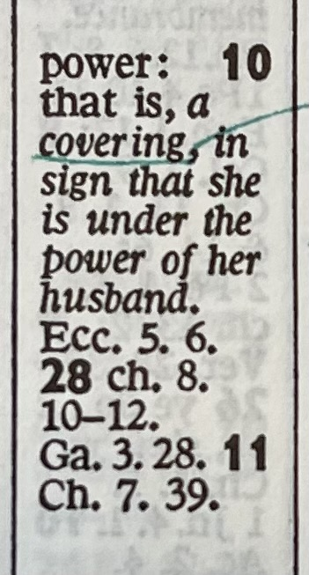
“There is neither male nor female…”
1 Corinthians 11
⁴ Every man praying or prophesying, having his head covered, dishonoureth his head.
⁵ But every woman that prayeth or prophesieth with her head uncovered dishonoureth her head:
God
Christ
Christ
Man
Man
Woman
- Diversity In Discipleship -

Slide 31
“There is neither male nor female…”
1 Corinthians 1v29
That no flesh should glory in his presence.
1 Corinthians 11
¹⁵ But if a woman have long hair, it is a glory to her: for her hair is given her for a covering.
¹⁶ But if any man seem to be contentious, we have no such custom, neither the churches of God.
G2619
κατακαλύπτω
katakaluptō
kat-ak-al-oop'-to
From G2596 and G2572; to cover wholly, that is, veil: - cover, hide.
G4018
περιβόλαιον
peribolaion
per-ib-ol'-ah-yon
Neuter of a presumed derivative of G4016; something thrown around one, that is, a mantle, veil: - covering, vesture.
- Diversity In Discipleship -

Slide 32

“There is neither male nor female…”
^{Genesis 3}
⁶ And when the woman saw that the tree was good for food, and that it was pleasant to the eyes, and a tree to be desired to make one wise, she took of the fruit thereof, and did eat, and gave also unto her husband with her; and he did eat.
^{1 Timothy 2}
¹⁴ And Adam was not deceived, but the woman being deceived was in the transgression.
- Diversity In Discipleship -

Slide 33
“There is neither male nor female…”
1 Timothy 2
⁸ I will therefore that men pray every where, lifting up holy hands, without wrath and doubting.
G435
ἀνήρ
anēr
an'-ayr
A primary word (compare G444); a man (properly as an individual male): - fellow, husband, man, sir.
- Diversity In Discipleship -

Slide 34
“There is neither male nor female…”
1 Timothy 2
¹¹ Let the woman learn in silence with all subjection.
¹² But I suffer not a woman to teach, nor to usurp authority over the man, but to be in silence.
¹³ For Adam was first formed, then Eve.
¹⁴ And Adam was not deceived, but the woman being deceived was in the transgression.
^{1 Corinthians 14}
³³ For God is not the author of confusion, but of peace, as in all churches of the saints.
³⁴ Let your women keep silence in the churches: for it is not permitted unto them to speak; but they are commanded to be under obedience, as also saith the law.
- Diversity In Discipleship -

Slide 35
“There is neither male nor female…”
Titus 2
² That the aged men be sober, grave, temperate, sound in faith, in charity, in patience.
³ The aged women likewise, that they be in behaviour as becometh holiness, not false accusers, not given to much wine, teachers of good things;
⁴ That they may teach the young women to be sober, to love their husbands, to love their children,
⁵ To be discreet, chaste, keepers at home, good, obedient to their own husbands, that the word of God be not blasphemed.
- Diversity In Discipleship -

Slide 36
“There is neither male nor female…”
1 Timothy 1
Paul, an apostle of Jesus Christ by the commandment of God our Saviour, and Lord Jesus Christ, which is our hope;
1 Corinthians
Paul called to be an apostle of Jesus Christ through the will of God, and Sosthenes our brother,
Galatians 1
Paul, an apostle, (not of men, neither by man, but by Jesus Christ, and God the Father, who raised him from the dead;)
- Diversity In Discipleship -

