Slide 1

“For ye are all one in Christ Jesus”
- Diversity In Discipleship -

Slide 2
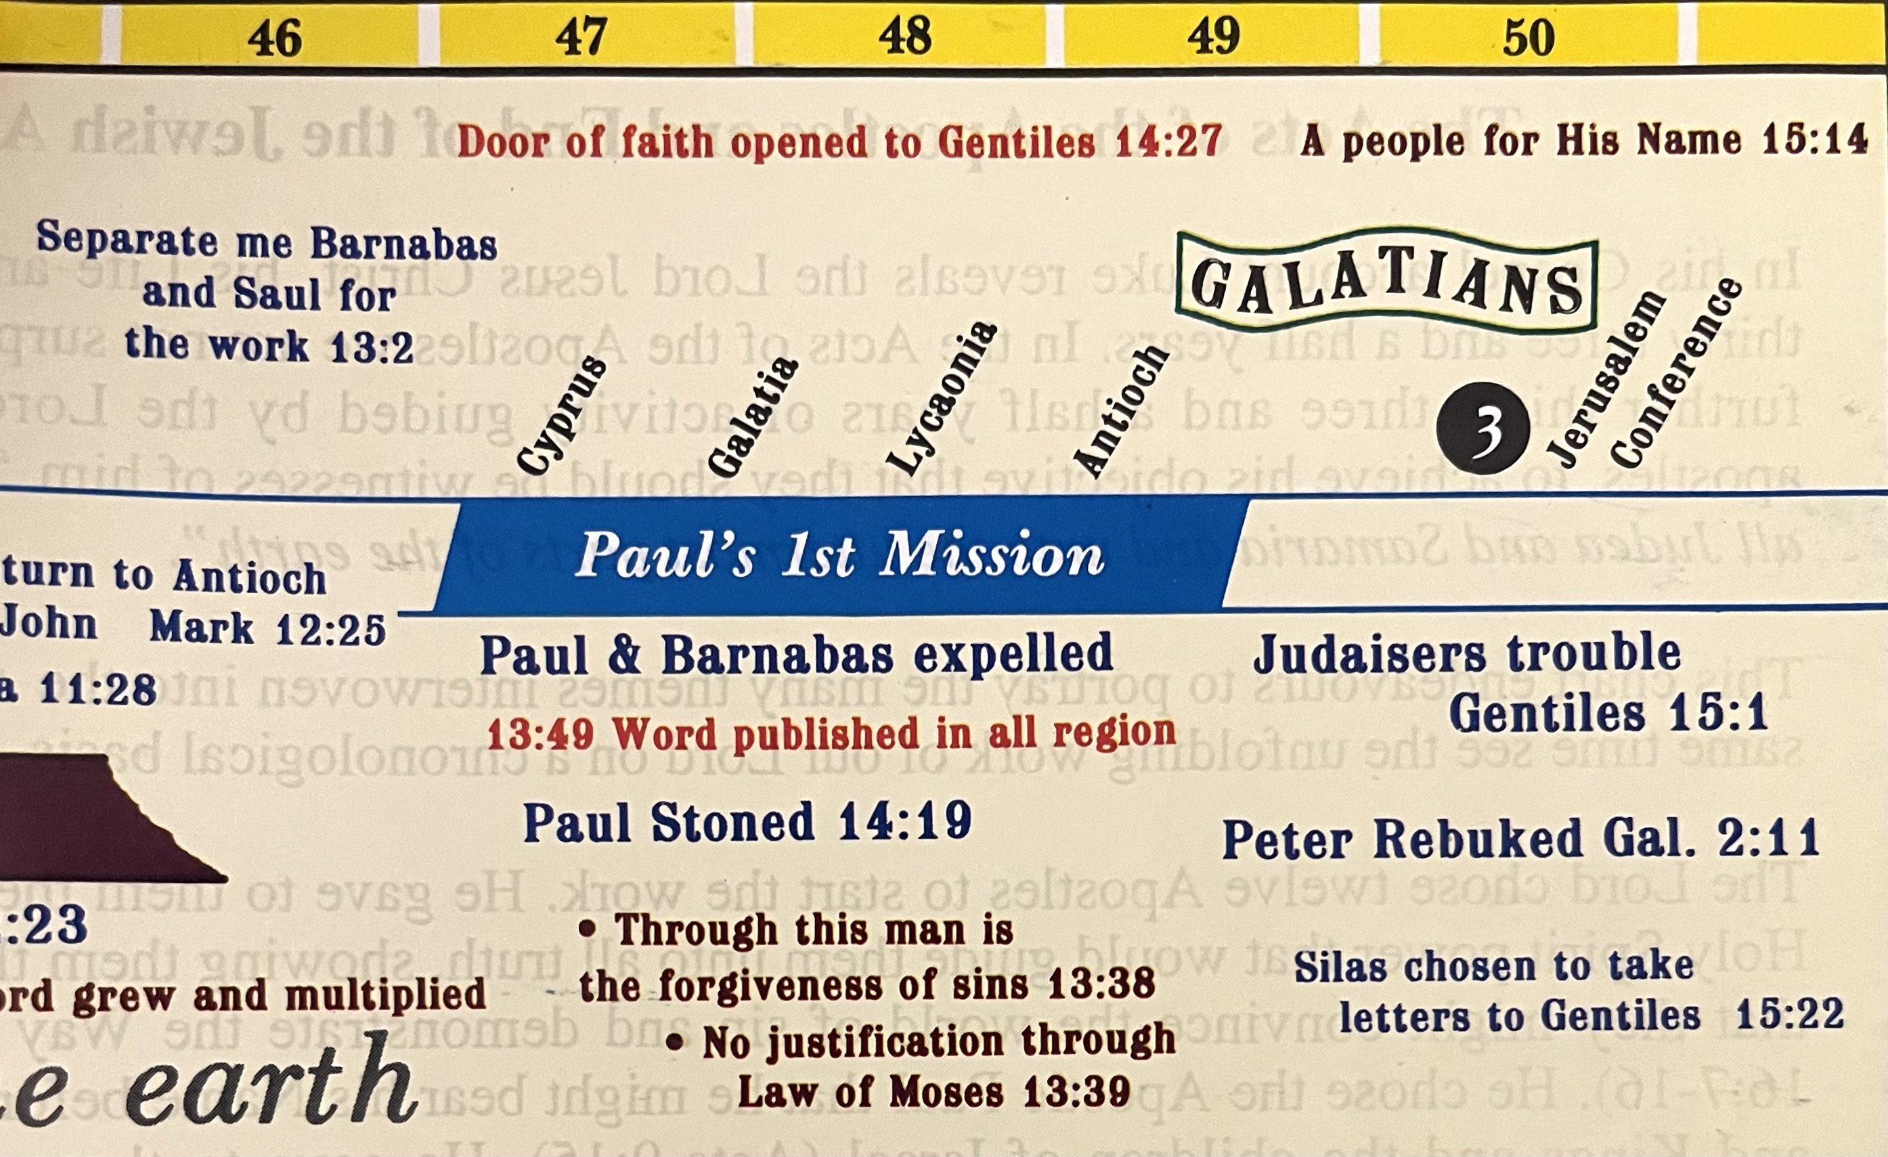
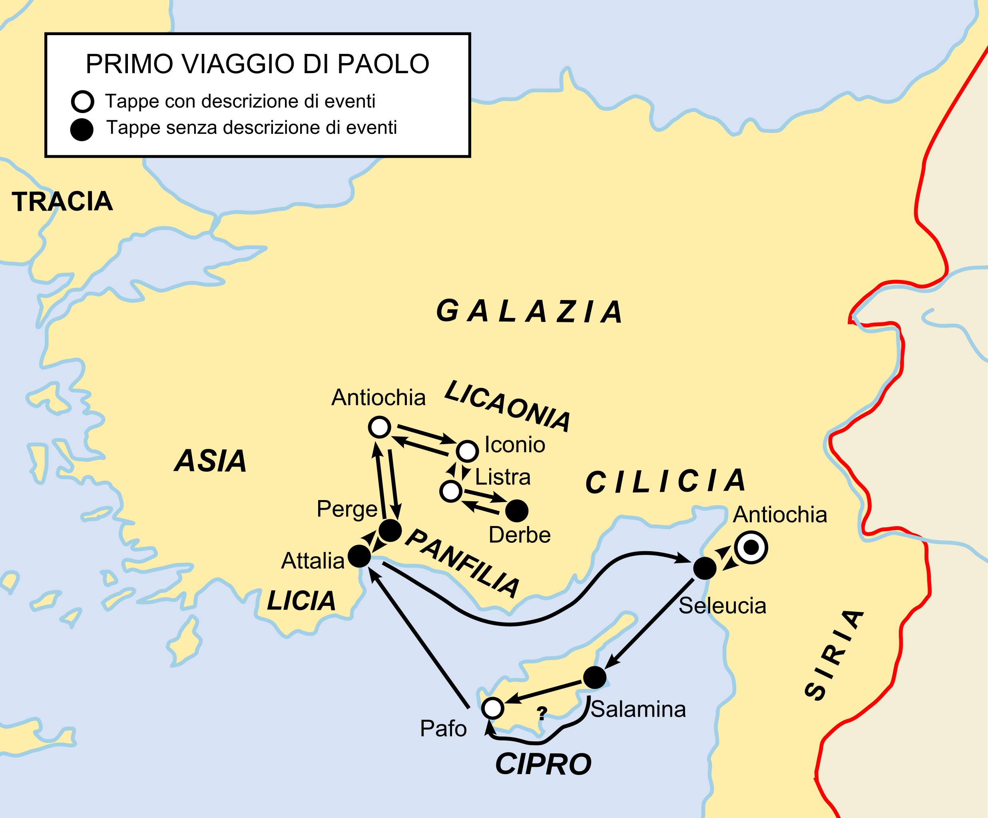
“For ye are all one in Christ Jesus”
- Diversity In Discipleship -

Slide 3
“For ye are all one in Christ Jesus”
^{Galatians 1}
⁶ I marvel that ye are so soon removed from him that called you into the grace of Christ unto another gospel:
⁷ Which is not another; but there be some that trouble you, and would pervert the gospel of Christ.
^{Galatians 3}
¹ O foolish Galatians, who hath bewitched you, that ye should not obey the truth, before whose eyes Jesus Christ hath been evidently set forth, crucified among you?
- Diversity In Discipleship -

Slide 4

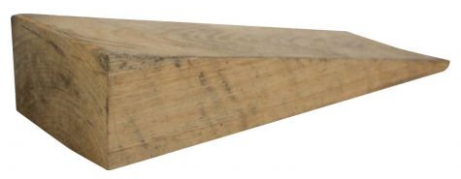
“For ye are all one in Christ Jesus”
- Diversity In Discipleship -

Slide 5
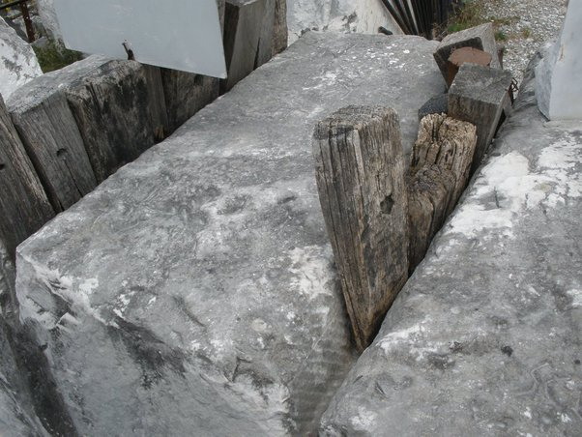
“For ye are all one in Christ Jesus”
- Diversity In Discipleship -

Slide 6
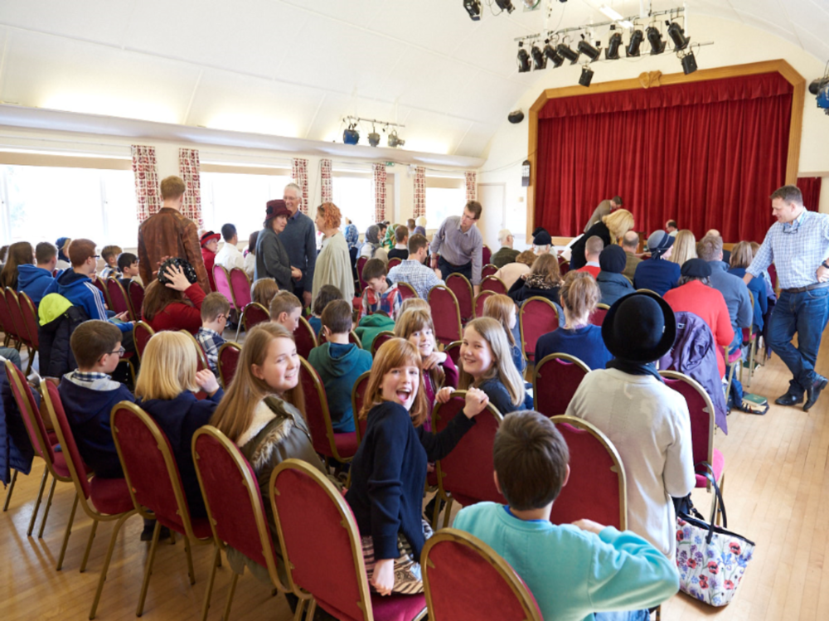
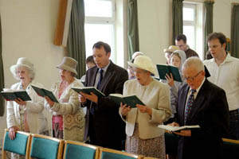
“For ye are all one in Christ Jesus”
Being of ‘One’ Apparel
- Diversity In Discipleship -

Slide 7
“For ye are all one in Christ Jesus”
^{Galatians 3}
²⁶ For ye are all the children of God by faith in Christ Jesus.
²⁷ For as many of you as have been baptized into Christ have put on Christ.
²⁸ There is neither Jew nor Greek, there is neither bond nor free, there is neither male nor female: for ye are all one in Christ Jesus.
²⁹ And if ye be Christ's, then are ye Abraham's seed, and heirs according to the promise.
- Diversity In Discipleship -

Slide 8
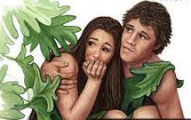
“For ye are all one in Christ Jesus”
^{Genesis 3}
⁷ And the eyes of them both were opened, and they knew that they were naked; and they sewed fig leaves together, and made themselves aprons.
H2290
חֲגֹרָה חֲגוֹרָה חֲגֹר חֲגוֹר
chăgôr chăgôr chăgôrâh chăgôrâh
(1,2) khag-ore', (3,4) khag-o-raw'
From H2296; a belt (for the waist): - apron, armour, gird (-le).
- Diversity In Discipleship -

Slide 9
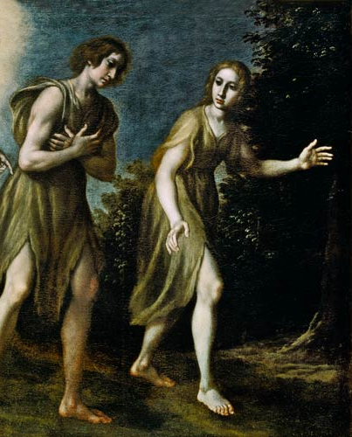
“For ye are all one in Christ Jesus”
^{Genesis 3}
²¹ Unto Adam also and to his wife did the LORD God make coats of skins, and clothed them.
H3801
כֻּתֹּנֶת כְּתֹנֶת
k^{e}thôneth kûttôneth
keth-o'-neth, koot-to'-neth
From an unused root meaning to cover (compare H3802); a shirt: - coat, garment, robe.
- Diversity In Discipleship -

Slide 10
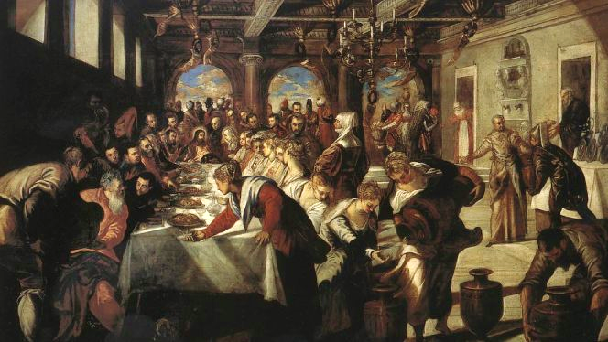
“There is neither Jew nor Greek…”
^{Matthew 22}
² The kingdom of heaven is like unto a certain king, which made a marriage for his son,
³ And sent forth his servants to call them that were bidden to the wedding: and they would not come.
- Diversity In Discipleship -

Slide 11
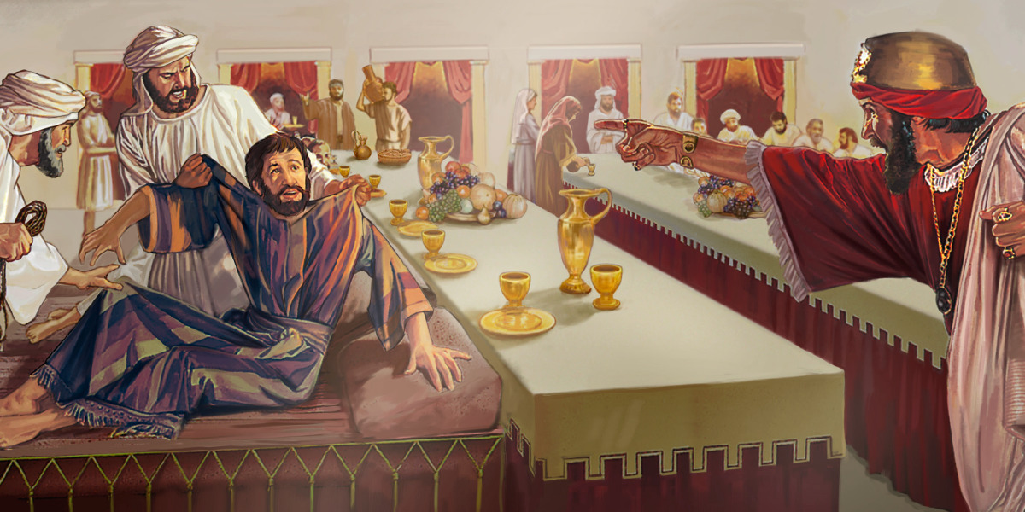
“There is neither Jew nor Greek…”
^{Matthew 22}
¹¹ And when the king came in to see the guests, he saw there a man which had not on a wedding garment:
¹² And he saith unto him, Friend, how camest thou in hither not having a wedding garment? And he was speechless.
¹³ Then said the king to the servants, Bind him hand and foot, and take him away, and cast him into outer darkness; there shall be weeping and gnashing of teeth.
¹⁴ For many are called, but few are chosen.
- Diversity In Discipleship -

Slide 12
“There is neither Jew nor Greek…”
^{Galatians 3}
²⁶ For ye are all the children of God by faith in Christ Jesus.
²⁷ For as many of you as have been baptized into Christ have put on Christ.
^{Romans 13}
¹⁴ But put ye on the Lord Jesus Christ, and make not provision for the flesh, to fulfil the lusts thereof.
- Diversity In Discipleship -

Slide 13
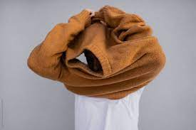

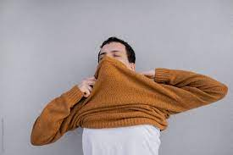
“There is neither Jew nor Greek…”
^{Romans 13}
¹⁴ But put ye on the Lord Jesus Christ, and make not provision for the flesh, to fulfil the lusts thereof.
G1746
ἐνδύω
enduō
en-doo'-o
From G1722 and G1416 (in the senese of sinking into a garment); to invest with clothing (literally or figuratively): - array, clothe (with), endue, have (put) on.
- Diversity In Discipleship -

Slide 14
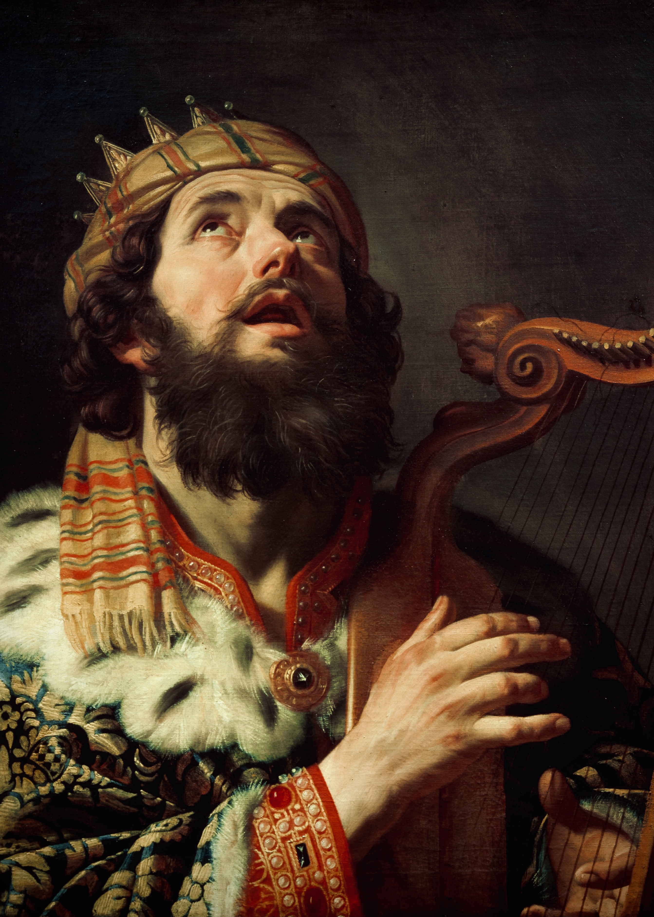
“For ye are all one in Christ Jesus”
^{2 Samuel 12}
²⁰ Then David arose from the earth, and washed, and anointed himself, and changed his apparel, and came into the house of the LORD, and worshipped:
- Diversity In Discipleship -

Slide 15
“For ye are all one in Christ Jesus”
^{2 Samuel 12}
²⁰ Then David arose from the earth, and washed, and anointed himself, and changed his apparel, and came into the house of the LORD, and worshipped:
- Diversity In Discipleship -

Slide 16
“For ye are all one in Christ Jesus”
^{2 Samuel 12}
²⁰ Then David arose from the earth, and washed, and anointed himself, and changed his apparel, and came into the house of the LORD, and worshipped:
- Diversity In Discipleship -

Slide 17
“For ye are all one in Christ Jesus”
^{2 Samuel 12}
²⁰ Then David arose from the earth, and washed, and anointed himself, and changed his apparel, and came into the house of the LORD, and worshipped:
- Diversity In Discipleship -

Slide 18
“For ye are all one in Christ Jesus”
^{2 Samuel 12}
²⁰ Then David arose from the earth, and washed, and anointed himself, and changed his apparel, and came into the house of the LORD, and worshipped:
- Diversity In Discipleship -

Slide 19
“For ye are all one in Christ Jesus”
Being all of ‘One’ Mind
- Diversity In Discipleship -

Slide 20
“For ye are all one in Christ Jesus”
^{Acts 1}
¹³ And when they were come in, they went up into an upper room, where abode both Peter, and James, and John, and Andrew, Philip, and Thomas, Bartholomew, and Matthew, James the son of Alphaeus, and Simon Zelotes, and Judas the brother of James.
¹⁴ These all continued with one accord in prayer and supplication...
G3661
ὁμοθυμαδόν
homothumadon
hom-oth-oo-mad-on'
Adverb from a compound of the base of G3674 and G2372; unanimously: - with one accord (mind).
- Diversity In Discipleship -

Slide 21
“For ye are all one in Christ Jesus”
^{Acts 1}
¹³ And when they were come in, they went up into an upper room, where abode both Peter, and James, and John, and Andrew, Philip, and Thomas, Bartholomew, and Matthew, James the son of Alphaeus, and Simon Zelotes, and Judas the brother of James.
¹⁴ These all continued with one accord in prayer and supplication...
- Diversity In Discipleship -

Slide 22
“For ye are all one in Christ Jesus”
^{Acts 1}
¹³ And when they were come in, they went up into an upper room, where abode both Peter, and James, and John, and Andrew, Philip, and Thomas, Bartholomew, and Matthew, James the son of Alphaeus, and Simon Zelotes, and Judas the brother of James.
¹⁴ These all continued with one accord in prayer and supplication, with the women, and Mary the mother of Jesus, and with his brethren.
- Diversity In Discipleship -

Slide 23
“For ye are all one in Christ Jesus”
For Worship…
G3948
παροξυσμός
paroxusmos
par-ox-oos-mos'
From G3947 (“paroxysm”); incitement (to good), or dispute (in anger): - contention, provoke unto.
^{Acts 2}
¹ And when the day of Pentecost was fully come, they were all with one accord in one place.
^{Hebrews 10}
²⁴ And let us consider one another to provoke unto love and to good works:
²⁵ Not forsaking the assembling of ourselves together, as the manner of some is; but exhorting one another: and so much the more, as ye see the day approaching.
- Diversity In Discipleship -

Slide 24
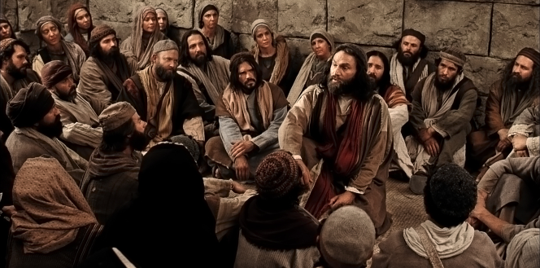
“For ye are all one in Christ Jesus”
Working Through Dispute…
^{Acts 15}
²⁵ It seemed good unto us, being assembled with one accord, to send chosen men unto you with our beloved Barnabas and Paul.
- Diversity In Discipleship -

Slide 25
“For ye are all one in Christ Jesus”
Being all on ‘One’ Level
- Diversity In Discipleship -

Slide 26

“For ye are all one in Christ Jesus”
^{1 Corinthians 12}
¹⁸ But now hath God set the members every one of them in the body, as it hath pleased him.
¹⁹ And if they were all one member, where were the body?
²⁰ But now are they many members, yet but one body.
²¹ And the eye cannot say unto the hand, I have no need of thee: nor again the head to the feet, I have no need of you.
²² Nay, much more those members of the body, which seem to be more feeble, are necessary:
- Diversity In Discipleship -

Slide 27
“For ye are all one in Christ Jesus”
^{1 Corinthians 12}
¹⁸ But now hath God set the members every one of them in the body, as it hath pleased him.
¹⁹ And if they were all one member, where were the body?
²⁰ But now are they many members, yet but one body.
²¹ And the eye cannot say unto the hand, I have no need of thee: nor again the head to the feet, I have no need of you.
²² Nay, much more those members of the body, which seem to be more feeble, are necessary:
G1380
δοκέω
dokeō
dok-eh'-o
A prolonged form of a primary verb δόκω dokō (used only as an alternate in certain tenses; compare the base of G1166); of the same meaning; to think; by implication to seem (truthfully or uncertainly): - be accounted, (of own) please (-ure), be of reputation, seem (good), suppose, think, trow.
- Diversity In Discipleship -

Slide 28
“For ye are all one in Christ Jesus”
^{Matthew 25}
³⁵ For I was an hungred, and ye gave me meat: I was thirsty, and ye gave me drink: I was a stranger, and ye took me in:
³⁶ Naked, and ye clothed me: I was sick, and ye visited me: I was in prison, and ye came unto me.
³⁷ Then shall the righteous answer him, saying, Lord, when saw we thee an hungred, and fed thee? or thirsty, and gave thee drink?
³⁸ When saw we thee a stranger, and took thee in? or naked, and clothed thee?
³⁹ Or when saw we thee sick, or in prison, and came unto thee?
- Diversity In Discipleship -

Slide 29
“For ye are all one in Christ Jesus”
Are we doing in order to be?
Or
Being in order to do?
- Diversity In Discipleship -

Slide 30
“For ye are all one in Christ Jesus”
^{Matthew 25}
⁴⁰ And the King shall answer and say unto them, Verily I say unto you, Inasmuch as ye have done it unto one of the least of these my brethren, ye have done it unto me.
- Diversity In Discipleship -

Slide 31

“For ye are all one in Christ Jesus”
Recording Brother
AB’s
Is there a hierarchy in the ecclesia?
Committee Heads
General
Assembly
- Diversity In Discipleship -

Slide 32
“For ye are all one in Christ Jesus”
1 Timothy 3
⁵ (For if a man know not how to rule his own house, how shall he take care of the church of God?);
Recording Brother
AB’s
Committee Heads
General
Assembly
- Diversity In Discipleship -

Slide 33
“For ye are all one in Christ Jesus”
The Headship Of Christ
^{Ephesians 1}
²² And hath put all things under his feet, and gave him to be the head over all things to the church,
²³ Which is his body, the fulness of him that filleth all in all.
- Diversity In Discipleship -

Slide 34
“For ye are all one in Christ Jesus”
The Headship Of Christ
^{Ephesians 4}
¹⁵ But speaking the truth in love, may grow up into him in all things, which is the head, even Christ:
¹⁶ From whom the whole body fitly joined together and compacted by that which every joint supplieth, according to the effectual working in the measure of every part, maketh increase of the body unto the edifying of itself in love.
- Diversity In Discipleship -

Slide 35
“For ye are all one in Christ Jesus”
The Headship Of Christ
^{Colossians 1}
¹⁸ And he is the head of the body, the church: who is the beginning, the firstborn from the dead; that in all things he might have the preeminence.
- Diversity In Discipleship -

Slide 36
“For ye are all one in Christ Jesus”
The Headship Of Christ
^{Colossians 2}
⁹ For in him dwelleth all the fulness of the Godhead bodily.
¹⁰ And ye are complete in him, which is the head of all principality and power:
- Diversity In Discipleship -

Slide 37
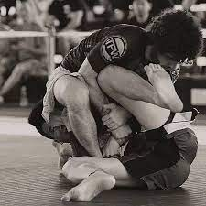
“For ye are all one in Christ Jesus”
Submission…
- Diversity In Discipleship -

Slide 38

“For ye are all one in Christ Jesus”
Submission…
^{1 Peter 2}
¹³ Submit yourselves to every ordinance of man for the Lord's sake: whether it be to the king, as supreme;
¹⁴ Or unto governors, as unto them that are sent by him for the punishment of evildoers, and for the praise of them that do well.
- Diversity In Discipleship -

Slide 39
“For ye are all one in Christ Jesus”
Submission…
^{Ephesians 5}
²² Wives, submit yourselves unto your own husbands, as unto the Lord.
^{Colossians 3}
¹⁸ Wives, submit yourselves unto your own husbands, as it is fit in the Lord.
- Diversity In Discipleship -

Slide 40
“For ye are all one in Christ Jesus”
Submission…
^{James 5}
⁷ Submit yourselves therefore to God. Resist the devil, and he will flee from you.
⁸ Draw nigh to God, and he will draw nigh to you. Cleanse your hands, ye sinners; and purify your hearts, ye double minded.
- Diversity In Discipleship -

Slide 41
“For ye are all one in Christ Jesus”
Submission…
^{Ephesians 5}
²¹ Submitting yourselves one to another in the fear of God.
^{Philippians 2}
¹ If there be therefore any consolation in Christ, if any comfort of love, if any fellowship of the Spirit, if any bowels and mercies,
² Fulfil ye my joy, that ye be likeminded, having the same love, being of one accord, of one mind.
³ Let nothing be done through strife or vainglory; but in lowliness of mind let each esteem other better than themselves.
- Diversity In Discipleship -

Slide 42
“For ye are all one in Christ Jesus”
Submission…
^{Philippians 4}
⁸ Finally, brethren, whatsoever things are true, whatsoever things are honest, whatsoever things are just, whatsoever things are pure, whatsoever things are lovely, whatsoever things are of good report; if there be any virtue, and if there be any praise, think on these things.
G703
ἀρέτη
aretē
ar-et’-ay – Excellence (attributed)
G3056
λόγος
Logos - Motive & Intent
- Diversity In Discipleship -

Slide 43
“For ye are all one in Christ Jesus”
1) Monday:
Diversity In Personality
2) Tuesday:
Diversity In Culture
3) Wednesday:
Diversity In Bonds
4) Thursday:
Diversity In Gender
- Diversity In Discipleship -

Slide 44
“For the body is not one member, but many”
Hebrews 1
God, who at sundry times and in divers manners spake in time past unto the fathers by the prophets,
² Hath in these last days spoken unto us by his Son, whom he hath appointed heir of all things, by whom also he made the worlds;
³ Who being the brightness of his glory, and the express image of his person, and upholding all things by the word of his power, when he had by himself purged our sins, sat down on the right hand of the Majesty on high:
- Diversity In Discipleship -

Slide 45
“For the body is not one member, but many”
G541
ἀπαύγασμα
apaugasma
ap-ow'-gas-mah
From a compound of G575 and G826; an off flash, that is, effulgence: - brightness.
Hebrews 1
God, who at sundry times and in divers manners spake in time past unto the fathers by the prophets,
² Hath in these last days spoken unto us by his Son, whom he hath appointed heir of all things, by whom also he made the worlds;
³ Who being the brightness of his glory, and the express image of his person, and upholding all things by the word of his power, when he had by himself purged our sins, sat down on the right hand of the Majesty on high:
- Diversity In Discipleship -

Slide 46
“For the body is not one member, but many”
^{Daniel 12}
² And many of them that sleep in the dust of the earth shall awake, some to everlasting life, and some to shame and everlasting contempt.
³ And they that be wise shall shine as the brightness of the firmament; and they that turn many to righteousness as the stars for ever and ever.
…Amen
- Diversity In Discipleship -

