Slide 1
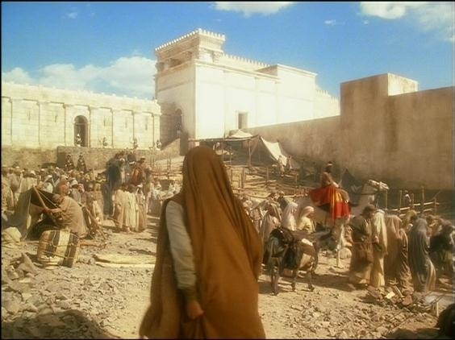
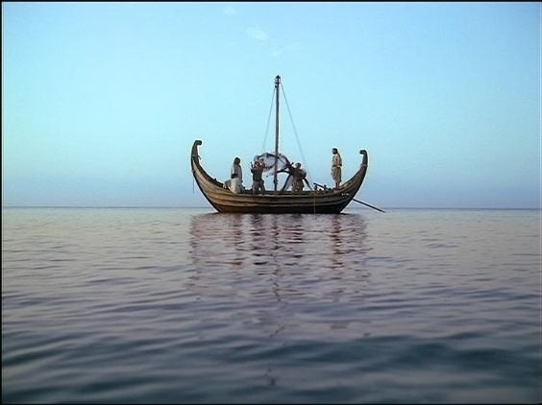
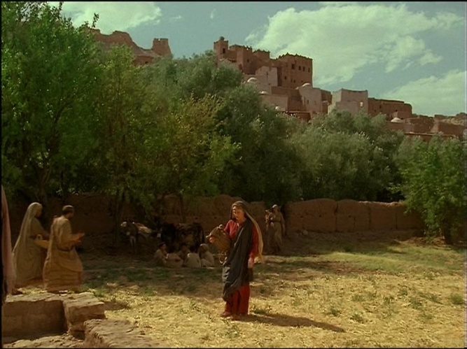
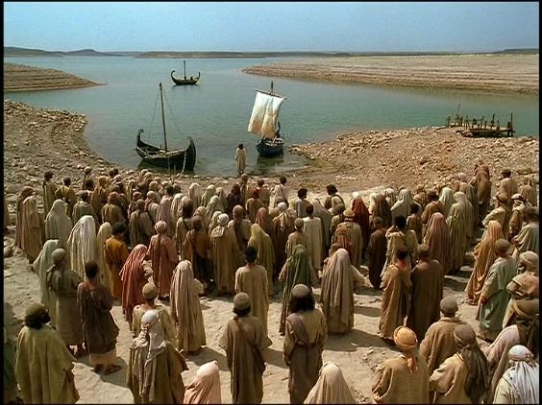
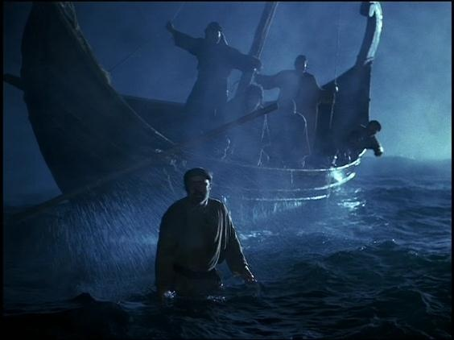
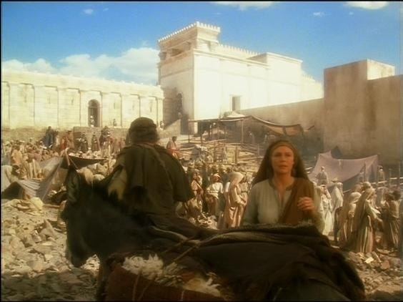
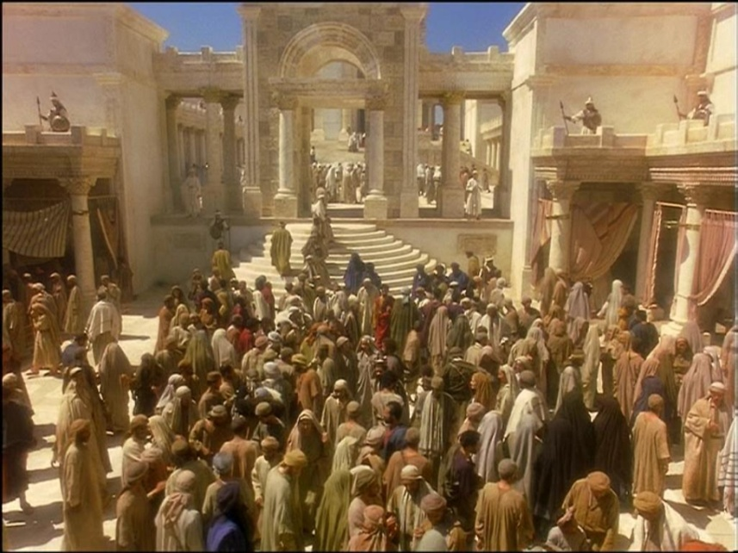
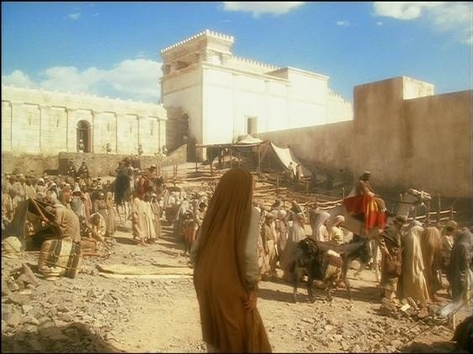
Faith overcoming all things
Faith overcoming Trial
Faith overcoming Obstacles
Faith overcoming Doubt
Faith in Gods Promise
Faithful to the End
What do we think about, when we can think about, what we want to think about?

Slide 2
“Confident anticipation in things hoped for.”
Study 1. Luke 4 - Jesus in the wilderness was confident in the words spoken by the Father.
Study 2. Mark 2. Four friends whose confidence in Jesus went beyond hopefulness to enter the realm of spiritual certainty.
Study 3. John 9 The man born blind was challenged to remain confident in words spoken by the Son.
Study 4. Mark 11. Disciples were called to step out of themselves to have confidence in the larger purpose of God.
Study 5. Matt. 24-25 You and I are encouraged to anticipate with every confidence that soon our Lord will be here.
2
2

Slide 3
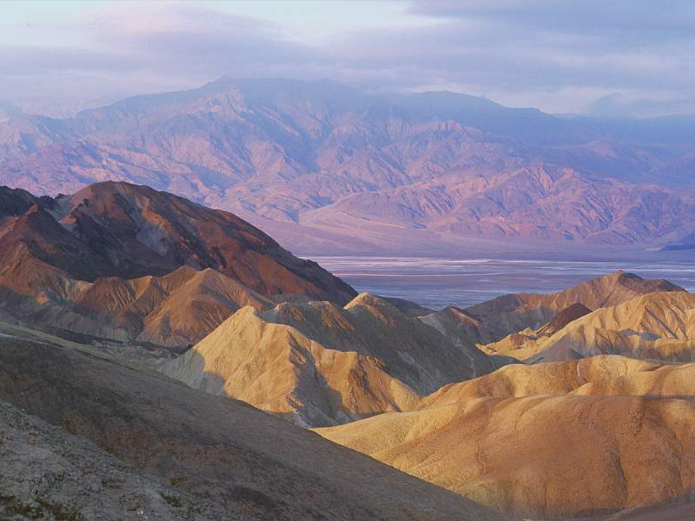
“Confident anticipation of things hoped for.”
Study 1. Luke 4 - Jesus in the wilderness was confident in the words spoken by the Father.
Faith overcoming trial
3

Slide 4
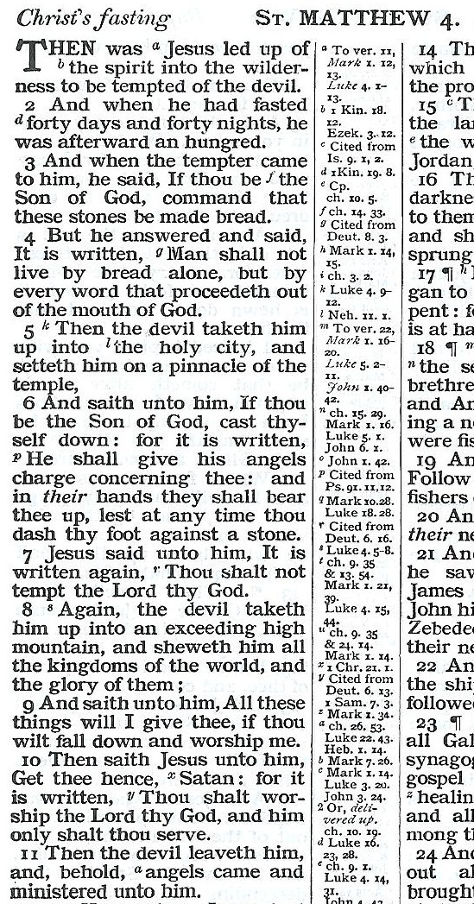
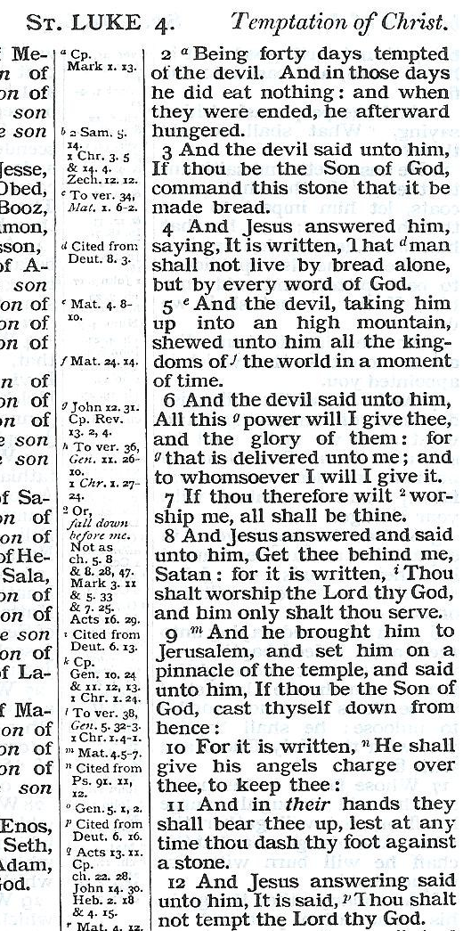
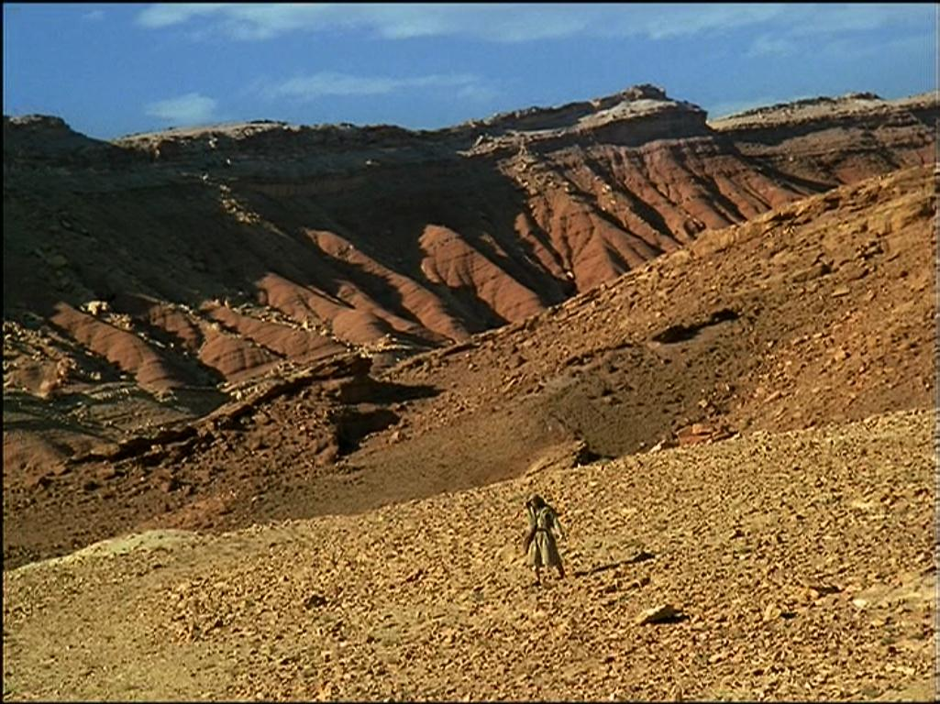
1
Flesh
1
Eyes
3
2
3
Pride
2
Gk.= ‘And when the devil had ended every kind of temptation..’
13 ‘And when the devil had ended all the temptation, he de-parted from him for a season.’
4

Slide 5
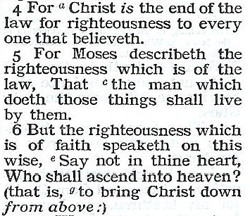
V.4
Christ is the end of the idea that righteousness can be obtained by law.
“It is Written”
Flesh
1
Romans 10
“All that is in the world....”
3
1John 2:15-17
Eyes
1John 5:4
“This is the victory that overcometh the world, our faith”
Cited from Leviticus.
LAW !
Pride
Cited from Deuteronomy 30 Note vv11-14
FAITH !
2
Gk.= ‘And when the devil had ended every kind of temptation..’
3
5

Slide 6
The command had to come from God!
“All the commandments which I command thee this day shall ye observe to do that ye may live.” Deut. 8:1
6
6

Slide 7
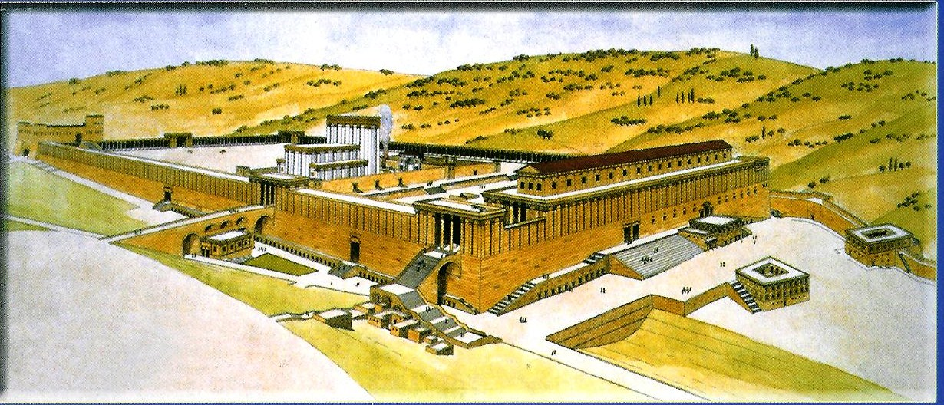
1
S. E. corner of the temple. 150 metres
Pinnacle Gk.= ‘Winglet’ ‘Extremity’ ‘Top corner’
“cast thyself down from hence: For it is written. He shall give his angels charge over thee, to keep thee…” Psa. 91:11-12
Language calculated to justify fleshly action.
2
8
8
7

Slide 8
The focus is squarely on self!
No veneer of righteousness at all!
This was an undisguised challenge to forsake God and reward the flesh.
3
9
8

Slide 9
Serving God or Self?
“And was led by the Spirit into the wilderness.”
Do we really want to give the control of our life to an authority outside of ourselves?
Confident? – Willing?
9

Slide 10
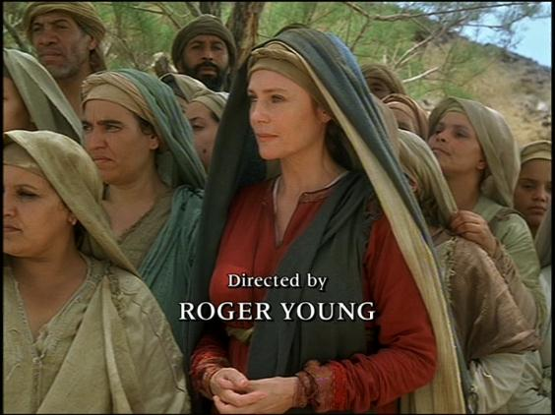
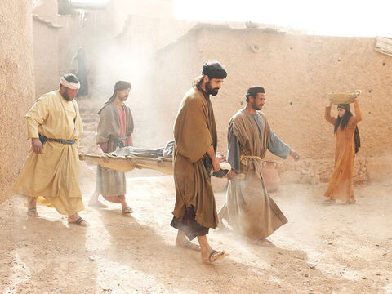
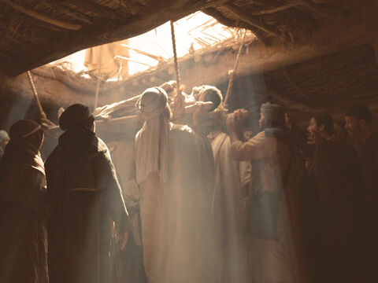
Faith overcoming obstacles
The Paralytic and the Publican – Mark 2
Next session (God willing)
“When Jesus saw their faith.”

Slide 12
Perth Central Y. G. Weekend 2013
Next session
(God willing)
Faith overcoming doubt
John 9:1-22
“I washed and now I see”

Slide 13
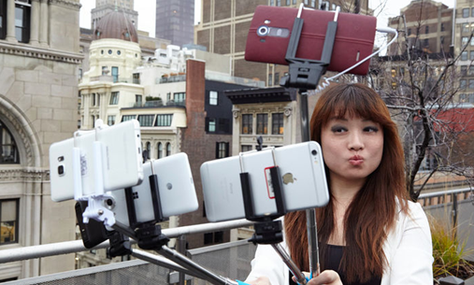
Idols - Serving ourselves through them.
(So attractive - So numerous - Why?)
They're so much more tangible than God.
They're apparently so much more accessible.
They're easy to influence & then pay them off.
They're far less demanding than the God of truth and righteousness.
5

Slide 14
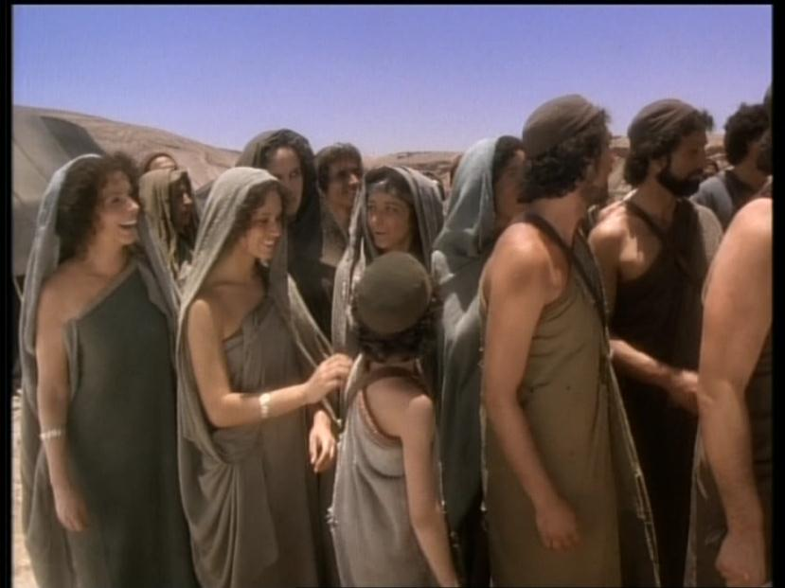
Idols - Serving ourselves through them.
“And was led by the Spirit into the wilderness.”
Would anyone believe in idols if they didn’t offer some comfort or provide some help? .....Would they?
Do we really want to go out on a limb and let God be the ultimate authority in our life?
Do we actually want to give the control of our life to an authority outside of ourselves?
4
6

Slide 15
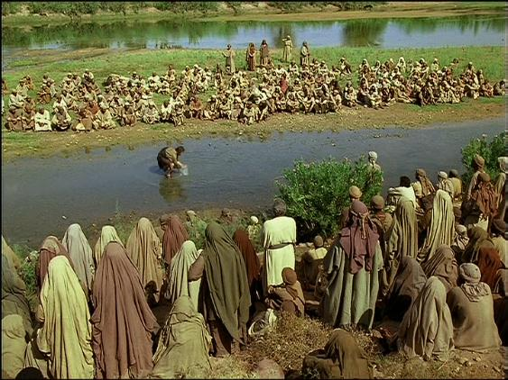
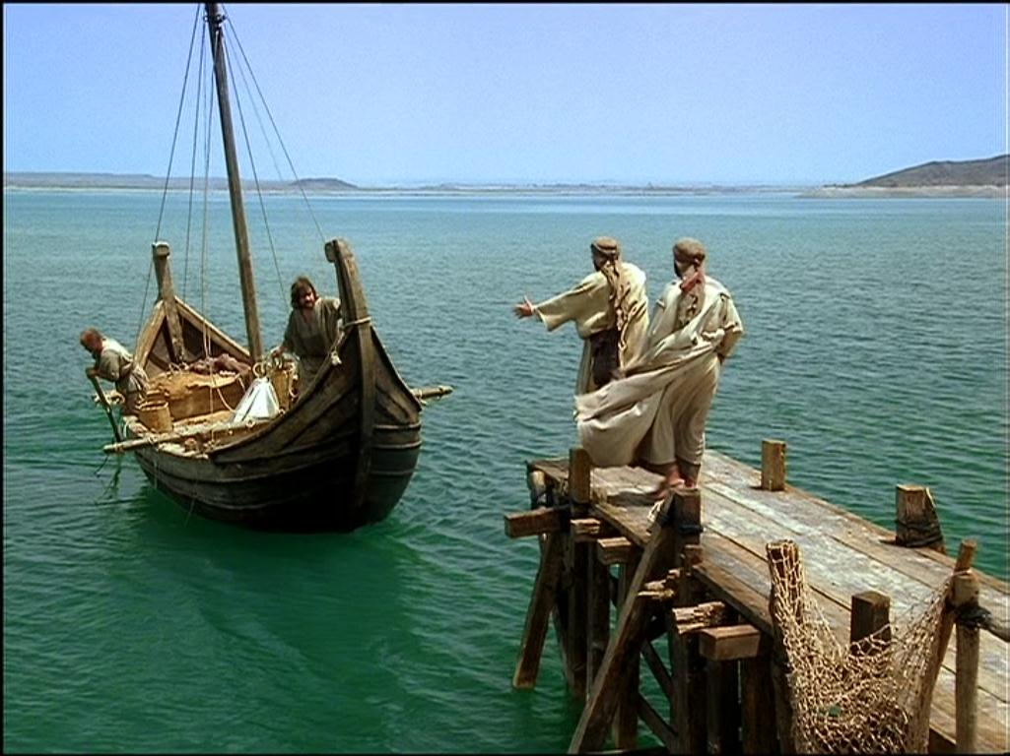
Faith overcoming all things

