Slide 1
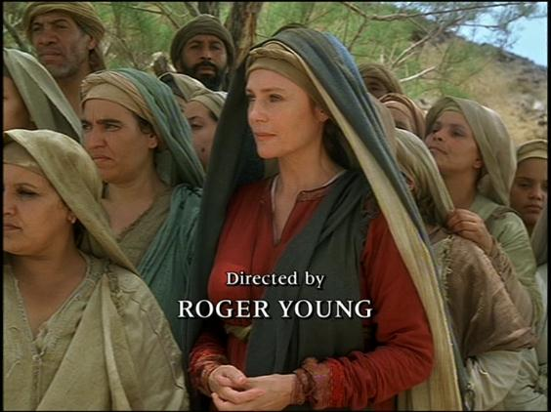
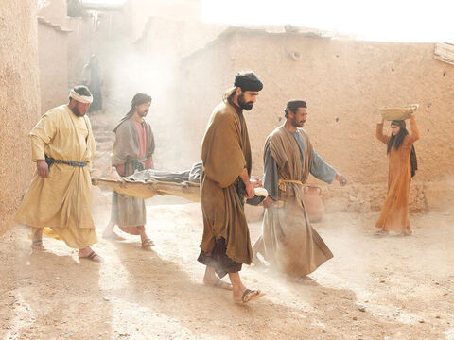
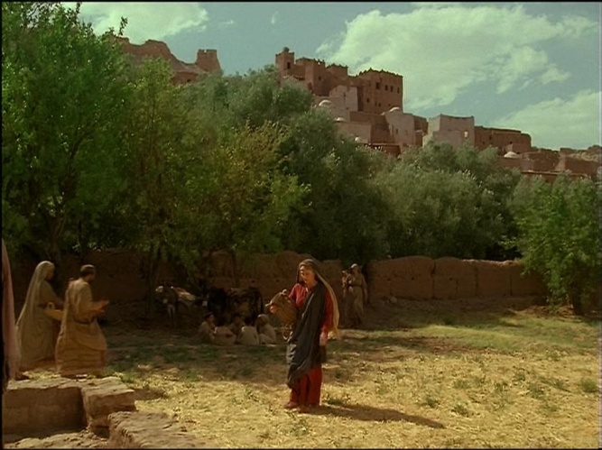
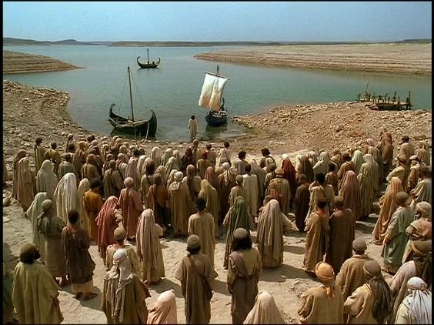
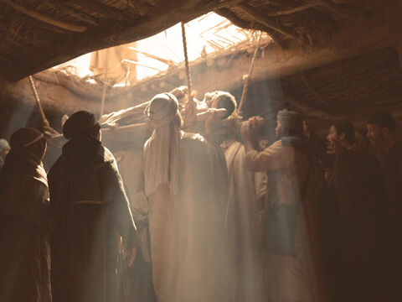
Faith overcoming obstacles
The Paralytic and the Publican – Mark 2
Study 2

Slide 2
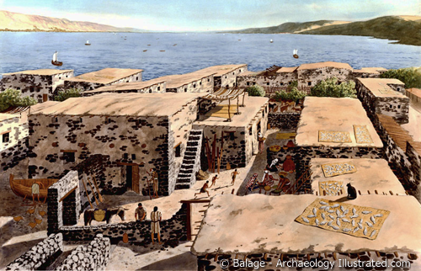
Matt. 9 Mark 2 Luke 5
V.1
V.1
And he entered into a ship and passed over and came into his own city.
And again he entered into Capernaum after some days and it was noised that he was in the house.
V.2
V.17
And straightway many were gathered together in so much that there was no room to receive them no, not so much as about the door: and he preached the word unto them.
And it came to pass on a certain day as he was teaching, that there were Pharisees and doctors of the law sitting by which were come out of every town of Galilee and Judaea and Jerusalem and the power of the lord was present to heal them.
The Setting
Matthew & Mark focus on where Jesus was & therefore what he was to bring. Comfort!
3
3

Slide 3
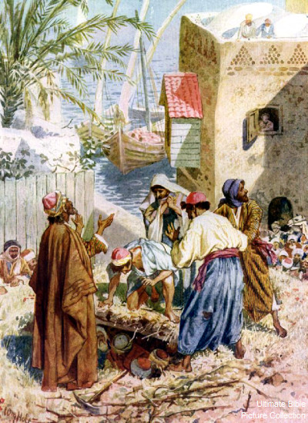
Matt. 9 Mark 2 Luke 5
The Act
V.4
V.19
“And when they could not come nigh unto him for the press they uncovered the roof where he was: and when they had broken it up they let down the bed wherein the sick of the palsy lay.”
And when they could not find by what way they might bring him in because of the multitude they went upon the housetop, and let him down through the tiling with his couch into the midst before Jesus.
V.2 cont.
V.5
V.20
“and Jesus seeing their faith said unto the sick of the palsy; Son, be of good cheer; thy sins be forgiven thee.”
“When Jesus saw their faith, he said unto the sick of the palsy, Son, thy sins be forgiven thee.”
And when he saw their faith, he said unto him, Man, thy sins are forgiven thee.”
Numbers 11:11-14, 17
4

Slide 4
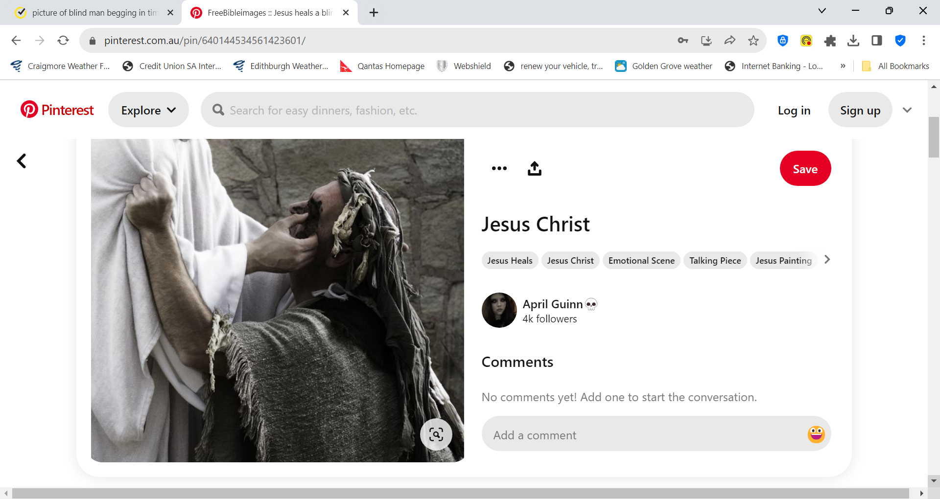
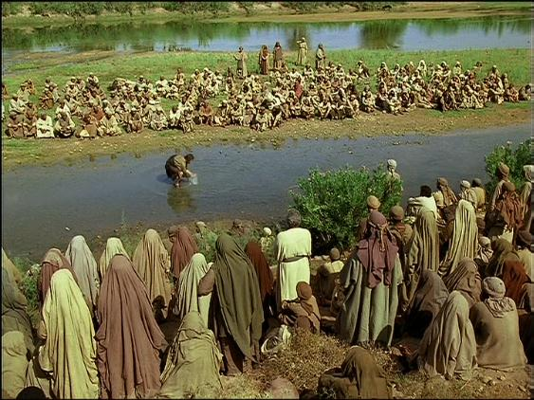
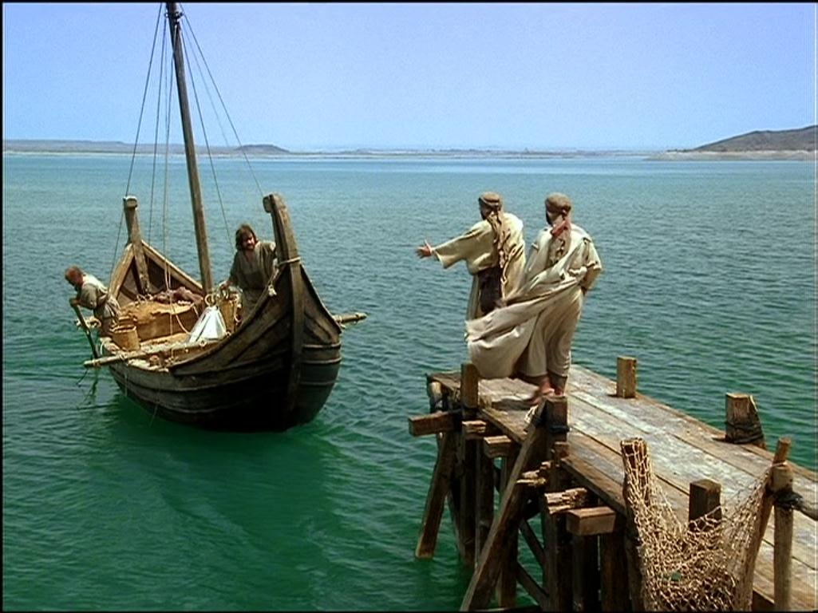
Faith overcoming doubt
Man born blind - John 9
Next session God willing

