Slide 1
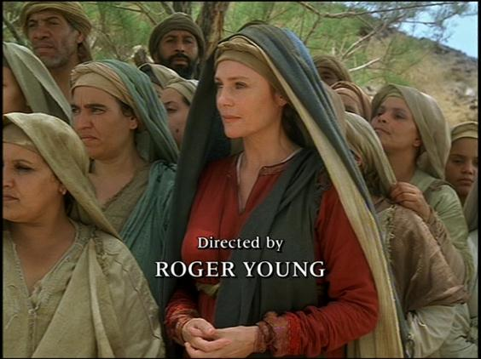
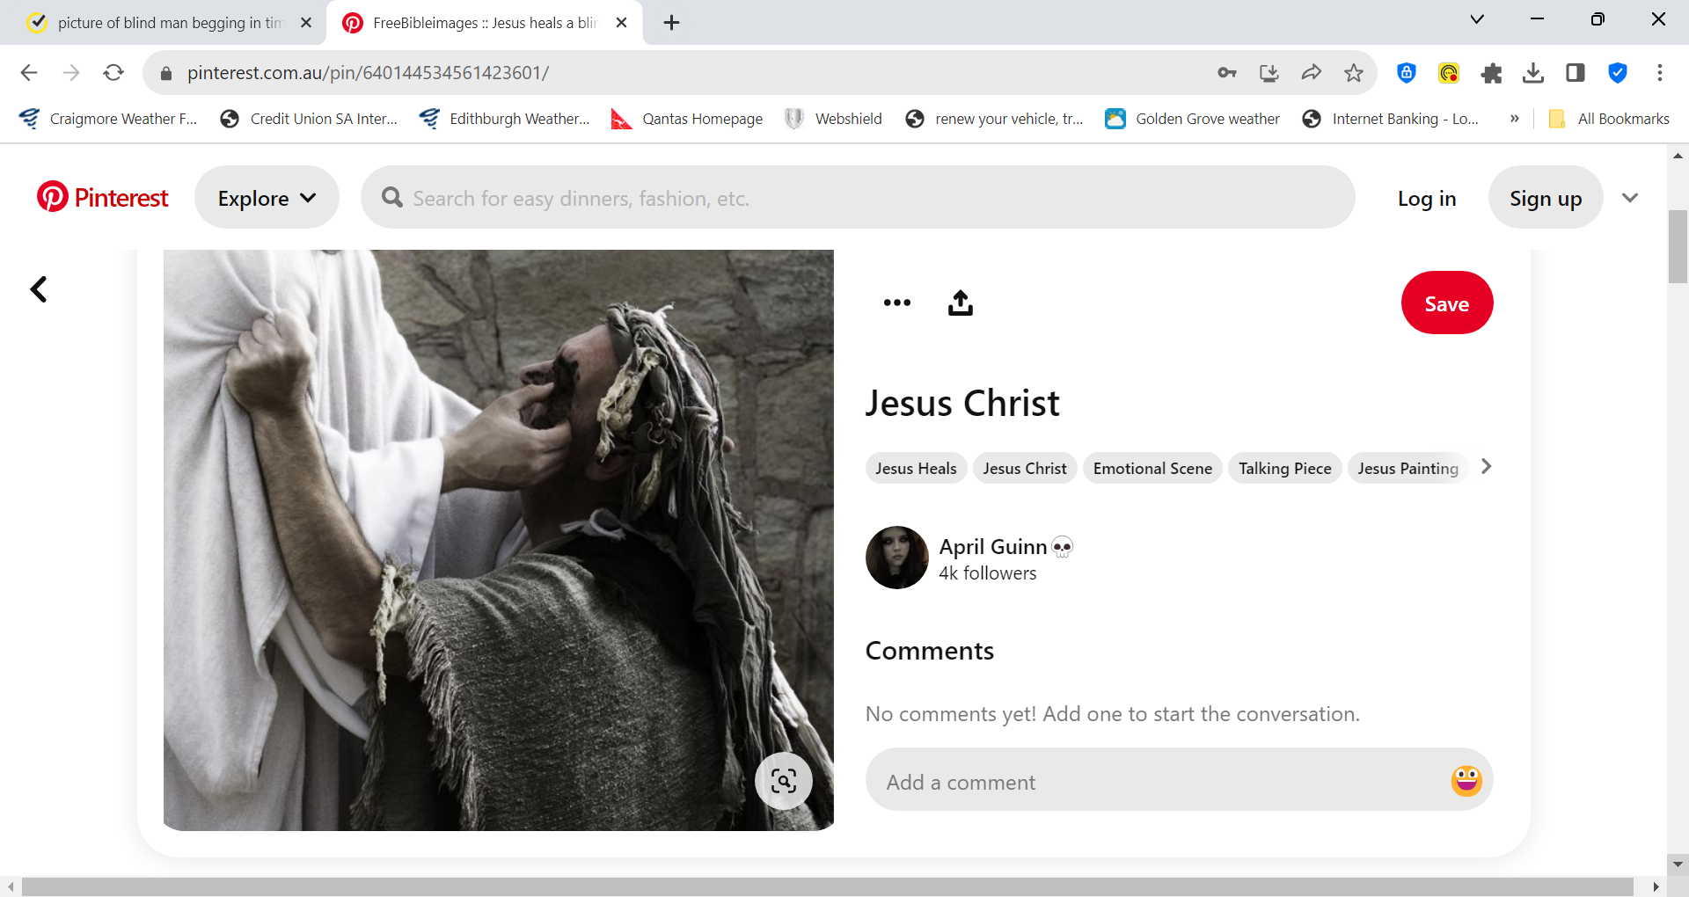
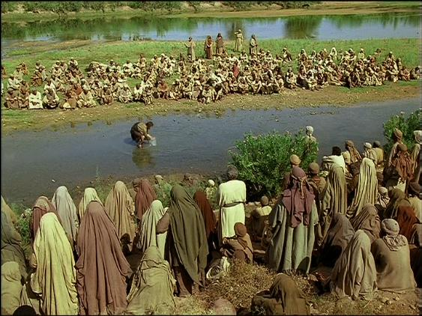
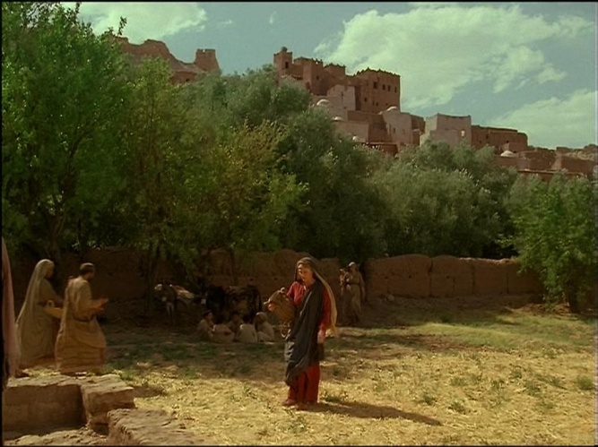
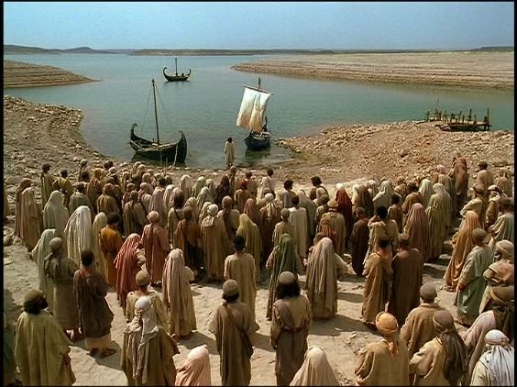
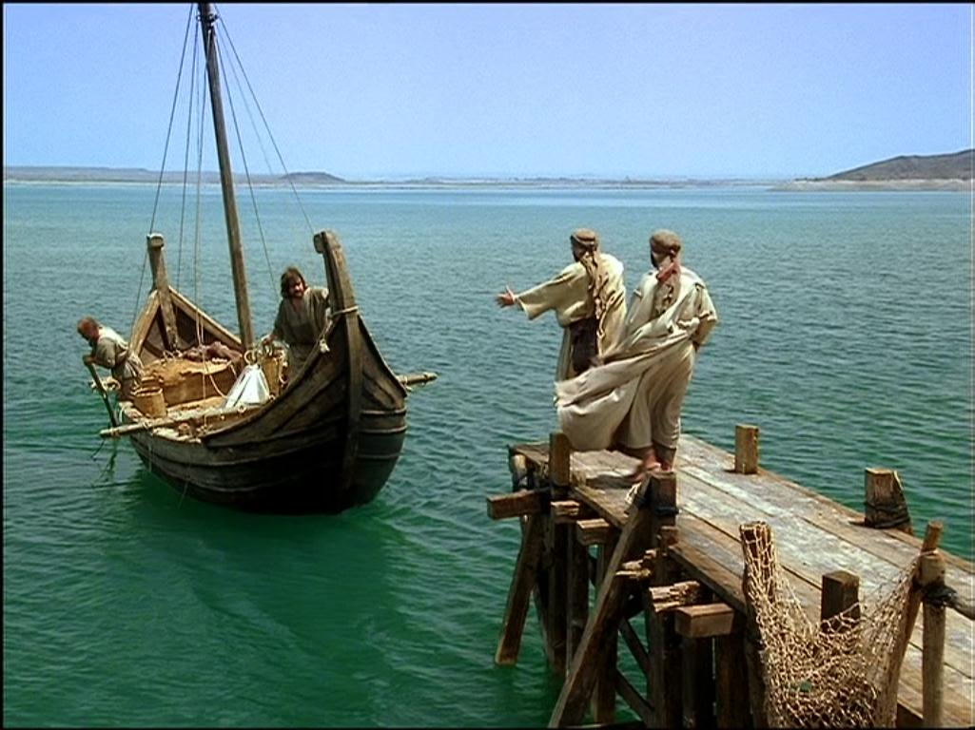
Faith overcoming doubt
Man born blind - John 9

Slide 2
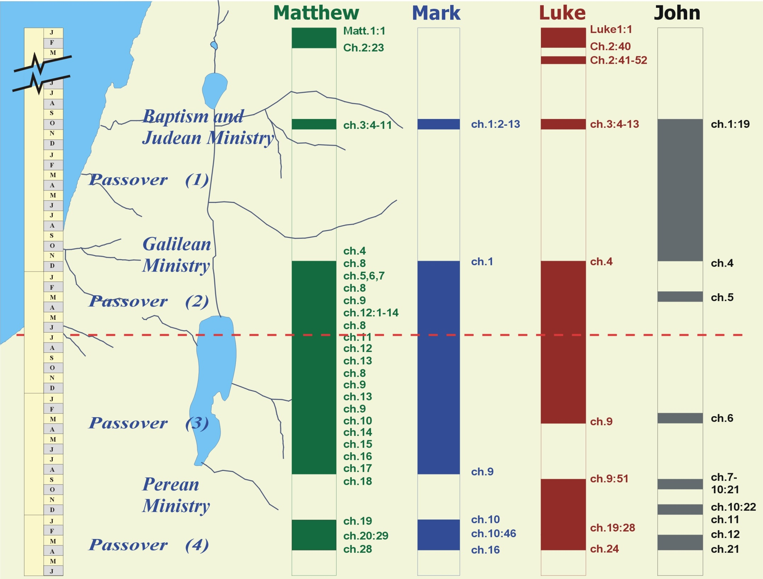
ch.2
ch.5
3

Slide 3
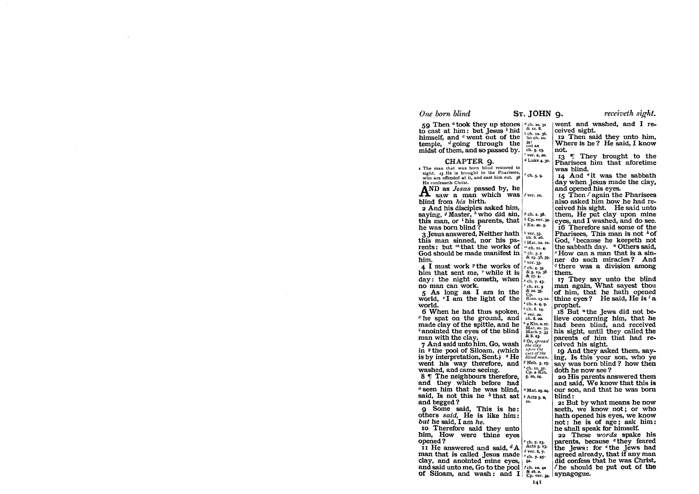
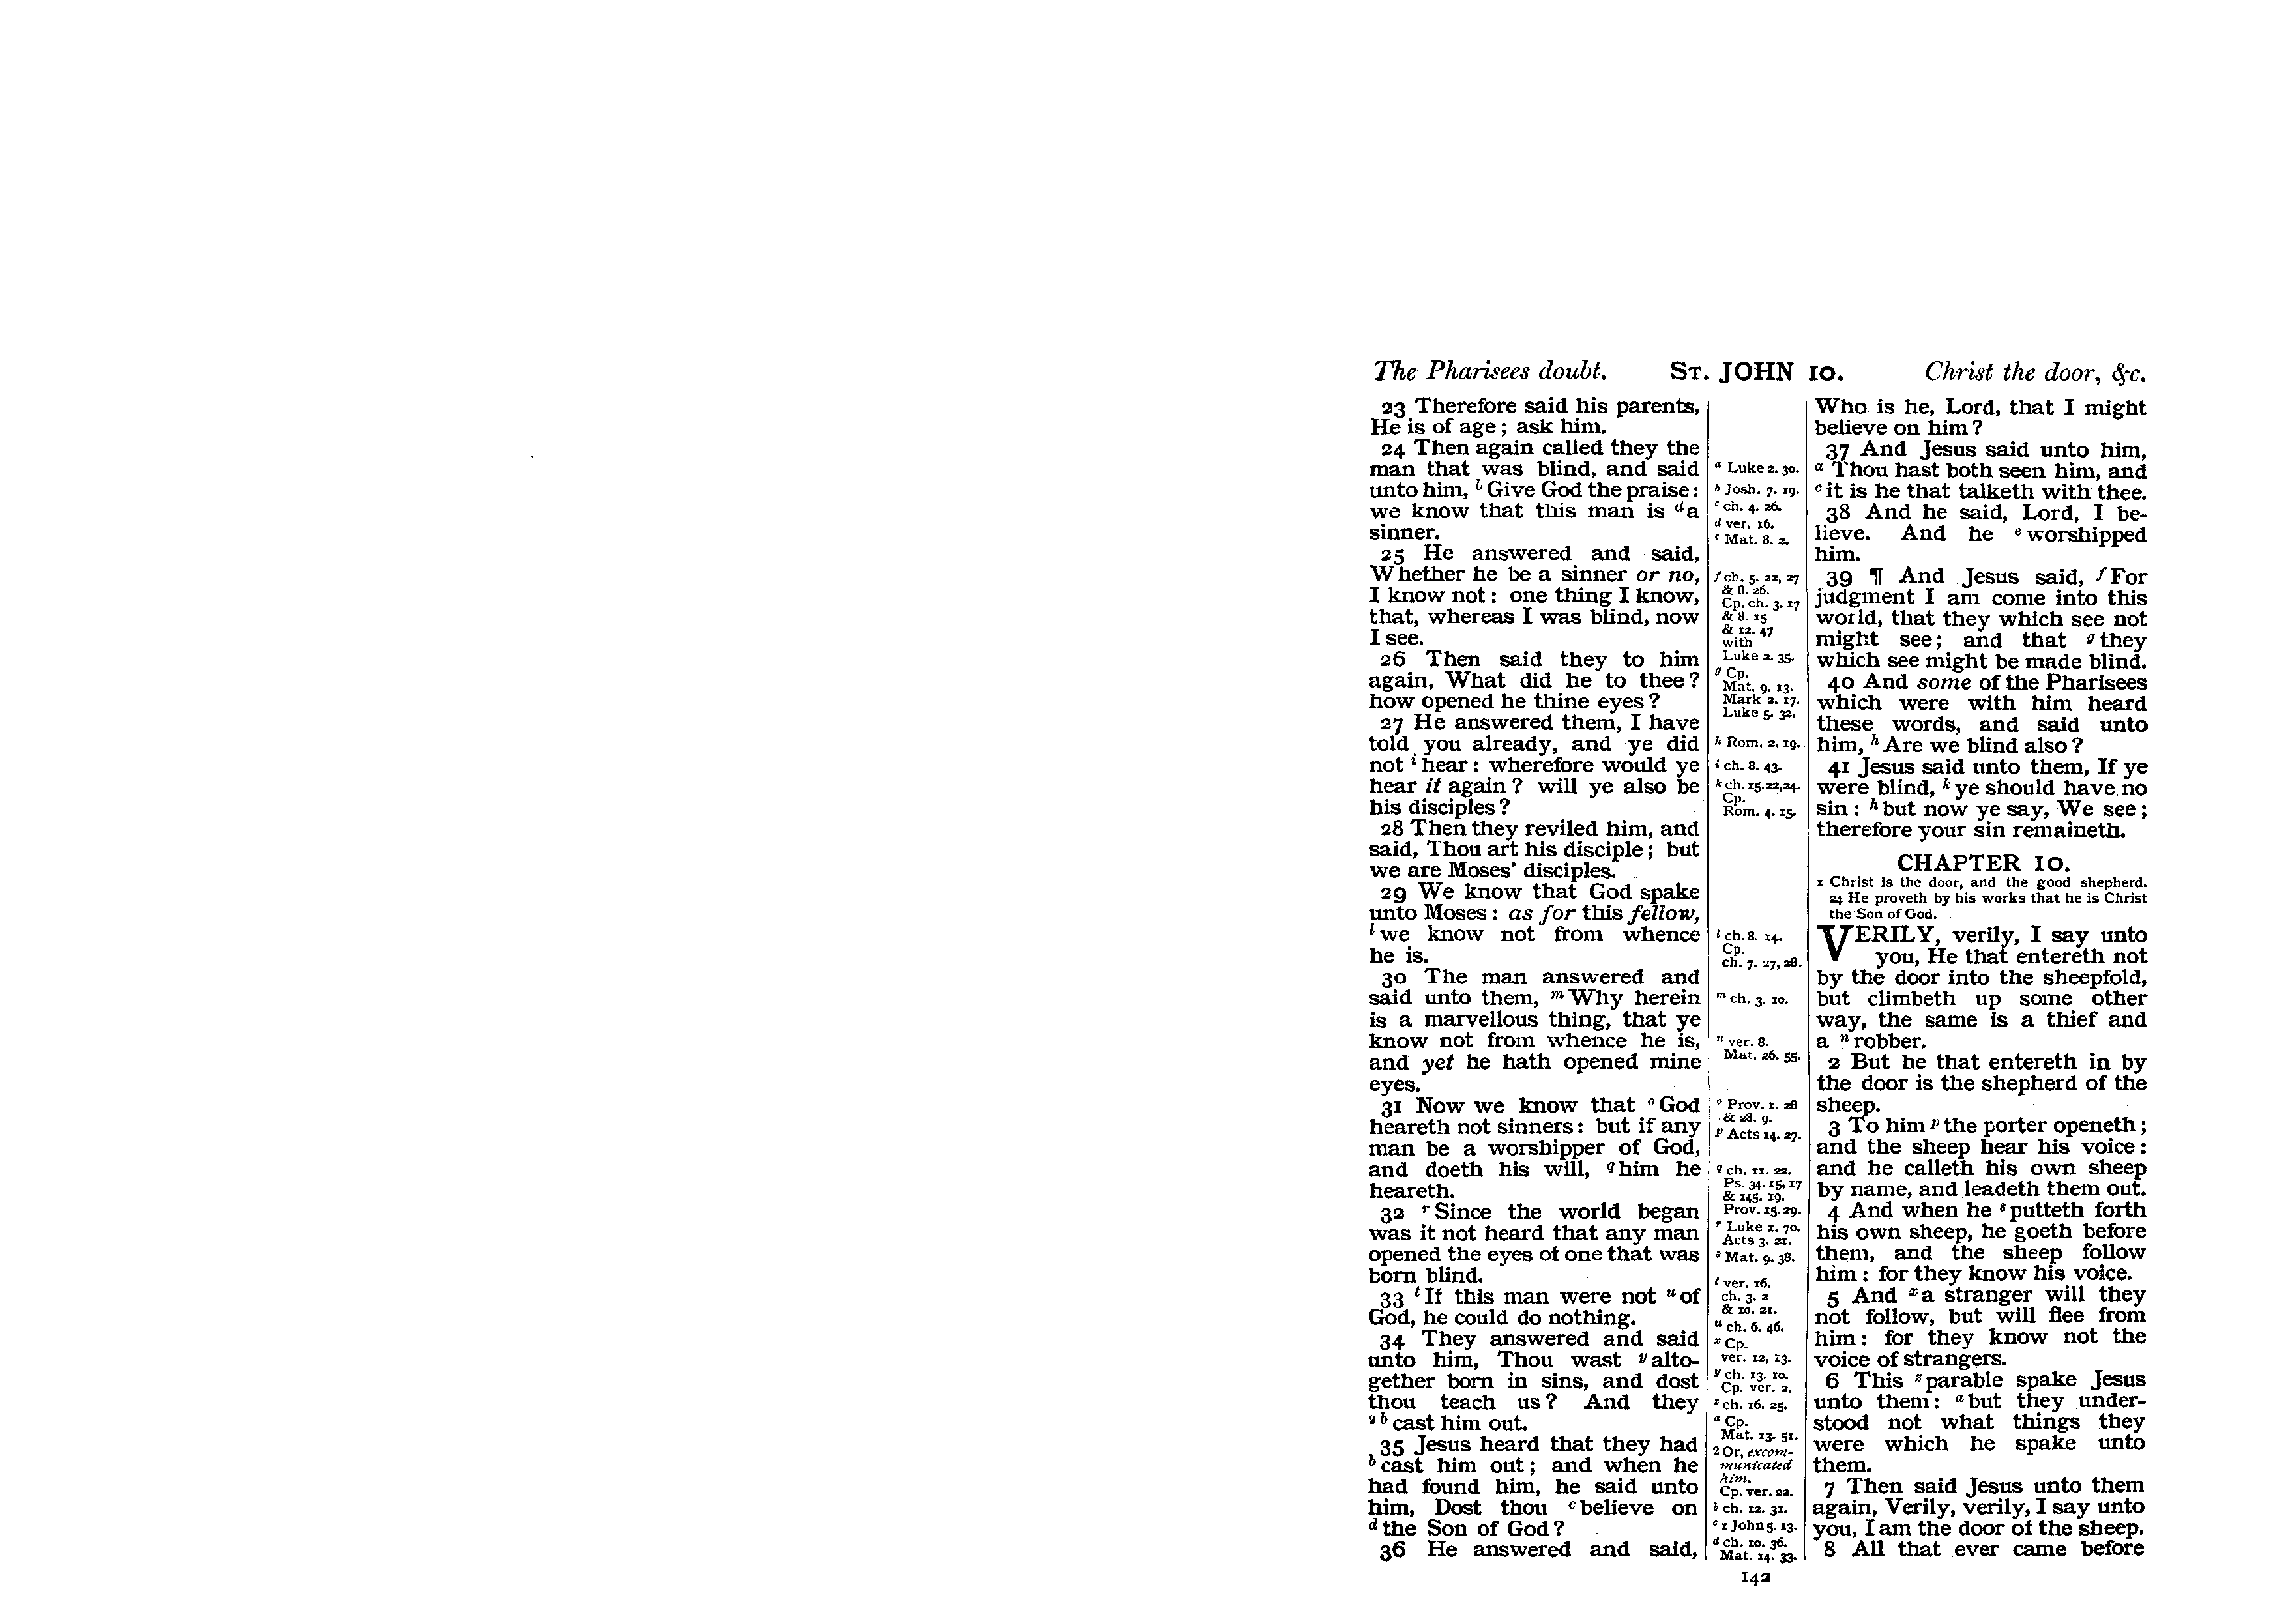
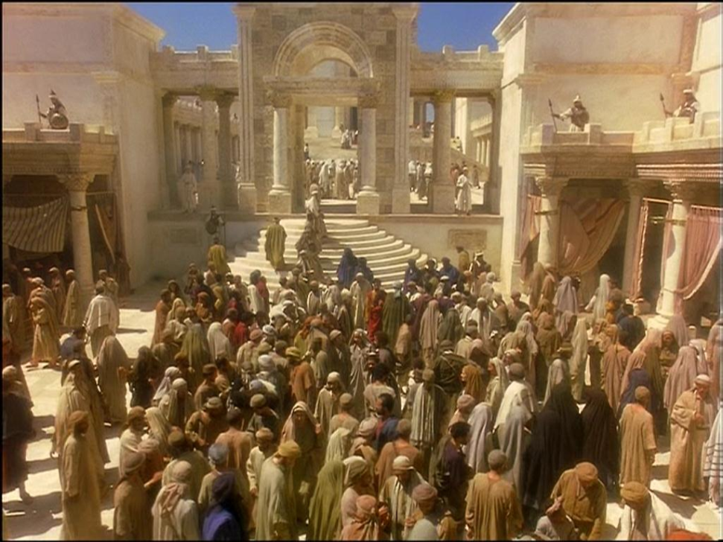
Chapter of Questions.
2

Slide 4
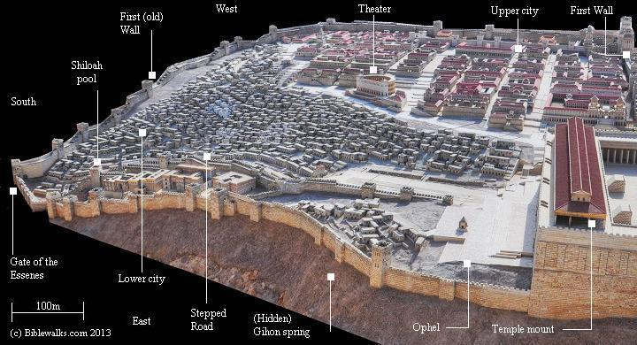
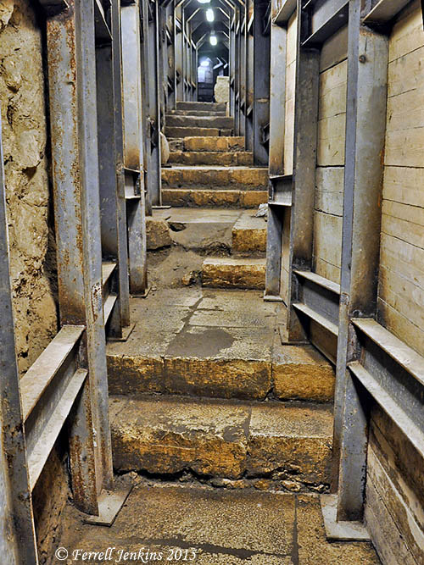
Do you believe ?
3

Slide 5
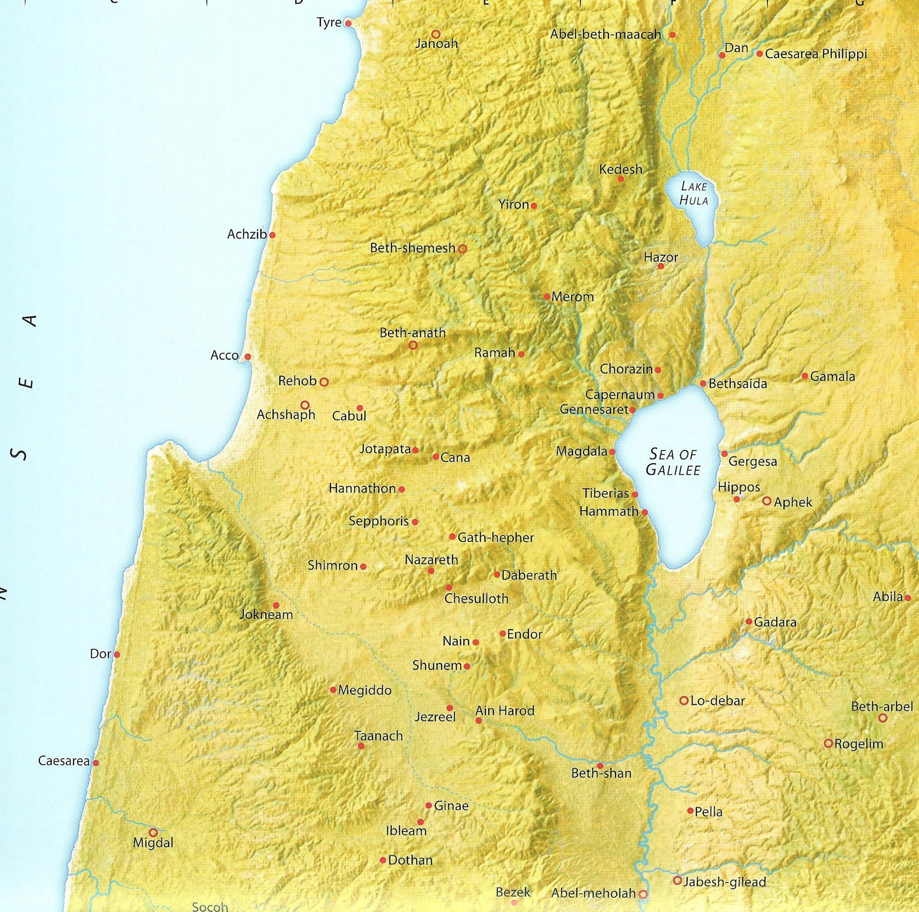
Seven Sabbath Healings
Man with unclean spirit. Mark 1:23-26.
Peters mother- in- law. Mark 1:29-31
The lame man. John 5:1-18
Man with withered hand. Luke 6;6-11
Man born blind. John 9:1-34
Crippled woman. Luke 13:10-17
Man with dropsy. Luke 14:1-6
Jesus had complete control over all things carnal, as he will in the Sabbath to come.
“Have thou the dominion.”
4

Slide 6
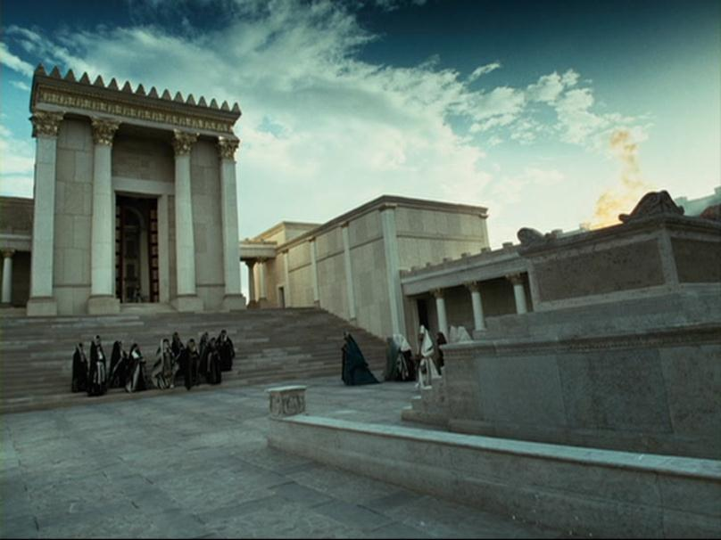
5

Slide 7
6

Slide 8
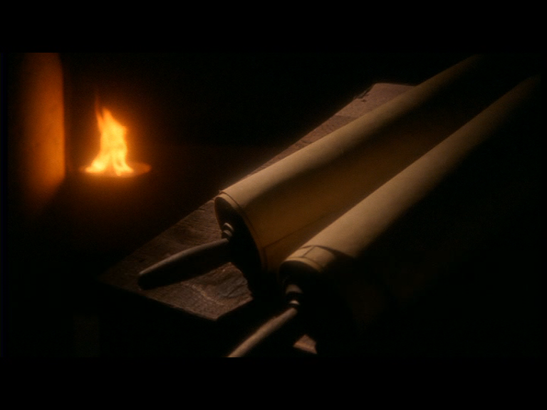
Faith in Gods Promise
Next session (God willing)
“Have faith in God.”

Slide 9
John 7:1-3
ch.2
ch.5
John 7:10
3

