Slide 1
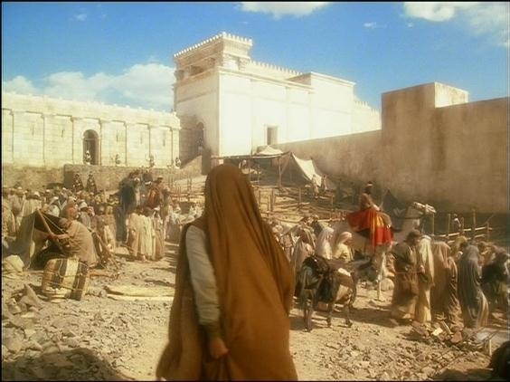
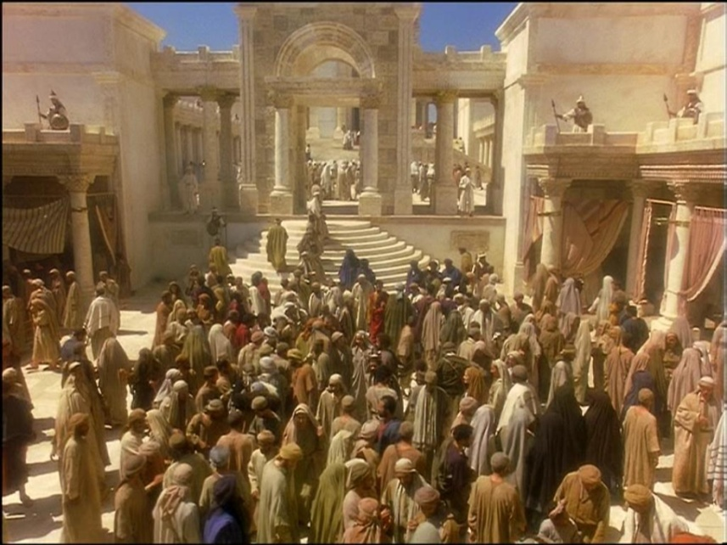
Perth Central Y. G. Weekend 2013
Faith in Gods Promise
Have faith in God
Mark 10:46 -11:1-24

Slide 2
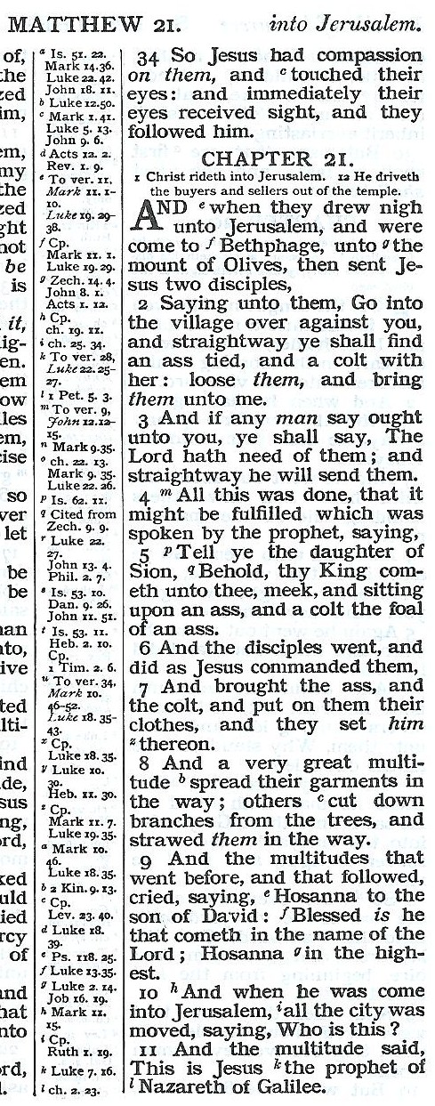
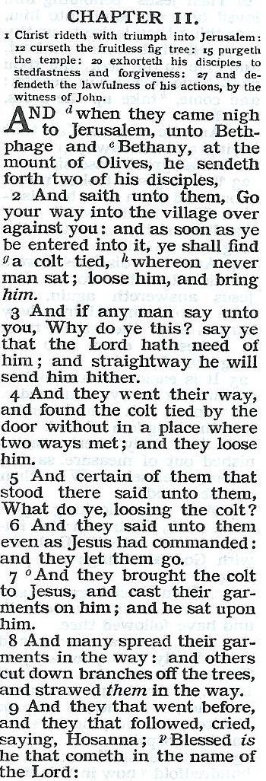
Two would become one!
2
Two villages (or 2 houses)
Bethphage. (house of figs)
Bethany. (house of dates)
Two disciples
Probably Peter and John.
Two animals
Donkey and colt.
Two ways
One leading to figs.
One leading to dates.
Two crowds
One who followed from Galilee & Perea & joining those at Bethany.
The other coming out of the city.
2

Slide 3
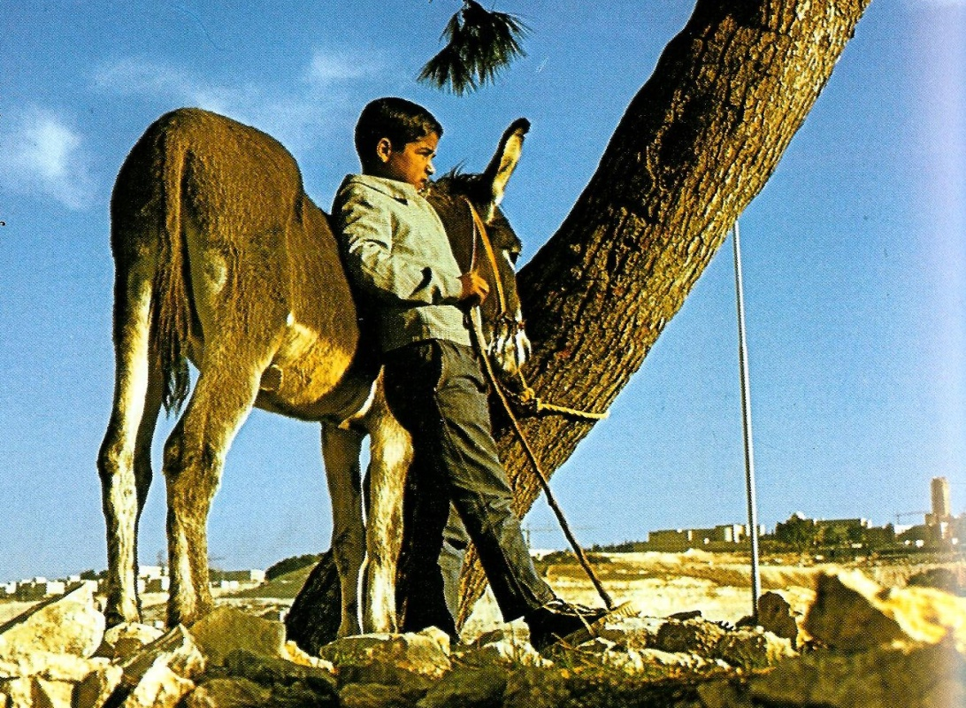
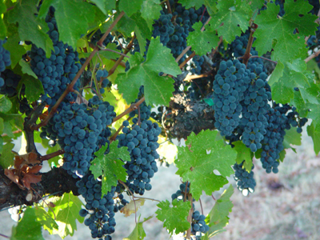
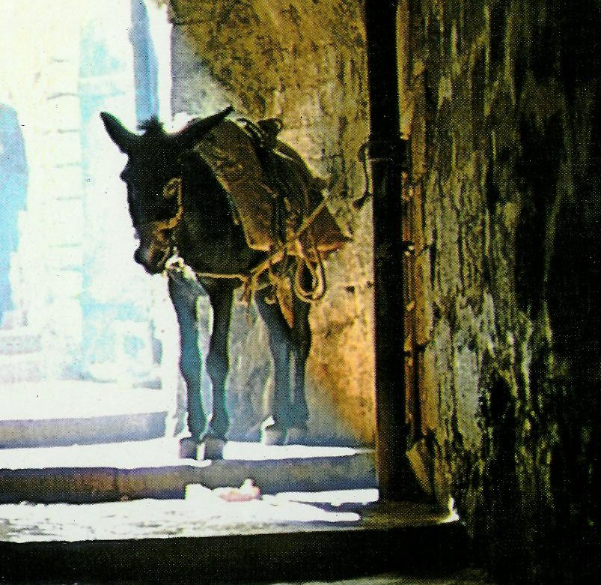
Gk. = a donkey
Gk. = under the yoke
4
3

Slide 4
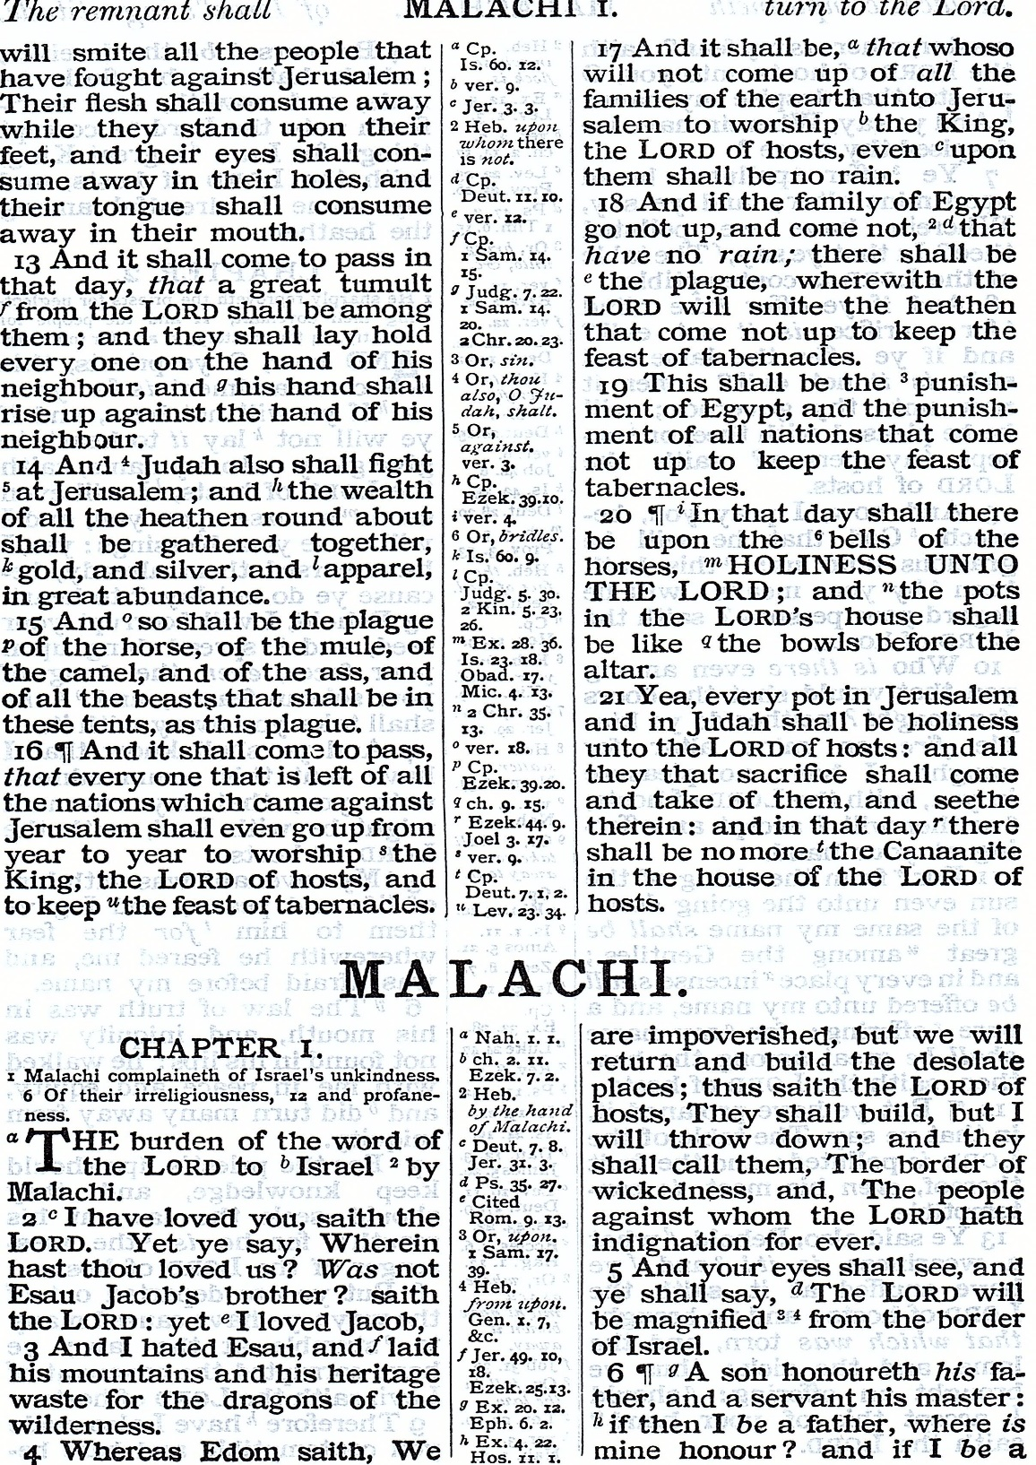
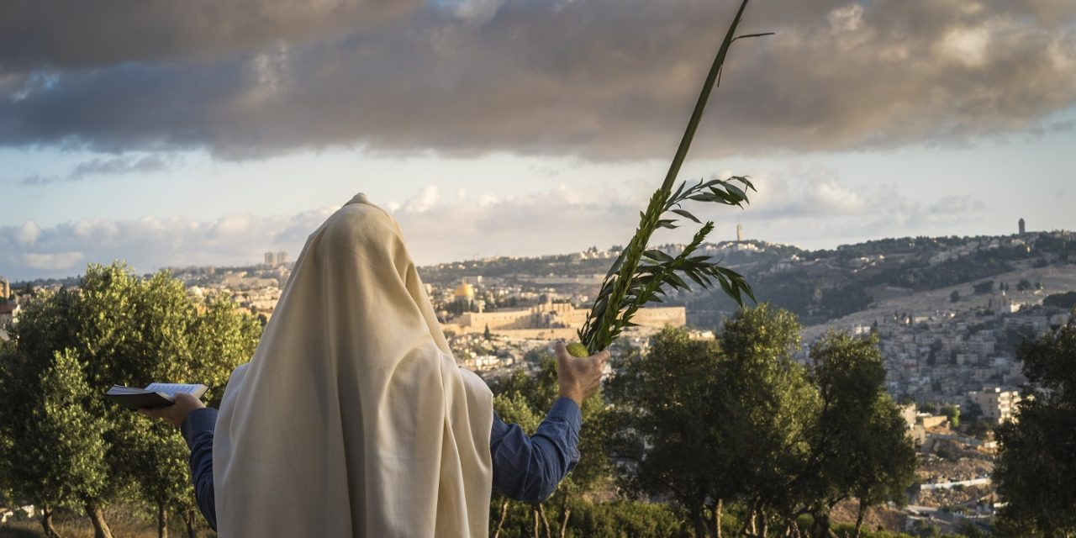
4

Slide 5
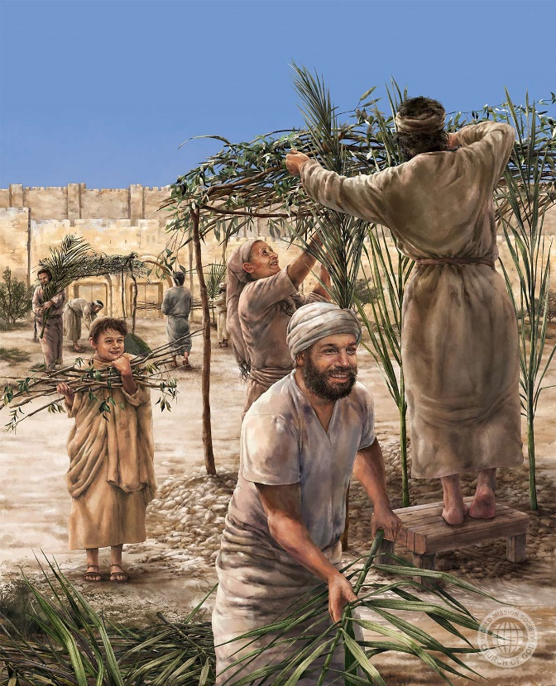
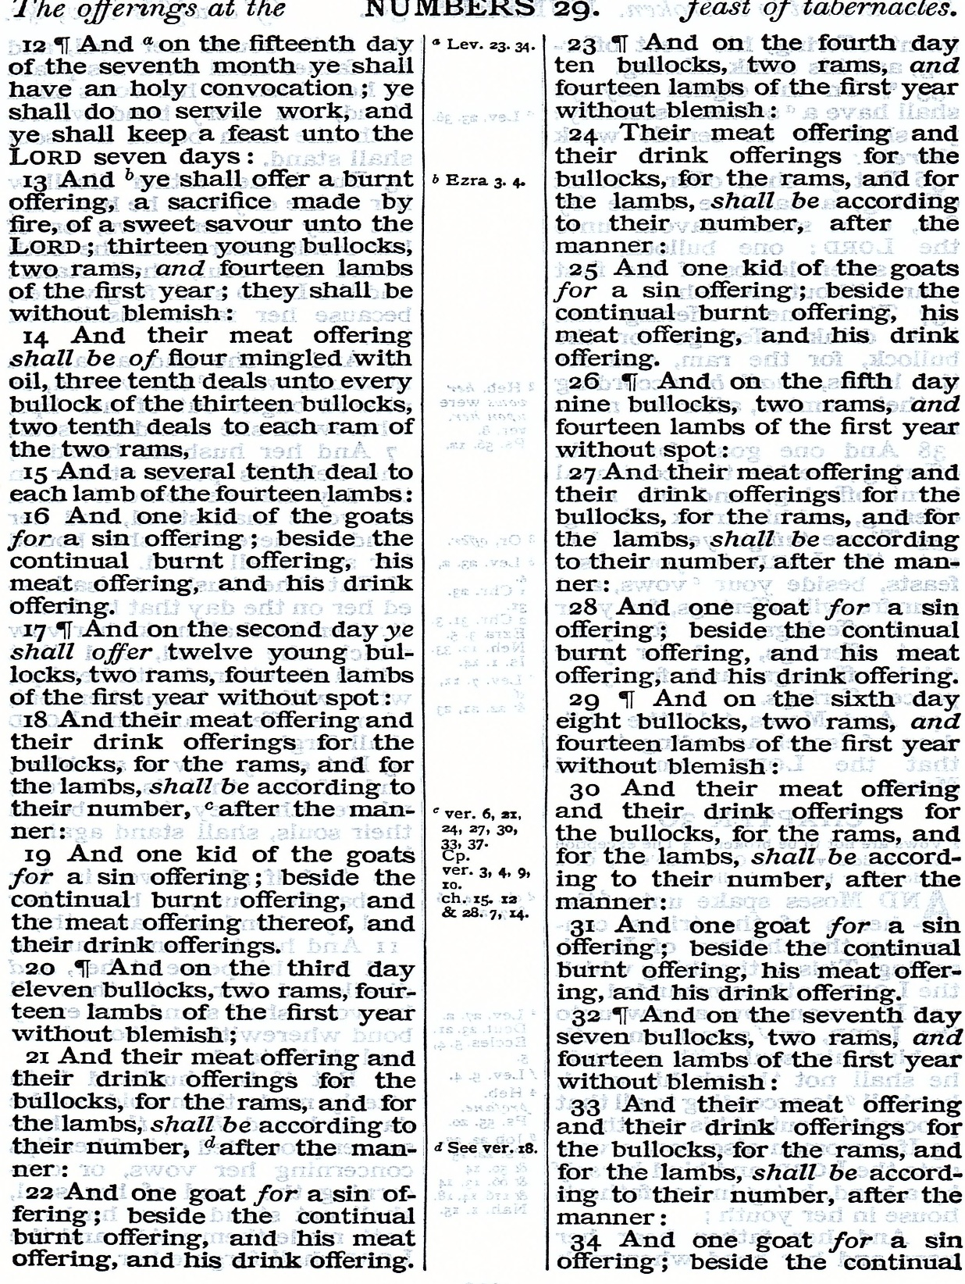
70
All nations keeping the feast of tabernacles
5

Slide 6
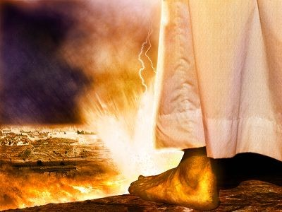
Merchant
Trafficker
When Jesus rode into Jerusalem, he knew that in 5 days time he would proclaim, “This is the blood of the new covenant.”
6

Slide 7
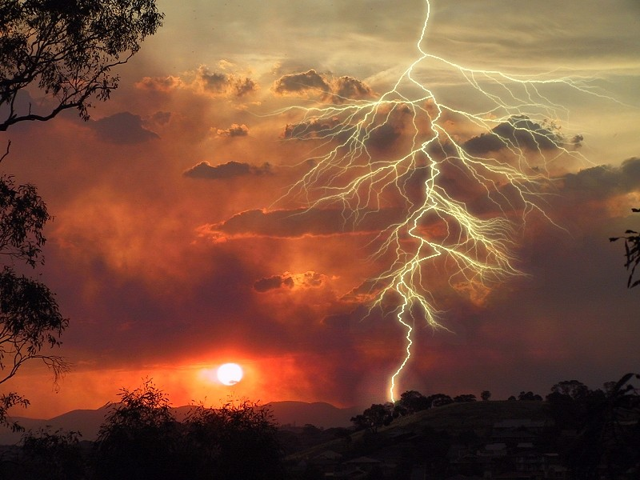
Faithful to the end
Next session (God willing)
“When shall these things be?”
“What shall be the sign of thy coming?”
“When shall be the end of the world”
“For as the lightning cometh out of the east, and shineth even unto the west; so shall the coming of the Son of man be.” Matt. 24:27

Slide 8
“Confident anticipation in things hoped for.”
Study 1. Luke 4 - Jesus in the wilderness was confident in the words spoken by the Father.
Study 2. Mark 2. Four friends whose confidence in Jesus went beyond hopefulness to enter the realm of spiritual certainty.
Study 3. John 9 The man born blind was challenged to remain confident in words spoken by the Son.
Study 4. Mark 11. Disciples are called to step out of themselves to have confidence in the larger purpose of God.

