Slide 1
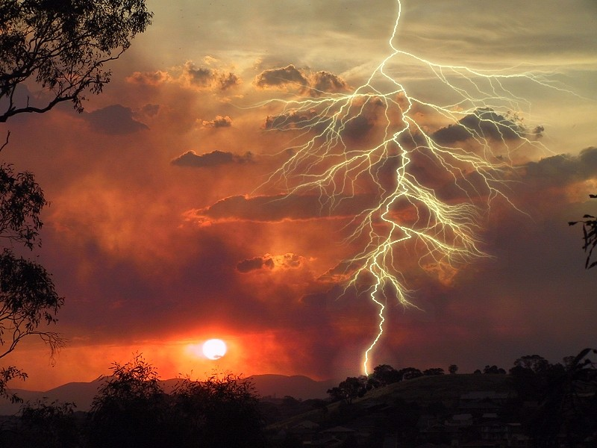
Faithful to the end
“When shall these things be?”
“What shall be the sign of thy coming?”
“When shall be the end of the world”
“For as the lightning cometh out of the east, and shineth even unto the west; so shall the coming of the Son of man be.” Matt. 24:27

Slide 2
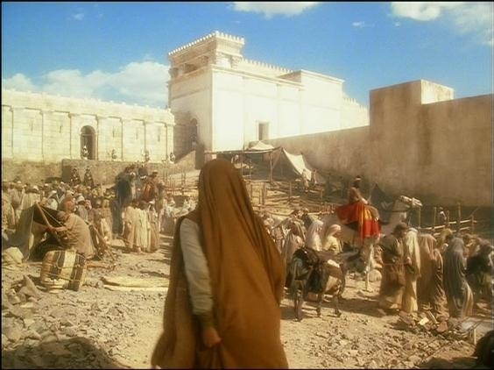
“Confident anticipation in things hoped for.”
Study 1. Luke 4 - Jesus in the wilderness was confident in the words spoken by the Father.
Study 2. Mark 2. Four friends whose confidence in Jesus went beyond hopefulness to enter the realm of spiritual certainty.
Study 3. John 9 The man born blind was challenged to remain confident in words spoken by the Son.
Study 4. Mark 11. Disciples were called to step out of themselves to have confidence in the larger purpose of God.
Study 5. Matt. 24-25 You and I are encouraged to anticipate with every confidence that soon our Lord will be here.
2

Slide 3
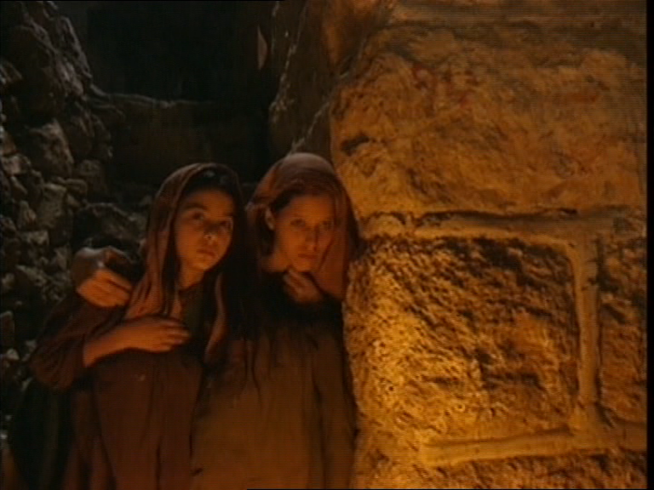
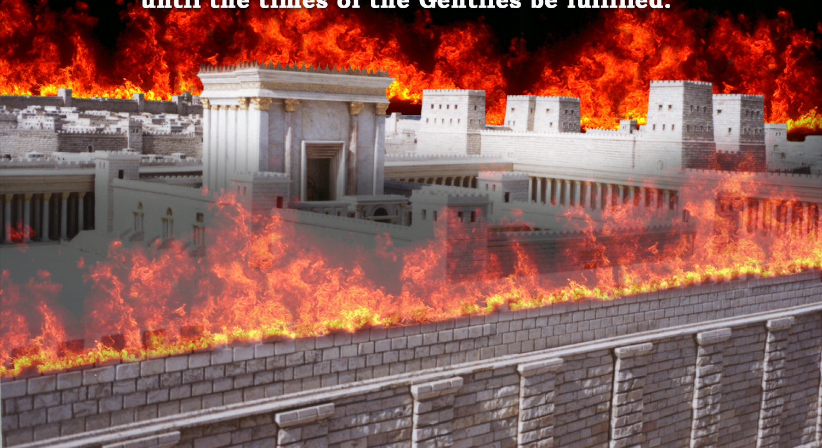
Two Houses
Matt.24 & 25
National
23:38. 24:1-2
Personal
24:43
2

Slide 4
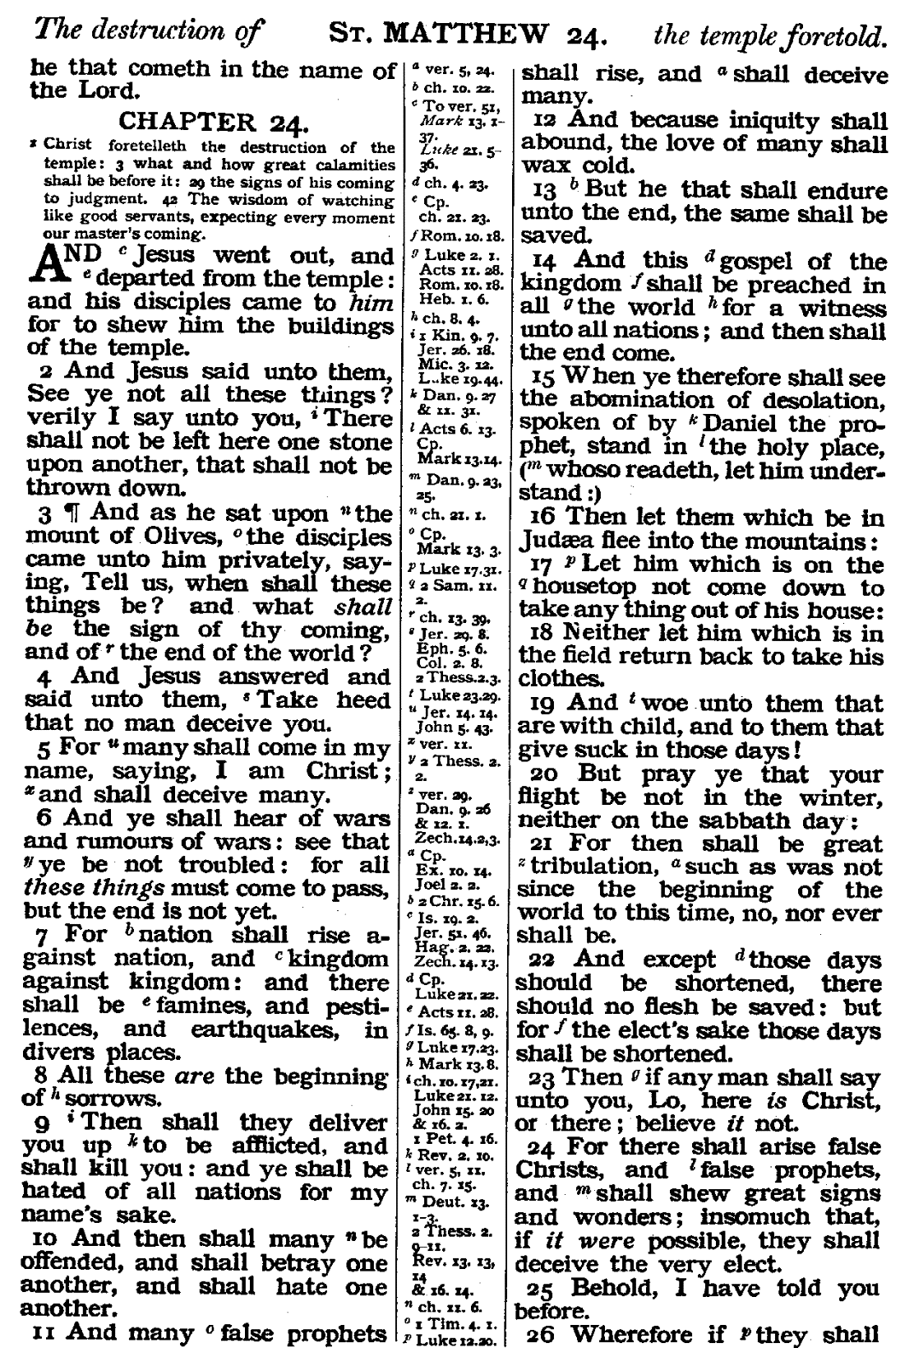
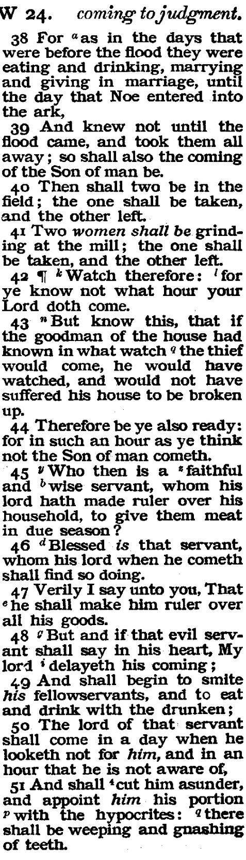
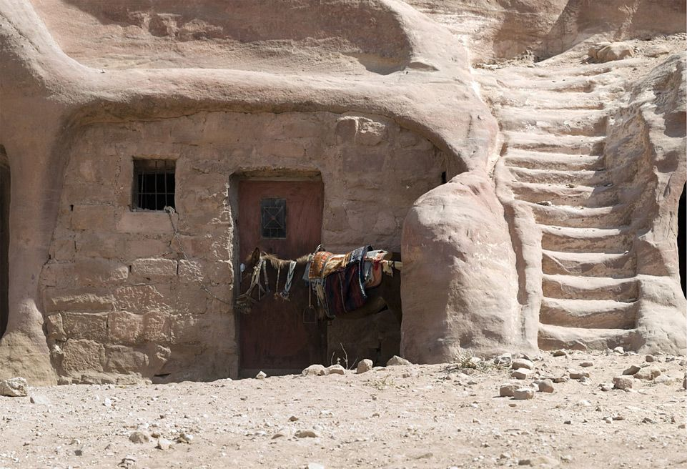

Slide 5
Two Houses
Matt.24 & 25
National
23:38. 24:1-2
Personal
24:43
2

Slide 6
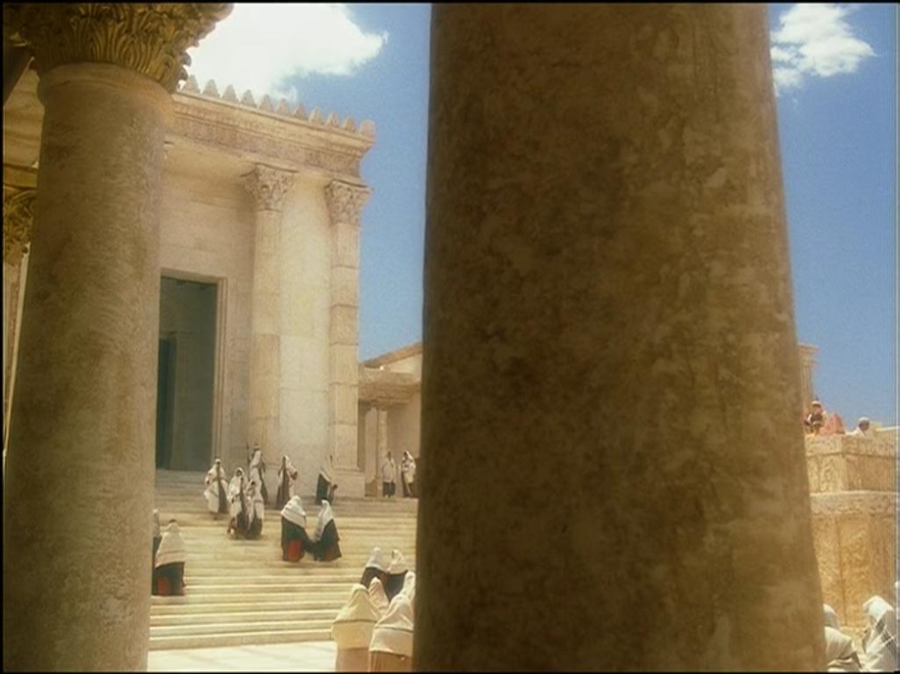
What shall be the sign of thy coming?
“And as he sat upon the mount of olives, the disciples came unto him privately, saying, Tell us, when shall these things be? And what shall be the sign of thy coming, and of the end of the world?” Matt. 24:3
3 Questions
When? - Temple destroyed.
What? - Sign of thy coming.
When? - End of the World (Age)
3

Slide 7
What shall be the sign of thy coming?
End of age equated with presence of Jesus
Jesus would come in apostles life time
Matt.10:23
John 21:18-23
Matt.24:14 cp Col.1:23
4

Slide 8
What shall be the sign of thy coming?
“And as he sat upon the mount of olives, the disciples came unto him privately, saying, Tell us, when shall these things be? And what shall be the sign of thy coming, and of the end of the world?” Matt. 24:3
Phrase is exclusive to Matthew among the gospel writers.
Only occurs 7 times in N.T.
In all cases it refers to end of the Jewish age. AD 70
Matt. 13:39, 40, 49. Matt. 24:3. Matt. 28:20. 1 Cor.10:11. Heb.9:26
5

Slide 9
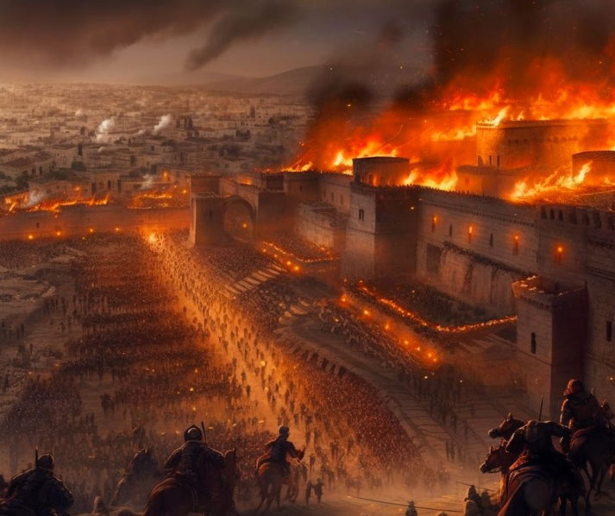
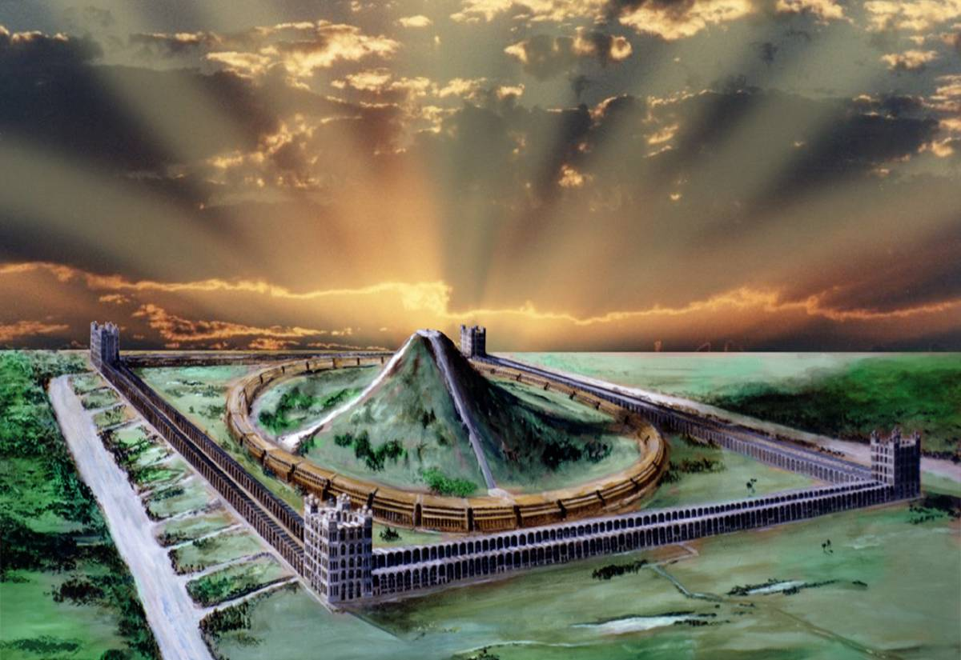
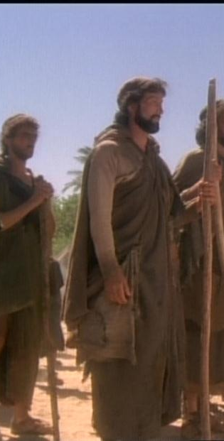
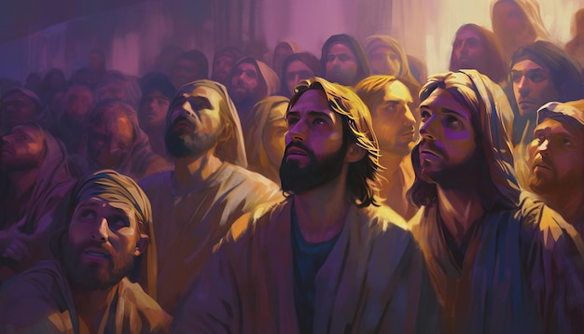
The 3 comings of our Lord
40 yrs
2000 yrs
1st coming through John's baptism Acts 13:24
Isa. 40:3
2nd coming to take away the daily sacrifice
3rd coming to remove the kingdom of men and to restore the kingdom to Israel
Matt 24:15
Dan. 8:9-11

Slide 10
What shall be the sign of thy coming?
“Titus was adored by the Eastern Legions, which under his command, had recently achieved the conquest of Judea.”
Psa.18:14
Nah. 3:3
Zech.9:14
Edward Gibbon
“For as lightning cometh out of the east, and shineth even unto the west; so shall the coming of the Son of man be.” Matt. 24:27

Slide 11
What shall be the sign of thy coming?
“The Roman armies were the military embodiment of the power of Jesus of Nazareth , the king of the Jews, for the destruction of the Mosaic Commonwealth: so that where the Roman power was , there was the anointed prince Royal of Judah, whether he were visible to mortal eyes or not.”
Bro. Thomas Last Days of Judah's Commonwealth. p.28
7

Slide 12
Tale of Two Houses
Matt.24
National
Vv.1-2
Personal
v.42-43
1
8

Slide 13
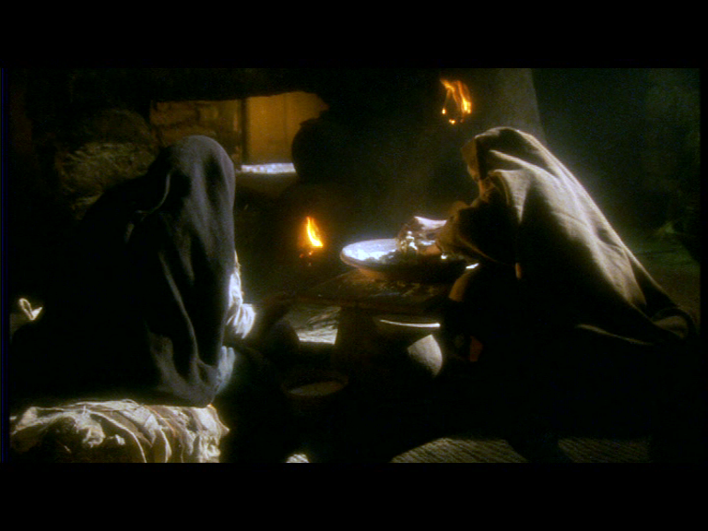
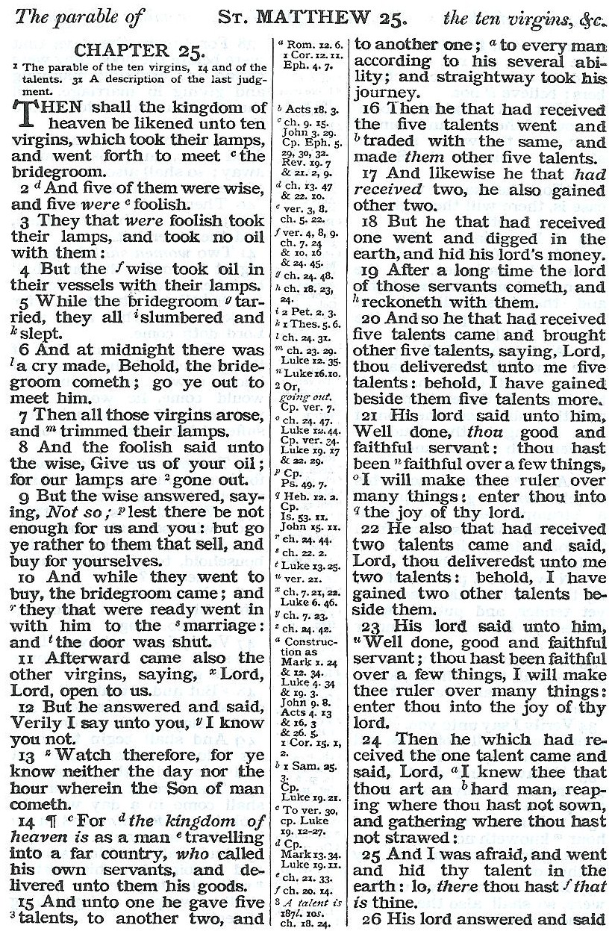
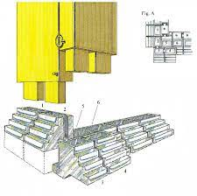
Gr. = “a torch” a flaming torch”
Note John 18:3
Acts 20:8
Rev. 4:5 Rev.8:10
Two hands and the house stands!
Note Exod. 26:15-17
V.7 “trimmed” Gr.= Kosmeo “adorned”
Note Rev. 21:2
“And I John saw the holy city, new Jerusalem, coming down from God out of heaven, prepared as a bride adorned for her husband”
10
“Two tenons”
Heb. = Two female hands
2
9

Slide 14

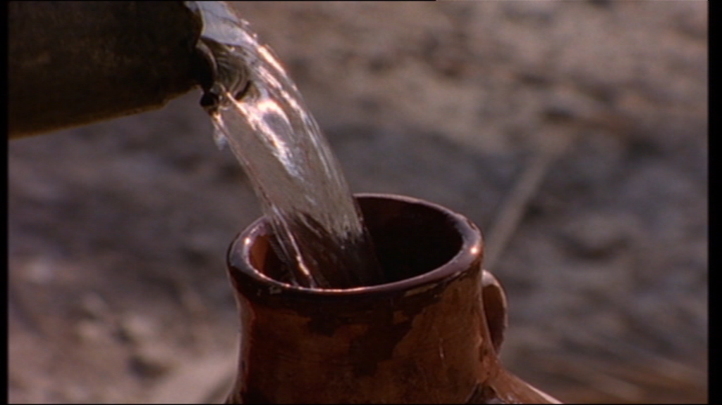
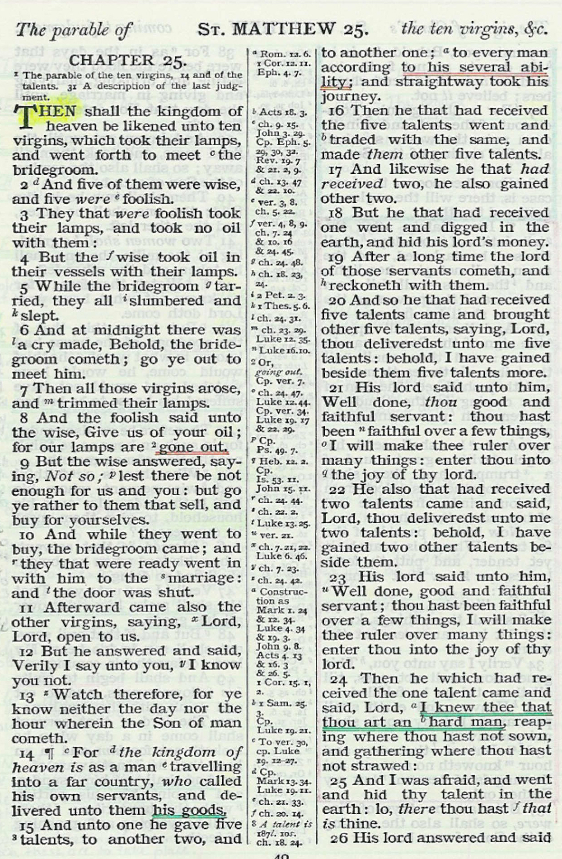
Tell us, when shall these things be?
‘Delivered’
“But God be thanked, that ye were the servants of sin, but ye have obeyed from the heart that form of doctrine which was delivered you” Rom.6:17
5 5
“ye have obeyed from the heart that form of doctrine where to ye were delivered ”
2 2
1 0
The Nazarite
The Nazarite
Numbers 6
Temporary
Numbers 6
Perpetual
Temporary
Perpetual
MANY
SAMSON
MANY
SAMSON
SAMUEL
Separate in 3 things.
SAMUEL
JOHN the BAPTIST
Separate in 3 things.
JOHN the BAPTIST
Joy and happiness would come through uncluttered communion with God.
The Vine
Joy and happiness would come through uncluttered communion with God.
The Vine
3 only!
3 only!
The Hair
Crown of Glory.
Dignity free of transgression.
Crown of Glory.
Dignity free of transgression.
The Hair
Jer. 7:29
Jer. 7:29
The Dead
Removed from that which corrupts.
The Dead
Removed from that which corrupts.
Symbol of Priest
and High Priest
Symbol of Priest
and High Priest
Lev. 21:1-2, 10-11
Lev. 21:1-2, 10-11

Slide 15
But know this, that if the Goodman of the house had known in what watch the thief would come, he would not have suffered his house to be broken up’ Matt. 24:43
Faithful to the end

Slide 16
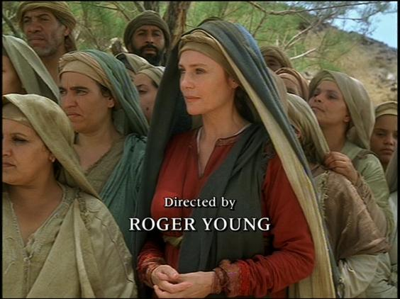
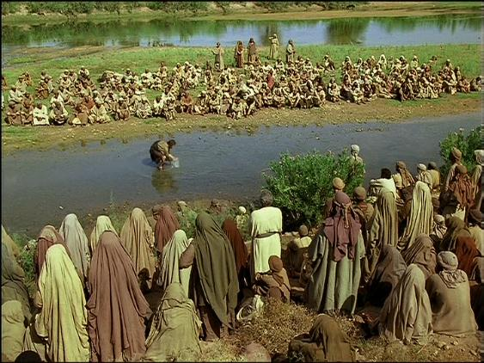
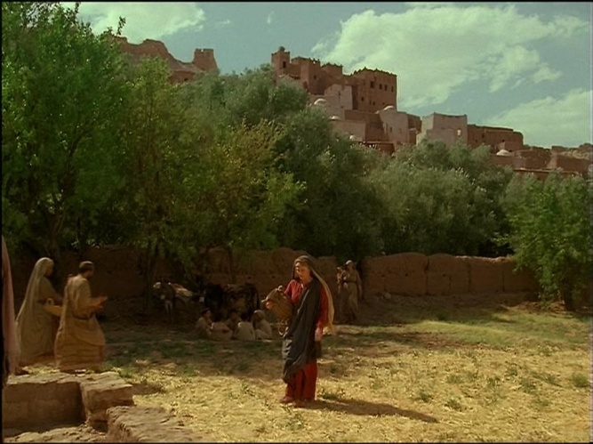
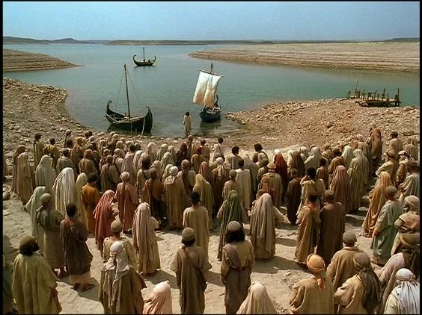
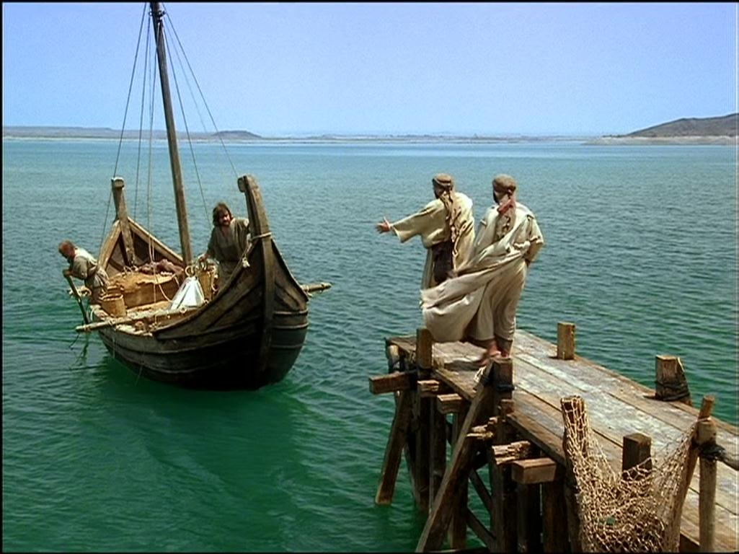
Faith overcoming all things

Slide 18
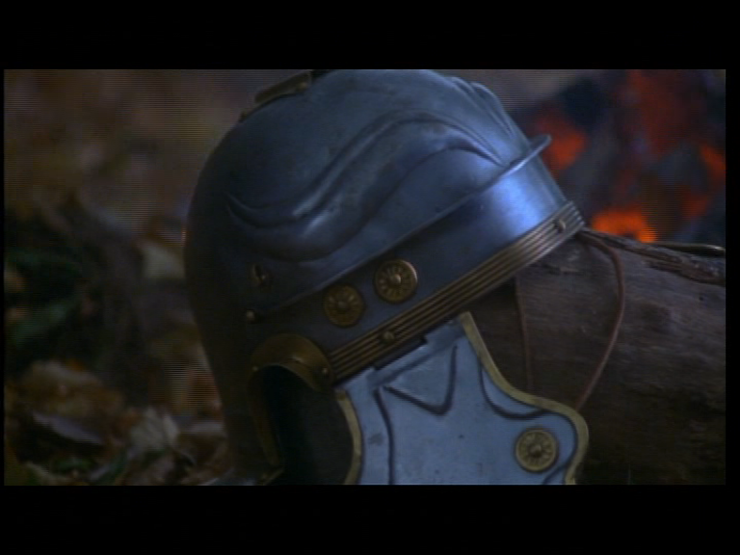
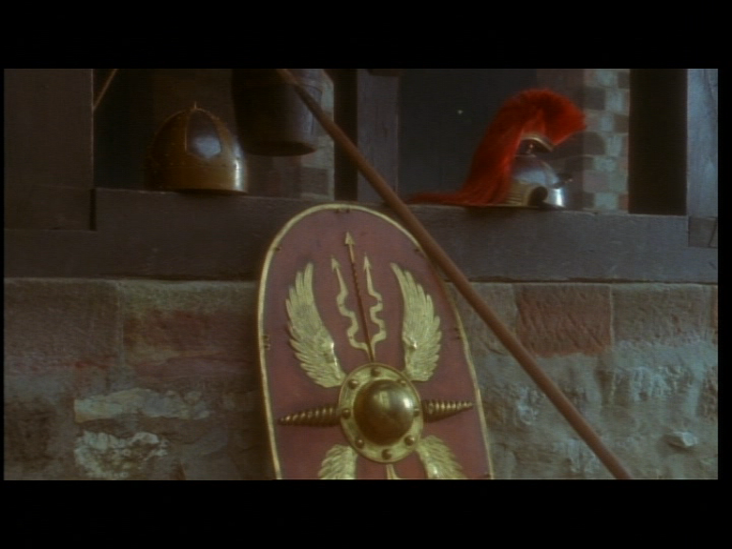
What shall be the sign of thy coming?
He worked through the Roman army and came in their coming.
Matt.24:27-28 Rome
Weapon used by God.
God’s executioners.
His army / His people.
Deut.28: 48-49 Rome
Rome
"The people of the Prince"
Dan.9:26
"The armies of the King"
Mattt.21:40-41
Mattt.22:7
End of age equated with presence of Jesus

Slide 19
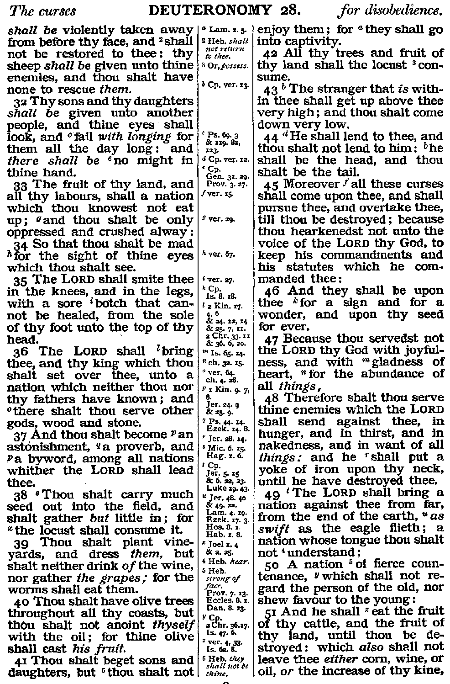
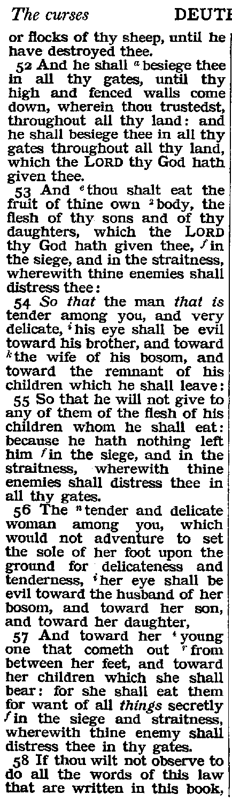
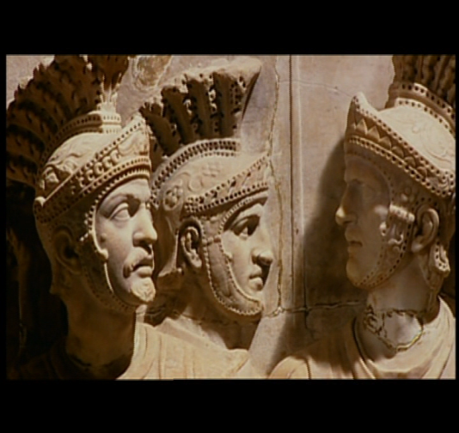
The iron power of Neb’s Image .
Dan.2
The iron band round the stump of the Babylonian tree
Dan.4
The fourth beast with great iron teeth
Dan.7
One of the fowls of the air that would devour the carcase of Israel. v26
From the end of the Eastern System of powers of which Israel was a part.

Slide 20
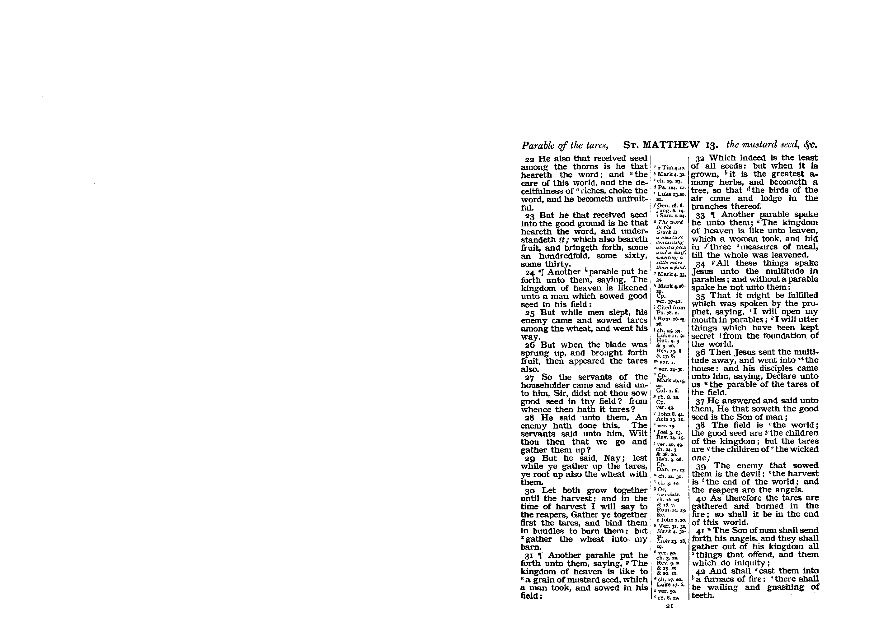
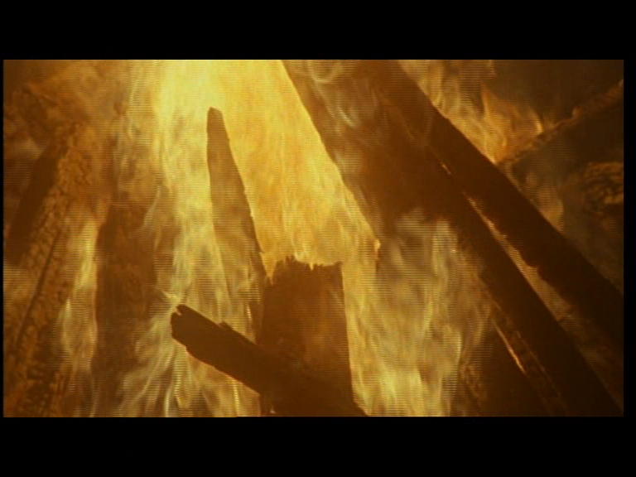
Coming of Christ
in the parables
Jesus
Truth
Jewish World
Authorities
End of Mosaic Age
Roman Army
Isa.31:9
2Pet.3:3-4,10

Slide 21
What shall be the sign of thy coming?
He worked through the Roman army and came in their coming.
Weapon used by God.
God’s executioners.
His army / His people.
Matt.24:27-28 - Rome
End of age equated with presence of Jesus
6

