Slide 1
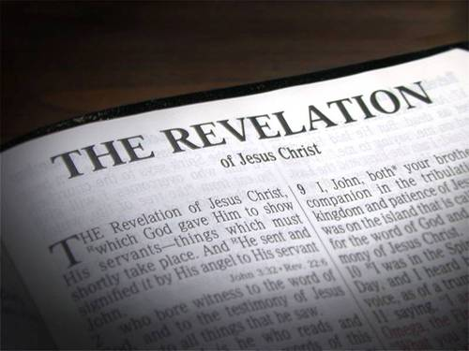
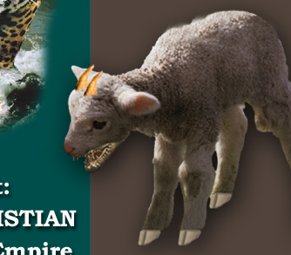
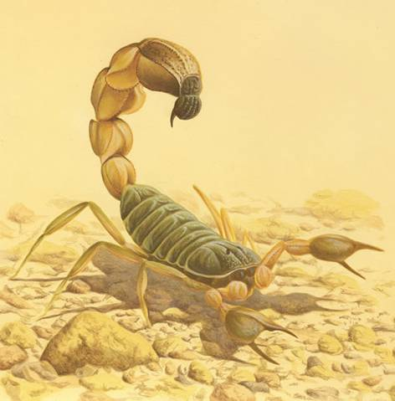

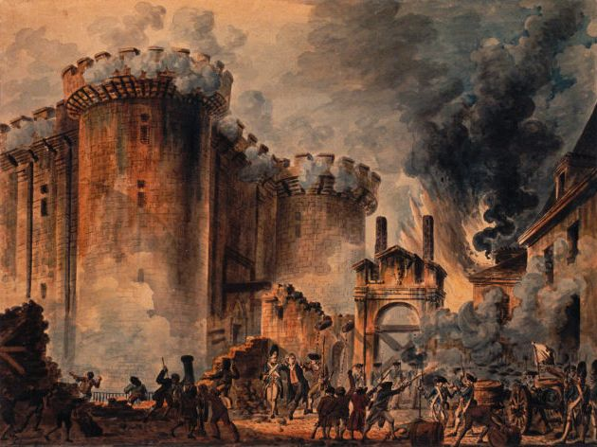
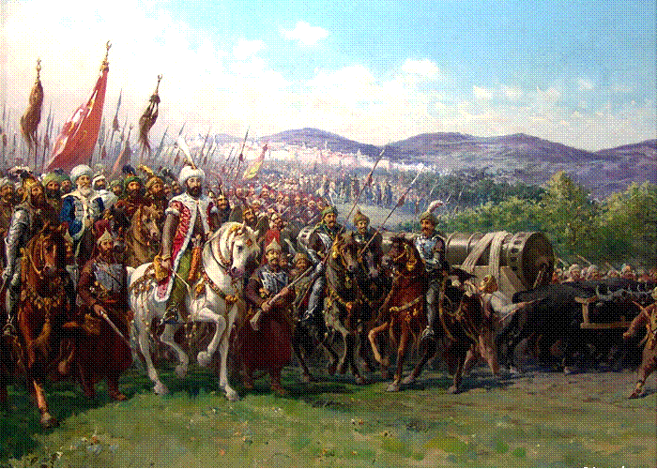
Time Periods of the Apocalypse.
“Blessed is he that Readeth”

Slide 2

Time Periods of the Apocalypse.
8:1 1/2hour 14yrs
8:12 1/3 day & 1/3 night 240yrs
9:5 5 months 150yrs
9:10 5 months 150yrs
9:15 1 hour-1 day–1 month–1 year 391yrs 1mth
11:2 Forty two months 1260yrs
11:3 1260 days 1260yrs
11:9 3 1/2 days 105yrs
11:13 1 hour 30yrs
12:6 1260 days 1260yrs
12:14 Time, Times, Dividing of Time 1260yrs
13:5 42 months 1260yrs
14:7 1 Hour 30yrs
17:12 1 Hour 30yrs
18:10 1 Hour 30yrs
18:17 1 Hour 30yrs
18:19 1 Hour 30yrs

Slide 3
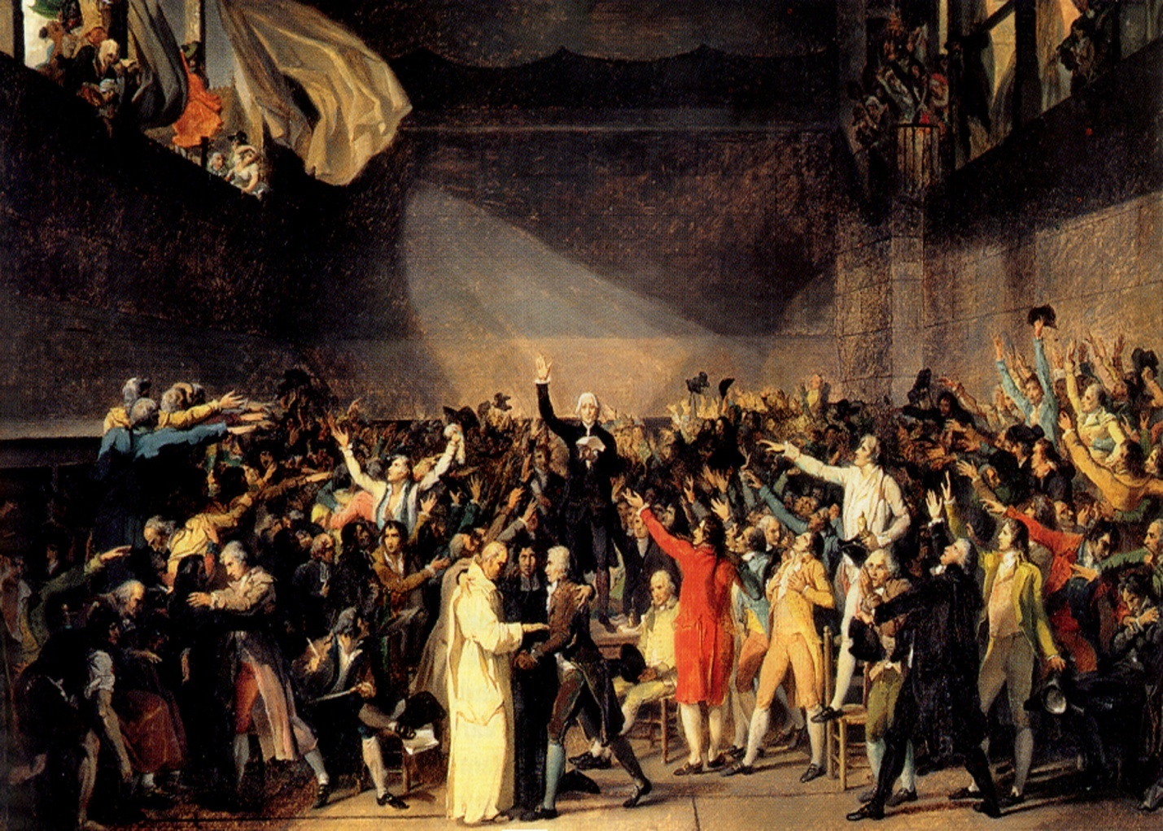
Time Periods of the Apocalypse.
  Key to unlocking time periods.
    Single conversion – Double conversion – No conversion?
Day for a Year. Gen.47:9, Num.14:34, Ezek. 4:4-6, Luke13:32

Slide 4

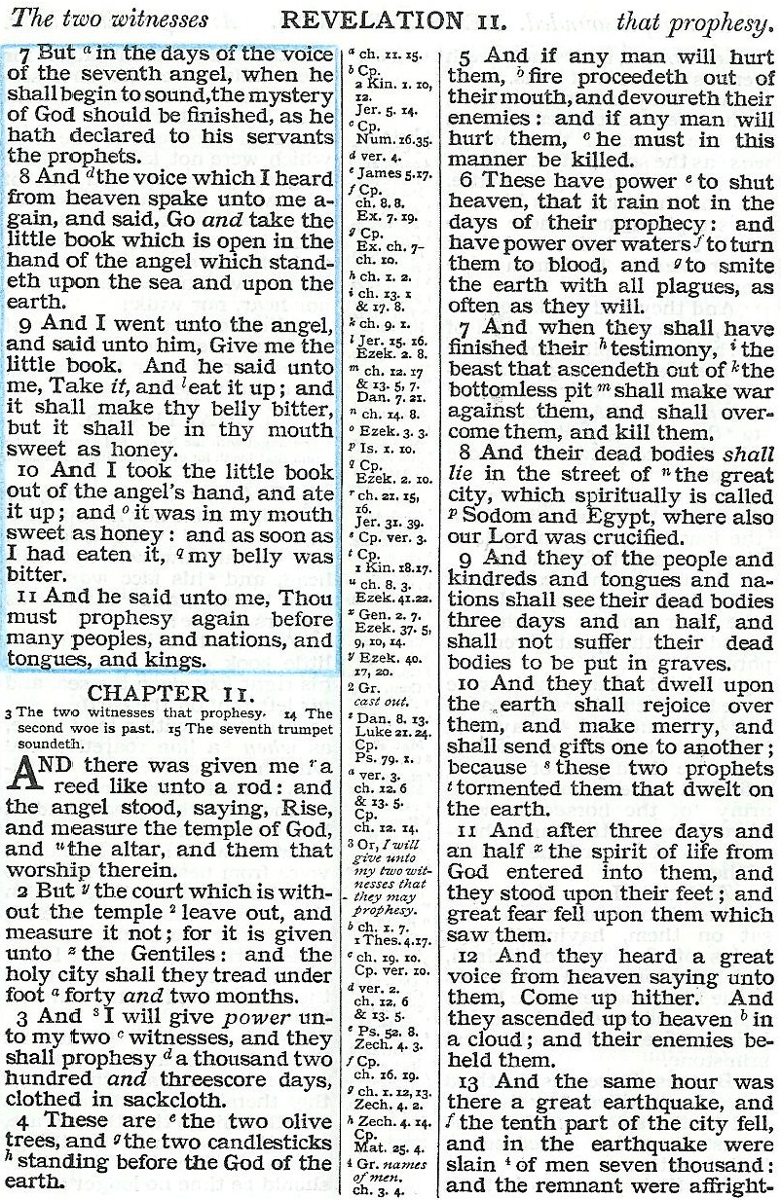
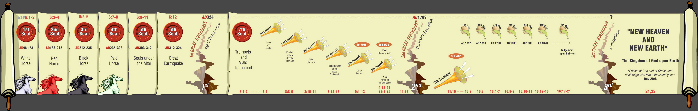
Fight!
Take away peace!
That they should feed her there 1260 days Rev. 12:6
Killed! 1572
Speak out! Beginning in 312 AD

Slide 5
Time Periods of the Apocalypse.
  Key to unlocking time periods.
    Single conversion – Double conversion – No conversion?
      Decorum of the symbol.
      Context.
      Consistent with indisputable knowns.
Day for a Year. Gen.47:9, Num.14:34, Ezek. 4:4-6, Luke13:32

Slide 6
Fight!
Take away peace!
That they should feed her there 1260 days Rev. 12:6
Killed! 1572
Speak out! Beginning in 312 AD

Slide 7
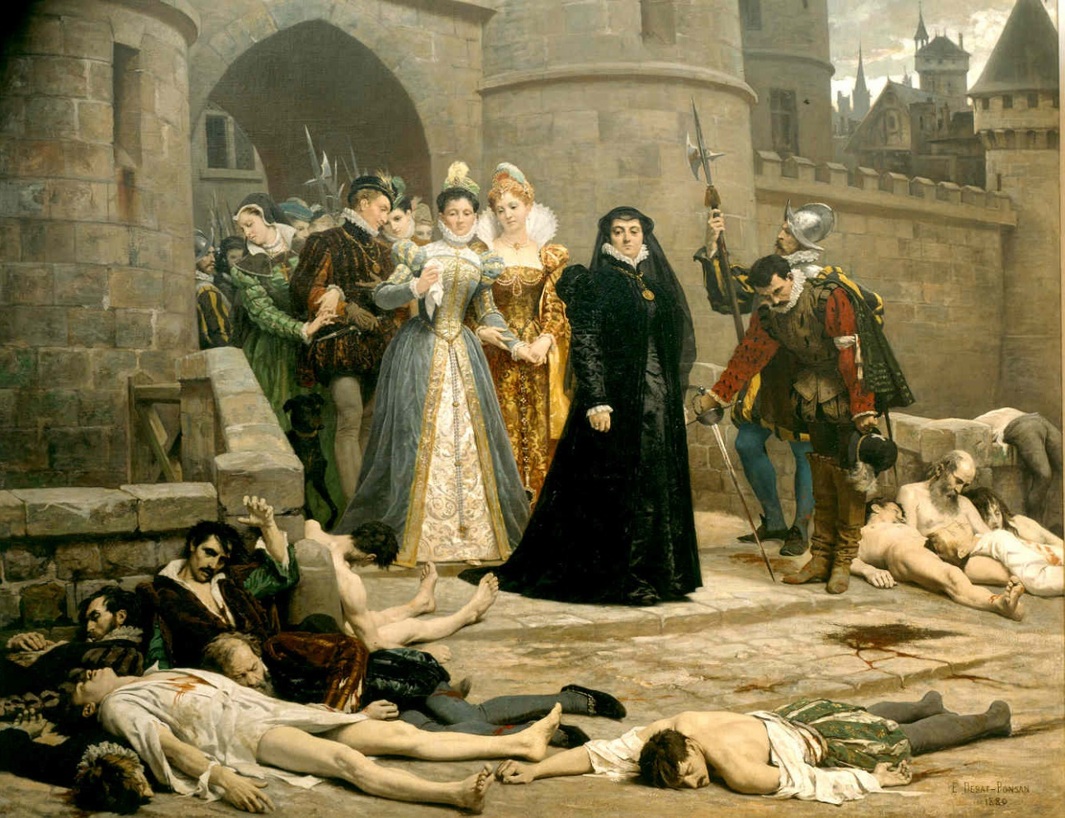
Revocation of Edict of Nantes (Witnesses suffer extreme political death) Rev. 11:8-9
Rev.11:9,11
3 ½ days (105yrs)
312
1572
1685
1789
1260yrs
1598
1685
“And their dead bodies shall lie in the street of the great city, which spiritually is called Sodom and Egypt, where also our Lord was crucified”
Edict of Nantes
Woman & Earth
Rev.11:3
Rev.12:6, 14-17
Massacre St Bartholomew's day (slaying of witnesses began) Rev.11:7

Slide 8

Death of the Witnesses
Rev. 11:9-11
Die politically.
3 ½ days later they are raised politically.
3 ½ days = 105yrs.
Bodies remained in a state of non-decay. Could not therefore be called a death of 105 days.
1685 - 1789
Decorum of the symbol requires another solution!
Days = Lunar days (time it takes for moon to revolve once around the earth. = 30 of our days.)

Slide 9
Time Periods of the Apocalypse.
8:1 1/2hour 14yrs
8:12 1/3 day & 1/3 night 240yrs
9:5 5 months 150yrs
9:10 5 months 150yrs
9:15 1 hour-1 day–1 month–1 year 391yrs 1mth
11:2 Forty two months 1260yrs
11:3 1260 days 1260yrs
11:9 3 1/2 days 105yrs
11:13 1 hour 30yrs
12:6 1260 days 1260yrs
12:14 Time, Times, Dividing of Time 1260yrs
13:5 42 months 1260yrs
14:7 1 Hour 30yrs
17:12 1 Hour 30yrs
18:10 1 Hour 30yrs
18:17 1 Hour 30yrs
18:19 1 Hour 30yrs
Single conversions

Slide 10

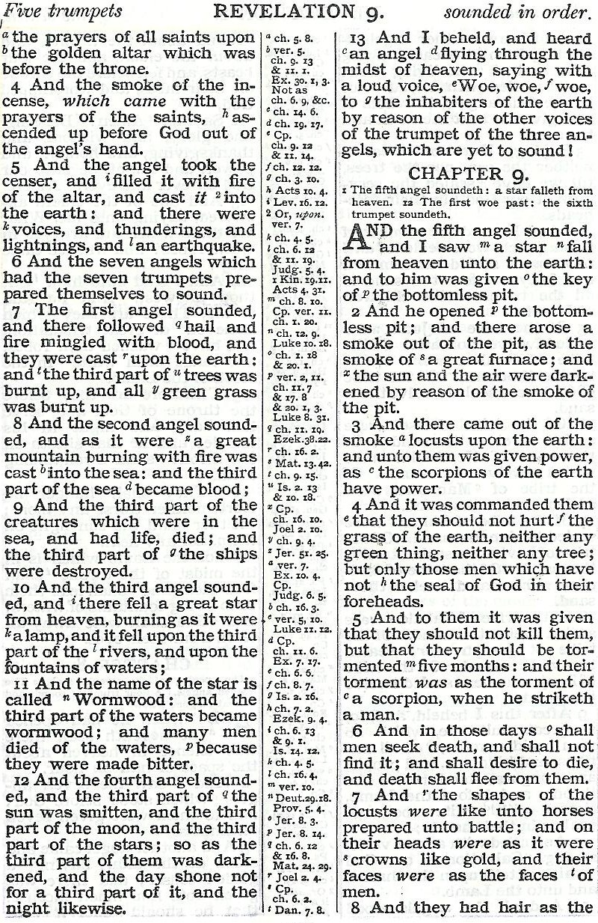
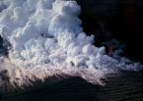
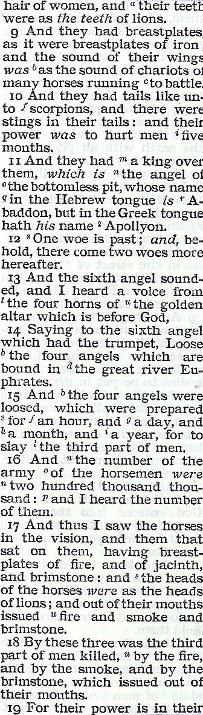
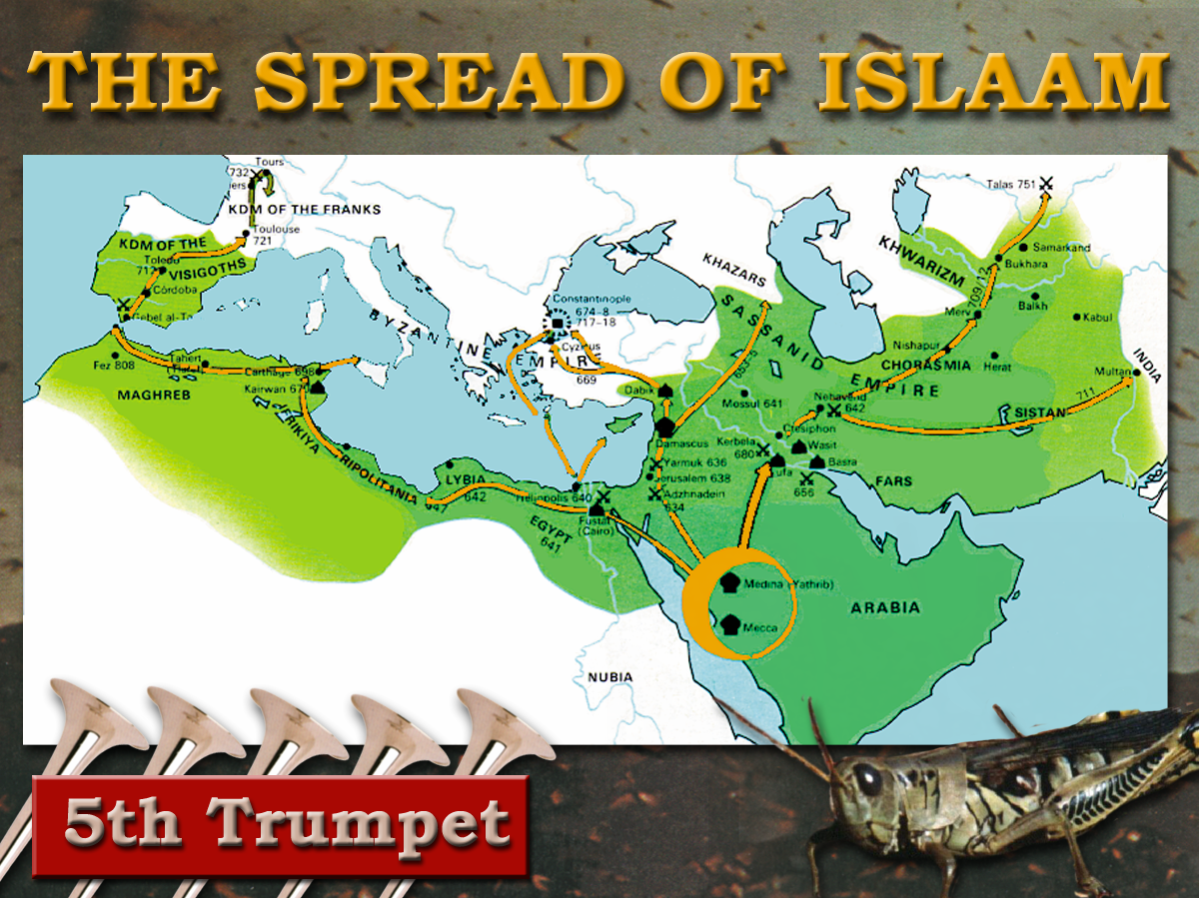
7
Trumpets
1 2 3 4 5 6
Judgement - Christian Rome

Slide 11
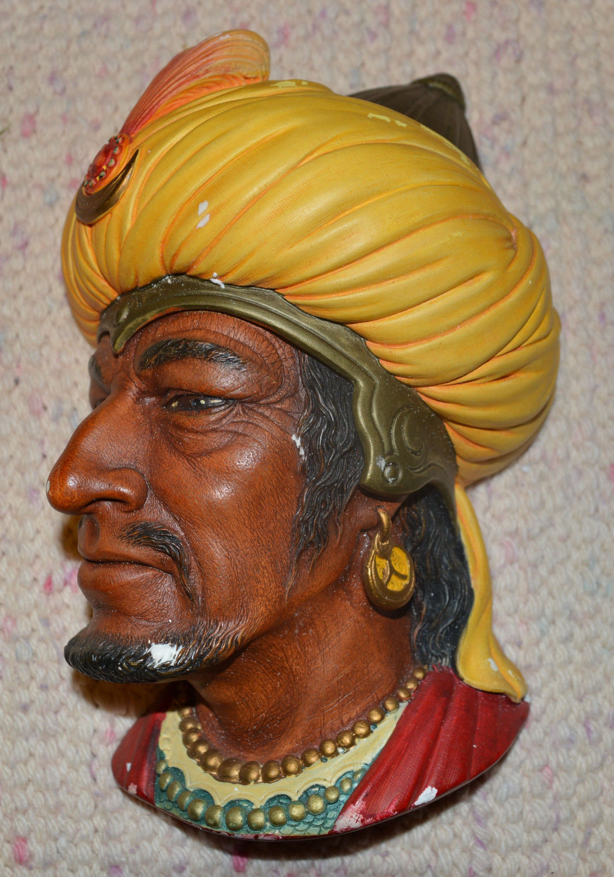
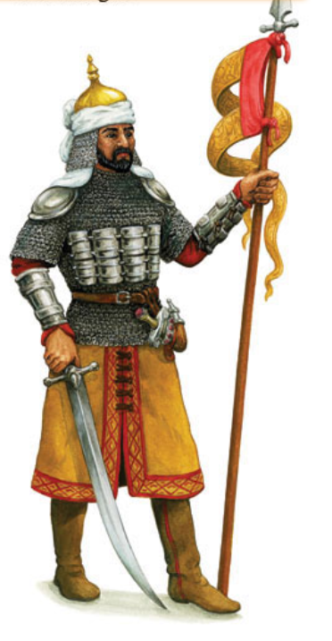
“And Allah hath given you … coats of mail which protect you in your wars”
Koran, Chap An-nahl (16), Verse 81

Slide 12
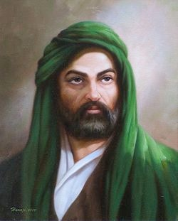
Teeth of Lions
Mohammed:
Who will be my Vizier and Lieutenant?
Ali ibn Abi Talib
O prophet, I will be thy Vizier. I am the
man. Whoever rises against thee, I will
dash out his teeth, tear out his eyes,
break his legs, rip up his belly. O
prophet, I will be thy Vizier.
Ali the Lion of Allah
Notes:
The Teeth of Lions refer to the violent manner in which Islam would treat its enemies
Ali - one of Mohammed’s followers was called “The Lion of God” - here was his ferocious mindset!
READ SLIDE.

Slide 13
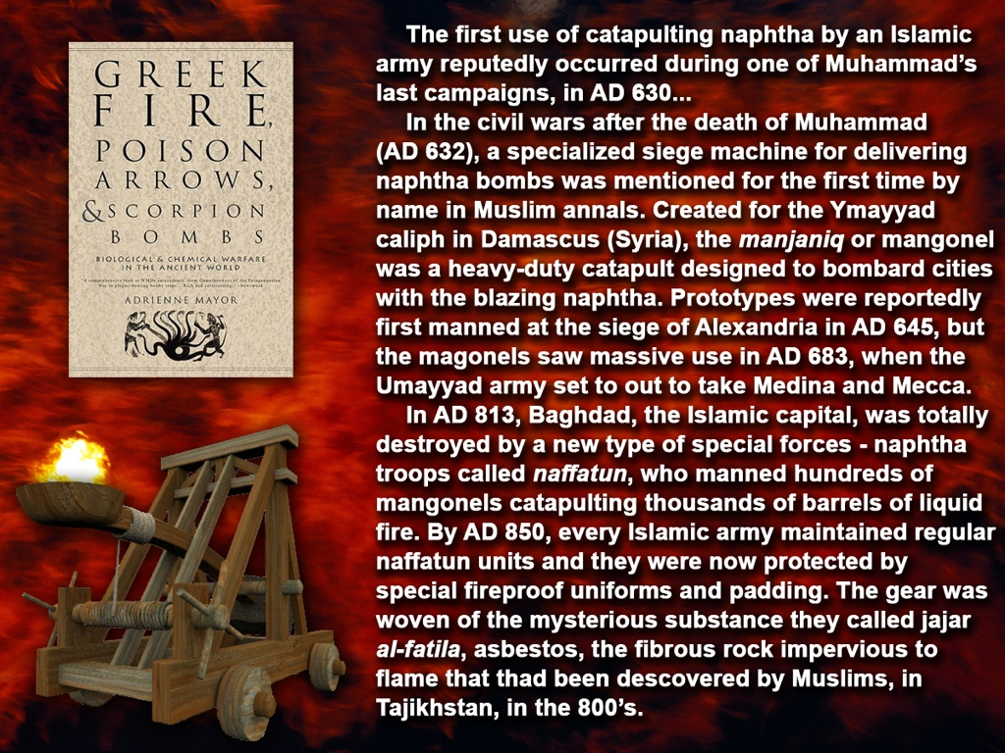
Scorpion. Dictionary definition “An ancient form of ballista or catapult for hurling stones, etc.”
“Saracen fire” Burning crude oil mixed with secret chemicals to intensify the burning.
A new and powerful sting!
AD 636 - 936

Slide 14
Time Periods of the Apocalypse.
9:5 5 months 150yrs
9:10 5 months 150yrs
9:15 1 hour-1 day–1 month–1 year 391yrs 1mth
11:2 Forty two months 1260yrs
11:3 1260 days 1260yrs
12:6 1260 days 1260yrs
12:14 Time, Times, Dividing of Time 1260yrs
13:5 42 months 1260yrs
Single conversions

Slide 15
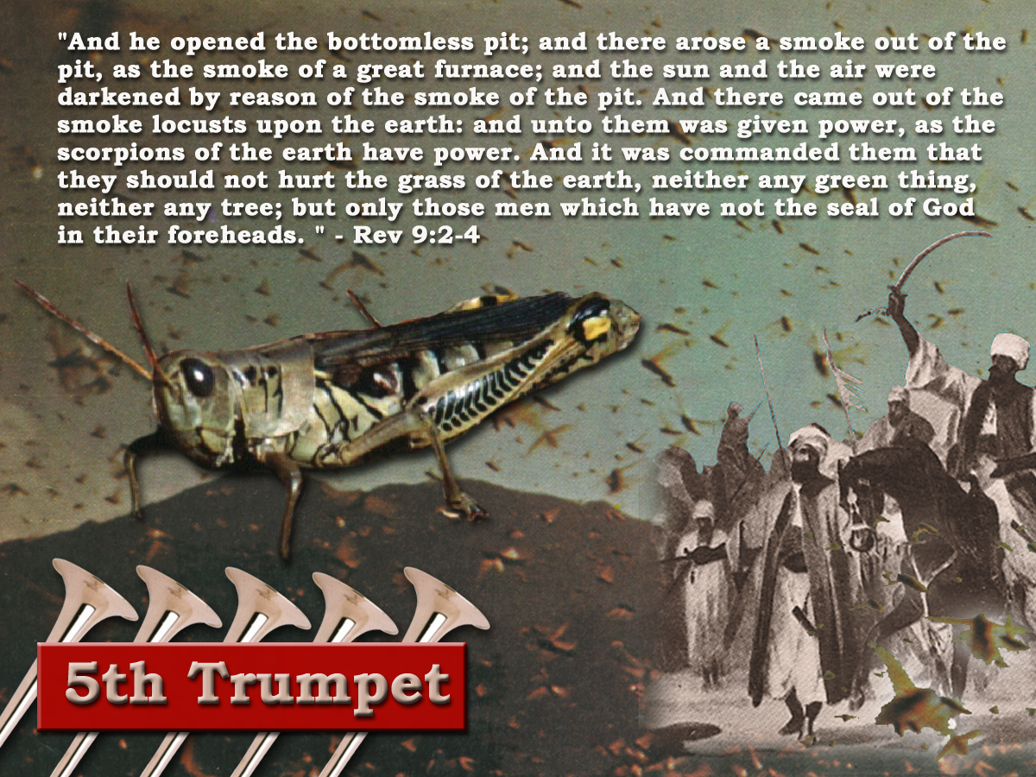
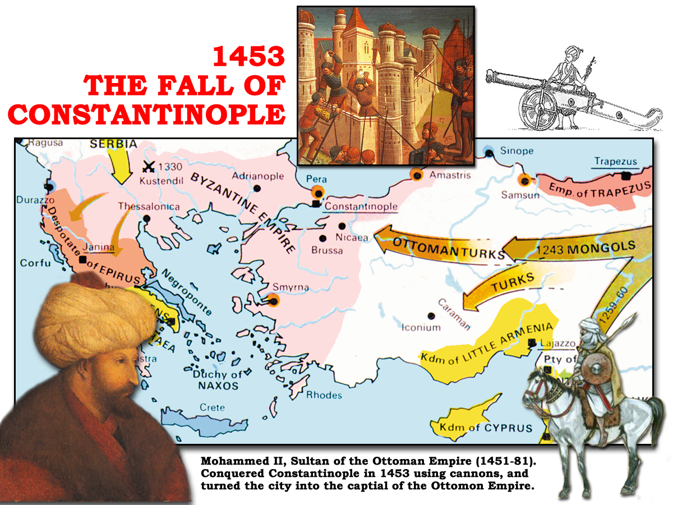
6th Trumpet
“And the four angels having been prepared were loosed for an hour, and a day, and a month, and a year, for to slay the third part of men.” Rev 9:15

Slide 16
6th Trumpet
1 hour (1/12 of a day) = 1month
1 day = 1 year
1 month (30days) = 30 years
1 year (360days) = 360 years
391years 1month
29/ 5/ 1453 Constantinople fell to Mohammed
27/ 4/ 1062 Togrul Beg married Caliph’s daughter and became head of Mohammedan faith and began series of assaults on Constantinople

Slide 17
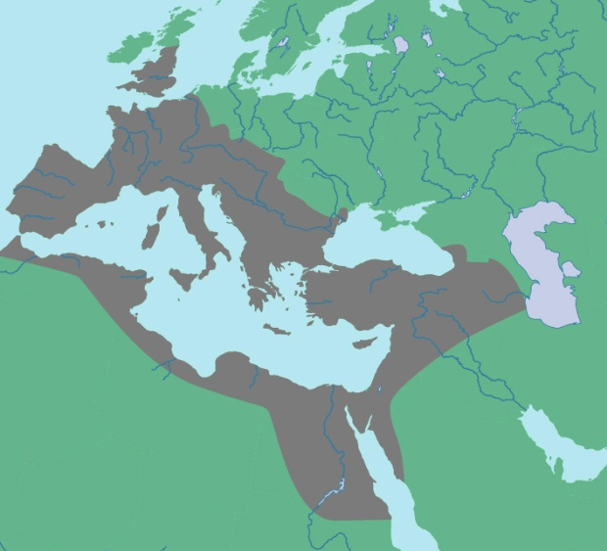
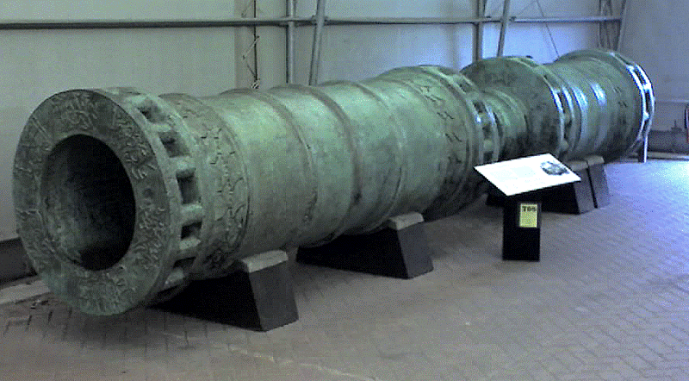
“The hinge of battle at Constantinople was gunpowder and the cannon, a weapon destined to revolutionise future warfare. And a gate left wide open.”
THE FALL OF
CONSTANTINOPLE
1453
LATIN WEST
Durschmied -The Hinges of Battle p70
HELLENIZED EAST
“And by these three was the third part of men killed, by the fire, and by the smoke, and by the brimstone, which issued out of their mouths”
HELLENIC EAST
Rev.9:18
Note v.17,19

Slide 18
Time Periods of the Apocalypse.
8:1 1/2hour 14yrs
9:5 5 months 150yrs
9:10 5 months 150yrs
9:15 1 hour-1 day–1 month–1 year 391yrs 1mth
11:2 Forty two months 1260yrs
11:3 1260 days 1260yrs
11:9 3 1/2 days 105yrs
11:13 1 hour 30yrs
12:6 1260 days 1260yrs
12:14 Time, Times, Dividing of Time 1260yrs
13:5 42 months 1260yrs
14:7 1 Hour 30yrs
17:12 1 Hour 30yrs
18:10 1 Hour 30yrs
18:17 1 Hour 30yrs
18:19 1 Hour 30yrs
Single conversions

Slide 19
Time Periods of the Apocalypse.
8:1 1/2hour 14yrs
8:12 1/3 day & 1/3 night 240yrs
9:5 5 months 150yrs
9:10 5 months 150yrs
9:15 1 hour-1 day–1 month–1 year 391yrs 1mth
11:2 Forty two months 1260yrs
11:3 1260 days 1260yrs
11:9 3 1/2 days 105yrs
11:13 1 hour 30yrs
12:6 1260 days 1260yrs
12:14 Time, Times, Dividing of Time 1260yrs
13:5 42 months 1260yrs
14:7 1 Hour 30yrs
17:12 1 Hour 30yrs
18:10 1 Hour 30yrs
18:17 1 Hour 30yrs
18:19 1 Hour 30yrs
Double conversions

Slide 20
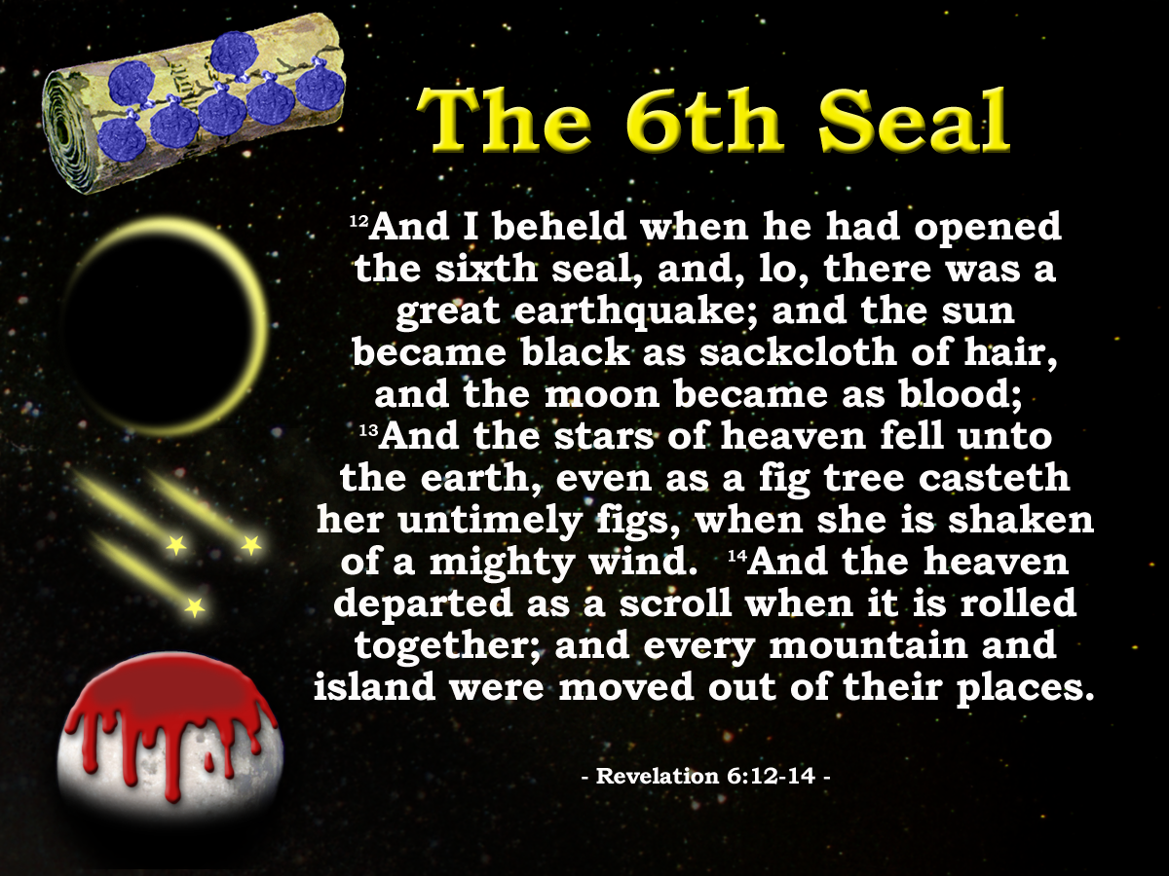
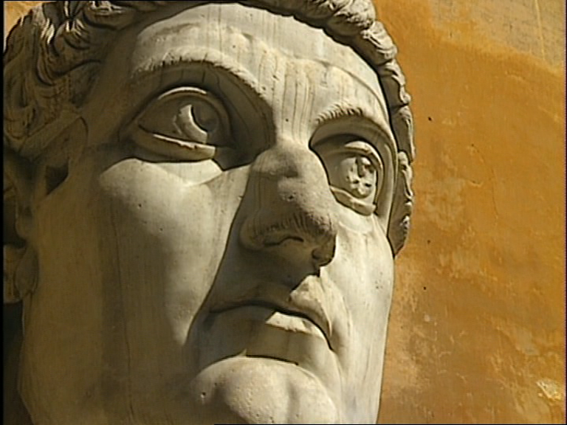
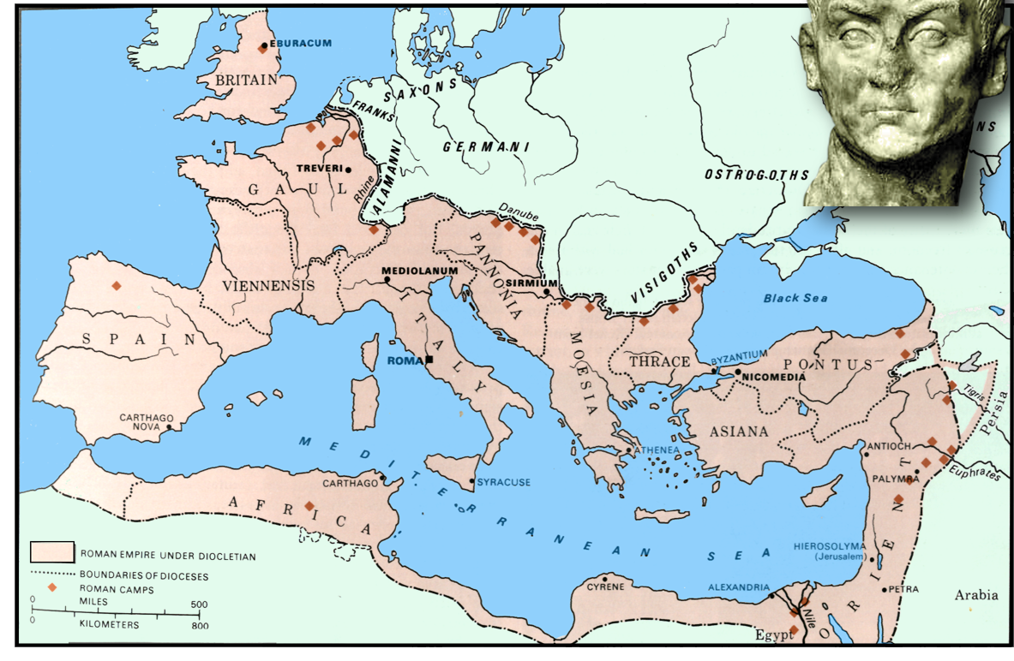
Constantine
312
324
330
337
Rev.12:12
Ruler in Rome
Constantinople
Ruler of whole Empire
Constantine dies
Chaos
Silence!
14yrs
Rev. 8:1

Slide 21
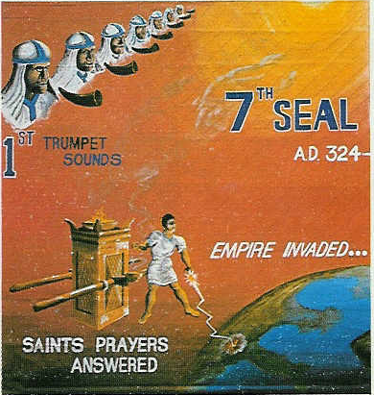
“there was silence in heaven about the space of half an hour”. Rev 8:1
Chapter 8 opens
John listens
Hears nothing
Silence for about ½ hour
Day for a Year. Gen.47:9, Num.14:34, Ezek. 4:4-6, Luke13:32
“Jesus answered, are there not twelve hours in the day?” John 11:9
12hrs in a Jewish day
1 hour = 1/12 of a day
½ hour = 1/24 of a day
Twelve hours in a Jewish Day
12 months in a year
1 month = 1/12 of a year or 30days
½ month = 1/24 of a year or 15days
“And it was about the sixth hour, and there was darkness over the earth until the ninth hour.” Luke 23:44
15 days = 15yrs
= 14yrs
AD 324 - 337
Peace as a result of Constantine’s victory over paganism

Slide 22
“..there was silence in heaven about the space of half an hour.”
Rev.8:1
Constantine
312
313
324
330
337
Rev.12:12
Ruler in Rome
Constantinople
Ruler of whole Empire
Constantine dies
Edict of Milan
Chaos
Silence!
Chaos
14yrs
8:5

Slide 23
Time Periods of the Apocalypse.
8:1 1/2hour 14yrs
8:12 1/3 day & 1/3 night 240yrs
9:5 5 months 150yrs
9:10 5 months 150yrs
9:15 1 hour-1 day–1 month–1 year 391yrs 1mth
11:2 Forty two months 1260yrs
11:3 1260 days 1260yrs
11:9 3 1/2 days 105yrs
11:13 1 hour 30yrs
12:6 1260 days 1260yrs
12:14 Time, Times, Dividing of Time 1260yrs
13:5 42 months 1260yrs
14:7 1 Hour 30yrs
17:12 1 Hour 30yrs
18:10 1 Hour 30yrs
18:17 1 Hour 30yrs
18:19 1 Hour 30yrs
Double conversions

Slide 24
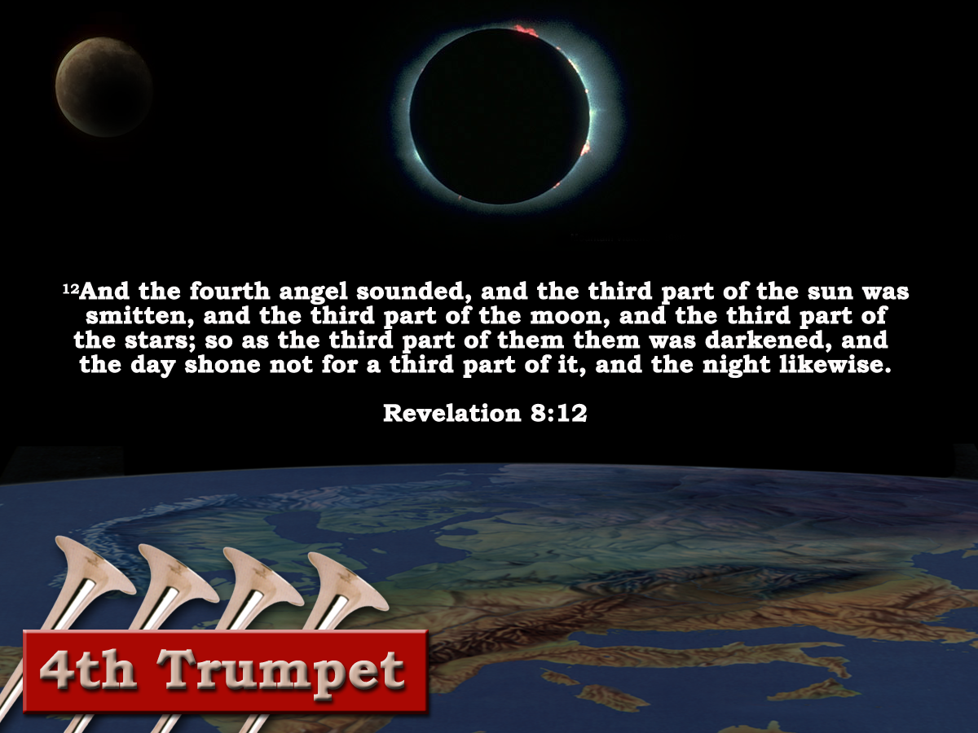

“And the fourth angel sounded, and the third part of the sun was smitten, and the third part of the moon, and the third part of the stars; so as the third part of them was darkened, and the day shone not for a third part of it, and the night likewise."
(Revelation 8:12)
and the day shone not for a third part of it, and the night likewise."
(Revelation 8:12)
1hour =1month or 30days
1/3 of day =4hrs
4 X 30 =120days or 120yrs
1/3 of night =4hrs
4 X 30 =120days or 120yrs
240yrs of total eclipse
560 AD - 800 AD
Justinian's ‘Pragmatic Sanction’ – Rome degraded to second rate city. – Italy becomes province of Byzantium Empire.
“Charlemagne – The restorer of the empire”
Gibbon
LATIN WEST
Notes:
The Fourth trumpet was characterized by the eclipse of the sun, moon and stars that shone over the Latin 1/3 of the empire.

Slide 25
Time Periods of the Apocalypse.
40yrs
8:1 1/2hour 14yrs
11:9 3 1/2 days 105yrs
11:13 1 hour 30yrs
14:7 1 Hour 30yrs
17:12 1 Hour 30yrs
18:10 1 Hour 30yrs
18:17 1 Hour 30yrs
18:19 1 Hour 30yrs
8:12 1/3 day & 1/3 night 240 yrs
Mid Heaven proclamation 10 yrs.
Catholic Europe Destroyed
30 yrs
Rome Destroyed
Double conversions

Slide 26
Time Periods of the Apocalypse.
8:1 1/2hour 14yrs
8:12 1/3 day & 1/3 night 240 yrs
9:5 5 months 150yrs
9:10 5 months 150yrs
9:15 1 hour-1 day–1 month–1 year 391yrs 1mth
11:2 Forty two months 1260yrs
11:3 1260 days 1260yrs
11:9 3 1/2 days 105yrs
11:13 1 hour 30yrs
12:6 1260 days 1260yrs
12:14 Time, Times, Dividing of Time 1260yrs
13:5 42 months 1260yrs
14:7 1 Hour 30yrs
17:12 1 Hour 30yrs
18:10 1 Hour 30yrs
18:17 1 Hour 30yrs
18:19 1 Hour 30yrs
1000 years?
Rev. 20:6

Slide 27
Time Periods of the Apocalypse.
“Blessed is he that Readeth”

Slide 29
7
Seals
7
1 2 3 4 5 6
Trumpets
7
1 2 3 4 5 6
Vials
Judgement - Pagan Rome
1 2 3 4 5 6
Judgement - Christian Rome
Rev.6
Judgement - Holy Roman Empire
Rev.8 & 9
AD 96 – AD 324
Rev.16
AD 395 – AD 1685
AD 1789 – AD 1820
Contrasting Link

Slide 30

Revelation 8:7-12 “The third part”
9:1-19
Saracens swarmed out of the ‘Pit’ determined to take the ‘Abyss’.Rev.9:1-11
Byzantines and Persians so caught up with each other, failed to see the smoke.
Caliphs wanted all 3 parts converted to Islam. God deemed otherwise.
NOTE: 9:5-6 cp 9:18
LATIN WEST
HELLENIC EAST
HELLENIZED EAST
Trumpet 5
1st Woe Trumpet
Trumpet 6
2nd Woe Trumpet

Slide 31
Scorpion. Dictionary definition “An ancient form of ballista or catapult for hurling stones, etc.”
“Saracen fire” Burning crude oil mixed with secret chemicals to intensify the burning.
A new and powerful sting!

Slide 32
7
Trumpets
1 2 3 4 5 6
Judgement - Christian Rome

Slide 33
Revelation 8:7-12 “The third part”
9:1-19
7
Trumpets
1 2 3 4 5 6
Judgement on Christian Rome
Judgement on Christian Rome
LATIN WEST
HELLENIC EAST
Rev.8 & 9
AD 395 – AD 1685
HELLENIZED EAST
In AD330 Constantine moved the seat of his empire to Byzantium. From this time the Empire was divided into 3 parts.
Trumpets 1- 4
Trumpet 5
Trumpet 6

