Slide 1

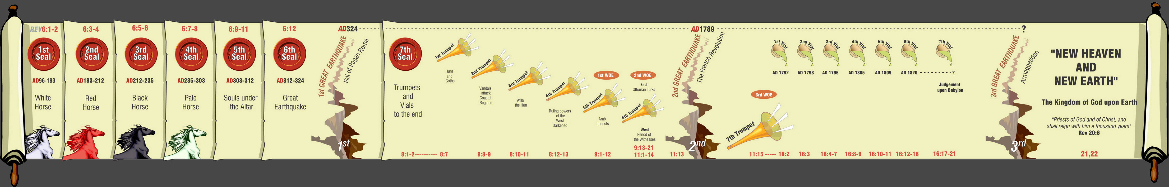
Unlocking Revelation
3 Great Earthquakes
7
Seals
7
1 2 3 4 5 6
Trumpets
7
1 2 3 4 5 6
Vials
Judgement - Pagan Rome
1 2 3 4 5 6
Judgement - Christian Rome
Rev.6
Judgement - Holy Roman Empire
Rev.8 & 9
AD 96 – AD 324
Rev.16
AD 395 – AD 1685
AD 1789 – AD 1820

Slide 2
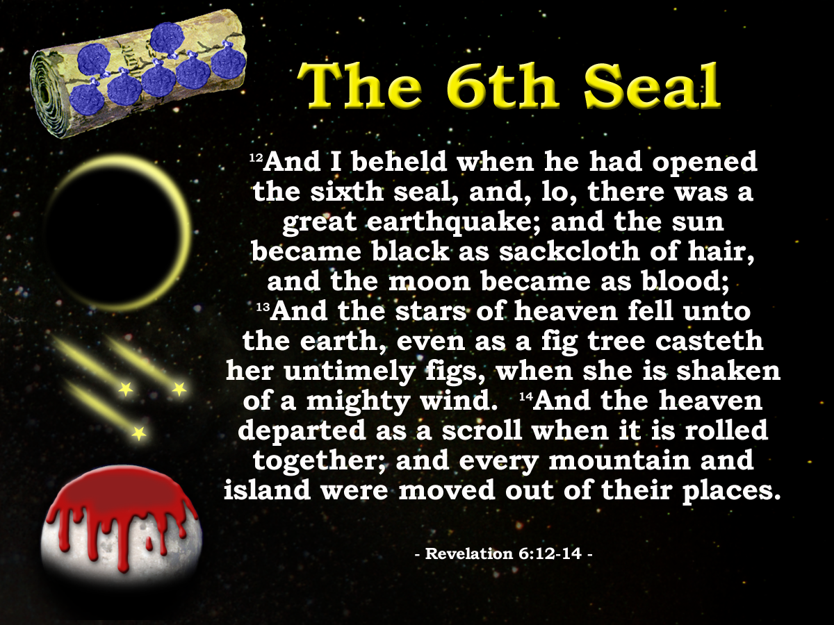
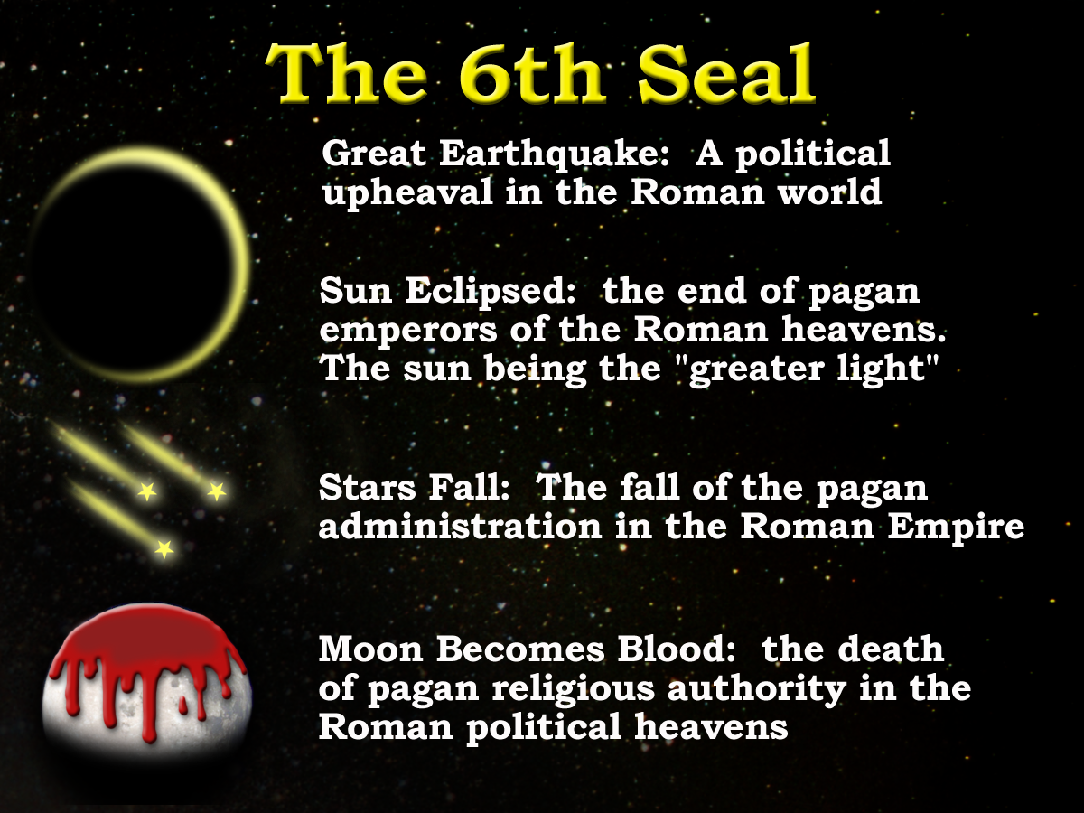
3 Great Earthquakes
Rev.6:12
Rev.11:13
Rev.16:18
Note the only other two occasions
Rev.8:5
Rev.11:19

Slide 3
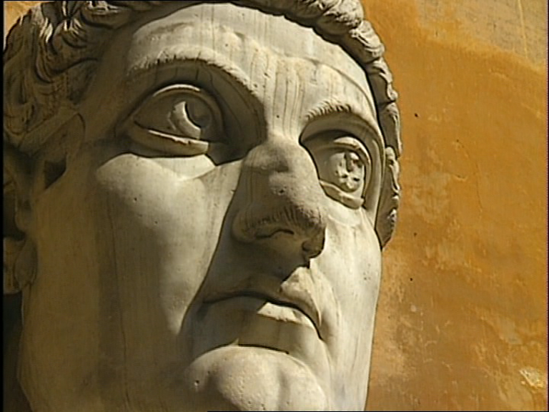
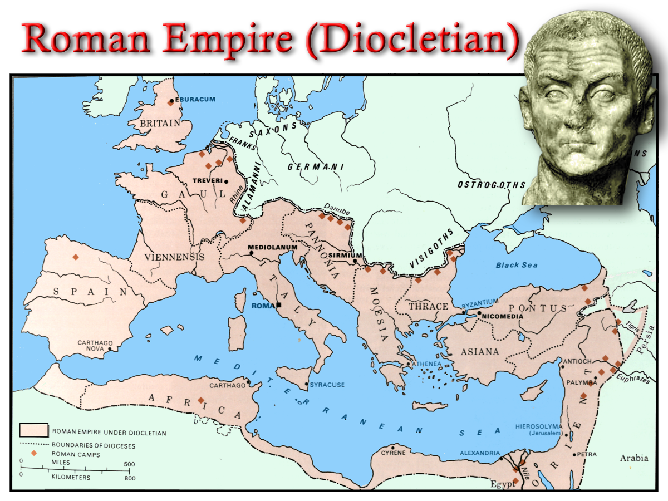
Constantine
312
324
330
337
Rev.12:12
Ruler in Rome
Constantinople
Ruler of whole Empire
Constantine dies
Chaos
Silence!
14yrs
Rev. 8:1

Slide 4
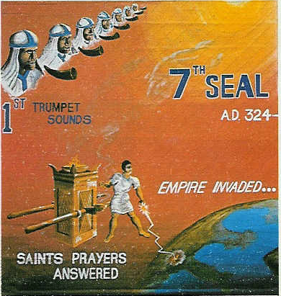
“there was silence in heaven about the space of half an hour”. Rev 8:1
Chapter 8 opens
John listens
Hears nothing
Silence for about ½ hour
Day for a Year. Gen.47:9, Num.14:34, Ezek. 4:4-6, Luke13:32
“Jesus answered, are there not twelve hours in the day?” John 11:9
12hrs in a Jewish day
1 hour = 1/12 of a day
½ hour = 1/24 of a day
Twelve hours in a Jewish Day
12 months in a year
1 month = 1/12 of a year or 30days
½ month = 1/24 of a year or 15days
“And it was about the sixth hour, and there was darkness over the earth until the ninth hour.” Luke 23:44
15 days = 15yrs
= 14yrs
AD 324 - 337
Peace as a result of Constantine’s victory over paganism

Slide 5
“..there was silence in heaven about the space of half an hour.”
Rev.8:1
Constantine
312
313
324
330
337
Rev.12:12
Ruler in Rome
Constantinople
Ruler of whole Empire
Constantine dies
Edict of Milan
Chaos
Silence!
Chaos
14yrs
8:5

Slide 6
Rev. 6:12-13
Political upheaval in the Roman World
Notes:
We see the great earthquake effect all aspects of Roman life – Political and Religious
Each symbol representing a slightly different aspect of these POLITICAL HEAVENS
READ SLIDE

Slide 7
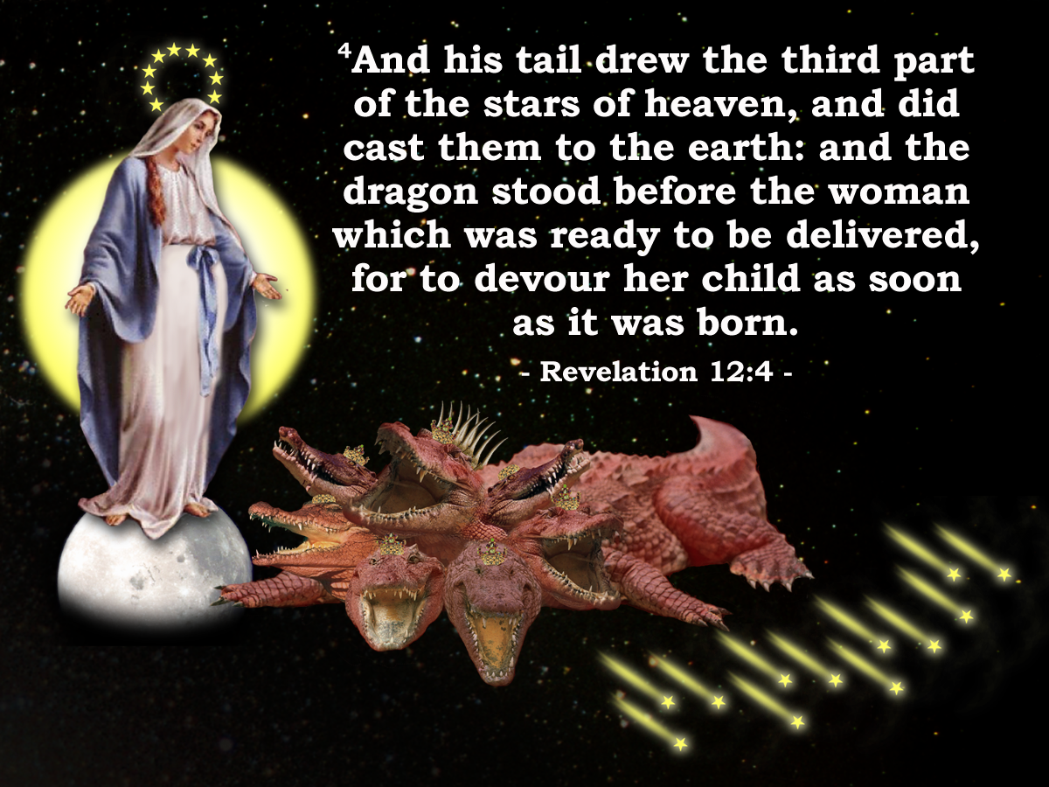
Sixth Seal
Rev. 6:12-17
Rev. 12
v.12 Great earthquake
v.7 Paganism cast out (Dragon) Michael (He like God) Constantine
v.13 Stars of heaven fell to the earth
v.4 Drew the third part of the stars of heaven
v.12 Sun black – Moon blood
v.1 Clothed with the sun, moon under her feet
v.16 ... Fall on us and hide us from the face of him that sitteth on the throne and from the wrath of the lamb
v.10-11 … And they over came him by the blood of the lamb…..

Slide 8
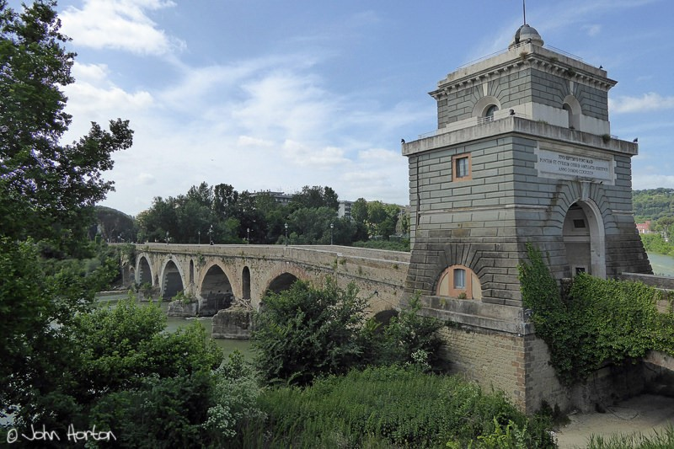

Struggle for Imperial Title
Chi - Rho
ΧΡΙΣΤΟΣ
Labarum
Licinius
Constantine
Milvian Bridge
312 AD
Maximin
311 AD
305 AD
285 AD

Slide 9
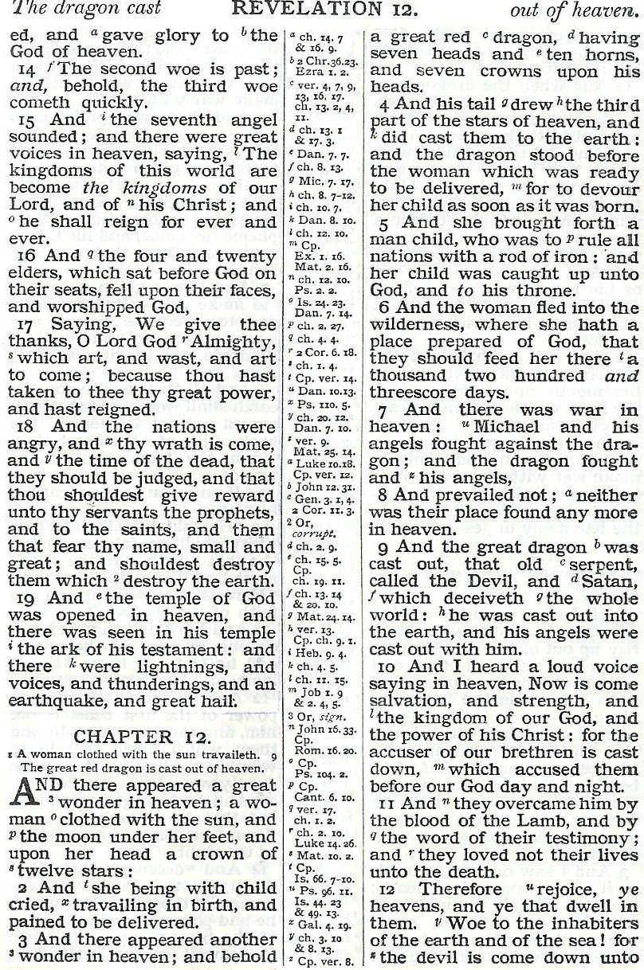
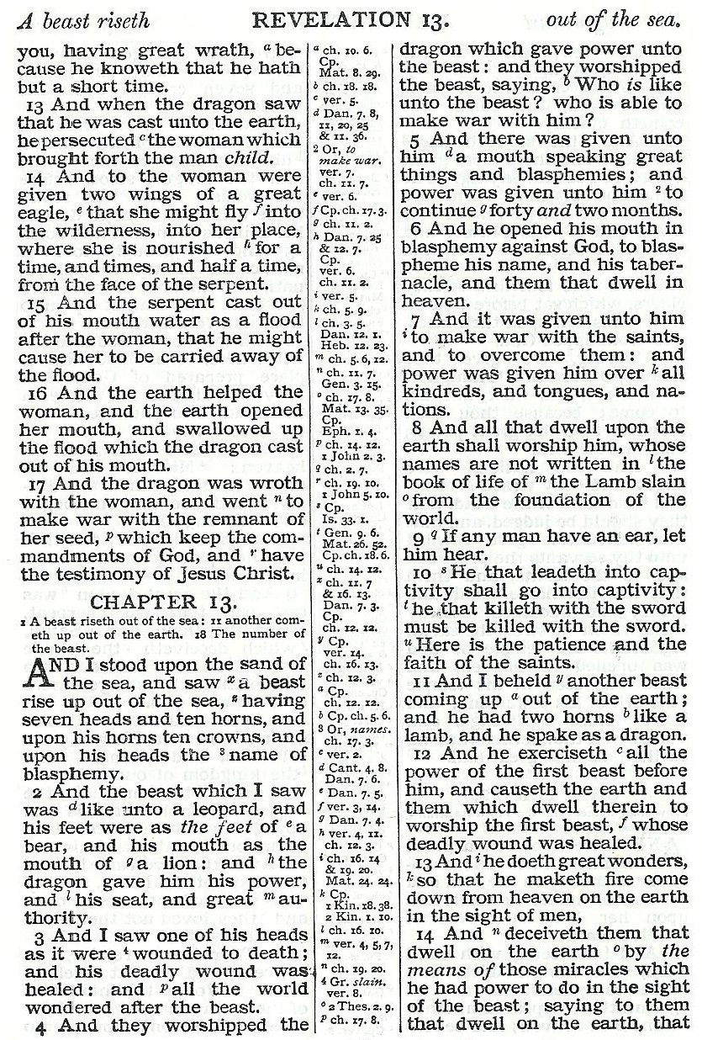
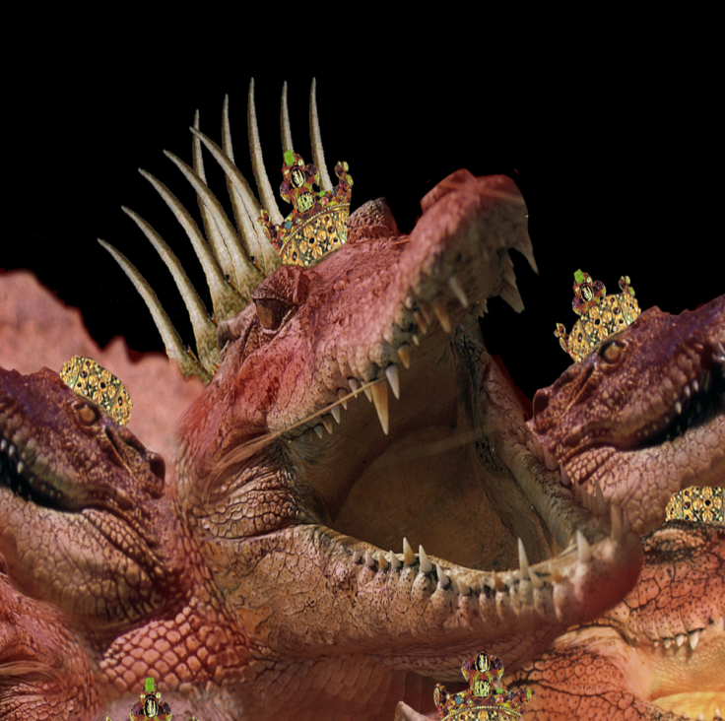
War in Political Heaven – War for Rome!
Pagan Dragon
Maxentius
Licinius

Slide 10
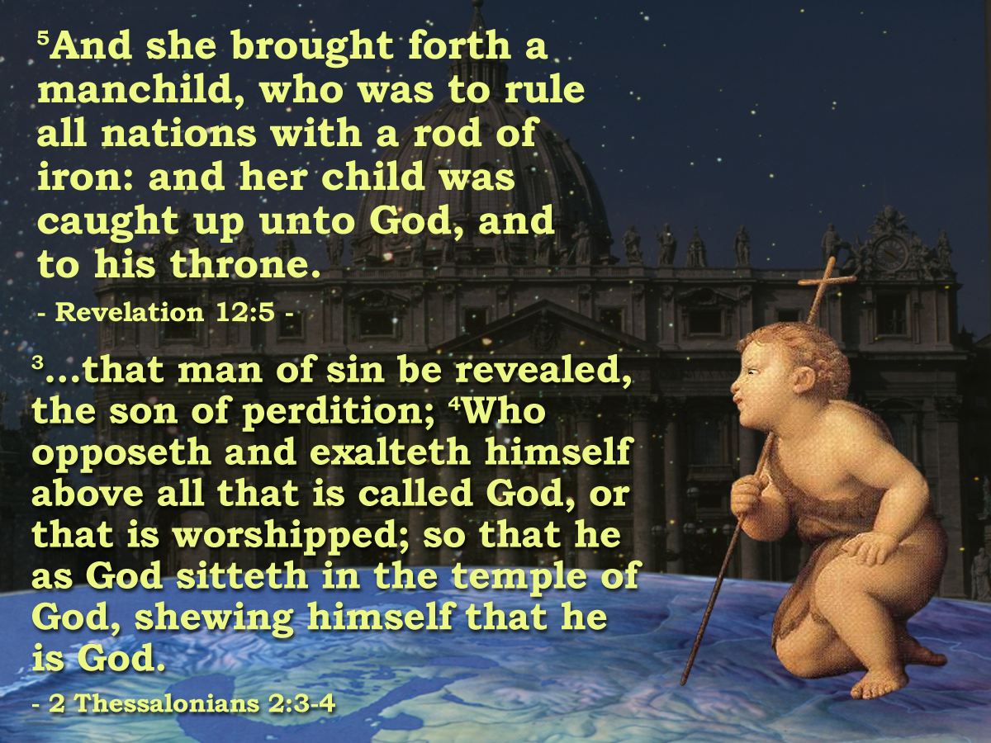
ROME?
Pagan Dragon
War for Rome!
Christian Dragon
Constantine and successors

Slide 11
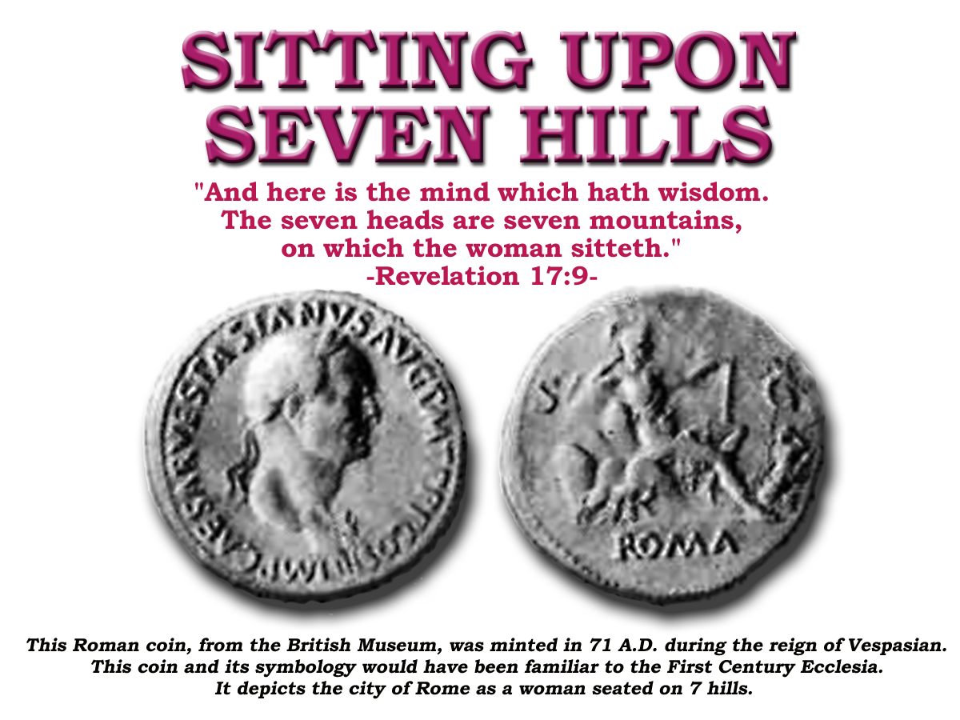
Revelation 17
v9 7 Heads = 7 Mountains (geographic identification)
v10 “and there are seven kings:” = 7 forms of Government (political identification)
“five are fallen”
“one is”
“the other is not yet come”
Regal
Consular
Dictatorial
Decemviral
Tribunitial
Imperial
Goths
‘and when he cometh he must continue a short space.’

Slide 12
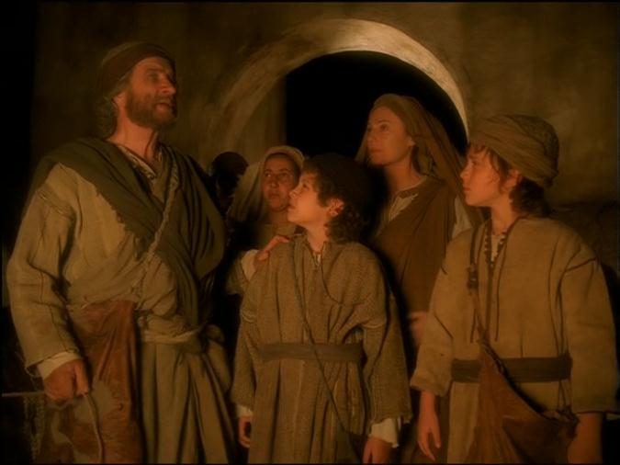
Revelation 17
v10 “and there are seven kings:” = 7 forms of Government
“.. not yet come, when he comes he must continue a short space”
“five are fallen”
“one is”
8th Head
“The one that was and is not”
Rev. 13:3

Slide 13
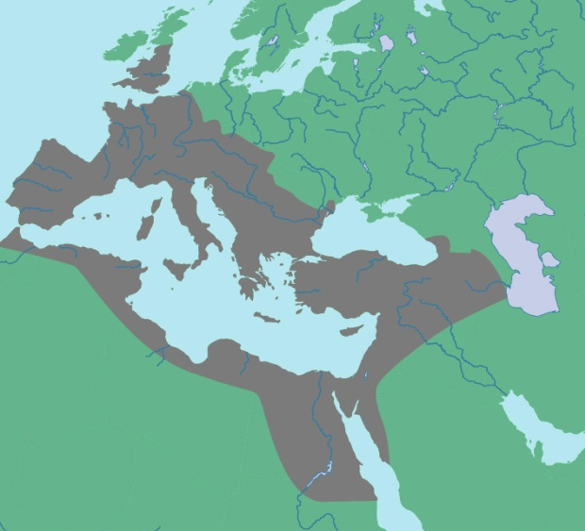
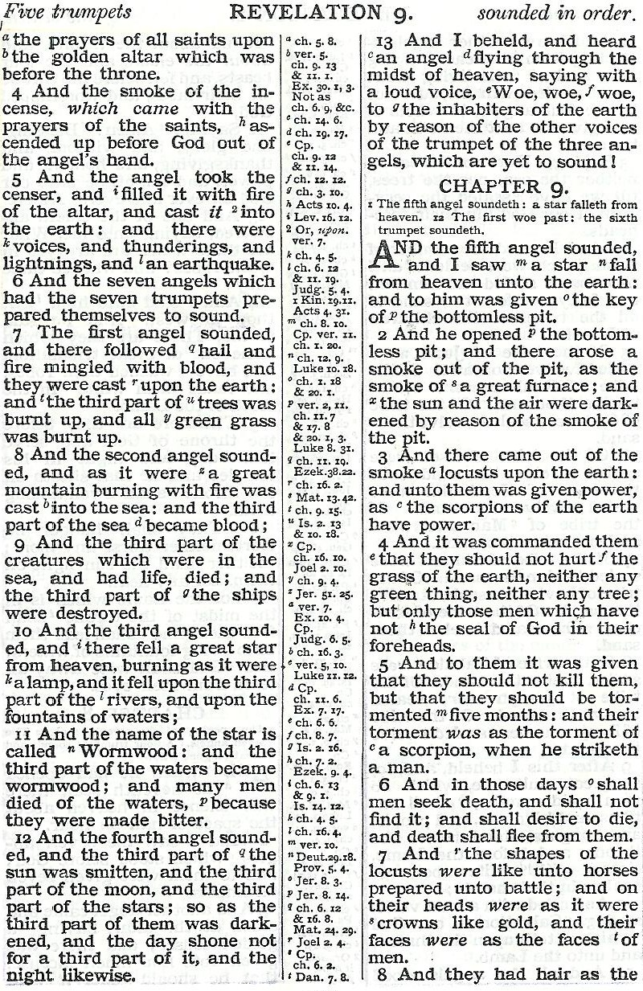
LATIN WEST
1
7
Alaric and the Visigoths 410 AD
2
8
Genseric and the Vandals 429 AD
3
10
Attila and the Huns 450 AD
4
12
Odoacer 476 AD Theodoric and the Ostrogoths 493 AD

Slide 14
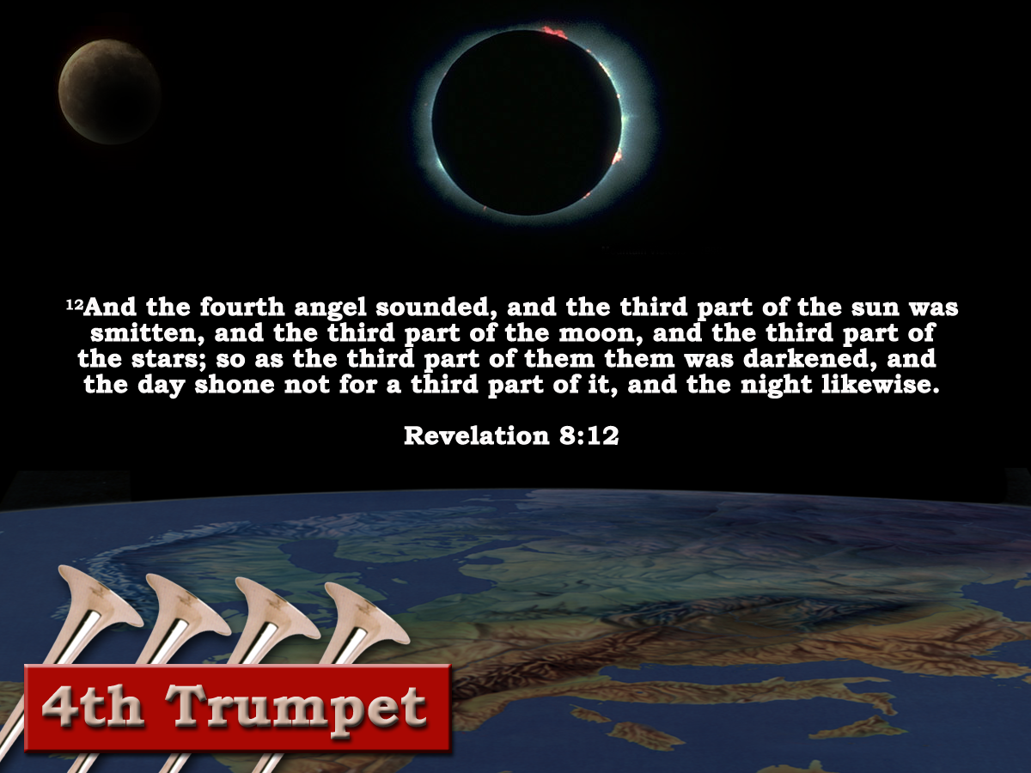

“And the fourth angel sounded, and the third part of the sun was smitten, and the third part of the moon, and the third part of the stars; so as the third part of them was darkened, and the day shone not for a third part of it, and the night likewise."
(Revelation 8:12)
and the day shone not for a third part of it, and the night likewise."
(Revelation 8:12)
1hour =1month or 30days
1/3 of day =4hrs
4 X 30 =120days or 120yrs
1/3 of night =4hrs
4 X 30 =120days or 120yrs
240yrs of total eclipse
560 AD - 800 AD
Justinian's ‘Pragmatic Sanction’ – Rome degraded to second rate city. – Italy becomes province of Byzantium Empire.
“Charlemagne – The restorer of the empire”
Gibbon
LATIN WEST
Notes:
The Fourth trumpet was characterized by the eclipse of the sun, moon and stars that shone over the Latin 1/3 of the empire.

Slide 15
ROME!
Pagan Dragon
War in Political Heaven – War for Rome!

Slide 16
Struggle for Imperial Title
Chi - Rho
ΧΡΙΣΤΟΣ
Labarum
Licinius
Constantine
Milvian Bridge
312 AD
Maximin
311 AD
305 AD
285 AD

Slide 17
Licinius
Rev.12:4
Notes:
The two characters are:
The woman (apostate ecclesia)
The dragon (pagan Rome)
Dragon Ready To Devour:
As Christianity increased in popularity it became increasingly more involved in politics it became a threat to the Roman State
The Christians had their own lands, their own “public purse”; system of taxation (called tithing); system of government
The more the ecclesia apostatized from the truth the more of a threat it became to the Roman Government of the day.
Consequently the emperor Diocletian attempted to destroy the political birth that was about to take place

Slide 18
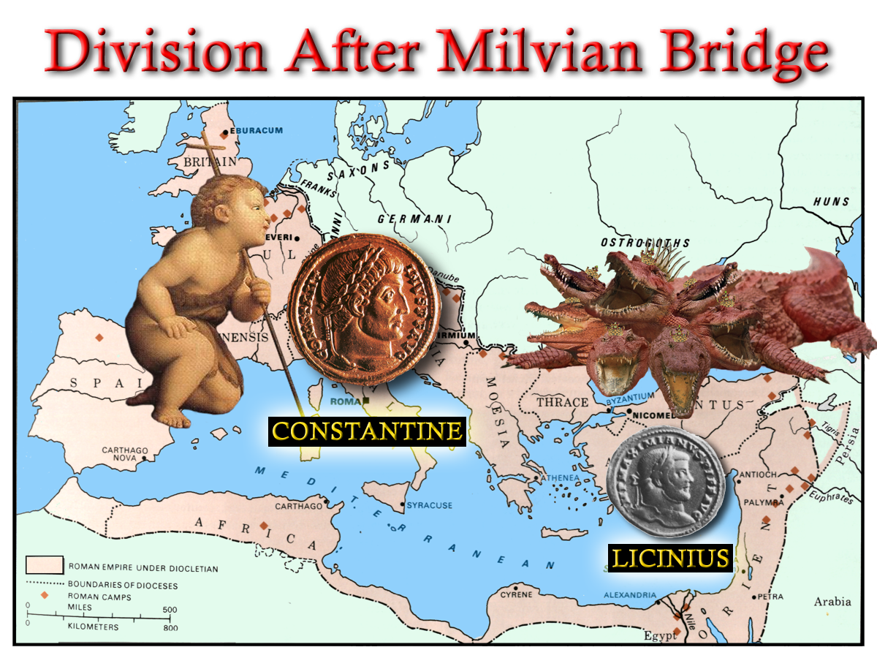
Struggle for Imperial Title
“And his tail drew the third part of the stars of heaven, and did cast them to the earth:”
Rev.12:4
Constantine
Licinius
Maximin
Notes:
The empire had grown substantially up until Diocletian
The Christian Religion had become very wide spread in the empire as a result of the fervent preaching campaign of the brethren (the first Seal)
This emperor enacted the role of the Dragon who “stood before the woman which was ready to be delivered, for to devour her child as son as it was born.”
The persecution of the 5th Trumpet time Period was to soon be avenged.
The divine finger had plotted a course that would see the Roman Dragon cast out of the political heavens – as recorded in Revelation 12.

Slide 19
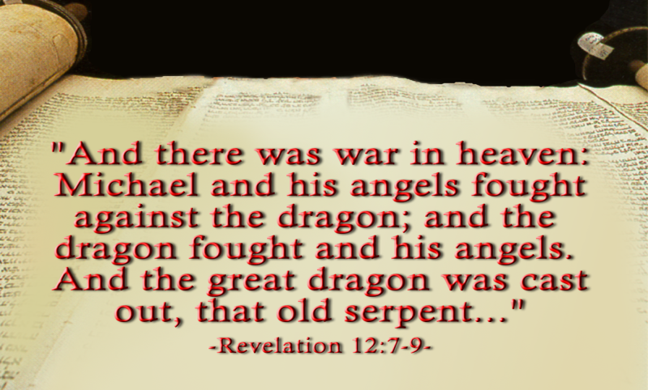
The Dragon and the Man Child
Note v8-9,12-13
Notes:
In the mean time Licinus had defeated Galerius in an attempt to consolidate his own hold on power – and was emperor of the east.
Constantine issued an Edict throughout the Empire to restore all properties to the Christians that had been removed under Diocletian.
Licinius and Constantine held an 8 year truce that ended when Licinius conspired against Constantine.
The scripture demanded that the Pagan Dragon be cast out of the heaven – at this point only one half had been rid of the Dragon!
The Final battle took place place at ADRIANOPLE where 150.000 infantry; 15,000 cavalry; and 350 galleons had confronted Constantine’s measly 120,000 infantry with only 200 small vessels.
The Dragon (Licinius) was cast out!

Slide 20
The Dragon and the man child
Just before the final battle, Licinius assembled friends in a sacred grove and offered sacrifices and said,
“Friends and fellow warriors. These are the gods of our ancestors, whom, received from our earliest predecessors as objects of worship, we honour; but he who commands the army that is drawn up against us, having adopted an atheistic opinion, violates the customs of the fathers, venerating a god from abroad, I know not whence, and disgraces his troops with his ignominious standard (the cross with the monogram of Christ) trusting in which he arms not so much against us as against the gods whom he offends…………If the foreign god whom we now deride, should appear the mightiest, we must acknowledge and honour him, and bid farewell to these to whom we have vainly lit wax tapers.”
“and there was war in heaven Michael and his angels fought against the dragon…….”
Rev.12:4

Slide 21
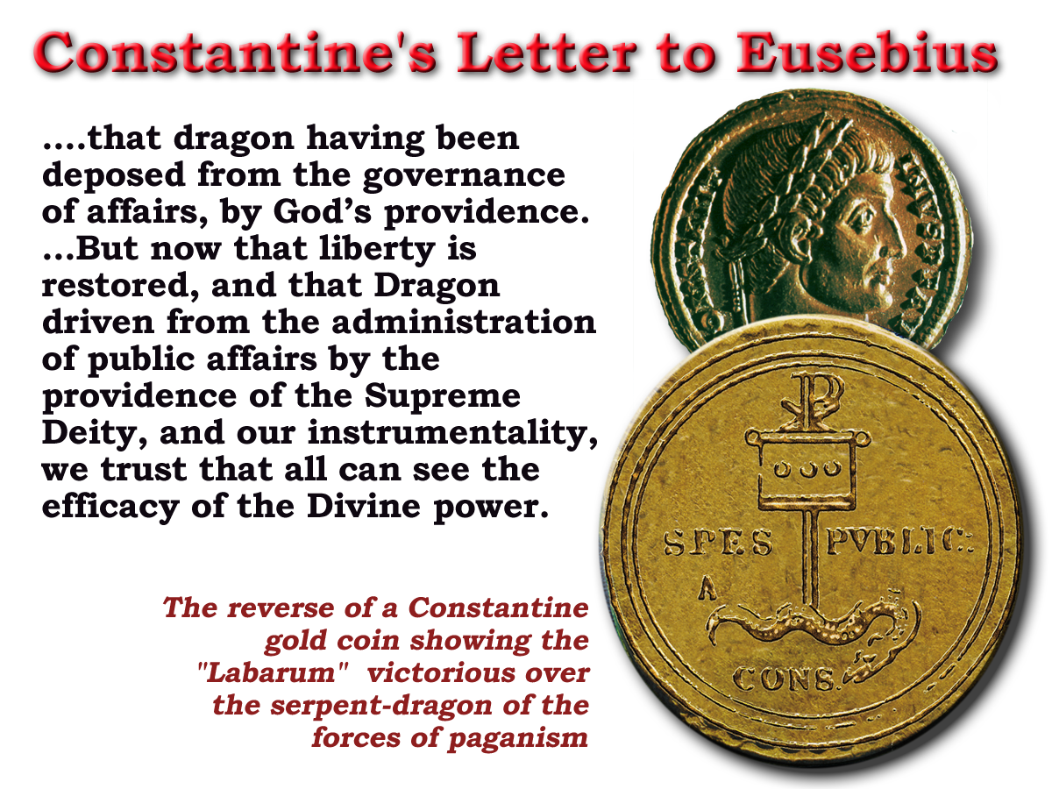
“ Now is come salvation and strength and the kingdom of our God and the power of his Christ”
Rev.12:10
Lactanius wrote:
“ Let us celebrate the triumph of God with gladness; let us commemorate His victory with praise; let us make mention in our prayers day and night of the peace which after ten years of persecution, He has conferred on his people.”
“ …and hide us from the face of him that sitteth upon the throne, and from the wrath of the Lamb:
For the great day of his wrath is come; and who shall be able to stand?”
Rev.6:16-17
Notes:
READ OVERHEAD – at end of notes
Constantine's close advisor – Eusebius was an apostate bishop who had supported the war effort.
He no doubt had an influence on Constantine’s mind – through the scripture
Constantine saw himself as a fulfillment of the prophecy of the book of Revelation
On his coins he depicted victory of the Labarum (Cross) over the Dragon
In a letter to Eusebius (which Eusebius records for us) he wrote the following:
READ OVERHEAD – at end of notes

Slide 22
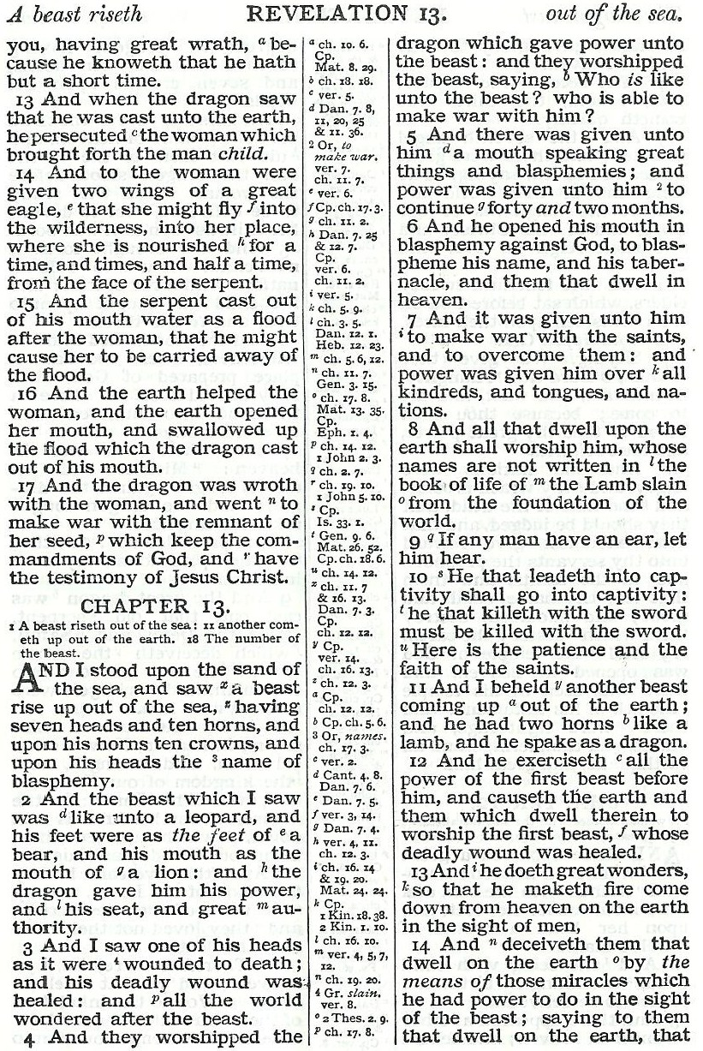
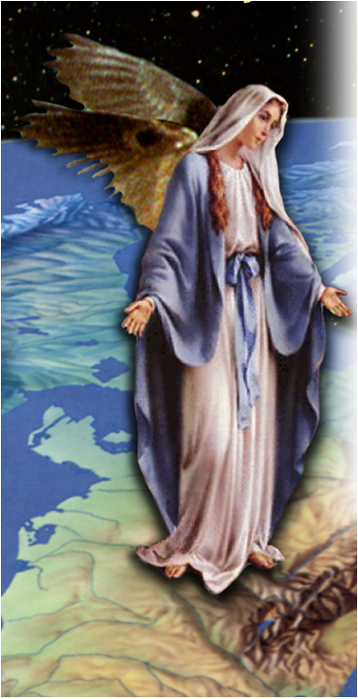
Pagan Dragon
Catholic Church

Slide 23
“And she being with child cried, travailing in birth, and pained to be delivered.”
Rev.12:2
Galerius / Maxentius
“For I am jealous over you with Godly jealousy : for I have espoused you to one husband that I may present you as a chaste virgin to Christ.”
Woman with Child
2 Cor.11:2
“For the mystery of iniquity doth already work:”
2 Thess.2:7
280 days 280 yrs.
AD 33 AD 313
Notes:
The two characters are:
The woman (apostate ecclesia)
The dragon (pagan Rome)
Dragon Ready To Devour:
As Christianity increased in popularity it became increasingly more involved in politics it became a threat to the Roman State
The Christians had their own lands, their own “public purse”; system of taxation (called tithing); system of government
The more the ecclesia apostatized from the truth the more of a threat it became to the Roman Government of the day.
Consequently the emperor Diocletian attempted to destroy the political birth that was about to take place

Slide 24
The woman minus the Catholic sect
Pagan Dragon
Catholic Church
Gr.=“Remnants of her seed” The First use in Revelation. = Rev. 2:24 cp v.20
Saints

Slide 25
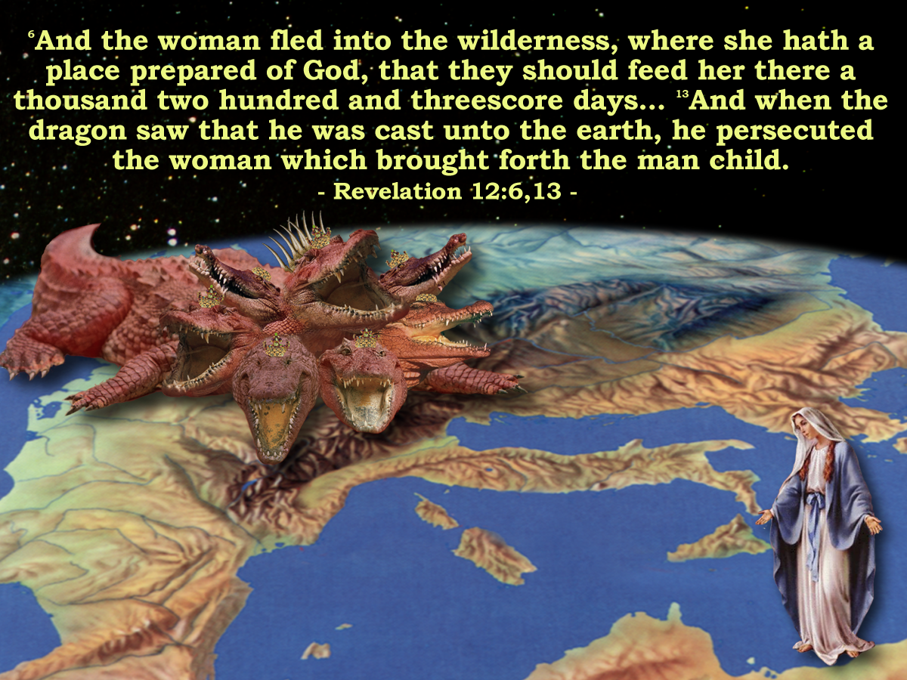
Rev.12:6
312 + 1260 =
1572
Rev.12:14
Rev.11:3
Notes:
The Book of Revelation describes the next phase in the drama:
READ PASSAGE
The ecclesia had been infested with the LAODICIAN APOSTACY for 200 years.
With the rise of Constantine to power the APOSTACY SEPARATED from the ecclesia – making a POLITICAL POWER UNION with the state
The woman – and the remnant of her seed had to flee into the wilderness to avoid persecution by this newly empowered APOSTACY.
Those who did not support this doctrine were eventually banished from the Roman society and had to move to the extremities of the empire.

Slide 26
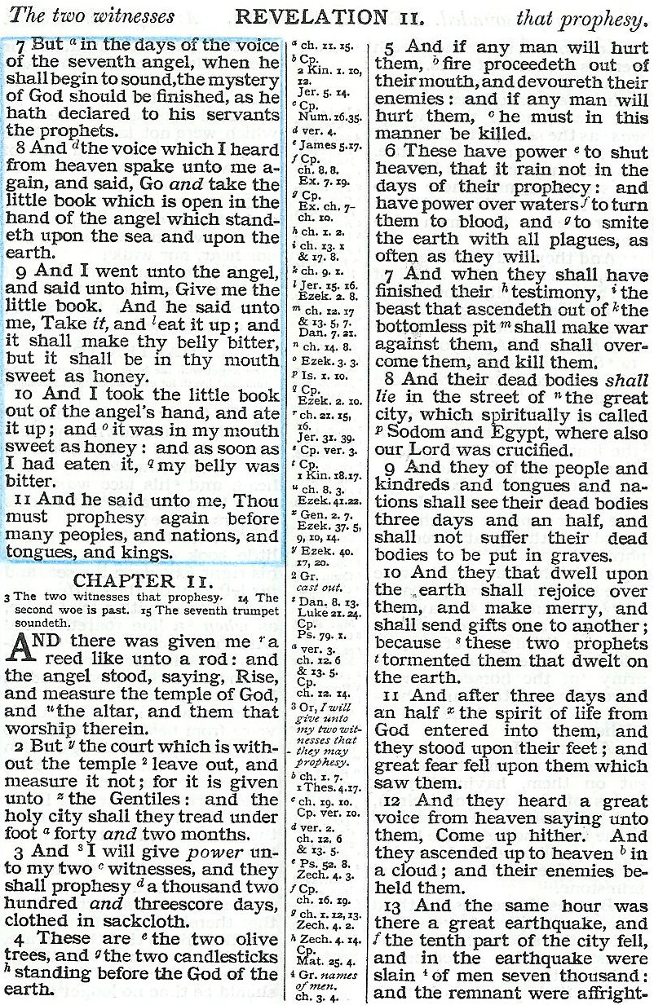
Fight!
Take away peace!
That they should feed her there 1260 days Rev. 12:6
Killed! 1572
Speak out! Beginning in 312 AD

Slide 27
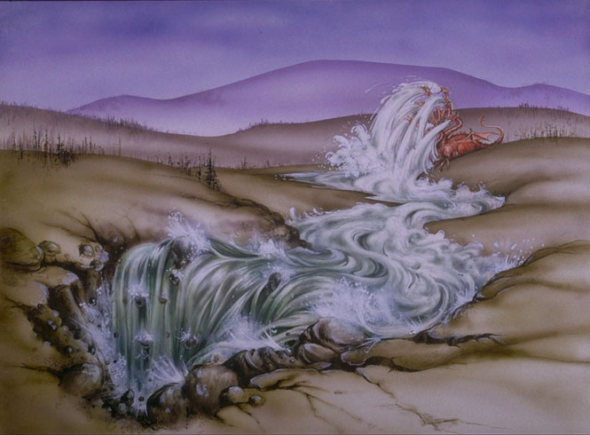
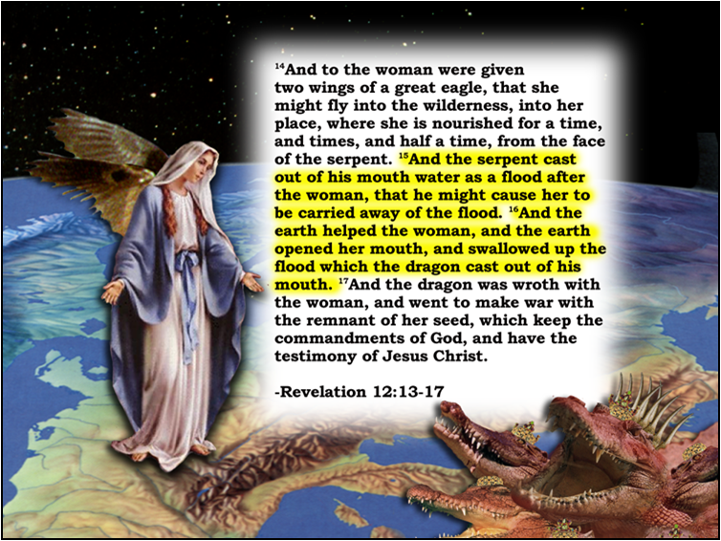
15
“And the serpent cast out of his mouth water as a flood after the woman, that he might cause her to be carried away of the flood.”
And the earth opened her mouth
and swallowed up the flood
The Circumcellions of North Africa
Isa.8:7
Jer.46:7-8
v16

Slide 29
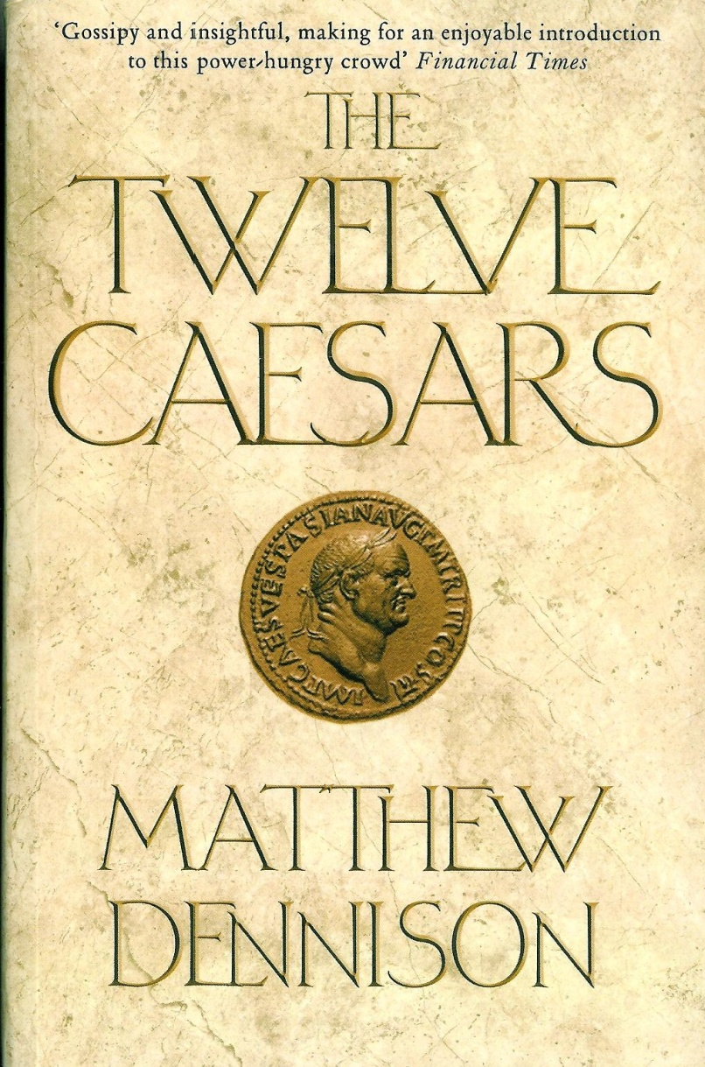
“And there appeared a great wonder in heaven, a woman clothed with the sun, and the moon under her feet, and upon her head a crown of twelve stars.”
Division now occurs within in the ranks of the woman
Rev.12:6
Rev.12:1
Premature !
We remain separate from political involvement until invited to do so. Rev.4:1. 19:17
Emperors
“Under their rule, Rome was transformed from a republic to an empire, whose model of regal autocracy would survive in the west for more than a thousand years.”
Political authority
Psa.89:36
State religion
Notes:
The two characters are:
The woman (apostate ecclesia)
The dragon (pagan Rome)
Dragon Ready To Devour:
As Christianity increased in popularity it became increasingly more involved in politics it became a threat to the Roman State
The Christians had their own lands, their own “public purse”; system of taxation (called tithing); system of government
The more the ecclesia apostatized from the truth the more of a threat it became to the Roman Government of the day.
Consequently the emperor Diocletian attempted to destroy the political birth that was about to take place

Slide 30
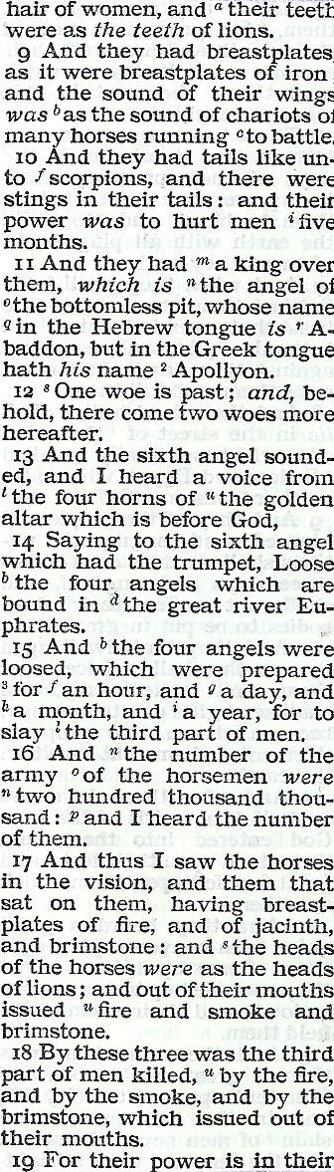
LATIN WEST
5
1
7
13
6
2
8
HELLENIZED EAST
3
10
HELLENIC EAST
4
12

