Slide 1
“Ye Shall Be Unto Me a Kingdom of Priests”
CLASS 1 -
2024 Rogue River Christadelphian Bible School

Slide 2
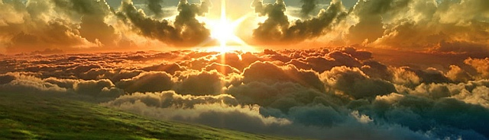
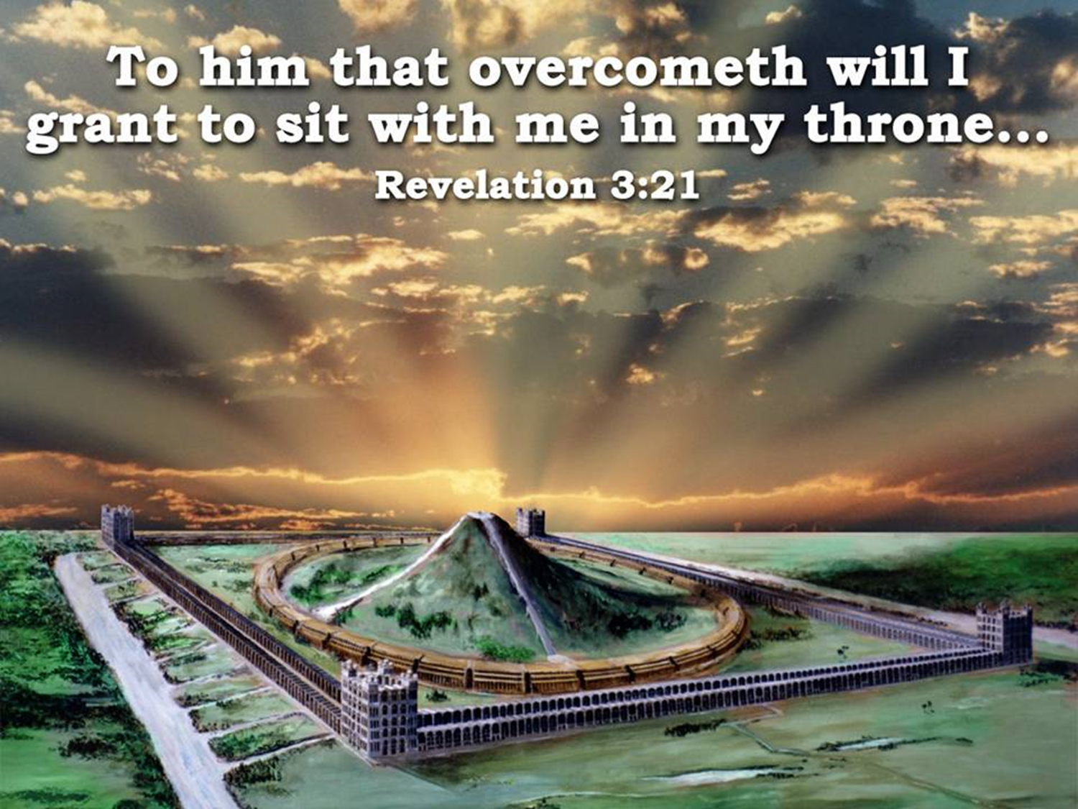
Passing the Torch From the Cherubim to the Faithful
"Then shall the righteous shine forth as the Sun in the Kingdom of their Father” (Matt. 13:43 ; Ezek. 43:1-9).

Slide 3
Overview
God’s purpose with the nation of Israel and all believers (2)
The Six Changes of Priesthood Through Time
Definition of Cherub (slides 10, 11)
Examples of the use of the Cherubim in Scripture
  In Eden
  In the Tabernacle
  In Solomon’s Temple
  In the future House of Prayer

Slide 4
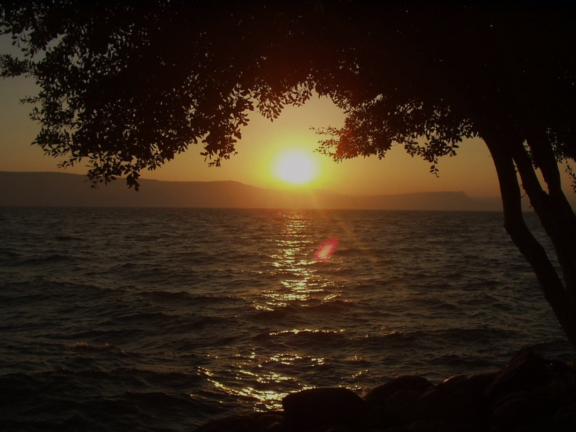
Exo 19:1 In the third month, when the children of Israel were gone forth out of the land of Egypt, the same day came they into the wilderness of Sinai.
2 For they were departed from Rephidim, and were come to the desert of Sinai, and had pitched in the wilderness; and there Israel camped before the mount.
3 And Moses went up unto God, and the LORD called unto him out of the mountain, saying, Thus shalt thou say to the house of Jacob, and tell the children of Israel;
4 Ye have seen what I did unto the Egyptians, and how I bare you on eagles' wings, and brought you unto myself.
5 Now therefore, if ye will obey my voice indeed, and keep my covenant, then ye shall be a peculiar treasure unto me above all people: for all the earth is mine:
6 And ye shall be unto me a kingdom of priests, and an holy nation. These are the words which thou shalt speak unto the children of Israel.
Notes:
God’s promise to not only redeem Israel from all of her national enemies but to make her a healer and saviour to those nations that learn to submit and learn of that divine power which Yahweh Ropheka administers to all of those who recognize His love and offer to make those nations whole and prosperous.

Slide 5
Rev 1:5 and from Jesus Christ the faithful witness, the firstborn of the dead, and the ruler of kings on earth. To him who loves us and has freed us from our sins by his blood
Rev 1:6 and made us a kingdom, priests to his God and Father, to him be glory and dominion forever and ever. Amen.
Notes:
That promise to both NATIONAL and SPIRITUAL Israel to deliver them from the threat of the annihilator and terminator of humanity by a kingdom that is ruled over by magistrates that have ascended in existential nature through the belief of the Gospel of the Kingdom and things of Jesus Christ, the faithful witness.

Slide 6
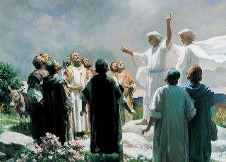
The Six Changes Of Priesthood Through Time
“In the beginning God…”- A Sinless State
1. The Elohistic – Between Yahweh and Man
2. The Firstborn of Adamic – Between Yahweh Elohim and Man
3. The Noahic – Between Noah & the World and Yahweh
4. The Melchizedek – Between El Elyon and Abram
5. The Levitical – Between Yahweh and the Nation of Israel
6. Christ After The Order of Melchizedek at God’s Right Hand - Between Yahweh and the Enlightened today in heaven
7. The Dual Order of Melchizedek and Levite in the Kingdom – Between Yahweh and the Whole World
“God All and In All” – A Sinless State
Notes:
The six changes of the divine priesthood through time.
1.The Elohistic in Eden setting the divine standard for the Firstborn of Adamic race
2. The Melchizedek

Slide 7
Eze 43:1 Afterward he brought me to the gate, even the gate that looketh toward the east:
2 And, behold, the glory of the God of Israel came from the way of the east: and his voice was like a noise of many waters: and the earth shined with his glory.
3 And it was according to the appearance of the vision which I saw, even according to the vision that I saw when I came to destroy the city: and the visions were like the vision that I saw by the river Chebar; and I fell upon my face.
4 And the glory of the LORD came into the house by the way of the gate whose prospect is toward the east.
5 So the spirit took me up, and brought me into the inner court; and, behold, the glory of the LORD filled the house.
6 And I heard him speaking unto me out of the house; and the man stood by me.
7 And he said unto me, Son of man, the place of my throne, and the place of the soles of my feet, where I will dwell in the midst of the children of Israel for ever, and my holy name, shall the house of Israel no more defile, neither they, nor their kings, by their whoredom, nor by the carcases of their kings in their high places.
8 In their setting of their threshold by my thresholds, and their post by my posts, and the wall between me and them, they have even defiled my holy name by their abominations that they have committed: wherefore I have consumed them in mine anger.
9 Now let them put away their whoredom, and the carcases of their kings, far from me, and I will dwell in the midst of them for ever.
Notes:
Ezekiel’s vision of the Cherubim entering the House of Prayer for All Nations as the prophetical symbol of the literal “Melchizedek Mediators of the Millennium”

Slide 8
Eze_1:1 Now it came to pass in the thirtieth year, in the fourth month, in the fifth day of the month, as I was among the captives by the river of Chebar, that the heavens were opened, and I saw visions of God.
Eze_1:3 The word of the LORD came expressly unto Ezekiel the priest, the son of Buzi, in the land of the Chaldeans by the river Chebar; and the hand of the LORD was there upon him.
Eze_3:15 Then I came to them of the captivity at Telabib, that dwelt by the river of Chebar, and I sat where they sat, and remained there astonished among them seven days.
Eze_3:23 Then I arose, and went forth into the plain: and, behold, the glory of the LORD stood there, as the glory which I saw by the river of Chebar: and I fell on my face.
Eze_10:15 And the cherubims were lifted up. This is the living creature that I saw by the river of Chebar.
Eze_10:20 This is the living creature that I saw under the God of Israel by the river of Chebar; and I knew that they were the cherubims.
Eze_10:22 And the likeness of their faces was the same faces which I saw by the river of Chebar, their appearances and themselves: they went every one straight forward.
Eze_43:3 And it was according to the appearance of the vision which I saw, even according to the vision that I saw when I came to destroy the city: and the visions were like the vision that I saw by the river Chebar; and I fell upon my face.

Slide 9
Chebar - H3528 - From H3527; properly extent of time, that is, a great while; hence long ago, formerly, hitherto: - already, (seeing that which), now.
Ecc_1:10 Is there^{H3426} any thing^{H1697} whereof it may be said,^{H7945} ^{H559} See,^{H7200} this^{H2088} is new?^{H2319} it^{H1931} hath been^{H1961} already^{H3528} of old time,^{H5769} which^{H834} was^{H1961} before^{H4480} ^{H6440} us.
Ecc_2:12 And I^{H589} turned^{H6437} myself to behold^{H7200} wisdom,^{H2451} and madness,^{H1947} and folly:^{H5531} for^{H3588} what^{H4100} can the man^{H120} do that cometh^{H7945} ^{H935} after^{H310} the king?^{H4428} even^{(H853)} that which^{H834} hath been already^{H3528} done.^{H6213}
Ecc_2:16 For^{H3588} there is no^{H369} remembrance^{H2146} of the wise^{H2450} more than^{H5973} of the fool^{H3684} for ever;^{H5769} seeing that which now^{H7945} ^{H3528} is in the days^{H3117} to come^{H935} shall all^{H3605} be forgotten.^{H7911} And how^{H349} dieth^{H4191} the wise^{H2450} man? as^{H5973} the fool.^{H3684}
Ecc_3:15 That which hath been^{H4100} ^{H7945} ^{H1961} is now;^{H3528} and that^{H1931} which^{H834} is to be^{H1961} hath already^{H3528} been;^{H1961} and God^{H430} requireth^{H1245} ^{(H853)} that which is past.^{H7291}
Ecc_4:2 Wherefore I^{H589} praised^{H7623} ^{(H853)} the dead^{H4191} which are already^{H7945} ^{H3528} dead^{H4191} more than^{H4480} the living^{H2416} which^{H834} ^{H1992} are yet^{H5728} alive.^{H2416}
Ecc_6:10 That^{H4100} which hath been^{H7945} ^{H1961} is named^{H7121} ^{H8034} already,^{H3528} and it is known^{H3045} that^{H834} it^{H1931} is man:^{H120} neither^{H3808} may^{H3201} he contend^{H1777} with^{H5973} him that is mightier^{H7945} ^{H8623} than^{H4480} he.
Ecc_9:6 Also^{H1571} their love,^{H160} and^{H1571} their hatred,^{H8135} and^{H1571} their envy,^{H7068} is now^{H3528} perished;^{H6} neither^{H369} have they any more^{H5750} a portion^{H2506} for ever^{H5769} in any^{H3605} thing that^{H834} is done^{H6213} under^{H8478} the sun.^{H8121}
Ecc_9:7 Go^{H1980} thy way, eat^{H398} thy bread^{H3899} with joy,^{H8057} and drink^{H8354} thy wine^{H3196} with a merry^{H2896} heart;^{H3820} for^{H3588} God^{H430} now^{H3528} accepteth^{H7521} ^{(H853)} thy works.^{H4639}

Slide 10
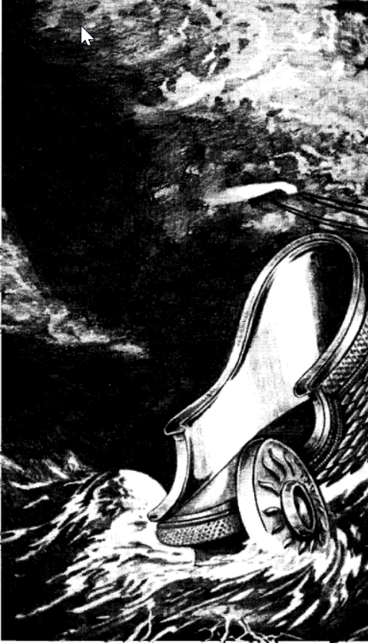
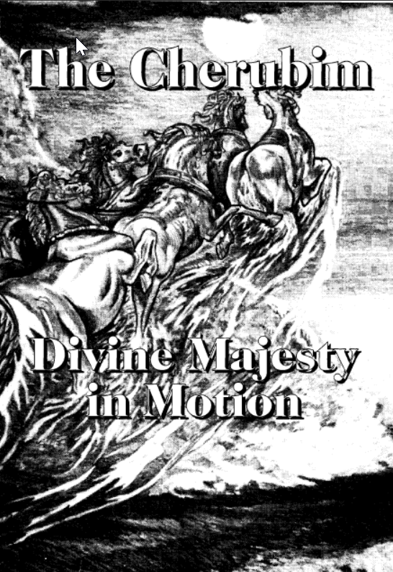
"The cherubim” is the Eternal Spirit post-resurrectionally manifested in Jesus and his brethren,“ ~ Dr. Thomas
Gesenius derives it from RKB by transposition of the letters, as rekeb, a chariot.
This idea harmonises well with all the allusions to the cherubim as the divine steeds, vehicles, and "chariots," also with the allusions to the wings, wheels, eyes, clouds, spirit, lightning, etc., that are found throughout the Bible.
The
Cherubim
Divine
Majesty
in
Motion

Slide 11
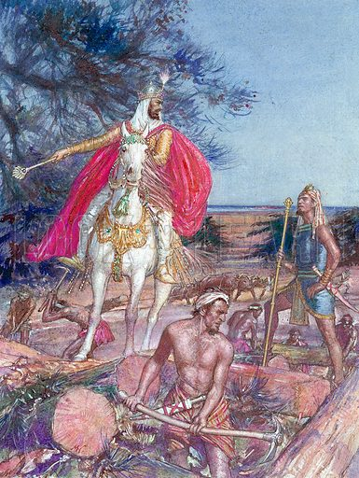
The Anointed Cherub That Covered in Eden
A Mortal “Cherub" The King of Tyre
(Eze. 28:14-16)
Described as "the anointed cherub that covereth," and of whom God says, “I have set thee so.”
"Thou hast been in Eden the garden of God, but I will cast thee as profane out of the mountain of God ; and I will destroy thee, O, covering cherub, from the midst of the stones of fire."
An ally of David and Solomon in the building of the temple of God at Jerusalem
The Tyrian power afterwards corrupted Israel, and was overthrown by the Babylonians and the Greeks
Today USA-Britain, the anti-typical Tyrian Tarshish power, is for a time “the anointed cherub that covereth" in the same "garden of God”

Slide 12
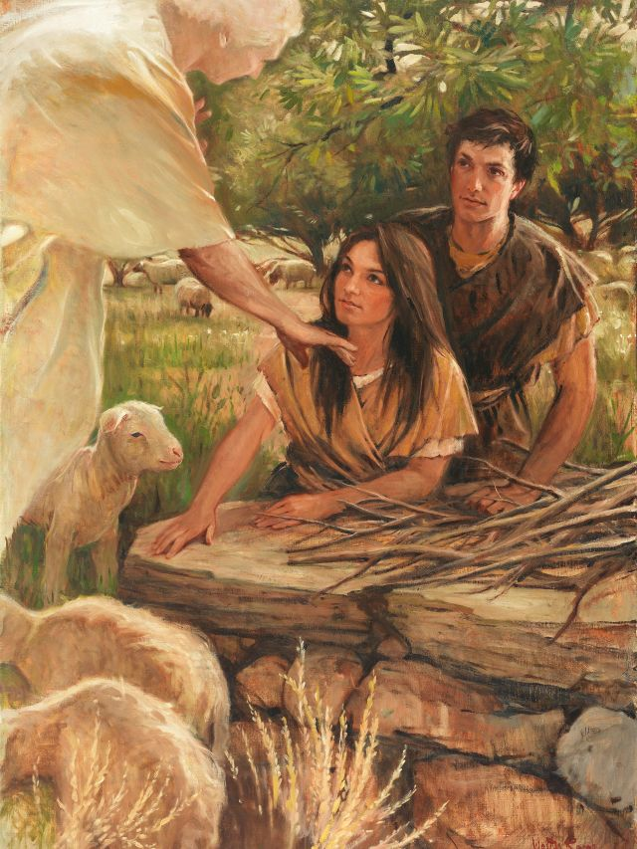
"And the LORD God (Yahweh Elohim) said, Behold, the man is become as one of us to know good and evil ; and now, lest he put forth his hand, and take also of the tree of life, and eat and live for ever : therefore the LORD God sent him forth from the garden of Eden, to till the ground from whence he was taken. So he drove out the man ; and he placed at the east of the garden of Eden the CHERUBIM (so the R.V., correctly) and a flaming sword which turned every way, to keep the way of the tree of life."
Here it seems obvious that "the Cherubim” are the guardian angels or “Elohim,” some of the “us” of the LORD God's allusion.
COMPARE BELOW…
Balaam (Num. 22:31), when he was withstood by " the angel of the LORD standing in the way with his sword drawn in his hand."
Joshua's meeting with the angelic " captain of the LORD'S host . . . with his sword drawn in his hand " (Josh. 5:13-15).
David's vision of " the angel of the LORD standing between the earth and the heaven, having a drawn sword in his hand stretched out over Jerusalem " (1 Chron. 21:15-18).
Notes:
The first occurrence of the word Cherubim in the Bible is in Gen. 3:24, where we read of the expulsion of Adam and Eve from the garden of Eden :
"And the LORD God (Yahweh Elohim) said, Behold, the man is become as one of us to know good and evil ; and now, lest he put forth his hand, and take also of the tree of life, and eat and live for ever : therefore the LORD God sent him forth from the garden of Eden, to till the ground from whence he was taken. So he drove out the man ; and he placed at the east of the garden of Eden the CHERUBIM (so the R.V., correctly) and a flaming sword which turned every way, to keep the way of the tree of life."
Here it seems obvious that "the Cherubim” are the guardian angels or “Elohim,” some of the “us” of the LORD God's allusion.
COMPARE BELOW…
Balaam (Num. 22:31), when he was withstood by " the angel of the LORD standing in the way with his sword drawn in his hand."
Joshua's meeting with the angelic " captain of the LORD'S host . . . with his sword drawn in his hand " (Josh. 5:13-15).
David's vision of " the angel of the LORD standing between the earth and the heaven, having a drawn sword in his hand stretched out over Jerusalem " (1 Chron. 21:15-18).

Slide 13
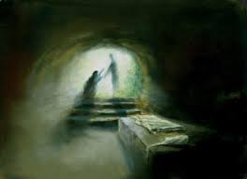
The promise of the Lord Jesus (Luke 20:36).
“They which shall be accounted worthy to obtain that age and the resurrection from the dead shall be equal unto the angels, and the children of God, being the children of the resurrection."
That is equivalent to saying they shall be “THE CHERUBIM” of that age and order
There is a doctrinal harmony here between this promise of Jesus and the saying of the LORD God in Gen. : "Behold the man is become as one of us."
Man was created "in the image of Elohim."
"And Elohim said, Let us make man in our image, and after our likeness " (Gen. 1:26)
That is as regards form and mental and moral capacity
But when man sinned, and was "made wise" in a sorrowful manner little anticipated, “likeness” extended to mental and moral experience
Elohim had “known evil," and had attained to the divine nature by redemption from the evil

Slide 14
The Diversity of Cherubic Forms
East of Garden in Eden | Tabernacle | Solomon’s Temple | Seraphim | Living Creatures | Future Temple | One like Son of Man | Throne in heaven
Gen. 3 | Exo. 25, 26 | 1 Kings 6, 7 2 Chron. 3 | Isa. 6 | Ezek. 1, 10 | Ezek. 41 | Rev. 1 | Rev. 4
Material | Material (Inanimate) | Material (Inanimate) | Visionary | Visionary | Visionary | Visionary | Visionary
Faces, Flaming sword | Faces (wings) | Wings Feet | Wings | Faces Wings Hands Calf’s feet Wheels Throne | Faces | Eyes like fire, feet like brass, voice like many waters, face bright as the sun | 24 Elders 4 Living Creatures

Slide 15
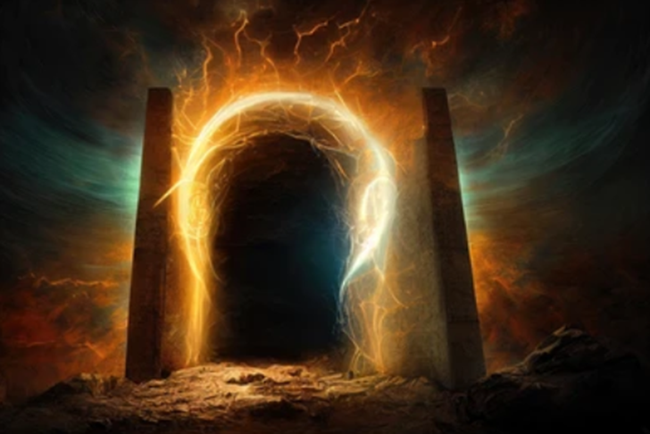
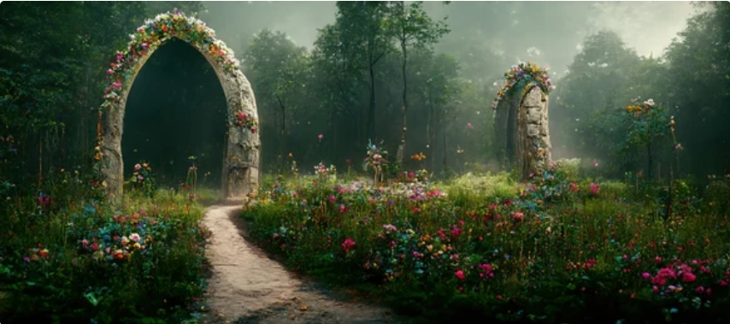
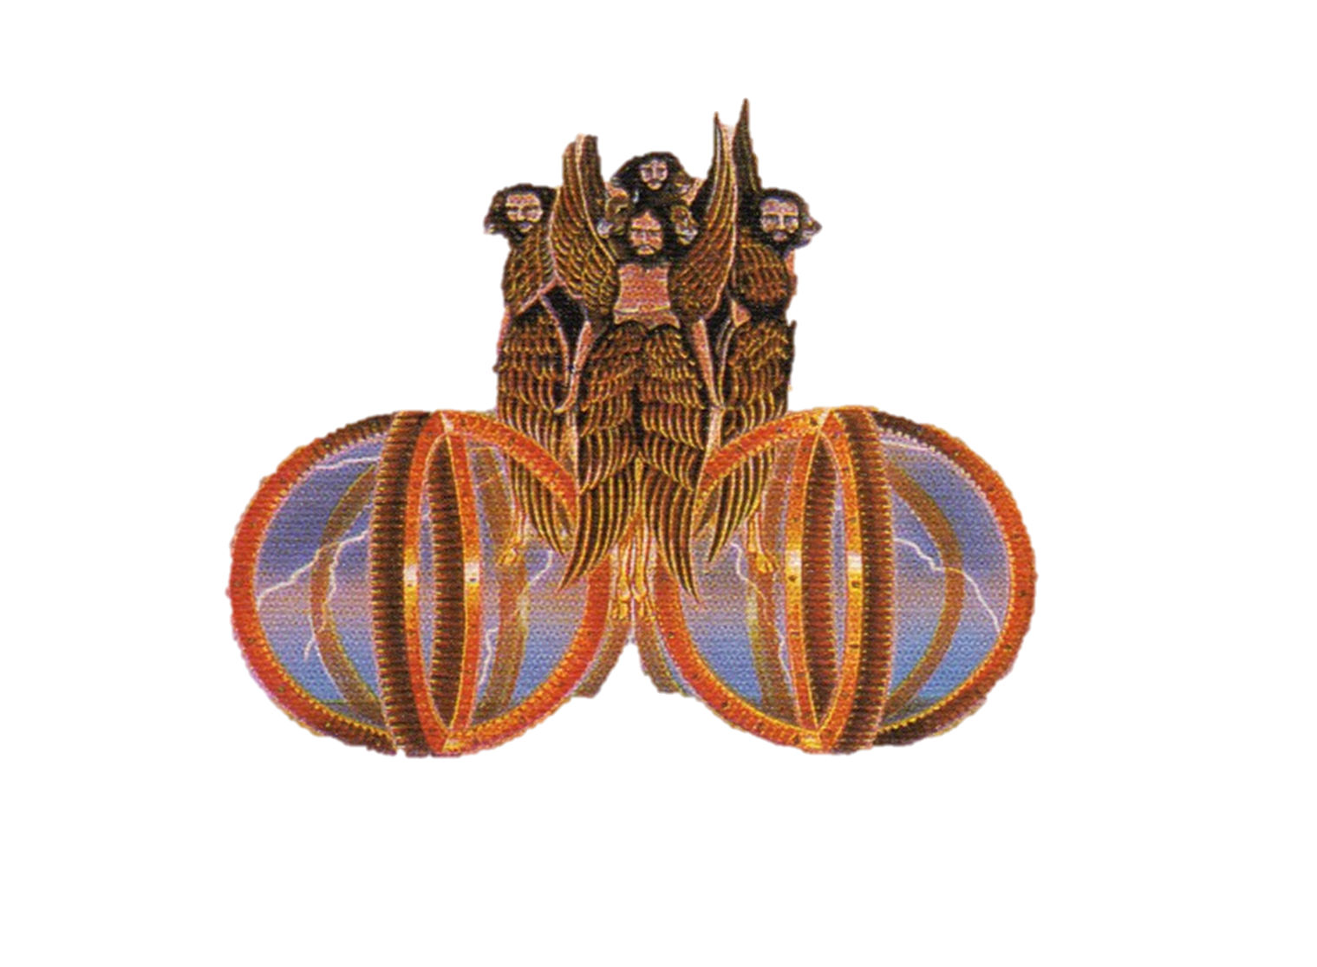
Gen. 3:24 contains some indication of A TABERNACLE AND ORDER OF WORSHIP.
"And he placed at the east of the garden the Cherubim," etc., is in the Hebrew Vayyashken, etc., literally : “And he caused to dwell” (as in a tabernacle), etc.,
The verb shahkan is used of God's dwelling in the tabernacle in …the midst of Israel (Ex. 25:8)…
…in Zion (Joel 3:17, 2) and
…in the (converted) "rebellious" for whom Christ has ascended upon high and has received " gifts " (Psa. 68:18 ; compared with Eph. 4:8-13)
A similar hint of a tabernacle and order of worship underlies the brief reference to Melchizedek, king of Salem, the priest of the most high God, who brought forth bread and wine, and blessed Abram upon his victorious return from his expedition against the confederate kings (Gen. 14).
He received tithes of Abram, being a very "great man" (Heb. 7:4), and a sign of Messiah by the oath of God (verse 21).
Thus on the very first mention of "the Cherubim" we are introduced to that theophany of which Jesus Christ is the center
Notes:
Gen. 3:24 contains some indication of a tabernacle and order of worship.
"And he placed at the east of the garden the Cherubim," etc., is in the Hebrew Vayyashken, etc., literally : And he caused to dwell (as in a tabernacle), etc.,
the verb shahkan being that which is used concerning God's dwelling in the tabernacle in the midst of Israel (Ex. 25:8), and in Zion (Joel 3:17, 21), and in the (converted) " rebellious " for whom Christ has ascended upon high and has received " gifts " (Psa. 68:18 ; compared with Eph. 4:8-13) .
A similar latent hint of a tabernacle and order of worship underlies the brief reference to Melchizedek, king of Salem, the priest of the most high God, who brought forth bread and wine, and blessed Abram upon his victorious return from his expedition against the confederate kings (Gen. 14).
He received tithes of Abram, being a very " great man " (Heb. 7:4), and a sign of Messiah by the oath of God (verse 21).
Thus on the very first mention of " the Cherubim " we are introduced to that theophany of which Jesus Christ is the center, and which we perceived was also indicated by “the seraphim” of Isaiah's vision.

Slide 16
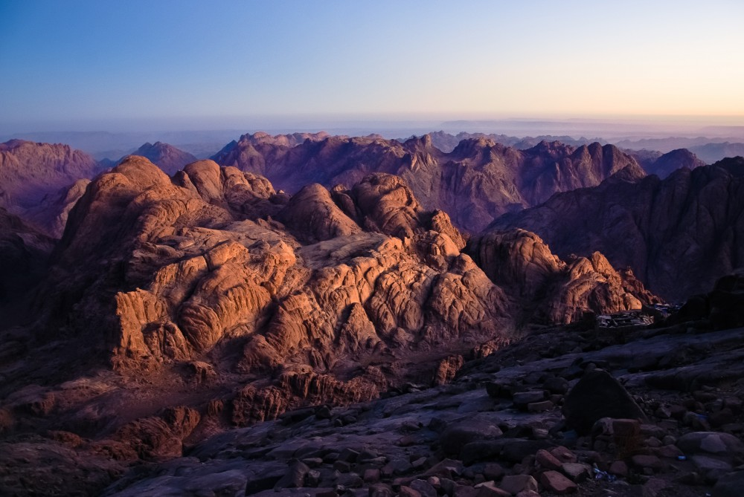
Exo 25:8 And let them make me a sanctuary; that I may dwell among them.
9 According to all that I shew thee, after the pattern of the tabernacle, and the pattern of all the instruments thereof, even so shall ye make it.
40 And look that thou make them after their pattern, which was shewed thee in the mount.
So when could that have possibly taken place?
Exo 24:1 And he said unto Moses, Come up unto the LORD, thou, and Aaron, Nadab, and Abihu, and seventy of the elders of Israel; and worship ye afar off.
Exo 24:9 Then went up Moses, and Aaron, Nadab, and Abihu, and seventy of the elders of Israel:
10 And they saw the God of Israel: and there was under his feet as it were a paved work of a sapphire stone, and as it were the body of heaven in his clearness.
11 And upon the nobles of the children of Israel he laid not his hand: also they saw God, and did eat and drink.
Notes:
The Ten Commandments form the basis
of the Mosaic Covenant (Exo. 34:28; Deu.
4:13), whilst the judgments of Exodus 21:1
to ch. 23:33 comprise the Book Of The
Covenant (Exo. 24:7). Upon this nucleus,
the rest of the Law is built. Having agreed
to the Covenant submitted (Exo. 19:7-8),
the nation now has to officially and
nationally ratify it in blood. For that
purpose, representatives of the people are
gathered together, an altar is erected,
sacrifices are offered, the Book of the Covenant is read, and the
people again proclaim their acceptance of it. So the ratification
proceeds. Afterwards, Moses and the elders of the people, eat and
drink, in confirmation of the covenant with the Elohim.
Moses and Joshua then leave the people and ascend into Horeb.
From there they move further to Sinai into whose heights Moses
alone ascends to remain for forty days and forty nights.

Slide 17
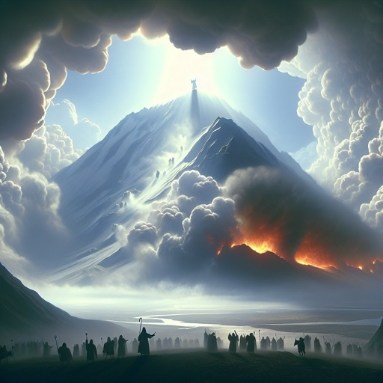
The Throne Room of the Most Holy
Exo 24:10 -“they saw the God of Israel: and there was under his feet as it were a paved work of a sapphire stone, and as it were the body of heaven in his clearness.
Isa 6:1-2 - “I saw also the LORD sitting upon a throne, high and lifted up, and his train filled the temple. Above (RSV – him) stood the seraphim”
Eze 1:26 -“the likeness of a throne, as…a sapphire stone: and upon the…throne was the likeness as the appearance of a man above upon it.
Rev 4:2 - behold, a throne was set in heaven, and one sat on the throne…a rainbow round about the throne…and round about the throne four and twenty elders

Slide 18
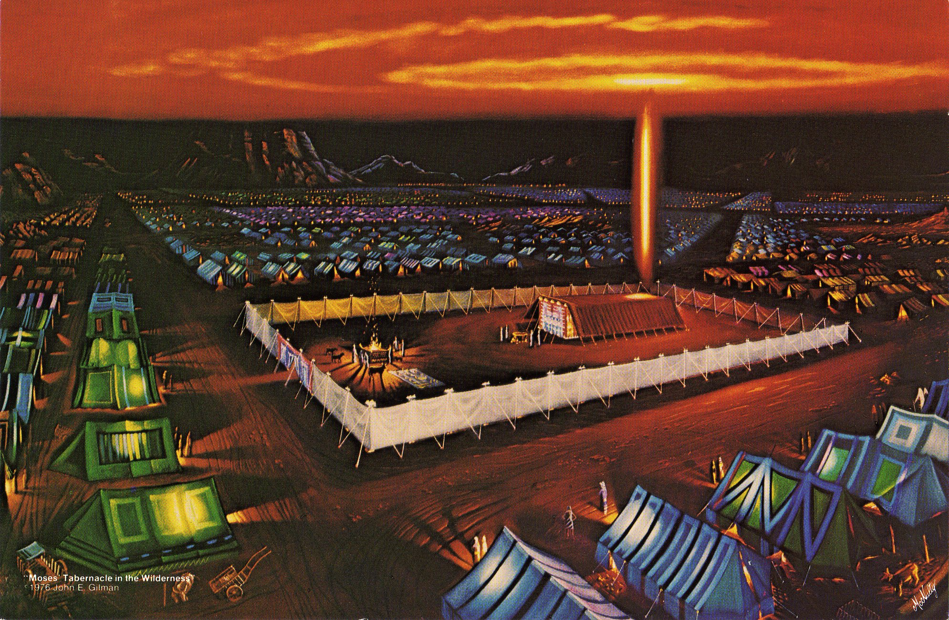
The next mention of cherubim is in connection with the Tabernacle in the Wilderness, and the divine specifications of structure and ritual that were connected with it.
Moses and Aaron, Nadab and Abihu, having been witnesses of a great theophany (Ex. 24), Moses was commanded by God to require of the children of Israel a willing offering of gold, silver, brass and various divinely specified materials.
And God said, “Let them make me a sanctuary that I may dwell among them. According to all that I shew thee, after the pattern of the tabernacle, and the pattern of all the instruments thereof, even so shall ye make it.” (Ex. 25:8, 9).

Slide 19
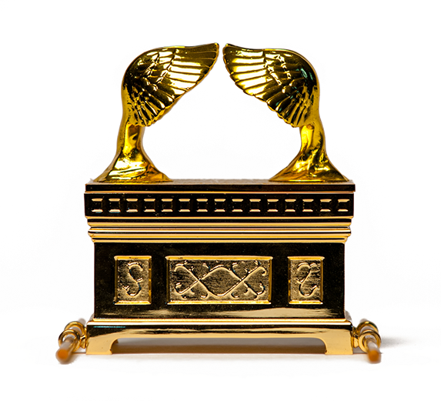
The ark of acacia wood overlaid with gold, and the divine specifications
"And thou shalt make a mercy seat (Heb. kapporeth, literally a covering, place of covering (for sin) ; Gk. hilasterion, a place of propitiation, reconciliation, atonement—Heb. 9:5) of pure gold . . . And thou shalt make two cherubim of gold, of beaten work shalt thou make them in the two ends of the mercy seat. And make one cherub on the one end, and the other cherub on the other end : of one piece (R.V.) with the mercy seat shall ye make the cherubim on the two ends thereof , . . . And the cherubim shall stretch forth their wings on high, covering the mercy seat with their wings, and their faces shall look one towards another ; towards the mercy seat shall the faces of the cherubim be."
"And thou shalt put the mercy seat above upon the ark ; and in the ark thou shalt put the testimony that I shall give thee. And there will I meet with thee, and I will commune with thee from above the mercy seat, from between the two cherubim which are upon the ark of the testimony, of all things which I will give thee IN COMMANDMENT unto the children of Israel " (Ex. 26:17-22).

Slide 20
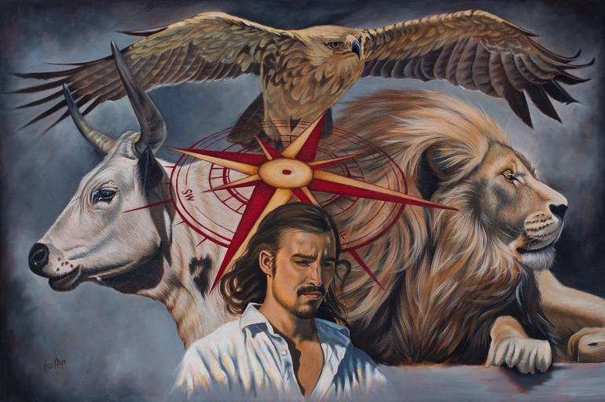
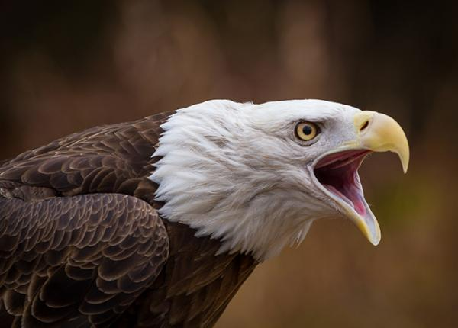
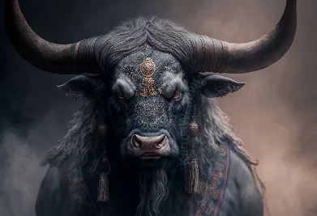
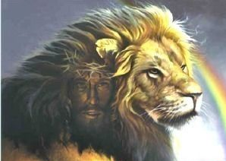
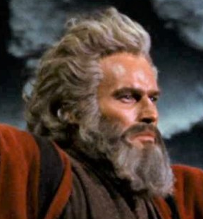
From the 4-square encampment with their respective 4 standards bearing the 4 faces of the Cherubim inward towards the Holy of Holies wherein was the Cherubim and Mercy Seat atop the Ark the divine message is the Hope of Israel!
WEST
NORTH
EAST
SOUTH

Slide 21
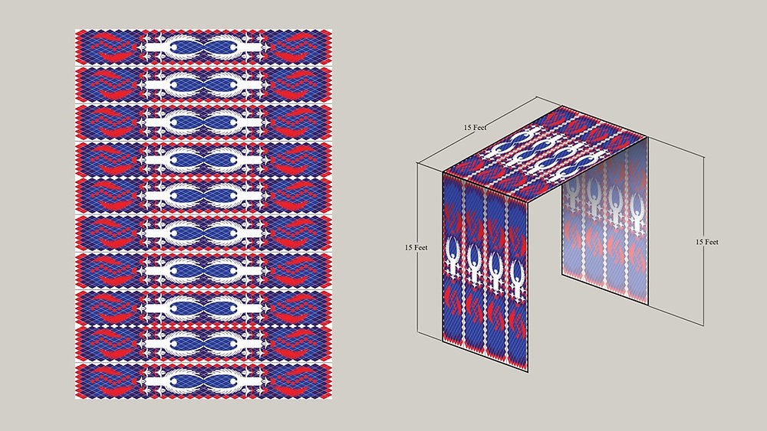
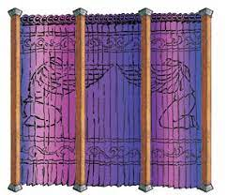
Exo_25:18 And thou shalt make two cherubims of gold, of beaten work shalt thou make them, in the two ends of the mercy seat.
Exo_25:19 And make one cherub on the one end, and the other cherub on the other end: even of the mercy seat shall ye make the cherubims on the two ends thereof.
Exo_26:1 Moreover thou shalt make the tabernacle with ten curtains of fine twined linen, and blue, and purple, and scarlet: with cherubims of cunning work shalt thou make them.
Exo_26:31 And thou shalt make a vail of blue, and purple, and scarlet, and fine twined linen of cunning work: with cherubims shall it be made:

Slide 22
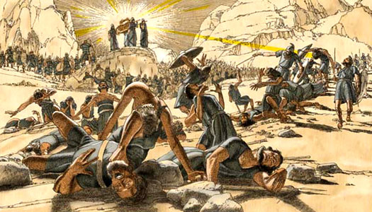
In the days of Eli and his sons, who were called to the high honor of the priesthood, “they trampled upon the sacrifice and offering” of the Lord (1 Sam. 13:29, R.V. mg)
In 1 Samuel 4 God had forsaken his tabernacle because of the iniquities of the house of Eli.
Nothing remained but their disgrace, disinheritance and death, and the raising up of a faithful priesthood in their stead.
The manufactured "cherubim" were but the ritual "sign" of something higher and more precious than themselves

Slide 23
We’re exhorted by Paul in the epistle to the Hebrews, after alluding to the Mosaic ritual and “the cherubim of glory," Paul says of willful sinners :
"He that despised Moses' law died without mercy under two or three witnesses. Of how much sorer punishment, suppose ye, shall he be thought worthy, who hath trodden under foot the Son of God, and hath counted the blood of the covenant, wherewith he was sanctified, an unholy thing, and hath done despite unto the spirit of grace?" (Heb. 10:28, 29).
These are unfit for an abiding place in "the Father's house,“ as "the habitation of God through the Spirit” (Eph. 2:22).
They have no place among "the cherubim."

Slide 24
Heb 10:19 Having therefore, brethren, boldness to enter into the holiest by the blood of Jesus,
20 By a new and living way, which he hath consecrated for us, through the veil, that is to say, his flesh;
21 And having an high priest over the house of God;
22 Let us draw near with a true heart in full assurance of faith, having our hearts sprinkled from an evil conscience, and our bodies washed with pure water.
23 Let us hold fast the profession of our faith without wavering; (for he is faithful that promised;)
24 And let us consider one another to provoke unto love and to good works:
25 Not forsaking the assembling of ourselves together, as the manner of some is; but exhorting one another: and so much the more, as ye see the day approaching.
26 For if we sin wilfully after that we have received the knowledge of the truth, there remaineth no more sacrifice for sins,
27 But a certain fearful looking for of judgment and fiery indignation, which shall devour the adversaries.

Slide 25
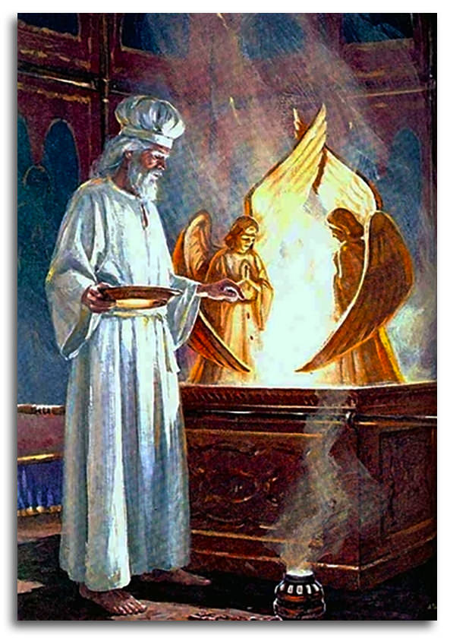
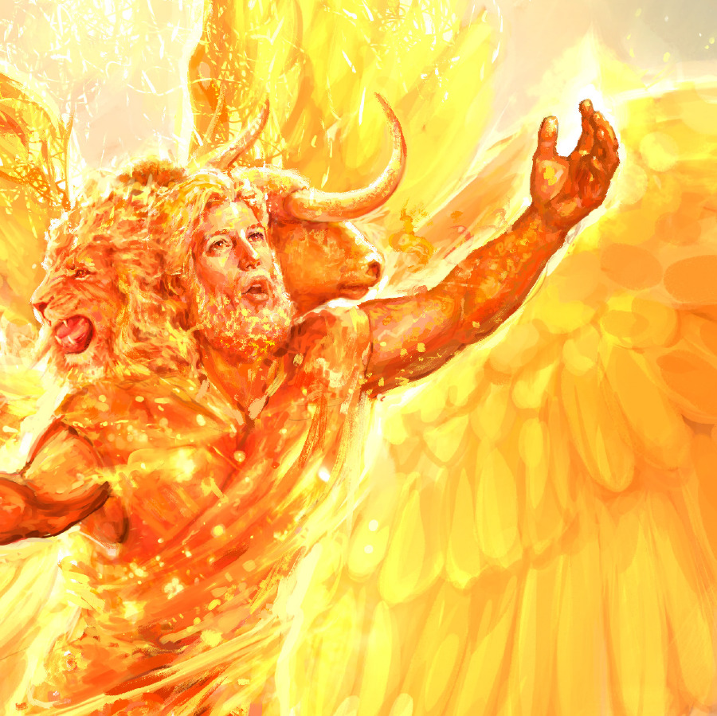
the LORD of Hosts, that dwelleth between the cherubim
2 Sam. 6:2 - "David arose and went with all the people that were with him from Baale of Judah to bring up thence the ark of God, whose name is called by the name of the LORD of Hosts, that dwelleth between the cherubim."
Here it may be noticed that the word "between" is in italics and has no place in the text.
(Similar in 1 Sam. 4:4 ; Psa. 80:1 : 99:1 ; Isa. 37:16.
Not that the idea is literally wrong.
(The R.V. has "sitteth upon the cherubim" in all these places.)
The divine idea in the symbolic figures is that they represent the immortal sons of God in whom God will dwell by His spirit in the age to come, the head of all being Jesus Christ.
Notes:
And when the men of Bethshemesh were smitten by God with a great slaughter for profaning the ark, they besought the men of Kirjath-jearim to come to take charge of it. This they did, and brought it into the house of Abinadab and sanctified Eleazar his son " to keep the ark of the Lord " (1 Sam. 7:2).
And so for twenty years the ark rested there, until David was established in the Kingdom.

Slide 26
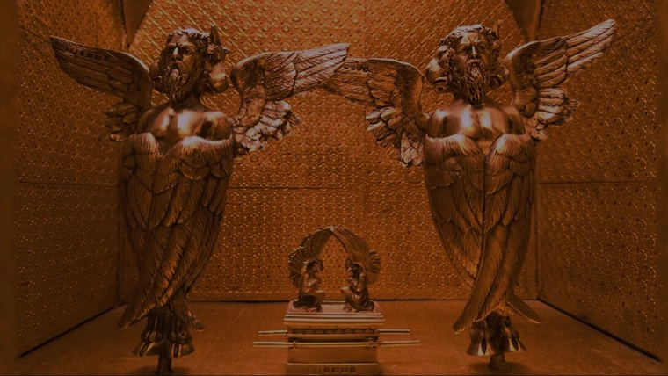
Solomon built the temple according to the divine specification, according to
"the pattern of all that he had by the spirit" from David his father (1 Chron. 28:12)
Just as God had exhorted Moses, to build according to the pattern shown him (Exo. 25:40 ; Heb. 8:5).
Preparing the gold and silver, David allotted…
"for the altar of incense refined gold by weight ; and gold for the pattern of the chariot of the cherubim that spread out their wings and covered the ark of the covenant of the Lord. All this said David, the Lord made me understand in writing by his hand upon me, even all the works of this pattern" (verses 18, 19).
The cherubim of this specification were of olive wood and ten cubits high, as recorded in 1 Kings 6
Their outstretched wings spanned the breadth of the temple.

Slide 27
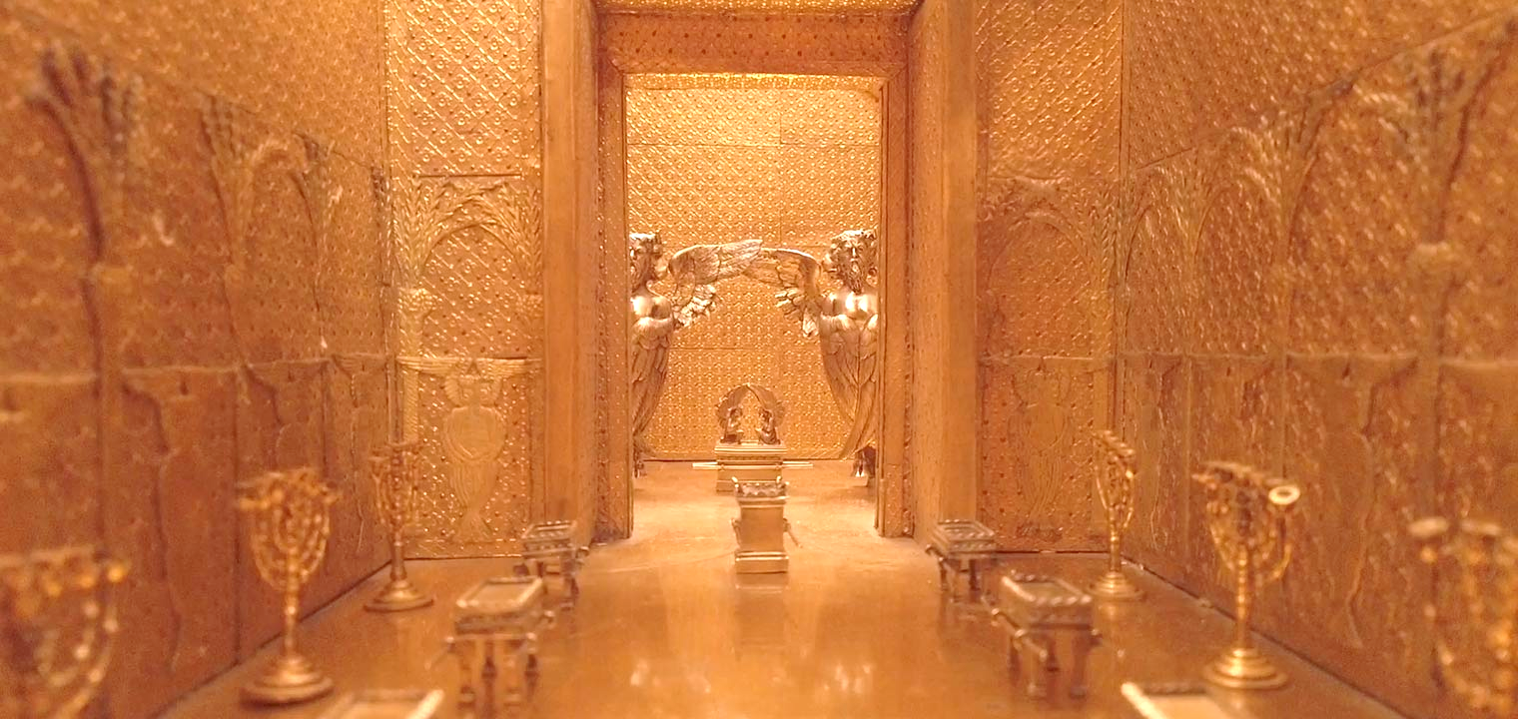
The walls also were carved with cherubim and palm trees, as likewise were the doors. On the bases also of the lavers " were lions, oxen and cherubim "
(1 Kings 7:29, 36)
So that cherubim figured very conspicuously in the temple of Solomon
And all their associations, whether with "the laver of regeneration” (Titus 3:4-6) or the ark of the covenant, ritually foreshadowed the glory of the Lord to be revealed in Christ and his brethren.

Slide 28
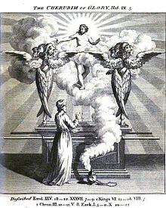
Asaph's prayer in Psalm 80 opens with these words :
"Give ear 0 Shepherd of Israel, thou that leadest Joseph like a flock ; thou that dwellest between the cherubim, shine forth."
Here the lamentation is over the adversities of Israel, and the prayer is for restoration and salvation under the figure of replanting and establishing the "vine" of Israel.
" Return we beseech thee, 0 God of hosts, look down from heaven and behold and visit this vine, and the vineyard which thy right hand hath planted, and the branch thou madest strong for thyself . . . Let thy hand be upon the Man of thy right hand, upon the Son of Man whom thou madest strong for thyself."
That is upon Jesus Christ who is that Son of Man, and the "Cherub" by pre-eminence, whose mission it is to "restore again the kingdom to Israel " (Acts 1:6) and bring Jacob again to God (Isa. 49:5).

Slide 29
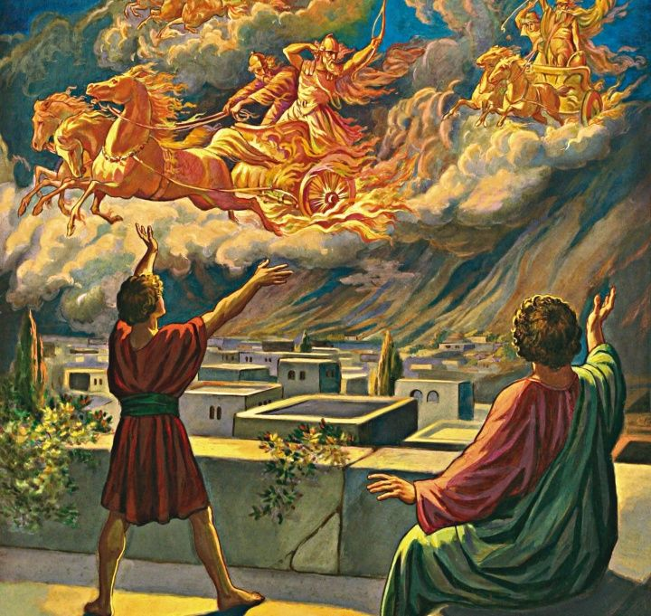
SLIDE FOR CLASS 4
The allusions of the Psalms and the prophets are all in harmony with this.
David, celebrating God's deliverance of him from Saul and from all his enemies, said that at the voice of his cry God " bowed the heavens and came down ; and darkness was under his feet. And he rode upon a cherub and did fly ; yea, he did fly upon the wings of the wind " (or spirit, ruach).
The figure of the vehicle, chariot or steed is here maintained in harmony with other allusions, and the angelic deliverance of David and his kingdom is typical of that of Christ and his kingdom that is to be revealed.

Slide 30
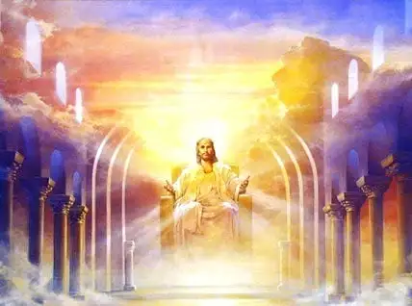
When he accomplishes that great regeneration the vision of Psalm 99 in the revelation of
"the cherubim" will be realized upon earth.
Psa 99:1 -The Lord reigneth ; let the peoples tremble : he sitteth between the cherubims ; let the earth be moved. The Lord is great in Zion ; and he is high above all the peoples."
And the Psalm goes on to exhort all to worship God because of the manifestation of "the king's strength in the midst of his redeemed."
Hezekiah, in his prayer to God against the Assyrian invader, appealed to the "Lord of hosts the God of Israel, who dwellest between the cherubim” (Isa. 38:16), and was heard for God's own sake and for David's sake (v 35).
The blasphemous boasts of the Assyrian king were silenced in the cherubic (angelic) destruction of his army, and his own death in disgrace at the hands of his own sons in the temple of his god.
Notes:
2 The LORD is great in Zion; and he is high above all the people.
3 Let them praise thy great and terrible name; for it is holy.
4 The king's strength also loveth judgment; thou dost establish equity, thou executest judgment and righteousness in Jacob.
5 Exalt ye the LORD our God, and worship at his footstool; for he is holy.
6 Moses and Aaron among his priests, and Samuel among them that call upon his name; they called upon the LORD, and he answered them.
7 He spake unto them in the cloudy pillar: they kept his testimonies, and the ordinance that he gave them.
8 Thou answeredst them, O LORD our God: thou wast a God that forgavest them, though thou tookest vengeance of their inventions.
9 Exalt the LORD our God, and worship at his holy hill; for the LORD our God is holy.

Slide 31
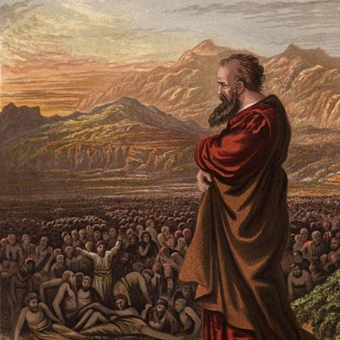
Of all the prophets EZEKIEL, a Levite priest, is the one who most particularly alludes to the CHERUBIM.
The prophet/priest himself is eminently “a sign” of that "Son of Man” who is "the CHERUB” by pre-eminence, the Lord Jesus Christ
Ezekiel— “The Strength of God,” or “Whom God Strengthens” speaks of Christ—"the Son of Man whom the Father made strong for himself."
The prophet/priest Ezekiel bears that title, "Son of Man," many times in his book, being called and commissioned by the Spirit of God under that title
Jesus frequently used that phrase of himself and though of divine origin, he bore our nature, "that through death he might destroy him that had the power of death, that is the Devil."
Notes:
Of all the prophets EZEKIEL, a Levite priest, is the one who most particularly alludes to the cherubim.
The prophet/priest himself is eminently "a sign” of that "Son of Man” who is "the CHERUB” by pre-eminence, that is the Lord Jesus Christ
Ezekiel's very name— ”The Strength of God,” or “Whom God Strengthens” speaks of Christ—"the Son of Man whom the Father made strong for himself."
The prophet/priest Ezekiel bears that title, "Son of Man," many times in his book, being called and commissioned by the Spirit of God under that title.
Jesus frequently used that phrase of himself.
He would have us realize that, though of divine origin, he bore our nature, "that through death he might destroy him that had the power of death, that is the Devil."

Slide 32
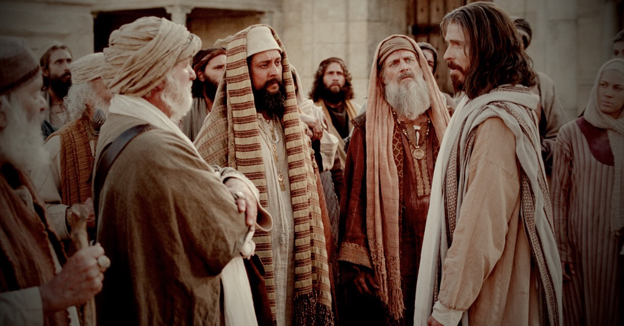
Jesus “…through death he would ascend to the divine nature " and reveal God's cherubim.
His office as priest/prophet, word and work all strongly foreshadow those of "Ezekiel the priest, the son of Buzi," in "the word of the Lord which came expressly unto him" in the land of the Chaldeans, in “the end” of the age of the kingdom of Judah
If our Lord Jesus was the one, divinely accepted sacrifice to be offered up during his mortal probation then who was the priest responsible for examining him for any defects that might render him deficient?
Joh 8:46 Which of you convinceth me of sin? And if I say the truth, why do ye not believe me?
Notes:
And that thus “through death he would ascend to the divine nature” and reveal God's cherubim.
His office as priest/prophet, word and work in this direction are all strongly foreshadowed by those of " Ezekiel the priest, the son of Buzi," in " the word of the Lord which came expressly unto him " in the land of the Chaldeans, in " the end " of the age of the kingdom of Judah.

Slide 33
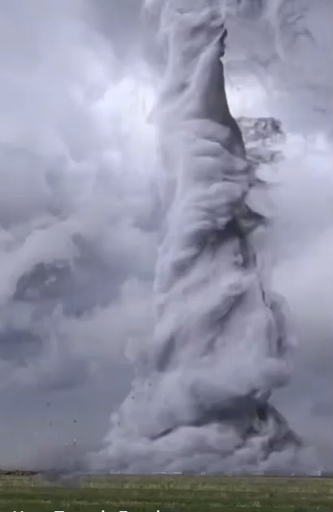
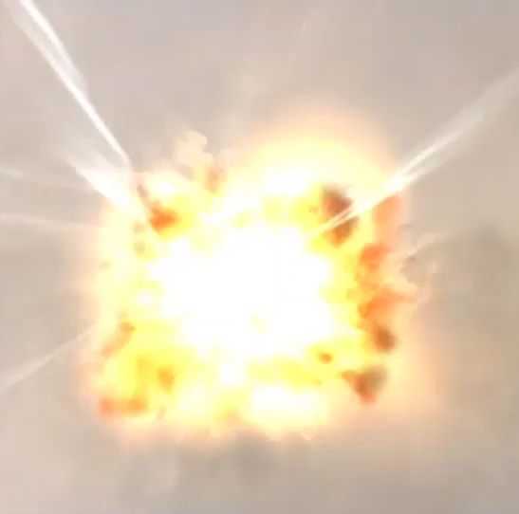
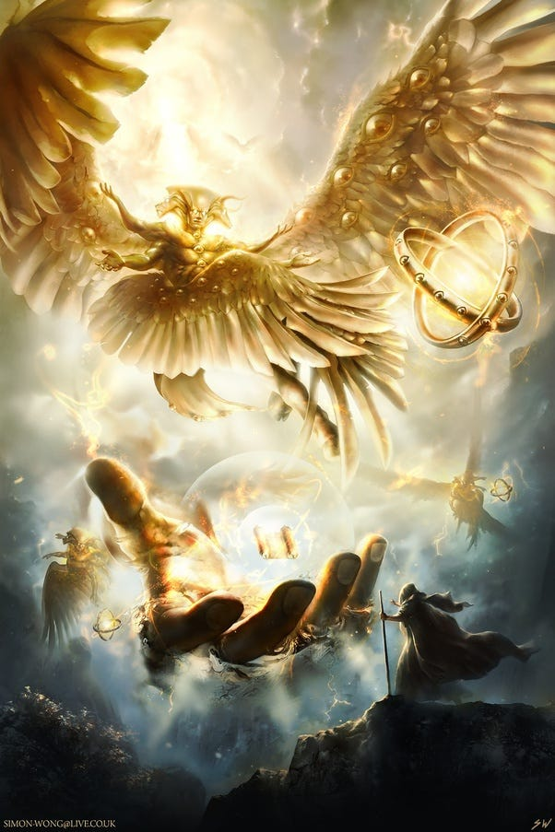
He saw a whirlwind come out of the north, with a great cloud and fire, and out of the midst came the likeness of four living creatures which had the likeness of a man.
They had 4 faces and 4 wings, and their feet were straight feet, and the sole of their feet was like the sole of a calf's foot ; and they sparkled like the color of burnished brass.
Compare the imagery of Mic. 4:12 : "Arise and thresh, o daughter of Zion ; for I will make thine horn iron and thy hoofs brass ; and thou shalt beat in pieces many peoples ; and I will consecrate their gain unto the LORD (Yahweh) and their substance unto the Lord (Jesus) of the whole earth."
Notes:
He saw a whirlwind come out of the north, with a great cloud and fire, and out of the midst came the likeness of four living creatures which had the likeness of a man.
They had four faces and four wings, and their feet were straight feet, and the sole of their feet was like the sole of a calf's foot ; and they sparkled like the color of burnished brass.
Here we can scarcely miss comparison with the imagery of Mic. 4:12 : "Arise and thresh, o daughter of Zion ; for I will make thine horn iron and thy hoofs brass ; and thou shalt beat in pieces many peoples ; and I will consecrate their gain unto the LORD (Yahweh) and their substance unto the Lord (Jesus) of the whole earth."

Slide 34
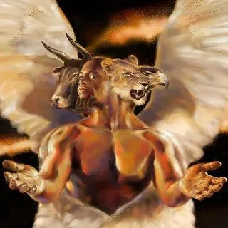
The redeemed “daughter of Zion” under the “man of God's right hand” executing the judgments written!
Ezekiel describes the wings and faces of the “living creatures,” which turned not aside from their course but "went everyone straight forward."
They had the face of a man,
and the face of a lion on the right side, and the face of an ox and the face of an eagle on the left.
LION
OX
EAGLE
MAN
The “living creatures" of Ezekiel
They went “whither the spirit was to go,” like “lightning” (v 14).

Slide 35
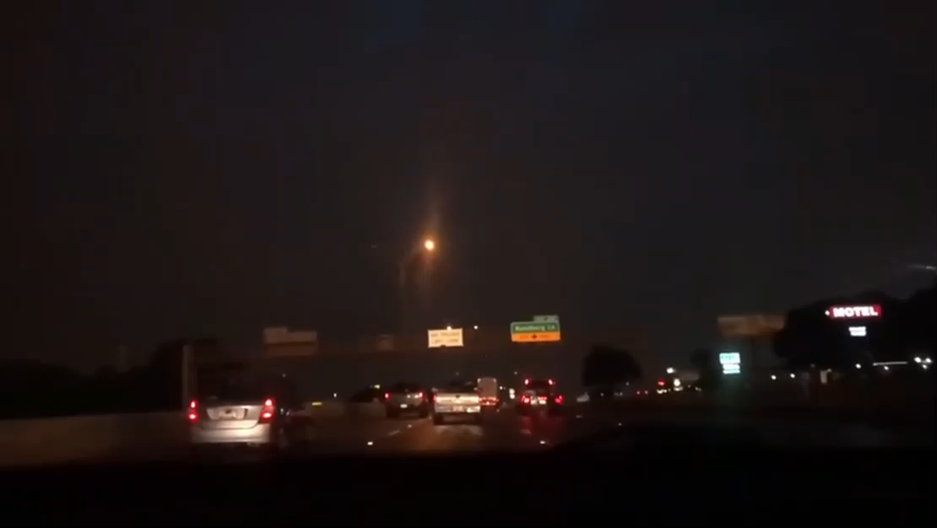
Christ speaks concerning the divine characteristics of his coming "day."
" For as the lightning cometh out of the east and shineth even unto the west, so also shall the coming of the Son of Man be. For wheresoever the carcass is there will the eagles be gathered together " (Matt. 24:7-28).
"in the clouds of heaven with power and great glory. And he shall send forth his angels with a great sound of a trumpet, and they shall gather together his elect from the four winds, from one end of heaven to the other."
Ezekiel describes the "wheels” of “the chariot of the cherubim” as being "full of eyes round about."
Notes:
The disciples were not to be distracted by rumors of false Christs,…
This is from his prophecy of his second advent

Slide 36
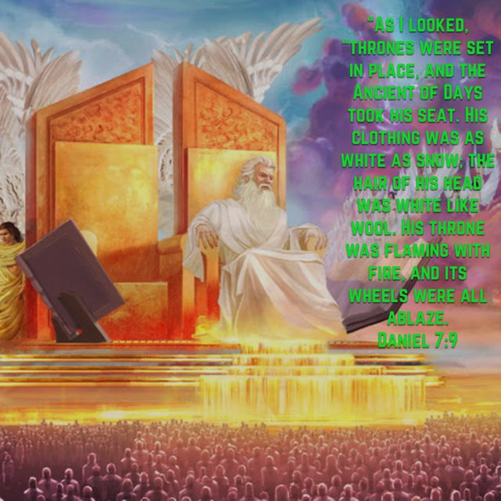
Daniel and John both had visions of the same divine manifestation.
Daniel in his night visions of "one like the Son of Man," saw the thrones (of " the regeneration ") set up, and the Ancient of Days did sit (was enthroned). His garment was white as snow, and the hair of his head like the pure wool ; his throne was like the fiery flame, and his wheels as burning fire.
The Lord Jesus appropriated to himself this vision of Daniel (chapter seven, particularly verses 13, 14) when he spoke the parable of "a certain nobleman who went into a far country to receive for himself a kingdom and to return" (Luke 19:12-27).

Slide 37
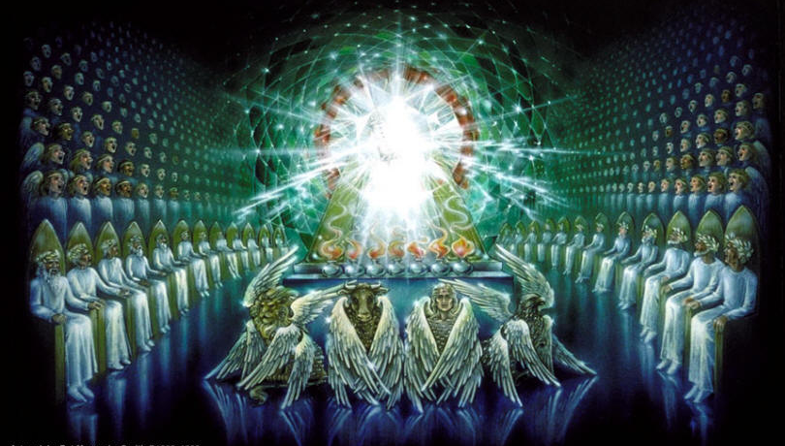
John in the Revelation, in his vision of "one like unto the Son of Man," describes the same theophany.
We cannot doubt it when we read the two visions.
And he, too (in chs. 4 & 5), describes the vision of four living creatures round about the throne.
"They sing a new song, saying (to "the Lamb '), Thou art worthy to take the book and open the seals thereof ; for thou wast slain and hast redeemed us to God by thy blood out of every kindred and tongue and people and nation ; and hast made us unto our God kings and priests, and we shall reign on the earth." (Rev. 5:9)

Slide 38
2 And immediately I was in the spirit: and, behold, a throne was set in heaven, and one sat on the throne.
3 And he that sat was to look upon like a jasper and a sardine stone: and there was a rainbow round about the throne, in sight like unto an emerald.
4 And round about the throne were four and twenty seats: and upon the seats I saw four and twenty elders sitting, clothed in white raiment; and they had on their heads crowns of gold.
5 And out of the throne proceeded lightnings and thunderings and voices: and there were seven lamps of fire burning before the throne, which are the seven Spirits of God.
6 And before the throne there was a sea of glass like unto crystal: and in the midst of the throne, and round about the throne, were four beasts full of eyes before and behind.
7 And the first beast was like a lion, and the second beast like a calf, and the third beast had a face as a man, and the fourth beast was like a flying eagle.
8 And the four beasts had each of them six wings about him; and they were full of eyes within: and they rest not day and night, saying, Holy, holy, holy, Lord God Almighty, which was, and is, and is to come.
Notes:
John in the Revelation, in his vision of "one like unto the Son of Man," describes the same theophany.
We cannot doubt it when we read the two visions.
And he, too (in chs. 4 & 5), describes the vision of four living creatures round about the throne.
"They sing a new song, saying (to "the Lamb '), Thou art worthy to take the book and open the seals thereof ; for thou wast slain and hast redeemed us to God by thy blood out of every kindred and tongue and people and nation ; and hast made us unto our God kings and priests, and we shall reign on the earth." (Rev. 5:9)

Slide 39
Rev 4:1 After this I looked, and, behold, a door was opened in heaven: and the first voice which I heard was as it were of a trumpet talking with me; which said, Come up hither, and I will shew thee things which must be hereafter.
2 And immediately I was in the spirit: and, behold, a throne was set in heaven, and one sat on the throne.
3 And he that sat was to look upon like a jasper and a sardine stone: and there was a rainbow round about the throne, in sight like unto an emerald.
4 And round about the throne were four and twenty seats: and upon the seats I saw four and twenty elders sitting, clothed in white raiment; and they had on their heads crowns of gold.
5 And out of the throne proceeded lightnings and thunderings and voices: and there were seven lamps of fire burning before the throne, which are the seven Spirits of God.
6 And before the throne there was a sea of glass like unto crystal: and in the midst of the throne, and round about the throne, were four beasts full of eyes before and behind.
7 And the first beast was like a lion, and the second beast like a calf, and the third beast had a face as a man, and the fourth beast was like a flying eagle.
8 And the four beasts had each of them six wings about him; and they were full of eyes within: and they rest not day and night, saying, Holy, holy, holy, Lord God Almighty, which was, and is, and is to come.
9 And when those beasts give glory and honour and thanks to him that sat on the throne, who liveth for ever and ever,
10 The four and twenty elders fall down before him that sat on the throne, and worship him that liveth for ever and ever, and cast their crowns before the throne, saying,
11 Thou art worthy, O Lord, to receive glory and honour and power: for thou hast created all things, and for thy pleasure they are and were created.

Slide 40
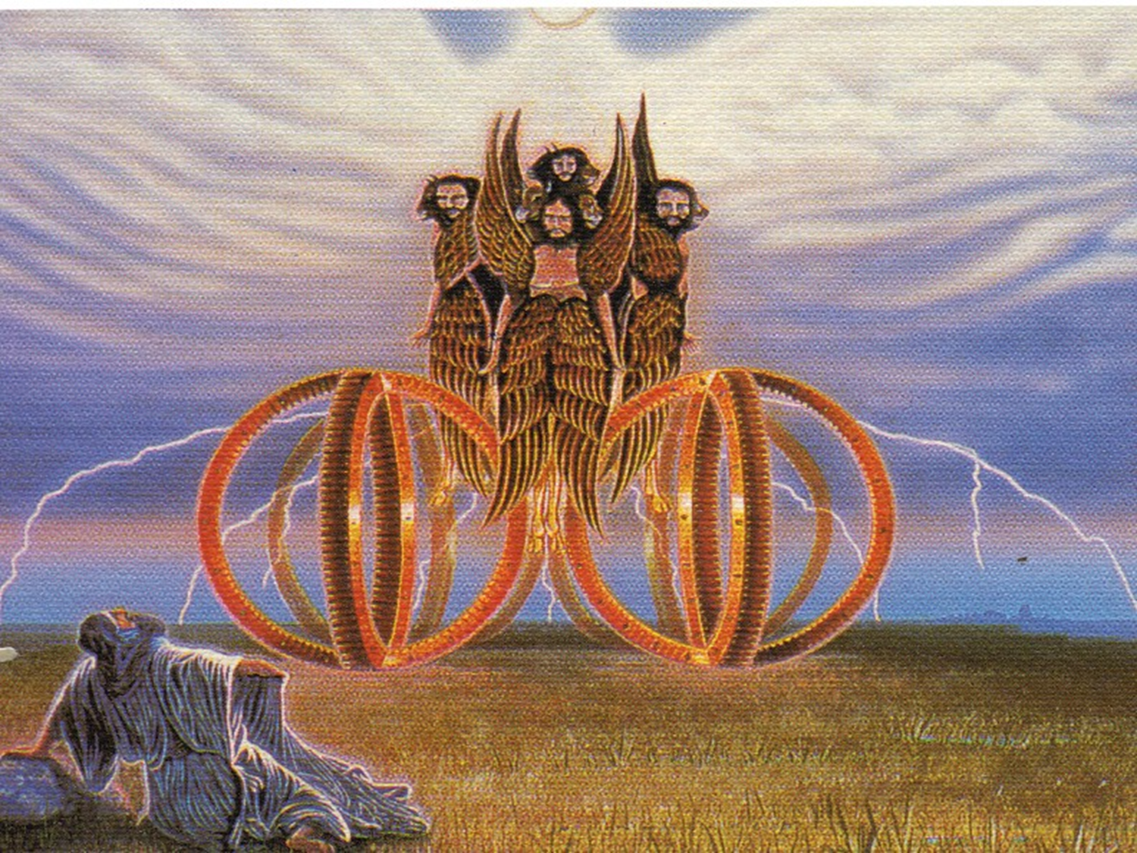
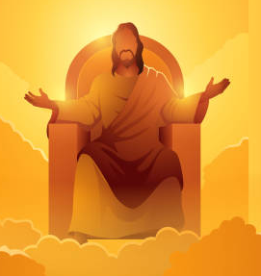
Ezekiel's vision of the likeness of a throne and the appearance of a man above upon it (Ezek. 1:26) .
Explained by Jesus to mean the throne of David "in the regeneration," and the "thrones of judgment" round about occupied by the "redeemed."
In the sixth year of the captivity Ezekiel had another vision of "the cherubim,” which comprehended the then present supervision of Jerusalem and the land of Israel by "them that had charge over the city" (ch. 9:1), that is…
This is the substance of Ezekiel's opening vision of the cherubim, that “likeness of the glory of the Lord" that so overawed him that when he saw it "he fell upon his face."
…the angels of the Lord, and the future manifestation of them that shall "have charge" in "the world to come," that is, Christ and the redeemed.

Slide 41
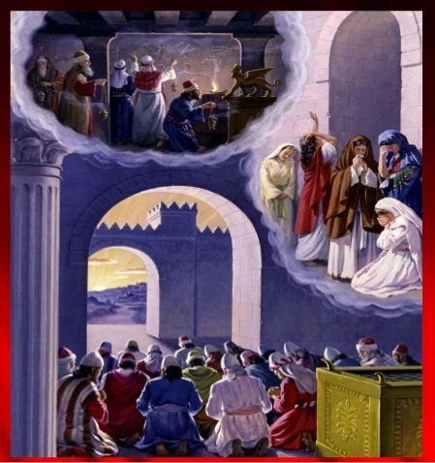
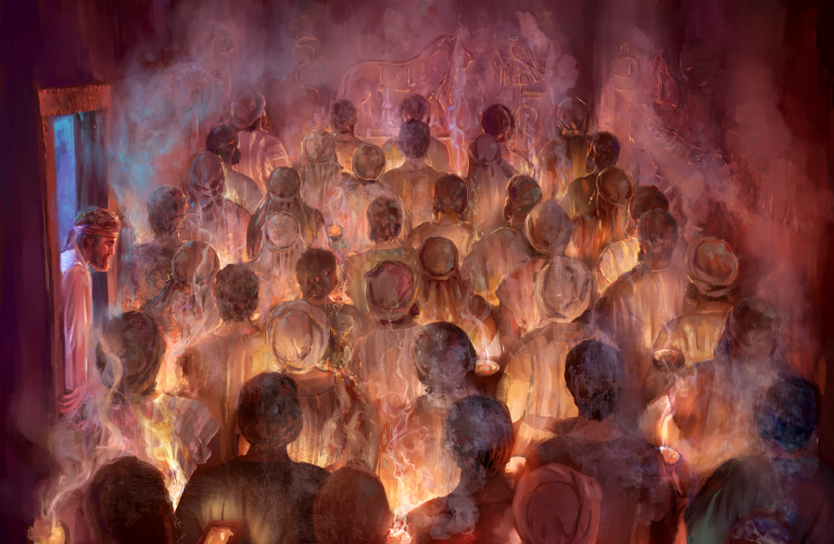
The prophet tells us in ch. 8 that as he sat in his house with the elders of Judah before him, the hand of the Lord was upon him, and in vision carried him to Jerusalem, where there appeared to him the vision of the glory of the Lord according to the vision he had seen in the plain (described in chapter 1).
He was shown all sorts of idolatry and "abomination" current in Jerusalem, and then, in chapter nine, he was shown the vision of the judgment thereof.

Slide 42
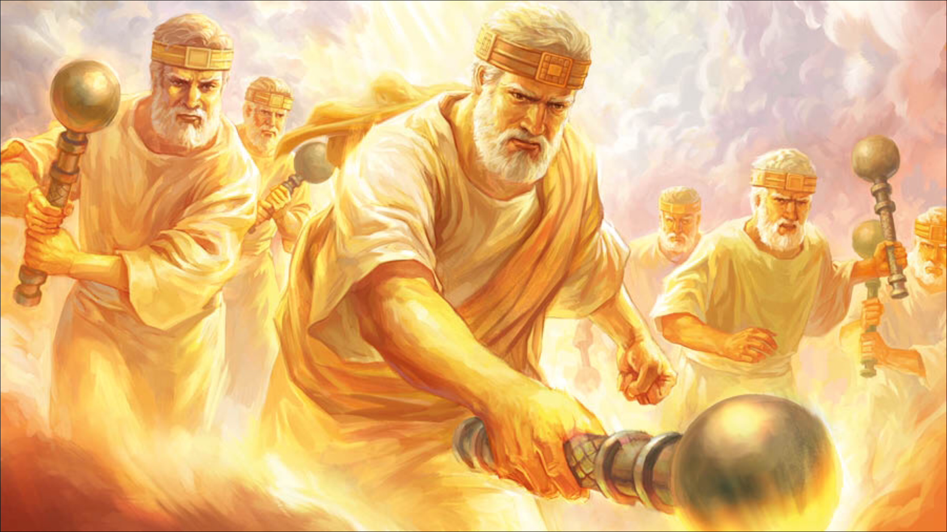
" He cried also in mine ears with a loud voice, saying, Cause them that have charge over the city to draw near, every man with his destroying weapon in his hand."
"And behold six men came from the way of the higher gate which lieth toward the north, and every man a slaughter weapon in his hand ; and one man among them was clothed with linen, with a writer's inkhorn by his side ; and they went in and stood beside the brazen altar."
"And the glory of the God of Israel was gone up from the cherub whereupon he was, to the threshold of the house. And he called to the Man clothed with linen which had the writer's inkhorn by his side. And the LORD said unto him, Go through the midst of the city, through the midst of Jerusalem, and set a mark upon the foreheads of the men that sigh and cry for all the abominations that be done in the midst thereof."
"And to the others he said in my hearing, Go ye after him through the city and smite ; let not your eye spare neither have ye pity ; slay utterly old and young, both maids and little children and women ; but come not near any man upon whom is the mark, and begin at my sanctuary."
" Then they began at the ancient men which were before the house. And he said unto them, Defile the house, and fill the courts with the slain ; go ye forth. And they went forth and slew in the city."
And the prophet, himself spared in the vision of the slaughter, fell upon his face and intreated the divine mercy for " the residue of Israel."
But the Almighty justified the slaughter : "
The iniquity of the house of Israel and Judah is exceeding great, and the land is full of blood and the city full of perverseness ; for they say, The LORD hath forsaken the earth, The LORD seeth us not."
Because of this God would not spare.
And the prophet says, " Behold the man clothed with linen, which had the inkhorn by his side, reported the matter, saying, I have done as thou hast commanded me."

Slide 43
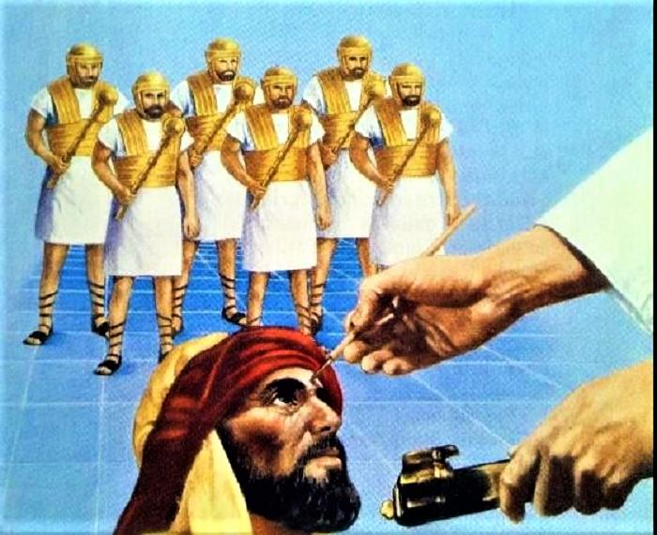
This vision of the judgment of Jerusalem, and the sparing of the marked men who sighed and cried over the sins of the city, is strongly reminiscent of the first Passover in the land of Egypt, when the destroying angel passed over the houses marked on lintel and doorpost with " the blood of the Lamb."
It is a lesson much to be heeded by them of "the great city which spiritually is called Sodom and Egypt," if only they could rise up to it.
Then Ezekiel (ch. 10.) had a vision of a throne on the firmament above the cherubim.
And the divine " man " enthroned (ch. 1. 26) commanded the recording angel to take coals of fire from " between the wheels " (" between the cherubim ") and scatter them over the city. And he did so. And the glory of the Lord stood over the threshold of the house, which was " full of the brightness of the Lord's glory." And the sound was " as the voice of the Almighty God (El-Shaddai) when he speaketh."
Cherubim with a flaming sword kept the way of the tree of life (Gen. 3:24).
There is no escaping the judgments of God that are about to be poured out upon the earth but by becoming "marked" by the recording angel, by coming under the cover of "the blood of the Lamb " (Rev. 12:11).
And there is this further reflection : The Marked men were mingled with the unmarked, even in the Sanctuary, for the commandment was, " Begin (to slay) at my sanctuary" (Ezek. 9:6).
It is the apostle Peter who applies this to " the house of God," to " us," thus :—" Let none of you suffer as a murderer, or as a thief, or as an evil-doer, or as a busybody in other men's matters. Yet if any man suffer as a Christian, let him not be ashamed ; but let him glorify God on this behalf. For the time is come that judgment must begin at the house of God ; and if it first begin at us, what shall the end be of them that obey not the gospel of God ? And if the righteous scarcely be saved, where shall the ungodly and the sinner appear ? " (1 Pet. 4:15-18).
Before the final revelation of the cherubim there must come the judgment of the house of God.
The prophet Ezekiel will be " left." (" They were slaying, and I was left").
He will be one of God's strong men among the cherubim, and those who now follow in his footsteps will be spared with him .

Slide 44
"There came two angels to Sodom at even" (Gen. 19:1). And next day " the Lord rained upon Sodom and upon Gomorrah brimstone and fire from the Lord out of heaven."But Lot's wife” looked back " and became a pillar of salt.
And it is Jesus who says, " Remember Lot's wife."
So in Ezekiel's days Jerusalem's leaders were likened by God to the people of the cities of the plain : " Hear the word of the Lord, ye rulers of Sodom ; give ear unto the law of our God, ye people of Gomorrah.. To what purpose is the multitude of your sacrifices unto me ? saith the Lord " (Isa. 1:10, 11 ) .
And so the fire of God fell upon His own house and city.
And so again, when Jesus - came unto his own, and his own received him not " (John i. 1 1 ) , " wrath to the uttermost " came upon the land and city.
And "yet once more"
“The Lord Jesus shall be revealed from heaven with his mighty angels in flaming fire taking vengeance on them that know not God and that obey not the gospel of our Lord Jesus Christ : who shall be punished with everlasting destruction from the presence of the Lord, and from the glory of his power ; when he shall come to be glorified in his saints, and to be admired in all them that believe " (2 Thess. i. 7-10).
Ezekiel was mightily impressed with this vision of the coming glory of the saints, under the figure of " the chariot of the cherubim." He said, " As for the wheels, it was cried unto them in my hearing, 0 wheel " (10:13, A.V.). But this version does not quite give us the prophet's meaning.
The margin is better : " They were called in my hearing wheel, or galgal," haggalgal, literally " the rolling " (hence wheel). But why were the ophanytirn, wheels, thus " called," or proclaimed?
The answer must be found in the typical history of Israel after the flesh under Joshua.

Slide 45
When the nation, " redeemed of the Lord " from Egypt, crossed the Jordan into the promised Land, fear fell upon all the kings of the Amorites, the cup of whose " iniquity " was now " full " (Gen. 15:16), and upon -whom the long-threatened judgments of God were about to fall, by the hand of a chosen generation of Israelites purged from the company of the " unbelievers," whose " carcases had fallen in the wilderness."
At this time God commanded Joshua to circumcise those who had been born in the wilderness and were not yet circumcised.
This having been accomplished, " The Lord said unto Joshua, This day have I rolled away (galothi) the reproach of Egypt from off you, wherefore the name of the place is called GILGAL (Rolling) unto this day " (Josh. 5:10). And then the manna ceased, and the people of " the Rolling " ate the first Passover in the Land, and the angelic captain of the Lord's host came and directed Joshua's strategy against Jericho.
All this is typically related to Ezekiel's visions of " the chariot of the cherubim," and the mystic proclamation of " the Rolling," that is of " the chariot of the Cherubim," or in apostolic phrase, " the Manifestation of the Sons of God."
It affirms that what the prophet saw was a vision of " the Israel of God," having borne the reproach of Christ (Heb.13:13) in " the wilderness " (Rev. 17:3), and now being " circumcised with the circumcision made without hands, in putting off the body of the sins of the flesh by the circumcision of Christ " (Col. b.. 11), have the reproach of " Sodom and Egypt " rolled away from off them for ever (Rev. 11:8), being "confessed” by the antitypical Joshua before the Father and the holy angels (Rev. 3:5) and about to eat and drink in the Passover in the Kingdom of God (Luke 22:16, 30), and to go forth with " the King," " equal unto the angels " (Luke 22:36), for the conquest of the world to God.
This was the " substance " of what Ezekiel saw when he " came to destroy the city " (ch. xi. 3, with ix.).
The cherubim stood at the East gate of the temple into which the prophet was brought.
He saw the iniquity of the princes, and as he prophesied against them, " Pelatiah the son of Benaiah died " (xi. 13). And the prophet made entreaty for " the remnant of Israel." And God said he would gather the remnant from all the countries of their dispersion and would bring them again into the land of Israel, where they should be truly converted with " a new spirit within them." But the wicked should perish. Then the cherubim and the glory of the Lord left the temple and the city and stood upon the Mount of Olives " which is on the east side of the city."
"So,” said the prophet, " the vision that I had seen went up from me."

Slide 46
Long afterwards God was manifested in the flesh in the temple and the city in the person of Jesus, of whom the apostle says, even in the days of his flesh, " We beheld his glory, the glory as of the only begotten of the Father, full of grace and truth."
He, too, like Ezekiel, " judged the bloody city," though he wept over it. " Your house is left unto you desolate," he said, " and ye shall see me no more henceforth until ye shall say, Blessed is he that cometh in the name of the Lord."
And, being raised from the dead, he took his departure from the Mount of Olives, and so " the glory of the Father " has " gone up from us."
“ He led them out as far as to Bethany, and he lifted up his hands and blessed them, and it came to pass that while he blessed them he was parted from them and carried up into heaven " (Luke 24:50, 51).
But Ezekiel saw the glory of the Lord return to the temple and the city.
" The glory of the Lord came into the house by the way of the gate whose prospect is towards the east. So the spirit took me up and brought me into the inner court, and behold the glory of the Lord filled the house. And I heard him speaking unto me out of the house ; and the man stood by me. And he said unto me, Son of Man, the place of my throne, and the place of the soles of my feet, where I will dwell in the midst of the children of Israel for ever, and my holy name shall the house of Israel no more defile " (Ezek. 43:4-7).
" This same Jesus," said the angels to the disciples on the Mount of Olives—" This same Jesus which is taken up from you into heaven, shall so come in like manner as ye have seen him go into heaven " (Acts i. 11).
" The Son of Man shall come in the glory of his Father with his angels ; and then he shall reward every man according to his works " (Matt. xvi. 27).

Slide 47
Ezekiel likewise saw cherubim incorporated in the architecture of the temple of the age to come, of which he gives so exhaustive a divine specification in the last nine chapters of his book.
Speaking of " the temple " (ch. 41), he tells us that, as in Solomon's temple, cherubim and palm trees figured upon the walls and doors. " It was made with cherubim and palm trees, so that a palm tree was between a cherub and a cherub ; and every cherub had two faces. So that the face of a man was toward the palm tree on the one side, and the face of a young lion towards the palm tree on the other side ; it was made through all the house round about. From the ground unto above the door were cherubim and palm trees made, and on the wall of the temple " (verses 18-20).
Here it will be noticed " two " faces only appear, instead of the " four " specified in the opening vision (ch. 1:6). The " man" and the " lion " faces are retained ; but the " ox " and the " eagle " faces are omitted.
Why is this ?
The " ox " would stand for the sacrificial aspect—" the blood of bulls and goats."
And the eagle for the carnivorous aspect—" Wheresoever the cardcase is there will the eagles be gathered together."
These phases of the character of Christ are past when the temple of the age to come is erected, and only the "man” (image of God) and “lion" (reigning majesty of God) phases remain.

Slide 48
On this brother Sulley has the following remarks in The Temple of Ezekiel's Prophecy, page 52 (3rd edition) :—
"Cherubim ten feet wide and some twenty-four feet high, having each two faces, and upwards of eight hundred in number, planted on the porches all round the three mile circuit of the temple, in combination with ' the pillars by the posts,' form an architectural display of imposing beauty. Whether we consider their size and number or their physico-theological peculiarity, we are impressed with wonder at their place in the design—a place, in view of the premises, quite appropriate, and withal unique."
The spiritual significance of these figures may be anticipated. The lion face on the one side speaks of the Lion of the tribe of Judah,' and the face of a young man ' points to none other than to Him who is worthy to bear the title—the One who is ' the Man of Jehovah's right hand ' (Psa. 80:17).
He is the Branch springing out of Jesse's roots ' (Isa. 11:1), the tree planted by rivers of water ' (Psa. 1:3 ; Jer. 17:7, 8).
As the head of the spiritual house which He has builded (Heb. 3:3-6), He is fittingly honored by representative imagery in the central portion of that house which is also built by Him.
Every son of Adam going up between the cherubim would see on either hand a memorial of this exalted One, now no longer rejected and despised of His people, but ruling in the midst of His enemies, in power and great glory (Psa. cx. ; Matt. xxvi. 64).
These figures would represent the triumph of God in the earth, and testify to the existence of a power that beareth not the sword in vain '—' a terror to evildoers, but a blessing to those who do well ' (Rom. 13:1-4).
To one pointing at those curious figures, and asking what they mean, the answer comes :
They represent ' the Lion of the tribe of Judah,' the resurrected wise immortal King of Peace, through whom the Father shows to the nations the light of life, and who representatively and by descent is the Father ' of the new and fruitful age now opening upon mankind (Isa. ix. 6)."

