Slide 1
Class 2 - Patriarchs, Promises and the Priesthood
The Activity of Priesthood in the Lives of the Fathers

Slide 2
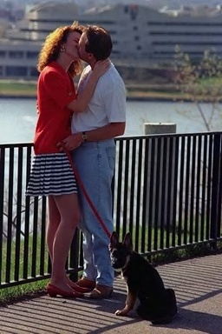
Genesis 6:1-3
And it came to pass, when men began to multiply on the face of the earth, and daughters were born unto them, that the sons of God saw the daughters of men that they were fair; and they took them wives of all which they chose.

Slide 3
Adam & Eve
Cain
Abel
Seth
Cain’s
descendants
“Daughters
of Men”
Inter-marriage between Cain’s & Seth’s descendants
Seth’s
descendants
“Sons of
God”
Lust of the eyes
Lust of the flesh
Pride of life
Walk by sight
Worship by feelings
Self-willed celebrities
The “Way of the Tree of Life” compromised by true believers!
False religion

Slide 4

2nd Creation Day – Division of the Waters
Gen 1:6 And Elohim said, “Let an expanse come to be in the midst of the waters, and let it separate the waters from the waters.”
7 And Elohim made the expanse, and separated the waters which were under the expanse from the waters which were above the expanse. And it came to be so.
8 And Elohim called the expanse ‘heavens.’ And there came to be evening and there came to be morning, the second day.

Slide 5

Genesis 6:4-5
And the LORD said, My spirit shall not always strive with man, for that he also is flesh: yet his days shall be an hundred and twenty years (he’s only got 120 more years before I flood his world)….
And God saw that the wickedness of man was great in the earth, and that every imagination of the thoughts of his heart was only evil continually.

Slide 6

v.5 Jesus refers to a similar condition in Matthew 24:37, which would exist in the last days and can only be corrected by God's intervention.
There was a gradual compromise in doctrines & principles that regulated the behavior of the “Sons of Elohim” (True Believers) until that “spirit” of God-likeness had evaporated between the “upper waters” and the “lower waters.”

Slide 7
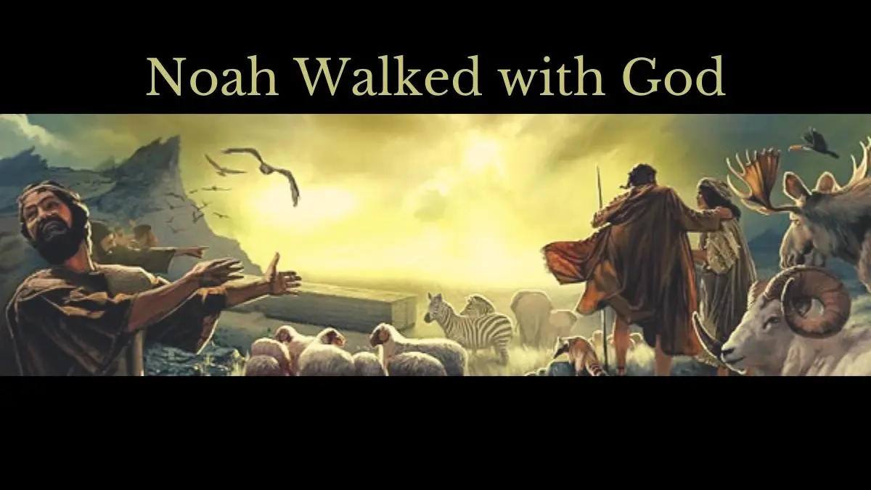

Slide 8
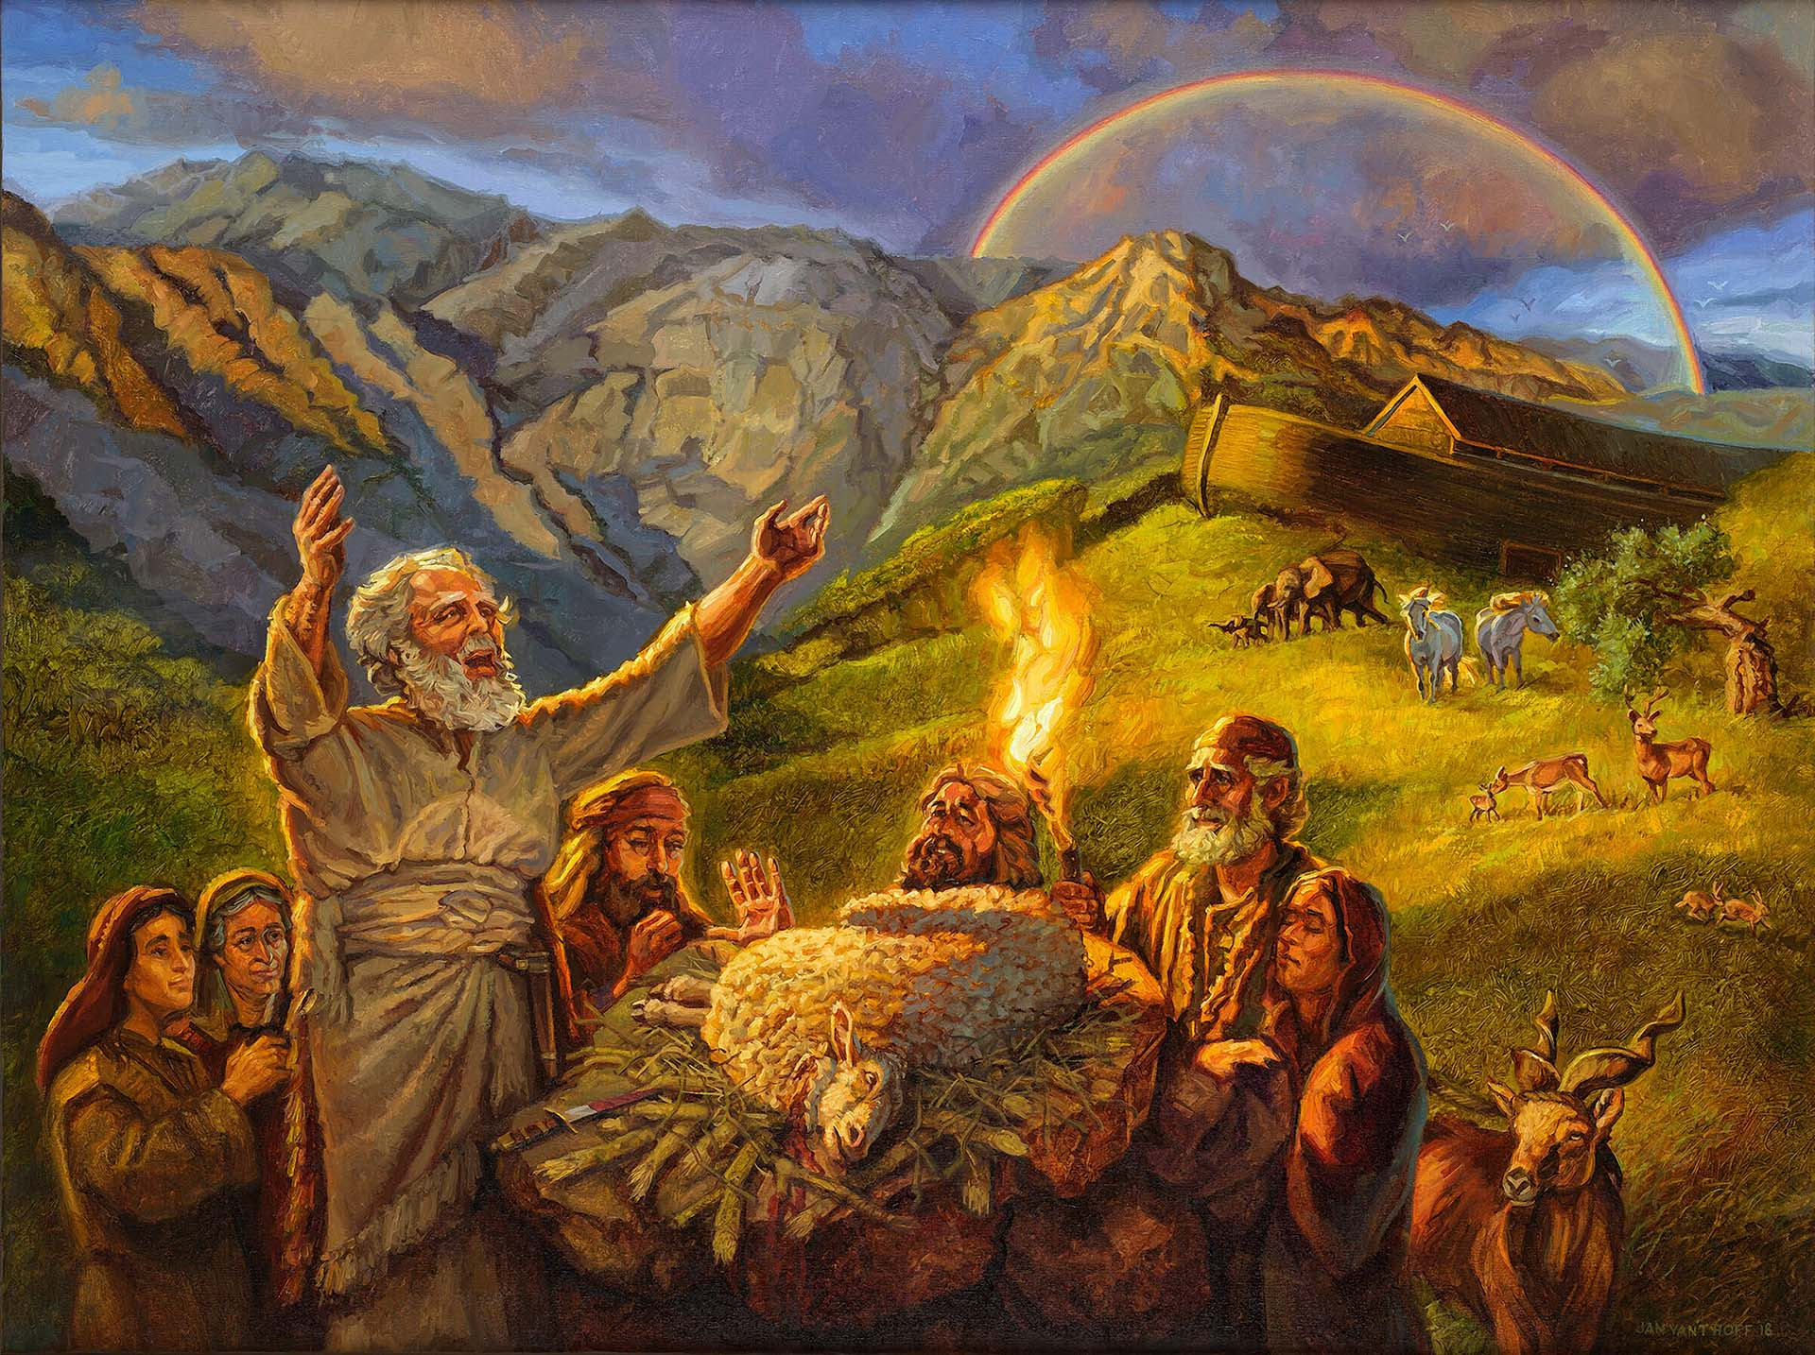
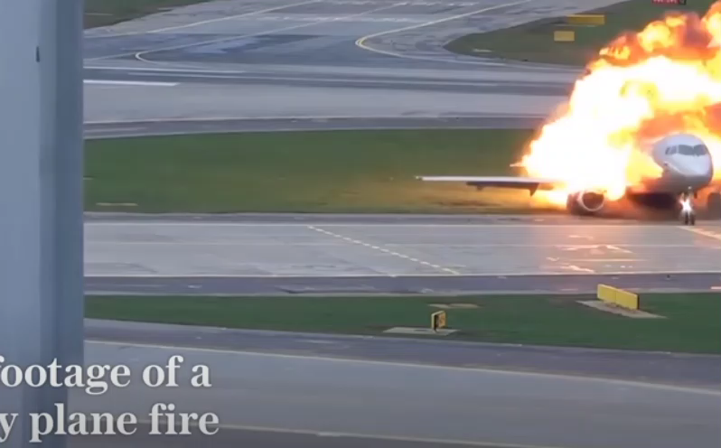
Gen. 8:20 -"And Noah builded an altar unto Yahweh"
— 1st reference to an altar in the Bible, though not the first one set up.
Heb. is mizbeach from zabach, to slaughter an animal in sacrifice.
Moses was instructed that altars were to be set up only at places where Yahweh recorded His Name (Exod. 20:24), where He manifested His power, and that they were to be built of "unhewn stone"
They pointed forward to Christ "our altar" (Heb. 13:10) through whom, all offerings should be made to God via priestly ministrations.
Though Jesus was of our nature (stone), his character was Divine (John 1:14), and he was represented by "unhewn stone", or stone shaped by the hand of Yahweh.

Slide 9
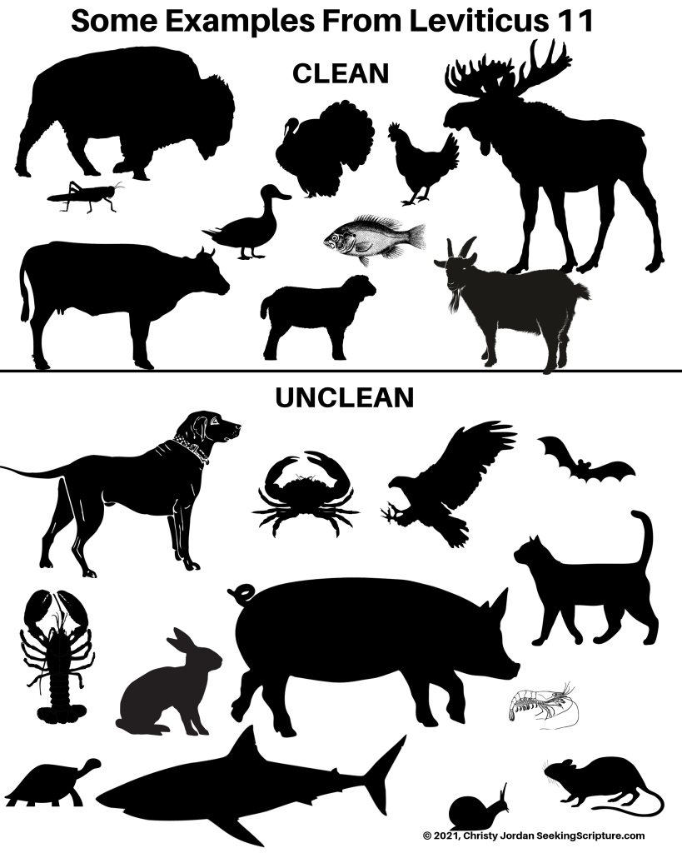
"And took of every clean beast, and of every clean fowl" —
These pointed forward to the offering of Christ.
He was the antitypical priest, altar and sacrifice, and, as sinless before Yahweh alone among men, was fit to fulfil the type of the offerings.
He was the lamb of God "without blemish and without spot" (1 Pet. 1:19).

Slide 10
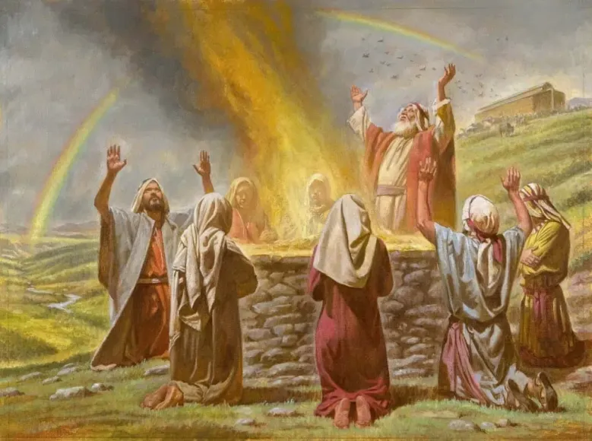
"And offered burnt offerings upon the altar"
References to clean and unclean animals, to altars, and to offerings and sacrifices, strongly suggest that there was a formal system of religion in vogue, which was doubtless handed down from the days of Eden onwards.
No doubt this would not have differed much, if at all, from the Mosaic system even though the divine requirements had not been legislated beforehand so far as we are aware
Rom 5:14 Nevertheless death reigned from Adam to Moses, even over them that had not sinned after the similitude of Adam's transgression, who is the figure of him that was to come.

Slide 11
Hence, the burnt offerings that Noah offered required…
(1) the slaying of the sacrificial animal
(2) the dismemberment of its parts
(3) the meticulous washing of them in water
(4) the careful and orderly placing of them upon the altar, in order that the fire might easily penetrate
(5) the entire consumption of it into the ascending smoke (Lev. 1:1-17) (Teaching principle of the transforming of flesh into spirit nature.)

Slide 12
An animal sacrifice was representative of the offeror, who was taught to see himself in its symbolism
Hence Christ, as the perfect offering, is representative of those "in him"
He put self to death; he was clean in character; he was consumed with fiery zeal for Yahweh; he gave his head, and members (intellect, work and walk) to his Father; he was entirely consumed by the Spirit Word, and attained unto Spirit nature
Those "in him" should manifest the same characteristics, if they claim him as their representative

Slide 13
A burnt offering was killed, cleansed and consumed, pointing forward to what Yahweh required in those who would come nigh unto Him
Noah's altar and offerings were prophetic of what Yahweh would accomplish in the promised Redeemer (Gen. 3:15), through whom would come peace (John 14:27)
In this worship, Noah expressed his faith and confidence in the Divine purpose to provide the seed of the woman to that end
Strong’s H5930 -‛ôlâh ‛ôlâh - o-law'
Feminine active participle of H5927; a step or (collectively stairs, as ascending); usually a holocaust (as going up in smoke): - ascent, burnt offering (sacrifice), go up to. See also H5766.
Total KJV occurrences: 288

Slide 14
Eze_40:38 And the chambers and the entries thereof were by the posts of the gates, where they washed the burnt offering.
39 And in the porch of the gate were two tables on this side, and two tables on that side, to slay thereon the burnt offering and the sin offering and the trespass offering.
42 And the four tables were of hewn stone for the burnt offering, of a cubit and an half long, and a cubit and an half broad, and one cubit high: whereupon also they laid the instruments wherewith they slew the burnt offering and the sacrifice.
Eze_43:24 And thou shalt offer them before the LORD, and the priests shall cast salt upon them, and they shall offer them up for a burnt offering unto the LORD.
Eze_44:11 Yet they shall be ministers in my sanctuary, having charge at the gates of the house, and ministering to the house: they shall slay the burnt offering and the sacrifice for the people, and they shall stand before them to minister unto them.

Slide 15
Eze_45:15 And one lamb out of the flock, out of two hundred, out of the fat pastures of Israel; for a meat offering, and for a burnt offering, and for peace offerings, to make reconciliation for them, saith the Lord GOD.
17 And it shall be the prince's part to give burnt offerings, and meat offerings, and drink offerings, in the feasts, and in the new moons, and in the sabbaths, in all solemnities of the house of Israel: he shall prepare the sin offering, and the meat offering, and the burnt offering, and the peace offerings, to make reconciliation for the house of Israel.
23 And seven days of the feast he shall prepare a burnt offering to the LORD, seven bullocks and seven rams without blemish daily the seven days; and a kid of the goats daily for a sin offering.
25 In the seventh month, in the fifteenth day of the month, shall he do the like in the feast of the seven days, according to the sin offering, according to the burnt offering, and according to the meat offering, and according to the oil.

Slide 16
Eze. 46:2 And the prince shall enter by the way of the porch of that gate without, and shall stand by the post of the gate, and the priests shall prepare his burnt offering and his peace offerings, and he shall worship at the threshold of the gate: then he shall go forth; but the gate shall not be shut until the evening.
4 And the burnt offering that the prince shall offer unto the LORD in the sabbath day shall be six lambs without blemish, and a ram without blemish.
12 Now when the prince shall prepare a voluntary burnt offering or peace offerings voluntarily unto the LORD, one shall then open him the gate that looketh toward the east, and he shall prepare his burnt offering and his peace offerings, as he did on the sabbath day: then he shall go forth; and after his going forth one shall shut the gate.
13 Thou shalt daily prepare a burnt offering unto the LORD of a lamb of the first year without blemish: thou shalt prepare it every morning.
15 Thus shall they prepare the lamb, and the meat offering, and the oil, every morning for a continual burnt offering.

Slide 17
The word, ‘burnt offering’ is found 42 times in the book of Ezekiel within only the last 8 chapters.
These last 8 chapters reveal the House of Prayer for All Nations through which Ezekiel was escorted by the ‘Man of Brass’
Psa 40:6 Sacrifice and offering thou didst not desire; mine ears hast thou opened: burnt offering and sin offering hast thou not required.
7 Then said I, Lo, I come: in the volume of the book it is written of me,
8 I delight to do thy will, O my God: yea, thy law is within my heart.

Slide 18
Psa 51:6 Behold, thou desirest truth in the inward parts: and in the hidden part thou shalt make me to know wisdom.
7 Purge me with hyssop, and I shall be clean: wash me, and I shall be whiter than snow.
8 Make me to hear joy and gladness; that the bones which thou hast broken may rejoice.
9 Hide thy face from my sins, and blot out all mine iniquities.
10 Create in me a clean heart, O God; and renew a right spirit within me.
11 Cast me not away from thy presence; and take not thy holy spirit from me.
12 Restore unto me the joy of thy salvation; and uphold me with thy free spirit.
13 Then will I teach transgressors thy ways; and sinners shall be converted unto thee.
14 Deliver me from bloodguiltiness, O God, thou God of my salvation: and my tongue shall sing aloud of thy righteousness.
15 O Lord, open thou my lips; and my mouth shall shew forth thy praise.
16 For thou desirest not sacrifice; else would I give it: thou delightest not in burnt offering.
17 The sacrifices of God are a broken spirit: a broken and a contrite heart, O God, thou wilt not despise.
18 Do good in thy good pleasure unto Zion: build thou the walls of Jerusalem.
19 Then shalt thou be pleased with the sacrifices of righteousness, with burnt
offering and whole burnt offering: then shall they offer bullocks upon thine altar.

Slide 19
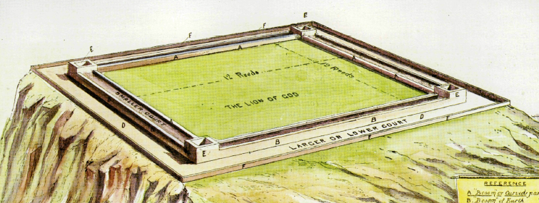
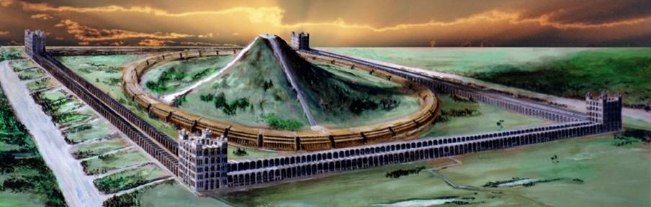
The Great Brass Altar in IHOP
SACRIFICIAL ARRANGEMENTS.
Chapter 40:47 ; 43: 13-17.
I. THE POSITION OF THE ALTAR AND ITS COURT.
He measured the court, an hundred cubits long, and an hundred cubits broad, foursquare, and the altar before the house.
Here we see that measurement of the altar court is made while Ezekiel and his guide are in the inner court, and the altar is said to be before the house.
The signification of the word translated " before “ has already been considered. Its full import is in the presence of. There appears to be only one position for the altar where that condition can be fulfilled, i.e., in the centre oj the sanctuary. Truly, then, the altar would be before the house in the full acceptation of the term. In any other position outside the circle it could not be before the house.
Notes:
SACRIFICIAL ARRANGEMENTS.
Chapter XL. 47 ; XLIII. 13-17.
I. THE POSITION OF THE ALTAR AND ITS COURT.
THE ALTAR is first mentioned in the 47th verse of
chapter XL. Its position is there described, but
particulars are not given of its construction. These are
found in chapter XLIII. The first-mentioned testimony
reads :
He measured the court, an hundred cubits long, and an
hundred cubits broad, foursquare, and the altai before
the house.
Here we see that measurement of the altar court is made
while Ezekiel and his guide are in the inner court, and
the altar is said to be before the house.
The signification of the word translated " before "
has already been considered. Its full import is in the
presence of. There appears to be only one position for
the altar where that condition can be fulfilled, i.e., in
the centre oj the sanctuary. Truly, then, the altar would be
before the house in the full acceptation of the term. In
any other position outside the circle it could not be
before the house.

Slide 20
Class 2 - Patriarchs, Promises and the Priesthood
The Activity of Priesthood in the Lives of the Fathers

Slide 21
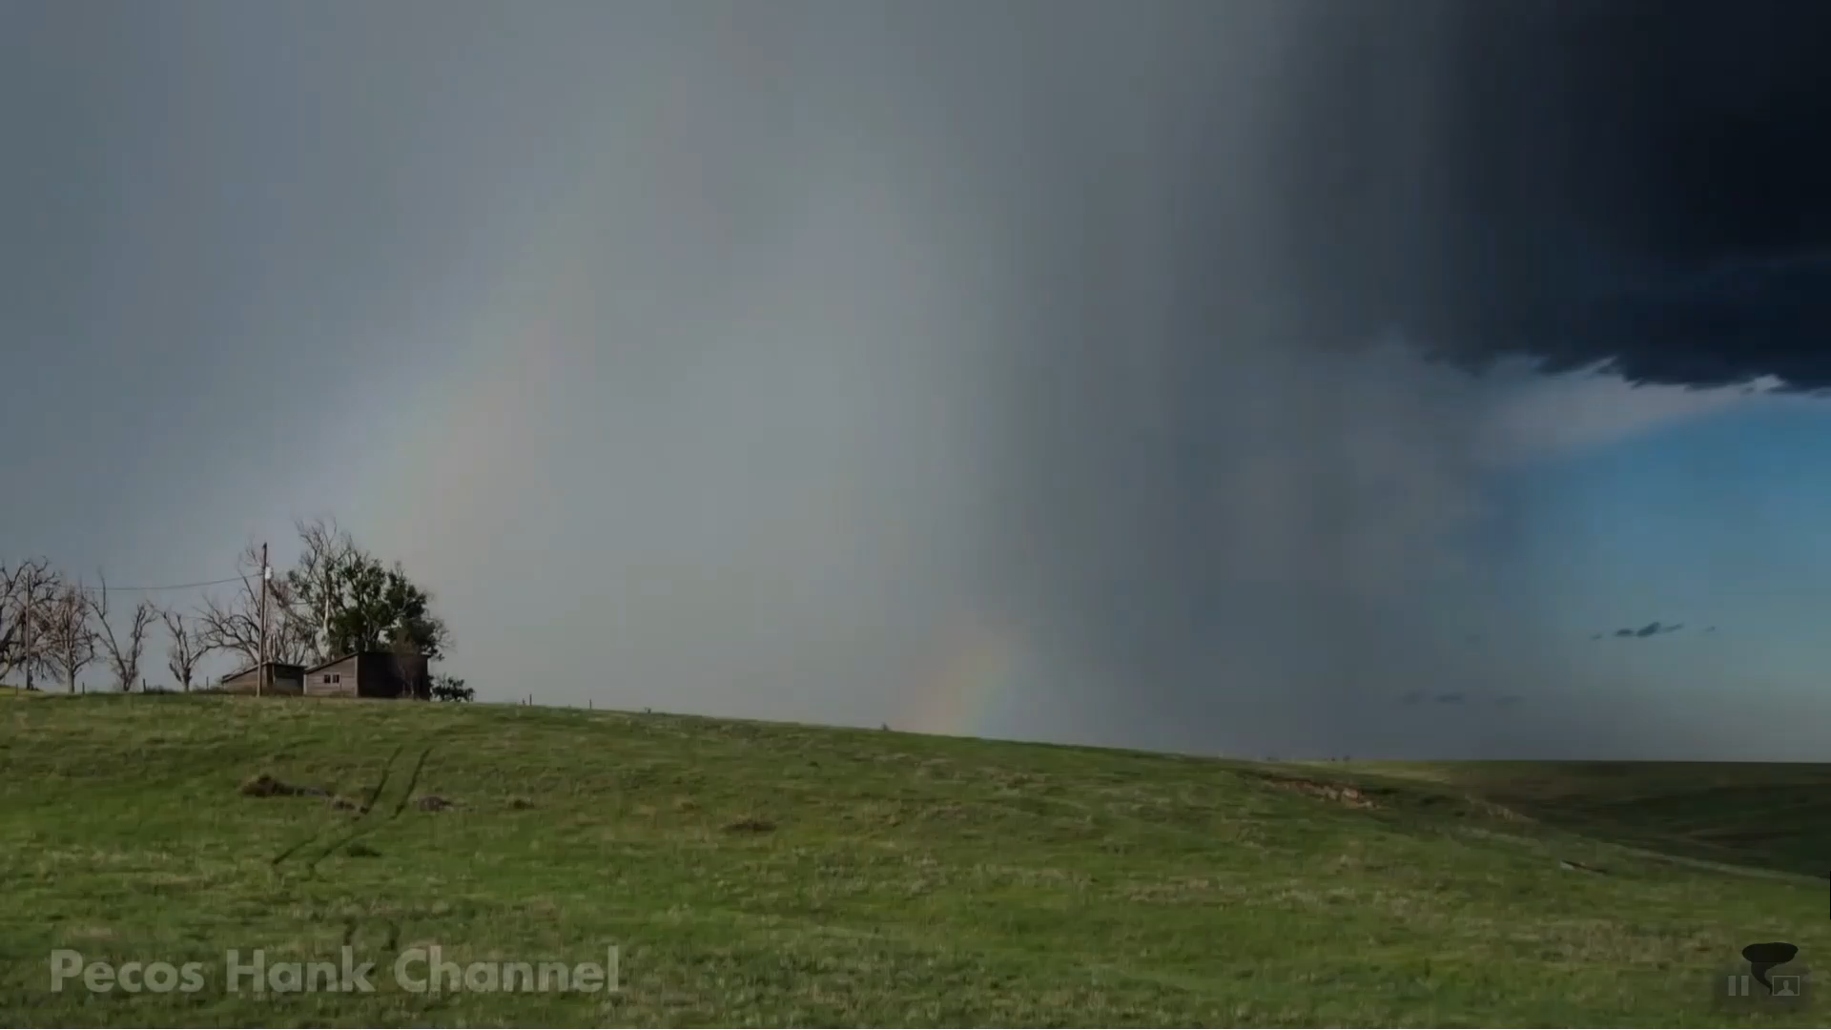

— 1st reference to an altar in the
Bible, though not the first one set up.
All altar stones unhewn: "if thou lift up thy tool upon it, thou hast polluted it" (Exod. 20:25).
Human nature in its own power cannot manifest the Divine likeness but must be sacrificed to that end
An altar represented Yahweh in sacrificial manifestation; and found its fulfilment in Christ Jesus
Every altar referred to in the Bible has a typical significance unique to itself, pointing forward to the work of God in Christ
Noah's altar of peace was no exception to this general rule
Gen. 8:20 -"And Noah builded an altar unto Yahweh"

Slide 22
Isa 61:1 The Spirit of the Lord GOD is upon me; because the LORD hath anointed me to preach good tidings unto the meek; he hath sent me to bind up the brokenhearted, to proclaim liberty to the captives, and the opening of the prison to them that are bound;
2 To proclaim the acceptable year of the LORD, and the day of vengeance of our God; to comfort all that mourn;
3 To appoint unto them that mourn in Zion, to give unto them beauty for ashes, the oil of joy for mourning, the garment of praise for the spirit of heaviness; that they might be called trees of righteousness, the planting of the LORD, that he might be glorified.
4 And they shall build the old wastes, they shall raise up the former desolations, and they shall repair the waste cities, the desolations of many generations.
5 And strangers shall stand and feed your flocks, and the sons of the alien shall be your plowmen and your vinedressers.
6 But ye shall be named the Priests of the LORD: men shall call you the Ministers of our God: ye shall eat the riches of the Gentiles, and in their glory shall ye boast yourselves.
7 For your shame ye shall have double; and for confusion they shall rejoice in their portion: therefore in their land they shall possess the double: everlasting joy shall be unto them.
8 For I the LORD love judgment, I hate robbery for burnt offering; and I will direct their work in truth, and I will make an everlasting covenant with them.
9 And their seed shall be known among the Gentiles, and their offspring among the people: all that see them shall acknowledge them, that they are the seed which the LORD hath blessed.
10 I will greatly rejoice in the LORD, my soul shall be joyful in my God; for he hath clothed me with the garments of salvation, he hath covered me with the robe of righteousness, as a bridegroom decketh himself with ornaments, and as a bride adorneth herself with her jewels.
11 For as the earth bringeth forth her bud, and as the garden causeth the things that are sown in it to spring forth; so the Lord GOD will cause righteousness and praise to spring forth before all the nations.

Slide 23
Abraham

Slide 24
Abraham
As priest of his own house: Events typical of his work in the Kingdom
Abraham’s call to be a priest
  Gen. 12:1-3 – God’s promise to make his name great
  Gen. 12:7 - He builds an altar in Shechem
  Gen. 12:8 – He builds another altar east of Bethel
  Gen. 13:7-9 - Abram intercedes as the priest between Lot’s herdsmen and his own; He builds another altar (v. 18) and the Promises are reiterated
  Gen. 13:10 – Eden and Egypt! Note where the Spirit Voice has brought the reader
  Gen. 13:14 – Prospective rule of the Cherubim in V. 14 – Abraham told to look N, S, E and W.
  Gen. 14:17-24 - Abram Blessed by Melchizedek
  Gen. 15:6-19 – God’s Covenant
  Gen. 17 –v. 15-27- Abraham and the Covenant of Circumcision; v. 5 – name changed to Abraham; vv10-14-males must be circumcised at age 8 days (future of Earth)
  Gen.18:22-33 – Abraham intercedes for the ecclesia in Sodom
  Gen. 19:27-29 - God remembered Abraham and saved Lot from the destruction of Sodom
  Gen. 21:4 – Abraham circumcises Isaac at 8 days old (Eight is the number of perfection, pointing forward to the eighth millennium, when finally all flesh shall be cut off (Rev. 20:12-15).
  Gen. 22 :1-19 – Abraham offers up his son, Isaac; God confirms the promises

Slide 25
Abraham
Abraham is called upon to offer up his only Son - Gen.22:1-5
God subjects all his sons to trial in order to purify them.
When the multitudinous Christ is glorified in the Age to come, it will be found that whilst only one man will have rendered perfect obedience to the Father, not one would have been untried.
Abraham's trial is a severe one as this chapter narrates.
He is called upon to offer up his son. No explanation is given. Killing Isaac seems to serve no clear purpose, and, apparently, would be a useless waste.
Moreover, what of the promises of God which rested in the son!
Nevertheless, dominated by faith in God and seeing beyond the present circumstances, Abraham complies with the request.

Slide 26
As priest of his own house: Events typical of his work in the Kingdom
Gen 22:16 And said, By myself have I sworn, saith the LORD, for because thou hast done this thing, and hast not withheld thy son, thine only son:
Gen 22:17 That in blessing I will bless thee, and (a) in multiplying I will multiply thy seed as the stars of the heaven, and as the sand which is upon the sea shore;(b) and thy seed shall possess the gate of his enemies;
18 And in thy seed shall all the nations of the earth be blessed; because thou hast obeyed my voice.
Notice the progression of development in the promise:
first, the seed is multiplied at the Judgment Seat (v. 17a);
second, Christ subdues his enemies at Armageddon (v. 17b);
third, the Kingdom is established throughout the earth (v. 18).
As priest in the Kingdom Age
Mic 7:18 Who is a God like unto thee, that pardoneth iniquity, and passeth by the transgression of the remnant of his heritage? he retaineth not his anger for ever, because he delighteth in mercy.
19 He will turn again, he will have compassion upon us; he will subdue our iniquities; and thou wilt cast all their sins into the depths of the sea.
20 Thou wilt perform the truth to Jacob, and the mercy to Abraham, which thou hast sworn unto our fathers from the days of old.

Slide 27
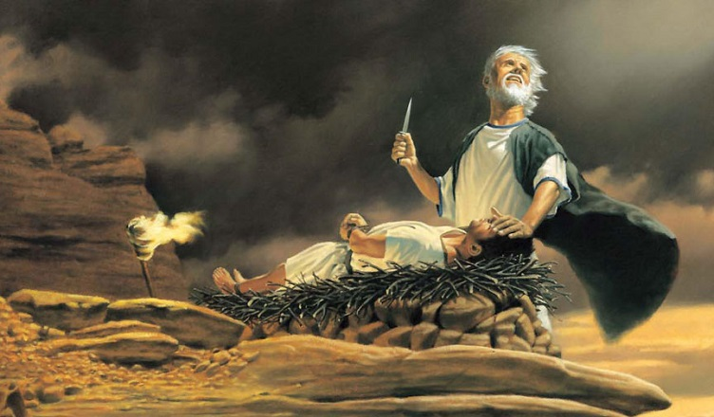
Abraham as Priest offering up a burnt offering
Heb 11:17 By faith Abraham, when he was tried, offered up Isaac: and he that had received the promises offered up his only begotten son,
18 Of whom it was said, That in Isaac shall thy seed be called:
19 Accounting that God was able to raise him up, even from the dead; from whence also he received him in a figure.

Slide 28
Isaac
Gen 22:19 So Abraham returned unto his young men, and they rose up and went together to Beersheba; and Abraham dwelt at Beersheba.
(Note that only Abraham returned leaving Isaac up in the Mount; a TYPE of the mediatorship of Christ in heaven after his and his Father’s sacrifice.)
86 verses later in Gen. 24:62 – The Spirit reveals Isaac meeting his Bride, Rebecca for the first time!
Gen 24:62 And Isaac came from the way of the well Lahairoi (Well of The Living One Who Sees, or The Well Of Life And Vision); for he dwelt in the south country.
63 And Isaac went out to meditate in the field at the eventide: and he lifted up his eyes, and saw, and, behold, the camels were coming.
64 And Rebekah lifted up her eyes, and when she saw Isaac, she lighted off the camel.
67 And Isaac brought her into his mother Sarah's tent, and took Rebekah, and she became his wife; and he loved her: and Isaac was comforted after his mother's death.

Slide 29
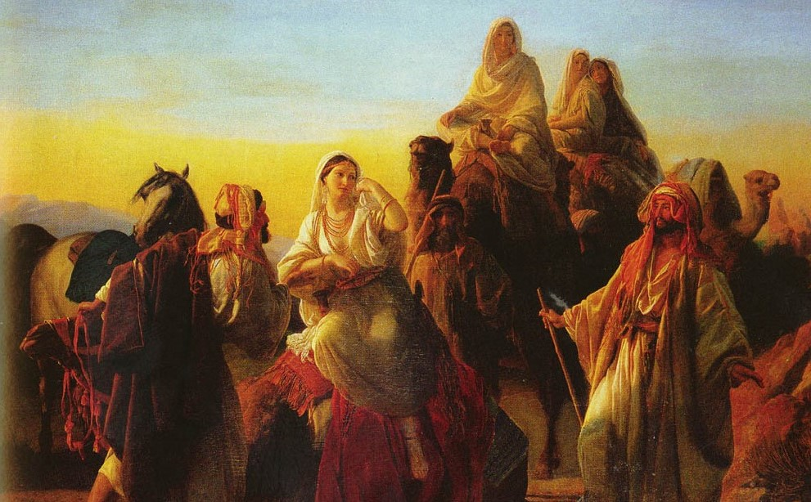
Isaac
As priest of his own house: Events typical of his work in the Kingdom
As priest in the Kingdom Age
Our lessons from his faith and work

Slide 30
Jacob’s Promise and Priestly Activity – Gen. 25
VERSE 31 – “And Jacob said, Sell me this day thy birthright”
To Jacob, the birthright meant everything; to Esau it was of secondary consideration
Whereas Jacob saw the possession of it as the great objective in life Esau treated it with flippant disregard.
The privileges of the birthright were threefold: priesthood, authority and inheritance.
  The firstborn was consecrated to God (cp. Exod. 13:2; 22:29)
  the authority of the family was conferred upon him (2 Chron. 21:3);
  he received a double portion of inheritance (Deut. 21:15-17).
The benefits of the birthright, therefore, all lay in the future, whereas Esau's pleasure was in the present.
He was not particularly interested in "laying up for himself a good reward in time to come."

Slide 31
VS 15 - "And Rebekah took goodly raiment of her eldest son Esau“
The Hebrew is desirable raiment (see mg).
Esau's raiment comprised desirable garments as far as Jacob was concerned, because they were probably the priestly garments of the firstborn. They belonged to Esau as the "eldest son."
(The Hebrew word rendered "raiment" signifies a covering, and is used of the sacred, distinctive robes, as worn by the priests to denote their holy office (See Exod. 28:2,4; Lev. 10:6; 21:10)
Exo 28:2 And thou shalt make holy garments for Aaron thy brother for glory and for beauty.;
Exo 28:4 And these are the garments which they shall make; a breastplate, and an ephod, and a robe, and a broidered coat, a mitre, and a girdle: and they shall make holy garments for Aaron thy brother, and his sons, that he may minister unto me in the priest's office.;
Lev 10:6 And Moses said unto Aaron, and unto Eleazar and unto Ithamar, his sons, Uncover not your heads, neither rend your clothes; lest ye die, and lest wrath come upon all the people: but let your brethren, the whole house of Israel, bewail the burning which the LORD hath kindled.;
Lev 21:10 And he that is the high priest among his brethren, upon whose head the anointing oil was poured, and that is consecrated to put on the garments, shall not uncover his head, nor rend his clothes; )

Slide 32
Jacob’s Promise and Priestly Activity – Gen. 25
Jacob secured both the PRIESTLY birthright of the firstborn from Esau
He then secured the blessings of the firstborn.
As priest of his own house: Events typical of his work in the Kingdom
As a priest in the Kingdom Age
Our lessons from his faith and work

Slide 33
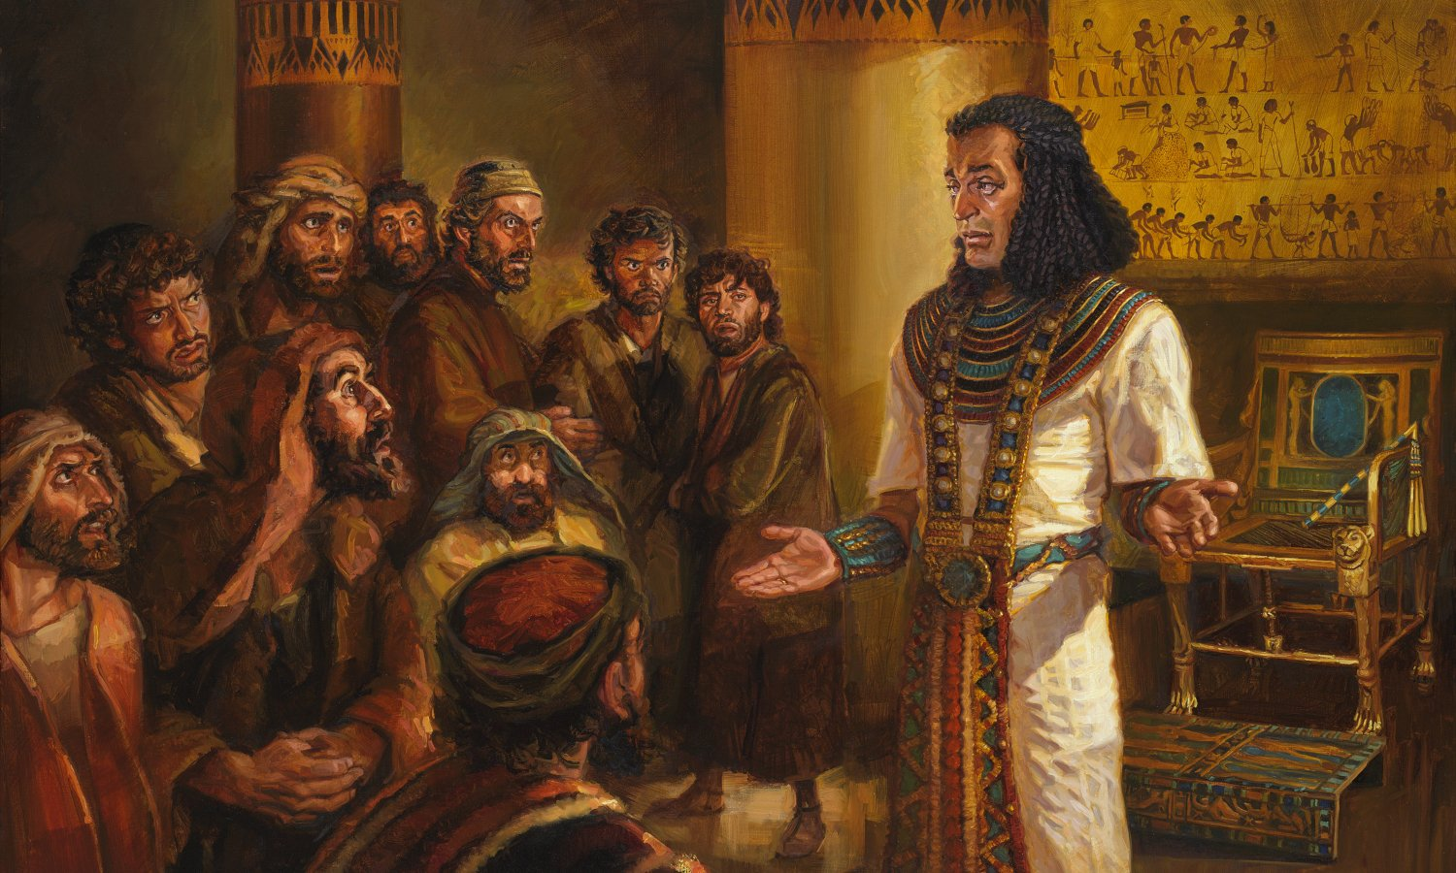
Joseph
THE PRIESTHOOD OF JOSEPH
Joseph’s favored status by his father, Jacob put him as Firstborn and Priest Elect receiving the Raiment of Mediation over his half-brothers
Joseph’s divinely inspired dreams confirmed his father’s recognition of him as the familial “chosen one.”
His experience as a type of the prophesied “Chosen One,” Jesus Christ who would come as Israel’s national savior and Messiah

Slide 34
Gen. 37:3 - "And he made him a coat of many colours" — The Hebrew is ketonet passim
The word ketonet, is derived from katha signifying to cover, and it means coat or garment. It is used of sacrificial garments (Gen. 3:21), priestly coats (Exod. 28:4,39,40; 29:5 etc.), and of the special raiment given to Esau which indicated his original status of privilege (Gen. 27:15).
Passim rendered "many colours" is from pacac signifying extremity or ends. Strong relates it to the palm of the hands or the sole of the feet, and sees, as the plural form (as in the verse before us), reference to "a long sleeved tunic" (the margin of the A.V. has pieces).
The term, therefore, does not of itself indicate "many colors," but rather a distinctive robe. It is used elsewhere to designate a robe of royalty (2 Sam. 13:18).
Reuben's crime had shown that he was unworthy of the position of firstborn, and was deposed in favour of Joseph (1 Chron. 5:1-2).
The distinctive garment that Jacob prepared for his son became the insignia of his office among the other brethren.
It was a priestly garment, that completely covered the flesh, and so testified to the character and standing of Joseph in the sight of his father.
Jesus, likewise, wore a distinctive gown, which typified his standing in the sight of the Father (cp. John 19:23-34).

Slide 35
Gen. 41:14
"Then Pharaoh sent and called Joseph, and they brought him hastily out of the dungeon" — The Lord was brought out of the prison-house of death, and presented to the Father (Dan. 7:13).
"And he shaved himself, and changed his raiment, and came in unto Pharaoh" — Shaving was a custom of Egyptians. Budge in The Dwellers On The Nile writes: "The Egyptians of the upper classes paid great attention to their personal appearance and to the physical wellbeing of the body.
As a rule men shaved off their beards and sidewhiskers, but not the hair of their head." According to Herodotus (2.37), "The priests shave their whole body every third day," this being for purposes of cleanliness.
Joseph, therefore, followed the custom, knowing that it would please Pharaoh.
Figuratively, he said: "Not my will, but thine be done."
His action illustrates the type, for shaving symbolised the state of one cleansed (Lev. 14:8), and the Lord was physically cleansed after he had risen from the dead.
Next, Joseph "changed his raiment," which points to a change of nature (cp. Zech. 3:4, Rom. 6:4).
Finally, he came in unto Pharaoh, as the Lord did unto the Ancient of Days in heaven (Dan. 7:13).

Slide 36
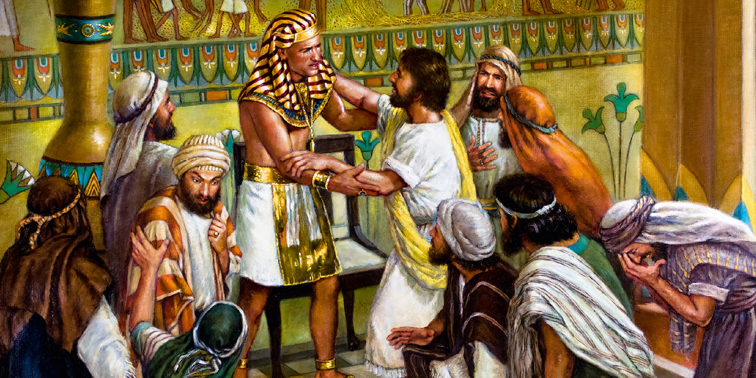
VERSE 42 – Joseph exalted by Pharoah to a Prime Minister and Priest
"And Pharaoh took off his ring from his hand, and put it upon Joseph's hand" — This ring was the seal of authority (cp. Est. 3:10; 8:2,10). Christ was sealed with the divine authority (see John 6:27).
"And arrayed him in vestures of fine linen" — Herodotus states (Book 2:81) that the priests of Egypt, who constituted the aristocracy of the nation, wore linen garments. Christ will exercise both religious and civil authority.
"And put a gold chain about his neck" — This was the symbol of authority to rule (see Dan. 5:29).

Slide 37
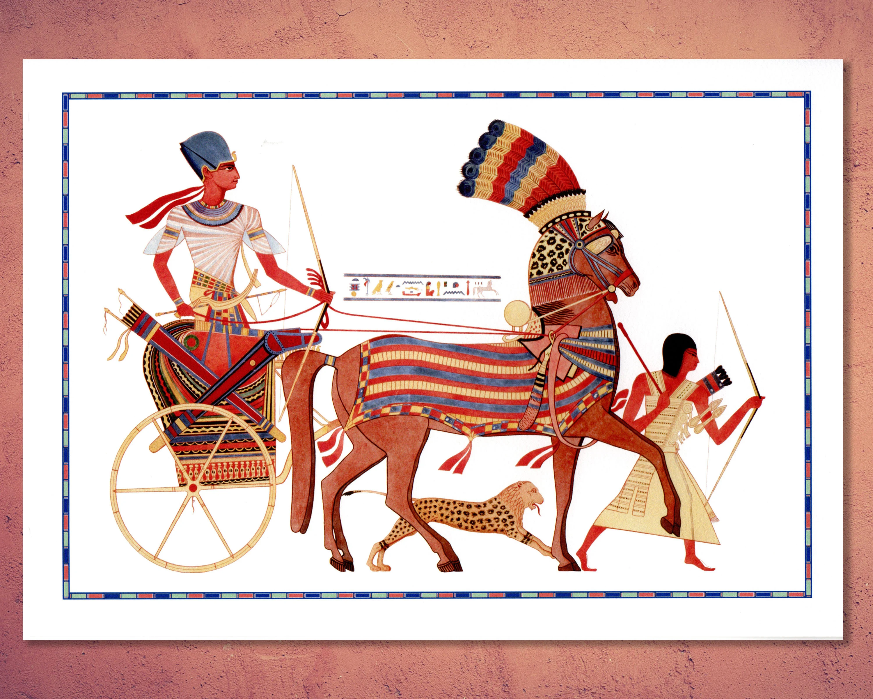
VS 43 – A type of the Cherubim of Glory in the future
"And he made him to ride in the second chariot which he had" — Special chariots were constructed for the Pharaohs, some of which were discovered in Tutankhamen's tomb.
These chariots gilded over with gold, and with vanquished and bound enemies as their principal decorative motif, were the official vehicles for the Pharaohs, and were resplendent as the sun.
There was no mistaking them. The appearance of Joseph in one of the royal chariots would establish his status in the sight of all.
"And they cried before him, Bow the knee" — The Hebrew is Abrek, which the margin gives as Tender Father, deriving the latter word from Ab, Father, in the Hebrew.

Slide 38
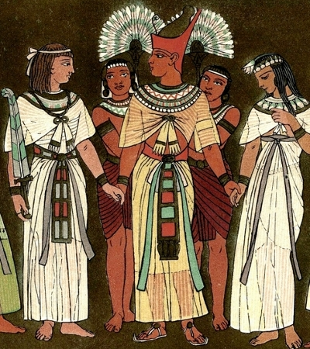
VS 45 -
"And he gave him to wife Asenath the daughter of Potipherah priest of On" — This was a position of high authority and prestige in the land ,
By marriage, Joseph became associated with the priesthood, and so, by a remarkable type, the elevation of the Lord Jesus as priest was foreshadowed. (See Heb. 7:12-13).
The marriage with Asenath took place, and was recorded, for the purpose of foreshadowing the purpose of God in Christ.
We can be quite sure that Joseph would have educated his wife in the principles of true worship, and that his home in Egypt would be a centre for such.
Heb 7:12 For the priesthood being changed, there is made of necessity a change also of the law.
13 For he of whom these things are spoken pertaineth to another tribe, of which no man gave attendance at the altar.

Slide 39
Psa 81:3 Blow the trumpet at the new moon, at the full moon, on our feast day.
4 For it is a statute for Israel, a rule of the God of Jacob.
5 He made it a decree in Joseph when he went out over the land of Egypt. I hear a language I had not known:
6 “I relieved your shoulder of the burden; your hands were freed from the basket.
7 In distress you called, and I delivered you; I answered you in the secret place of thunder; I tested you at the waters of Meribah. Selah
      ESV

