Slide 1

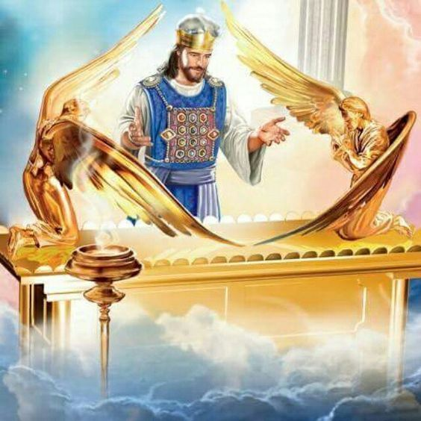
Class 3
God’s Covenant With Levi of Life and Peace
Class 3
God’s Covenant With Levi of Life and Peace
The Levitical Priesthood and Its Blessings
The Levitical Priesthood and Its Blessings

Slide 2
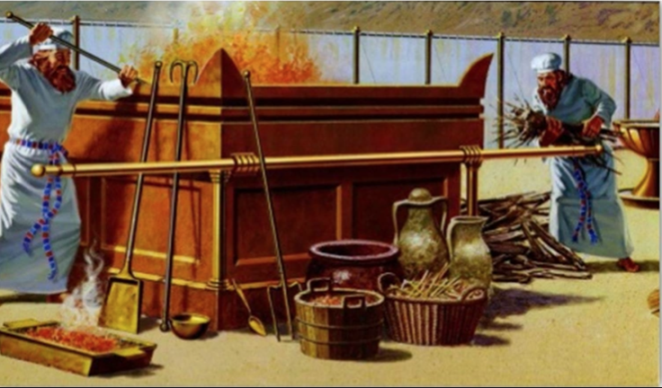
The Covenant Between YHWH and Levi
Mal 2:4 And ye shall know that I have sent this commandment unto you, that my covenant might be with Levi, saith the LORD of hosts.
5 My covenant was with him of life and peace; and I gave them to him for the fear wherewith he feared me, and was afraid before my name.
6 The law of truth was in his mouth, and iniquity was not found in his lips: he walked with me in peace and equity, and did turn many away from iniquity.
7 For the priest's lips should keep knowledge, and they should seek the law at his mouth: for he is the messenger of the LORD of hosts.

Slide 3
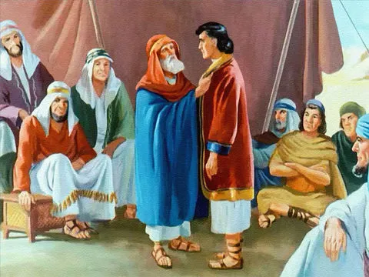
The Back Story of Levi
Birth to Jacob’s lesser loved wife, Leah, Levi was 3rd born of the first 4 sons, Reuben, Simeon, Levi and Judah (Gen. 29:31-35)
Shechem, son of Hamor the Hivite, prince of the country sells out his entire family and tribe, & his own life for a promise of marriage to Jacob’s daughter, Dinah. The sons of Jacob and the Covenant token of circumcision as a ruse.
On the 3rd day of healing Simeon & Levi slew all of the men of the city, rescued Dinah and along with their brothers spoiled the city of all their wealth, their little ones, their wives and all that was in their house.
Gen 34:30 And Jacob said to Simeon and Levi, Ye have troubled me to make me to stink among the inhabitants of the land, among the Canaanites and the Perizzites: and I being few in number, they shall gather themselves together against me, and slay me; and I shall be destroyed, I and my house.
Notes:
Gen 34:25 And it came to pass on the third day, when they were sore, that two of the sons of Jacob, Simeon and Levi, Dinah's brethren, took each man his sword, and came upon the city boldly, and slew all the males.
26 And they slew Hamor and Shechem his son with the edge of the sword, and took Dinah out of Shechem's house, and went out.
27 The sons of Jacob came upon the slain, and spoiled the city, because they had defiled their sister.
28 They took their sheep, and their oxen, and their asses, and that which was in the city, and that which was in the field,
29 And all their wealth, and all their little ones, and their wives took they captive, and spoiled even all that was in the house.
30 And Jacob said to Simeon and Levi, Ye have troubled me to make me to stink among the inhabitants of the land, among the Canaanites and the Perizzites: and I being few in number, they shall gather themselves together against me, and slay me; and I shall be destroyed, I and my house.
31 And they said, Should he deal with our sister as with an harlot?

Slide 4
Gen 34:25 And it came to pass on the third day, when they were sore, that two of the sons of Jacob, Simeon and Levi, Dinah's brethren, took each man his sword, and came upon the city boldly, and slew all the males.
26 And they slew Hamor and Shechem his son with the edge of the sword, and took Dinah out of Shechem's house, and went out.
27 The sons of Jacob came upon the slain, and spoiled the city, because they had defiled their sister.
28 They took their sheep, and their oxen, and their asses, and that which was in the city, and that which was in the field,
29 And all their wealth, and all their little ones, and their wives took they captive, and spoiled even all that was in the house.
30 And Jacob said to Simeon and Levi, Ye have troubled me to make me to stink among the inhabitants of the land, among the Canaanites and the Perizzites: and I being few in number, they shall gather themselves together against me, and slay me; and I shall be destroyed, I and my house.
31 And they said, Should he deal with our sister as with an harlot?

Slide 5
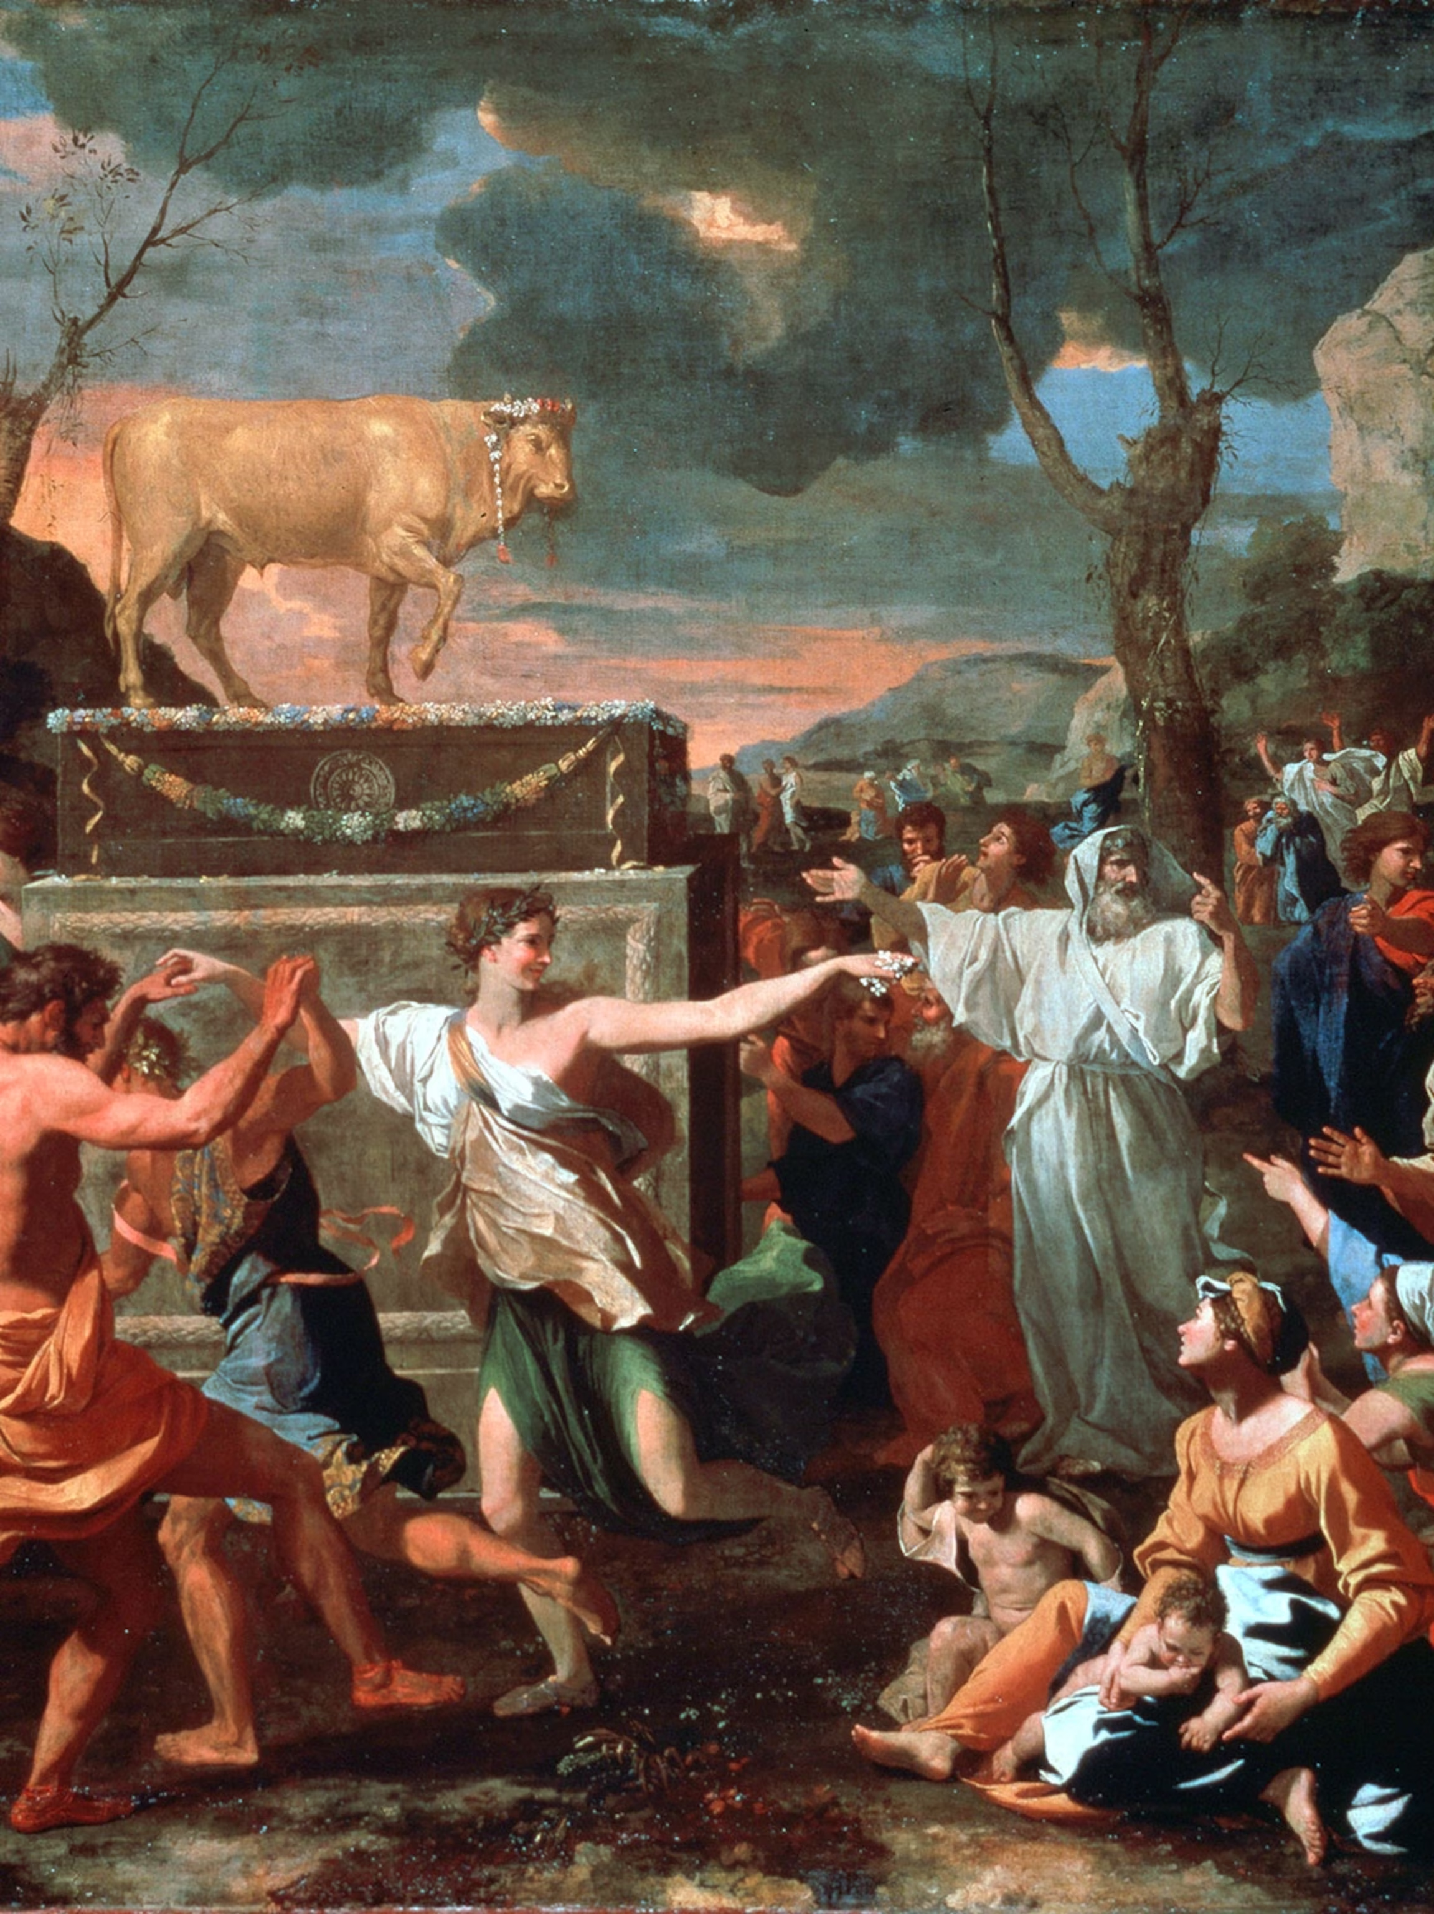
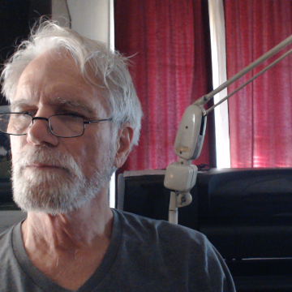
Basis of Divine Selection of Levi as YHWH’S Priestly Tribe
Exo 32:25 Moses knew that the people were out of control and that it was Aaron's fault. And now they had made fools of themselves in front of their enemies.
26 So Moses stood at the gate of the camp and shouted, "Everyone who is on the LORD's side come over here!" Then the men of the Levi tribe gathered around Moses,
27 and he said to them, "The LORD God of Israel commands you to strap on your swords and go through the camp, killing your relatives, your friends, and your neighbors."
28 The men of the Levi tribe followed his orders, and that day they killed about three thousand men.
29 Moses said to them, "You obeyed the LORD and did what was right, and so you will serve as his priests for the people of Israel. It was hard for you to kill your own sons and brothers, but the LORD has blessed you and made you his priests today."
Notes:
The Golden Calf
Exo 32:1 And when the people saw that Moses delayed to come down out of the mount, the people gathered themselves together unto Aaron, and said unto him, Up, make us gods, which shall go before us; for as for this Moses, the man that brought us up out of the land of Egypt, we wot not what is become of him.
Exo 32:2 And Aaron said unto them, Break off the golden earrings, which are in the ears of your wives, of your sons, and of your daughters, and bring them unto me.
Exo 32:3 And all the people brake off the golden earrings which were in their ears, and brought them unto Aaron.
Exo 32:4 And he received them at their hand, and fashioned it with a graving tool, after he had made it a molten calf: and they said, These be thy gods, O Israel, which brought thee up out of the land of Egypt.
Exo 32:5 And when Aaron saw it, he built an altar before it; and Aaron made proclamation, and said, To morrow is a feast to the LORD.
Exo 32:6 And they rose up early on the morrow, and offered burnt offerings, and brought peace offerings; and the people sat down to eat and to drink, and rose up to play.

Slide 6

That God should dwell with men at all was esteemed by Solomon a great condescension on the part of a Being to whom it is humbling Himself "to behold the things that are in heaven, and in the earth" (Psa. 113:6).
That He should dwell with unclean and rebellious man seemed contrary to the fitness of things.
In a sense it was so, as is shown by the reservations by which the condescension was safeguarded.

Slide 7
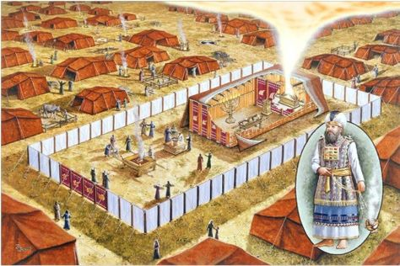
The fabrication of the Tabernacle was an intimation of His willingness to be approached by man for mercy, but not at the sacrifice of His holiness, or His authority, or His majesty.
Hence, familiar and indiscriminate approach was not invited: "I will be sanctified in them that come nigh me.”
He would be approached in a consecrated and concealed recess,
…and that only once a year,
…and that only by blood shed,
…and that only presented by a man of His own choice,
…assisted by men of His own appointment,
…and attired in a way prescribed by Himself.

Slide 8
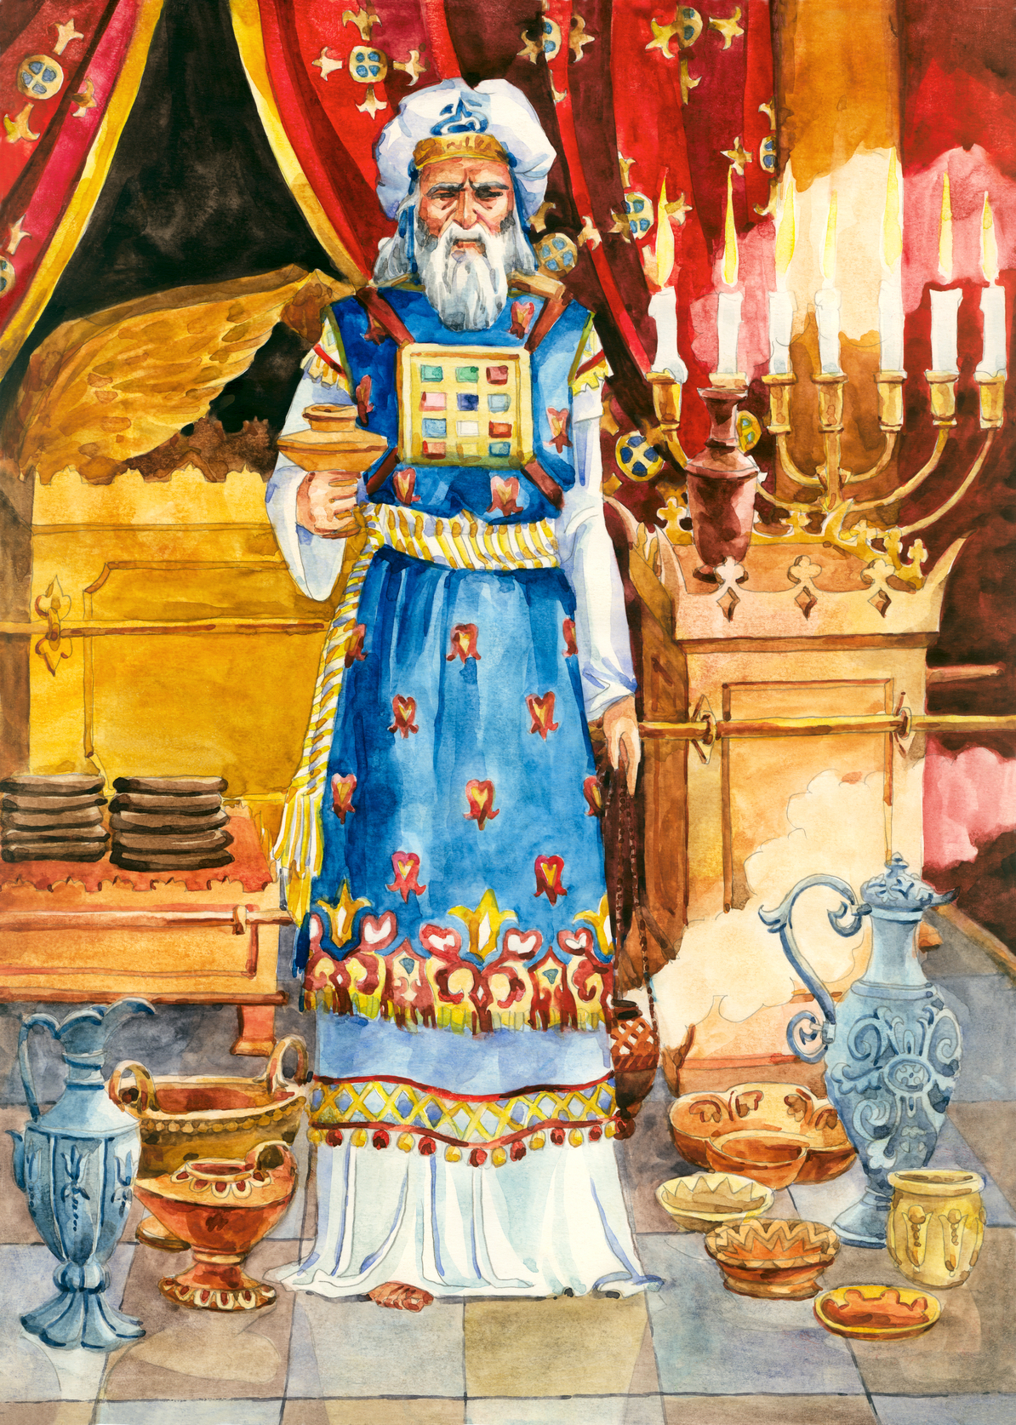
Moses was directed to "take Aaron, thy brother, and his sons with him, from among the children of Israel, that he may minister unto me in the priest's office“.
The priesthood was to be Aaron's and his successors by a perpetual ordinance: any stranger obtruding himself upon the sacred office was to be put to death (Num. 18:7).

Slide 9
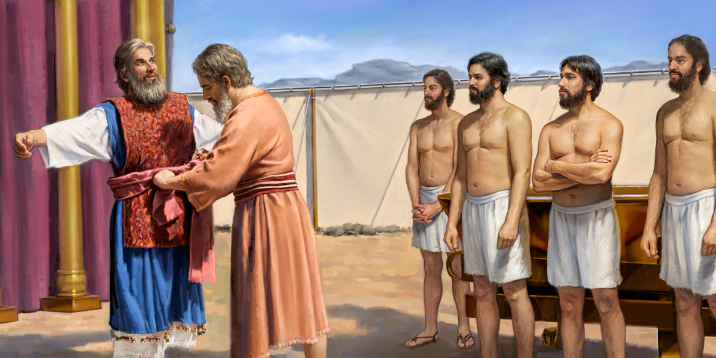
The sons were to be assistants: the father only was to be high priest: all were to be physically without blemish.
Any disfigurement was to be a disqualification, though not for the eating of the sacrifices (Lev. 21:17-23).
They were to live by the offerings made to God by the people: they were not to have any land inheritance: God was to be their inheritance (Num. 18:12-20).

Slide 10
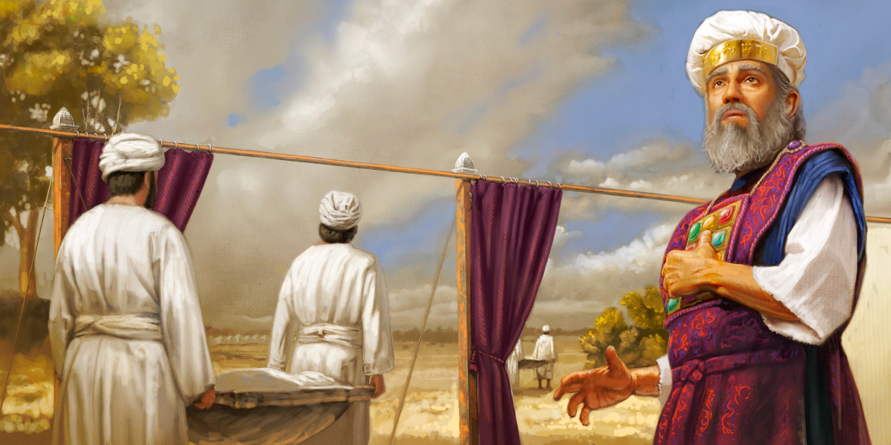
They were to stand between God and the people.
This was all part of "the figure for the time then present" (Heb. 9:9); part of "the form of (divine) knowledge and of the truth" (Rom. 2:20).
Its general significance is scarcely to be missed.
We have seen it in other connections: that man cannot approach God except in God's own way: that this we can only learn by the revelation of His mind, and that all other so-called religion is the mere device of human ignorance and presumption.

Slide 11
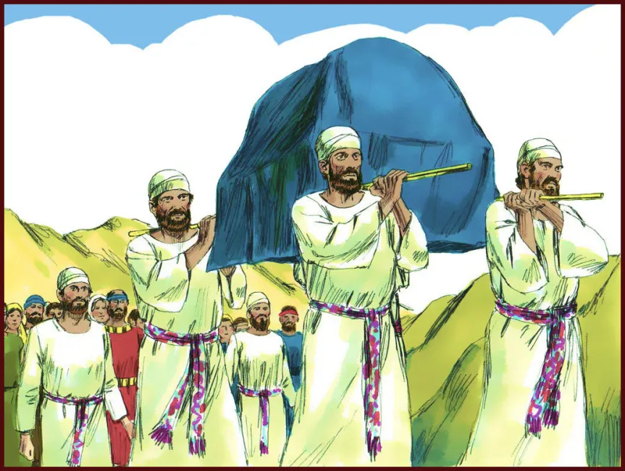
Num 3:5 And the LORD spake unto Moses, saying,
6 Bring the tribe of Levi near, and present them before Aaron the priest, that they may minister unto him.
7 And they shall keep his charge, and the charge of the whole congregation before the tabernacle of the congregation, to do the service of the tabernacle.
8 And they shall keep all the instruments of the tabernacle of the congregation, and the charge of the children of Israel, to do the service of the tabernacle.
9 And thou shalt give the Levites unto Aaron and to his sons: they are wholly given unto him out of the children of Israel.
10 And thou shalt appoint Aaron and his sons, and they shall wait on their priest's office: and the stranger that cometh nigh shall be put to death.
11 And the LORD spake unto Moses, saying,
12 And I, behold, I have taken the Levites from among the children of Israel instead of all the firstborn that openeth the matrix among the children of Israel: therefore the Levites shall be mine;
13 Because all the firstborn are mine; for on the day that I smote all the firstborn in the land of Egypt I hallowed unto me all the firstborn in Israel, both man and beast: mine shall they be: I am the LORD.

Slide 12
He shall sit as a refiner and purifier of silver
"come to his temple" — The Lord
Jesus came to the Israel-temple 2,000 years
ago (John 1:11), but when his people
rejected him, he commenced the work of
building a new temple with living stones
(1 Peter 2:6-8) drawn from both Jews and
Gentiles (2Cor. 6:16; Eph. 2:20-22).
Mal 3:1 Behold, I will send my messenger, and he shall prepare the way before me: and the Lord, whom ye seek, shall suddenly come to his temple, even the messenger of the covenant, whom ye delight in: behold, he shall come, saith the LORD of hosts.
2 But who may abide the day of his coming? and who shall stand when he appeareth? for he is like a refiner's fire, and like fullers' soap:
3 And he shall sit as a refiner and purifier of silver: and he shall purify the sons of Levi, and purge them as gold and silver, that they may offer unto the LORD an offering in righteousness.
4 Then shall the offering of Judah and Jerusalem be pleasant unto the LORD, as in the days of old, and as in former years.
"for he is like a refiner's fire" — The
refiner applied fire to his equipment in
order to separate and bring the impurities
to the surface, so that they could be
removed, and the metal purified.
Fiery judgments shall be poured out on both
Jews and Gentiles to purge the world of
iniquity. (Isa. 1:25; Zech. 13:9 and contrast
with Jer. 6:30)

Slide 13

Purifying Levi Awaits the Appearance of the Messenger
Levi after the flesh has been in apostasy for ages, and will continue to be so until "Yahweh, the Messenger of the Covenant," shall come. When the time appointed arrives, he will suddenly come in, and proceed to the work of purifying the sons of Levi, that they may offer unto Yahweh an offering in righteousness (Mal. 3:1-4). From this future time "they will keep the covenant", even the New Covenant of which Jesus, not Moses, is the Mediator.
— J.T. (Eureka, vol. 2, p. 329).
When thus purified from dross in this glowing furnace (Eze. 20:33-38), the Jewish nation will be brass and silver well refined (Mal. 3:2). The rebellious dross will have been cleaned out, and Anti-Mosaic Judaism, by which they are now caused to wander out of the way, will have been destroyed from the earth.
— J.T. (Eureka, vol. 1, p. 180).

Slide 14
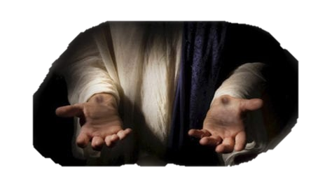
The Types of The Levitical Priesthood in the Future
2 Ch_4:1 Moreover he made an altar of brass,^{H5178} twenty cubits the length thereof, and twenty cubits the breadth thereof, and ten cubits the height thereof.
9 Furthermore he made the court of the priests, and the great court, and doors for the court, and overlaid the doors of them with brass.^{H5178}
16 The pots also, and the shovels, and the fleshhooks, and all their instruments, did Huram his father make to king Solomon for the house of the LORD of bright^{H4838} brass.^{H5178}
18 Thus Solomon made all these vessels in great abundance: for the weight of the brass^{H5178} could not be found out.
17 In the plain of Jordan did the king cast them, in the clay ground between Succoth (tabernacles) and Zeredathah (piercing).
“…and they shall look upon me whom they have pierced, and they shall mourn for him, as one mourneth for his only son…” ~Zech. 12:10

Slide 15
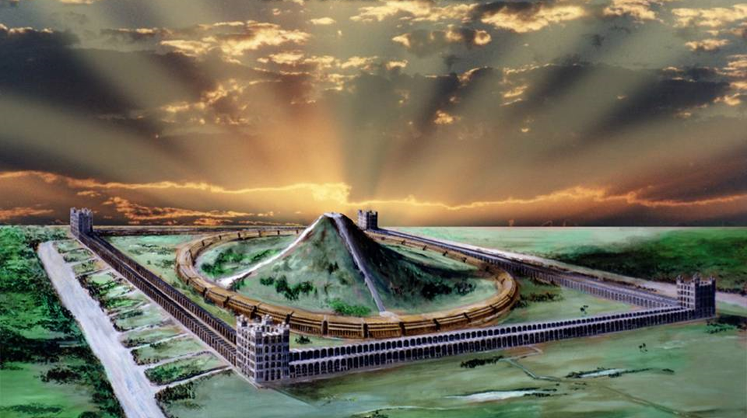
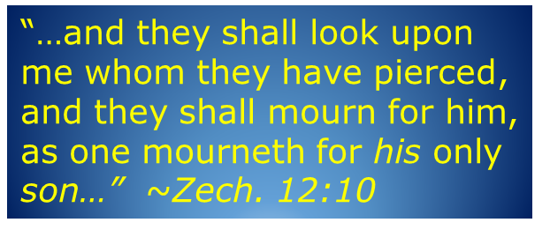
In the plain of Jordan did the king cast them, in the clay ground between Succoth (booths) and Zeredathah (pierced)
~2 Chr. 4:17.
Zec 14:16 And it shall come to pass, that every one that is left of all the nations which came against Jerusalem shall even go up from year to year to worship the King, the LORD of hosts, and to keep the feast of tabernacles (Succoth).

Slide 16

“Peace Within Thy Walls & Prosperity Within Thy Palaces”
The Psalmist tells us to pray for “the peace of Jerusalem” (Psa. 122:6)
Isaiah speaks of her peace flowing like a river Isa 48:18 “O that thou hadst hearkened to my commandments! then had thy peace been as a river, and thy righteousness as the waves of the sea”
Hag 2:9 The glory of this latter house shall be greater than of the former, saith the LORD of hosts: and in this place will I give peace, saith the LORD of hosts.

Slide 17
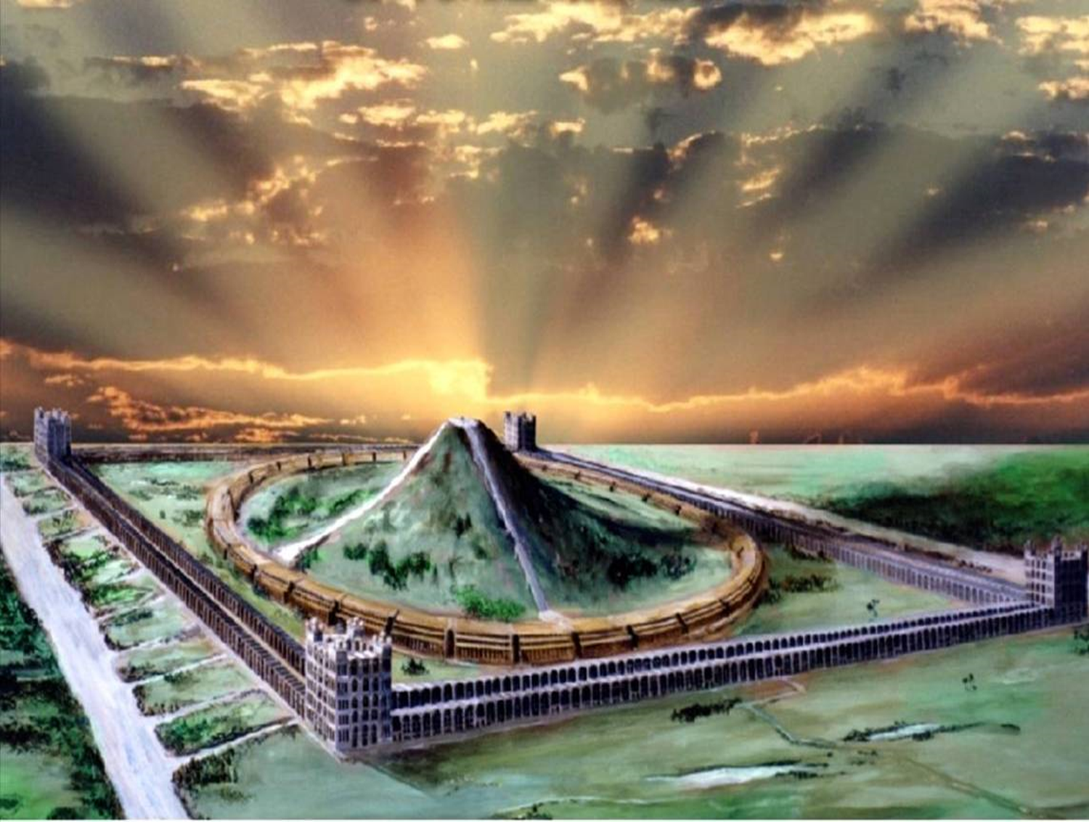
Ezekiel Proclaims Her Peaceful Future
Eze 37:26 Moreover I will make a covenant of peace with them; it shall be an everlasting covenant with them: and I will place them, and multiply them, and will set my sanctuary in the midst of them for evermore.
27 My tabernacle also shall be with them: yea, I will be their God, and they shall be my people.
28 And the heathen shall know that I the LORD do sanctify Israel, when my sanctuary shall be in the midst of them for evermore.

Slide 18
Zechariah’s Prophecy of Peace
Zec 6:12 And speak unto him, saying, Thus speaketh the LORD of hosts, saying, Behold the man whose name is The BRANCH; and he shall grow up out of his place, and he shall build the temple of the LORD:
Zec 6:13 Even he shall build the temple of the LORD; and he shall bear the glory, and shall sit and rule upon his throne; and he shall be a priest upon his throne: and the counsel of peace shall be between them both.

Slide 19
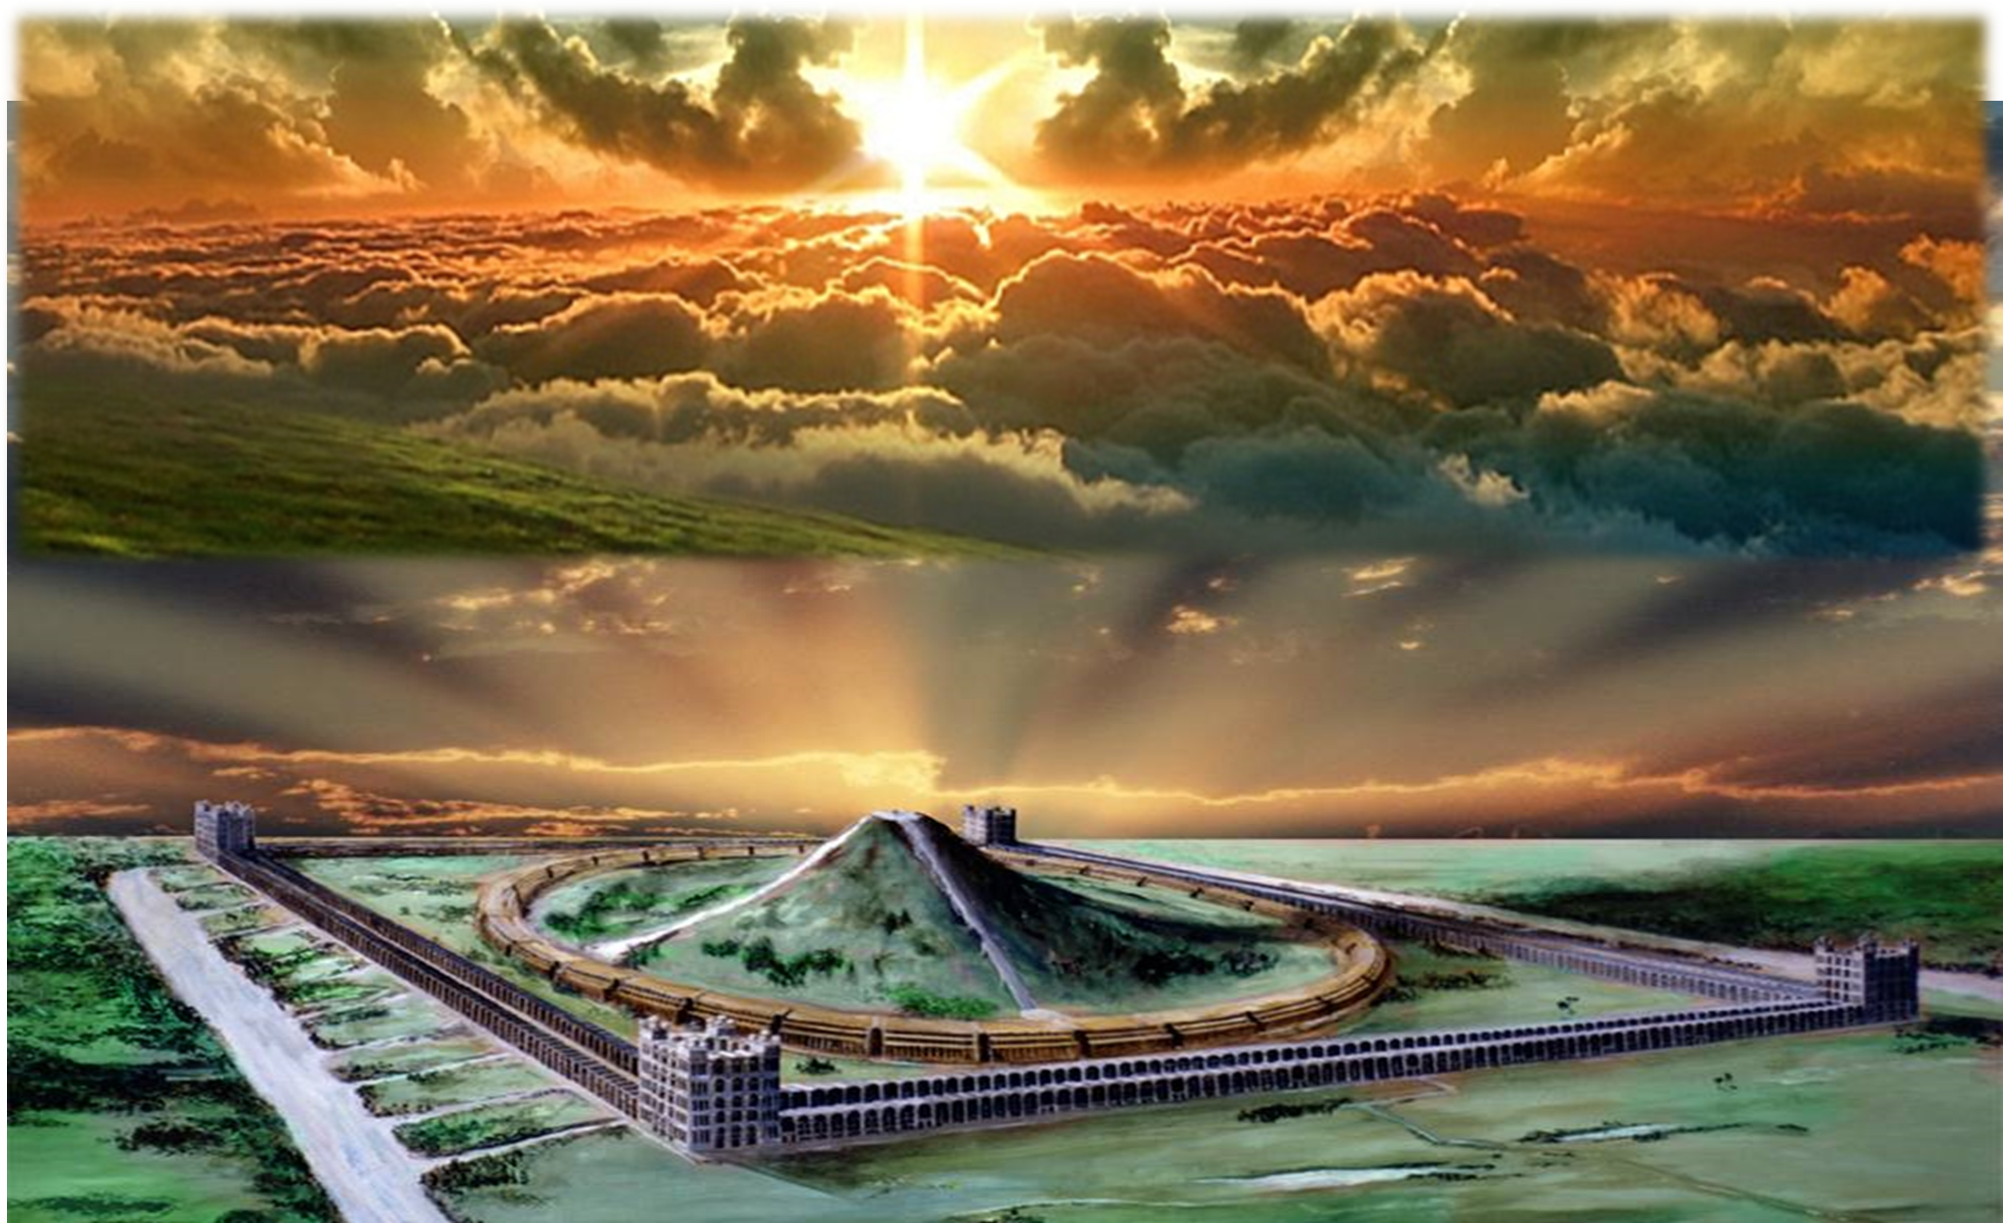
Priesthood and Jerusalem Coincide
First mention of Jerusalem in Scripture – Gen. 14:18 – as the city of “Salem”
The predominant idea of the city is expounded in Heb. 7:1-2 about Melchizedek
King of Salem, that is “King of Peace”
Peace is the dominating but elusive characteristic of that troubled city
Christ wept as he spoke of her blindness to what he could do for her in that regard Luke 19:42
John 14:27 – Jesus offers us that peace today

Slide 20
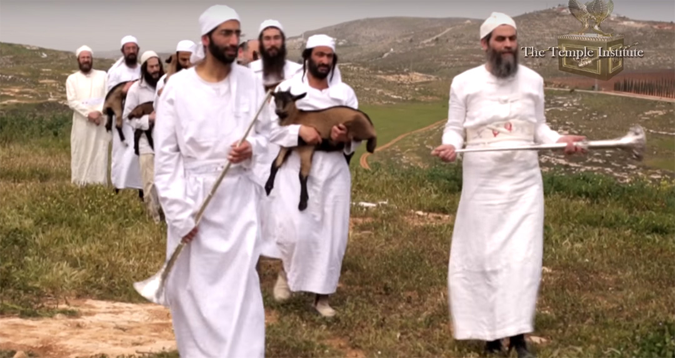
Degrees of Holiness?
Eze 44:10 And the Levites that are gone away far from me, when Israel went astray, which went astray away from me after their idols; they shall even bear their iniquity.
11 Yet they shall be ministers in my sanctuary, having charge at the gates of the house, and ministering to the house: they shall slay the burnt offering and the sacrifice for the people, and they shall stand before them (the people) to minister unto them.
12 Because they ministered unto them before their idols, and caused the house of Israel to fall into iniquity; therefore have I lifted up mine hand against them, saith the Lord GOD, and they shall bear their iniquity.
13 And they shall not come near unto me, to do the office of a priest unto me, nor to come near to any of my holy things, in the most holy place: but they shall bear their shame, and their abominations which they have committed.
14 But I will make them keepers of the charge of the house, for all the service thereof, and for all that shall be done therein.

Slide 21
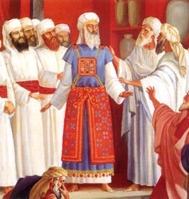
The Incident of Korah, Dathan and Abiram is worth rehearsing for our greater understanding of God’s divine appointment of …
“THOSE WHOM HE WOULD CAUSE TO DRAW NEAR TO HIMSELF!”
2 And they rose up before Moses, with certain of the children of Israel, two hundred and fifty princes of the assembly, famous in the congregation, men of renown:
3 And they gathered themselves together against Moses and against Aaron, and said unto them, Ye take too much upon you, seeing all the congregation are holy, every one of them, and the LORD is among them: wherefore then lift ye up yourselves above the congregation of the LORD?
4 And when Moses heard it, he fell upon his face:
5 And he spake unto Korah and unto all his company, saying, Even to morrow the LORD will shew who are his, and who is holy; and will cause him to come near unto him: even him whom he hath chosen will he cause to come near unto him.
Num 16:1 Now Korah, the son of Izhar, the son of Kohath, the son of Levi, and Dathan and Abiram, the sons of Eliab, and On, the son of Peleth, sons of Reuben, took men:

Slide 22
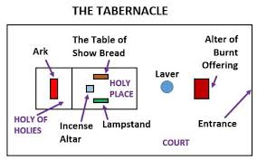
Three Areas of Holiness Within the Tabernacle, Temples
1. Courtyard – Congregation ministered to by Levite order of Priests
2. Holy Place – Levites serve & minister within
3. Most Holy Place – Sons of Zadok Order of Priests ONLY allowed here

Slide 23
The Two Witnesses
Rev 11:1 And there was given me a reed like unto a rod: and the angel stood, saying, Rise, and measure the temple of God, and the altar, and them that worship therein.
Rev 11:2 But the court which is without the temple leave out, and measure it not; for it is given unto the Gentiles: and the holy city shall they tread under foot forty and two months.

Slide 24
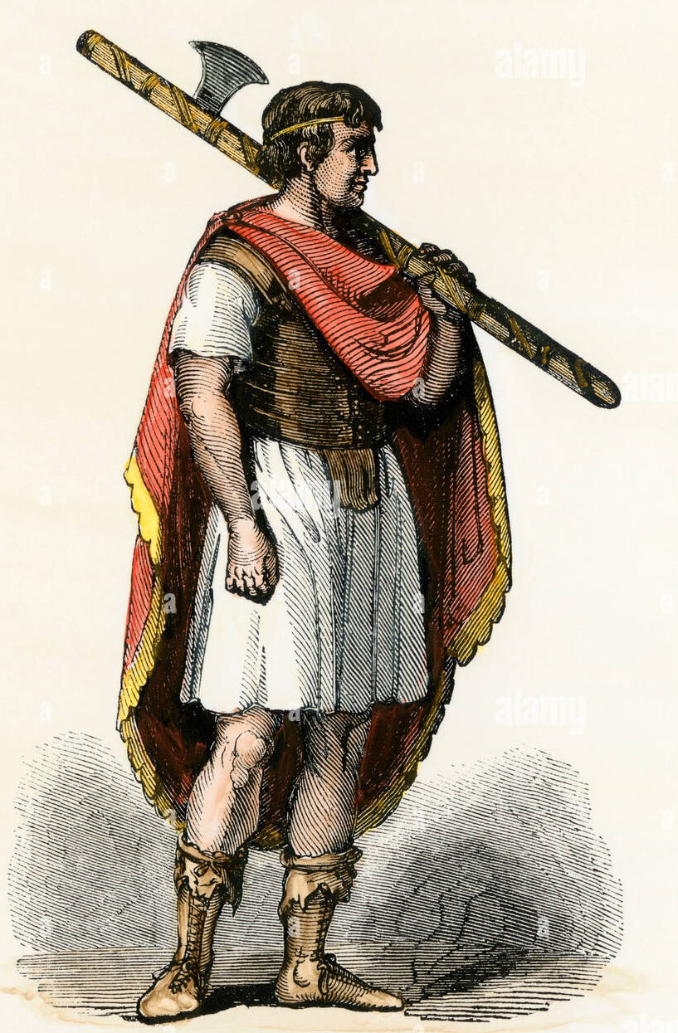
Romans 15:16
"That I should be the minister of Jesus Christ to the Gentiles"
Rom 13:4 For he is the minister of God to thee for good. But if thou do that which is evil, be afraid; for he beareth not the sword in vain: for he is the minister of God, a revenger to execute wrath upon him that doeth evil.
  This position of authority had been granted him through the grace of God (Gal. 2:7, 9; I Tim. 2:7).
  The word "minister" is the Gr. leitourgos. An official position as a public minister, a servant of the state, being used in Rom. 13:6 of earthly rulers who, though they do not act consciously as servants of God, yet discharge functions which are the ordinances of God.
  The word also is used particularly of the Levitical priests officiating in the temple (e.g., Heb. 10:11; 8:2).
Notes:
Rom 15:14 And I myself also am persuaded of you, my brethren, that ye also are full of goodness, filled with all knowledge, able also to admonish one another.
Rom 15:15 Nevertheless, brethren, I have written the more boldly unto you in some sort, as putting you in mind, because of the grace that is given to me of God,
Rom 15:16 That I should be the minister of Jesus Christ to the Gentiles, ministering the gospel of God, that the offering up of the Gentiles might be acceptable, being sanctified by the Holy Ghost.
Rom 15:17 I have therefore whereof I may glory through Jesus Christ in those things which pertain to God.

Slide 25
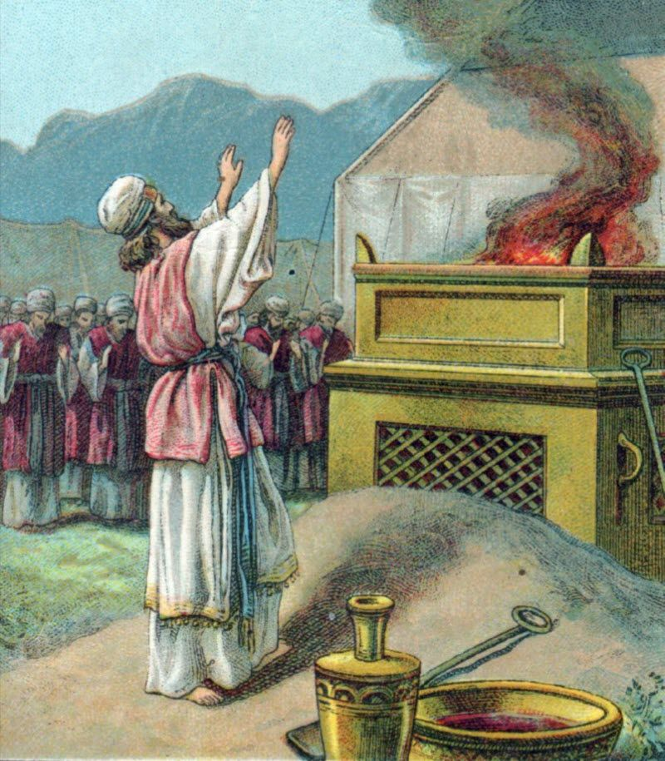
Romans 15:16
"That I should be the minister of Jesus Christ to the Gentiles"
  In Rom. 15:8 - Jesus Christ is described as the "minister (deacon, servant) of the circumcision"; here Paul asserts himself to be the "public servant" of Jesus Christ to carry that ministry to the wider field of the Gentiles.
  As a public servant, in a spiritual sense, Paul acted to support and maintain the work of his Master; in a priestly capacity he would bring the ecclesia as an offering unto Yahweh through the Christ altar (see Rom. 12:1).
Notes:
Rom 15:14 And I myself also am persuaded of you, my brethren, that ye also are full of goodness, filled with all knowledge, able also to admonish one another.
Rom 15:15 Nevertheless, brethren, I have written the more boldly unto you in some sort, as putting you in mind, because of the grace that is given to me of God,
Rom 15:16 That I should be the minister of Jesus Christ to the Gentiles, ministering the gospel of God, that the offering up of the Gentiles might be acceptable, being sanctified by the Holy Ghost.
Rom 15:17 I have therefore whereof I may glory through Jesus Christ in those things which pertain to God.

Slide 26
VERSE 16
"Ministering" — Gr. hierourgeo, to be a temple worker; to officiate as a priest offering sacrifices. The NEB has: "My priestly service is the preaching of the gospel of God".
"The gospel of God, that the offering up of the Gentiles" — Gr. prosphora: an oblation, sacrifice. In a spiritual sense, Paul brought the Gentile offering unto the Christ-altar, to be presented before Yahweh. But Gentile believers could only be offered up to God sacrificially if they willingly followed in the steps of Christ by putting to death the flesh, thereby presenting their bodies "a living sacrifice, holy, acceptable unto God" (ch. 12:1).
"Might be acceptable" — Gr. euprosdektos; well-received, approved, favorable. It could only be thus if the offering was "without blemish", and in order that this be the case, Paul had written this epistle to instruct the ecclesia in the elements of sanctification.

Slide 27
VERSE 16
"Being sanctified by the Holy Spirit" — Sanctification comes by the Spirit Word (Jn. 6:63), as the power given by God to convert mankind to divine use.
The DIAGLOTT and literal Greek read "having been sanctified by spirit holy".
That is, through "the spirit of holiness" which has been discovered by believers, in the Word of Truth (Jn. 17:17).
The word "sanctified" is hagiazo; to hallow, purify, consecrate.
As under the Law, a sacrifice was sanctified by preparation with salt, oil and frankincense, according to the nature of the sacrifice, so now the offering up of the Gentile ecclesia was rendered holy by the purifying and cleansing influence of the Holy Spirit in the message delivered unto them (cp. Rom. 12:1).
A similar expression is used by Peter in Acts 10:34-38; 11:7-8.

Slide 28
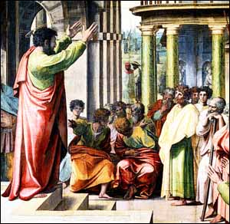
VERSE 17
“I have therefore whereof I may glory through Jesus Christ” — Paul gloried (Gr. kauchesis: to boast; see Rom. 3:27) in…
  the appointment bestowed upon him by Christ,
  and by which alone he had authority to write as he did, concerning the matters of salvation.
“In those things which pertain to God”
— Paul's desire was to share with others
  the principles of salvation the had received from God,
  and recognized this purpose that he was called to service
    (Gal. 1:15; Acts 9:15).

