Slide 1
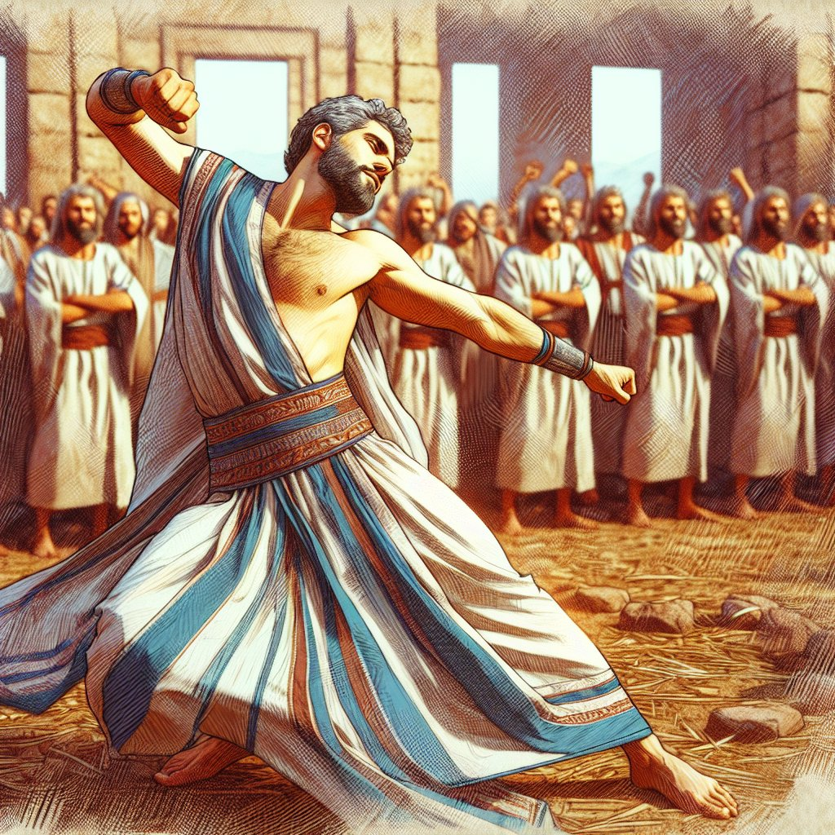
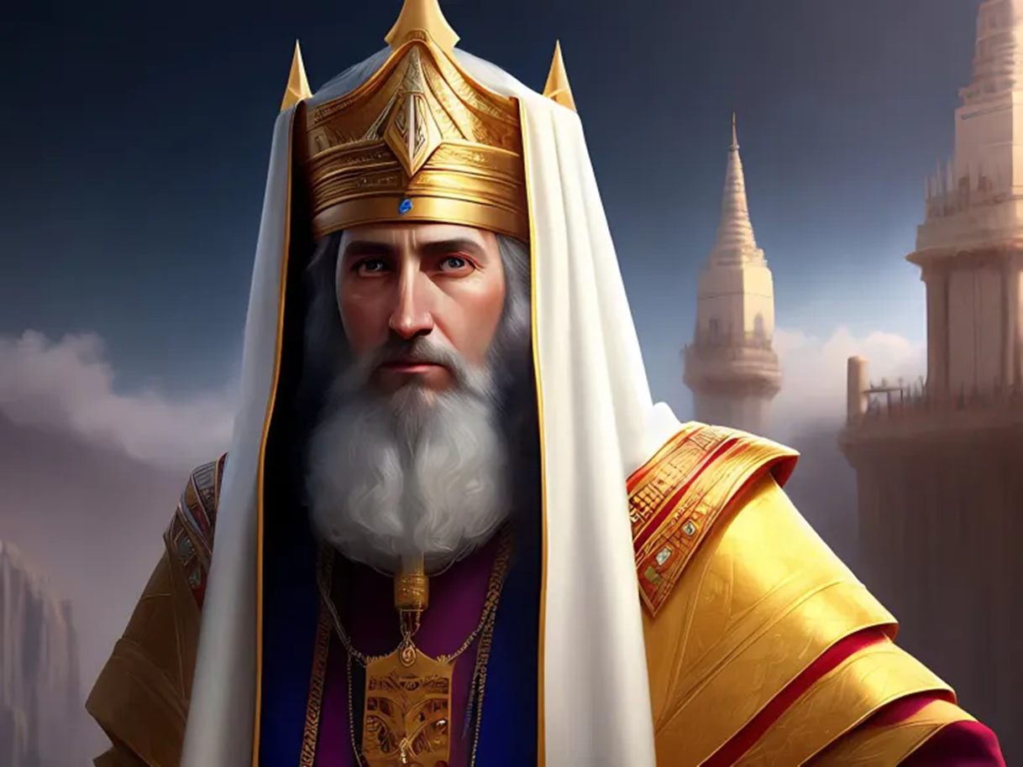
Class 4
“Priestly Kings and the Sacrifices of God”
Psa. 51
“Create in Me a Clean Heart, O God”++

Slide 2
Outline of the Class Objectives
How the roles of kings and priests are so different in the realm of the Spirit’s activities
Define the development of the king as opposed to that of the priest
Explain examples of how kings characterised the role of the priest
Examine the spirit of kings in the lives of Christ’s disciples vs his own spirit of service
King Saul
King David
King Solomon
King Jeroboam’s Repeat of Aaron’s Apostate Activity
King Uzziah – Offering incense as a high priest in the Temple
King Hezekiah – Approaching YHWH in prayer

Slide 3
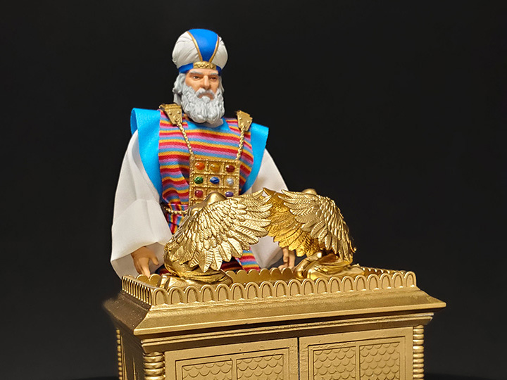
Yahweh’s Throne
Psa 80:1 Shepherd of Israel, you lead the descendants of Joseph, and you sit on your throne above the winged creatures. Listen to our prayer and let your light shine
Yahweh’s throne in Israel was between the Cherubim of the mercy seat upon the Ark of the covenant
Exo 25:20 And the cherubims shall stretch forth their wings on high, covering the mercy seat with their wings, and their faces shall look one to another; toward the mercy seat shall the faces of the cherubims be.
21 And thou shalt put the mercy seat above upon the ark; and in the ark thou shalt put the testimony that I shall give thee.
22 And there I will meet with thee, and I will commune with thee from above the mercy seat, from between the two cherubims which are upon the ark of the testimony, of all things which I will give thee in commandment unto the children of Israel.

Slide 4
The King’s Dominion or “Kingdom of God”
1 Ch 29:23 Then Solomon sat on the throne of the LORD as king instead of David his father, and prospered; and all Israel obeyed him.
14 Turn, O backsliding children, saith the LORD; for I am married unto you: and I will take you one of a city, and two of a family, and I will bring you to Zion:
15 And I will give you pastors according to mine heart, which shall feed you with knowledge and understanding.
16 And it shall come to pass, when ye be multiplied and increased in the land, in those days, saith the LORD, they shall say no more, The ark of the covenant of the LORD: neither shall it come to mind: neither shall they remember it; neither shall they visit it; neither shall that be done any more.
17 At that time they shall call Jerusalem the throne of the LORD; and all the nations shall be gathered unto it, to the name of the LORD, to Jerusalem: neither shall they walk any more after the imagination of their evil heart.

Slide 5
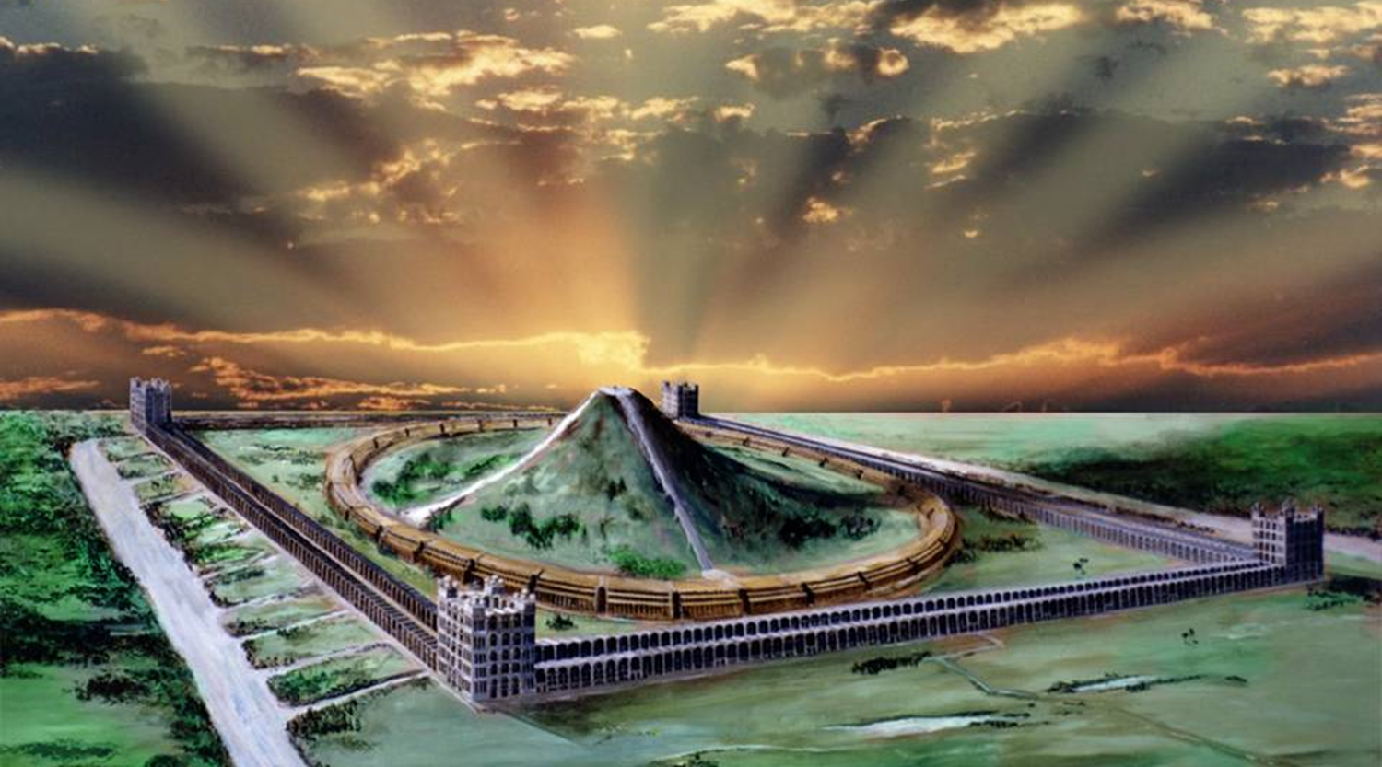
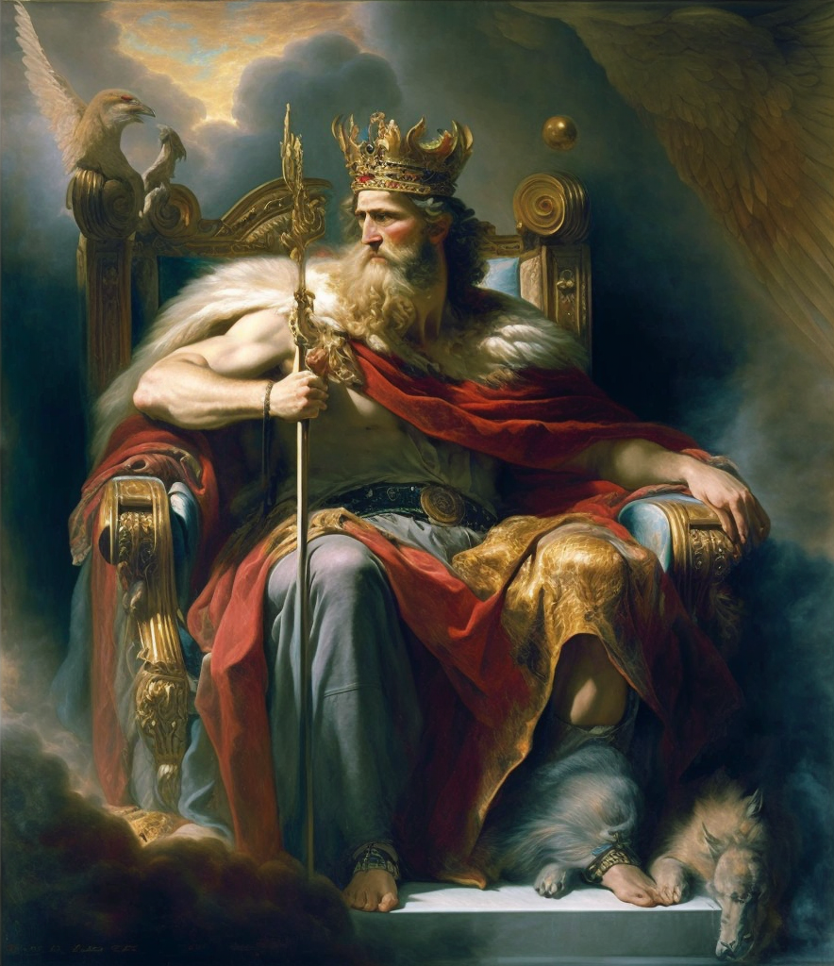
Rev 5:5 And one of the elders saith unto me, Weep not: behold, the Lion of the tribe of Juda, the Root of David, hath prevailed to open the book,…
It is significant that elsewhere the
  King of Israel (Rev. 5:5),
  the City of Jerusalem (Isa. 29:1),
  and the Altar of the House of Prayer of the future age (Ezek. 43:16) , are all given the title of Lion (mg.), for "Ariel" in the latter references signifies Lion of God.
Christ, as the Lion of Judah, will be king, ruling from Jerusalem; and priest, presiding over the millennial temple (Isa. 56:7); and altar to receive the offerings.
He represents the ruling authority (Rev. 5:5), the antitypical New Jerusalem (Rev. 21:23), and the altar (Heb. 13:10).
Isa 29:1 Woe to Ariel, to Ariel, the city where David dwelt! add ye year to year; let them kill sacrifices.
Eze 43:16 And the altar shall be twelve cubits long, twelve broad, square in the four squares thereof.
Notes:
It is significant that elsewhere the
King of Israel (Rev. 5:5),
the City of Jerusalem (Isa. 29:1),
and the Altar of the House of Prayer of the future age (Ezek. 43:16) , are all given the title of Lion (mg.), for "Ariel" in the latter references signifies Lion of God.
Christ, as the Lion of Judah, will be king, ruling from Jerusalem; priest, presiding over the millennial temple (Isa. 56:7); and altar to receive the offerings.
He represents the ruling authority (Rev. 5:5), the antitypical New Jerusalem (Rev. 21:23), and the altar (Heb. 13:10).
See also references to the Lion of Judah in Joel 3:16; Num. 23:24; 24:9; Deut. 33:20-21

Slide 6
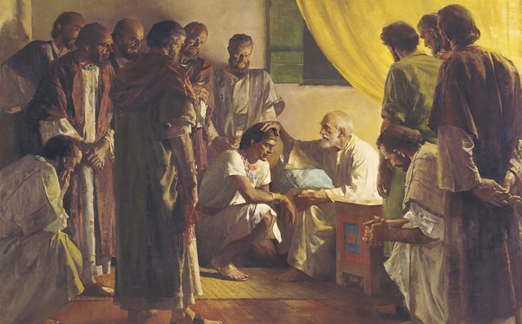
Jacob’s blessing upon Judah as Royal Tribe
Gen 49:8 Judah, thou art he whom thy brethren shall praise
But when have the brethren of Judah praised him?
Only for a very brief period in the past, under David and Solomon, when it is recorded that "Judah prevailed above his brethren"
(1 Chron. 5:2).
That brief moment was the period of the united Kingdom, which foreshadowed Messiah's reign (Amos 9:11).
So this prophecy sweeps on to the "last days" of Gentile ascendancy:
  the time when Messiah shall appear to "restore the kingdom to Israel"
  (Acts 1:6),
  and as "the Lion of the tribe of Judah" (Rev. 5:5),
  to receive the praise of all the tribes (Ps. 65:1 )

Slide 7
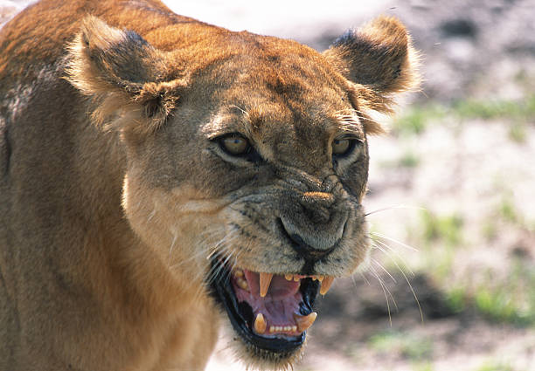
Gen 49:9 Judah is a lion's whelp: from the prey, my son, thou art gone up: he stooped down, he couched as a lion, and as an old lion; who shall rouse him up?
Here the Lion of Judah is described as …
(1) a whelp - youth
(2) a full grown lion - experience
(3) a lioness - productivity
The young lion is pictured as…
developing into full strength and ferocity,
roaming the land in search of prey,
repairing to its lair to consume it and to protect its offspring

Slide 8
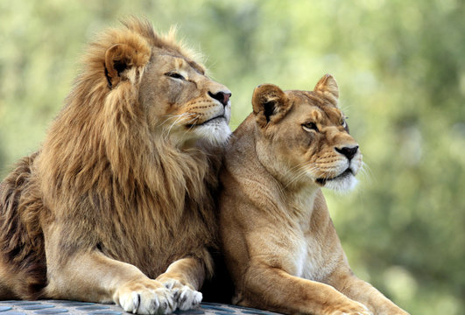
Gen 49:9 Judah is a lion's whelp: from the prey, my son, thou art gone up: he stooped down, he couched as a lion, and as an old lion; who shall rouse him up?
The representation of "he whom his brethren shall praise" (the Lion of Judah, Rev. 5:5) as a lioness is significant, for it suggests the reproduction of seed.
It is written of the Lord that he "travailed" to bring forth seed (Isa. 53:10-11), so that the feminine gender is appropriate to the Lord as the multitudinous Christ.
“…behold, the Lion^{G3023} ^{(G5607)} (lioness) of the tribe of Juda,

Slide 9
"From the prey, my son, thou art gone up" —
An expression denoting that the prey has been caught and consumed and that the king of beasts has returned in peace.
It indicates that the one referred to will not always be tearing down and consuming, but rather, once his objective has been satisfied, he will return in peace from the prey.
That One is represented as being so strong and courageous that when he seizes his prey none can resist him; when he goes up from it, none dare pursue him to avenge it.
It is significant that Jacob refers to one in particular, styled "my son" who would accomplish the prophecy.
It was never done so by Judah personally, so obviously the patriarch must have looked beyond his immediate son to the promised Messiah.

Slide 10
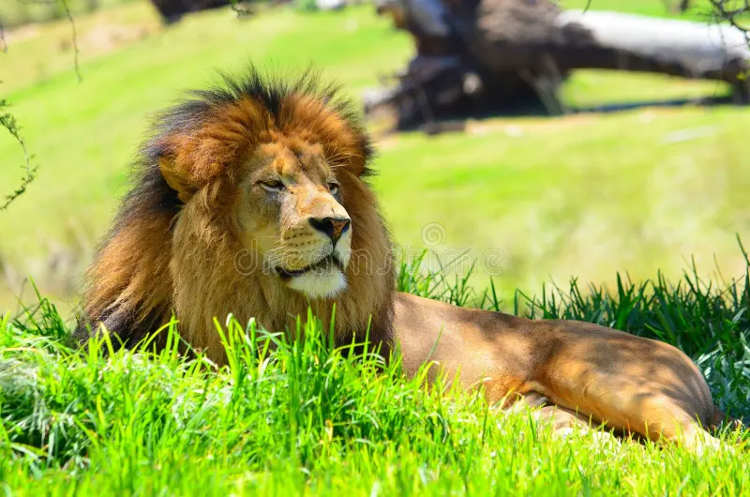
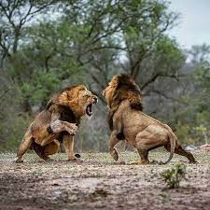
"He stooped down, he couched as a lion" — In these terms the lion is represented as couchant, at peace.
This suggests that Messiah will not make war for the sake of war, but to establish peace.
"In righteousness, he doth judge and make war"
(Rev. 19:11).
The prophecy thus describes the Lion of Judah as stalking the prey, consuming the prey, and returning in peace.
This is a remarkable allusion to the work of Messiah in subduing the nations in order to establish peace
(Isa. 9:6-7).

Slide 11
"And as an old lion; who shall rouse him up?" — Here the word is in the feminine gender, and has so been translated by the R.V.: "As a lioness.”
The lioness is particularly fierce in defending her cubs, and will exceed the male beast in so doing.
The figure therefore suggests that Messiah will not only overthrow his enemies and return in peace, but will successfully protect his own against molestation.
Messiah, appropriately, is described as both lion and lioness, for the prophecy does not apply to him merely, but also to the multitudinous Christ, who as one with him, is described as his bride.
This vision of Jacob should be aligned with the revelation of John: "The Lion of the tribe of Judah... hath prevailed" (Rev. 5:5).
The final clause: "Who shall rouse him up," can read: "Who dare rouse him up !"
What man is hardy enough to dare antagonise a ferocious and virile lion, ready to defend its own?]

Slide 12
Gen 49:10 The sceptre shall not depart from Judah, nor a lawgiver from between his feet, until Shiloh come; and unto him shall the gathering of the people be.
Vs 10 "The sceptre shall not depart from Judah" — The exercise of authority and rulership, was one of the privileges of the firstborn,
"Nor a lawgiver from between his feet" — Messiah is to be both Prince and Lawgiver.
The Law he will establish throughout the earth at his coming, are found in Isaiah 2:2-4; 42:4; Mal. 4:4, and elsewhere.
In anticipation of this, Yahweh declared: "Judah is My lawgiver" (Ps. 60:7; 108:8).
This was never the case until the Lord set forth the principles of his "new commandments" as set forth in his policy speech for kingdom citizenship (see Matthew 5,6,7).

Slide 13
Gen 49:10 The sceptre shall not depart from Judah, nor a lawgiver from between his feet, until Shiloh come; and unto him shall the gathering of the people be.
VERSE 10 "The sceptre shall not depart from Judah" — The exercise of authority and rulership, was one of the privileges of the firstborn,
"Nor a lawgiver from between his feet" — Though based upon the Law of Moses, it went so far above and beyond it as to constitute a new Law (John 13:34).
This will form the basis of the Law that shall emanate from Zion when the Kingdom is established.
As Brother Thomas remarks: "Moses was a lawgiver, not of Judah, but of Levi; but when Shiloh comes as the lawgiver of Judah, then 'the law shall go forth from Zion, and the word of the Lord from Jerusalem' (Isa. 2:3)" (Elpis Israel p. 281).

Slide 14
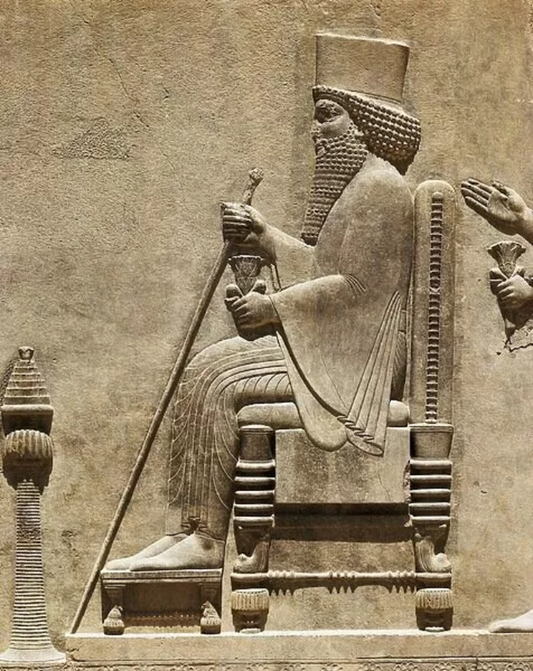
The lawgiver is described as being "between the feet" of the one whom his brethren shall praise.
This is a reference to the staff of office held upright in front of the dispenser of the law.
The R.V. gives "lawgiver" as ruler's staff, whilst The New Old Testament has leader's staff.
According to Strong, however, the Hebrew relates to a dispenser of law, the staff of which, as the insignia of his office, is described as being "between the knees" of Shiloh, the Messiah

Slide 15
"Until Shiloh come" — The Hebrew has tsad ki, "for that" which is equivalent to "because."
Brother Thomas comments: "The passage is easy enough, and teaches that the reason why the staff or sceptre shall not depart from Judah is 'because Shiloh shall come'" (Herald Of The Kingdom And Age To Come, vol. 8, p. 103).
This translation makes the verse consistent with the facts. It shows that the coming of Shiloh was necessary for the continuance of the sceptre in the hand of Judah, and the issuing of a Law from the same source.
Jacob saw not the limiting of these matters, but the perpetuity of them "for that Shiloh shall come."
His presence alone would make the prophecy possible.
The prophecy is taken up by Ezekiel, who told Zedekiah, the last king to sit on David's throne: "I will overturn, overturn, overturn, it; and it shall be no more, until he comes whose right it is, and I will give it him" (Ezek. 21:27; cp. the expressions concerning Jehoichin in Jer. 22:2,30).
But who is Shiloh? The word comes from a Hebrew root signifying peace, rest, tranquility.
As a proper noun it can signify The Bringer of Peace or Tranquility.
This title will be appropriate to the Lord at his second advent. When he appeared among men 1900 years ago, he declared: "Think not that I am come to send peace on earth; I came not to send peace but a sword" (Mat. 10:34).
He extended peace to his followers (Jn. 14:27), but not to the world either Jewish or Gentile.
At his second advent, however, he will be revealed as the Prince of Peace (Isa. 9:6).
He will be manifested as Shiloh whose lionlike roar (Joel 3:16) will put fear into the hearts of his enemies, and establish peace in the earth (Psa. 72:3,7; 85: 8).
Jerusalem will then be established in peace, and for this the Lord's people continually pray (Psa. 122:6-7).
Meanwhile, as Shiloh, the Lord offers "rest" to his people (Mat. 11:28-30).

Slide 16
"And unto him shall the gathering of the people be" — The word "people" is in the plural amim, and therefore relates to the peoples of the earth.
Having established his authority in the earth, and laid the foundation of peace in Jerusalem, Shiloh will extend the Kingdom of God into an empire embracing all nations (Ps. 72:11).
Moreover, they will ascend up to Jerusalem to worship before the King (Zech. 14:16; Isaiah 2:2-4; Jer. 3:17).
The Hebrew is even more expressive of what shall be accomplished by the Lord as Shiloh.
It is yiggarah amim, "obedience of the nations" as rendered by The New Old Testament.
The R.V. has "unto him shall the obedience of the peoples be."
He shall command and receive the respect and obedience of all peoples (Isa. 60:12).

Slide 17

Yahweh was Israel’s king from the foundation of their nation
Only after the divinely appointed Mediatorial Institution had corrupted did the people rise up and demand a monarch “like all the nations” to lead them.
REALLY?? The nation that already had the GREATEST king possible wanted what they thought would be an “UPGRADE?”
So God granted it to them with warnings of the consequences! (1 Sam. 8:10-22)

Slide 18
And the basis of their standards for choosing a “BETTER KING” was to observe how all of those other nations were doing it and get themselves one of THOSE KINDS OF KINGS!!
Let me know how that works out for you, Israel!
Maybe one like a past family member that’s had some success in leading men…like, uhh…maybe ESAU?

Slide 19
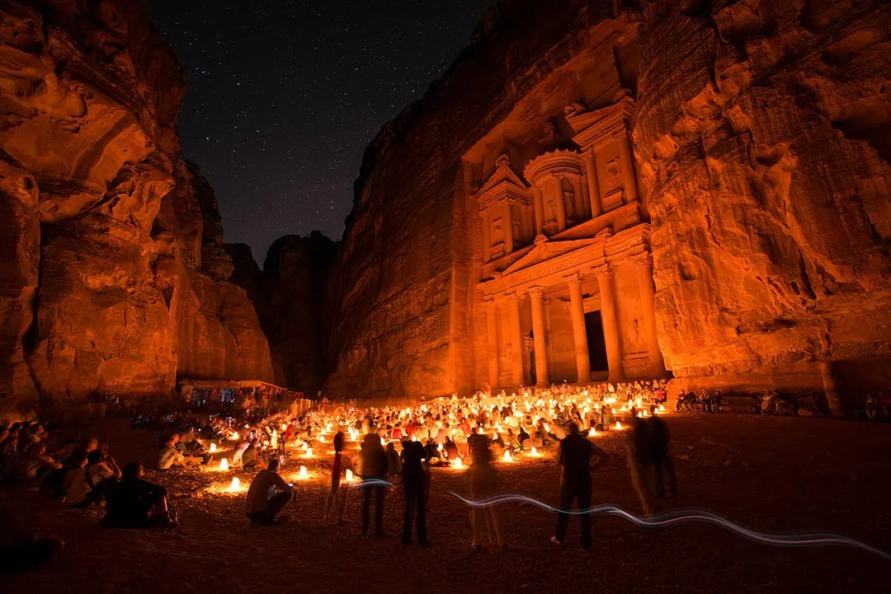
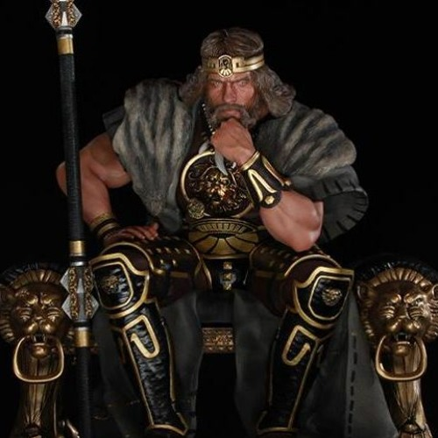
Gen 36:1 Now these are the generations of Esau, who is Edom.
Gen 36:31 And these are the kings^{H4428} that reigned^{H4427} in the land of Edom, before there reigned^{H4427} any king^{H4428} over the children of Israel.
Or, perhaps a king like one that…from our collective, intelligent POV, rules over men in the nations of our enemies?
Notes:
Oba 1:17 But upon mount Zion shall be deliverance, and there shall be holiness; and the house of Jacob shall possess their possessions.
Oba 1:18 And the house of Jacob shall be a fire, and the house of Joseph a flame, and the house of Esau for stubble, and they shall kindle in them, and devour them; and there shall not be any remaining of the house of Esau; for the LORD hath spoken it. Oba 1:21 And saviours shall come up on mount Zion to judge the mount of Esau; and the kingdom shall be the LORD'S.

Slide 20

“We pause this program for station identification…”

Slide 21
The Last Words of David
2 Sa 23:1 Now these be the last words of David. David the son of Jesse said, and the man who was raised up on high, the anointed of the God of Jacob, and the sweet psalmist of Israel, said,
2 The Spirit of the LORD spake by me, and his word was in my tongue.
3 The God of Israel said, the Rock of Israel spake to me…
He that ruleth over men must be just, ruling in the fear of God.

Slide 22

Now back to your regularly, scheduled programming.
“And now back to your regularly scheduled program!”

Slide 23
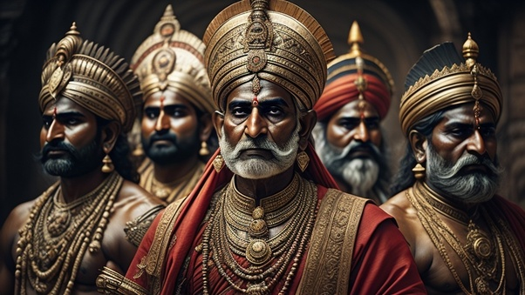
Past Foreign Kings of the Bible
Gen 14:1 And it came to pass in the days of Amraphel king of Shinar, Arioch king of Ellasar, Chedorlaomer king of Elam, and Tidal king of nations;
Gen 14:2 That these made war with Bera king of Sodom, and with Birsha king of Gomorrah, Shinab king of Admah, and Shemeber king of Zeboiim, and the king of Bela, which is Zoar.
Gen 14:18 And Melchizedek king of Salem brought forth bread and wine: and he was the priest of the most high God.
Gen 20:2 And Abraham said of Sarah his wife, She is my sister: and Abimelech king of Gerar sent, and took Sarah.
Gen 26:1 And there was a famine in the land, beside the first famine that was in the days of Abraham. And Isaac went unto Abimelech king of the Philistines unto Gerar.
Gen 36:31 And these are the kings that reigned in the land of Edom, before there reigned any king over the children of Israel.
Gen 41:46 And Joseph was thirty years old when he stood before Pharaoh king of Egypt. And Joseph went out from the presence of Pharaoh, and went throughout all the land of Egypt.

Slide 24
Gen_39:20 And Joseph's master took him, and put him into the prison, a place where the king's prisoners were bound: and he was there in the prison.
Gen_40:1 And it came to pass after these things, that the butler of the king of Egypt and his baker had offended their lord the king of Egypt.
Gen_40:5 And they dreamed a dream both of them, each man his dream in one night, each man according to the interpretation of his dream, the butler and the baker of the king of Egypt, which were bound in the prison.
Gen_41:46 And Joseph was thirty years old when he stood before Pharaoh king of Egypt. And Joseph went out from the presence of Pharaoh, and went throughout all the land of Egypt.
Exo_1:8 Now there arose up a new king over Egypt, which knew not Joseph.
Exo_1:15 And the king of Egypt spake to the Hebrew midwives, of which the name of the one was Shiphrah, and the name of the other Puah:
Exo_1:17 But the midwives feared God, and did not as the king of Egypt commanded them, but saved the men children alive.
Exo_1:18 And the king of Egypt called for the midwives, and said unto them, Why have ye done this thing, and have saved the men children alive?
Exo_2:23 And it came to pass in process of time, that the king of Egypt died: and the children of Israel sighed by reason of the bondage, and they cried, and their cry came up unto God by reason of the bondage.
Exo_3:18 And they shall hearken to thy voice: and thou shalt come, thou and the elders of Israel, unto the king of Egypt, and ye shall say unto him, The LORD God of the Hebrews hath met with us: and now let us go, we beseech thee, three days' journey into the wilderness, that we may sacrifice to the LORD our God.
Exo_3:19 And I am sure that the king of Egypt will not let you go, no, not by a mighty hand.
Exo_5:4 And the king of Egypt said unto them, Wherefore do ye, Moses and Aaron, let the people from their works? get you unto your burdens.
Exo_6:11 Go in, speak unto Pharaoh king of Egypt, that he let the children of Israel go out of his land.
Exo_6:13 And the LORD spake unto Moses and unto Aaron, and gave them a charge unto the children of Israel, and unto Pharaoh king of Egypt, to bring the children of Israel out of the land of Egypt.
Exo_6:27 These are they which spake to Pharaoh king of Egypt, to bring out the children of Israel from Egypt: these are that Moses and Aaron.
Exo_6:29 That the LORD spake unto Moses, saying, I am the LORD: speak thou unto Pharaoh king of Egypt all that I say unto thee.
Exo_14:5 And it was told the king of Egypt that the people fled: and the heart of Pharaoh and of his servants was turned against the people, and they said, Why have we done this, that we have let Israel go from serving us?
Exo_14:8 And the LORD hardened the heart of Pharaoh king of Egypt, and he pursued after the children of Israel: and the children of Israel went out with an high hand.

Slide 25
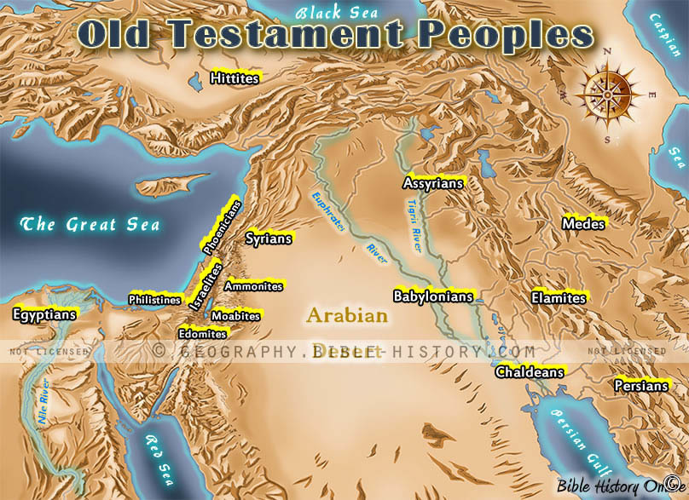
Foreign Kings Post-Exodus
Num 20:14 And Moses sent messengers from Kadesh unto the king of Edom
Num 21:1 And when king Arad the Canaanite, which dwelt in the south,
Num 21:26 For Heshbon was the city of Sihon the king of the Amorites, who had fought against the former king of Moab,
Num 31:8 And they slew the kings of Midian, beside the rest of them that were slain; namely, Evi, and Rekem, and Zur, and Hur, and Reba, five kings of Midian: Balaam also the son of Beor they slew with the sword.
Deu 3:11 For only Og king of Bashan remained of the remnant of giants;

Slide 26
Gen 35:9 And God appeared unto Jacob again, when he came out of Padanaram, and blessed him.
10 And God said unto him, Thy name is Jacob: thy name shall not be called any more Jacob, but Israel shall be thy name: and he called his name Israel.
11 And God said unto him, I am God Almighty: be fruitful and multiply; a nation and a company of nations shall be of thee, and kings shall come out of thy loins;
12 And the land which I gave Abraham and Isaac, to thee I will give it, and to thy seed after thee will I give the land.
13 And God went up from him in the place where he talked with him.
14 And Jacob set up a pillar in the place where he talked with him, even a pillar of stone: and he poured a drink offering thereon, and he poured oil thereon.
15 And Jacob called the name of the place where God spake with him, Bethel.

Slide 27
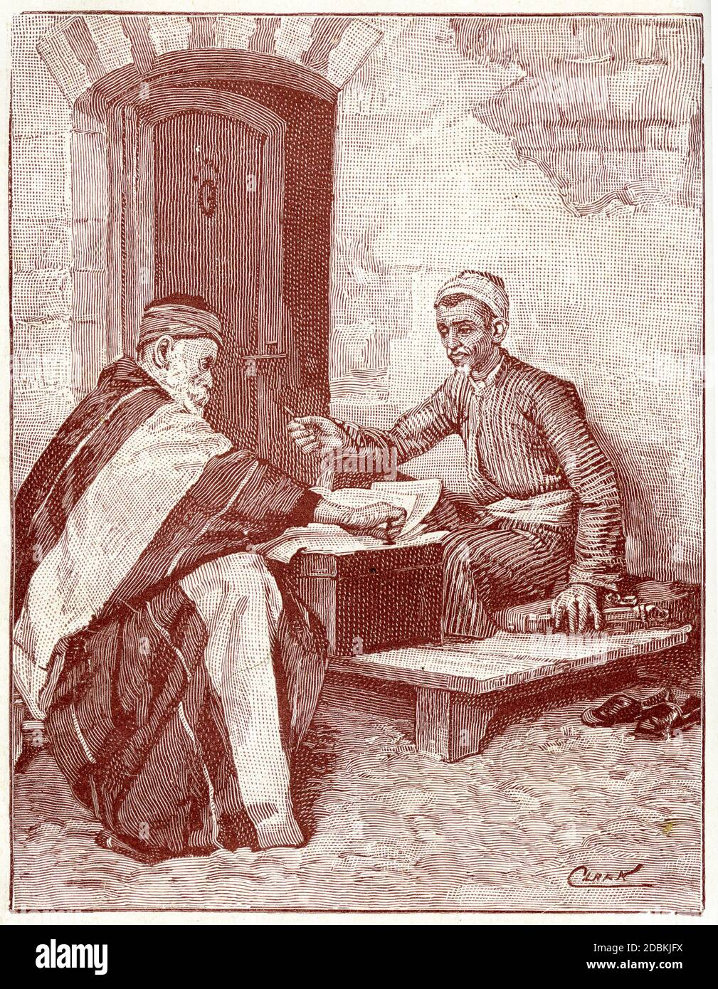
Yahweh’s Royal Standard of Israel’s Kings
Deu 17:14 When thou art come into the land, which the Lord thy God will give thee, and possessest it, and shalt say: I will set a king over me, as all nations have that are round about:
15 Thou shalt set him whom the Lord thy God shall choose out of the number of thy brethren. Thou mayst not make a man of another nation king, that is not thy brother.
16 And when he is made king, he shall not… multiply horses to himself, nor lead back the people into Egypt, being lifted up with the number of his horsemen, especially since the Lord hath commanded you to return no more the same way.
17 He shall not have many wives, that may allure his mind, nor immense sums of silver and gold.
18 But after he is raised to the throne of his kingdom, he shall copy out to himself the Deuteronomy of this law in a volume, taking the copy of the priests of the Levitical tribe,
19 And he shall have it with him, and shall read it all the days of his life, that he may learn to fear the Lord his God, and keep his words and ceremonies, that are commanded in the law;
20 And that his heart be not lifted up with pride over his brethren, nor decline to the right or to the left, that he and his sons may reign a long time over Israel.

Slide 28
King Saul Inducted Into The Spiritual Class
1 Sa 9:24 And the cook took up the shoulder, and that which was upon it, and set it before Saul. And Samuel said, Behold that which is left! set it before thee, and eat: for unto this time hath it been kept for thee since I said, I have invited the people. So Saul did eat with Samuel that day.
1 Sa 10:10 And when they came thither to the hill, behold, a company of prophets met him; and the Spirit of God came upon him, and he prophesied among them.
11 And it came to pass, when all that knew him beforetime saw that, behold, he prophesied among the prophets, then the people said one to another, What is this that is come unto the son of Kish? Is Saul also among the prophets?
1Sa 10:23 So they ran and brought Saul, and when he stood among the people, he was a head taller than any of the others.
24 Samuel said to all the people, “Do you see the one the LORD has chosen? There is no one like him among all the people.” And all the people shouted, “Long live the king!”
25 Then Samuel explained to the people the rights of kingship. He wrote them on a scroll and laid it up before the LORD. And Samuel sent all the people away, each to his own home.
26 Saul also went to his home in Gibeah, and the men of valor whose hearts God had touched went with him.
1Sa 11:6 When Saul heard their words, the Spirit of God rushed upon him, and he burned with great anger.
7 He took a pair of oxen, cut them into pieces, and sent them by messengers throughout the land of Israel, proclaiming, “This is what will be done to the oxen of anyone who does not march behind Saul and Samuel.” Then the terror of the LORD fell upon the people, and they turned out as one man.

Slide 29
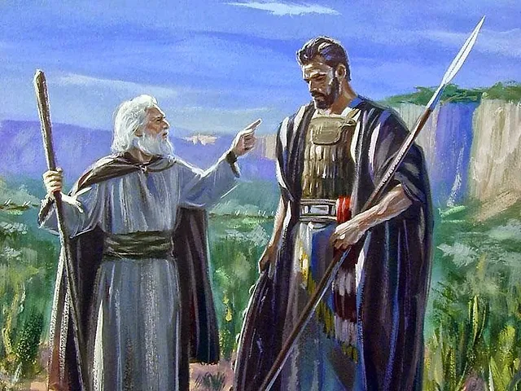
1 Sa 13:8 And Saul waited seven days for the time appointed by Samuel, but Samuel did not come to Gilgal, and the troops began to desert Saul.
9 So he said, “Bring me the burnt offering and the peace offerings.” And he offered up the burnt offering.
10 Just as he finished offering the burnt offering, Samuel arrived, and Saul went out to greet him.
11 “What have you done?” Samuel asked. And Saul replied, “When I saw that the troops were deserting me, and that you did not come at the appointed time and the Philistines were gathering at Michmash,
12 I thought, ‘Now the Philistines will descend upon me at Gilgal, and I have not sought the favor of the LORD.’ So I felt compelled to offer the burnt offering.”
13 “You have acted foolishly,” Samuel declared. “You have not kept the command that the LORD your God gave you; if you had, the LORD would have established your kingdom over Israel for all time.
14 But now your kingdom will not endure; the LORD has sought a man after His own heart and appointed him ruler over His people, because you have not kept the command of the LORD.”

Slide 30
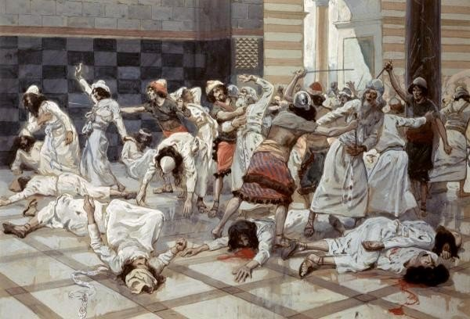
1 Sa 22:21 And Abiathar told David that Saul had killed the priests of the LORD.

Slide 31
After the slaughter of the Priests at Nob
1 Sam. 23:6 And it came to pass, when Abiathar the son of Ahimelech fled to David to Keilah, that he came down with an ephod in his hand.
9 And David knew that Saul secretly practised mischief against him; and he said to Abiathar the priest, Bring hither the ephod.
10 Then said David, O LORD God of Israel, thy servant hath certainly heard that Saul seeketh to come to Keilah, to destroy the city for my sake.
Upon the Loss of Ziklag
1 Sam. 30:1 And it came to pass, when David and his men were come to Ziklag on the third day, that the Amalekites had invaded the south, and Ziklag, and smitten Ziklag, and burned it with fire;
6 And David was greatly distressed; for the people spake of stoning him, because the soul of all the people was grieved, every man for his sons and for his daughters: but David encouraged himself in the LORD his God.
7 And David said to Abiathar the priest, Ahimelech's son, I pray thee, bring me hither the ephod. And Abiath
8 And David enquired at the LORD, saying, Shall I pursue after this troop? shall I overtake them? And he answered him, Pursue: for thou shalt surely overtake them, and without fail recover all.

Slide 32
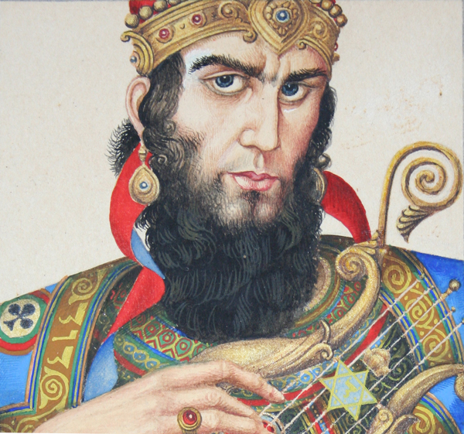
Act 13:22 And when he had removed him (Saul), he raised up unto them David to be their king; to whom also he gave testimony, and said, I have found David the son of Jesse, a man after mine own heart, which shall fulfil all my will.
Notes:
Apostle Paul: In Antioch in Pisidia, and went into the synagogue on the sabbath day.

Slide 33
David & His Men Partake of Levite Offerings
One of the “Priestly Highlights” of his life is seen as he runs from King Saul to the Tabernacle in Shiloh. There David seeks bread for his own men
1 Sam. 21:1 Then came David to Nob to Ahimelech the priest: and Ahimelech was afraid at the meeting of David, and said unto him, Why art thou alone, and no man with thee?
2 And David said unto Ahimelech the priest, The king hath commanded me a business, and hath said unto me, Let no man know any thing of the business whereabout I send thee, and what I have commanded thee: and I have appointed my servants to such and such a place.
3 Now therefore what is under thine hand? give me five loaves of bread in mine hand, or what there is present.
4 And the priest answered David, and said, There is no common bread under mine hand, but there is hallowed bread; if the young men have kept themselves at least from women.
5 And David answered the priest, and said unto him, Of a truth women have been kept from us about these three days, since I came out, and the vessels of the young men are holy, and the bread is in a manner common, yea, though it were sanctified this day in the vessel.
:6 So the priest gave him hallowed bread: for there was no bread there but the shewbread, that was taken from before the LORD, to put hot bread in the day when it was taken away.

Slide 34
Jesus’ response to the Pharisees
Luk 6:1 And it came to pass on the second sabbath after the first, that he went through the corn fields; and his disciples plucked the ears of corn, and did eat, rubbing them in their hands.
Luk 6:2 And certain of the Pharisees said unto them, Why do ye that which is not lawful to do on the sabbath days?
Luk 6:3 And Jesus answering them said, Have ye not read so much as this, what David did, when himself was an hungred, and they which were with him;
Luk 6:4 How he went into the house of God, and did take and eat the shewbread, and gave also to them that were with him; which it is not lawful to eat but for the priests alone?
Luk 6:5 And he said unto them, That the Son of man is Lord also of the sabbath.

Slide 35
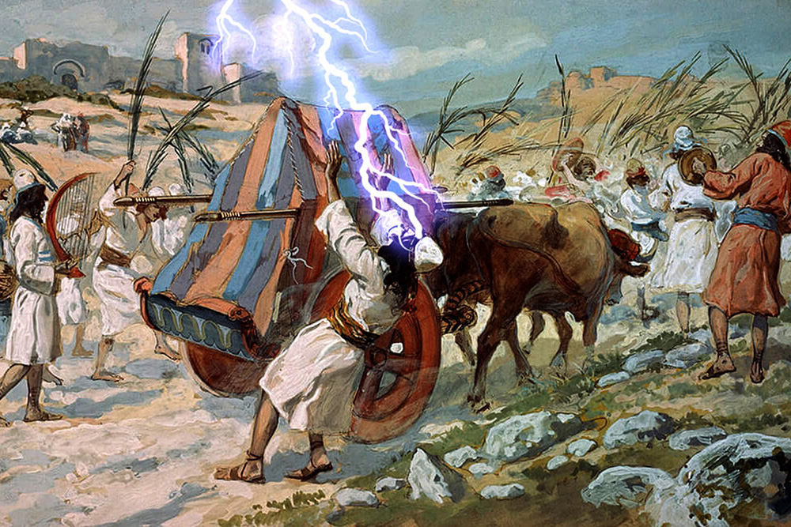
King David’s 1st Attempt to Bring Up The Ark to Jerusalem
1Ch 13:1 And David consulted with the captains of thousands and hundreds, and with every leader.
2 And David said unto all the congregation of Israel, If it seem good unto you, and that it be of the LORD our God, let us send abroad unto our brethren every where, that are left in all the land of Israel, and with them also to the priests and Levites which are in their cities and suburbs, that they may gather themselves unto us:
3 And let us bring again the ark of our God to us: for we enquired not at it in the days of Saul.
4 And all the congregation said that they would do so: for the thing was right in the eyes of all the people.
10 And the anger of the LORD was kindled against Uzza, and he smote him, because he put his hand to the ark: and there he died before God.
11 And David was displeased, because the LORD had made a breach upon Uzza: wherefore that place is called Perezuzza to this day.
12 And David was afraid of God that day, saying, How shall I bring the ark of God home to me?
13 So David brought not the ark home to himself to the city of David, but carried it aside into the house of Obededom the Gittite.
Notes:
And when the men of Bethshemesh were smitten by God with a great slaughter for profaning the ark, they besought the men of Kirjath-jearim to come to take charge of it. This they did, and brought it into the house of Abinadab and sanctified Eleazar his son " to keep the ark of the Lord " (1 Sam. 7:2).
And so for twenty years the ark rested there, until David was established in the Kingdom.

Slide 36
But even David was but little better instructed than the men of Bethshernesh ; and the death of Uzzah for touching the ark made him afraid, so that he dared not bring the ark into the city, but turned it aside to the house of Obededom the Gittite.
But when the Lord blessed this man and all his household, David was encouraged, and, having made preparation of the Levites according to the Law of Moses (1 Chron. 15), brought the ark into the city and pitched for it a tent. "
Because ye did it not at the first," said David, " the Lord our God made a breach upon us, for that we sought him not after the due, order " (verse 13).
The ark of the covenant with "the cherubim of glory shadowing the mercy-seat" was to be accounted most holy, and the Almighty saw fit to uphold this principle at the cost of much human life.
Notes:
And when the men of Bethshemesh were smitten by God with a great slaughter for profaning the ark, they besought the men of Kirjath-jearim to come to take charge of it. This they did, and brought it into the house of Abinadab and sanctified Eleazar his son " to keep the ark of the Lord " (1 Sam. 7:2).
And so for twenty years the ark rested there, until David was established in the Kingdom.

Slide 37
The Ark Brought to Jerusalem
1Ch 15:1 And David made him houses in the city of David, and prepared a place for the ark of God, and pitched for it a tent.
2 Then David said, None ought to carry the ark of God but the Levites: for them hath the LORD chosen to carry the ark of God, and to minister unto him for ever.
3 And David gathered all Israel together to Jerusalem, to bring up the ark of the LORD unto his place, which he had prepared for it.
4 And David assembled the children of Aaron, and the Levites:
5 Of the sons of Kohath; Uriel the chief, and his brethren an hundred and twenty:(Acts 1:15)
6 Of the sons of Merari; Asaiah the chief, and his brethren two hundred and twenty:
7 Of the sons of Gershom; Joel the chief, and his brethren an hundred and thirty:
8 Of the sons of Elizaphan; Shemaiah the chief, and his brethren two hundred:
9 Of the sons of Hebron; Eliel the chief, and his brethren fourscore:
10 Of the sons of Uzziel; Amminadab the chief, and his brethren an hundred and twelve.

Slide 38
1 Ch 15:11 - And David called for Zadok and Abiathar the priests, and for the Levites, for Uriel, Asaiah, and Joel, Shemaiah, and Eliel, and Amminadab,
12 And said unto them, Ye are the chief of the fathers of the Levites: sanctify yourselves, both ye and your brethren, that ye may bring up the ark of the LORD God of Israel unto the place that I have prepared for it.
13 For because ye did it not at the first, the LORD our God made a breach upon us, for that we sought him not after the due order.
14 So the priests and the Levites sanctified (Principle of sanctification – Lev. 10:3) themselves to bring up the ark of the LORD God of Israel.
15 And the children of the Levites bare the ark of God upon their shoulders with the STAVES thereon, as Moses commanded according to the word of the LORD.
מוֹטָהH4133-môṭâh mo-taw’ Feminine of H4132; a pole; by implication an ox bow; hence a yoke
16 And David spake to the chief of the Levites to appoint their brethren to be the singers with instruments of musick, psalteries and harps and cymbals, sounding, by lifting up the voice with joy.
Notes:
V.14 - 1Pe 3:15 But sanctify the Lord God in your hearts: and be ready always to give an answer to every man that asketh you a reason of the hope that is in you with meekness and fear:
1Pe 3:16 Having a good conscience; that, whereas they speak evil of you, as of evildoers, they may be ashamed that falsely accuse your good conversation in Christ.
1Pe 3:17 For it is better, if the will of God be so, that ye suffer for well doing, than for evil doing.
1Pe 3:18 For Christ also hath once suffered for sins, the just for the unjust, that he might bring us to God, being put to death in the flesh, but quickened by the Spirit:

Slide 39
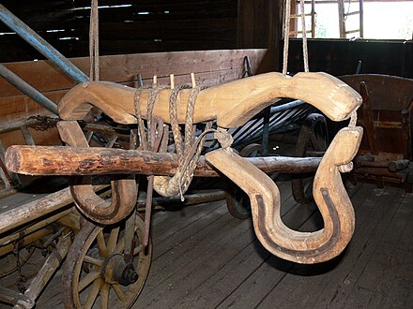
H4133
מוֹטָה
môṭâh
mo-taw'
Feminine of H4132; a pole; by implication an ox bow; hence a yoke (either literally or figuratively): - bands, heavy, staves, yoke.
Total KJV occurrences: 12
YOKE
POLE
Heb. motah
Notes:
Num_4:10 And they shall put^{H5414} it and all^{H3605} the vessels^{H3627} thereof within^{H413} a covering^{H4372} of badgers'^{H8476} skins,^{H5785} and shall put^{H5414} it upon^{H5921} a bar.^{H4132}
Num_4:12 And they shall take^{H3947} ^{(H853)} all^{H3605} the instruments^{H3627} of ministry,^{H8335} wherewith^{H834} they minister^{H8334} in the sanctuary,^{H6944} and put^{H5414} them in^{H413} a cloth^{H899} of blue,^{H8504} and cover^{H3680} them with a covering^{H4372} of badgers'^{H8476} skins,^{H5785} and shall put^{H5414} them on^{H5921} a bar:^{H4132}
Num_13:23 And they came^{H935} unto^{H5704} the brook^{H5158} of Eshcol,^{H812} and cut down^{H3772} from thence^{H4480} ^{H8033} a branch^{H2156} with one^{H259} cluster^{H811} of grapes,^{H6025} and they bare^{H5375} it between two^{H8147} upon a staff;^{H4132} and they brought of^{H4480} the pomegranates,^{H7416} and of^{H4480} the figs.^{H8384}
Psa_66:9 Which holdeth^{H7760} our soul^{H5315} in life,^{H2416} and suffereth^{H5414} not^{H3808} our feet^{H7272} to be moved.^{H4132}
Psa_121:3 He will not^{H408} suffer^{H5414} thy foot^{H7272} to be moved:^{H4132} he that keepeth^{H8104} thee will not^{H408} slumber.^{H5123}
Nah_1:13 For now^{H6258} will I break^{H7665} his yoke^{H4132} from off^{H4480} ^{H5921} thee, and will burst thy bonds in sunder.^{H5423} ^{H4147}
6 verses found, 6 matches
Numbers 3 verses found 3 matches
Psalms 2 verses found 2 matches
Nahum 1 verse found 1 match

Slide 40
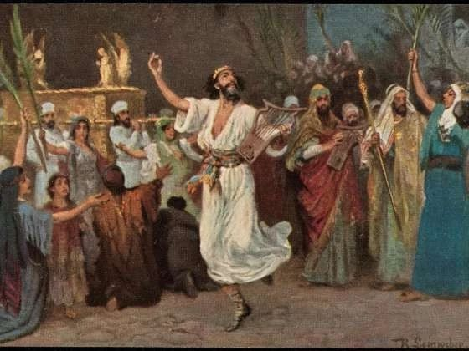
1Ch. 15:25 So David, and the elders of Israel, and the captains over thousands, went to bring up the ark of the covenant of the LORD out of the house of Obededom with joy.
26 And it came to pass, when God helped the Levites that bare the ark of the covenant of the LORD, that they offered seven bullocks and seven rams.
27 And David was clothed with a robe of fine linen, and all the Levites that bare the ark, and the singers, and Chenaniah the master of the song with the singers: David also had upon him an ephod of linen.
28 Thus all Israel brought up the ark of the covenant of the LORD with shouting, and with sound of the cornet, and with trumpets, and with cymbals, making a noise with psalteries and harps.
29 And it came to pass, as the ark of the covenant of the LORD came to the city of David, that Michal the daughter of Saul looking out at a window saw king David dancing and playing: and she despised him in her heart.

Slide 41
Mat 11:28 Come unto me, all ye that labour and are heavy laden, and I will give you rest.
29 Take my yoke upon you, and learn of me; for I am meek and lowly in heart: and ye shall find rest unto your souls.
30 For my yoke is easy, and my burden is light.
2 Co 6:14 Be ye not unequally yoked together with unbelievers: for what fellowship hath righteousness with unrighteousness? and what communion hath light with darkness?
15 And what concord hath Christ with Belial? or what part hath he that believeth with an infidel?
16 And what agreement hath the temple of God with idols? for ye are the temple of the living God; as God hath said, I will dwell in them, and walk in them; and I will be their God, and they shall be my people.
17 Wherefore come out from among them, and be ye separate, saith the Lord, and touch not the unclean thing; and I will receive you,
18 And will be a Father unto you, and ye shall be my sons and daughters, saith the Lord Almighty.

Slide 42

“Why Does the Great, Brass Altar Replace the Golden Ark of the Covenant in the Heart of the House of Prayer For All Nations in the Kingdom?

Slide 43
King Solomon’s Blessing, Prayer of Dedication, Benediction and Sacrifices Upon the Ark’s Entrance to the Temple
1 Ki 8:1 Then Solomon assembled the elders of Israel, and all the heads of the tribes, the chief of the fathers of the children of Israel, unto king Solomon in Jerusalem, that they might bring up the ark of the covenant of the LORD out of the city of David, which is Zion.
5 And king Solomon, and all the congregation of Israel, that were assembled unto him, were with him before the ark, sacrificing sheep and oxen, that could not be told nor numbered for multitude.
6 And the priests brought in the ark of the covenant of the LORD unto his place, into the oracle of the house, to the most holy place, even under the wings of the cherubims.
10 And it came to pass, when the priests were come out of the holy place, that the cloud filled the house of the LORD,
11 So that the priests could not stand to minister because of the cloud: for the glory of the LORD had filled the house of the LORD.
22 And Solomon stood before the altar of the LORD in the presence of all the congregation of Israel, and spread forth his hands toward heaven:

Slide 44
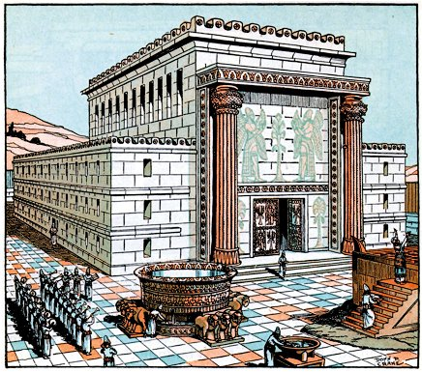
1 Kg. 7:13-51 – Types in the Temple of Solomon pointing to Levites in the future House of Prayer for All Nations
1 Ki 7:45 And the pots, and the shovels, and the basons: and all these vessels, which Hiram made to king Solomon for the house of the LORD, were of bright brass.
46 In the plain of Jordan did the king cast them, in the clay ground between Succoth (tabernacles - Zec. 14:16) and Zarthan. (piercing - Zec 13:6 Those with which I was wounded in the house of my friends.)
47 And Solomon left all the vessels unweighed, because they were exceeding many: neither was the weight of the brass found out.
Mar 7:3 For the Pharisees, and all the Jews, except they wash their hands oft, eat not, holding the tradition of the elders.
4 And when they come from the market, except they wash, they eat not. And many other things there be, which they have received to hold, as the washing of cups, and pots, brasen vessels, and of tables.
5 Then the Pharisees and scribes asked him, Why walk not thy disciples according to the tradition of the elders, but eat bread with unwashen hands?
6 He answered and said unto them, Well hath Esaias prophesied of you hypocrites, as it is written, This people honoureth me with their lips, but their heart is far from me.
7 Howbeit in vain do they worship me, teaching for doctrines the commandments of men.
8 For laying aside the commandment of God, ye hold the tradition of men, as the washing of pots and cups: and many other such like things ye do.
9 And he said unto them, Full well ye reject the commandment of God, that ye may keep your own tradition.
Notes:
Mar 7:1 Then came together unto him the Pharisees, and certain of the scribes, which came from Jerusalem.
Mar 7:2 And when they saw some of his disciples eat bread with defiled, that is to say, with unwashen, hands, they found fault.
Mar 7:3 For the Pharisees, and all the Jews, except they wash their hands oft, eat not, holding the tradition of the elders.
Mar 7:4 And when they come from the market, except they wash, they eat not. And many other things there be, which they have received to hold, as the washing of cups, and pots, brasen vessels, and of tables.
Mar 7:5 Then the Pharisees and scribes asked him, Why walk not thy disciples according to the tradition of the elders, but eat bread with unwashen hands?
Mar 7:6 He answered and said unto them, Well hath Esaias prophesied of you hypocrites, as it is written, This people honoureth me with their lips, but their heart is far from me.
Mar 7:7 Howbeit in vain do they worship me, teaching for doctrines the commandments of men.
Mar 7:8 For laying aside the commandment of God, ye hold the tradition of men, as the washing of pots and cups: and many other such like things ye do.
Mar 7:9 And he said unto them, Full well ye reject the commandment of God, that ye may keep your own tradition.

Slide 45
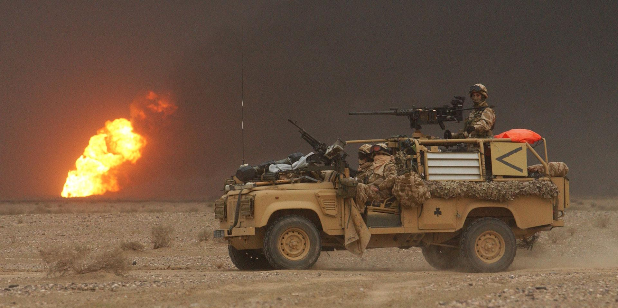
Zec 12:2 Behold, I will make Jerusalem a cup of trembling unto all the people round about, when they shall be in the siege both against Judah and against Jerusalem.
Eze 22:17 And the word of the LORD came unto me, saying,
18 Son of man, the house of Israel is to me become dross: all they are brass, and tin, and iron, and lead, in the midst of the furnace; they are even the dross of silver.
19 Therefore thus saith the Lord GOD; Because ye are all become dross, behold, therefore I will gather you into the midst of Jerusalem.
20 As they gather silver, and brass, and iron, and lead, and tin, into the midst of the furnace, to blow the fire upon it, to melt it; so will I gather you in mine anger and in my fury, and I will leave you there, and melt you.
21 Yea, I will gather you, and blow upon you in the fire of my wrath, and ye shall be melted in the midst thereof.
22 As silver is melted in the midst of the furnace, so shall ye be melted in the midst thereof; and ye shall know that I the LORD have poured out my fury upon you.

Slide 46
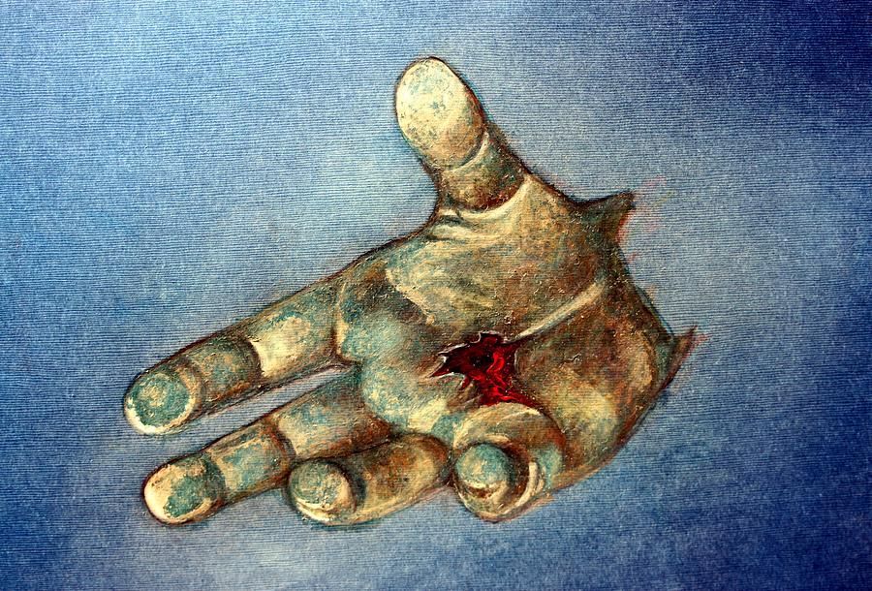
The Melting of Israel’s Brazen Heart
Zec 12:10 And I will pour upon the house of David, and upon the inhabitants of Jerusalem, the spirit of grace and of supplications: and they shall look upon me whom they have pierced, and they shall mourn for him, as one mourneth for his only son, and shall be in bitterness for him, as one that is in bitterness for his firstborn. 11 In that day shall there be a great mourning in Jerusalem, as the mourning of Hadadrimmon in the valley of Megiddon.

Slide 47
Ezek.43:17 describes the Altar. Lit. the verse reads: "And the court (i.e. altar court) fourteen long and fourteen broad ..."
To determine what these 14 "measures" are, Henry Sulley uses the consistent rule that all unspecified measures must be the original measuring staff held by the measuring angel - Ezek.40:3,5.
This we are told was one reed long. When it is intended that some smaller division of the reed measure is being applied, the Hebrew text invariably specifies some other measure, for example a cubit, span, or handbreadth (Cf 43:13).
Any attempt to expound this prophecy with a disregard for this rule, is destined to confusion. One cannot insert or omit measures at will. It is entirely inappropriate to apply cubits to the altar of the temple of the age to come, for a 14 cubit altar would be smaller than Solomon's altar, which was 20 cubits, and yet this future altar is intended for “all nations”, not just Israel!
(From “The Handbook on The Temple of Ezekiel’s Prophecy”)

Slide 49
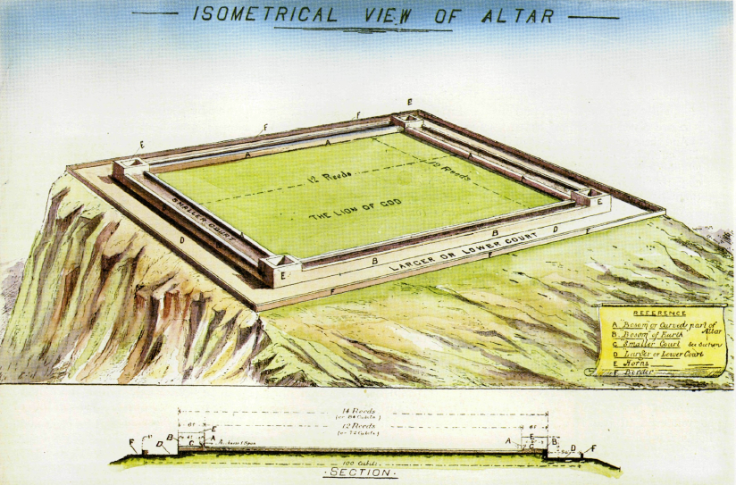
Eze 40:47 So he measured the altar (court) , an hundred cubits (200’) long, and an hundred cubits (200’) broad, foursquare; and the altar that was before the house.

Slide 50
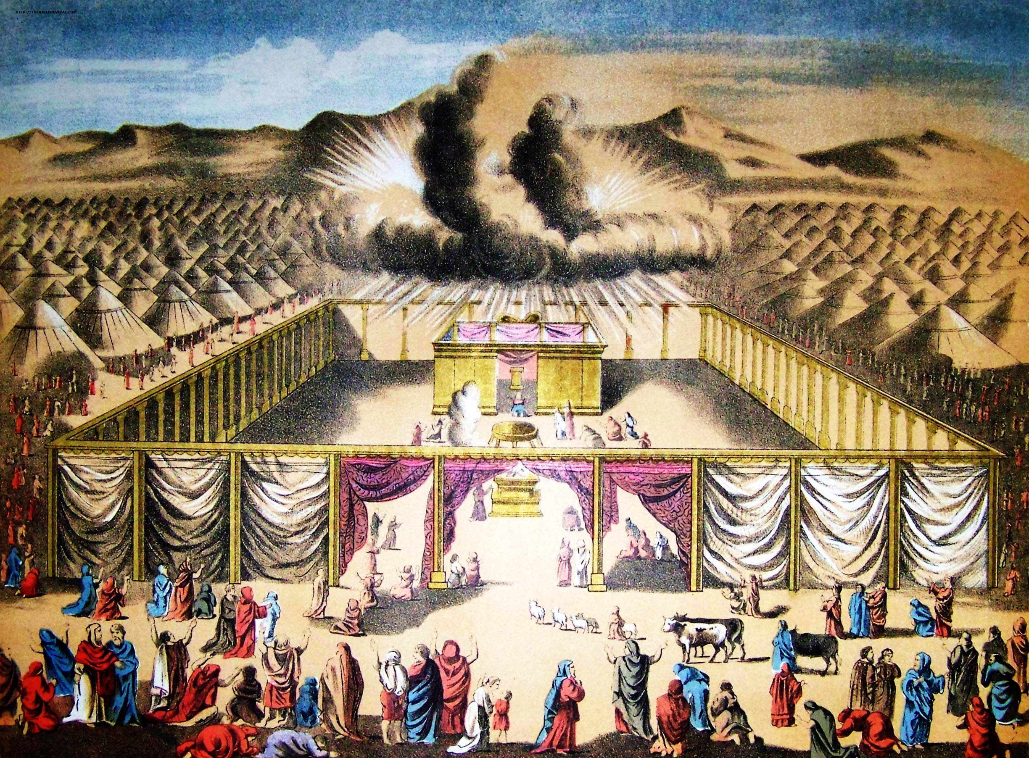
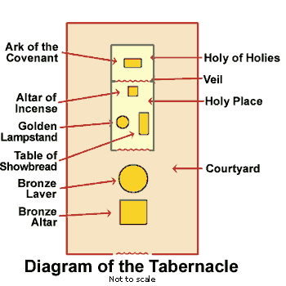
The Altar of the Tabernacle
Gen 41:32 And for that the dream was doubled unto Pharaoh twice; it is because the thing is established by God, and God will shortly bring it to pass.
PHYSICAL GLORIFICATION
BORN OF SPIRIT
15’
15’
MORAL APPLICATION
BORN OF WATER
MENTAL PREPARATION
BORN OF WORD
7.5’
7.5’
A PROCESS FROM START TO FINISH

Slide 51
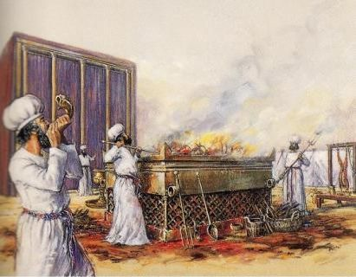
The Altar of the Tabernacle
Exo 27:1 And thou shalt make an altar of shittim wood, five cubits (7.5’) long, and five cubits (7.5’) broad; the altar shall be foursquare: and the height thereof shall be three (4.5’) cubits.
2 And thou shalt make the horns of it upon the four corners thereof: his horns shall be of the same: and thou shalt overlay it with brass.

Slide 52
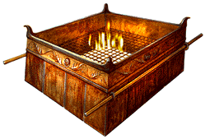
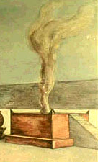
Altar of Tabernacle
Altar of Solomon’s Temple
Altar of House of Prayer
The FOURSQUARE geometric shape, four horns at the corners and brass material of the Altar are consistent features of all three altars.

Slide 53
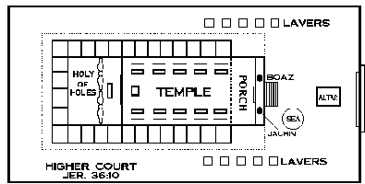
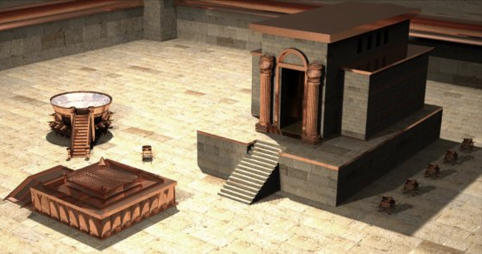
Solomon’s Temple: 2 Ch 3:8 And he made the MOST HOLY house, the length whereof was according to the breadth of the house, twenty cubits (30’), and the breadth thereof twenty cubits (30’):
30’
30’
30’
ALTAR
30’
30’
30’
30 ft.
30 ft.
2 Ch 4:1 Moreover he made an ALTAR of brass, twenty cubits (30’) the length thereof, and twenty cubits (30’) the breadth thereof, and ten cubits (15’) the height thereof.

Slide 55
King Jeroboam Reconstructs Aaron’s Folly
1 Ki 12:25 Then Jeroboam built Shechem in mount Ephraim, and dwelt therein; and went out from thence, and built Penuel.
26 And Jeroboam said in his heart, Now shall the kingdom return to the house of David: (FEAR)
27 If this people go up to do sacrifice in the house of the LORD at Jerusalem, then shall the heart of this people turn again unto their lord, even unto Rehoboam king of Judah, and they shall kill me, and go again to Rehoboam king of Judah. (FEAR)
28 Whereupon the king took counsel (SOUGHT CONFIRMATION), and made two calves of gold, and said unto them, It is too much for you to go up to Jerusalem (GOV’T LIES): behold thy gods, O Israel, (MORE LIES) which brought thee up out of the land of Egypt.
29 And he set the one in Bethel, and the other put he in Dan. (SET UP APOSTACY)
30 And this thing became a sin: for the people went to worship before the one, even unto Dan. (
31 And he made an house of high places, and made priests of the lowest of the people, which were not of the sons of Levi.
32 And Jeroboam ordained a feast in the eighth month, on the fifteenth day of the month, like unto the feast that is in Judah, and he offered upon the altar. So did he in Bethel, sacrificing unto the calves that he had made: and he placed in Bethel the priests of the high places which he had made.
33 So he offered upon the altar which he had made in Bethel the fifteenth day of the eighth month, even in the month which he had devised of his own heart; and ordained a feast unto the children of Israel: and he offered upon the altar, and burnt incense.

Slide 56
King Hezekiah
2 Ki 19:1 And it came to pass, when king Hezekiah heard it, that he rent his clothes, and covered himself with sackcloth, and went into the house of the LORD.
14 And Hezekiah received the letter of the hand of the messengers, and read it: and Hezekiah went up into the house of the LORD, and spread it before the LORD.
15 And Hezekiah prayed before the LORD, and said, O LORD God of Israel, which dwellest between the cherubims, thou art the God, even thou alone, of all the kingdoms of the earth; thou hast made heaven and earth.
16 LORD, bow down thine ear, and hear: open, LORD, thine eyes, and see: and hear the words of Sennacherib, which hath sent him to reproach the living God.
17 Of a truth, LORD, the kings of Assyria have destroyed the nations and their lands,
18 And have cast their gods into the fire: for they were no gods, but the work of men's hands, wood and stone: therefore they have destroyed them.
19 Now therefore, O LORD our God, I beseech thee, save thou us out of his hand, that all the kingdoms of the earth may know that thou art the LORD God, even thou only.
2 Ki 19:34 For I will defend this city, to save it, for mine own sake, and for my servant David's sake.
35 And it came to pass that night, that the angel of the LORD went out, and smote in the camp of the Assyrians an hundred fourscore and five thousand: and when they arose early in the morning, behold, they were all dead corpses.

Slide 57
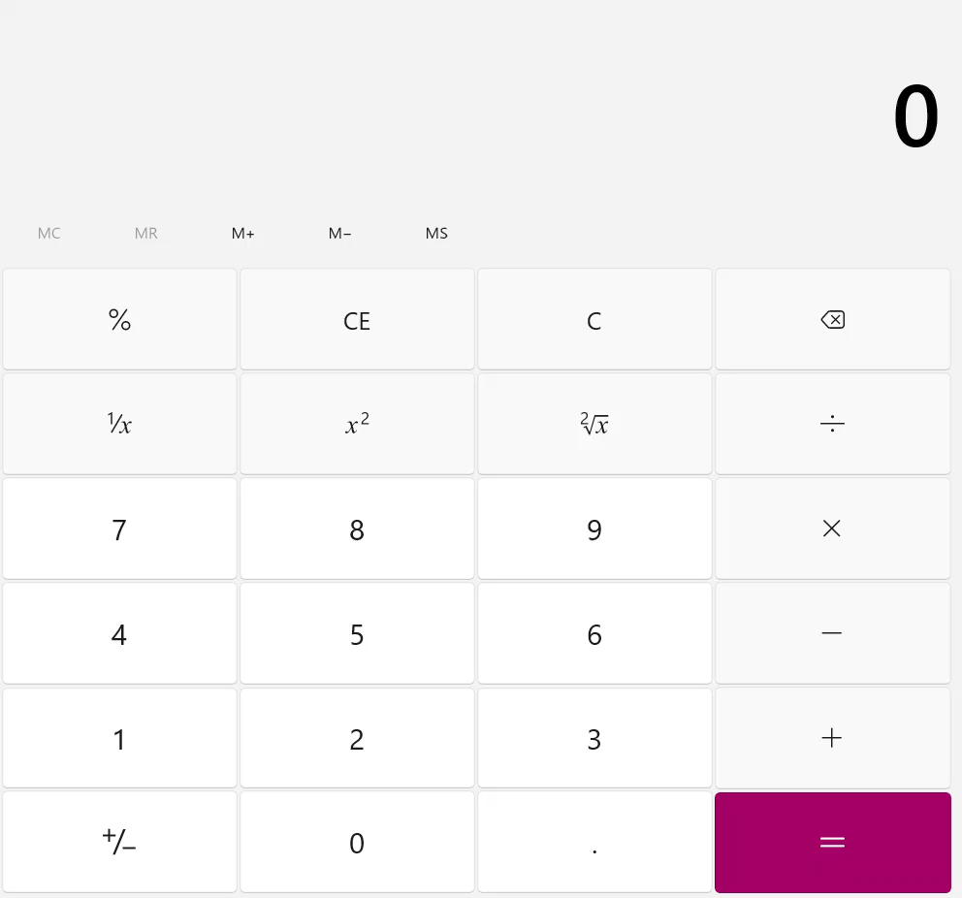
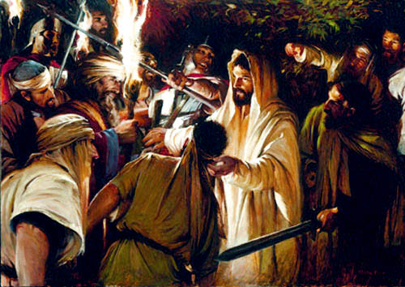
At Jesus’ Arrest in the Garden
12 LEGIONS OF ANGELS X 6k = 72k
(6k IN 1 LEGION)
Mat 26:51 And, behold, one of them which were with Jesus stretched out his hand, and drew his sword, and struck a servant of the high priest's, and smote off his ear.
52 Then said Jesus unto him, Put up again thy sword into his place: for all they that take the sword shall perish with the sword.
53 Thinkest thou that I cannot now pray to my Father, and he shall presently give me more than twelve legions of angels?
72k X 185k SLAIN BY 1 ANGEL =

Slide 58
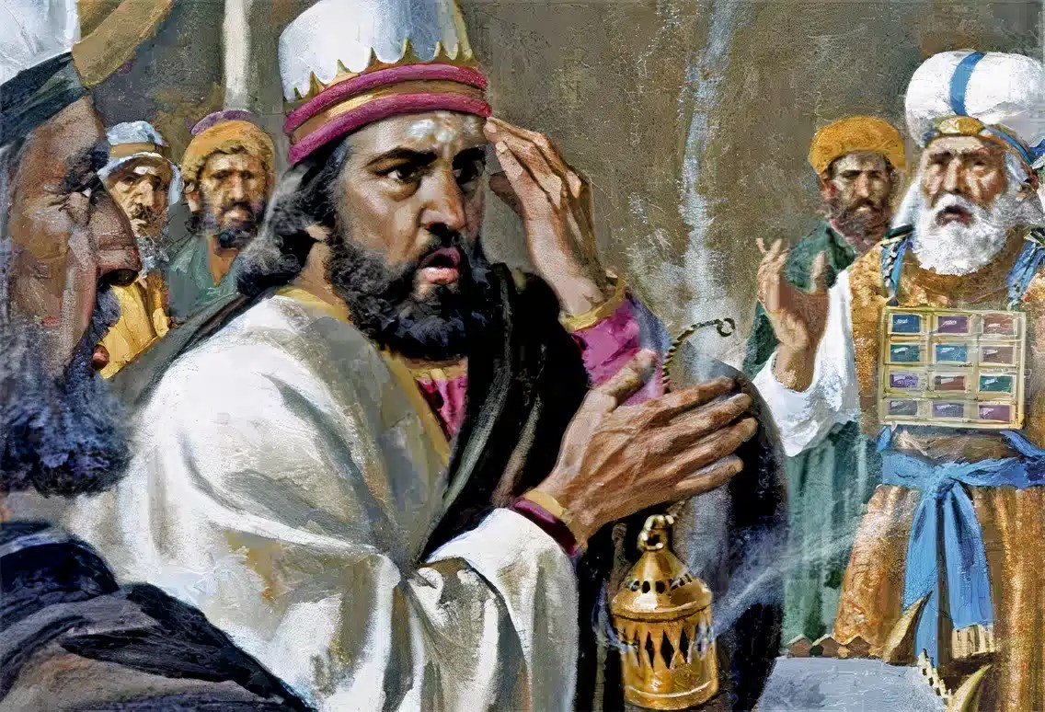
King Uzziah Attempts to Usurp the Role of Priest
2 Chron. 26:16 - 23
Notes:
2Ch 26:1 Then all the people of Judah took Uzziah, who was sixteen years old, and made him king in the room of his father Amaziah.
2Ch 26:2 He built Eloth, and restored it to Judah, after that the king slept with his fathers.
2Ch 26:3 Sixteen years old was Uzziah when he began to reign, and he reigned fifty and two years in Jerusalem. His mother's name also was Jecoliah of Jerusalem.
2Ch 26:4 And he did that which was right in the sight of the LORD, according to all that his father Amaziah did.
2Ch 26:5 And he sought God in the days of Zechariah, who had understanding in the visions of God: and as long as he sought the LORD, God made him to prosper.
2Ch 26:6 And he went forth and warred against the Philistines, and brake down the wall of Gath, and the wall of Jabneh, and the wall of Ashdod, and built cities about Ashdod, and among the Philistines.
2Ch 26:7 And God helped him against the Philistines, and against the Arabians that dwelt in Gurbaal, and the Mehunims.
2Ch 26:8 And the Ammonites gave gifts to Uzziah: and his name spread abroad even to the entering in of Egypt; for he strengthened himself exceedingly.
2Ch 26:9 Moreover Uzziah built towers in Jerusalem at the corner gate, and at the valley gate, and at the turning of the wall, and fortified them.
2Ch 26:10 Also he built towers in the desert, and digged many wells: for he had much cattle, both in the low country, and in the plains: husbandmen also, and vine dressers in the mountains, and in Carmel: for he loved husbandry.
2Ch 26:11 Moreover Uzziah had an host of fighting men, that went out to war by bands, according to the number of their account by the hand of Jeiel the scribe and Maaseiah the ruler, under the hand of Hananiah, one of the king's captains.
2Ch 26:12 The whole number of the chief of the fathers of the mighty men of valour were two thousand and six hundred.
2Ch 26:13 And under their hand was an army, three hundred thousand and seven thousand and five hundred, that made war with mighty power, to help the king against the enemy.
2Ch 26:14 And Uzziah prepared for them throughout all the host shields, and spears, and helmets, and habergeons, and bows, and slings to cast stones.
2Ch 26:15 And he made in Jerusalem engines, invented by cunning men, to be on the towers and upon the bulwarks, to shoot arrows and great stones withal. And his name spread far abroad; for he was marvellously helped, till he was strong.
2Ch 26:16 But when he was strong, his heart was lifted up to his destruction: for he transgressed against the LORD his God, and went into the temple of the LORD to burn incense upon the altar of incense.
2Ch 26:17 And Azariah the priest went in after him, and with him fourscore priests of the LORD, that were valiant men:
2Ch 26:18 And they withstood Uzziah the king, and said unto him, It appertaineth not unto thee, Uzziah, to burn incense unto the LORD, but to the priests the sons of Aaron, that are consecrated to burn incense: go out of the sanctuary; for thou hast trespassed; neither shall it be for thine honour from the LORD God.
2Ch 26:19 Then Uzziah was wroth, and had a censer in his hand to burn incense: and while he was wroth with the priests, the leprosy even rose up in his forehead before the priests in the house of the LORD, from beside the incense altar.
2Ch 26:20 And Azariah the chief priest, and all the priests, looked upon him, and, behold, he was leprous in his forehead, and they thrust him out from thence; yea, himself hasted also to go out, because the LORD had smitten him.
2Ch 26:21 And Uzziah the king was a leper unto the day of his death, and dwelt in a several house, being a leper; for he was cut off from the house of the LORD: and Jotham his son was over the king's house, judging the people of the land.
2Ch 26:22 Now the rest of the acts of Uzziah, first and last, did Isaiah the prophet, the son of Amoz, write.
2Ch 26:23 So Uzziah slept with his fathers, and they buried him with his fathers in the field of the burial which belonged to the kings; for they said, He is a leper: and Jotham his son reigned in his stead.

Slide 59
Heb.1:8 But unto the Son he saith, Thy throne, O God, is for ever and ever: a sceptre of righteousness is the sceptre of thy kingdom.
Heb. 4:16 Let us therefore come boldly unto the throne of grace, that we may obtain mercy, and find grace to help in time of need.

Slide 60
Heb_8:1 Now of the things which we have spoken this is the sum: We have such an high priest, who is set on the right hand of the throne of the Majesty in the heavens;
Heb 8:10 For this is the covenant that I will make with the house of Israel after those days, saith the Lord; I will put my laws into their mind, and write them in their hearts: and I will be to them a God, and they shall be to me a people:
11 And they shall not teach every man his neighbour, and every man his brother, saying, Know the Lord: for all shall know me, from the least to the greatest.
12 For I will be merciful to their unrighteousness, and their sins and their iniquities will I remember no more.
13 In that he saith, A new covenant, he hath made the first old. Now that which decayeth and waxeth old is ready to vanish away.
Heb_12:2 Looking unto Jesus the author and finisher of our faith; who for the joy that was set before him endured the cross, despising the shame, and is set down at the right hand of the throne of God.

Slide 61
Dan Revisited
Micah and the Levite
Jdg 17:1 And there was a man of mount Ephraim, whose name was Micah.
Jdg 17:2 And he said unto his mother, The eleven hundred shekels of silver that were taken from thee, about which thou cursedst, and spakest of also in mine ears, behold, the silver is with me; I took it. And his mother said, Blessed be thou of the LORD, my son.
Jdg 17:3 And when he had restored the eleven hundred shekels of silver to his mother, his mother said, I had wholly dedicated the silver unto the LORD from my hand for my son, to make a graven image and a molten image: now therefore I will restore it unto thee.
Jdg 17:4 Yet he restored the money unto his mother; and his mother took two hundred shekels of silver, and gave them to the founder, who made thereof a graven image and a molten image: and they were in the house of Micah.
Jdg 17:5 And the man Micah had an house of gods, and made an ephod, and teraphim, and consecrated one of his sons, who became his priest.
Jdg 17:6 In those days there was no king in Israel, but every man did that which was right in his own eyes.
Jdg 17:7 And there was a young man out of Bethlehemjudah of the family of Judah, who was a Levite, and he sojourned there.
Jdg 17:8 And the man departed out of the city from Bethlehemjudah to sojourn where he could find a place: and he came to mount Ephraim to the house of Micah, as he journeyed.
Jdg 17:9 And Micah said unto him, Whence comest thou? And he said unto him, I am a Levite of Bethlehemjudah, and I go to sojourn where I may find a place.
Jdg 17:10 And Micah said unto him, Dwell with me, and be unto me a father and a priest, and I will give thee ten shekels of silver by the year, and a suit of apparel, and thy victuals. So the Levite went in.
Jdg 17:11 And the Levite was content to dwell with the man; and the young man was unto him as one of his sons.
Jdg 17:12 And Micah consecrated the Levite; and the young man became his priest, and was in the house of Micah.
Jdg 17:13 Then said Micah, Now know I that the LORD will do me good, seeing I have a Levite to my priest.

Slide 62
Prophecy of Christ’s Army Marching to Battle
Deu 33:1 This is the blessing that Moses the man of God pronounced upon the Israelites before his death.
2 He said: “The LORD came from Sinai and dawned upon us from Seir; He shone forth from Mount Paran and came with myriads of holy ones, with flaming fire at His right hand.
3 Surely You love the people; all the holy ones are in Your hand, and they sit down at Your feet; each receives Your words—
4 the law that Moses gave us, the possession of the assembly of Jacob.
5 So YAHWEH became King in Jeshurun when the leaders of the people gathered, when the tribes of Israel came together.
                Berean Study Bible

Slide 63
