Slide 1
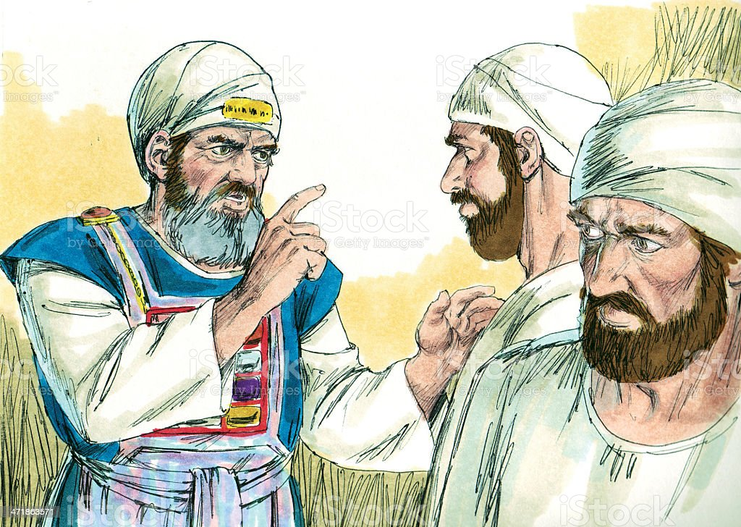
The Sons of Zadok — Ezekiel 44:15-16
"The law was weak through the flesh" (Rom. 8:3), not in itself, but flesh couldn't keep it.
Nadab and Abihu, through strong drink, were destroyed; Aaron, through fear of the people, made a golden calf.
Yahweh spoke to Samuel because Eli's sons had "turned the grace of God into lasciviousness".
"Now the sons of Eli were sons of Belial; they knew not Yahweh" (1 Sam. 2:12).
In the message to Samuel Yahweh said, "And I will raise me up a faithful priest, that shall do according to that which is in mine heart and in my mind" (v. 35).
Notes:
"The law was weak through the flesh" (Rom. 8:3), not in itself, but flesh couldn't keep it.
Nadab and Abihu, through strong drink, were destroyed; Aaron, through fear of the people, made a golden calf.
Yahweh spoke to Samuel because Eli's sons had "turned the grace of God into lasciviousness".
"Now the sons of Eli were sons of Belial; they knew not Yahweh" (1 Sam. 2:12).
In the message to Samuel Yahweh said, "And I will raise me up a faithful priest, that shall do according to that which is in mine heart and in my mind" (v. 35).
To this priest those left of Eli's house would come seeking redemption (v. 36). (Silver is used of redemption in scripture Exod. 30:11-16).
Undoubtedly the prophecy refers to Jesus Christ, yet it does have an earlier application in the next faithful priest who is Zadok.

Slide 2
The Sons of Zadok — Ezekiel 44:15-16
To this priest those left of Eli's house would come seeking redemption (v. 36). (Silver is used of redemption in scripture Exod. 30:11-16).
Undoubtedly the prophecy refers to Jesus Christ, yet it does have an earlier application in the next faithful priest who is Zadok.
Notes:
To this priest those left of Eli's house would come seeking redemption (v. 36). (Silver is used of redemption in scripture Exod. 30:11-16).
Undoubtedly the prophecy refers to Jesus Christ, yet it does have an earlier application in the next faithful priest who is Zadok.

Slide 3
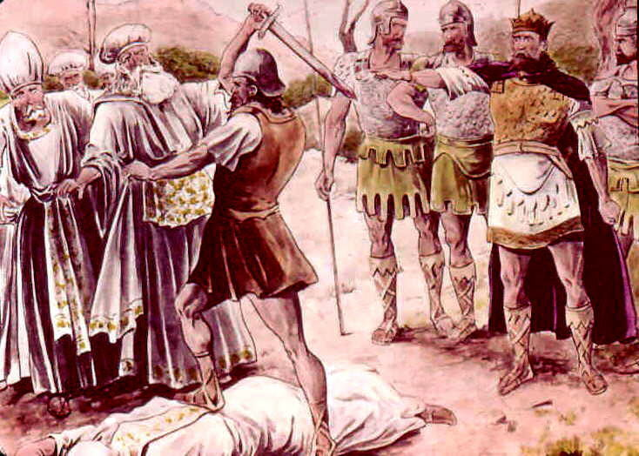
Because Ahimelech, the High Priest, had fed David and those with him, Saul slew Ahimelech together with eighty-five of the priests (1 Sam. 22:17-19).
In this wicked deed Saul used Doeg, a Gentile, fulfilling the prophecy that "there shall not be an old man in thine (Eli's) house" (1 Sam. 2:31).
One escaped however; Abiathar fled to David with the ephod (hence also the breastplate, Urim and Thummim etc.).
This enabled David to enquire of Yahweh by Urim and Thummim whenever necessary (e.g. 1 Sam. 23:9-12).
Notes:
Because Ahimelech, the High Priest, had fed David and those with him, Saul slew Ahimelech together with eighty-five of the priests (1 Sam. 22:17-19).
In this wicked deed Saul used Doeg, a Gentile, fulfilling the prophecy that "there shall not be an old man in thine (Eli's) house" (1 Sam. 2:31).
One escaped however; Abiathar fled to David with the ephod (hence also the breastplate, Urim and Thummim etc.).
This enabled David to enquire of Yahweh by Urim and Thummim whenever necessary (e.g. 1 Sam. 23:9-12).
In time Abiathar became the high priest for David but David later favors Zadok, and rivalry arose between the two priests.
This favor can be seen from 2 Sam. 15:24¬25, 27, 29, where Zadok is mentioned and given responsibility before Abiathar.
The rivalry would be made all the more acute by family descent and prophecy.

Slide 4
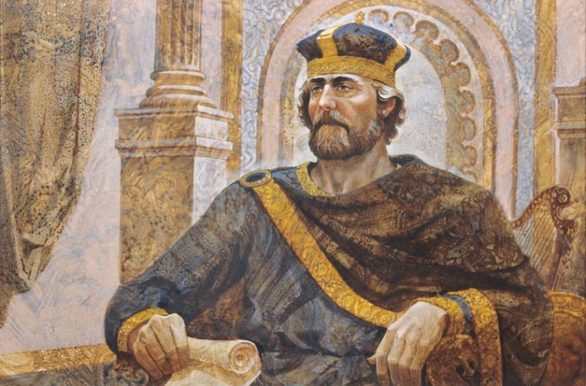
In time Abiathar became the high priest for David but David later favors Zadok, and rivalry arose between the two priests.
This favor can be seen from 2 Sam. 15:24¬25, 27, 29, where Zadok is mentioned and given responsibility before Abiathar.
The rivalry would be made all the more acute by family descent and prophecy.
Notes:
Because Ahimelech, the High Priest, had fed David and those with him, Saul slew Ahimelech together with eighty-five of the priests (1 Sam. 22:17-19).
In this wicked deed Saul used Doeg, a Gentile, fulfilling the prophecy that "there shall not be an old man in thine (Eli's) house" (1 Sam. 2:31).
One escaped however; Abiathar fled to David with the ephod (hence also the breastplate, Urim and Thummim etc.).
This enabled David to enquire of Yahweh by Urim and Thummim whenever necessary (e.g. 1 Sam. 23:9-12).
In time Abiathar became the high priest for David but David later favors Zadok, and rivalry arose between the two priests.
This favor can be seen from 2 Sam. 15:24¬25, 27, 29, where Zadok is mentioned and given responsibility before Abiathar.
The rivalry would be made all the more acute by family descent and prophecy.

Slide 5
Zadok was of the line of Eliezer, the oldest son of Aaron, but Abiathar was of Ithamar, the youngest son of Aaron, and therefore of the line of Eli.
Two major FAILS faced him:
~ the prophecy, "I will raise me up a faithful priest" (1 Sam. 2:35)
~ and it was the end of Eli's sons in the priesthood.
Wherein did Abiathar 's fall come? Was he not faithful to David?
Yes, he was faithful — till the end of David's life.
To regain all that he was to lose, Abiathar supported the revolt of “Adonijah the ‘Wannabee king” — it seemed his last opportunity!
Notes:
Zadok was of the line of Eliezer, the oldest son of Aaron, but Abiathar was of Ithamar, the youngest son of Aaron, and therefore of the line of Eli.
Two major FAILS faced him: the prophecy, "I will raise me up a faithful priest" (1 Sam. 2:35) and of the end of Eli's sons in the priesthood.
Wherein did Abiathar 's fall come? Was he not faithful to David? Yes, he was faithful — till the end of David's life.
To regain all that he was to lose, Abiathar supported the revolt of “Adonijah the ‘Wannabee king” — it seemed his last opportunity
Zadok remained faithful to David and Solomon and the revolt was frustrated.
"So Solomon thrust out Abiathar from being priest unto Yahweh; that he might fulfil the word of Yahweh which he spake concerning the house of Eli in Shiloh" (1 Kings 2:27).
"And Zadok the priest did the king put in the room of Abiathar" (v. 35).

Slide 6
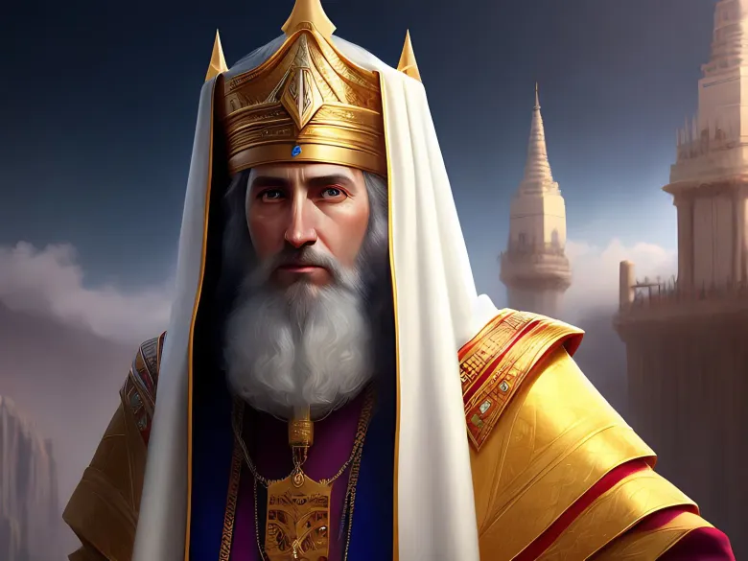
Zadok remained faithful to David and Solomon and the revolt was frustrated.
"So Solomon thrust out Abiathar from being priest unto Yahweh; that he might fulfil the word of Yahweh which he spake concerning the house of Eli in Shiloh" (1 Kings 2:27).
"And Zadok the priest did the king put in the room of Abiathar" (v. 35).
Notes:
Zadok was of the line of Eliezer, the oldest son of Aaron, but Abiathar was of Ithamar, the youngest son of Aaron, and therefore of the line of Eli.
Two major FAILS faced him: the prophecy, "I will raise me up a faithful priest" (1 Sam. 2:35) and of the end of Eli's sons in the priesthood.
Wherein did Abiathar 's fall come? Was he not faithful to David? Yes, he was faithful — till the end of David's life.
To regain all that he was to lose, Abiathar supported the revolt of “Adonijah the ‘Wannabee king” — it seemed his last opportunity
Zadok remained faithful to David and Solomon and the revolt was frustrated.
"So Solomon thrust out Abiathar from being priest unto Yahweh; that he might fulfil the word of Yahweh which he spake concerning the house of Eli in Shiloh" (1 Kings 2:27).
"And Zadok the priest did the king put in the room of Abiathar" (v. 35).

Slide 7

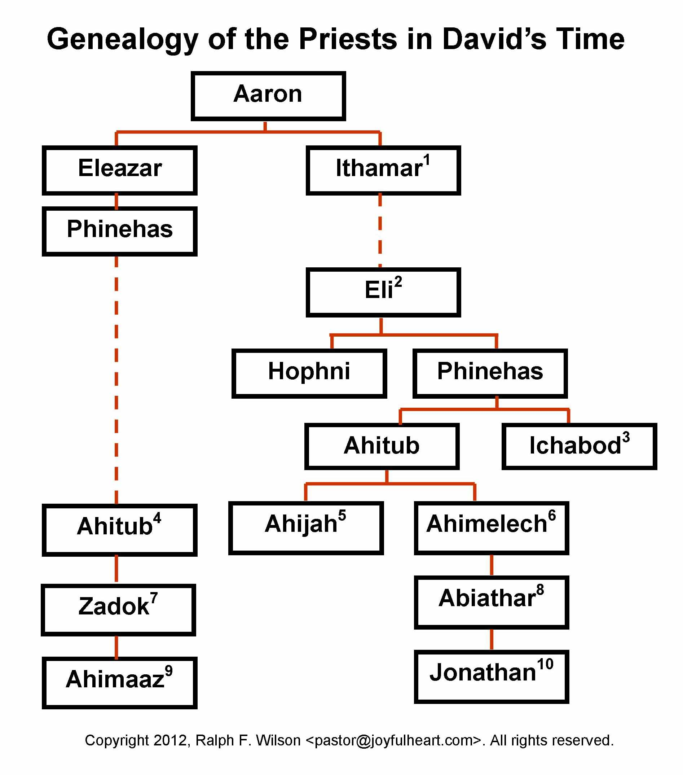
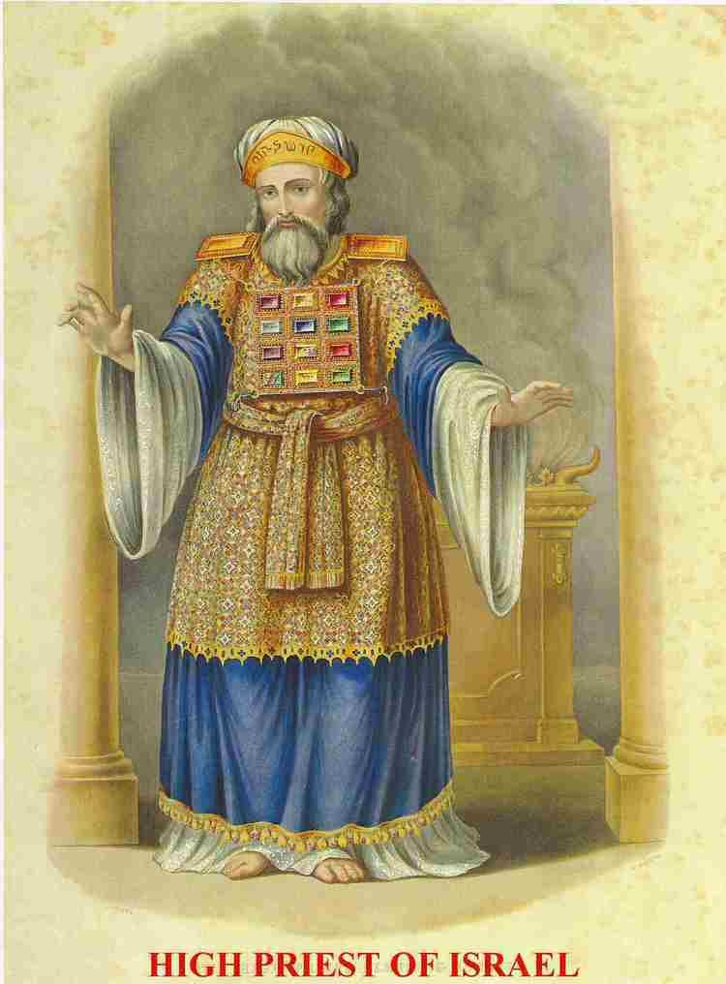
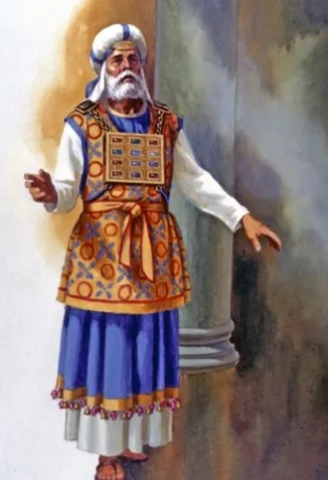
OLDER SON
YOUNGER SON

Slide 8
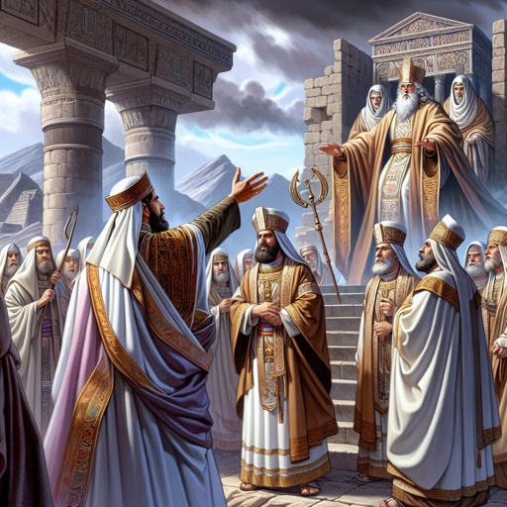
There was now Solomon as KING and Zadok as PRIEST — both men types of Christ, the king-priest.
"For thus saith Yahweh; David shall never want a man to sit upon the throne of the house of Israel; neither shall the priests the Levites want a man before me to offer burnt offerings, and to kindle meal offerings and to do sacrifice continually" (Jer. 33:17-18).
Abiathar was the 11th priest from Aaron (his name means father of abundance) and Zadok the 12th from Aaron (Zadok = righteous or just one, and is typical of Christ, "the Just One" (Acts 3:14; 7:52)
Notes:
There was now Solomon as KING and Zadok as PRIEST — both men types of Christ, the king-priest.
"For thus saith Yahweh; David shall never want a man to sit upon the throne of the house of Israel; neither shall the priests the Levites want a man before me to offer burnt offerings, and to kindle meal offerings and to do sacrifice continually" (Jer. 33:17-18).
Abiathar was the 11th priest from Aaron (his name means father of abundance) and Zadok the 12th from Aaron (Zadok = righteous or just one, and is typical of Christ, "the Just One" (Acts 3:14; 7:52).
It is now the prophet Ezekiel who continues the story for us in Chapter 40:45-46.
Here, two orders of priest are mentioned in the temple of the age to come.
There are those who have "charge of the house" (v. 45) similar to the Levites in the Mosaic service, and those who have "charge of the altar; these are the sons of Zadok" (v. 46).
Now "We have an altar whereof they have no right to eat that serve the tabernacle" (Heb. 13:10). The sons of Zadok represent then those who are "Israelites indeed,"

Slide 9
The prophet Ezekiel who continues the story for us in Chp. 40:45-46
Here, TWO orders of priest are mentioned in the Temple of the age to come!
There are those who have "charge of the house" (v. 45) similar to the Levites in the Mosaic service, and…
those who have "charge of the altar; these are the sons of Zadok" (v. 46)
Now "We have an altar whereof they have no right to eat that serve the tabernacle" (Heb. 13:10)
Notes:
There was now Solomon as KING and Zadok as PRIEST — both men types of Christ, the king-priest.
"For thus saith Yahweh; David shall never want a man to sit upon the throne of the house of Israel; neither shall the priests the Levites want a man before me to offer burnt offerings, and to kindle meal offerings and to do sacrifice continually" (Jer. 33:17-18).
Abiathar was the 11th priest from Aaron (his name means father of abundance) and Zadok the 12th from Aaron (Zadok = righteous or just one, and is typical of Christ, "the Just One" (Acts 3:14; 7:52).
It is now the prophet Ezekiel who continues the story for us in Chapter 40:45-46.
Here, two orders of priest are mentioned in the temple of the age to come.
There are those who have "charge of the house" (v. 45) similar to the Levites in the Mosaic service, and those who have "charge of the altar; these are the sons of Zadok" (v. 46).
Now "We have an altar whereof they have no right to eat that serve the tabernacle" (Heb. 13:10). The sons of Zadok represent then those who are "Israelites indeed,"

Slide 10
The sons of Zadok represent those who are "Israelites indeed, "circumcised in heart", the saints who will minister as Priests at the altar of Christ.
Ezekiel, chp. 44 deals with the tasks of the mortal order of Levites who serve the people in the future age.
He also mentions "the sons of Zadok, that kept the charge of my sanctuary ... they shall come near to me, and they shall stand before me .. . shall come near to my table . ." (vv. 15-16).
These must be the saints made immortal, for no mortal can perform these tasks.

Slide 11
How appropriately they are described as "sons of Zadok“
An order of firstborns who have replaced the faithless Aaronic priesthood.
Priests of the Temple replacing the tent of temporary dwelling, as Zadok and his sons in the days of David's other son, Solomon.
These are not literal sons of Zadok, just as the seed of Abraham are not literal children by flesh descent, but those who are of the faith of their father Abraham (Rom. 4:11-16; John 8:33-40).

Slide 12
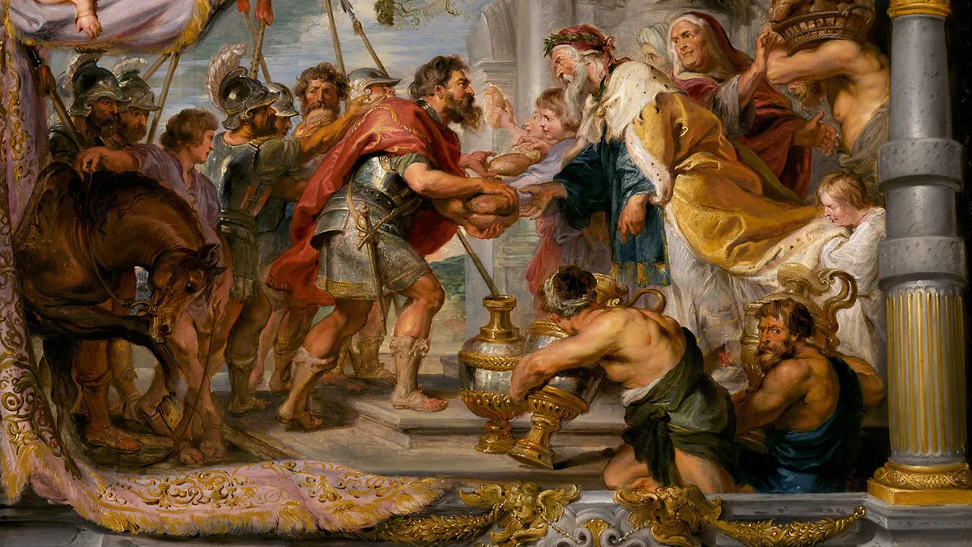
CLASS 5
THOU ART A PRIEST FOREVER AFTER THE ORDER OF MELCHIZEDEK
Psalm 110

Slide 13
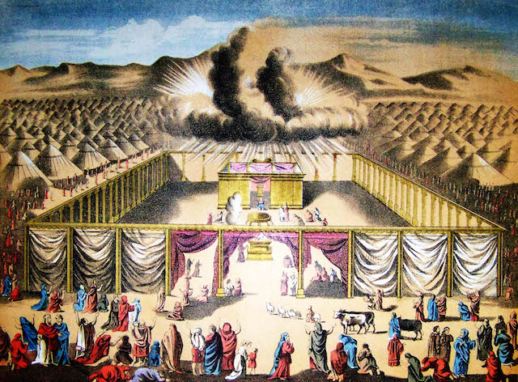
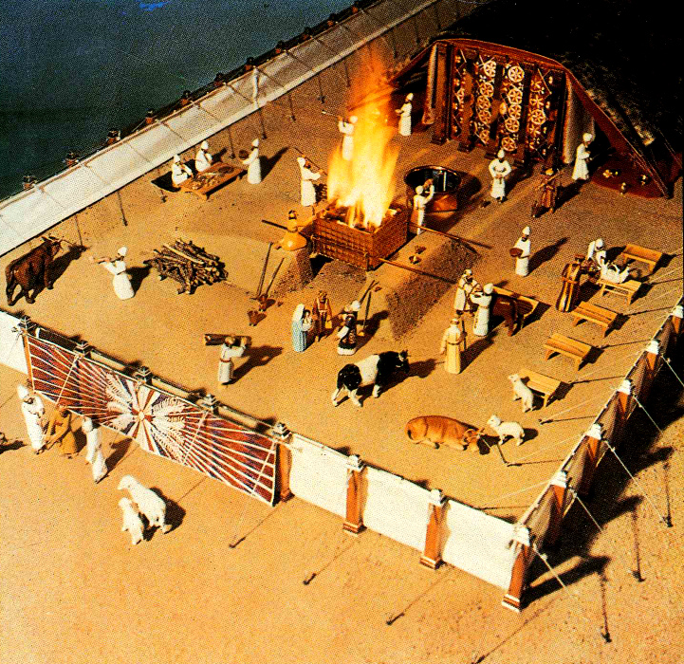
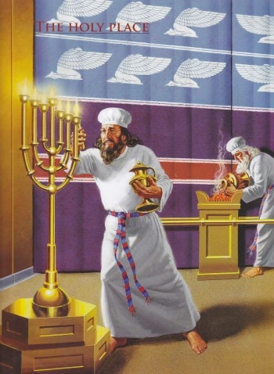
Moses' tabernacle was but a "shadow of heavenly things.. . not made with hands, which are the figures of the true; but into heaven itself, now to appear in the presence of God for us" (Heb. 9:24).
It is Paul, once the student and ardent supporter of the law, who has been foremost in putting the law in its proper perspective.
He wrote, "for the law made nothing perfect, but the bringing in of a better hope did; by the which we draw nigh unto God" (Heb. 7:19).
In bringing in this better hope our Lord "did not come to destroy, but to fulfil" the law (Matt. 5:17).
It was a "schoolmaster to bring us unto Christ" (Gal. 3:24), "that we might be justified by faith".

Slide 14
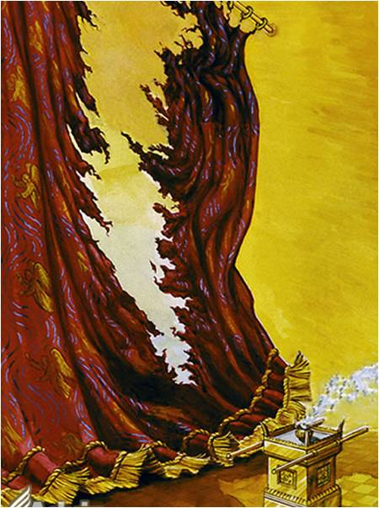
At his death the veil of the temple was rent (Matt. 27:51) signifying that the age of the law had passed, that access to God (the Most Holy) was now open through one who had fulfilled law.
Yes, the law has passed, but "Jesus Christ, is the same yesterday, and today, and forever" (Heb. 13:8).
We, in him, are the temple of God, as said our apostle, "for ye are the temple of the living God, as God hath said, I will dwell in them, and walk in them; and I will be their God and they shall be my people" (2 Cor. 6:16; 1 Cor. 3:16).
May "Holiness to Yahweh" provide the keynote to our worship in this dispensation of grace "till he come".

Slide 15
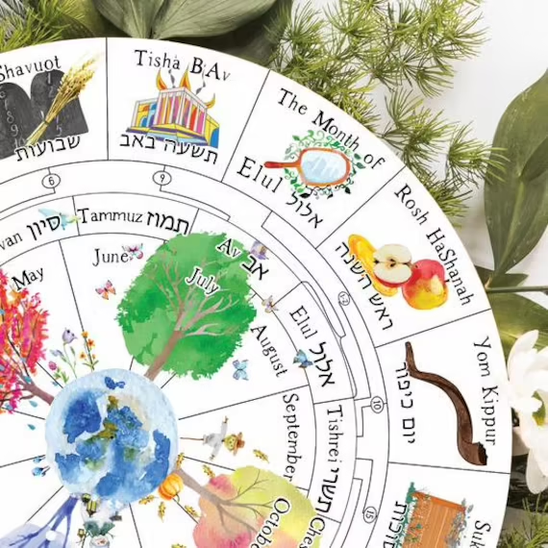
The Inadequacy Of The Sacrifices
Each year as the time for the Day of Atonement drew near one would be constrained to ask, "Why another Day of Atonement? What was wrong with the day last year?"
In the first place perfection was not possible by the Levitical priesthood
  "for the law made nothing perfect" (Heb. 7:11,18),
  and in the second, "it is not possible that the blood of bulls and of goats should take away sins" (Heb. 10:4), but in them "is a remembrance again made of sins every year" (v. 3).
The animals, though physically without blemish, were not morally perfect.
They were symbols only, lacking the essential identification with sinful flesh which could only be provided in a human sacrifice.
God cannot be bought off with an artificial substitute.
Notes:
Each year as the time for the Day of Atonement drew near one would be constrained to ask, "Why another Day of Atonement? What was wrong with the day last year?"
In the first place perfection was not possible by the Levitical priesthood
"for the law made nothing perfect" (Heb. 7:11,18),
and in the second, "it is not possible that the blood of bulls and of goats should take away sins" (Heb. 10:4), but in them "is a remembrance again made of sins every year" (v. 3).
The animals, though physically without blemish, were not morally perfect.
They were symbols only, lacking the essential identification with sinful flesh which could only be provided in a human sacrifice.
God cannot be fobbed off with an artificial substitute.

Slide 16
Heb. 7:1
First thing to be noted about Melchisedec is the fact that he must have been a mortal man, because Paul defines a priest as he that is "taken from among men" (5v1).
There are only three passages of Scripture which deal with this remarkable man, and they are separated from each other by separate periods of a thousand years.
The only historical account of Melchisedec we have is that contained in…
Gen. l4v18-20, and even here the three verses read as though they are injected into the narrative, so breaking the sequence of thought
A thousand years subsequent to this man's appearance, David speaks of him in Psa.110v4, to show that Messiah would be a priest after his order
Here in Heb.7, Paul expounds upon the two other passages making every application possible in setting before these Hebrews, the "order" of this remarkable priesthood

Slide 17
Abram Blessed By Melchizedek
Gen 14:18 And Melchizedek king of Salem brought forth bread and wine: and he was the priest of the most high God.
19 And he blessed him, and said, Blessed be Abram of the most high God, possessor of heaven and earth:
20 And blessed be the most high God, which hath delivered thine enemies into thy hand. And he gave him tithes of all.

Slide 18
Heb. 7 - THE ORDER OF MELCHISEDEC
v1-3. Statement of his "order" of priesthood.
v4-10. Inherent greatness of Melchisedec above other priests.
v11-19. Levitical priesthood superceded.
v20-22. Christ appointed by oath.
v23-25. His unchangeable priesthood. v26-28.
Christ's fitness as high priest.

Slide 19
v2. "first being by interpretation King of righteousness"
This commences his exposition of the "order."
He expounds the meaning of his name, "Melchi-sedec" - "king - righteousness."
When we say this commences his exposition of the "order," in actual fact this is the ONE AND ONLY qualification for this priesthood, the reign of righteousness!
Jesus Christ as the manifestation of Yahweh, is the "Lord our righteousness“ (Jer.23v6).
By virtue of the assimilation of the Divine ideas, and the development of the Divine characteristics of his Father, our Lord enabled righteousness to reign in his life and having become the monarch of righteousness, he is able to bring others, through the grace of God, into his dominion (Rom.5v21).

Slide 20
7:2 - "after that also King of Salem"
The Apostle shows that righteousness must precede peace.
This is a Divine principle (see Isa.32v17, Luke 2v14, James 3v17).
There is no peace to the wicked (Ez.13v10-16, Isa.48v22).
Jesus Christ is our righteousness (Jer.23v6, 1 Cor. lv30) and if by identification with him, he becomes "righteousness" to us, he then becomes also our "peace" (Eph. 2v14, John 14v27, John 16v33).
The combination of the principles of righteousness and peace are those which give us access into the Divine presence through our high priest (Psa.85v10, Rom.5v1).

Slide 21
v3. "Without father, without mother, without descent"
- The R.V. has for "descent," "genealogy." Under the Law, the priesthood was restricted to Levi, and of that tribe, narrowed down to the family of Aaron himself (Num.18v1-2).
It was subject to marriage laws (Lev.21v13-14), hence we have reference here to the "mother."
Before anybody could undertake the office according to the "order" of Aaron, he had of a necessity to prove his genealogy from that man (Ezra 2v61-63), but with Melchisedec no genealogy could be established, for there is no mention of his mother and father, though doubtless he would have had them.
So consequently, his "order can include king-priests "out of every nation, kindred, tongue and people" without exception (Rev.5v9-10).

Slide 22
v3. "Without father, without mother, without descent"
If only the Israelites had realized, this was the import of the promises which God made to them at Mount Sinai, "ye shall be unto me a KINGDOM OF PRIESTS" (Ex.19v6).
Now while the Law was in operation, this promise could never find its full realization, for by its legislation, not only was the priesthood confined to one particular family, but also the dual offices of kingship and priesthood were carefully separated between the tribes of Judah and Levi.
However, under the terms of the New Covenant with its one qualification for priesthood of "righteousness," it can be said of those who have been baptized into the "righteousness of God," as exemplified in the life, death, and resurrection of Christ, that they are indeed a "royal priesthood" (I Pet.2v9).
This office they will exercise in the age when jurisdiction will be given unto them, and for which this present mortal probation is a necessary training ground.

Slide 23
V3 - "beginning of days, nor end of life"
- The Levites who performed the service of the Tabernacle commenced that service at the age of 30 (Num.4v3) and retired from the work when they had reached the age of 50 (Num.8v25).
The age limit varied a little in the days of David (I Chron.23v24-27).
As for the priesthood itself, no age limit determined its commencement or end, but of course, death was the determining factor (v23).
In this respect the contrast is made with Melchisedec's order, for concerning that man no record is made of his death, so he stands in the Word of God as an eternal priest.

Slide 24
V3 - "made like unto the Son of God"
- The Greek word for "made" means "to assimilate closely," "to resemble."
The power of the Holy Spirit when it painted the portrait of Melchisedec in the record of Scripture, did so with the deliberate intent of reflecting forward to a greater priesthood than that which the Law of Moses offered.
Jesus Christ was the fulfilment of this prophetic picture, for "after the similitude of Melchisedec there ariseth another priest" (v15).
Here is another outstanding example of the way in which it can be said concerning God's Son, "by whom also he made the worlds" (1v2).
The ages were definitely supervised, all leading up to the manifestation of the Son of God at the fulness of time (I Pet.1v20, Gal.4v4).

Slide 25
V4 - "tenth of the spoils"
Gk. "akrothinion," the only occurrence of this Greek word, literally "chief spoils," or "top of the heap," understood by Vine as "pick of the spoil."
The payment of tithes was obviously calculated to impress the giver of the superiority of the receiver, for the tithe, or tenth part is looked upon in Scriptural terminology as representative of the whole, hence the giving of it was acknowledgement that he who received the tenth, virtually was the owner of all (Psa.24v1).

Slide 26
Heb_8:1 Now of the things which we have spoken this is the sum: We have such an high priest, who is set on the right hand of the throne of the Majesty in the heavens;
Heb 8:2 A minister of the sanctuary, and of the true tabernacle, which the Lord pitched, and not man.
Heb_8:3 For every high priest is ordained to offer gifts and sacrifices: wherefore it is of necessity that this man have somewhat also to offer.
Heb_8:4 For if he were on earth, he should not be a priest, seeing that there are priests that offer gifts according to the law:

Slide 27
Heb. 8v3. "For every high priest" - Messiah must completely fulfil the shadow institution of the Law, and to do this he must "of necessity" offer for himself as well as for the people (compare 5v3).
"have somewhat also to offer" - An indefinite pronoun, "some or any person or object."
This is the first of three great questions which the Apostle will now answer
These questions naturally arise out of the fact of his "different" order of priesthood (7v11).
If his order is different, then three questions naturally arise :
1. What will he offer? (the question asked here and fully answered in chapters 9 and 10).
2. Where will he officiate? (Paul already indicates the place of administration: Heaven itself).
3. Why does he make this different sacrifice? (Answered from v6-13, again 10v16-18).
The "somewhat also to offer," is in effect "his own blood" which he will offer for the sins of the world.

Slide 28
v4. "For if he were on earth, he should not be a priest" - The reasons for this are two-fold.
Dealing first with the second of these reasons, we note the Apostle says that the earthly sanctuary had a divine order of priesthood according to the Law of which Christ was not a member.
This to all the Hebrews would be palpably obvious.
However, the first reason is by far the most important consideration.
Christ's ministry can be conducted nowhere else, but in Heaven (v1).
His priesthood being "different," the difference lay in its eternal aspect as contrasted to the temporal (7v23-24).

Slide 29
His priesthood began in Heaven. Of that fact the Apostle is insistent (4v14, 5v9-10, 6v20, 9v24, 10v20).
His entry into Heaven itself was necessary to obtain eternal redemption (9v12).
Even the shadow institution of the Law clearly outlined this principle, namely to bring sacrifice into the Divine presence as the basis of its acceptance.
The killing of a sacrifice in itself never availed to remove sins.
This necessitated the blood being carried to make contact with the altar to have any atoning value at all, (Lev.17v11).
The individual offerer killed the animal, but could do no more than that.
It was the priest alone who was ordained to bring the blood to the altar (Lev. 4v4-5).

Slide 30
On the Day of Atonement…
….expiation was not granted until the blood was brought into the Most Holy (Lev. 16v17), all of which clearly points to the truth, that until Christ as our High Priest had entered into the presence of God, he could not have represented us to the Father in the eternal sense as foreshadowed by the blood of the sacrifices under the Law of Moses.

Slide 31
We as the “Sons of Zadok (righteousness)” in the Kingdom will continue to work out the principles of divine righteousness that are revealed in this amazing, eternal priesthood.

Slide 32
Psalm 110
Psa 110:1 The LORD said unto my Lord, Sit thou at my right hand, until I make thine enemies thy footstool.
2 The LORD shall send the rod of thy strength out of Zion: rule thou in the midst of thine enemies.
3 Thy people shall be willing in the day of thy power, in the beauties of holiness from the womb of the morning: thou hast the dew of thy youth.
4 The LORD hath sworn, and will not repent, Thou art a priest for ever after the order of Melchizedek.
5 The Lord at thy right hand shall strike through kings in the day of his wrath.
6 He shall judge among the heathen, he shall fill the places with the dead bodies; he shall wound the heads over many countries.
7 He shall drink of the brook in the way: therefore shall he lift up the head.

Slide 33
Psalm 110
VS 1 - Christ at Yahweh's right hand till his enemies of Jew and Gentile are crushed.
VS 2 - "Rod" — the "Branch" extended from midst of Israel "thine enemies". Here is both royal sceptre and Aaron's rod that budded representing God's selection of king and priest.
VS 3 - "Thy people" — the saints shall be freewill offerings (Judges 5:2,9). Freewill offerings were to be unblemished but if anything was lacking it was still acceptable (Lev. 22:17-23). Though we are not perfect, our offerings are acceptable if freely made and unblemished.
"Beauties of holiness" — "in holy attire" (Perowne) as priests.
"Womb of the morning" — saints at resurrection are Yahweh's firstboms set into the priesthood at the morning of Israel's new millennial day.
"Dew" — a beautiful symbol of resurrection at the sun's rising (Isa. 26:19) when the hidden manna (Rev. 2:17) is revealed.
"Youth" — lit. "young man," being forever in full prime of life in immortality.
Notes:
VS 1 - Christ at Yahweh's right hand till his enemies of Jew and Gentile are crushed.
VS 2 - "Rod" — the "Branch" extended from midst of Israel "thine enemies". Here is both royal sceptre and Aaron's rod that budded representing God's selection of king and priest.
VS 3 - "Thy people" — the saints shall be freewill offerings (Judges 5:2,9-Jdg 5:2 Praise ye the LORD for the avenging of Israel, when the people willingly offered themselves.” v9- “My heart is toward the governors of Israel, that offered themselves willingly among the people. Bless ye the LORD.”). Freewill offerings were to be unblemished but if anything was lacking it was still acceptable (Lev. 22:17-23). Though we are not perfect, our offerings are acceptable if freely made and unblemished.
"Beauties of holiness" — "in holy attire" (Perowne) as priests.
"Womb of the morning" — saints at resurrection are Yahweh's firstboms set into the priesthood at the morning of Israel's new millennial day.
"Dew" — a beautiful symbol of resurrection at the sun's rising (Isa. 26:19) when the hidden manna (Rev. 2:17) is revealed.
"Youth" — lit. "young man," being forever in full prime of life in immortality.

Slide 34
Psalm 110
VS 4 - "Yahweh hath sworn" — hence an unchangeable priesthood (Heb. 7:21).
"for ever" — Heb. 'Olahm' — "for the age". "For this man, because he continueth ever hath an unchangeable priesthood" (Heb. 7:24), i.e. not transferable, it will not pass to another. We can have full confidence in him.
"Melchizedek" — i.e. Melchi (king) Zedek or Zadok (righteous) (Heb. 7:2). An order of firstboms —"To the general assembly and ecclesia of the firstborns, which are written in heaven" (Heb. 12:23). This is in fulfilment of the prophecy through Noah of Shem (who is Melchizedek), "Blessed be Yahweh Elohim of Shem . . God shall enlarge (make room for) Japheth and he shall dwell in the tents of Shem". That is Shem (Jew) and Japheth (Gentile) were to be heirs of the promise and not Jew only (Gen. 9:26).

Slide 35
Psalm 110
VS 5 - "The Lord" — Yahweh (changed by Sopherim).
"at thy right hand" — formerly Christ sat at Yahweh's right hand (v.1), but now Yahweh stands at his for support (cf. Psa. 109:31). "For our sakes he became poor" (2 Cor. 8:9). "Hath not God chosen the poor of this world, rich in faith and heirs of the kingdom which he hath promised to them that love him" (James 2:5).
"wrath" — pent up anger.
VS 6 - "heathen" — nations.
"heads" — Heb. sing. "Rosh" or Russia who leads the confederacy of nations, particularly the European nations, whose bodies shall fill the land.

Slide 36
Psalm 110
VS 7 - "Drink of the brook" — Heb. "torrent". An echo of David's grief (1 Sam. 30:2-4; 9-10), typical of the grief and suffering of Christ.
"In his suffering for iniquity, I will chasten him with the rod of men, and with the stripes due to the children of men" (2 Sam. 7:14).
"Lift up the head" — for the joy set before him through the resurrection (Heb. 12:2-3; Luke 21:28).
We conclude with the Psalm of the Temple of the age to come, where Christ and the saints will minister before Yahweh.

Slide 37
PSALM 122
Vs 2 - "Gates" — give entrance to the courts.
Vs 3 - "compact together" — i.e. united as one (Eph. 4:16).
Vs 4 - "tribes" — Scion — Israel regrafted in (Rom. 11:23-24). "the testimony" — i.e. the ark of witness — Christ.
Vs 5 - "set" — to sin down, to marry — as Christ now marries his bride. - "Thrones of Judgment" — thrones of king-priests represented by the breastplate of judgment (Exod. 28:30).
"The house of David" — who brought the ark to Zion and ministered as a king-priest.
Vs 6 - "Jerusalem" — city of peace. "prosper" — Heb. shalom, peace.

Slide 38
PSALM 122
Vs 7 - "Peace" — Heb. shalom. "Walls" — bulwarks or outer buildings. "prosperity" — security, safety. "Palaces" — towers or elevated courts. "the highest and strongest," Gesenius.
In this verse we have the outer courts and the circular cellae therefore of Ezekiel's vision. *
Vs 8 - "Brethren and Companions" — Israel and the saints.
The whole Psalm is in harmony revolving around v. 5 — the Melchizedek order of kings and priests of righteousness who bring peace to Jerusalem. Verse 1 couples with v. 9, v. 2 with v. 8, v. 3 with v. 7 and v. 4 with v. 6.
May it be our Heavenly Father's good pleasure to give us the Kingdom (Luke 12:32).
* See Temple of Ezekiels Prophecy by Henry Sulley

Slide 39
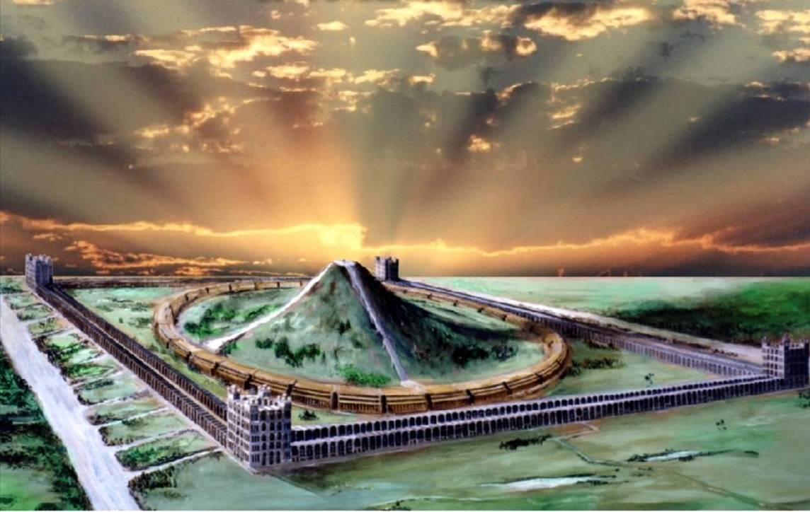
Isa. 16:5 – “And in mercy shall the throne be established: and he shall sit upon it in truth in the tabernacle of David, judging, and seeking judgment, and hasting righteousness.”
And it all begins in Gen. 14!
Cameos of the Kingdom

Slide 40
Addendum

Slide 41
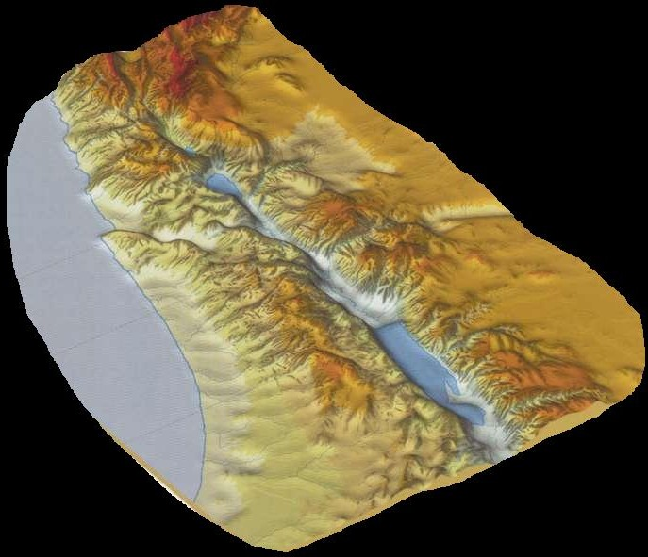
Abram defeats a northern confederacy
Genesis 14
Dan =
Judgement
Dan
Abraham meets Melchizedek – King-priest of Salem (Ps. 76:2) in the Valley of Shaveh (bread & wine)
Valleys
Salem
Hebron
Armageddon precedes the setting up
of the Kingdom of God
Chedorlaomer = “A handful of sheaves”
Northern confederacy takes Lot and his family into captivity – Zech. 14:2

Slide 42
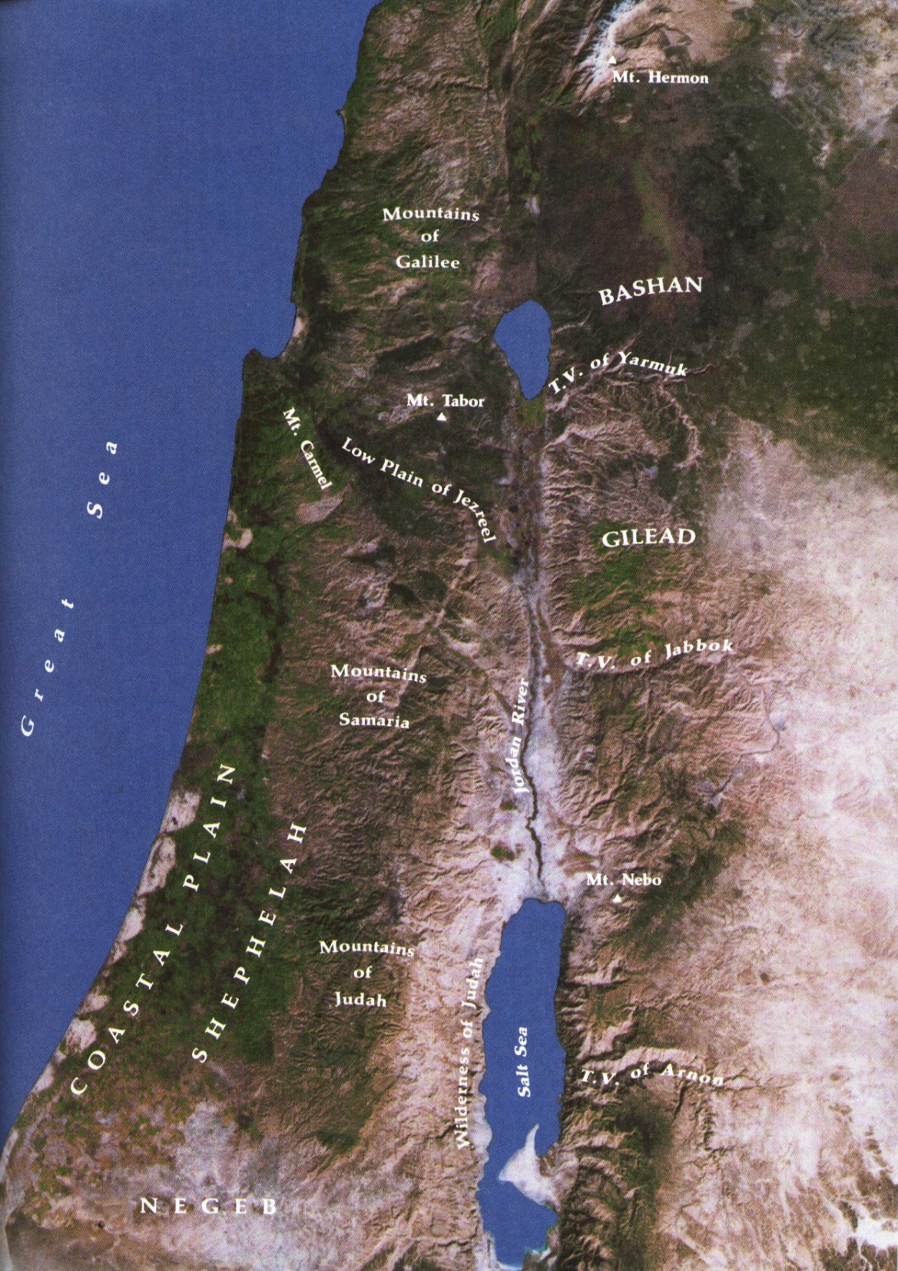
Armageddon
Gen. 14
Dan
Arema – a heap of sheaves = confederacy of Chedorlaomer - “a handful of sheaves”.
Gai – valley. Conflict begins in the vale of Siddim – Roth. - “the valley of the open fields”. Victory celebrated in “the valley of the king” v.17.
Dan – judgement – v.14. See Judges 18.
Cp. Gen. 14:13 and Rev. 16:16.
Salem
Hebron
Sodom

Slide 43
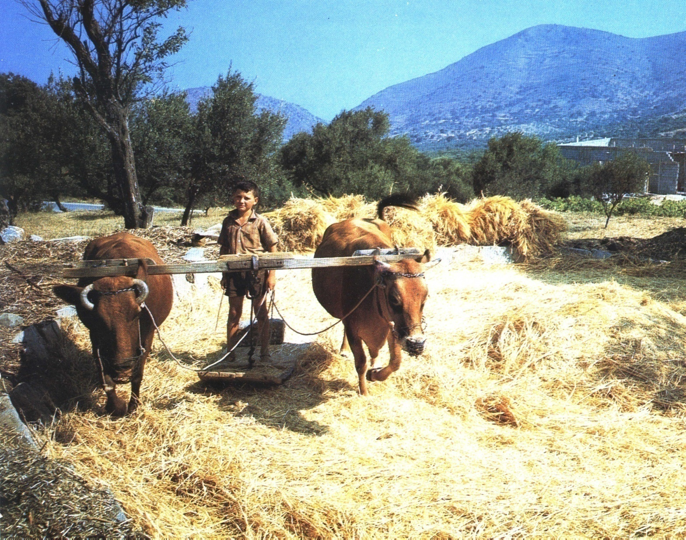
Revelation 16:16 – Armageddon
“And he gathered them together into a place called in the Hebrew tongue Armageddon.”
Aremah – a heap of sheaves
Gai – in a valley
Dan – for judgement
First occurrence of “Hebrew”
is in Gen. 14:13

Slide 44
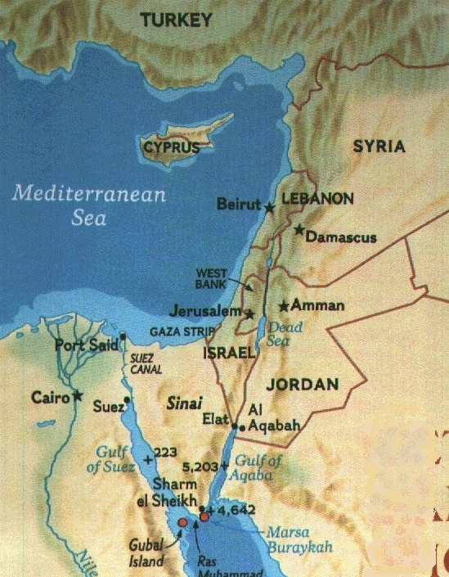
A place in the Hebrew tongue
The Middle East
Hebrew has been called the speech of Canaan, and Judaic, after the kingdom of Judah.
Modern Hebrew, Ivrit, was declared the official language of Israel in 1948.
Israel – the only land identified with Hebrew

Slide 45
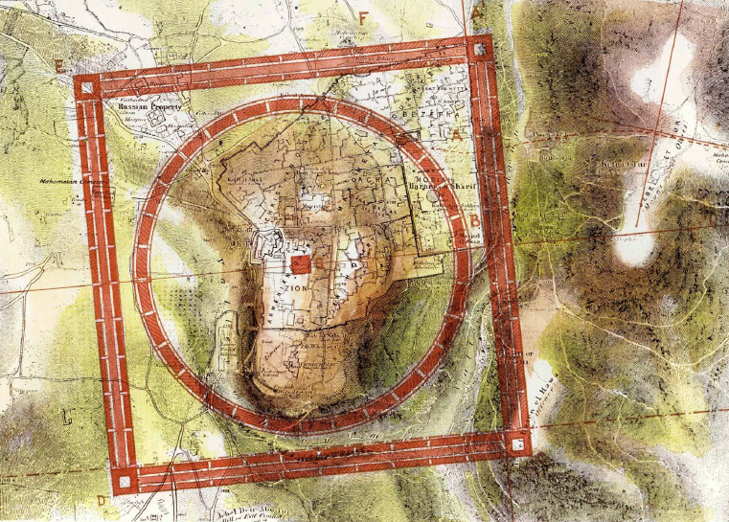
So where is the valley of Shaveh in relation to future events?
Shaveh - shâvâh - to agree with, be or become like, level, resemble.
Melchizedek “made like unto the Son of God...” - Heb. 7:3
This is the valley of Jehoshaphat or the Kidron Valley – called “the king’s dale” in Gen. 14:17
Abraham met Melchizedek here and was given bread and wine by him

Slide 46
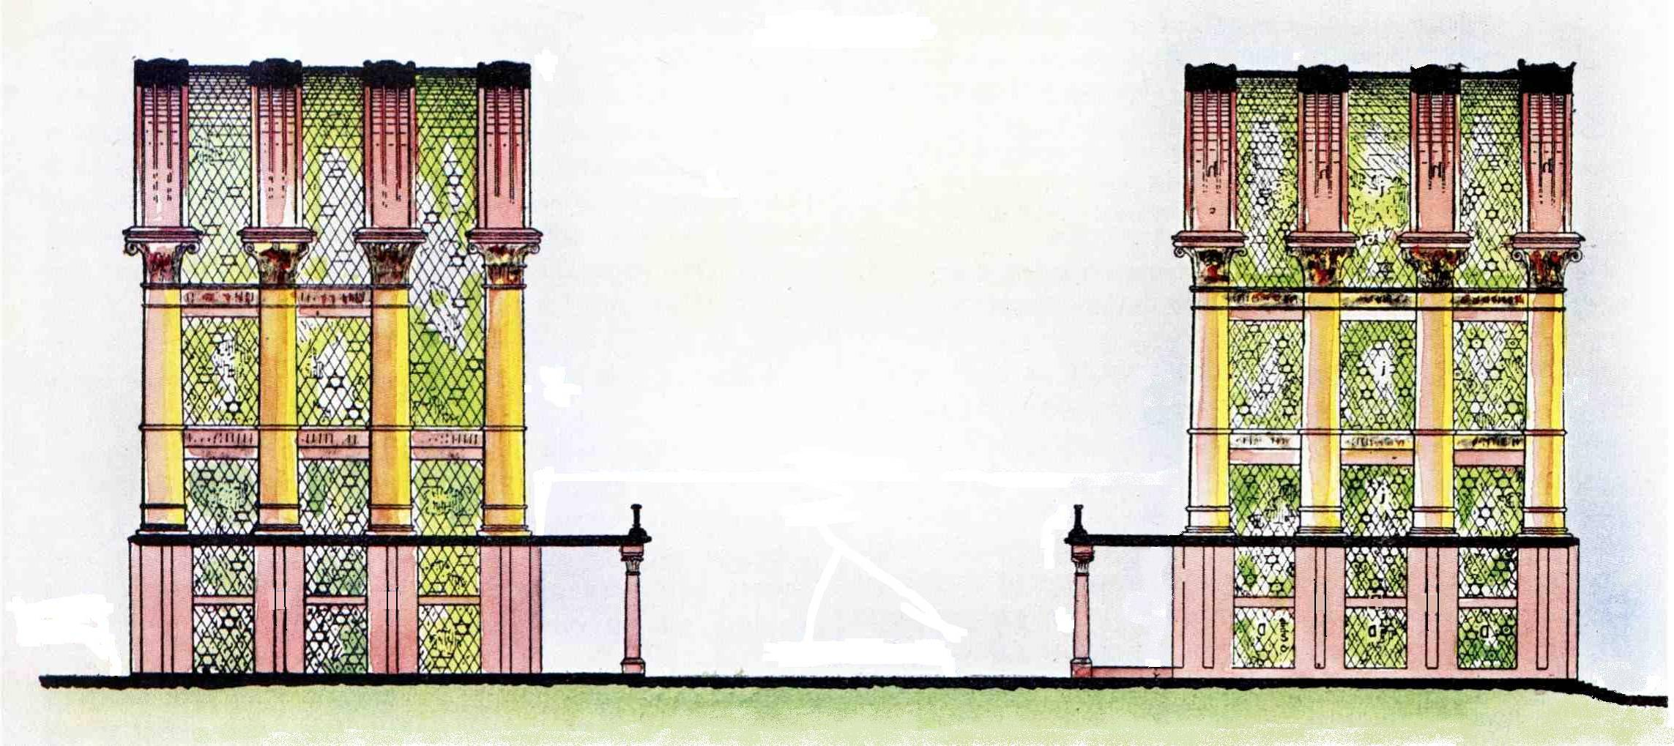
The Prince’s Court
The eastern court with its two rows of cellae (halls with 3 levels) is the palace of the Prince where he resides in the House. Here also he dines with the saints in the upper galleries of the outer range (Luke 12:35-40; 22:18).
The Prince resides here
The Prince worships here
Sacrifices for the Prince prepared here
Gates shut
Mt. Zion
East

Slide 47
In literal fact this is so, for as representing the offerer, he certainly did die on their behalf in the locality of Jerusalem, but even so the presentation of the positive aspect of his sacrifice took place when "by his own blood he entered in once into the Holy Place" (9v12).
Yet even in his priestly work in respect to his own offering, there is a marked difference which the Apostle is careful to note, for as he says, he offered himself without spot to God, "through an eternal spirit" (9v14), (not "the" eternal spirit as in AV), a term showing the basis upon which he operated.
It indicated the intrinsic value of his offering in respect to the moral life he lived, which was related to the eternal realm of Heaven itself (John 1v18, 3v18).

Slide 48
Ham, the father of Canaan, saw the nakedness of his father. Because of this sin of incest (Lev. 18:6-8) Canaan was cursed.
Of Shem, however, Noah said, "blessed be Yahweh Elohim of Shem" (Gen. 9:26).
Yahweh was known by Shem; Shem was the mediator for the family.
Approximately 370 years later Abram returning from the slaughter of the kings is met by Melchizedek, king of Salem and priest of the Most High God.
This Melchizedek was a spiritual elder to Abram, for not only did he bless Abram but Abram gave him tithes of all (Heb. 7:6-10).
Brother Thomas suggests that this is Shem who was then the eldest member of the family of Noah.*
* Elpis Israel p. 312.

Slide 49
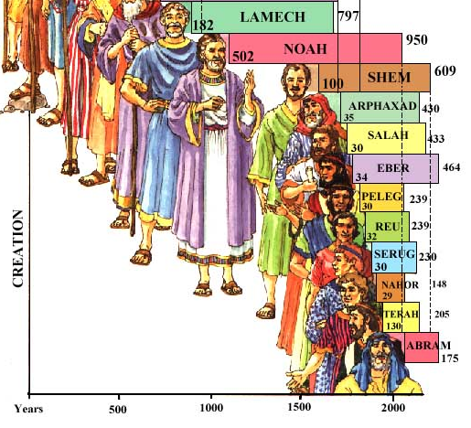
Noah
Shem (Melchizedek?)
Gen 10:25 And unto Eber were born two sons: the name of one was Peleg; for in his days was the earth divided; and his brother's name was Joktan.
CREATION
Abram
Genesis 10-22

Slide 50
For this brief reference, however, David in the spirit of prophecy is able to say, "Yahweh hath sworn and will not repent, Thou art a high priest for ever after the order of Melchizedek" (Psa. 110:4).
Psa 110:1 A Psalm of David. The LORD said unto my Lord, Sit thou at my right hand, until I make thine enemies thy footstool.
2 The LORD shall send the rod of thy strength out of Zion: rule thou in the midst of thine enemies.
3 Thy people shall be willing in the day of thy power, in the beauties of holiness from the womb of the morning: thou hast the dew of thy youth.
4 The LORD hath sworn, and will not repent, Thou art a priest for ever after the order of Melchizedek.
5 The Lord at thy right hand shall strike through kings in the day of his wrath.
6 He shall judge among the heathen, he shall fill the places with the dead bodies; he shall wound the heads over many countries.
7 He shall drink of the brook in the way: therefore shall he lift up the head.

Slide 51
The exposition of these two passages waited till the Apostle Paul's letter to the Hebrew believers who were still "zealous of the law" (Acts 21:20).
Christ is called to this order of priesthood by God, as Aaron had been to the Levitical priesthood (Heb. 5:4-5).
The Melchizedek priesthood depends not upon pedigree, but upon oath of God.
It is therefore "without father, without mother, without descent (Gk. pedigree) . . . abideth a priest continually" (Heb. 7:3).

Slide 52
Every member of this priesthood is immortal having "the power of an endless life" (v. 16) and therefore have "the surety of a better testament” an unchangeable priesthood.
Wherefore he is able to save them to the uttermost that come unto God by him seeing he ever liveth to make intercession for them" (vv. 24- 25 ).
Our High Priest, made such by oath, "is consecrated for evermore", and "is set on the right hand of the Majesty in the heavens" (Heb. 7:28; 8:1).

Slide 53
No Aaronic priest could make this boast. Hence before this Priest the Aaronic "decayeth and waxeth old and vanished away" (Heb. 8:13).
Our High Priest is "A minister of the sanctuary, and of the true tabernacle, which the lord pitched and not man" (Heb. 8:2).
Which sanctuary is the ecclesia of living God to which we, by grace, have been called (Eph. 2:19-22).

Slide 54
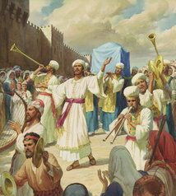
David as Priest
Now David, too, had in type, enacted the part of a priest though he was not of Levi but of Judah, "of which tribe Moses spake nothing concerning priesthood" (Heb. 7:14).
The record is in 2 Sam. 6 when the ark was brought to Zion. v. 14 says, "David was girded with a linen ephod", that is wearing the white, linen robe of a priest.
In vv. 17-18 it is recorded that David had pitched a second tabernacle for the ark (it is this system of David that is to be restored by Christ, Acts 15:16, not the Mosaic tabernacle) and "blessed the people" after offering burnt offerings and peace offerings.
Notes:
Now David, too, had in type, enacted the part of a priest though he was not of Levi but of Judah, "of which tribe Moses spake nothing concerning priesthood" (Heb. 7:14).
The record is in 2 Sam. 6 when the ark was brought to Zion. v. 14 says, "David was girded with a linen ephod", that is wearing the robe of a priest.
(Note: this would not be the garments for glory and for beauty of the high priest, but the white robe of Heb. "bad“ linen as was worn on the Day of Atonement).

Slide 55
David as Priest
In vv. 17-18 it is recorded that David had pitched a second tabernacle for the ark (it is this system of David that is to be restored by Christ, Acts 15:16, not the Mosaic tabernacle) and "blessed the people" after offering burnt offerings and peace offerings.
This was the work of the priest; the blessing probably being the words of Num. 6:22-27.
Num 6:22 And the LORD spake unto Moses, saying,
23 Speak unto Aaron and unto his sons, saying, On this wise ye shall bless the children of Israel, saying unto them,
24 The LORD bless thee, and keep thee:
25 The LORD make his face shine upon thee, and be gracious unto thee:
26 The LORD lift up his countenance upon thee, and give thee peace.
27 And they shall put my name upon the children of Israel; and I will bless them.

Slide 56
David, as Melchizedek before him (Gen. 14:18), brought forth bread and wine for the people (v. 19).
Further, when David receives through Nathan the promise of a greater son, we read "Then went King David in, and sat before Yahweh, and he said, "Who am I, O, Lord Yahweh? and what is my house, that thou hast brought me hitherto?" (2 Sam. 7:18).
What was David doing in the tabernacle which was not lawful for him to enter under the Mosaic law? And sitting! Priests never sat before Yahweh, they were only permitted to stand.
Obviously David is not only enacting the part of a priest, but that of a priest of a higher order than that of Aaron for his is a priest-king.

Slide 57
Our high priest is the anti-type, one who ascended to heaven and sat down at the right hand of God (Acts 2:33-34).
David writes of his experience as prophetic of his greater son in Psa. 110 which is quoted by Paul,
"And every priest standeth daily ministering and offering oftentimes the same sacrifices, which can never take away sins: But this man, after he had offered one sacrifice for sins for ever, sat down on the right hand of God; . . . For by one offering he hath perfected for ever them that are sanctified (Heb. 10:11-14).
There was a change of priesthood foreshadowed in David's action which indicated the future setting aside of the law.

Slide 58
The law itself foreshadowed this change in the law of the red heifer (Num. 19), for this ceremony required Eliezer, Aaron's eldest son, to officiate and not Aaron himself (vv. 3-4).
Numbers 20 records the change of priesthood from Aaron to Eliezer and the subsequent death of Aaron (vv. 23-29).
Now the name Eliezer, meaning God (El) is my helper, becomes Lazarus in the New Testament.

Slide 59
The record of the raising of Lazarus in John 11 gives a parable of the resurrection of Christ and his elevation to the priesthood over Caiaphas. Compare the parallels:—
v.3 Lazarus is loved but is sick
v.4 for the glory of God
v. 16 Disciples to die with him
v. 25 "I am the resurrection and the life"
v. 27 Martha's conviction that Jesus is the Christ the son of God (Psa. 2:2-7).
V. 30 outside the town
w. 34-36 Jesus wept
v. 37 He healed the sick
v. 38 The grave was a cave
v. 40 Glory of God shown in Lazarus' resurrection
Jesus the beloved Son (Matt. 17:5), partaker of weakness of sinful flesh (Rom. 8:3).
Christ manifested Yahweh's glory (John 17:4). Saints to die with Christ (Rom. 6:3-8)
i.e. Lazarus, God is my helper
"without the camp" (Heb. 13:13)
Eliezer — El is my helper. On cross Christ cried, "My El, My El why hast thou forsaken me" (Psa. 22:1; Matt. 27:66).
"He saved others, himself he cannot save" (Matt. 27:42).
As Christ's own tomb (Matt. 27:60)
Angels in glory raised the lord (Matt. 28:3) and God was glorified (John 13:32).
It was because of this miraculous resurrection that Caiaphas is caused to declare "that it is expedient for us, that one man should die for the people. and that the whole nation perish not" (John 11:50).

Slide 60
It seems that it had become customary for a company of the priests to chant the words, "for thou art a priest forever after the order of Melchizedek" (Psa. 110:4) during the temple services over the Passover.
While Caiaphas was interviewing Christ, as recorded in Matt. 26:59-60, these words would be heard.
It is interesting to see the use of scripture during the interview. "Jesus held his peace" (v. 63) — "as a sheep before her shearers is dumb so he openeth not his mouth" (Isa. 53:7).
"I adjure thee by the living God (putting Christ under oath) that thou tell us whether thou be the Christ (Psa. 2:2) the son of God (Psa. 2:7).
Jesus said unto him, Thou hast said: nevertheless I say unto you, Hereafter shall ye see the son of Man (Psa. 8:6, "What is man that thou art mindful of him? and the son of man that thou visitest him? For thou hast made him a little lower than the angels and crownest him with glory an honour") sitting on the right hand of power (Psa. 110:1) and coming in the clouds of heaven (Dan. 7:13-14 "I saw in the night visions, and behold, one like the Son of Man came with the clouds of heaven, and came to the ancient of days, and they brought him near before him. And there was given him dominion, and glory, and a kingdom"). And the high priest rent his clothes. (an act forbidden by law Lev. 21:10) saying, He hath spoken blasphemy" (v. 65).
The Aaronic High Priest by his action showed himself unfit for office. His righteousness was indeed "as filthy rags".
The priest of the Melchizedek order would soon take office instead.
In Lazarus (Eliezer) there was indicated the change of priesthood to one born from above and from beneath (cf. Isa. 7:11-14).
To Nicodemus Immanuel (God with us, John 3:2) said "Except a man be born from above, he cannot see the kingdom of God .. . Except a man be born of water (i.e. from beneath) and of the spirit (i.e. from above) he cannot enter into the kingdom of God" (John 3:3-8 cf. Rom. 10:6; Eph. 4:8-10).
In Jesus our lord we have one who both died and rose again.
Psa. 2 was being fulfilled in Jesus of Nazareth. "Why do the heathen rage (Herod. Pilate) and the people (Israel) imagine a vain thing? The kings of the earth (princes of Judah) set themselves, and the rulers (the priests and the sanhedrin) take council together, against Yahweh, and against his anointed" (Psa. 2:1-2; Acts 4:25-28).
Here was the symbol of the decay of the Aaronic order (Heb. 1:11-12), and the consecration of the better, "the high priest for ever after the order of Melchizedek" (Psa. 110:4).

Slide 61
Zadok the Priest
Choir of King’s College, Cambridge, David Willcocks, ...
Zadok the priest
And Nathan the prophet
Anointed Solomon king
And all the people
Rejoiced, rejoiced, rejoiced
And all the people
Rejoiced, rejoiced, rejoiced
Rejoiced, rejoiced, rejoiced
And all the people
Rejoiced, rejoiced, rejoiced and said
God save the king
Long live the king
God save the king
May the king live forever
Amen, amen, alleluia, alleluia, amen, amen
Amen, amen, alleluia, amen
God save the king
Long live the king
May the king live forever
Amen, amen, alleluia, alleluia, amen, amen
May the king live
May the king live
For ever, for ever, for ever,
Amen, amen, alleluia, alleluia, amen, amen
Alleluia, alleluia, amen, amen, amen
Amen, amen, alleluia, alleluia, alleluia, amen
Long live the king
God save the king
Long live the king
May the king live
May the king live
For ever, for ever, for ever,
Amen, amen, alleluia, alleluia, amen, amen
Alleluia, alleluia, amen, amen, amen
Amen, amen, alleluia, alleluia, alleluia, amen
Source: Musixmatch
Songwriters: George Frideric Handel

