Slide 1
“Judah First”
Study 1
“Pharez and Zarah – The saga of the red cord”

Slide 2
The roots of this study
Jesus Christ was born the son of David on his mother’s side.
Both Mary (Luke 3) and Joseph (Matt. 1 – ‘legal’ paternity) descended from David whose descent was from Judah.
Judah is a major character in Genesis.
His marriage, sons and character brings disgrace to Jacob’s family – Gen. 38.
His complete conversion makes him the leader and restorer of his brethren.
Jacob makes Judah the royal tribe.

Slide 3
The aims of this study
To explore the lessons of the conversion of Judah from profligate to reformer and leader of Jacob’s family.
Consider how the birth of Pharez and Zarah sets the scene for the unfolding purpose of God through Abraham.
Follow the red cord through Scripture.
Show why Judah is put first on so many occasions throughout Scripture.
Consider the prophetic implications of “Judah first”.

Slide 4
The family tree of Judah
Reuben
Simeon
Levi
Judah
Dan
Naphtali
Gad
Asher
Issachar
Zebulun
Joseph
Benjamin
Er, Onan, Shelah
Leah
Pharez
Zarah
Bilhah
Hezron
Ram
Amminadab
Nashon
Salmon
Boaz
Obed
Jesse
David
Zimri/Zabdi
Carmi
Achan
Zilphah
Leah
Dinah
Gen. 38
Rachel
Judah First

Slide 5
Leah’s trials and Judah’s birth
Gen.29:31-35
Though Jacob’s God-given wife, Leah is ‘not preferred’ – leads to birth of Judah.
Reuben – “See a son!” - Leah's victory cry in recognition of Yahweh’s intervention on her behalf to secure Jacob’s love.
Simeon – “Hearing” – Leah’s declaration that despite Jacob's failure to respond, Yahweh had heard her call for help. Perhaps Jacob might also “hear”!

Slide 6
Leah’s trials and Judah’s birth
Gen.29:31-35
Levi – “Joined” - Hopeful expression that three sons would convince Jacob to turn to her - but no mention of God.
Judah – “Praise” - Disappointed by man, Leah turns to Yahweh alone. Her faith in God provides compensation for the failure of Jacob's love, hence she “left bearing”.
Judah is named in the context of God being put first and trust in man excluded

Slide 7
Typical framework of Gen. 36-41
Genesis | The Types
36 | “Esau is Edom” = Adam – Represents the kingdom of men (problems of humanity)
37 | Joseph – First advent of Christ – hated by ‘brethren’ - betrayal and death
38 | Character of the nation into which Christ was born – apostate and corrupt
39 | Christ in the grave – 3 days/nights
40 | The principles of bread and wine
41 | Resurrection and exaltation to right hand

Slide 8
Esau is Edom – Gen. 36
Stated 5 times in Gen.36.
11th human generation (11th occ. of word).
The name Edom occurs 11 times in Gen.36.
There are 11 dukes in the final list - Gen.36:40-43.
(Eleven is the number of incompleteness and failure - see Ex.20:3-17; Acts 1:26)
Edom – “red” is from adom - rosy. The root word is adam - to show blood in the face; flush.
Hence, Esau is Edom (Adam) = Failure, incompleteness

Slide 9
Esau and the Nations
Esau produced many nations - Gen. 36:40-43.
70 = number of the nations - Gen.10; Deut. 32:8.
Gen. 36 lists 70 different names of the off-spring of Esau (exclude the names of cities, nations and women, and count male off-spring only once).
Esau established a kingdom in Mount Seir consisting first of dukes then kings – Gen. 36:15,31.

Slide 10
Esau represents the nations
In this way, Babylon and the Goat-nations are “made to drink of the wine of the wrath of the Deity, prepared without mixture in the cup of his indignation.” Esau will have had the dominion over Jacob long enough; and the time will now have arrived to prove to mankind “that there is a God that judgeth in the earth”. Esau has lived by his sword, but not righteously. He crucified the king of Israel, persecuted and killed his brethren, corrupted the faith, trod under foot the Holy City forty and two months, and poured out the blood of Jacob like water upon the ground. But they who war against Zion and her sons “shall be as nothing, as a thing of nought”.
Bro. Thomas – Eureka Vol. 5 pg. 50

Slide 11
The character of Judah – Gen. 38
V.1 – Friendship with the world – James 4:4. The ‘Jews’ of Christ’s day were in league with the Romans.
V.2 – Marriage with the alien.
V.7-10 – Evil children judged by God.
V.11-14 – Covenant breaker – fails to fulfil a promise and is entrapped by it.
V.15-16 – Fornicator ‘like Esau’ (Heb. 12:16).
V.24-26 – Exposed as a hypocrite. Hypocrisy a major failing of Jewish religion in Christ’s day – Matt. 23:13.

Slide 12
The birth of Pharez and Zarah Gen. 38:27-30
V.27 – “twins” – to’am – twins.
V.28 - “hand” – yad – the open hand.
“bound” – qashar – to tie, bind. Used Josh. 2:18,21. See use Deut. 6:8; 11:18.
V.29 – “broken forth” – parats – to break out.
“breach” – perets – a break. Root of the name Pharez = “breach”.
V.30 – “Zarah” – “rising” (BDB); “east, brightness” (Hitchcock).

Slide 13
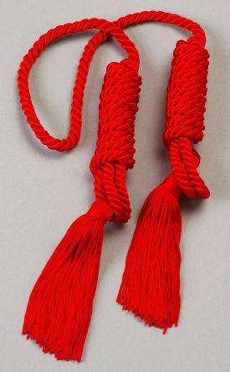
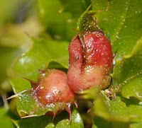
The red cord
Gen. 38:28 – “a scarlet thread” – shaniy - scarlet, crimson; properly, the insect ‘coccus ilicis’, the dried body of the female yielding colouring matter from which is made the dye used for cloth to colour it scarlet or crimson.
shaniy occurs 42 times in O.T. – 42 = 6 x 7.
The 33 occs. in the Law of Moses always with tola – the crimson grub.

Slide 14
Structure of allegory in Genesis
Abrahamic Covenant | Mosaic Covenant
Called the ‘second’ though first to be ‘born’ | Called the ‘first’ though 430 years later – Heb. 8:7
Represented by Sarah (free) – Isaac = children of faith | Represented by Hagar (bondwoman) – Ishmael = slaves to law
Zarah (‘born’ first – red cord) = Abrahamic order | Pharez (became ‘first’ by breach) = Mosiac order
Ephraim the youngest is type of Abrahamic ‘seed’ | Manasseh the firstborn type of Israel under law

Slide 15
The Divine Allegory
Gal. 4:22-31 – Paul uses Gen. 16 and 17 as the basis of an allegory.
Hagar
= Mosaic Covenant
Ishmael
= Israel under Law (circumcised in flesh but not in heart – Gen. 17:25)
Sarah
= Abrahamic Covenant
Isaac
= Spiritual Israel under grace (circumcised in heart – Jews inwardly – Rom. 2:29)
Ishmael was the result of human failure
– “Is anything too hard for Yahweh?”

Slide 16
Zarah - Abrahamic
Unlike Esau and Jacob (diverse twins) Pharez and Zarah were probably normal twins (i.e. virtually identical).
Like the Abrahamic Covenant, Zarah appeared first but was not ‘confirmed’.
430 years later the Mosaic Covenant superseded the Abrahamic for a time as a ‘school-master’ to lead Israel to Christ – Gal. 3:24 (see context V.17-29).
Christ finally confirmed the Abrahamic Covenant by his sacrifice – Rom. 15:8.

Slide 17
Pharez - Mosaic
The Mosaic Covenant was introduced “because of transgressions” until the ‘seed’ of Abraham (Christ – Gal. 3:16) appeared on the scene – Gal. 3:19.
In a sense, it was a ‘breach’ (Pharez) – an interruption for a time until Christ came to confirm the Abrahamic Covenant.
The Law of Moses was not opposed to the Abrahamic – Rom. 7:12.
Christ came to fulfil the Law, not destroy it – Matt. 5:17-18. Hence, it was a ‘twin’.

Slide 18
Two sons - Two Covenants
Though given first, the Abrahamic Covenant is called the second (and the “new” – Heb. 8:7; 10:9) because it was ratified by the sacrifice of Christ centuries after the Mosaic was ratified by animal sacrifices – Ex. 24.
Sacrifice of Christ
Abrahamic
Mosaic
430 yrs
Ratified by blood of animals
Ratified by the sacrifice of Christ – Rom. 15:8

Slide 19
Christ and the sons of Judah
Ruth 4:18-22 – Now these are the generations of Pharez: Pharez begat Hezron, And Hezron begat Ram, and Ram begat Amminadab, And Amminadab begat Nahshon, and Nahshon begat Salmon, And Salmon begat Boaz, and Boaz begat Obed, And Obed begat Jesse, and Jesse begat David.
This genealogy is repeated in Matt. 1:3-6 with additions:
V.3 mentions both Pharez and Zarah.
V.5 mentions both Rahab and Ruth.

Slide 20
So why was Christ from Pharez?
Rom. 15:8 - Now I say that Jesus Christ was a minister of the circumcision for the truth of God, to confirm the promises made unto the fathers.
It was necessary that Christ be both “born of a woman, made under the law” – Gal. 4:4.
Red cord
Pharez
Zarah
Hence, he fulfilled the Law in life (Matt. 5:17), although it condemned him in death (Gal. 3:13), but the Abrahamic Covenant was confirmed thereby.

Slide 21
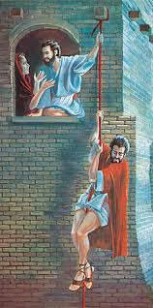
Rahab and the red cord Joshua 2
V.18 – “line” – tiqvah (1st occ.) – literally a cord (as an attachment; figuratively expectancy. Occs. 34 times O.T. – trans. ‘line’ (2), ‘expectation’, ‘expected’, ‘hope’ (22), ‘thing that
I long for’. See last occ. Zech. 9:12.
The red cord is a graphic symbol for the Hope of Israel – Acts 28:20.
“scarlet” – shaniy – scarlet, crimson. First two occs. Gen. 38:28,30.
“thread” – chut - cord, line, string.

Slide 22
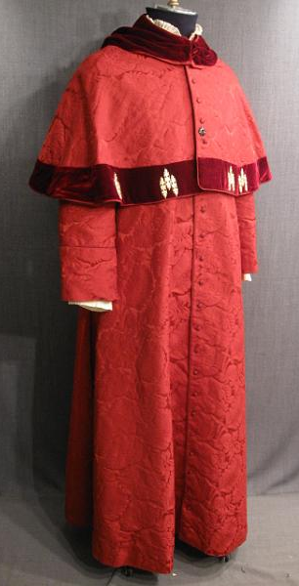
Achan the troubler of Israel
Joshua 7:1,15 – “trespass” – ma’al – treachery. Of the worst kind! Achan preserved the tokens of the Babylonian religion that God sought to utterly destroy – gold, silver and a priestly robe – Rev. 17:4; 18:12,16.
“accursed thing” – cherem – a thing devoted; i.e. to destruction – Josh. 6:17.
“Achan” – “troubler”.
“Zerah” – A Zarhite – Gen. 38:30.
Rahab was saved out of ‘Babylon’ with a red cord of faith – Achan was destroyed with Jericho because of greed towards a red robe!

Slide 23
Babylonian religion preserved
V.21 – “Babylonish garment” – shinar addereth – a splendid and costly robe of Shinar. The Vulgate Latin version calls it a scarlet robe.
Semiramis - Hellenized form of the Akkadian name “Sammur-amat”. “Sammur” when translated into Hebrew becomes “Shinar”. Her inner circle of priests wore red coats.
Jericho was the centre of Baal worship in Canaan – hence the decree to devote it.
Baal (Bel) was a title of Cush and Nimrod.

Slide 24
Next Study
(God willing)
Study 2
“The sceptre shall not depart from Judah”

Slide 25
… ….
...

