Slide 1
“Judah First”
Study 2
“The sceptre shall not depart from Judah”

Slide 2
The Pharez/Zarah allegory
Judah
Pharez
Hezron
Ram
Amminadab
Nashon
Salmon
Boaz
Obed
Jesse
David
Judah
Zarah (red cord)
Zimri, Ethan, Heman, Calcol, Dara (5)
Zabdi (Zimri)
Carmi
Achan
Abrahamic
Covenant
Law of Moses
Law of Moses
Rahab
Matt.1:5
Ruth
Rom. 15:8 - Now I say that Jesus Christ was a minister of the circumcision for the truth of God, to confirm the promises made unto the fathers.

Slide 3
Joseph’s sons – The prophecy
Two sons born “before the years of famine came” = The family of the “increaser” before the period of the apostasy – Gen. 41:50-52.
Manasseh – “causing to forget”.
The Jews – “My people have forgotten me days without number” (Jer. 2:32).
Ephraim – “fruitful” or “double fruit” (in the land of affliction).
The Nations – “A nation bringing forth the fruits thereof” (Matt. 21:43).

Slide 4
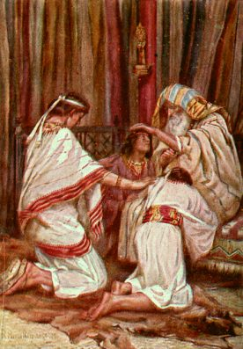
Jacob's act of Faith - Heb. 11:21
Gen.47:31

Slide 5
“Guiding his hands wittingly” Gen. 48:14
Manasseh – “causing to forget” = Natural Israel (Jer. 2:32).
Ex. 4:22 – “Israel is my son, even my firstborn”.
Ephraim – “fruitful” = Spiritual Israel (Matt. 21:43).
Gen. 48:19 – “His seed shall become a multitude of nations” (Gen. 17:4-5).

Slide 6
The Allegory of Joseph’s Sons Gen. 48:19-20
Joseph
“the increaser”
Christ
Manasseh
Natural Israel
Ephraim
Spiritual Israel
The blessings on Jacob’s sons deals with both natural and spiritual Israel.

Slide 7
The life pattern of Judah
Gen. 29:35 – Yahweh praised at his birth.
Gen. 37:26-27 – Betrayer - Instrumental in Joseph being sold into Egypt.
Gen. 38 – Judah’s shameful behaviour type of nation at time of Christ (37:26).
Gen. 43:1-14 – Judah provides sound leadership in Jacob’s family.
Gen. 44:14-34 – Judah as spokesman reveals a reformed character.
Gen. 46:28 – Judah trusted by Jacob leads his father into Egypt.

Slide 8
The reformation of Judah
What could change Judah – worldling, covenant breaker and fornicator into the leader and reformer of his family?
Gen. 43:1-14 – The calmness, firmness, resolution and altruism of Judah reveals a complete change of attitude towards God and his father.
Gen. 44:14-34 – Consciousness of God working in their lives and compassion for Jacob highlight a complete change.
Judah’s faith, conscience, sensitivity and sacrificial love = hallmarks of reformation.

Slide 9
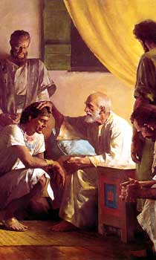
Jacob blesses his sons Gen. 49
Prophecies of the latter days in which the work of God in Christ is prominent.
For that reason 3 sons are ‘blessed’ but diminished – Judah ‘first’ to be truly blessed.

Slide 10
Blessings! Really? Gen. 49:1-7,28
Reuben, Simeon and Levi might have questioned that theirs was a ‘blessing’.
Better to be exposed and repent than to conceal and be rejected. That is a blessing!
Reuben lost all 3 aspects of the right of the firstborn – priesthood, authority and inheritance = diminished – 1 Chron. 5:1-2.
Simeon and Levi were ‘brethren’ in cruelty – they were divided in Jacob and scattered in Israel - relegated.

Slide 11
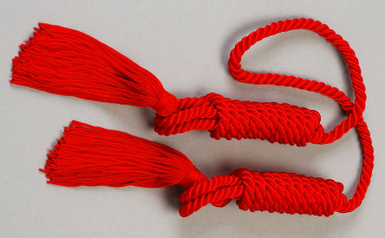
The Hope of Israel
“The blessing on Judah contains in it the hope of Israel. It shows what views Jacob had of the promises made to him and his fathers. His faith was of things substantial and definable. He looked for a kingdom and an empire, whose royal domain should be the land of Canaan, and especially that part of it allotted to Judah; and whose imperial ruler should be the Giver of Peace, descended from his loins in the line of Judah. The Spirit of God in Jacob marked him out to wield the sceptre and to give laws to the world, possessing the gate of his enemies, and blessing all the nations of the earth.”
Elpis Israel, pg. 281

Slide 12
Judah praised – Gen. 49:8
Judah means “praise”.
“whom thy brethren shall praise” – Awaits the time of Christ’s rule on David’s throne – Rev. 5:11-14.
“thy hand shall be in the neck of thine enemies” – Used of David subduing his enemies – Ps. 18:40.
“father’s children shall bow down before thee” – Foreshadowed in Gen. 37:9-10. All Israel will bow down to Christ as Prince in Judah – Rom. 11:25-26; Mic. 5:2-4.

Slide 13
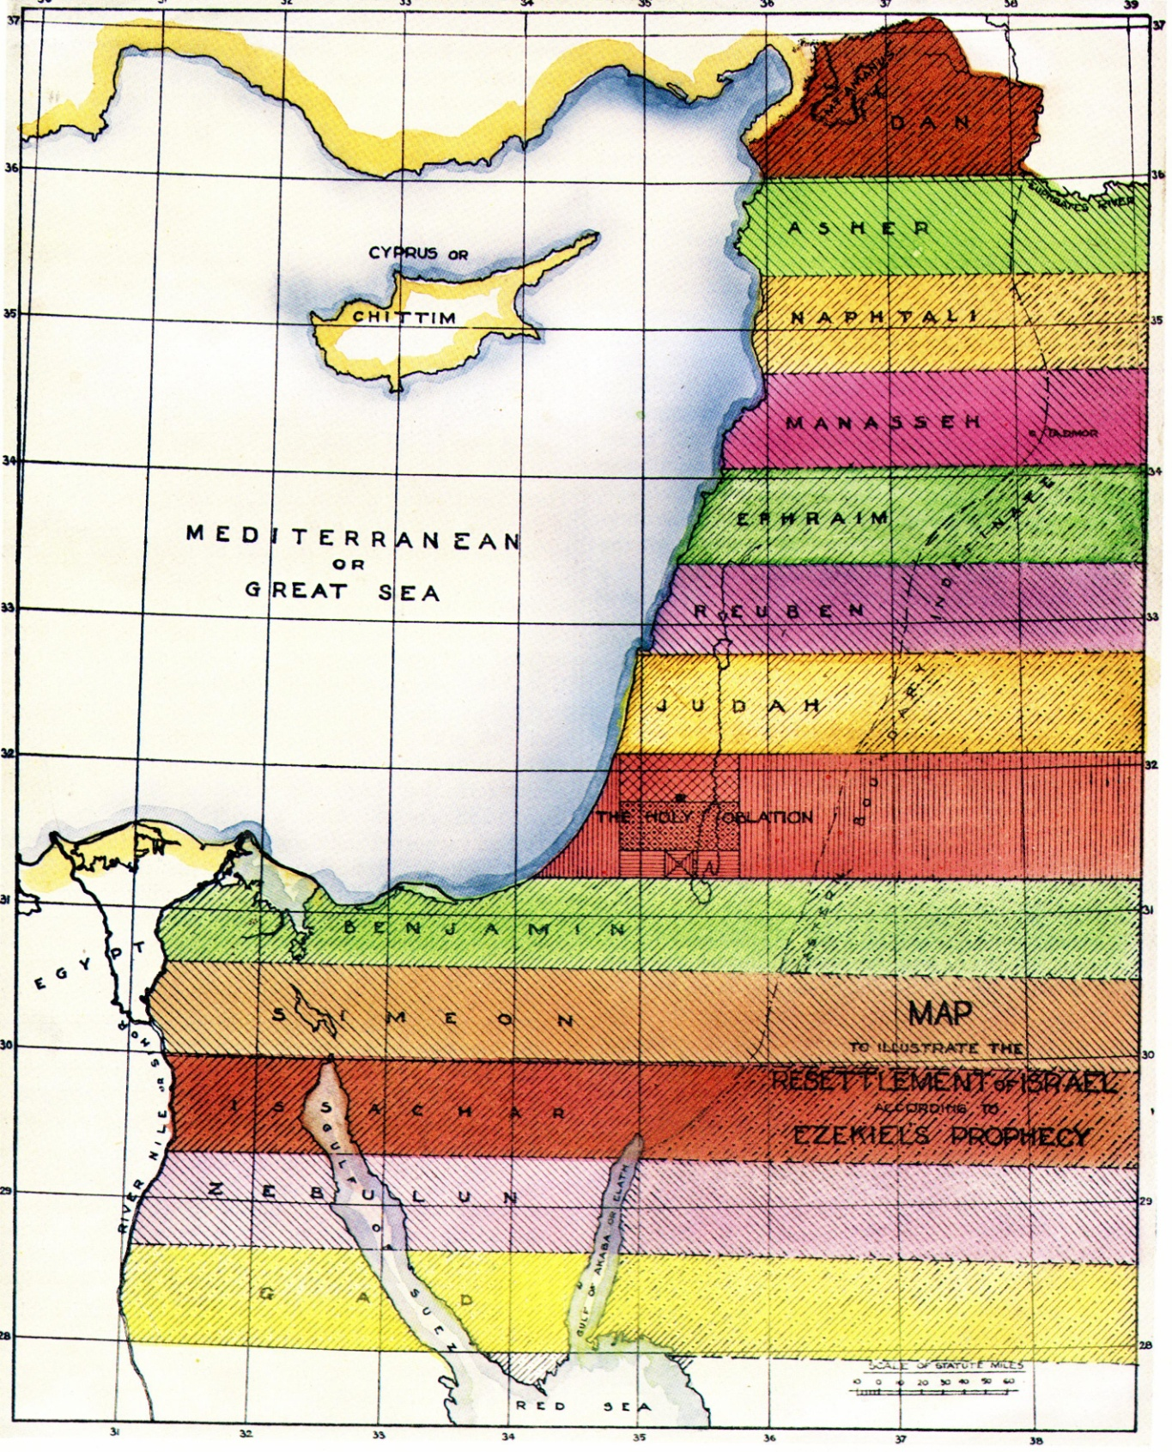
Judah’s inheritance in the Land in the future
The Holy Oblation subsumes nearly all Judah’s ancient territory (Zech. 2:12).
In the future, Judah occupies a prominent place north of the Holy Oblation.

Slide 14
The Lion of the tribe of Judah Gen. 49:9
“whelp” - guwr – cub, whelp, young. Young lion developing into full strength and ferocity in search of prey. Cp. Rev. 5:5.
“from the prey” - Grown lion caught and consumed prey, now returns – will not always tear and rend. Refers to the aftermath of Christ’s triumph over the nations.

Slide 15
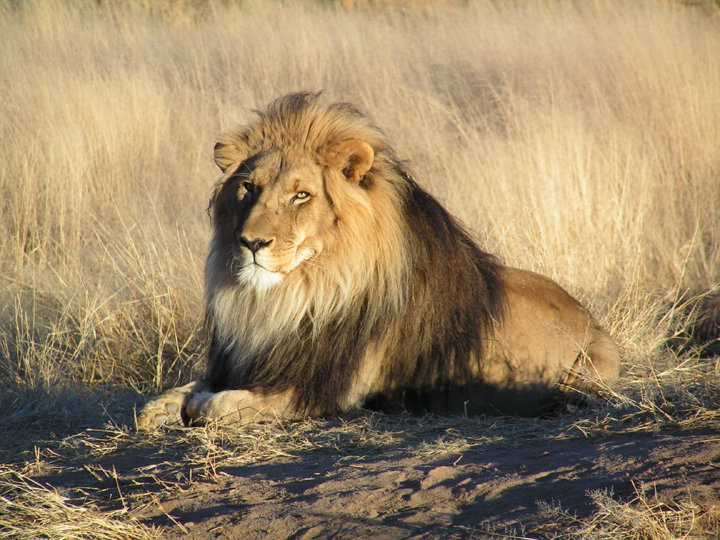
“He couched as a lion” Gen. 49:9
“couched” - rabats – lie down, recline.
The Lion of the tribe of Judah at rest and peace – Christ will only rest when the nations are subdued.

Slide 16
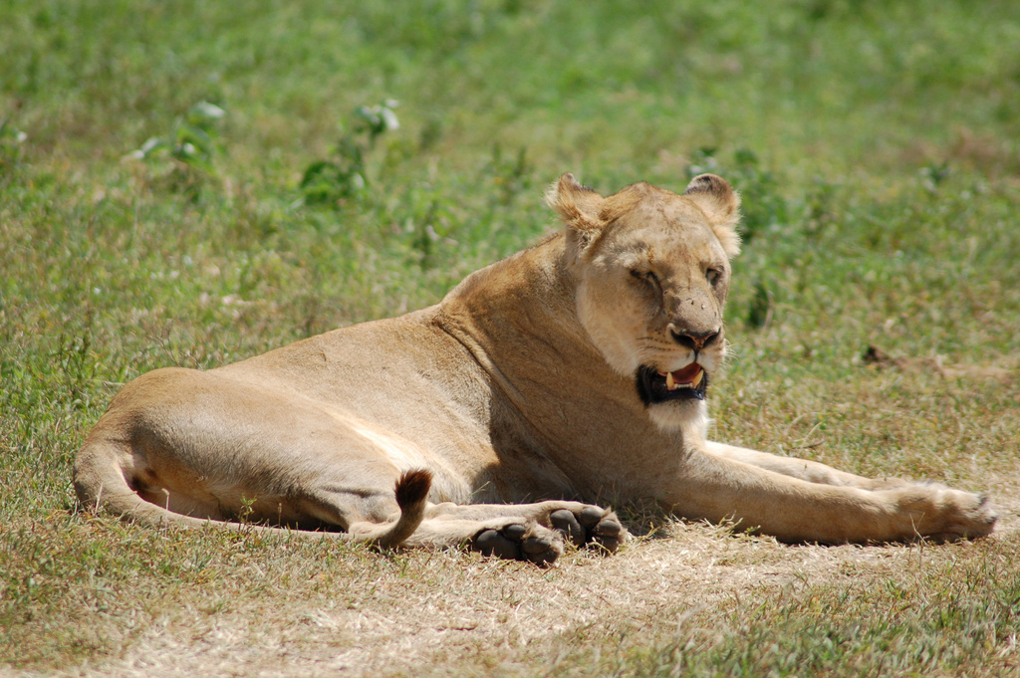
“Who shall rouse him up” Gen. 49:9
“old lion” - lebiya – lioness. R.V. – “as a lioness”. Fierce in protecting offspring as Christ will be of his people.
RSV – “who dares rouse him up”. None will challenge the rule of Christ once all nations subdued. Repeated by Balaam – Num. 24:8-9.

Slide 17
The sceptre shall not depart from Judah
“sceptre” - Authority (symbolised by rod or sceptre) of firstborn given to Judah because of qualities – Gen. 44:14-34. Ruling tribe in past and future.
“Moses was a lawgiver, not of Judah, but of Levi; but when Shiloh comes as the lawgiver of Judah, then ‘the law shall go forth from Zion, and the word of the Lord from Jerusalem’ (Isa. 2:3).”
Elpis Israel pg. 281

Slide 18
Shiloh shall come – Gen. 49:10
“lawgiver” - Roth. - “commander’s staff”. R.V. - “ruler’s staff”. When ancient kings sat to dispense law the rod was held between the feet as insignia of office. See Isa. 33:22.
“until” - ad ki – “to/for that” or “because”. Bro. Thomas – “because Shiloh shall come”.
“Shiloh” - “tranquil, peace”. Title of Christ – Isa. 9:6; Ps. 72.
“gathering” - yiqqarah – obedience. R.V. – “the obedience of the peoples”.

Slide 19
Shiloh and the vine – Gen. 49:11
“Binding” - asar – to yoke or hitch. Cp. Zech. 9:9; Matt. 21:4-5.
“foal” - ayir – young male ass (just broken to a load). Israel to come under Law (the ‘Pharez’ era).
“the vine” - Israel - Ps. 80:8-11 (same word for ‘vine’ used).
“ass’s colt” - ben athown – son of female ass. Refers to spiritual Israel (Jew and Gentile). Cp. Mark 11:1-11 (1st phase).

Slide 20
Shiloh and the vine – Gen. 49:11
“choice vine” - soreq – choice species of vine yielding purple grapes (the richest variety). Represents the Israel of God (John 15:3; Gal. 6:16; Eph. 6:12). Royalty of the Kingdom (2nd phase).
“he washed” - RSV – “he washes”. Two phases of Christ’s mission – [1] “Saving himself” (Zech. 9:9) – Redeemed out of death and received change of garments (Heb. 5:7; Zech. 3:4-5; Isa. 61:10) [2] Future work - stains his garments with the blood of Israel’s enemies – Isa. 63:1-6; Rev. 14:18-20; 19:13.

Slide 21
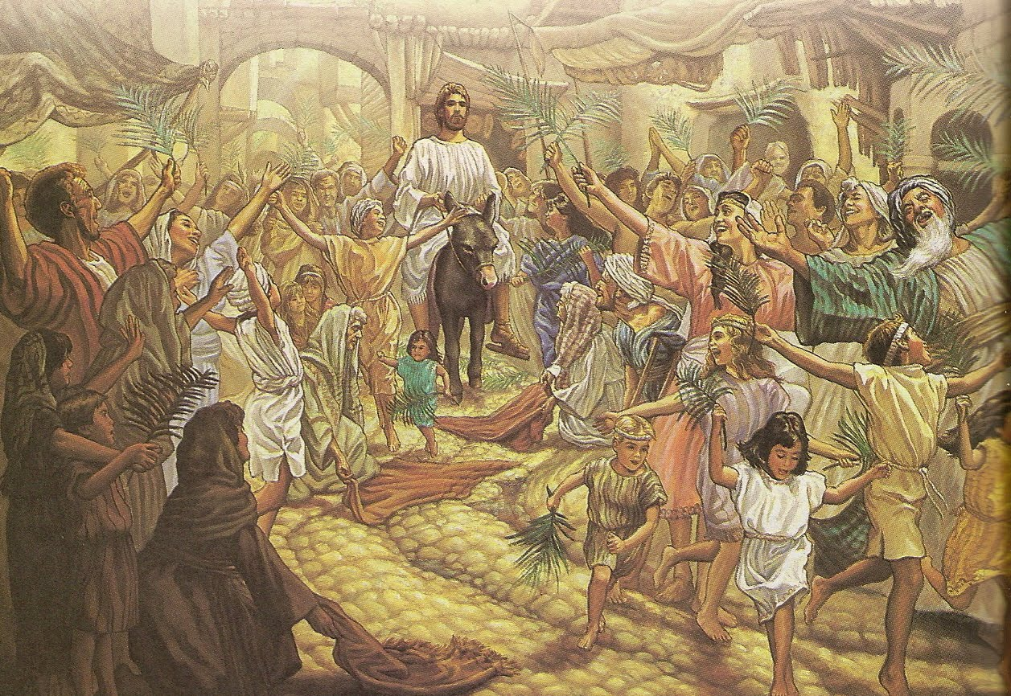
Christ rides into Jerusalem – Gentiles incorporated – Mark 11
Everything he does speaks eloquently of the inclusion of the Gentiles in his redemptive work.
Christ rides into Jerusalem on the colt the foal of an ass on the 10th of Abib (a Sabbath) to be inspected as “the Passover lamb”.
But how did he know which animal he would ride? Zech. 9:9 didn’t help, but Gen. 49:11 did!
10 Sabbath 11 Sunday 12 Mon 13 Tues 14 Wednesday 15 Thu 16 Fri 17 Sat

Slide 22
The enacted parable of Mark 11
Mark 10:46-52 – Blind Bartimaeus (Gentiles) cured follows Jesus in the way of the cross.
Mark 11:1 – 3 trees embrace Jew and Gentile – fig, palm, olive – Jew (Judah) first.
V.2-7 – Apostles sent to Gentiles – Jesus chooses the unbroken colt over the ass.
V.8-11 – Palm branches used – Inspection of Mosaic order disappoints – to Bethany.
V.12-14 – Fig tree set aside for Gentile age.
V.15-17 – Court of Gentiles cleansed – Mosaic system brought to halt – All nations.

Slide 23
Pharez and Zarah in Mark 11
Pharez the typical representative of Jews living under the Law of Moses.
Zarah the typical representative of the Gentiles incorporated by faith into the Israel of God.
V.22 – “Have faith in God” – The new order – constitution of the Abrahamic Covenant.
Red cord
Pharez
Zarah
Mark 11:9 - And they that went before, and they that followed, cried, saying, Hosanna.

Slide 24
Shiloh’s eyes and teeth – Gen. 49:12
“eyes” - Symbolise Spirit intelligences active in judgement (Zech. 4:10; Ezek. 1:18; Rev. 4:6,8; 5:6). Used of Christ – Rev. 1:14; 2:18; 19:12.
“red” - chakliyl (only occ.) – darkly flashing, brilliant (as stimulated by wine). Cognate word chaklilooth used Prov. 23:29 - “redness”. Not drunkenness here, but stimulation as in Zech. 9:15,17 (“cheerful” – nub – make to flourish).

Slide 25
Shiloh’s eyes and teeth – Gen. 49:12
“wine” = truth (Isa. 55:1; Cp. Prov. 23:23). Truth motivates Christ’s destruction of his enemies – Ps. 78:65-66.
“teeth white with milk” - Teeth - symbol for weapons (Prov. 30:14). Milk speaks of elementary truths (1 Pet. 2:2; Isa. 55:1; Heb. 5:13-14) as drivers of judgements to come. Cp. Song 5:1.

Slide 26
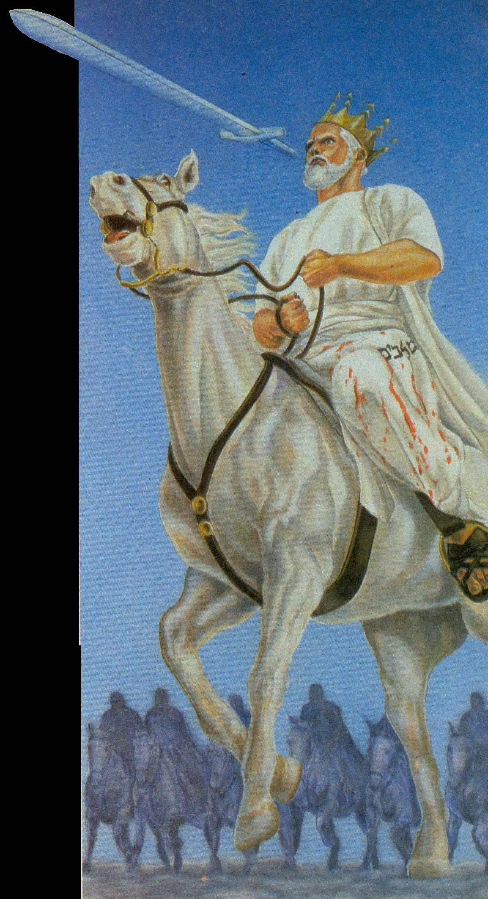
Rev. 19:11-21
And I saw heaven opened, and behold a white horse; and he that sat upon him was called Faithful and True, and in righteousness he doth judge and make war.
And he was clothed with a vesture dipped in blood: and his name is called The Word of God.

Slide 27
Next Study
(God willing)
Study 3
“Caleb and Othniel – Judah first”

Slide 28
… ….

