Slide 1
“Judah First”
Study 3
“Caleb and Othniel – Judah first”

Slide 2
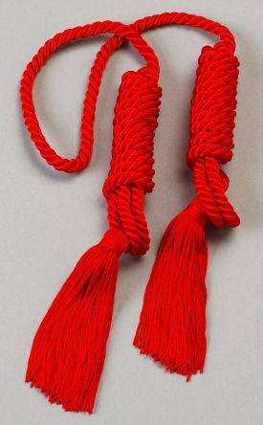
The family of the red cord
Caleb the son of Jephunneh (Num. 14:6) was of Gentile origin though a leader of Judah.
As one of two faithful spies he showed a true Abrahamic faith under duress – Num. 14:6-10.
His nephew, Othniel is a truly majestic type of Christ as ‘Shiloh’.

Slide 3
Structure of the Book of Judges
Chap. 1:1-3:6 The failure of Israel to consolidate their inheritance
Chap. 3:7-16:31 The history of Israel under the Judges
Chap. 17:1-21:25 - Two appendices to the book
Appendix 1
Chap. 17-18 Corruption of Doctrine
Appendix 2
Chap. 19-21 Corruption of Practice
Between 2:9 & 10

Slide 4
Two basic misconceptions – Jud. 1:1
Consider the chronological order – hence the position of Judges 1:1.
“Who shall go up for us against the Canaanites…”
“…first, to fight against them?”
Israel incorrect on two counts:
Responsibility of “every man” to go up and seize his inheritance – Josh. 24:28; Judges 2:6.
Yahweh had already gone up “first” to destroy organised resistance – Josh. 21:43-45.

Slide 5
Canaanites – Type of human nature
Hebrew – from the root kana – to bend the knee; hence to humiliate, vanquish; hence to be humble, be humbled, be subdued, be brought down, be low, be under, be brought into subjection.
Phil. 3:21 - “who shall transform the body of our humiliation to its becoming conformed to the body of his glory” (Young’s Literal)

Slide 6
Adoni-bezek
His name signifies “Lord (master) of lightning”.
King of Canaanites = King Sin (humiliation).
Humiliated captives by amputation.
Judah cut off his thumbs and big toes.
Adoni-bezek thought this was God’s revenge.
But Yahweh’s law was clear – extermination Deut. 20:15-16.
His mind was left to contrive and scheme until Jerusalem was finally lost – v.7,21.
Judaism restricts works (thumbs) and walk (toes), but leaves the carnal mind untouched.

Slide 7
“Judah shall go up”
Yahweh saw faith and leadership in Judah – in the family of Caleb!
But Judah as a tribe failed with Adoni-bezek resulting in the first case of……
National Judaism!
It was the ‘red cord’ element in Judah that led to one of the most graphic portrayals of the work of God in Christ

Slide 8
Caleb the son of Jephunneh
Caleb means “a dog”, from a root “to yelp, or to attack”. The dog was a Jewish symbol for the Gentiles.
Jephunneh means “he will be prepared” (Strong), or “he will be facing” (BDB).
Kenezite means “a descendent of Kenaz”. Kenaz signifies “hunter”.
Caleb’s prominent position in Judah (Num. 13:6) probably indicates his ancestors had joined the Patriarchs in the Land.

Slide 9
The paradox of the Kenites and Kenezites – Gen. 15:19
The first two tribes listed of 10 to be removed from the land so that Christ could inherit it.
Some Kenites (the Rechabites) will have a permanent inheritance in the Land (Jer. 35:18-19) while many Jews will not!
The most prominent Kenezite in history will have a place beside Abraham, Isaac and Jacob in the Land of Promise.

Slide 10
Caleb the Kenezite
Num. 32:6-12 – Not overwhelmed by the giants of Hebron – Num. 13:6,22-30; 14:6-10,24,30.
Josh. 14:6-15 – The focus on Hebron because of two families of ‘giants’. Twice called a “Kenezite” – v.6,14.
Josh. 21:9-12 – Caleb happy to give the city of Hebron to the Levites, so long as he could retain the fields – where the cave of Machpelah was!

Slide 11
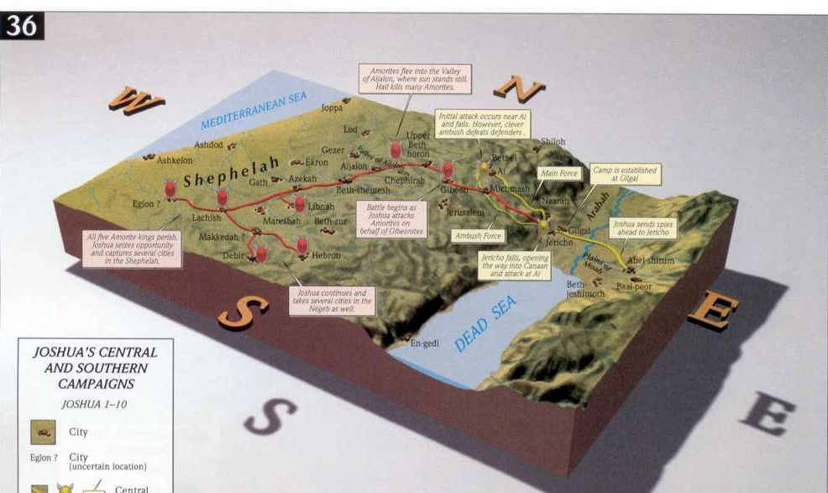
Then Hebron – Judges 1:9-10

Slide 12
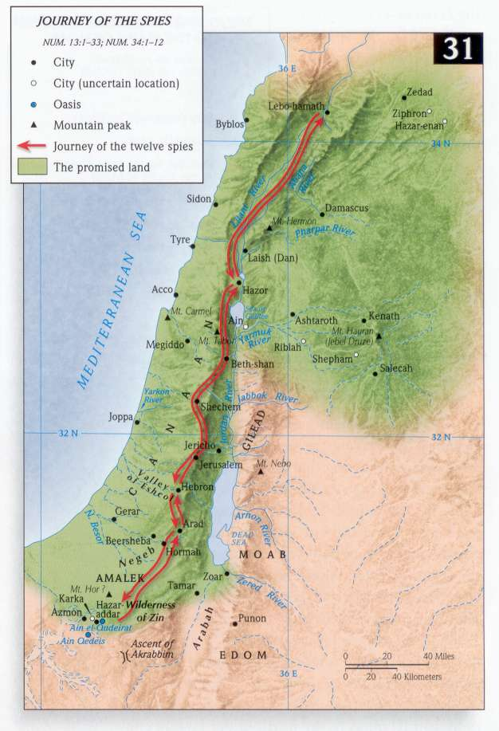
Hebron
Hebrew – from root cheber - association, shared; hence association; fellowship.
The stumbling-block to the 10 spies – Num. 13:22,28.
The patriarchs and their wives were buried in the cave of Machpelah - Gen. 23:19; 50:13.
This was the only place Caleb wanted as his inheritance – Josh. 14:6-15.

Slide 13
The three giants – Judges 1:10
Hebron – association; fellowship
Kirjath-arba - city of the four (giants)
Sheshai – whitish (like leprosy); six (Hitchcock) = Lust of the flesh
Ahiman - “my brother is a gift” = Lust of the eyes
Talmai – ridged; root meaning to accumulate; a bank or terrace = Pride of life
1 John 2:16 - “For all that is in the world, the lust of the flesh, and the lust of the eyes, and the pride of life…”

Slide 14
The capture of Debir
First called Kirjath-Sepher = “City of a book”; “Booktown”
Renamed Debir = “The shrine” (innermost part of the sanctuary)
Type of Jerusalem in two eras.
Hebron
Debir

Slide 15
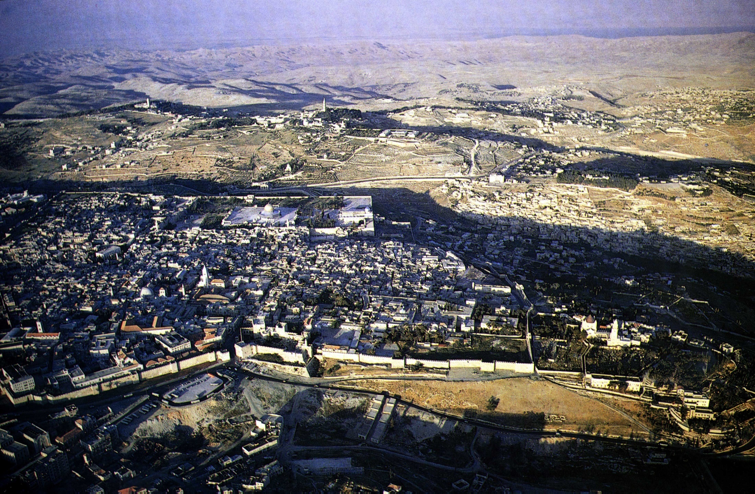
The City of the Book today
Jerusalem from the west

Slide 16
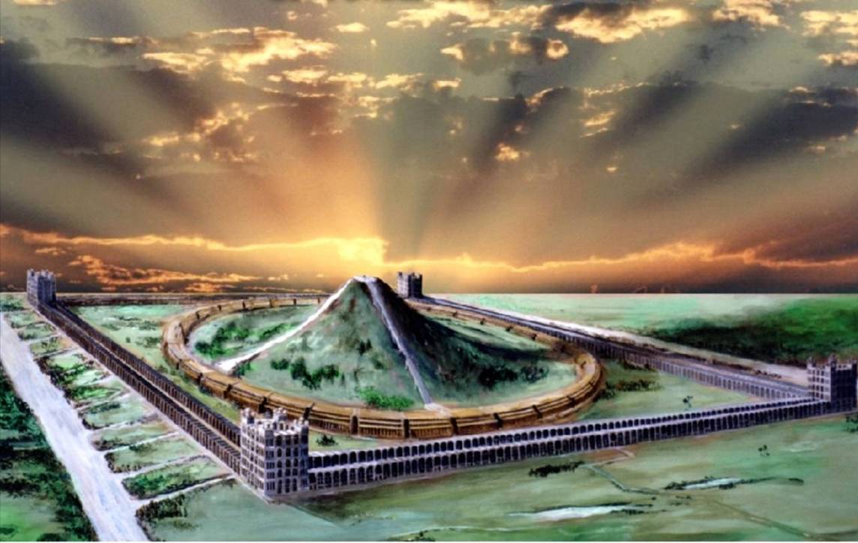
The Sanctuary
Cameos of the Kingdom

Slide 17
Othniel – Type of Christ
Othniel – “Lion of God” (Gesenius)
Of the tribe of Judah – Rev. 5:1-6
Son of Kenaz = “to hunt, hunter”
Called “Caleb’s younger brother” but actually his nephew – 1 Chron. 4:13-15
Israel’s first judge – Judges 3:9-10
Judged Israel for 40 years – Judges 3:11

Slide 18
Achsah – Type of the bride of Christ
Achsah – “anklet”; root a fetter; hence an anklet. She was a willing “bondslave” to her lord – Rom. 6:16; 1 Cor. 7:22-23.
Daughter of Caleb – “a dog” = Gentiles.
Caleb was a Kenezite - Josh. 14:6, 14; Gen. 15:19.
Therefore Achsah was of both Jewish and Gentile origin – like the Bride of Christ.

Slide 19
The importance of Water
Achsah “moved” (cuwth – to prick; stimulate) Othniel to ask Caleb for “the field” where she knew there were perennial springs.
She took the initiative to request from her father “the field” near Debir (“the shrine”) – had already spied out the land.
She equated “a blessing” with the supply of water in a dry land – the word “south” is negeb – to be parched.
Given the upper and lower springs – the fulness of blessings of the word of God – Eph. 5:26.

Slide 20
Judges 3:8-11 - Mesopotamia = Babylon
Cushan-risha-thaim
Mesopotamia means “the highland between the two rivers”

Slide 21
Othniel’s victory over Babylon
Cushan-risha-thaim = “Cush of double wickedness” – Judges 3:8,10.
King of Mesopotamia = “highland of the two rivers”; i.e. the area of ancient Babylon – the original Cush – Gen. 2:13; 10:10. This is where the kingdom of men was first established. Its founder was Nimrod, son of Cush – Gen. 10:8.
Cushan-risha-thaim is a type of “Babylon the great” in its final manifestation in opposition to the rule of Christ – Rev. 17:3-5;12-14.
V.11 - Othniel’s triumph and 40 years rest types Christ’s victory and the Millennial ‘rest’.

Slide 22
Next Study
(God willing)
Study 4
“Craftsmen of ancient things for the King’s work”

Slide 23
… ….
...

