Slide 1
“Judah First”
Study 4
“Craftsmen of ancient things for the King’s work”

Slide 2
Judah first in Chronicles
1 Chron. 1 – From Adam to Edom.
2:1-2 – The sons of Israel.
2:3 – The sons of Judah and their fate.
2:4 > – Sons of Tamar by Judah.
3:1> - The sons and line of David.
4:1-23 – The posterity of Judah.
5:1 – Reuben forfeits birthright to Joseph, but Judah is first.
5:2 – “For Judah prevailed above his brethren, and of him came the chief ruler; but the birthright was Joseph’s.”

Slide 3
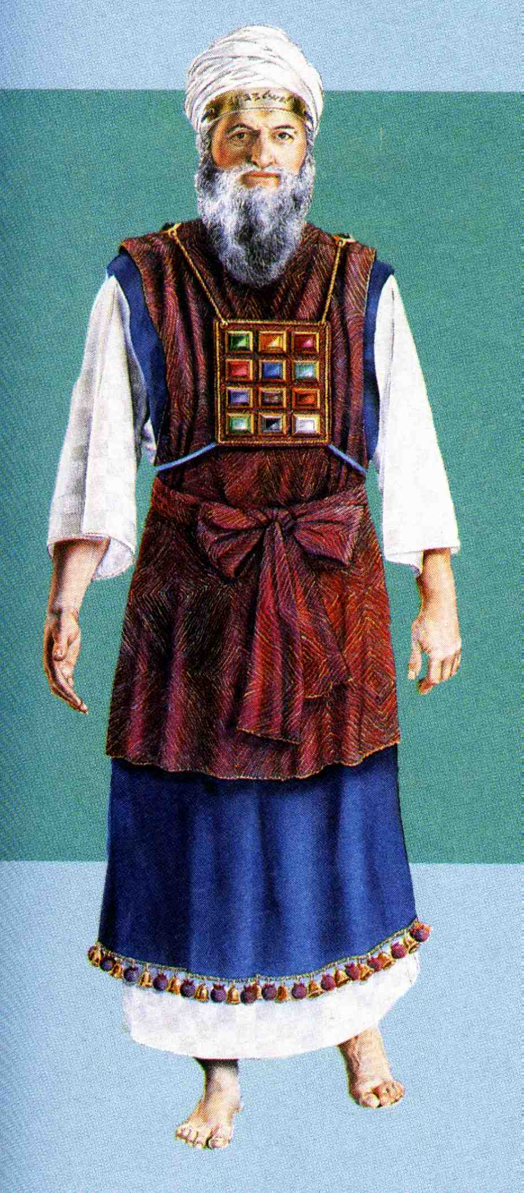
The craftsmen of Judah
1 Chron. 4:14 – “craftsmen” – charash - craftsman, engraver, artificer. 37 occs. O.T. – 1st Ex. 28:11 of the “engraving” of the names of the tribes of Israel on two onyx stones.
The shoulder is a symbol for bearing responsibility = government – Isa. 9:6.

Slide 4
The craftsmen of Judah
1 Chron. 4:14 – “craftsmen” – charash - craftsman, engraver, artificer.
2nd and 3rd occs. – Ex. 35:35; 38:23 of Bezaleel and Aholiab principal craftsmen in building the Tabernacle and furniture.
Ex. 35:30 – “Bezaleel” - “in the shadow (i.e. protection) of God”.
“Uri” – “fiery”.
“Hur” – Strong says from root chur – “white linen” (others say “hole”).
“of the tribe of Judah” – Judah first!

Slide 5
Craftsmen for curious works
Ex. 35:31 – “hath filled him with the spirit of God” – Cp. Christ - Isa. 11:2.
“workmanship” – melakah – Cp. 1 Chron. 4:23.
V.32 – “devise” – chashab - to think, plan, esteem, calculate, count, devise (124 occs.). 1st occ. Gen. 15:6 (“counted”) – last Mal. 3:16 (“thought”).
“curious works” - machăshebeth (also V.33) - thought, device, plan, purpose (56 occs.). 1st occ. Gen. 6:5 (“thoughts”) – last Mic. 4:12.

Slide 6
Willing craftsmen – Ex. 35
V.34 – “that he may teach” – i.e. the willing offerers of V.29.
“Aholiab” – “Father’s tent”. 5 occs. all Ex.
“Ahisamach” – “My brother is support”.
V.35 – “all manner of work” – kol melakah – RSV – “every sort of work”.
“cunning workman” – chashab – see V.32.
“scarlet” – tola shaniy – the crimson grub. RSV – “scarlet stuff”.
“fine linen” – shesh – white linen - V.30.

Slide 7
Potters for the king - 1 Chron. 4:21-23
The sons of Shelah the son of Judah were, Er the father of Lecah, and Laadah the father of Mareshah, and the families of the house of them that wrought fine linen, of the house of Ashbea,
And Jokim, and the men of Chozeba, and Joash, and Saraph, who had the dominion in Moab, and Jashubilehem. And these are ancient things.
These were the potters, and those that dwelt among plants and hedges: there they dwelt with the king for his work.

Slide 8
Ready for the king’s work
1 Chron. 4:21 – “Shelah” – “petition”. The youngest son of Judah, promised, but not given to Tamar – Gen. 38:11. His mother was a Canaanite – Gen. 38:2-5.
“fine linen” - buts – white linen.
“Ashbea” - “I shall make to swear”.
V.22 – “And these are ancient things” - RSV – “(now the records are ancient)”. Roth. – “…but, the records, are ancient.”

Slide 9
Working in the house of the king
1 Chron. 4:23 – “potters” - yatsar - to form, fashion, frame. 62 occs. O.T. – 1st 3 Gen. 2:7,8,19 - “formed”. Last Zech. 12:1 –”formeth”. Trans. “potter” (17).
Roth. – “They, were the potters and the inhabitants of Netaim (“among plants”), and Gederah.”
“hedges” - gedêrâh - wall, hedge, sheepfold.
“work” – melakah - occupation, work. 1st 3 occs. Gen. 2:2,3 “work”. Last Hag. 1:14. Roth. – “…with the king in his work, dwelt they there.”

Slide 10
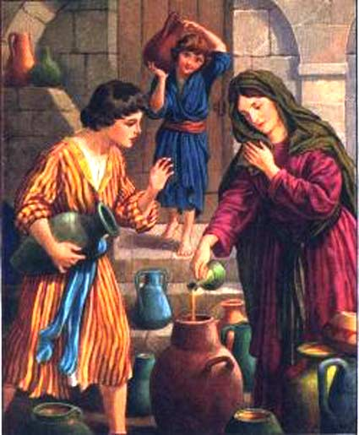
Vessels in the house of God
2 Tim. 2:20-21 - But in a great house there are not only vessels of gold and of silver, but also of wood and of earth; and some to honour, and some to dishonour.
If a man therefore purge himself from these, he shall be a vessel unto honour, sanctified, and meet for the master’s use, and prepared unto every good work.

Slide 11
Destiny of vessels – 1 Cor. 3:12-15
Now if any man build upon this foundation gold, silver, precious stones, wood, hay, stubble;
Every man’s work shall be made manifest: for the day shall declare it, because it shall be revealed by fire; and the fire shall try every man’s work of what sort it is.
If any man’s work abide which he hath built thereupon, he shall receive a reward.
If any man’s work shall be burned, he shall suffer loss: but he himself shall be saved; yet so as by fire.

Slide 12
The craftsmen of Judah
1 Chron. 4:13-14 - And the sons of Kenaz; Othniel, and Seraiah: and the sons of Othniel; Hathath.
And Meonothai begat Ophrah: and Seraiah begat Joab, the father of the valley of Charashim; for they were craftsmen.
“Charashim” – “valley of craftsmen”. A valley near Lydda, east of Joppa, founded by Joab of Othniel’s family – Acts 9:35-39.
“craftsmen” – charash (37 occs.) - craftsman, engraver, artificer. Last occ. Zech. 1:20.

Slide 13
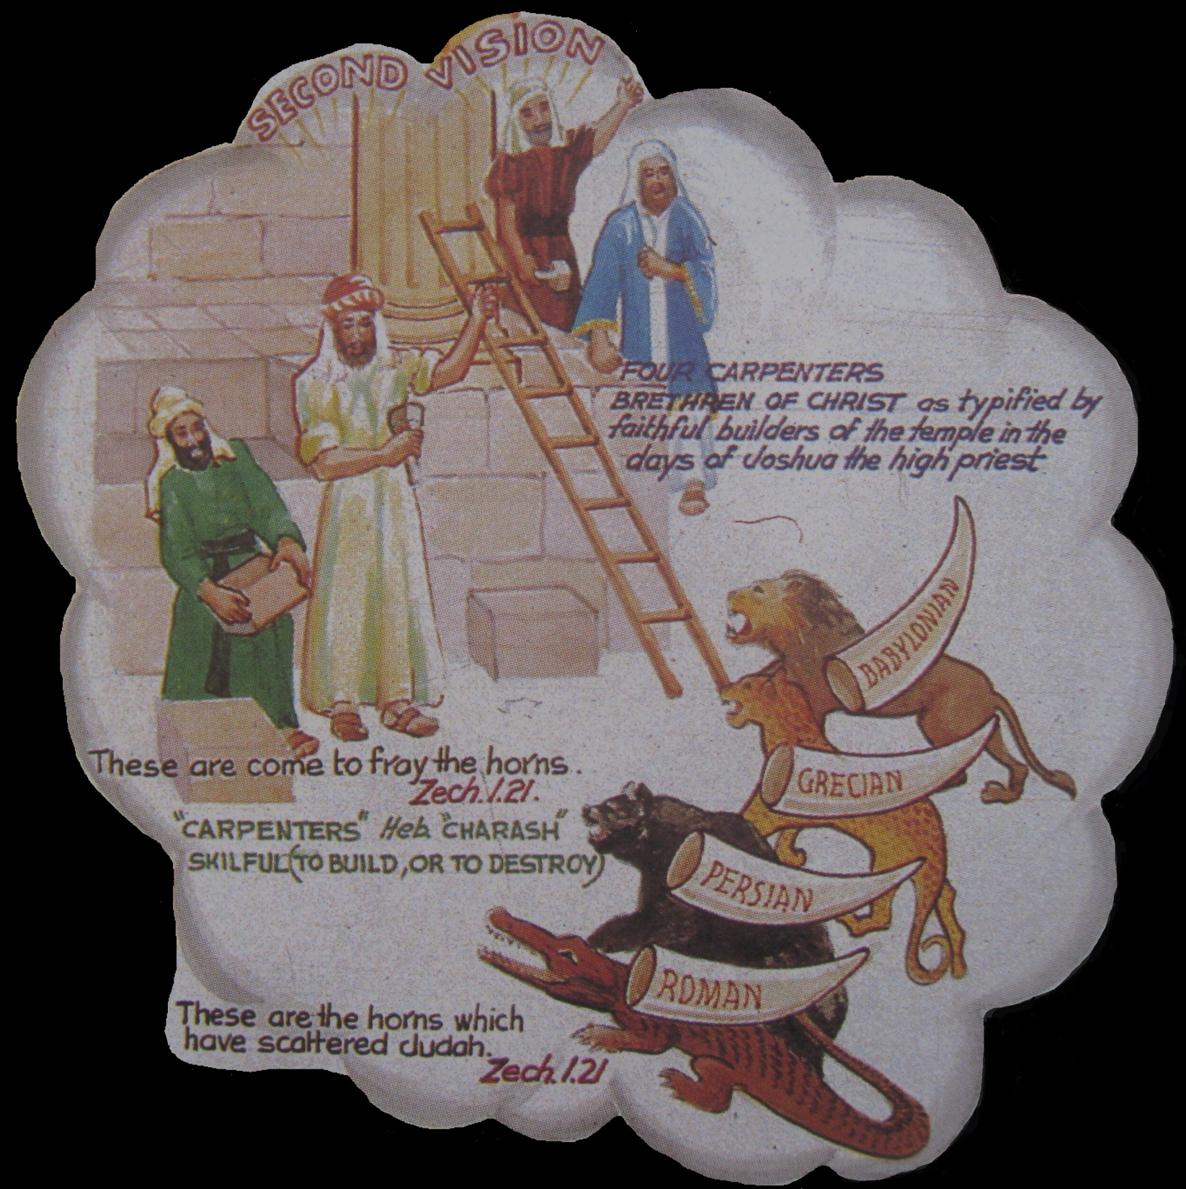
Zechariah’s 7 Night Visions
2nd Vision
The Man among the myrtle trees
Four horns and four craftsmen
The man with a measuring line
The coronation of Joshua the high priest
The lampstand and two olive trees
The woman in the ephah – flight of the storks
Two mountains of brass and four chariots

Slide 14
Four horns and four craftsmen Zech. 1:18-21
V.18 – “four horns” – Horn a symbol of power, therefore of nations – Dan. 8:21-22; Rev. 17:12.
V.19 – “the horns” - Represent four world empires which would scatter Jewry – Dan. 2 & 7.
V.20 – “four carpenters” – arba charash – Roth. – “Four Craftsmen”. Modelled by faithful builders in the house of God - Joshua and Zerrubabel & Haggai and Zechariah – ‘men of sign’ – Zech. 3:8.

Slide 15
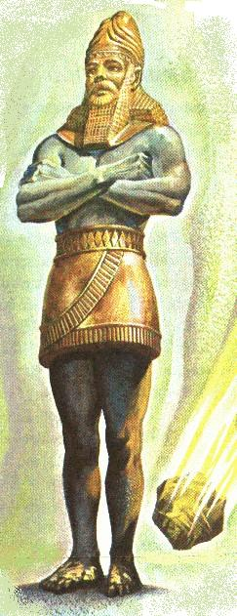
Four horns and four craftsmen - Zech. 1:18-21
The four craftsmen represent the perfect Israel of God formed to destroy Gentile power at Armageddon>.
V.21 – “What come these to do” – The saints in glory have a work to save ‘Judah’.
“so that no man did lift up his head” – Cp. V.18. Answer to trial = vision and diligent building in God’s house.

Slide 16
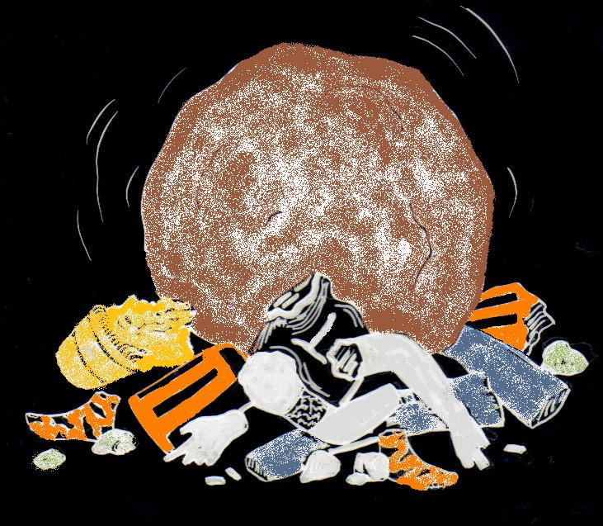
Four empires judged
V.21 – “but these are come” – The time for Divine vengeance will come.
“fray” – charad – to cause to tremble, drive in terror. 1st occ. Gen. 27:33.
“..to cast out the horns of the Gentiles, which lifted up their horn over the land of Judah to scatter it.”
“…and the stone that smote the image became a great mountain, and filled the whole earth.
Over a period of 40 years

Slide 17
Israel and Judah in the Prophetic Scriptures
‘Israel’, ‘Ephraim’ and ‘the remnant of Jacob’ – Refers to scattered Jewry worldwide – Zech. 9:13; Ezek. 20:27,30,39; Mic. 5:7-8.
‘Judah’ – Refers to the Jews in the Land at Christ’s return – Zech. 12:7.
When the people are the subject – not the Land!

Slide 18
Events leading to Armageddon
Russia invades Turkey and plunges down into Egypt
Christ and saints begin the subjugation of the Sinai Arab peoples
1
1
2
Judah First

Slide 19
Gog initially victorious
Tarshish nations fortify Jerusalem
Russia advances main force to Jerusalem
Christ and saints begin to smite and heal Egypt
Jews defeated, flee or are taken into captivity
6
Ships of
Tarshish
Gog
conquers
Egypt
Tarshish
powers
3
Gog a cruel lord in Egpyt
4
Gog rules Egypt
6
Christ and
saints advance
into Egypt
5
Judah First

Slide 20
Armageddon and aftermath
Zech. 12:7 – Yahweh also shall save the tents of Judah first.
Christ and the saints advance from Sinai to Jerusalem
Fleeing Jews return to the Land to meet their Messiah
Proclamation to the nations to submit to Christ’s rule
9
Proclamation to all nations
Armageddon
Throne of
David
established
8
Jews
“And his feet shall stand in that day upon the mount of Olives, which is before Jerusalem on the east, and the mount of Olives shall cleave in the midst thereof” – Zech. 14:4
7
Judah First

Slide 21
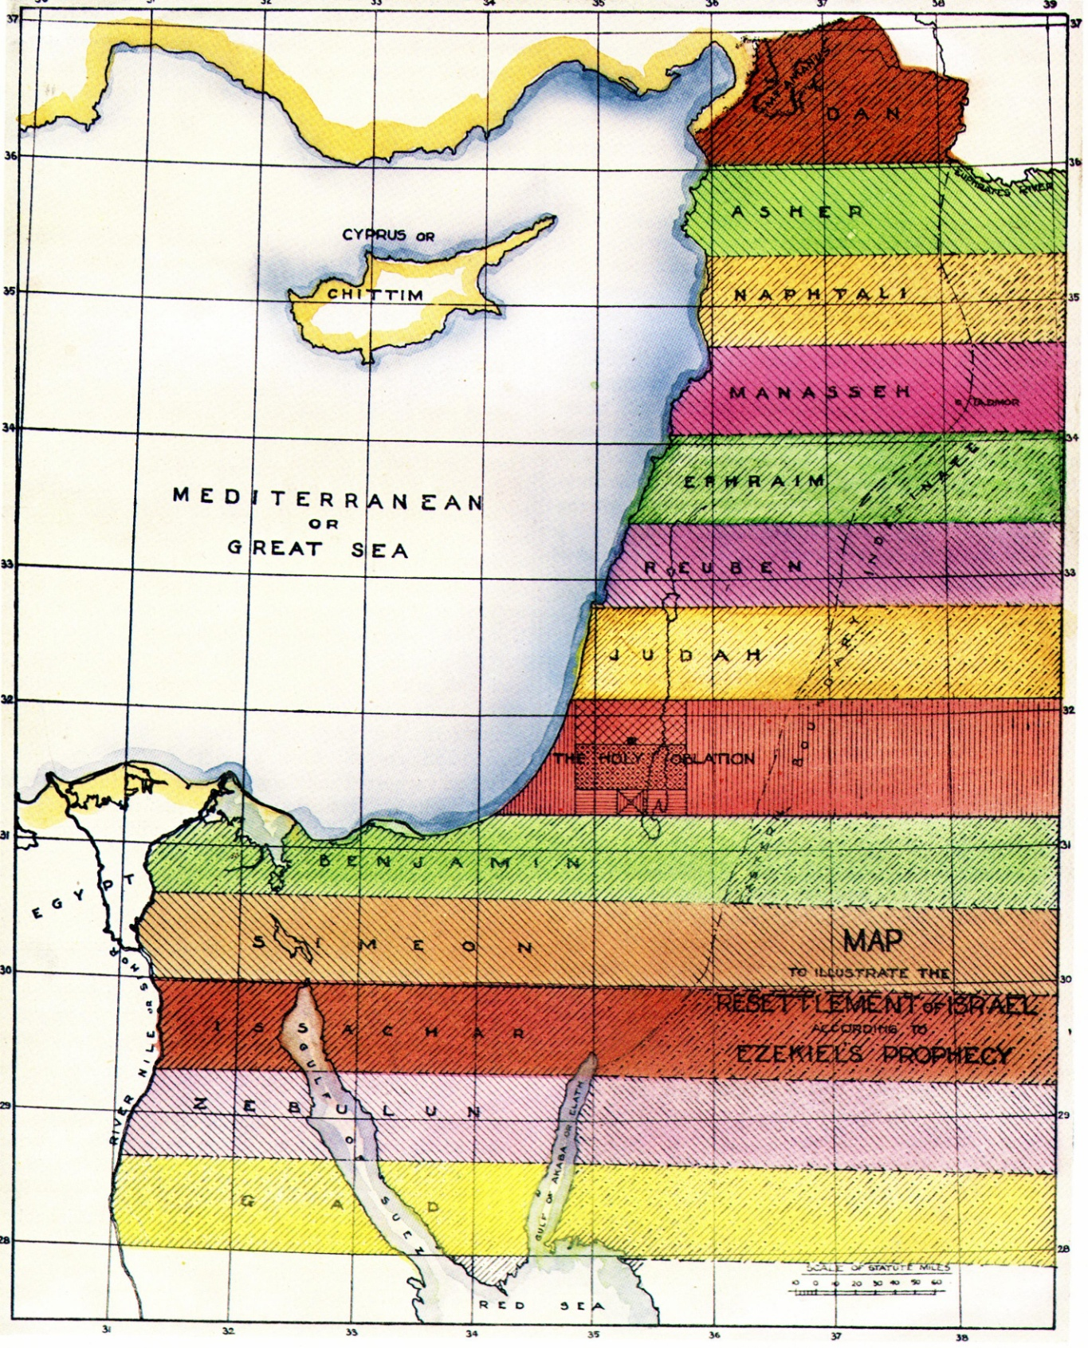
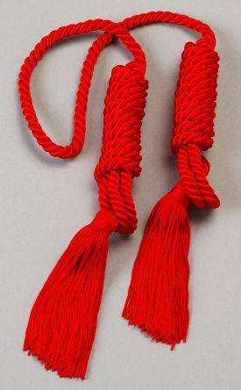
Judah’s inheritance beyond Armageddon
7 tribes north of the Holy Oblation
7 = Abrahamic Covenant – Hope of Israel
The Holy Oblation subsumes nearly all Judah’s ancient territory (Zech. 2:12).
In the future, Judah occupies a prominent place north of the Holy Oblation.
Judah first
Inheritance granted by Divine grace (5)
5 tribes south of the Holy Oblation

Slide 22
Next Study
(God willing)
Study 5
“Hur firstborn of Ephratah and father of Bethlehem”

Slide 23
… ….
...

