Slide 1
“Judah First”
Study 5
“Hur firstborn of Ephratah and father of Bethlehem”

Slide 2
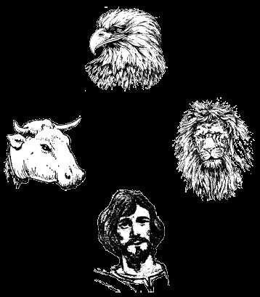
Four Gospels – Four faces of the Cherubim
Eagle = the Spirit - John
Each Gospel presents a different aspect of the greatness of the Lord Jesus Christ
Ox = servant - Mark
Man = the perfect man - Luke
Lion = king - Matthew

Slide 3
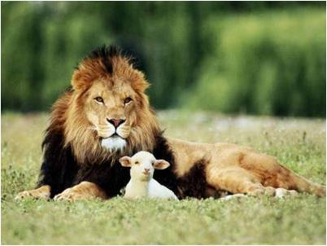
The Lion Gospel
The Gospel of Matthew reveals the lion face of the Cherubim – its focus is on Christ as the fulfilment of O.T. prophecy.
Bethlehem occurs 8 times in N.T. - 5 times in Matt. 2 :1,5,6,8,16 – then Luke 2:4,15; John 7:42.
Matthew focuses on Jesus Christ as the promised king of Israel – the son of David – the lion of the tribe of Judah.

Slide 4
The 14 Generations of Scripture
Gen. 2:4 – The heavens and the earth
Gen. 5:1 – Adam
Gen. 6:9 – Noah
Gen. 10:1 – The sons of Noah
Gen. 11:10 – Shem
Gen. 11:27 – Terah
Gen. 25:12 – Ishmael
Gen. 25:19 – Isaac
Gen. 36:1 – Esau
Gen. 36:9 – The sons of Esau
Gen. 37:1 - Jacob
11 generations in Genesis

Slide 5
The 14 Generations of Scripture
Num. 3:1 – Aaron and Moses
Ruth 4:18 – Pharez
Matt. 1:1 – Jesus Christ
Gal 4:4-5 - But when the fulness of the time was come, God sent forth his Son, made of a woman, made under the law,
To redeem them that were under the law, that we might receive the adoption of sons.
Matt. 1 contains 3 series of 14 generations – V.17 – Abraham to David; David to the Babylonian captivity; the Babylonian captivity to Christ.

Slide 6
The number 14 in Scripture
14 is 2 x 7
Seven is (among other things) the covenant number. When a matter is doubled in Scripture it is “established by God” and is therefore certain – Gen. 41:32.
The spiritual significance of 14 is ‘the certainty of covenant’.
And for that the dream was doubled unto Pharaoh twice; it is because the thing is established by God, and God will shortly bring it to pass.

Slide 7
The red cord in Matt. 1
¹ The book of the generation of Jesus Christ, the son of David, the son of Abraham.
² Abraham begat Isaac; and Isaac begat Jacob; and Jacob begat Judas and his brethren;
³ And Judas begat Phares and Zara of Thamar; and Phares begat Esrom; and Esrom begat Aram;
⁴ And Aram begat Aminadab; and Aminadab begat Naasson; and Naasson begat Salmon;
The red cord ‘firstborn’ displaced by his brother

Slide 8
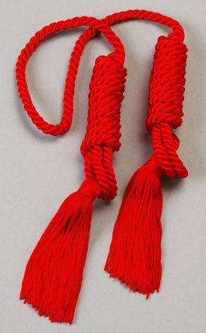
The red cord in Matt. 1
⁵ And Salmon begat Boaz of Rachab; and Boaz begat Obed of Ruth; and Obed begat Jesse;
⁶ And Jesse begat David the king; and David the king begat Solomon of her that had been the wife of Urias;
Josh. 2:18,21 – Rahab the red cord Gentile convert
Ruth the Moabitess – another ‘red cord’ convert
Inclusion of Gentiles

Slide 9
Bethlehem Ephratah - Mic. 5:2
“though thou be little among the thousands” – Roth. – “though, little, to be among the thousands of Judah”; i.e. “too small to be among”.
“unto me” – Not to Israel!
“goings forth” – motsa’ah – origin, place of going forth. Strong says sig. “a family descent”.
“from everlasting” – min yome olam – Roth. – “from the days of age-past time”, i.e. he would be the son of God.

Slide 10
Bethlehem Ephratah
Bethlehem - “House of bread”.
Name occurs 49 times in Scripture – 41 O.T. and 8 N.T. Josh. 19:15 is of a town in the tribe of Zebulun.
Ephratah - “fruitfulness”. 10 occs. O.T. – 1st Gen. 35:16 (here Rachel died V.19); last Mic. 5:2.
Place - The first name of Bethlehem – Gen. 35:19; 48:7.
Person - Second wife of Caleb, Hezron’s son; mother of Hur; grandmother of Bezaleel.

Slide 11
Hur - 1 Chron. 4:4
“These are the sons of Hur, the firstborn of Ephratah, the father of Bethlehem.”
The inhabitants of Bethlehem descended from Hur through his son Salma, who is also called in 1 Chron. 2:51 ‘father of Bethlehem’.
“the father (founder) of Bethlehem,” which as late as the 13th century A.D. was famed for tapestry weaving, the art for which Bezaleel his grandson was famed. Jesse was said to have woven veils of the sanctuary. (Fausset)

Slide 12
Hur - 1 Chron. 4:4
Hitchcock - liberty; whiteness; hole. Strong – from root chur - “white linen”.
Josephus makes Hur the husband of Miriam, Ant. 3:8, section 4.
Ex. 24:14 – Given equal authority with Aaron in Moses absence.
Three of his sons founded communities of Judah in important centres – Kirjath-jearim, Bethlehem and Beth-gader.
His grandson Bezaleel played a critical role in the construction of the Tabernacle.

Slide 13
RSV - 1 Chron. 2:50-51
These were the descendants of Caleb. The sons of Hur the first-born of Eph’rathah: Shobal the father of Kir’iath-je’arim, Salma, the father of Bethlehem, and Hareph the father of Beth-gader.
The A.V. translates - “These were the sons of Caleb the son of Hur” hinting at another Caleb. This is not so.
Mention of Achsah (v.49) has troubled interpreters. The word “daughter” is most likely used in its wider sense of a later female descendant.

Slide 14
The family tree of Hur
Hezron
Dies
Caleb
Azubah
Ephratah
1 Chron. 2:18
1 Chron. 2:19
Jesher, Shobab, Ardon
Hur
1 Chron. 2:20
Shobal
Salma
Hareph
Uri
Father of Kirjath-jearim
Father of Bethlehem
Father of Beth-gader
Bezaleel

Slide 15
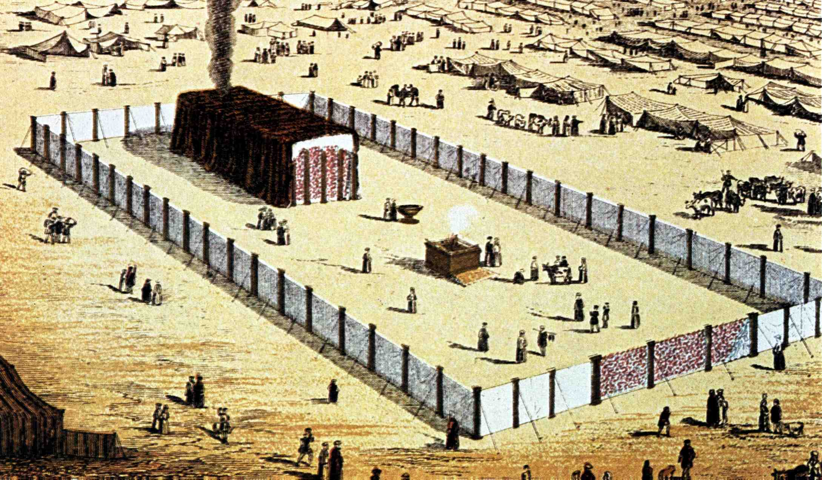
Bezaleel son of Uri
1 Chron. 2:20 – “Uri” – fiery.
“Bezaleel” – “in the shadow (i.e. protection) of God” – Ex. 31:2; 35:30; 36:1-2.
“I have filled him with the spirit of God, in wisdom, and in understanding, and in knowledge, and in all manner of workmanship.”

Slide 16
Two famous Caleb’s in Judah
The line of Pharez
Representatives of the Red Cord line
Hezron
Caleb
Hur
Uri
Bezaleel
Kenezites
Jephunneh
Caleb
Elah
Kenaz
Achsah
Mosaic
Abrahamic

Slide 17
Israel’s stations – Marah to Rephidim
Num. 33:5-14
6. Marah
7. Elim
8. Red Sea
9. Wilderness of Sin
10. Dophkah
11. Alush - “I will knead (bread)”.
12. Rephidim

Slide 18
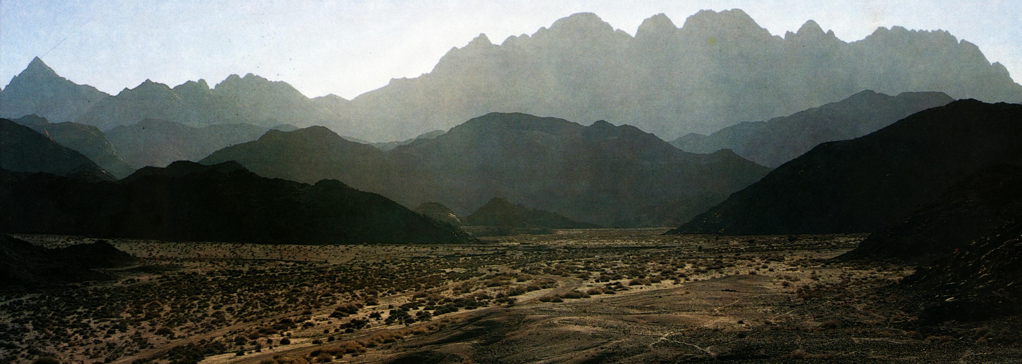
Amalek country
Deut. 25:17-18 – “Remember what Amalek did unto thee by the way, when ye were come forth out of Egypt;
How he met thee by the way, and smote the hindmost of thee, even all that were feeble behind thee, when thou wast faint and weary; and he feared not God.”

Slide 19
Amalek – Ex. 17:8
“Amalek” - occurs 24 times
“Amalekite/s” - occurs 27 times
Meaning:
“Warlike” (Young’s Concordance)
“A strangler of the people” (The Hebrew & English Bible Students Concordance)
Name occurs 7 times in chapter = complete manifestation in relation to a covenant - Gen. 3:15.
51 occs.

Slide 20
Joshua – Type of Christ
“Yah saves” or “Yahweh shall save“.
First appears in Scripture in Exodus 17:9.
Name occurs 4 times in chapter ( the number of righteousness, God manifestation and a new creation).
Son (ben) of Nun – “family builder of perpetuity”. Root - to resprout, that is, propagate by shoots; figuratively, to be perpetual.

Slide 21
The rod of God
Ex. 4:2-4 - Cast to ground, became a serpent - Related to the earth and sin.
Ex. 4:20; 17:9 - Called “the rod of God”.
Ex. 17:5-6 - Used to smite “rock” (Christ – 1 Cor. 10:4) - Represents the crucifixion of Christ.
In the hands of Moses represents the cross – the instrument of smiting (crucifixion).

Slide 22
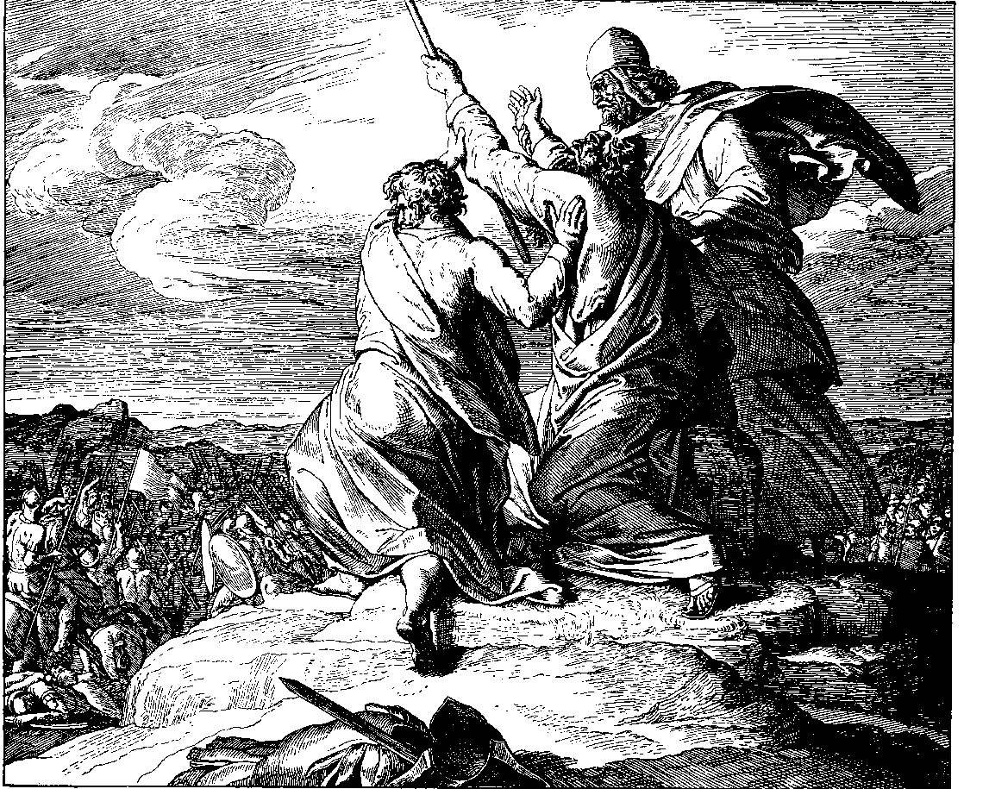
Moses hands – Ex. 17:9-12
Initially Moses uses only one hand to hold the rod high.
In v.12 he holds the rod in both hands - his arms supported by Aaron and Hur.
With both hands on the serpent rod Moses is presented in the posture of crucifixion.

Slide 23
“The joy set before him”
Aaron - High Priest elect - not yet appointed (Ex. 28:1) - Type of Christ as priest in preparation.
Moses - The man of God, Israel’s law-giver - Christ to be a prophet like unto Moses (Deut. 18:18).
Hur – “White linen” (Rev. 19:8) - of the tribe of Judah (Ex. 31:2) - the royal tribe - Christ as son of David and King-elect.
Represent Christ during his ministry

Slide 24
Rehearsed before Joshua
Ex. 17:14 - Young’s Literal - “Write this, a memorial in a Book, and set it in the ears of Joshua, that I do utterly wipe away the remembrance of Amalek from under the heavens”.
“rehearse” – siym – to put.
“the ears of Joshua” – Here a type of Christ. This is inserted for the benefit of Christ whose work was to “exterminate” Amalek.

Slide 25
Yahweh-Nissi Altar
The word “Nissi” is the Hebrew nes signifying a flag; also a sail; by imp. a flagstaff (Strong).
Gesenius – “something lifted up, a token to be seen far off”.
Used of a banner raised in war to gather the people to a place of assembly; a column or lofty pole; a sign by which anyone is warned.
First occurs in Ex. 17:15 - next occ. is Num. 21:8,9. 21 occs. in the O.T.
Paraphrase – “He who will be manifested (by sacrifice) on a pole to assemble his people for warfare.”

Slide 26
The Companion Bible on Ex.17:16
The margins of the A.V. and R.V. show the perplexity caused by the Ellipsis of the verb. “Surely the hand (lifted up) upon the banner of Yah (is to swear): for the war of Yahweh against Amalek is to be from generation to generation”. So it was. It was carried on by Ehud (Jud.3:13-15), Barak (Jud.5:14), Gideon (Jud.6:3; 7:12-14), Saul (1 Sam. 15:2-9, cp.v.11), Samuel (1 Sam.15:32-33), David (1 Sam.27:8; 30:1,17; 2 Sam. 8:12), Simeonites (1 Chron. 4:42,43) and Mordecai (Esther 3:1-6; 9:7-10).

Slide 27
Translations - Ex.17:16
Rotherham – “Because of a hand against the throne of Yah, Yahweh hath war with Amalek, - from generation to generation!”
Youngs Literal – “Because a hand is on the throne of Yah, war is to Yahweh with Amalek from generation - generation.”
Jerusalem Bible – “Lay hold of the banner of Yahweh! Yahweh is at war with Amalek from age to age.”
Moffatt – “We pledge loyalty to the Eternal's banner in his feud against Amalek from age to age!”

Slide 28
The final destruction of Amalek – Rev.20:8
The adversary which is released at the end of the Millennium and deceives (misleads) Gog and Magog is the serpent in political manifestation.
Gog and Magog (identified with Amalek) are not the nations of Ezek. 38 but represent the final outburst of human hostility to God and His people.
The word “battle” is polemos - warfare. It is the word used by Lxx in Ex. 17:16 (“Yahweh will have war with Amalek from generation to generation”.

Slide 29
The final occurrence of the name “Judah” is in the enumeration of the 144,000:
Rev. 7:4-5 - And I heard the number of them which were sealed: and there were sealed an hundred and forty and four thousand of all the tribes of the children of Israel.
Of the tribe of Judah were sealed twelve thousand…..
“Judah First”

Slide 30
… ….
...

