Slide 1

NEHEMIAH
SPIRITUAL LEADERSHIP
Strategist/Visionary
Motivator
Positive Communication Patterns
Confrontation – Anger Management
Managing Opposition

Slide 2
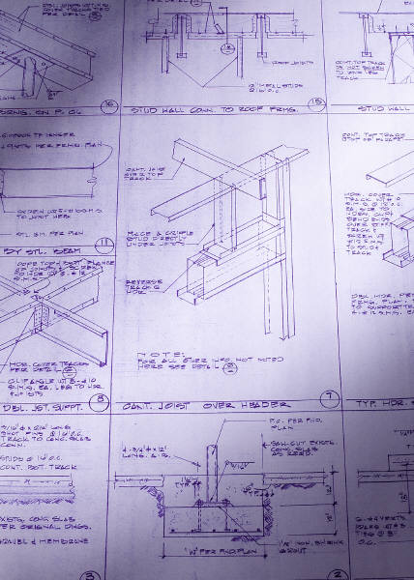
NEHEMIAH
STRATEGIST & VISIONARY

Slide 3
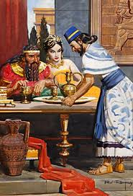
Nehemiah 2
STRATEGIST & VISIONARY
Verse 1
‘Nisan’
- 4 Months – cp 1:1 ‘Chisleu’
Formulate plan
Refine the plan
Assess Risks – ie confront the king
Establish priority – brethren & wall
Gain courage

Slide 4
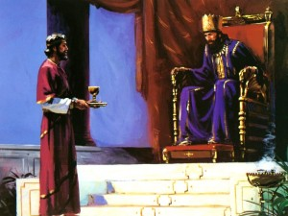
Nehemiah 2
STRATEGIST & VISIONARY
Verse 4
“for what dost thou make request”
Ezra 4:11-24
Note: v.21 - Nehemiah’s window of opportunity!
“So I prayed…”
- a short quick prayer prior to uttering a word
Prov. 3:6 - ‘In all thy ways acknowledge him….’
Phil. 4:6 - ‘…everything by prayer and supplication’

Slide 5
Nehemiah 2
STRATEGIST & VISIONARY
Verse 6-9
“pleased the king”
Proof Positive - Prov.21:1 - ‘king’s heart is in the hand of the Lord’
Prov.3:1,4 - ‘…find favour in the sight of God and man’
Is.58:8-12
‘thou shalt call and the Lord shall answer….
And thou shalt be called the repairer of the
breach, The restorer of paths to dwell in’
Gantt Chart (timeline) – ‘I set him a time’
Secured Passage – ‘letters…convey me over’
Supplies & Materials – ‘king’s forest’
Security – ‘captains and horsemen’
Project
Management

Slide 6
Nehemiah 2
STRATEGIST & VISIONARY
Verse 11
“So I came to Jerusalem and was there three days”
- no fanfare, no accolades
I Jn.3:1 - ‘the world knoweth us not’
Col.3:3 - ‘your life is hid with Christ’
Verse 12
“neither told I any man”
Exhort - The wisdom of keeping one’s tongue!
Psalm 141:3

Slide 7
Nehemiah 2
STRATEGIST & VISIONARY
Verse 13-16
Tower of Meah
Tower of Hananel
Fish Gate
Sheep Gate
‘the rulers knew not’
Old Gate
Prison Gate
Trust???
Ezra 9:2
Neh.6:17-19
East Gate
Horse Gate
Ophel
Tower
Water Gate
WHAT WAS HE
DOING?
Valley Gate
Fountain Gate
Dung Gate

Slide 8

Nehemiah 2
STRATEGIST & VISIONARY
Exhort
NEHEMIAH
What do we see when we walk the perimeter of our ecclesia?
When we view our ecclesia from the outside looking in?
MOTIVATOR
WHAT IS YOUR VISION? WHAT IS YOUR STRATEGY?

Slide 9


Nehemiah 2
MOTIVATED BY OPPORTUNITY
MOTIVATOR OF OTHERS
Verse 17
“Ye see the distress that we are in”
Exhort
Sometimes it takes a ‘stranger’ to see sharply what has been
softened by familiarity!
Lam. 2:2, 8-9
3:51 - ‘Mine eye affecteth mine heart’

Slide 10
Nehemiah 2
MOTIVATED BY OPPORTUNITY
MOTIVATOR OF OTHERS
Verse 17
SERVANT LEADERSHIP
‘…let us……that we be…
we His servants (v.17)’
“a reproach”
RSV - ‘disgrace’
Heb - ‘to expose by stripping, to betroth (as if a surrender)’
Exhort - Lethargy, apostacy and indifference -------- apathy!!!
Verse 18
“Let us rise up and build”
“then I told them…”
The people respond….
I Cor.3:10-11
“they strengthened their hands”
I Chron 19:13
Heb. 12:12-13

Slide 11

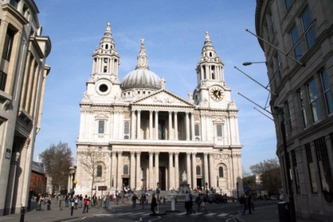
Nehemiah 2
MOTIVATED BY OPPORTUNITY
MOTIVATOR OF OTHERS
Verse 19
“laugh us to scorn”
Ps. 80:6 - ‘our enemies laugh among themselves’
Test the strength of our conviction!
Verse 20
"We his servants will
arise and build"

Slide 12
Nehemiah 2
STRATEGIST & VISIONARY
Exhort
NEHEMIAH
What do we see when we walk the perimeter of our ecclesia?
When we view our ecclesia from the outside looking in?
POSITIVE
COMMUNICATOR
WHAT IS YOUR VISION? WHAT IS YOUR STRATEGY?

Slide 13
NEHEMIAH
POSITIVE COMMUNICATION
PATTERNS
PRODUCING POWERFUL
RESULTS
Master Communicator

Slide 14

Pattern
LISTENS then PRAYS
objectively
empathetically
instinctively
Ja. 1:19 – ‘let every man be swift to hear, slooooooooooooow to speak’
Neh.1:2-4
sat down
wept
mourned
fasted
prayed
……certain days

Slide 15
Pattern
ALWAYS SPEAKS TO GOD BEFORE
ANSWERS MAN
Nehemiah 2:4-5
A short quick prayer of very few words!
Romans 12:12
Phil.4:6
Prov.3:6
Nehemiah 4:4-6, 7-9
Nehemiah 6:9

Slide 16
Pattern
KNOW WHEN TO KEEP SILENCE
Ecc. 3:7 – ‘a time to keep silence’
Nehemiah 2:12,16
‘set a watch O Lord, before my mouth; keep the door of my lips’
Ps. 141:3
‘whoso keepeth his mouth & his tongue keepeth
his soul from troubles’
Prov. 21:23

Slide 17
Pattern
POSITIVE MOTIVATIONAL COMMUNICATION
Nehemiah 2:17-18
Proverbs 29:18
‘Where there is no vision the people perish’
Heb. ‘to see with the mind’
NKJV – ‘cast off restraint’
Nehemiah gave the people the ability to see…..
…themselves differently!!!

Slide 18
Nehemiah 2
STRATEGIST & VISIONARY
Exhort
NEHEMIAH
What do we see when we walk the perimeter of our ecclesia?
When we view our ecclesia from the outside looking in?
CONFRONTATION
ANGER MANAGEMENT
WHAT IS YOUR VISION? WHAT IS YOUR STRATEGY?

Slide 19

Nehemiah 5
CONFRONTATION
ANGER MANAGEMENT
Verse 1-5
“a great cry of the people”
James 5:1-4
“against their brethren”
The Call of Brethren
Lev. 25:35-38
I Cor.6:6-8
Scenario
v.2 Our sons and daughters need food!
v.3 Mortgaged lands, houses, vineyards to buy food!
v.4 Borrowed money to pay king’s tribute against lands.
v.5 Sons and daughters taken into bondage as servants!

Slide 20

Nehemiah 5
CONFRONTATION
ANGER MANAGEMENT
Verse 6
‘I was very angry’ Heb. ‘was angering – to glow, grow warm’
ie Paul - II Cor. 11:29
Verse 7
‘consulted with myself’
NEB - ‘I mastered my feelings and reasoned with the elders’
Freedom to Choose

Slide 21


Nehemiah 2
CONFRONTATION
ANGER MANAGEMENT
STIMULUS
RESPONSE
Reactive

Slide 22

Nehemiah 2
CONFRONTATION
ANGER MANAGEMENT
STIMULUS
RESPONSE
Pause
Freedom to Choose

Slide 23
Nehemiah 2
CONFRONTATION
ANGER MANAGEMENT
STIMULUS
RESPONSE
Pause
Freedom to Choose
DIVINE PRINCIPLES FOR CONDUCT

Slide 24

Nehemiah 2
CONFRONTATION
ANGER MANAGEMENT
The 5 Step Process
1. Consciously acknowledge to yourself that you are angry.
Eph. 4:26 – “Be ye angry, and sin not”
Challenge is not ‘Don’t get angry’ but…. not to sin when we are angry!
Pause
2. Restrain your immediate response
Prov.29:11 – ‘A fool gives full vent to his anger’
Prov.19:11 – ‘People with good sense restrain their anger’
Prov.14:17 – ‘A quick tempered man does foolish things.’
‘Speak when you are angry and you will make the
best speech you will ever regret.’
Anonymous

Slide 25
Nehemiah 2
CONFRONTATION
ANGER MANAGEMENT
The 5 Step Process
3. Seek to understand before making yourself understood.
Principle – Ecc.5:1-2
James 1:19-20 – quick to listen…slooooooow to wrath !
CHANGE THE WAY WE THINK….
‘I assume I don’t fully understand, and I need to listen’
‘If I listen first and understand, then I will be better understood’

Slide 26
LEVELS OF LISTENING
Ignoring – making no effort to listen
Pretend Listening – making believe or giving the appearance
you are listening
Selective Listening – hearing only parts of the conversation that interest you
Attentive Listening – paying attention and focusing on what the speaker says
and comparing that to your own experiences
Empathic Listening – listening and responding with both the heart and mind to
understand the speaker’s words, intent and feelings

Slide 27
"EM" "PATHOS"
(Greek)
“in”
“feeling, suffering”
We have empathy when we put ourself in another’s place and experience
feelings as he or she experiences them. It does not mean we agree but that we
deeply understand another person emotionally and intellectually.
Indicator Phrases
‘As I get it, you felt that…’
‘I’m picking up that you…’
‘So, as you see it…’
‘What I guess I’m hearing is…’
‘I’m not sure I’m with you but…’
‘You place a high value on…’
‘As I hear it, you…’
‘You must have felt…’
‘Your message seems to be, I…’
Help the Speaker Feel Understood
Repeat Content
Rephrase Content in Own Words
Reflect Feelings
Rephrase & Reflect Feelings in Own Words

Slide 28
Nehemiah 2
CONFRONTATION
ANGER MANAGEMENT
The 5 Step Process
Consciously Decide to Overlook the Matter
- not same as storing your anger
- Releasing the anger to God – giving up the right to take revenge
Rom.12:9 – God’s prerogative
Prov 19:11 – ‘The discretion of a man deferreth his anger; and it is his
glory to pass over a transgression.’
Col.3:13 – ‘forbear’
4. Analyze Your Options
ii) Lovingly Confront the Person
Gal.6:1 – ‘restore such an one in the spirit of meekness’ – RESTORATION
Lu.17:3-4 – ‘…if thy brother trespass against thee, rebuke him…’
rebuke = ‘to set a weight upon’
laying a matter before a bro/sis kindly and firmly
realize there is always possibility you have misunderstood
suggestion – write it before you speak it
Result – 1. Explanation 2. Confession --- framework for reconciliation

Slide 29
Nehemiah 2
CONFRONTATION
ANGER MANAGEMENT
The 5 Step Process
5. Take Constructive Action
If we choose to let the offense go……PRAY !
If we choose to lovingly confront do so gently….PRAY!
Matt.5:22-24
Forgiveness
Must always be given
Is the promise that you will no longer hold this particular offense
against the person…
Your anger has served its purpose – it has motivated you to take
constructive action to see that the issue was resolved!

Slide 30
Nehemiah 2
CONFRONTATION
ANGER MANAGEMENT
1. Consciously acknowledge to yourself that you are angry.
v.6 ‘And I was very angry’
2. Restrain your immediate response
v.7 ‘I consulted with myself’
3. Seek to understand before making yourself understood.
v.8 ‘Then held they their peace, and found nothing to answer’
4. Analyze Your Options
Overlook the Matter
Lovingly Confront
v.9 – ‘It is not good that ye do…’
5. Take Constructive Action
v.12 – ‘Restore…require nothing…take an oath’
v.14-19 – Set an example

Slide 31
Nehemiah 2
STRATEGIST & VISIONARY
Exhort
NEHEMIAH
What do we see when we walk the perimeter of our ecclesia?
When we view our ecclesia from the outside looking in?
MANAGING OPPOSITION
WHAT IS YOUR VISION? WHAT IS YOUR STRATEGY?

Slide 32
Nehemiah 2,4,6
MANAGING OPPOSITION
OPPOSITION
Grief – 2:10
Ridicule – 2:19
Indignation, intimidation – 4:1-3
Violence – 4:3-8
Cunning craftiness – 6:1-2
Compromise – 6:5-7

Slide 33
Nehemiah 2,4,6
MANAGING OPPOSITION
STRATEGY
1. Let them know where they stand!
‘no portion, no right, no memorial in Jerusalem’ 2:20
2. Verbal or physical confrontation
Silence before the Opposition
Prayer to God. – 4:4,9
Progress continues. – 4:6,9,13-23
3. Craftiness or Compromise
Refuses to meet their terms – 6:4
Prayer to God. – 6:9
Progress continues. – 6:3,15

Slide 34
NEHEMIAH
SPIRITUAL LEADERSHIP
Strategist/Visionary
Motivator
Positive Communication Patterns
Confrontation – Anger Management
Managing Opposition
Are you the Spiritual Leader your ecclesia needs you to be?

