Slide 1

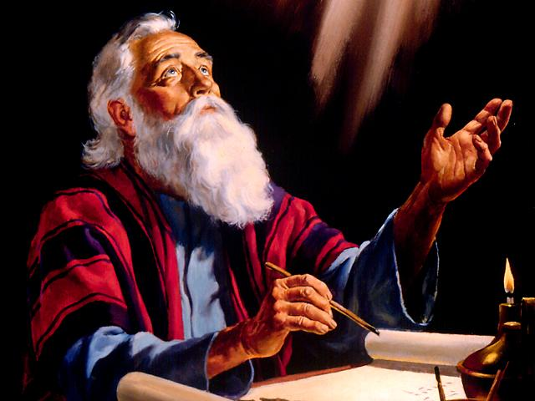
7
Seals
7
1 2 3 4 5 6
Trumpets
Vials
7
1 2 3 4 5 6
Judgement Pagan Rome
1 2 3 4 5 6
Judgement Christian Rome
Judgement H. R. Empire
Conquerors through Christ
Manitoulin Family Camp 2024

Slide 2

Conquerors through Christ.
7
Seals
7
1 2 3 4 5 6
Trumpets
7
1 2 3 4 5 6
Vials
Judgement - Pagan Rome
1 2 3 4 5 6
Judgement - Christian Rome
Rev.6
Judgement - Holy Roman Empire
Rev.8 & 9
AD 96 – AD 324
Rev.16
AD 395 – AD 1685
AD 1789 – AD 1820

Slide 3
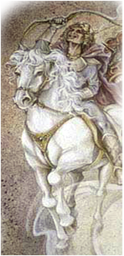
Conquerors through Christ.
7
Seals
1
4 5 6
AD 324
2 3
Study 1
“And he went forth conquering and to conquer.” (Seals 1-2)
Judgement - Pagan Rome Rev.6
2Thess.2:7
3

Slide 4
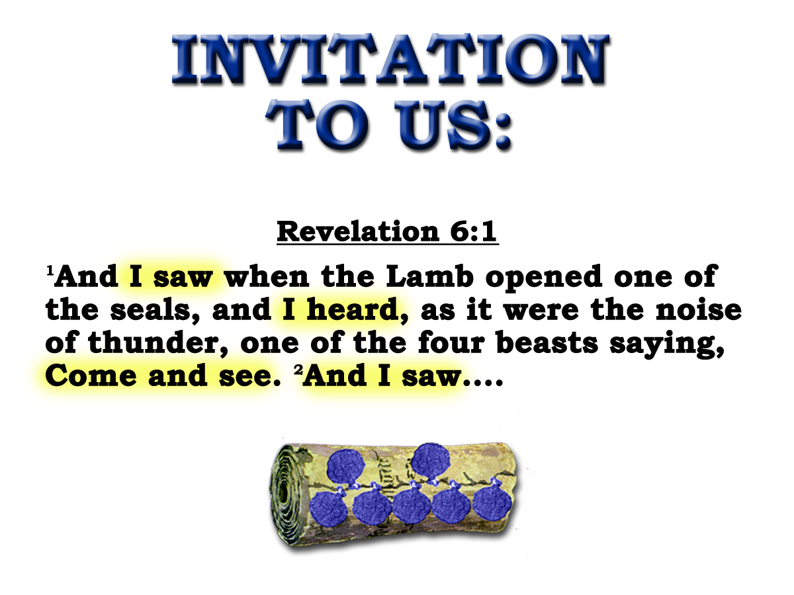
4

Slide 5
1
"Come and see"
6:1
First
four
seals
2
"Come and see"
6:3
3
"Come and see"
6:5
4
"Come and see"
6:7
5

Slide 6
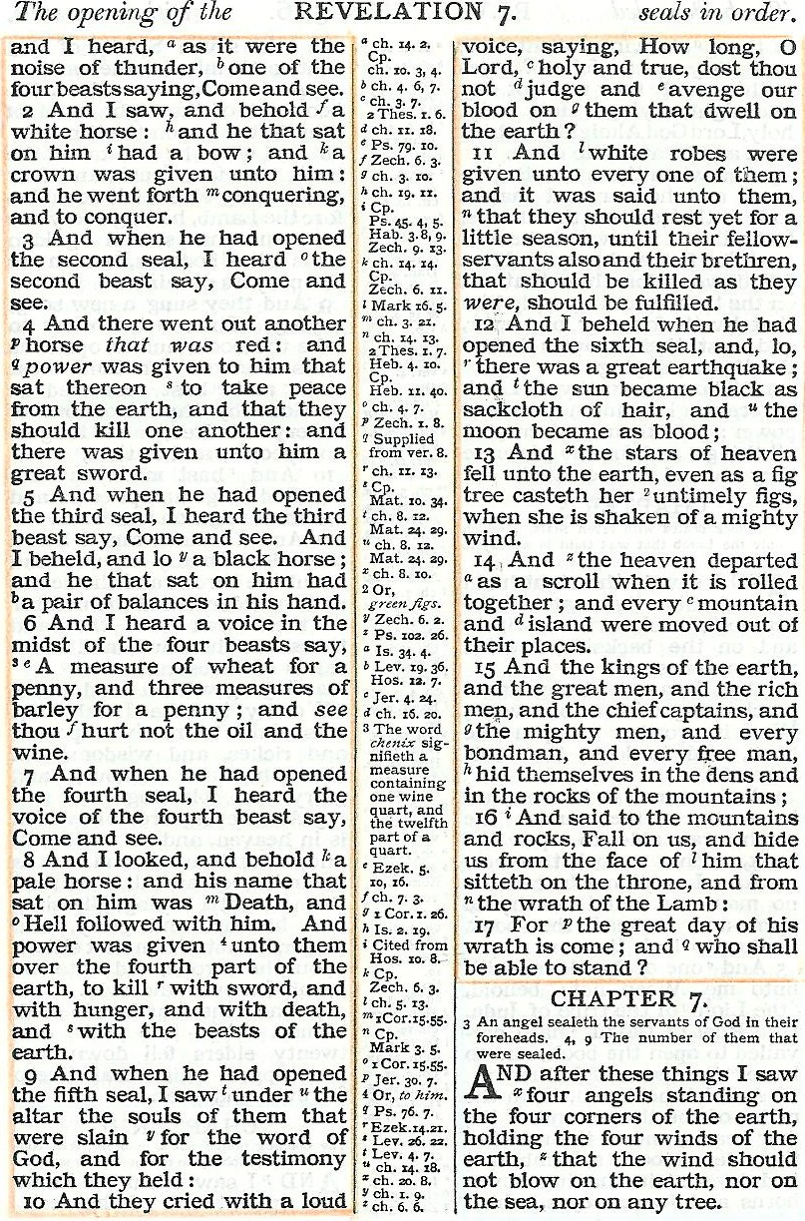
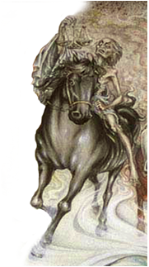
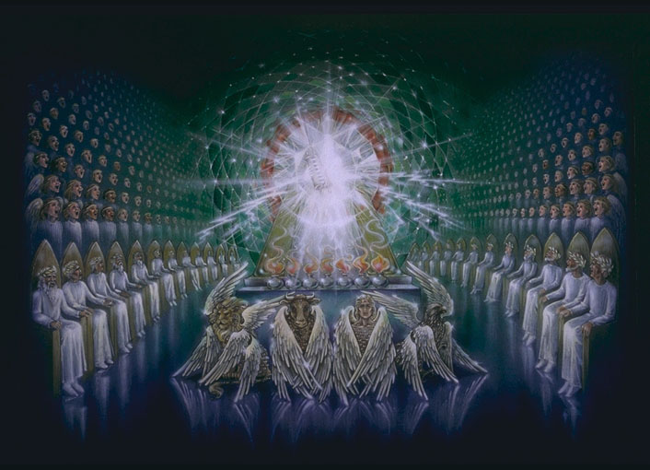
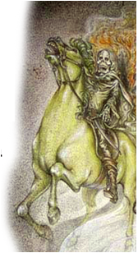
No ‘come and see’ !
No ‘living ones’ !
Note John 1:38-39
Revelation Ch.4:4-7
Four Beasts
Gk.=Zoa = Living Ones
6

Slide 7
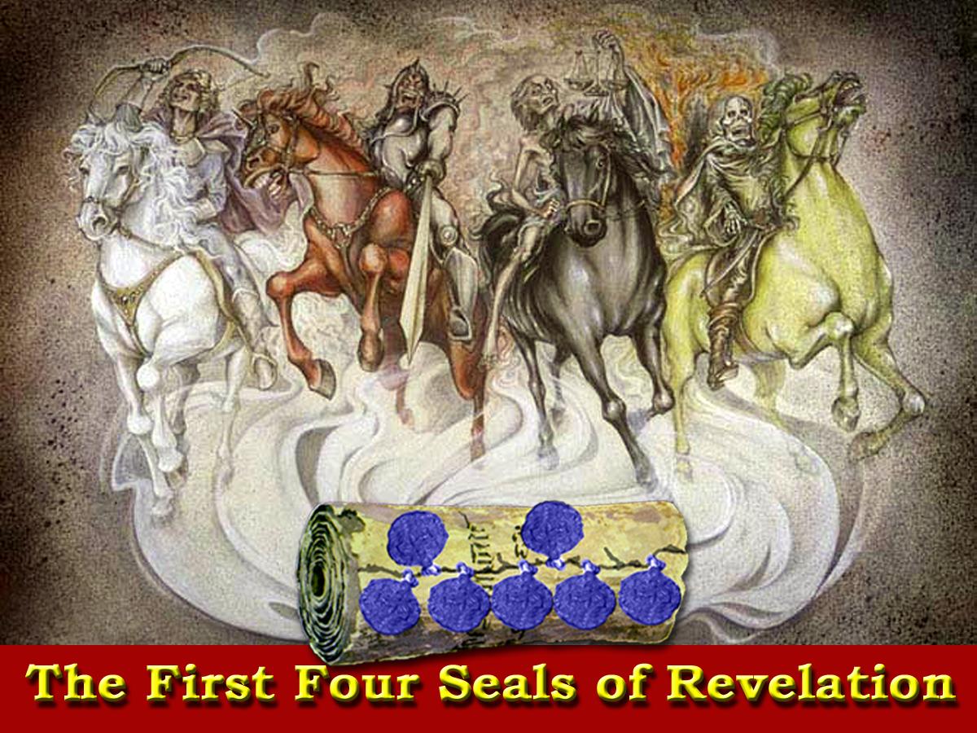
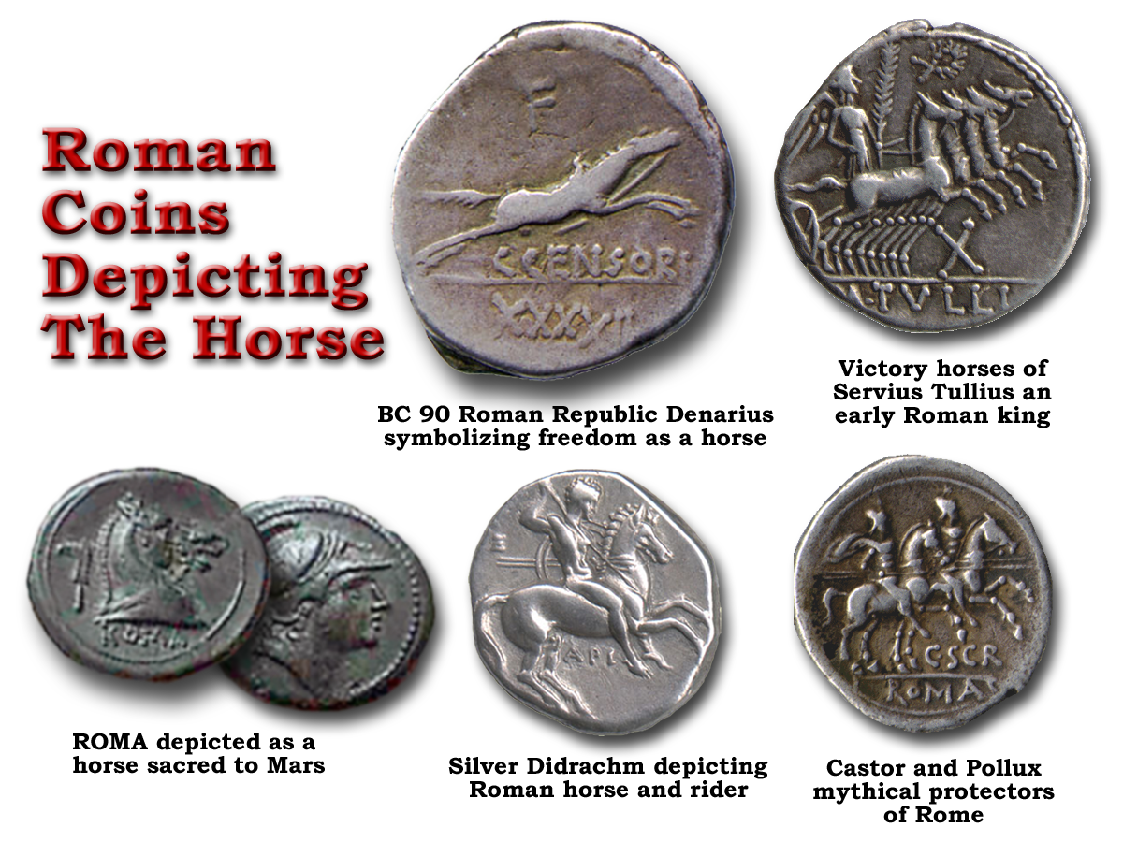
The horse was considered a symbol of the free spirit of Rome guided by the emperors
Blood
Death
Peace
Famine
Horses were as much a part of Rome’s heraldry as the eagle.
Rev.11:4Rev.6:8
The earth is the Empire
The horse its condition
The rider the reason

Slide 8
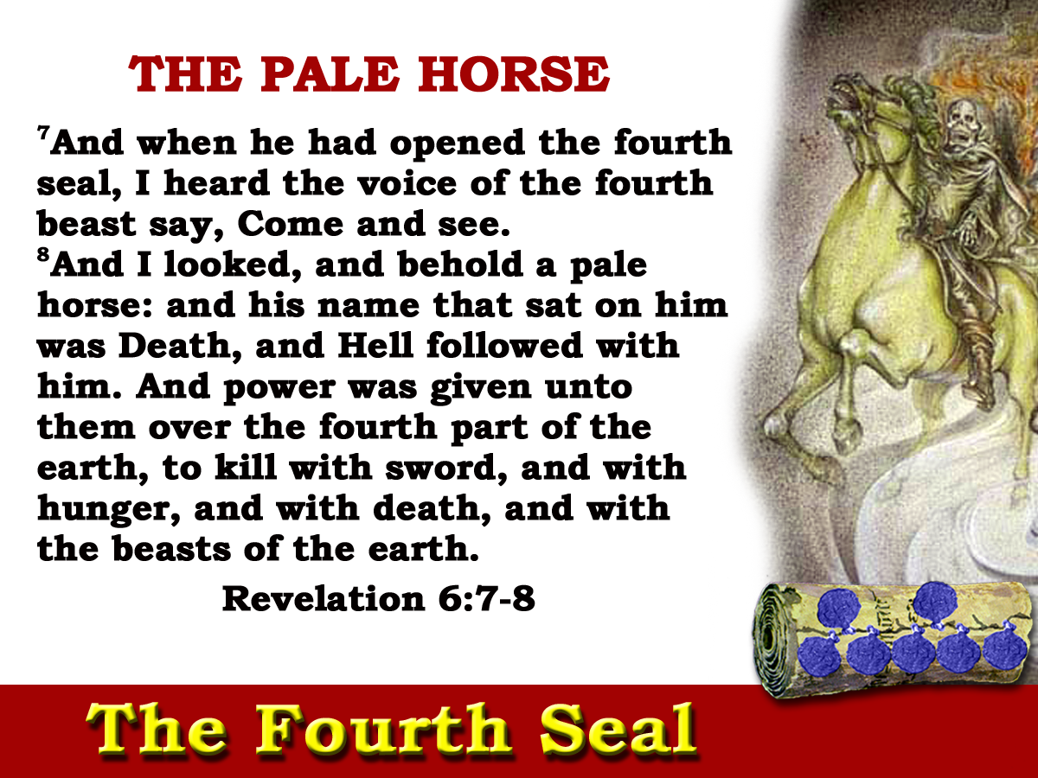
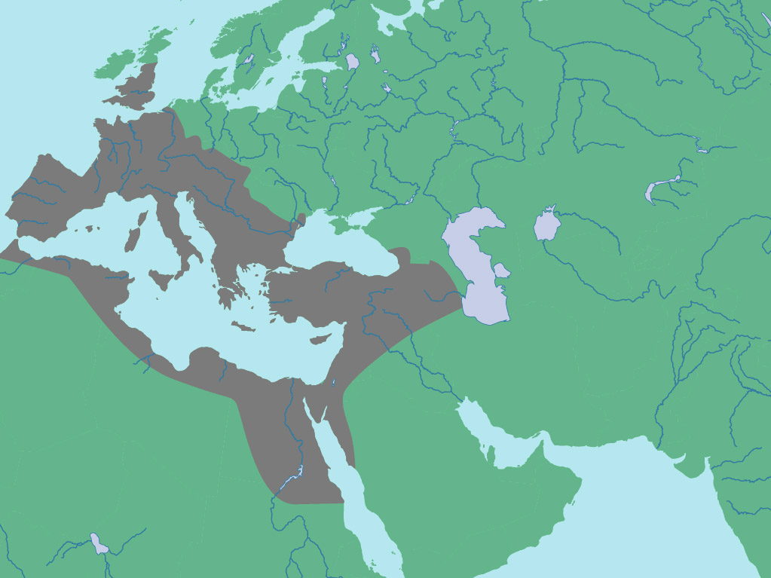
‘and power was given unto them over the fourth part of the earth”
Four Prefectures
Gaul
Italy
Illyricum
East
Ch6:8

Slide 10
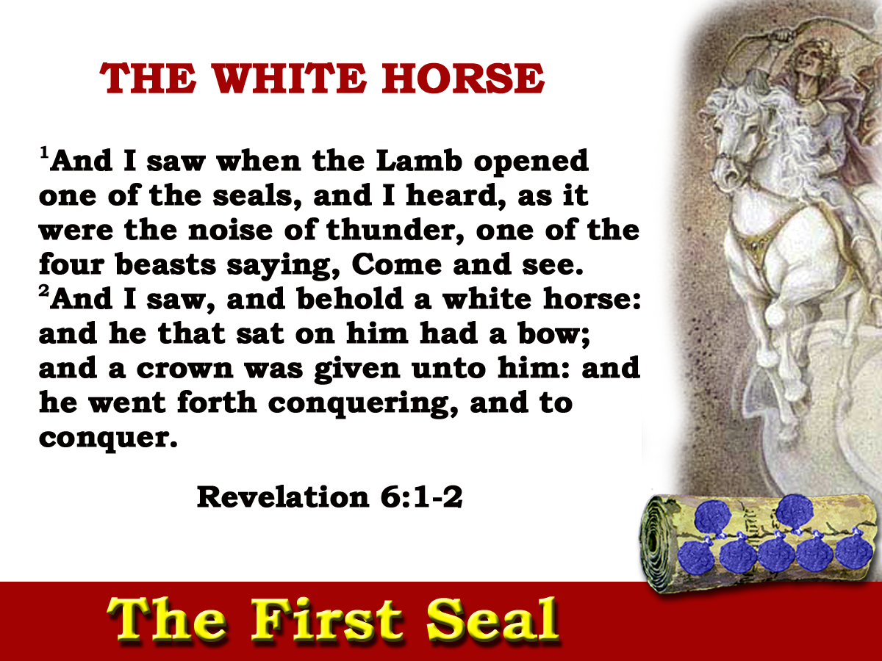
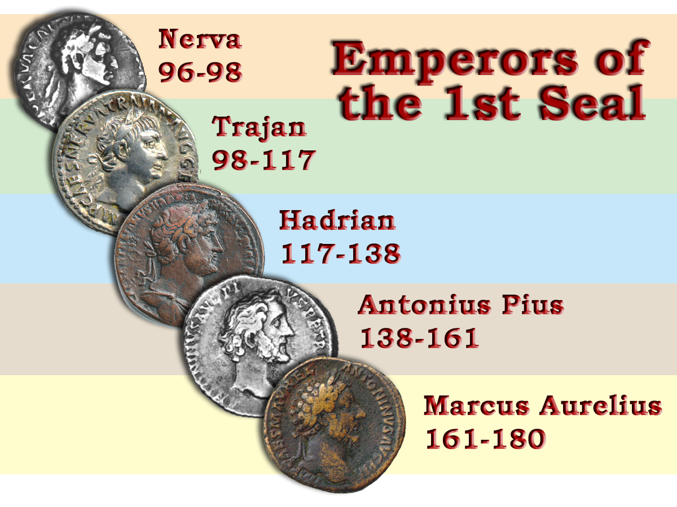
‘I heard one of the four living ones saying as with a voice of thunder.’ Diaglott
84yrs

Slide 11
‘I will send those that escape of them, sounders of the truth, and they shall declare my glory among the nations.’ Isa.66
Zech. 9:13 Isa. 66:19 Psa. 64:3-4
Multitude
Proclaiming truth
Tongues bent - Words as arrows shot forth
Note V4
84yrs

Slide 12
“To everyone the reign of Trajan seemed like the return to the golden age……It was during the reign of Antonius that the Roman Empire reached the zenith of its power and prosperity and for this reason his reign appears uninteresting and eventless…Marcus Aurelius had absolute need of domestic peace in order to carry out his foreign policy”
“If a man were called upon to fix a period in the history of the world, during which the condition of the human race was most happy and prosperous, he would, without hesitation, name that which elapsed from the death of Domitian to the accession of Commodus.” Gibbon Ch.3
Larousse History pp.208-209
84ys
Peace
Conquering the Roman world by the word of the covenant

Slide 13
“I am quite wearied with punishing and destroying the Galileans, or those of the sect called Christians according to your orders. Yet they never cease to profess voluntarily what they are, and to offer themselves to death. Wherefore I have laboured, by extortion and threatening, to discourage them from daring to confess to me that they are of that sect.”
(Letter to Trajan from Tiberianus.)
G5115
G5088
The Empire prospered & at peace; but the dominate force governing
2 Cor.10:4-5
the period was a warfare of faith against terrible odds.
84yrs
Notes:
'Bow' - only use of the word in the NT G5115
Note: Comes from base G5088
Total KJV Occurrences: 29 (always use in context of birth)
Not a warfare of death but of life!
Next time "white horse" appears is in Rev.19:11
This time it is Jewish in character. = zech 10:3
Conquering began in ch 6 but was not completed as horse turned red. but in ch19:11 the conquest of the world is fulfilled.

Slide 14
Blood
Peace
Nerva
Commodus
Trajan
Pertinax
Hadrian
Julian
Antonious Pious
Septimus Severus
Marcus Aurelius
Geta

Slide 15
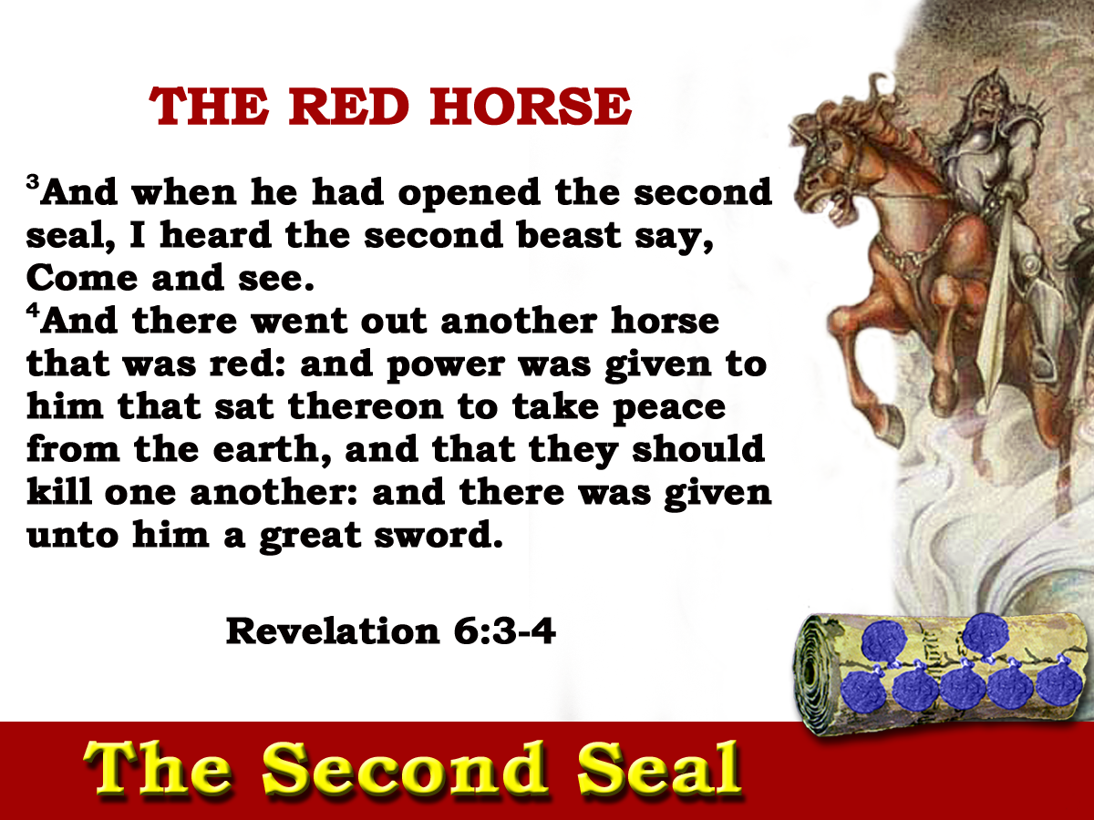
31yrs

Slide 16
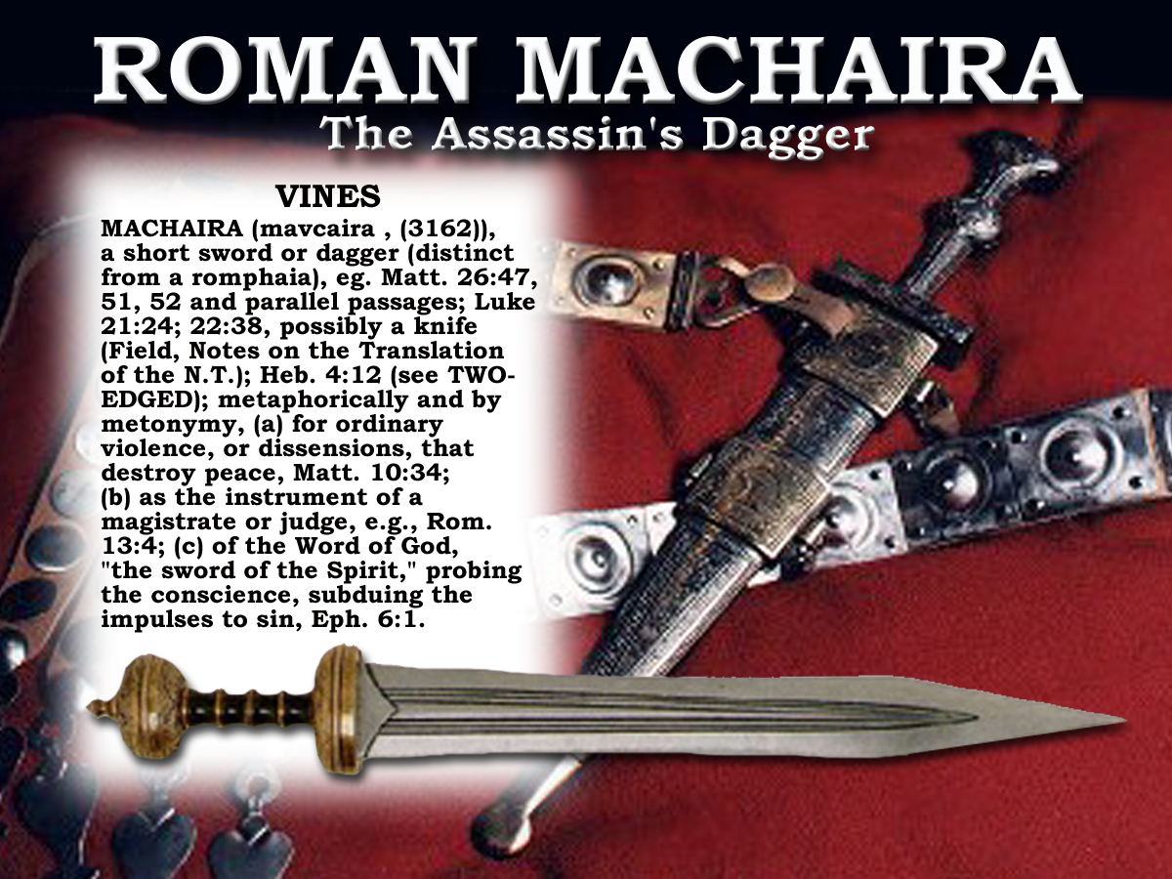
Note contrast between v4 and v8

Slide 17
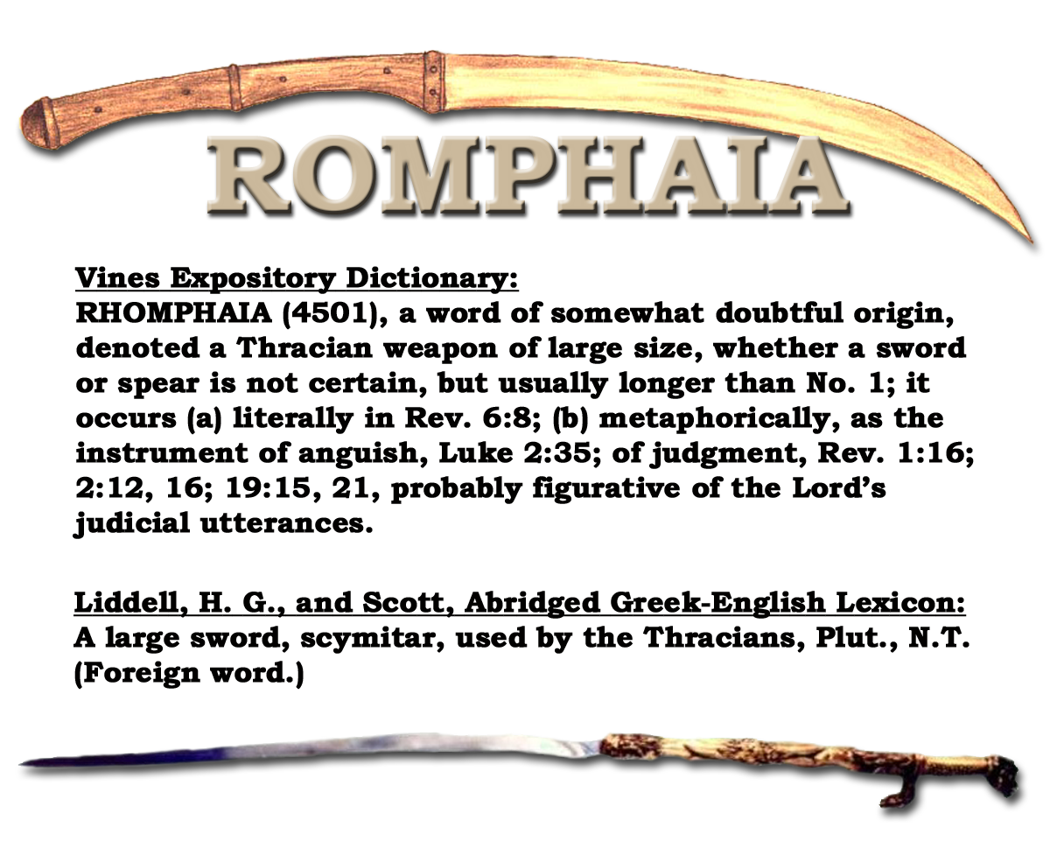
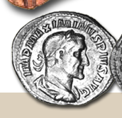
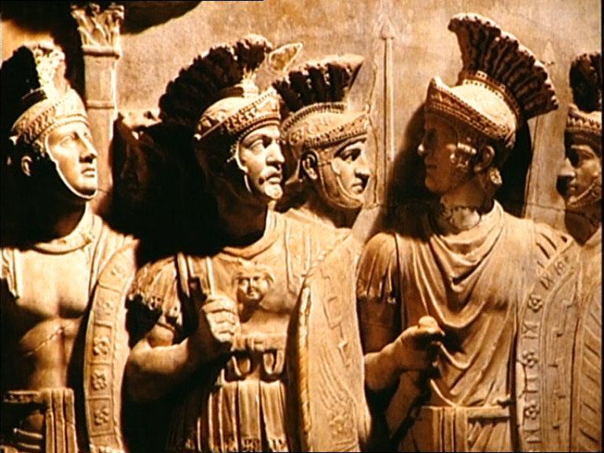

Slide 19
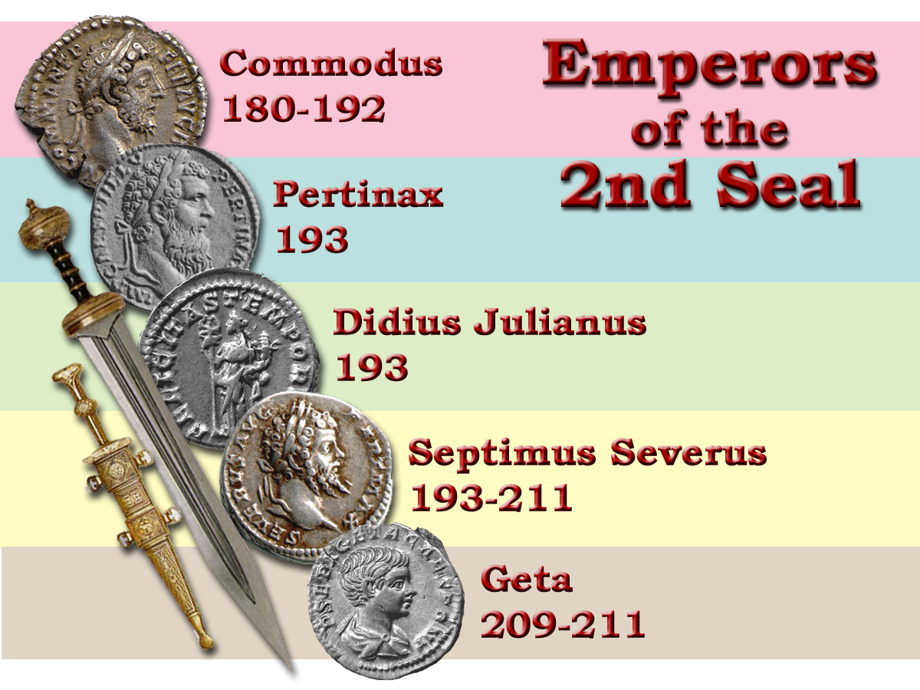
“Three years before his death, Marcus Aurelius had named as his successor his son Commodus.
Larousse History p.210
Blood
Empire descends into civil war
31ys
Notes:
The Second Seal lasted from Commodus until the emperor Geta.
It was a period characterized by assassination and civil unrest in the government while the MACHIRA did it’s work.

Slide 20
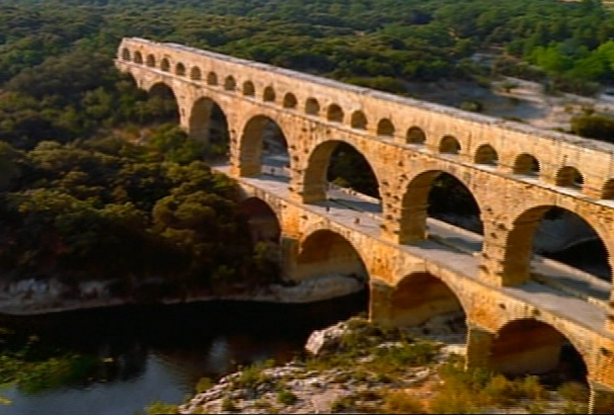

Slide 21
But he was incapable, a drunkard and a profligate.
Power at once went to his head and he demanded recognition and worship as a god.
He pillaged the treasury and persecuted the senate without mercy. Not unexpectedly, plots against his life were numerous.”
Larousse History p.210
Blood
Empire descends into civil war
“That they should kill one another”
31ys
Notes:
The Second Seal lasted from Commodus until the emperor Geta.
It was a period characterized by assassination and civil unrest in the government while the MACHIRA did it’s work.

Slide 22
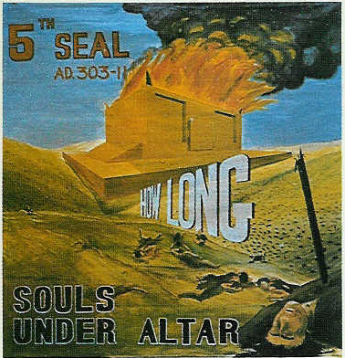
Blood
Peace
Nerva
Commodus
Trajan
Pertinax
Hadrian
Julian
Antonious Pious
Septimus Severus
Marcus Aurelius
Geta
The First Five Seals of Revelation

Slide 23
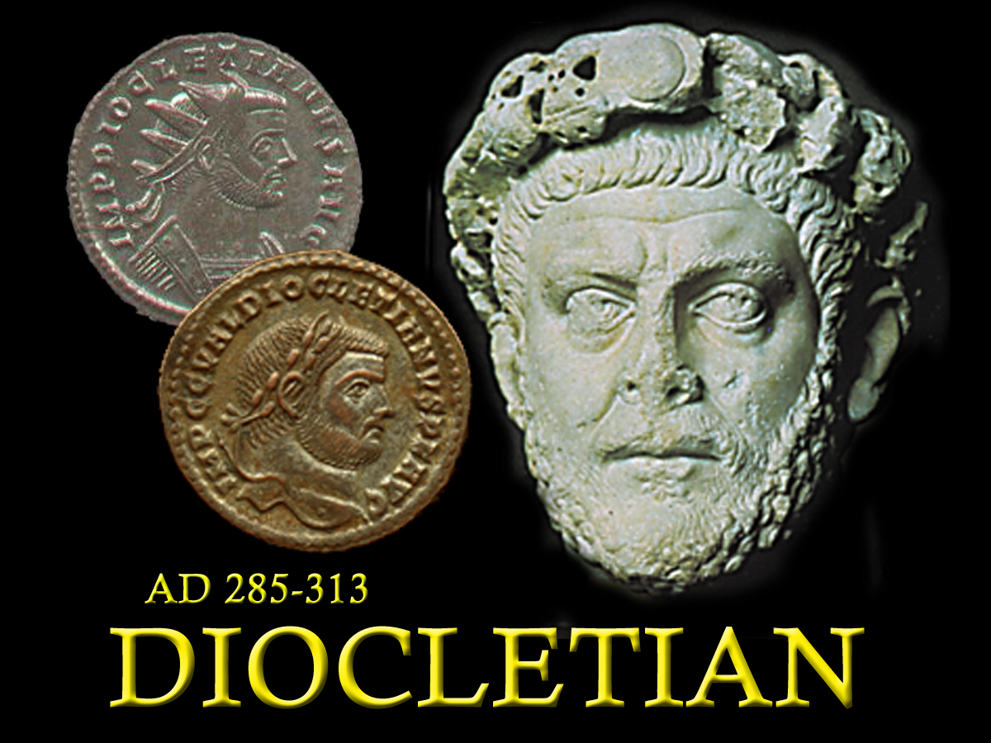
Next session – Seals 3-5.
Theme “How long, O Lord,”
Christ’s Brethren slain
285 - 305

Slide 25
Blood
Death
Peace
Famine
Rev.11:4Rev.6:8
The earth is the Empire
The horse its condition
The rider the reason

Slide 26
Unsealed - “Come and See!”
Witnessing for Christ
7
Seals
7
1 2 3 4 5 6
Trumpets
7
1 2 3 4 5 6
Vials
Judgement - Pagan Rome
1 2 3 4 5 6
Judgement - Christian Rome
Rev.6
Judgement - Holy Roman Empire
AD 96 – AD 324
Thunder! Rev. 10:3-4
White horse! Rev. 19:11,14
Dragon cast out! 2Thess.2:7 Rev. 12:9 Rev.20:3

Slide 27
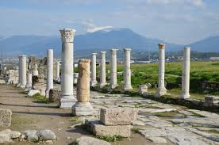
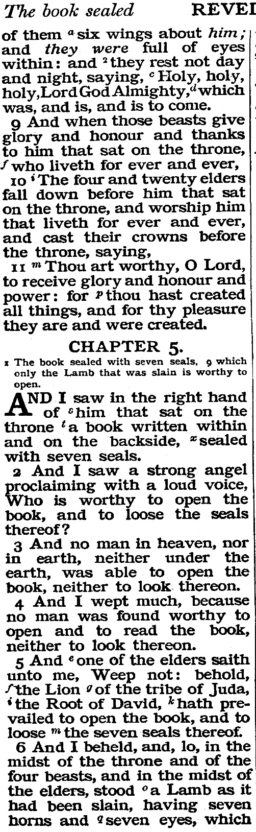
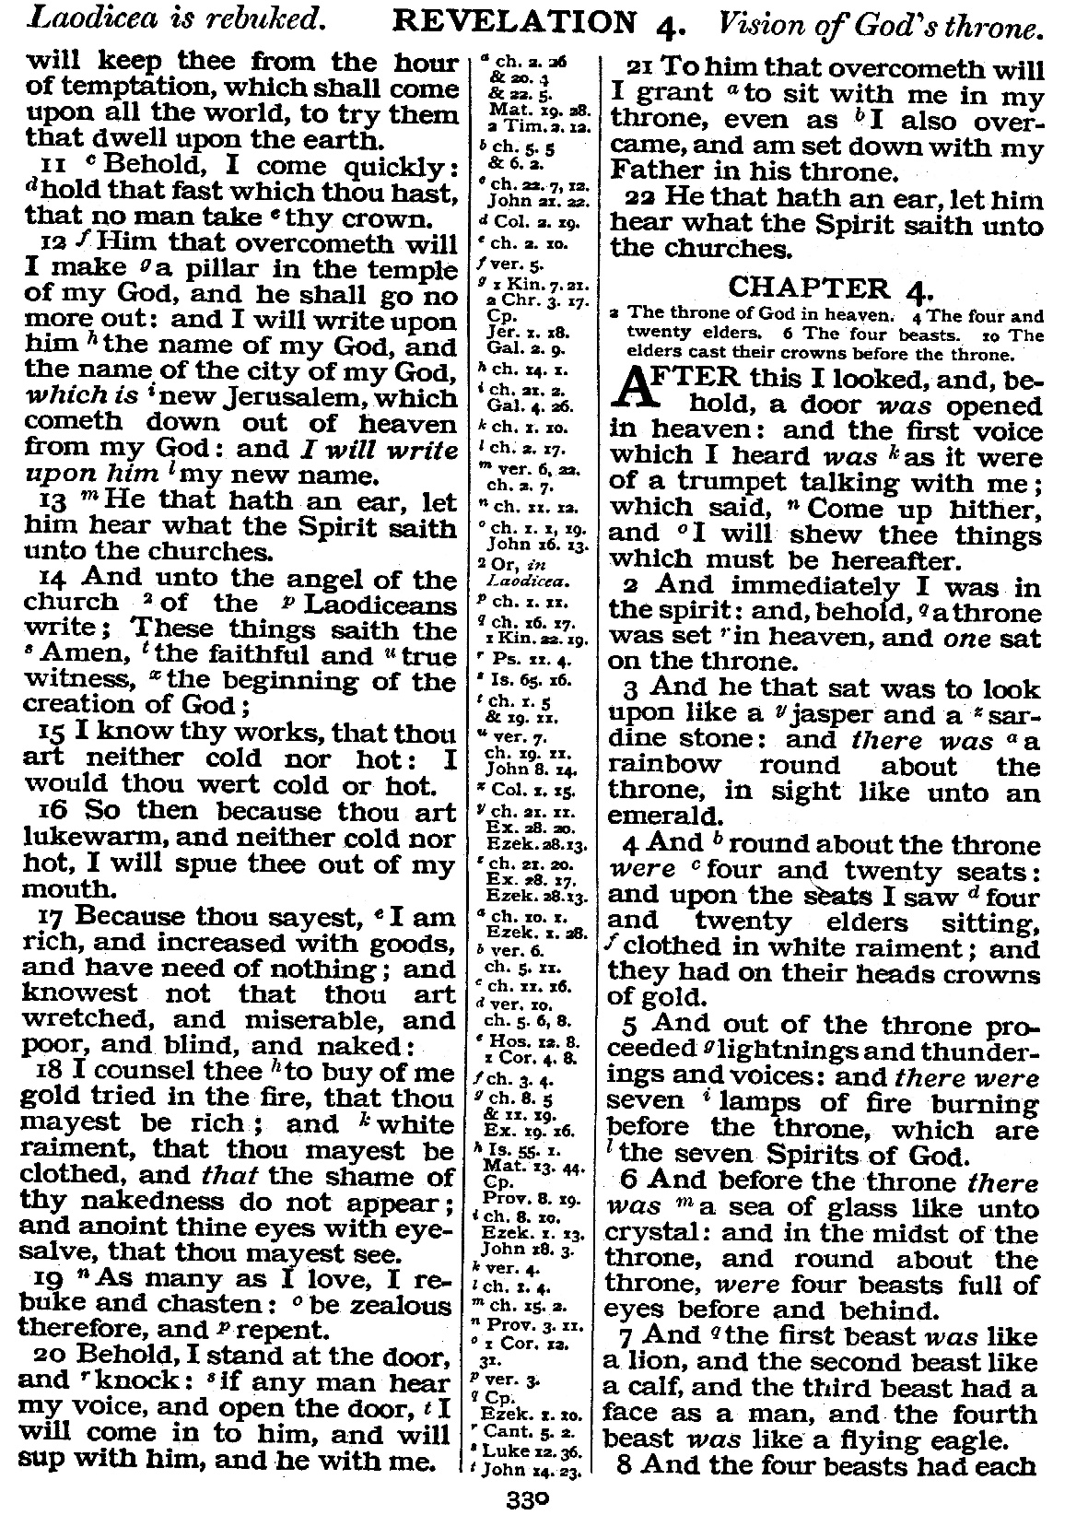
Throne
Matt. 5 x
Luke 3 x
Acts 2 x
Col. 1 x
Heb. 4 x
Rev. 46 x
3
3

Slide 28
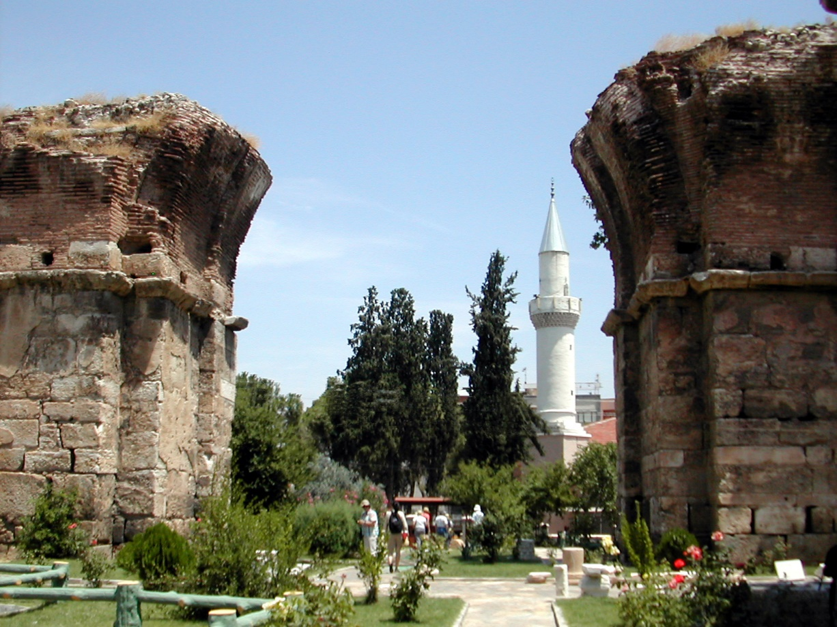
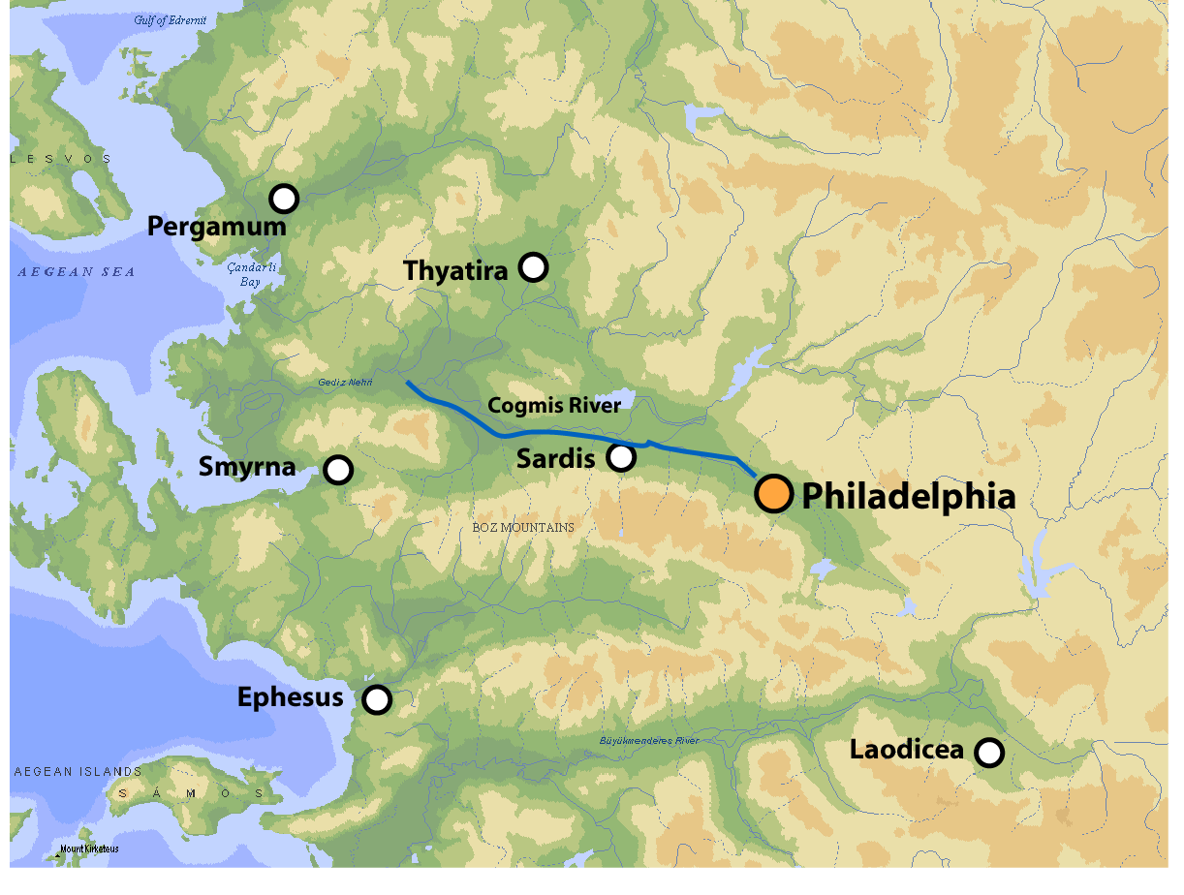
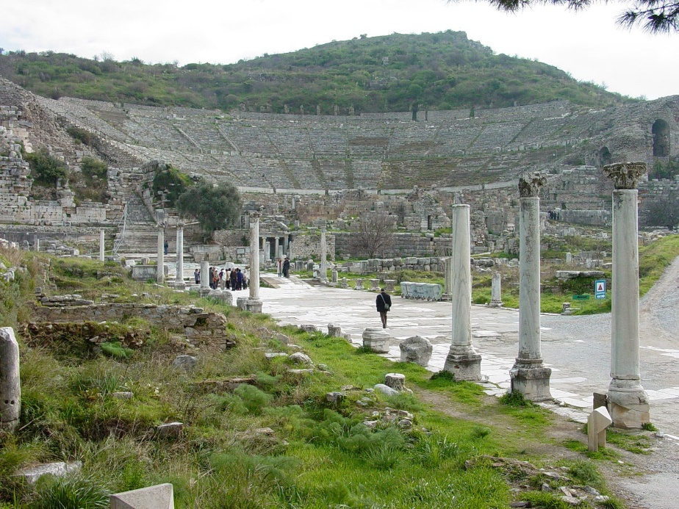
The 7 Ecclesia’s -Overcoming!-
Eat of the tree of life.
Not be hurt of the second death.
Eat of the hidden manna and a new name..
Power over the nations and the morning star.
Clothed in white raiment.
A pillar in the temple of my God.
Sit with me in my throne.
Philadelphia
A promise deeply rooted in
Personal closeness.
Personal reality.
4

Slide 29
Revelation Ch.4:4-7
“Come and see”
3

