Slide 1
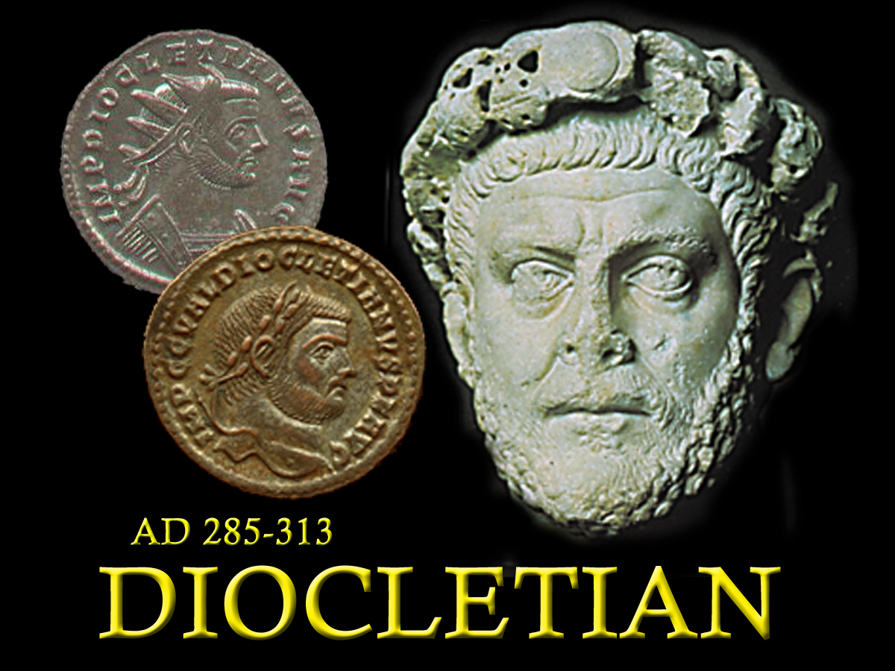
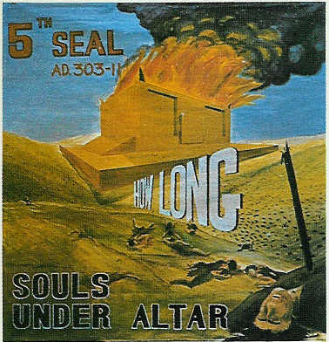
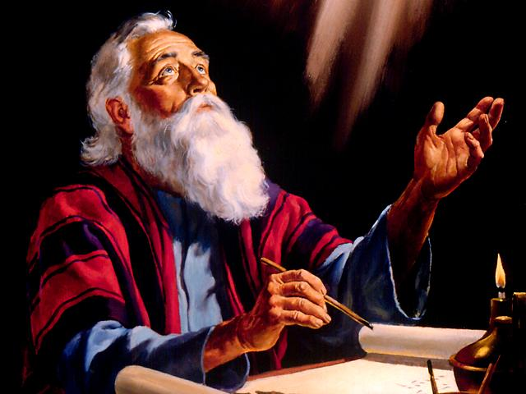
Seals 3-5.
Theme “How long, O Lord,”
- Christ’s Brethren slain -
Manitoulin Family Camp 2024
285 - 305

Slide 2
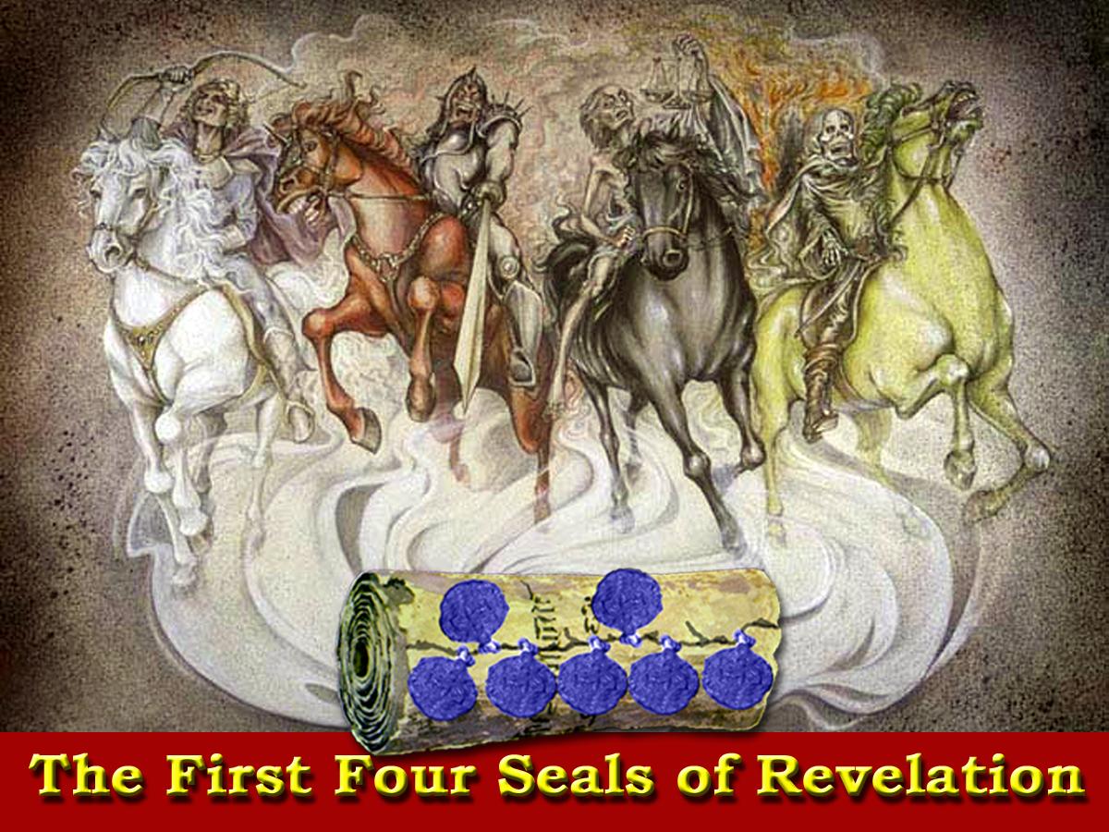
Peace
Blood
84 yrs
Injustice
31 yrs
Nerva
Caracalla
Trajan
Macrinus
Hadrian
Commodus
Pertinax
Elagabalas
Antonious Pious
Julian
Severus Alexander
Marcus Aurelius
Septimus Severus
Geta

Slide 3
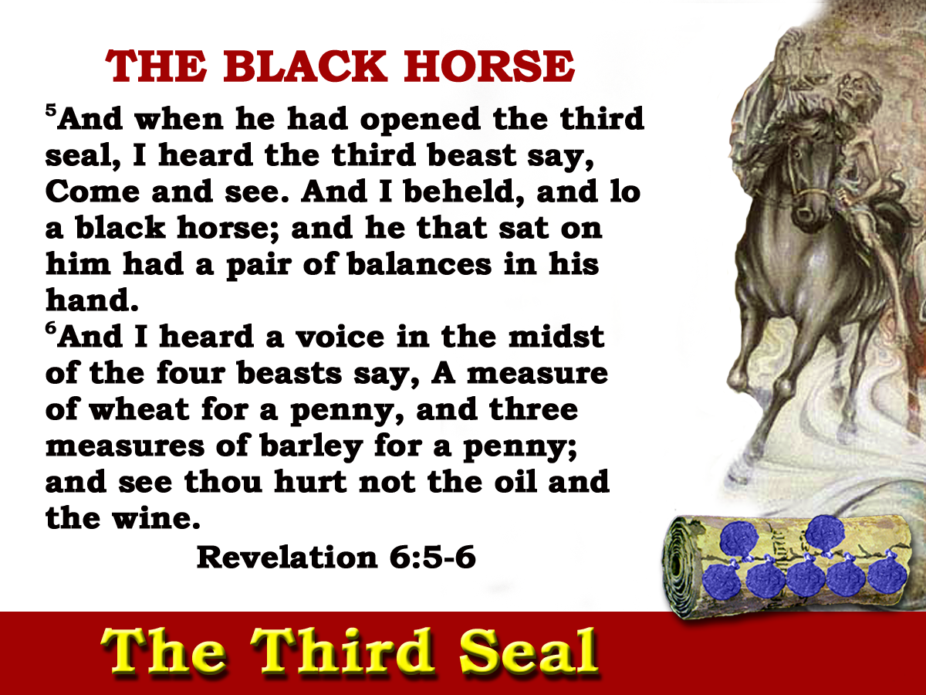
JOB 30:26-31
211-235
24yrs
Notes:
The Third Seal brought the black horse whose rider carried the balances.

Slide 4
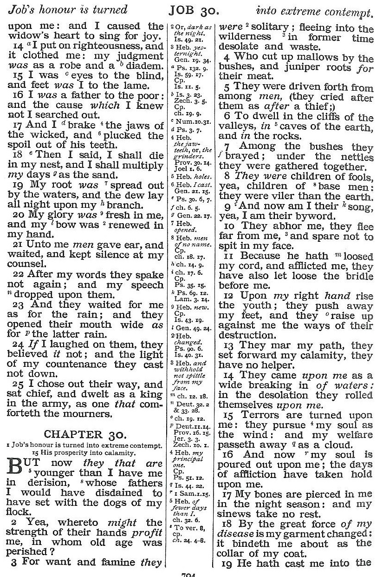
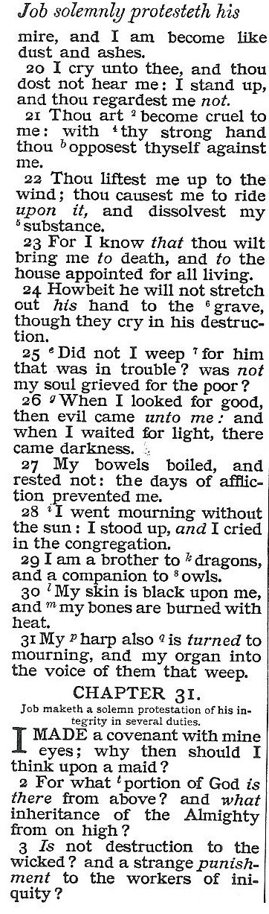
From God’s favour to God’s brutality
Respect to the object of a taunting song
evil
darkness
mourning
Security to un-certainty
black
mourning
weep
Honour to object of scorn
Robust health to door of death

Slide 5
Justice!
JOB 30:26-31
Mourning
Distress
Intense depression of mind
211-235
24yrs

Slide 6
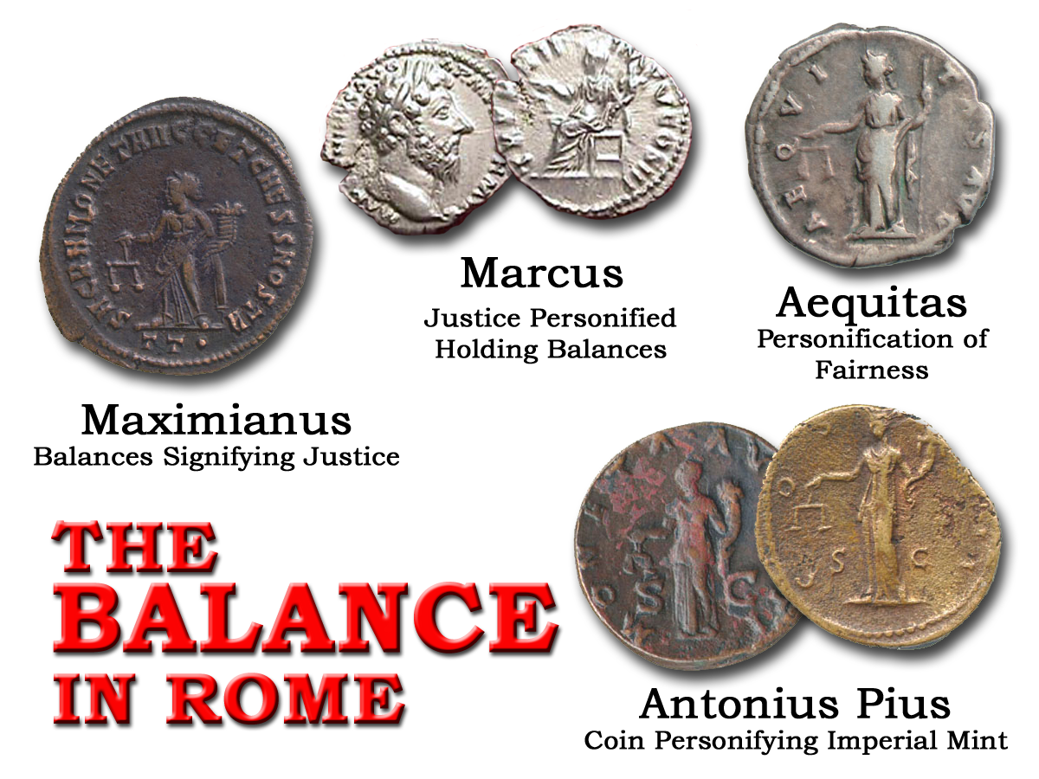

Slide 7
“Now in the first year of Cyrus king of Persia, that the word of the Lord by the mouth of Jeremiah might be fulfilled, the Lord stirred up the spirit of Cyrus king of Persia, that he made a proclamation throughout all his kingdom, and put it also in writing, saying,….”
(Mg. ‘caused a voice’)
Decrees and laws issued and carried out by those in authority
EZRA 1:1
?
EXOD. 4
211-235
24yrs

Slide 8
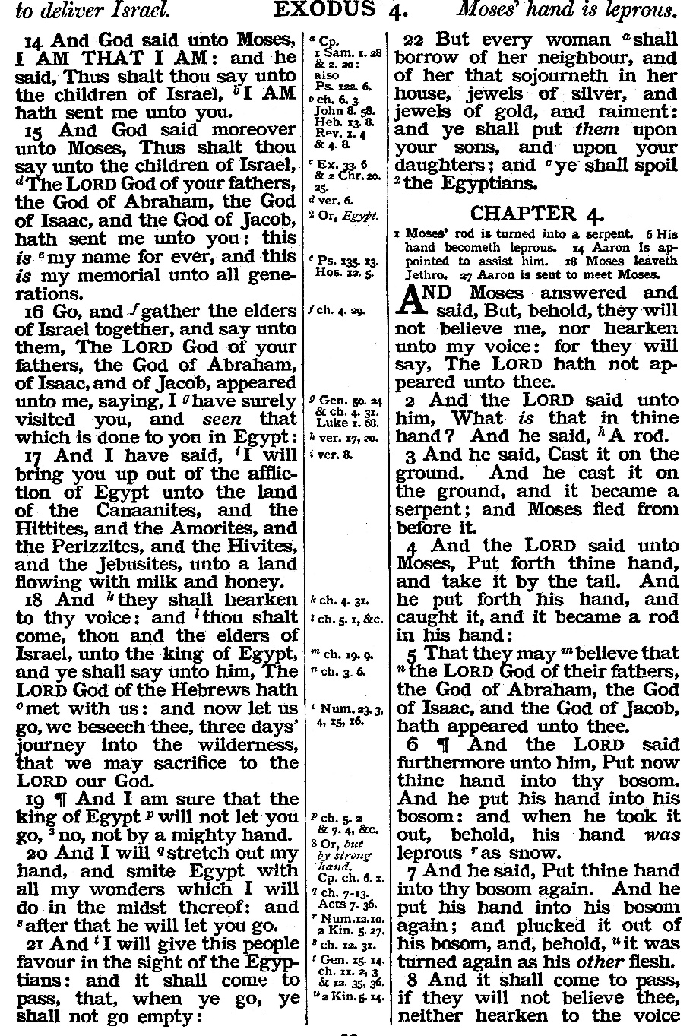
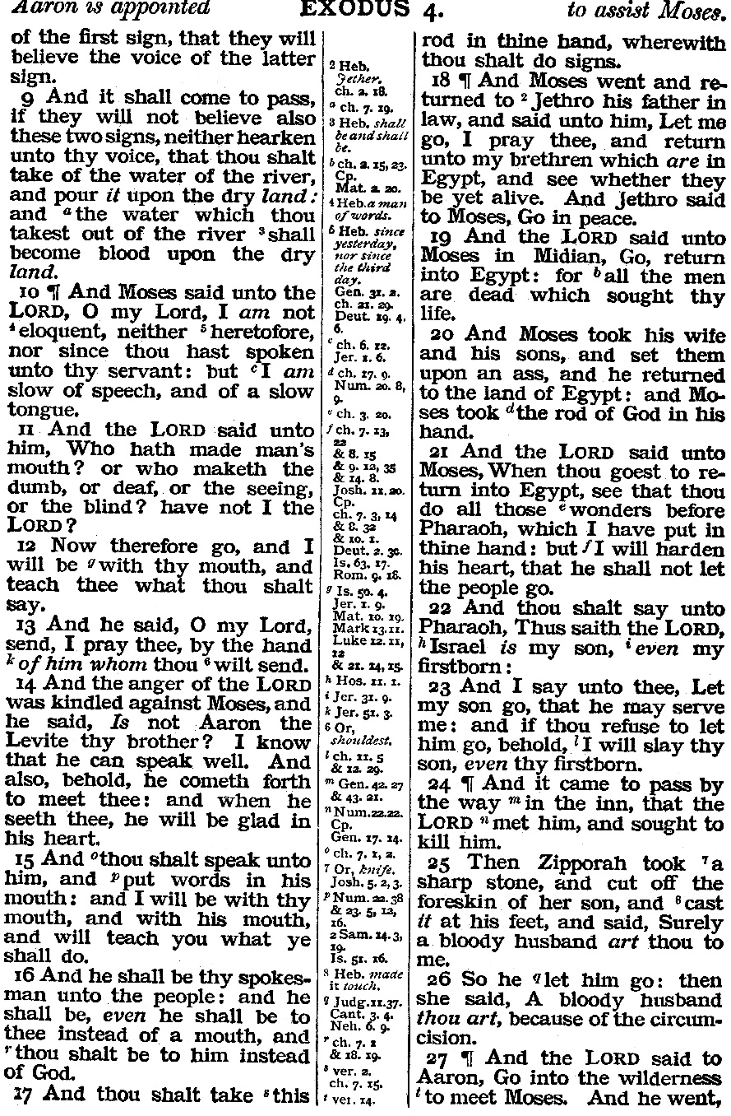
Sign Law
“And I heard a voice”

Slide 9
“Now in the first year of Cyrus king of Persia, that the word of the Lord by the mouth of Jeremiah might be fulfilled, the Lord stirred up the spirit of Cyrus king of Persia, that he made a proclamation throughout all his kingdom, and put it also in writing, saying,….”
(Mg. ‘caused a voice’)
Decrees and laws issued and carried out by those in authority
EZRA 1:1
?
EXOD. 4
211-235
24yrs

Slide 10
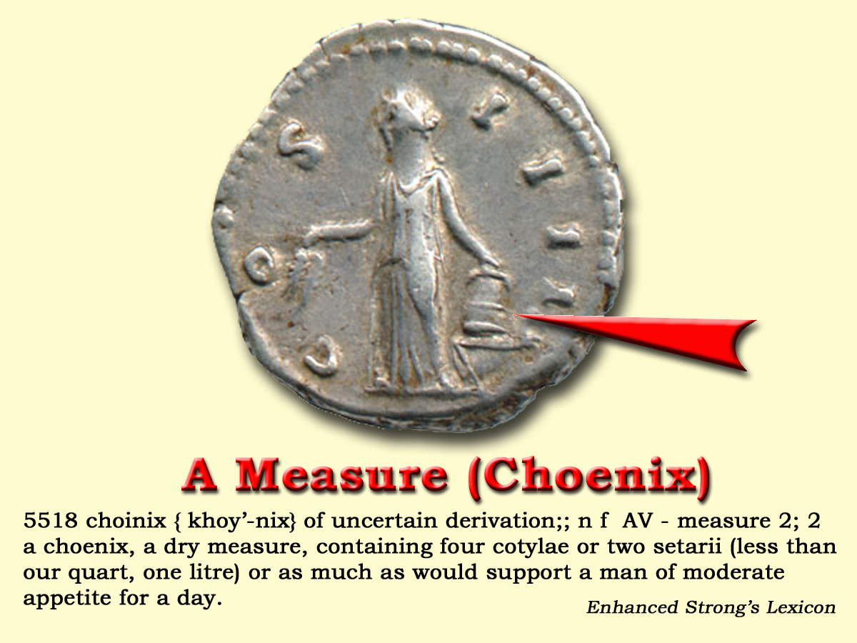
“a choinix of wheat a denarius: and three choinixes of barley a denarius; but the oil and the wine thou mayest not act unjustly by”
Taxation
Matt.20:2
Last crops
Relief
Last Emperor

Slide 11
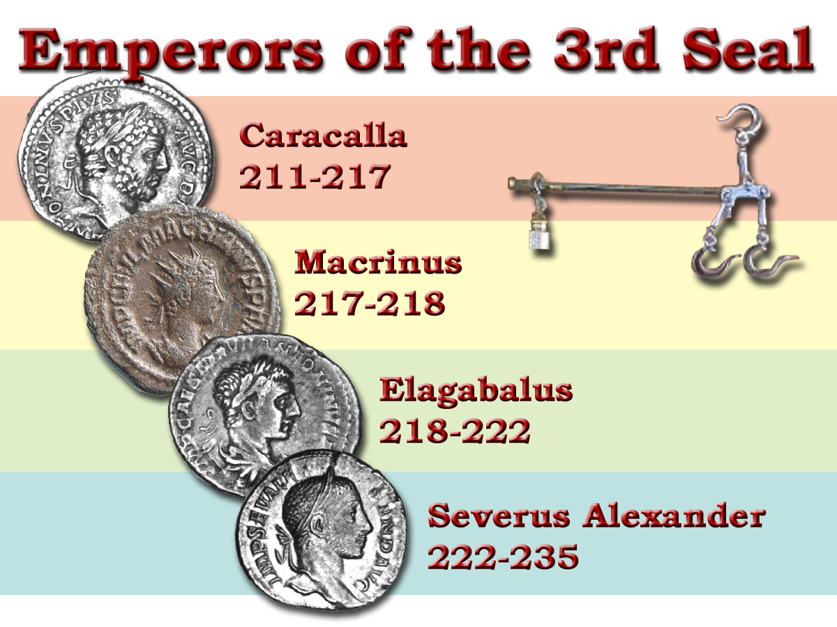
(The Savage Beast of Ausonia)
24ys
Famine
A period of heavy taxation

Slide 12
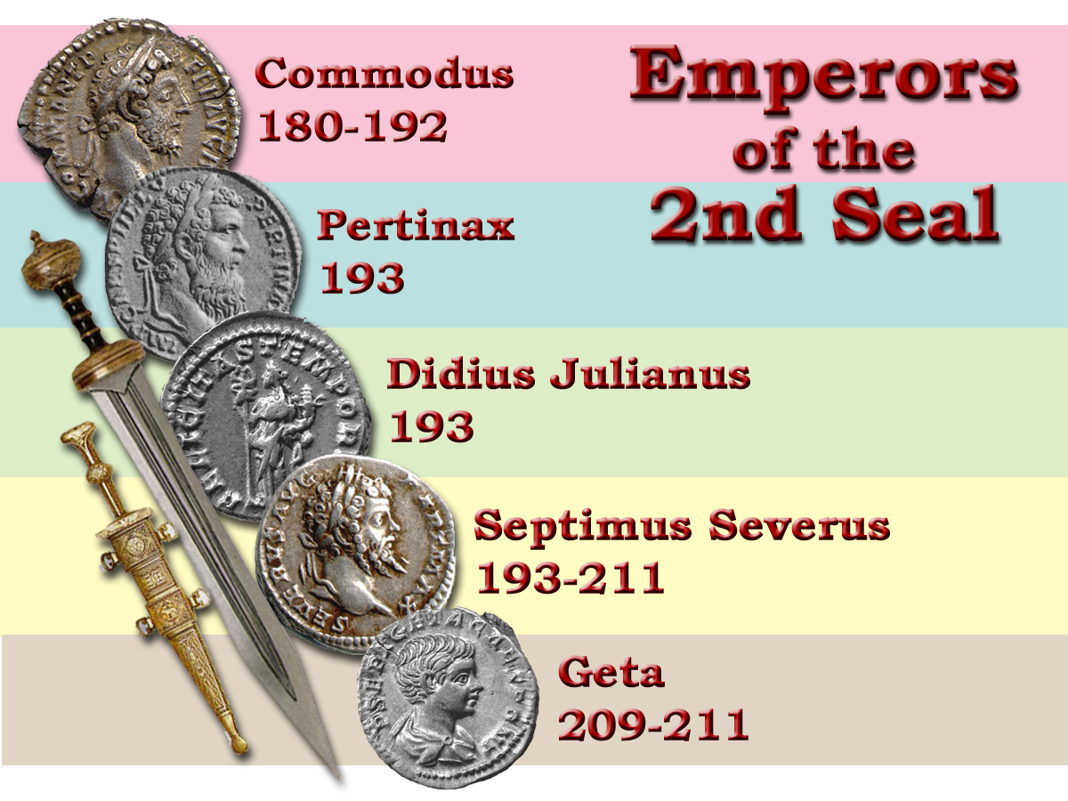

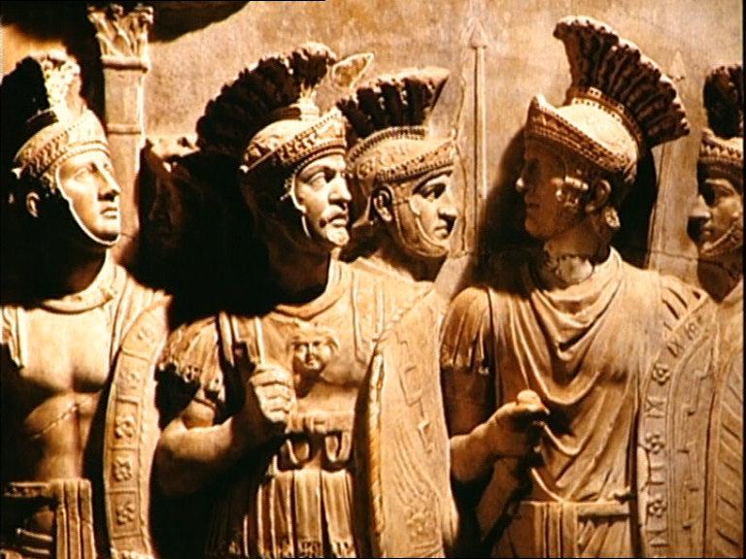
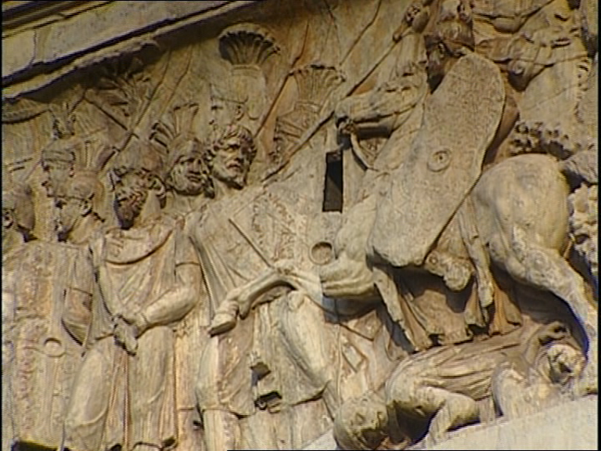

Slide 13
“The growing cost of the armed forces and the inflation which accompanied it compelled the emperors to increase existing taxes and to invent new ones. The spirit of the times was, moreover very susceptible to the message of Christianity, which made great advances.”
Larousse History p.217-218
24ys
Famine
A period of heavy taxation

Slide 14
Blood
Death
Peace
Injustice
Nerva
Caracalla
Trajan
Macrinus
Hadrian
Commodus
Maximin
Pertinax
Elagabalas
Antonious Pious
23
Julian
Severus Alexander
Marcus Aurelius
Septimus Severus
Diocletian
Geta
(39 claiming title in first 50 yrs.)

Slide 15
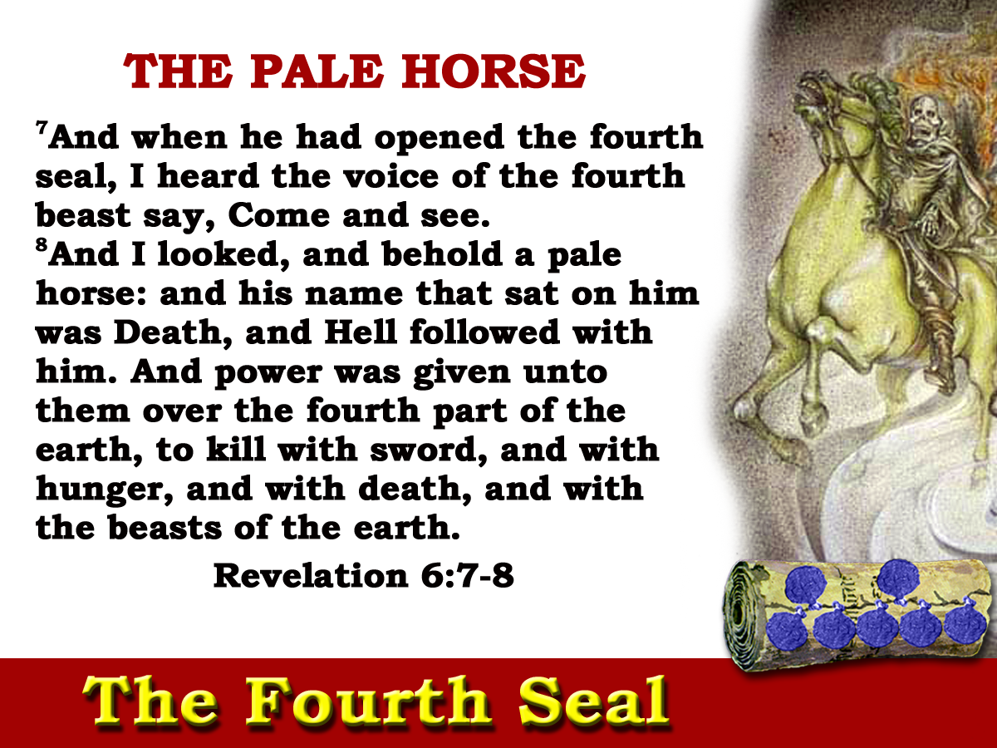
Mark 6:39 Rev. 8:7 Rev. 9:4
Gk.”Chloros”
“the animating health and vigour of the Empire were fled.”
Gibbon
235-303
68yrs

Slide 16
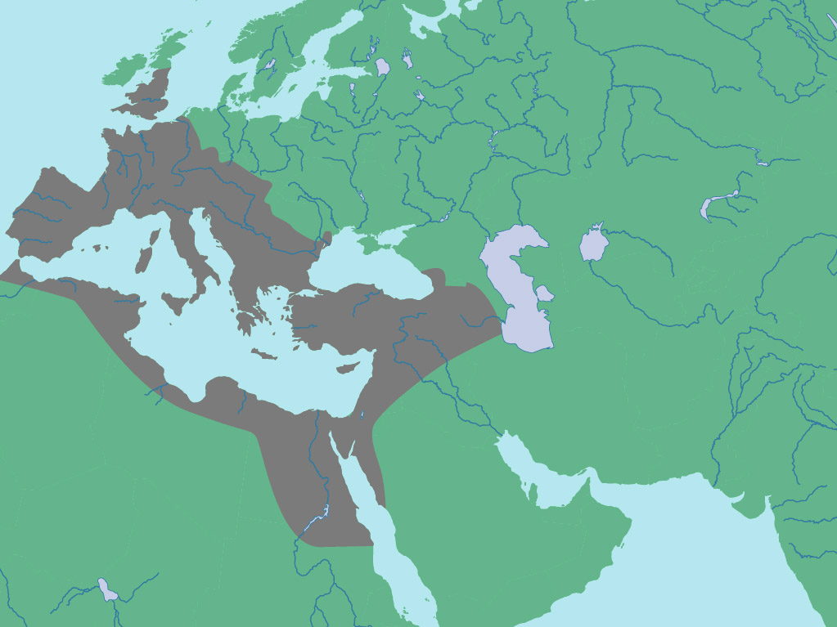
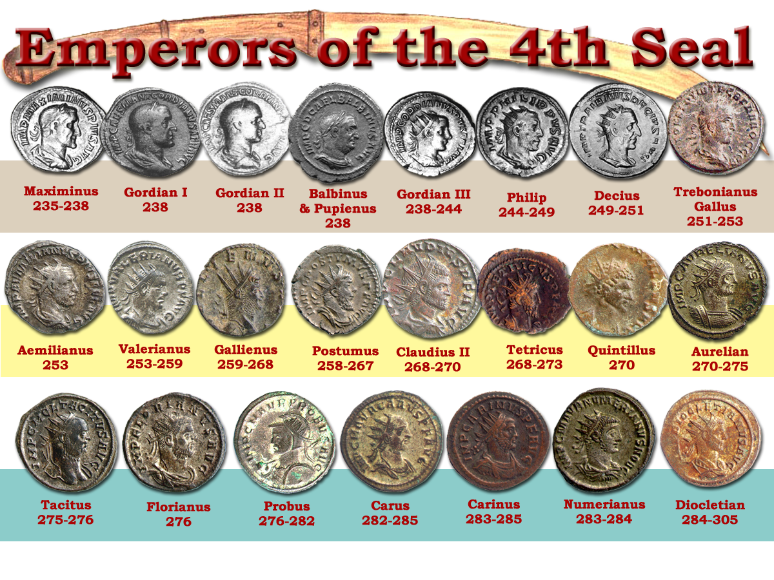
‘and power was given unto them over the fourth part of the earth”
Judgement brought home to the very heart and soul of the Empire in preparation for the final overthrow in the 6th Seal.
Four Prefectures
Gaul
Italy
Illyricum
“Famine is almost always followed by epidemic diseases, the effect of scanty and unwholesome food. Other causes must, however, have contributed to the furious plague which, from the year 250 to the year 265, raged without interruption in every province, every city, and almost every family of the Roman Empire .”
East
?
‘To kill with sword, and with hunger, and with death and with the beasts of the earth’.
Titus 1:12
235-303
68yrs
Gibbon
Gibbon

Slide 17
68yrs
“For nearly half a century- since the death of Severus Alexander- the Roman world had been on the verge of chaos, and the consequences were incalculable. The Empire emerged from the period in a state of collapse. Wherever the barbarians had passed they left behind waste and ruin while the peasants whose fields and homes were ravaged, had fled.”
Death
A period of murder, disease & famine
Larousse History p.218-220

Slide 18
285 - 305

Slide 19
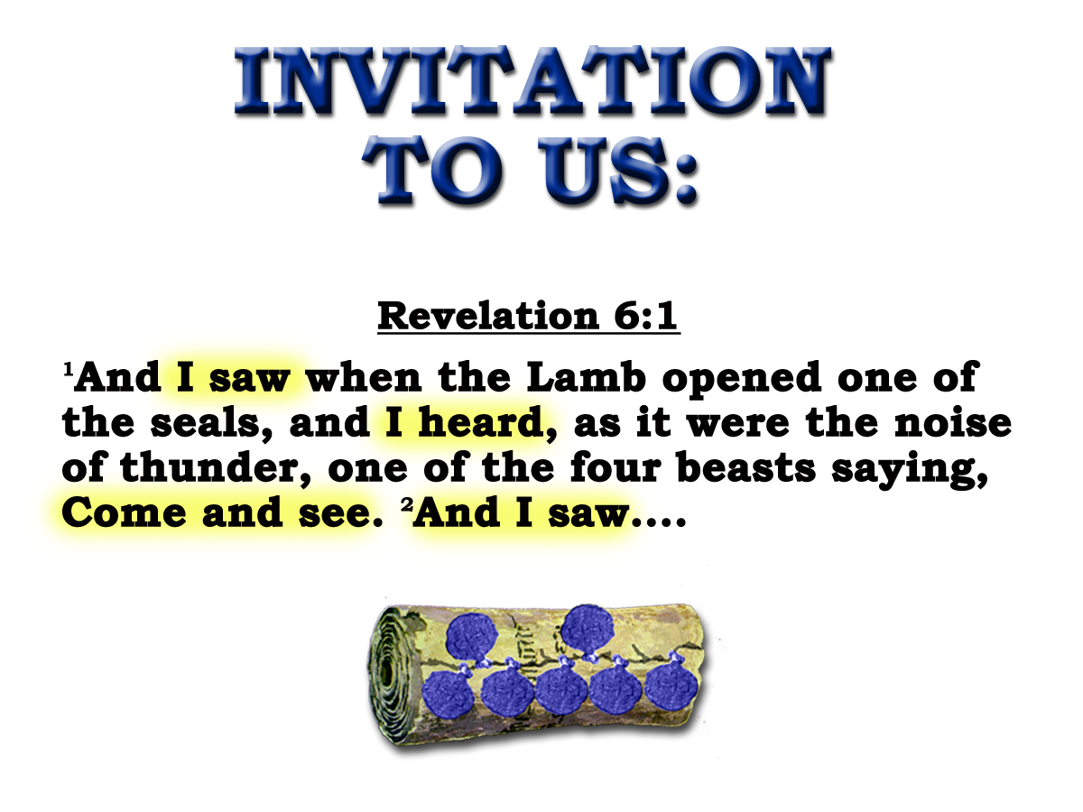
SOULS UNDER THE ALTAR
9
And when he had opened the fifth seal, I saw under the altar the souls of them that were slain for the word of God, and for the testimony which they held:
10
And they cried with a loud voice, saying, How long, O Lord, holy and true, dost thou not judge and avenge our blood on them that dwell on the earth?
Revelation 6:9-11
The Fifth Seal
303-311
8yrs

Slide 20
SOULS UNDER THE ALTAR
9
And when he had opened the fifth seal, I saw under the altar the souls of them that were slain for the word of God, and for the testimony which they held:
Heb.13:10
Lev.4:7
“When the faithful in Christ Jesus (those within the Altar) die, and return to their parent earth without violence, they are underneath the altar, sleeping in Jesus …
Gal.3:26-29
But if they are made to lie underneath the altar by the blood-shedding cruelty of the enemy, their souls are said, as in the language of the fifth seal, to cry with a great or loud voice for the judicial vengeance on the murderers who poured out their soul-blood unto death.”
Eureka Vol.2 p.238
The Fifth Seal
303-311
8yrs

Slide 21
SOULS UNDER THE ALTAR
9
And when he had opened the fifth seal, I saw under the altar the souls of them that were slain for the word of God, and for the testimony which they held:
Revelation 6:9
No living ones!
Note: Matt. 5:13
Note: Rev. 6:11
The Fifth Seal
303-311
8yrs

Slide 22
SOULS UNDER THE ALTAR
No living ones!
11
And white robes were given unto every one of them; and it was said unto them, that they should rest yet for a little season, until their fellow-servants also and their brethren, that they should be killed as they were, should be fulfilled.
Rev. 6:11
Diaglott = “Until both their fellow servants and their brethren.”
?
The Fifth Seal
303-311
8yrs

Slide 23
SOULS UNDER THE ALTAR
10
And they cried with a loud voice, saying, How long, O Lord, holy and true, dost thou not judge and avenge our blood on them that dwell on the earth?
Revelation 6:9-11
The Fifth Seal
303-311
8yrs

Slide 24
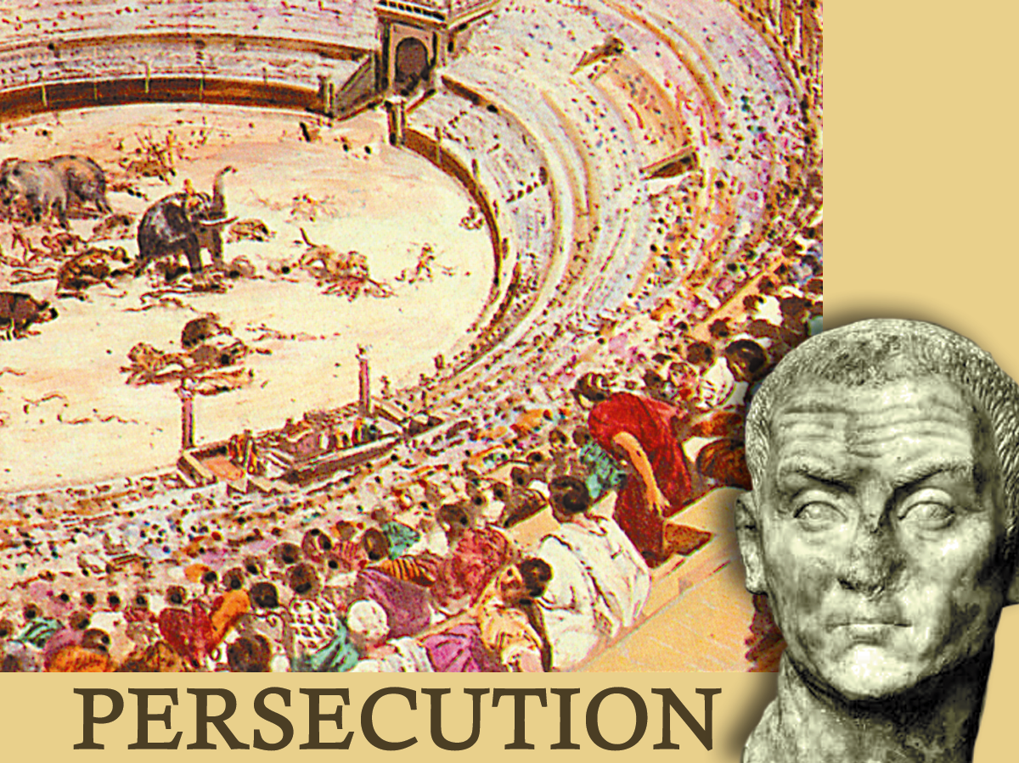
"THEY CRIED WITH A LOUD VOICE"
How would a man pray ?
How would a mother, a wife, pray ?

Slide 25
SOULS UNDER THE ALTAR
?
10
And they cried with a loud voice, saying, How long, O Lord, holy and true, dost thou not judge and avenge our blood on them that dwell on the earth?
Revelation 6:9-11
The Fifth Seal
303-311
8yrs

Slide 26


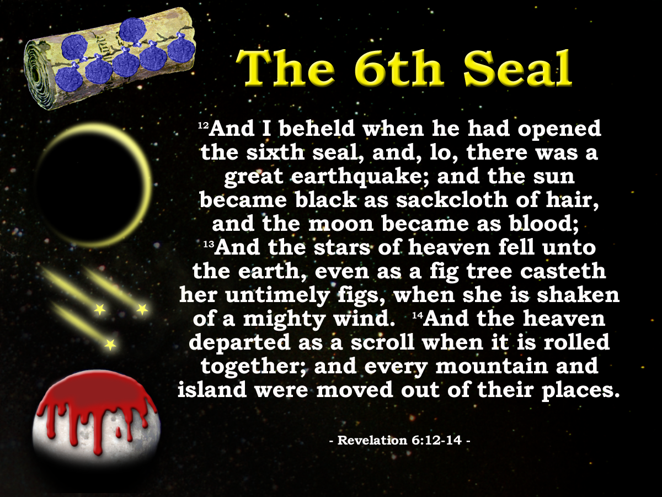
7
Seals
7
1 2 3 4 5 6
Trumpets
7
1 2 3 4 5 6
Vials
Judgement - Pagan Rome
1 2 3 4 5 6
Judgement - Christian Rome
Judgement - Holy Roman Empire
Next class : (God Willing)
God answers the prayers of the saints.
“And lo there was a great earthquake”

Slide 27
SOULS UNDER THE ALTAR
No living ones!
11
And white robes were given unto every one of them; and it was said unto them, that they should rest yet for a little season, until their fellow-servants also and their brethren, that they should be killed as they were, should be fulfilled.
Rev. 6:11
Diaglott = “Until both their fellow servants and their brethren.”
?
The Fifth Seal
303-311
8yrs

