Slide 1


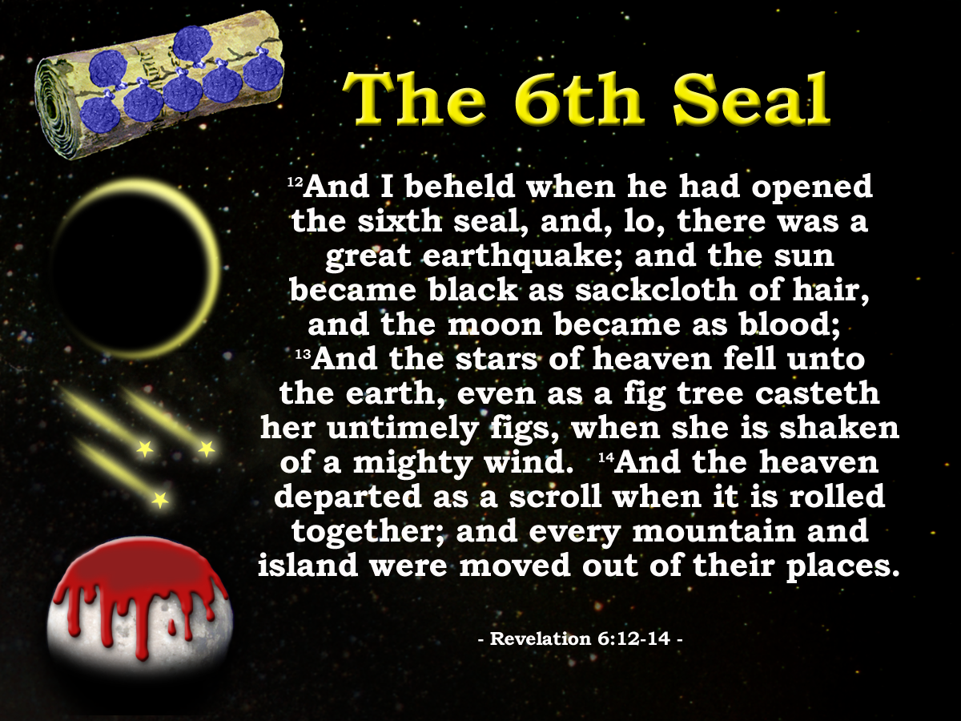
7
Seals
7
1 2 3 4 5 6
Trumpets
7
1 2 3 4 5 6
Vials
Judgement - Pagan Rome
1 2 3 4 5 6
Judgement - Christian Rome
Judgement - Holy Roman Empire
God answers the prayers of the saints. (The 6th Seal)
Manitoulin Family Camp 2024

Slide 2
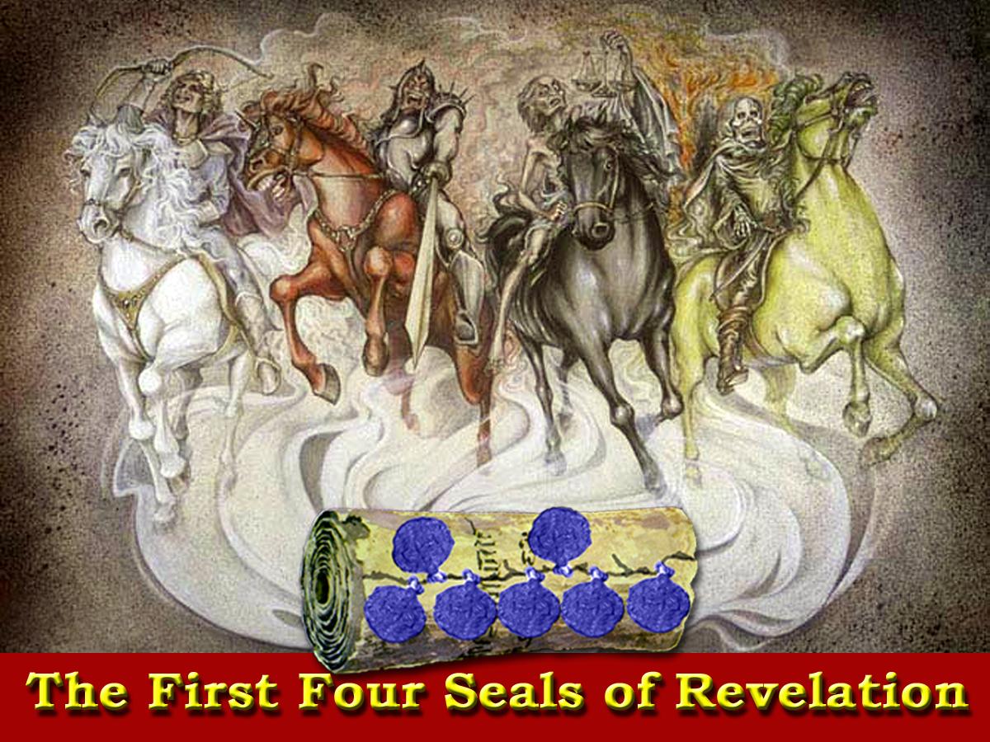
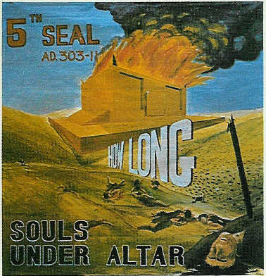
Blood
Injustice
Death
Peace
Nerva
Caracalla
Trajan
Commodus
Macrinus
Maximin
Hadrian
Pertinax
Elagabalas
Antonious Pious
Julian
23
Severus Alexander
Marcus Aurelius
Septimus Severus
Diocletian
Geta

Slide 3
“Come and See!”
Diocletian
311
96
180
211
235
303
1
2
3
4
84yrs
31yrs
24yrs
68yrs
5
White horse Truth preached
Black horse Injustice
Pale horse Death
Red horse Assassinations
8yrs
Souls under the Altar Persecution
Seals
Rev.6
1 2 3 4 5 6
Judgement on Pagan Rome
228yrs
AD 96 – AD 324

Slide 4
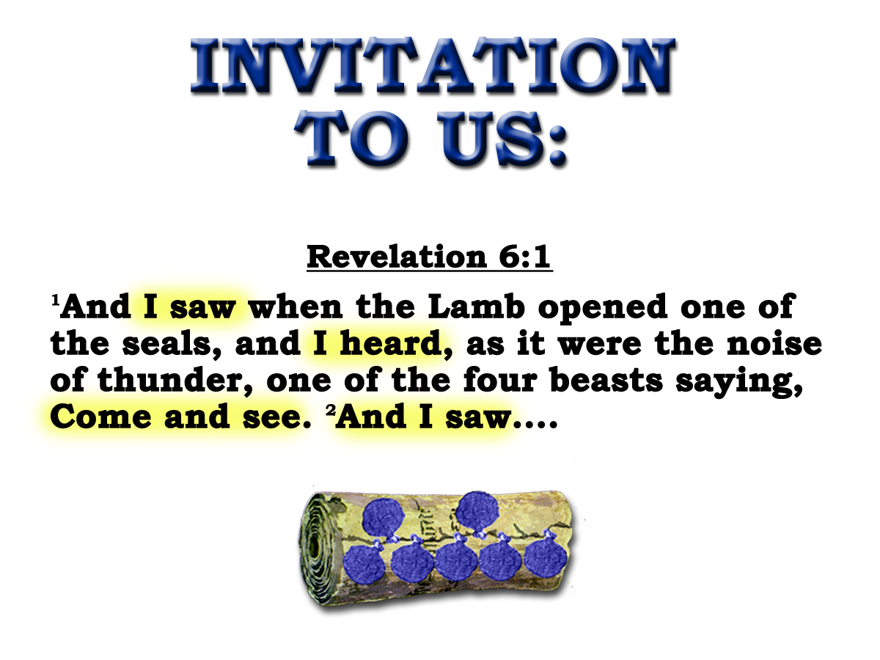
SOULS UNDER THE ALTAR
?
Gk. ”despot”
10
And they cried with a loud voice, saying, How long, O Lord, holy and true, dost thou not judge and avenge our blood on them that dwell on the earth?
Revelation 6:9-11
The Fifth Seal
303-311
8yrs

Slide 5
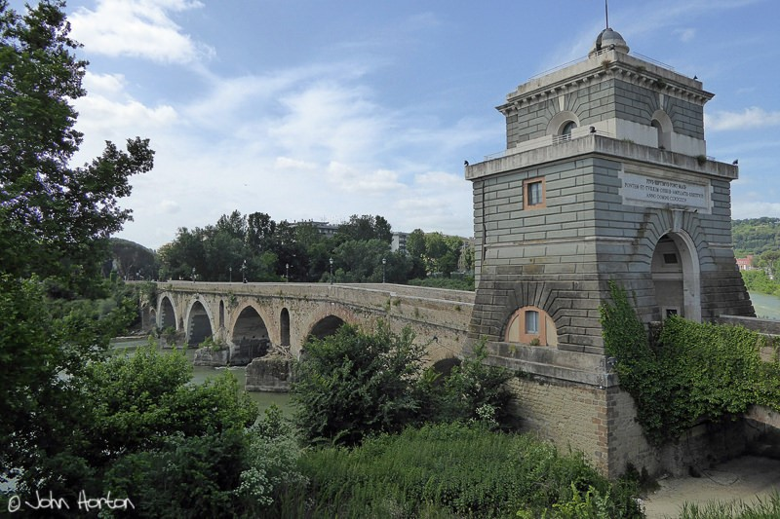
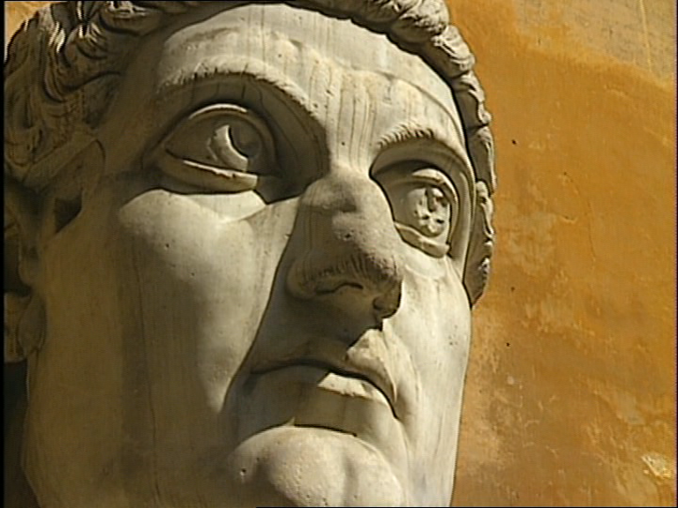
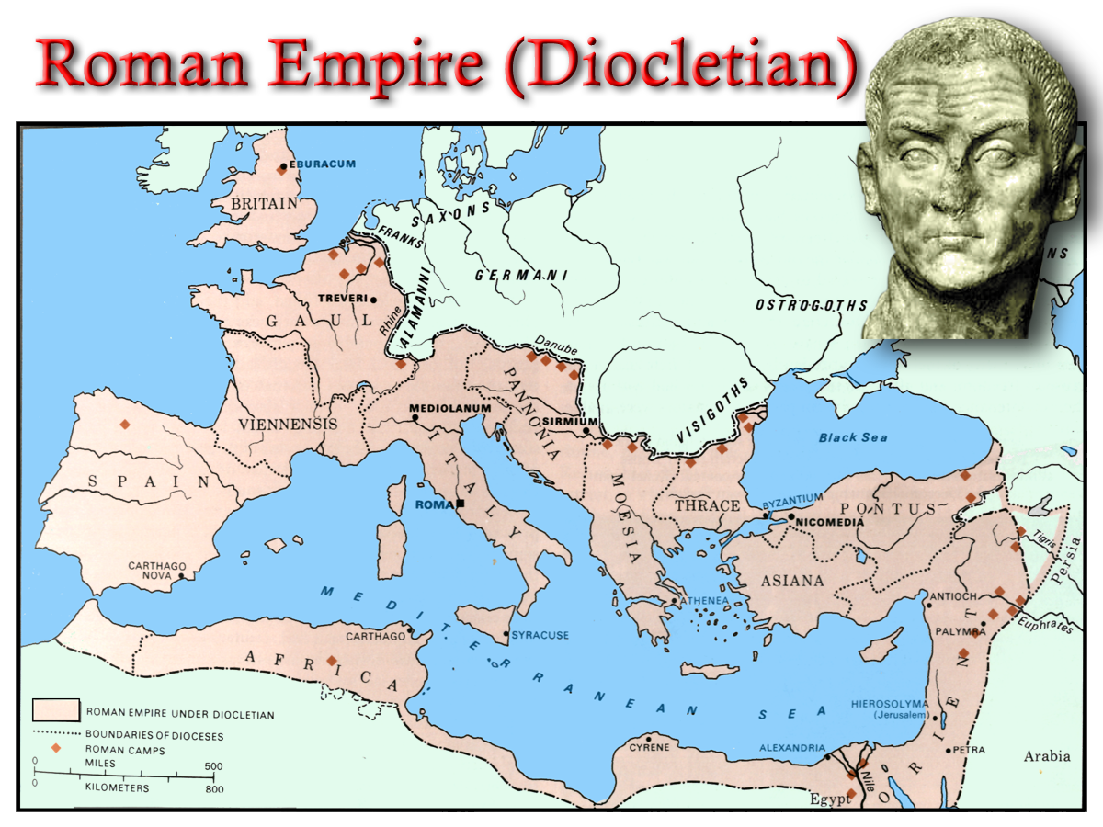

Struggle for Imperial Title
Maximian
Diocletian
Chi - Rho
ΧΡΙΣΤΟΣ
“And his tail drew the third part of the stars of heaven, and did cast them to the earth:”
Constantine
Constantius
Constantius
Rev.12:4
Edict of Milan
Labarum
313 AD
Licinius
Galerius
Maxentius
Galerius
Milvian Bridge
312 AD
“How long ,O Lord, holy and true dost thou not judge and avenge our blood on them that dwell on the earth”
Maximin
311 AD
305 AD
285 AD

Slide 6
“Come and See!”
Diocletian
311
96
180
211
235
303
324
1
2
3
4
6
84yrs
31yrs
24yrs
68yrs
5
White horse Truth preached
Black horse Injustice
Pale horse Death
Red horse Assassinations
8yrs
Souls under the Altar Persecution
Seals
Rev.6
1 2 3 4 5 6
Great earthquake Paganism cast out
Judgement on Pagan Rome
228yrs
AD 96 – AD 324

Slide 7
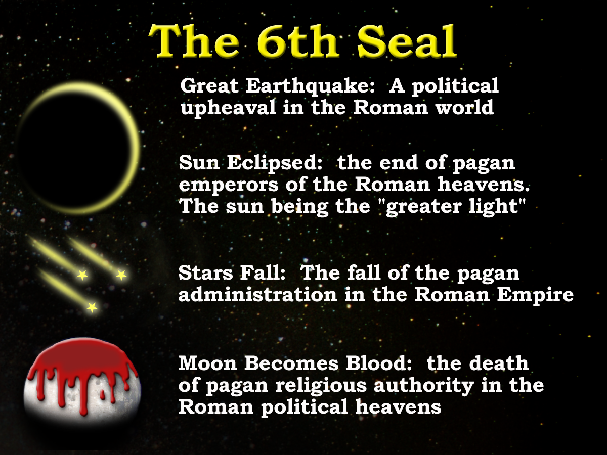
Deut.32:1
Isa.1.2,10
First of 3 Great Earthquakes in Apocalypse
Isa. 34:4-5

Slide 8

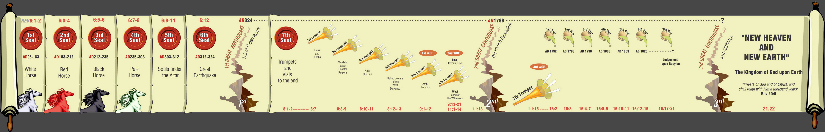
Unsealed - “Come and See!”
7
Seals
7
1 2 3 4 5 6
Trumpets
7
1 2 3 4 5 6
Vials
Judgement - Pagan Rome
1 2 3 4 5 6
Judgement - Christian Rome
Rev.6
Judgement - Holy Roman Empire
Rev.8 & 9
AD 96 – AD 324
Rev.16
AD 395 – AD 1685
AD 1789 – AD 1820

Slide 9
3 Great Earthquakes
Rev.6:12
Rev.11:13
Rev.16:18
Note the only other two occasions
Rev.8:5
Rev.11:19

Slide 10
Rev. 6:12-13
Political upheaval in the Roman World
Notes:
We see the great earthquake effect all aspects of Roman life – Political and Religious
Each symbol representing a slightly different aspect of these POLITICAL HEAVENS
READ SLIDE

Slide 11
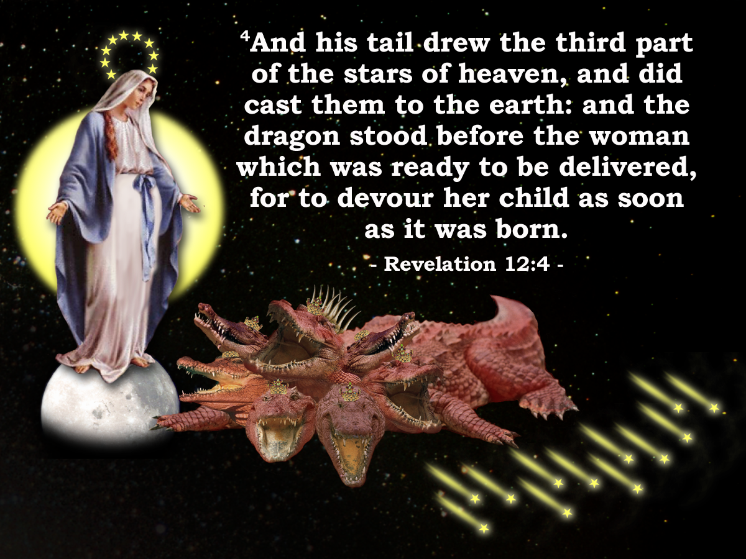
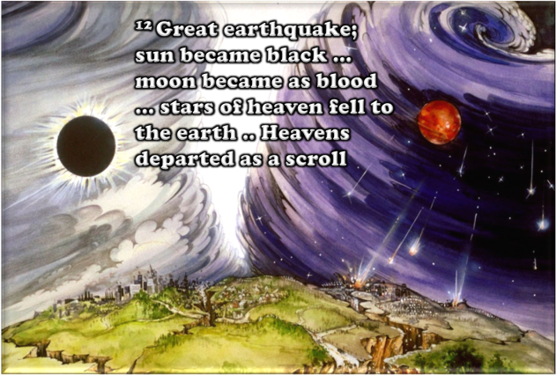
Sixth Seal
Rev. 6:12-17
Rev. 12
v.12 Great earthquake
v.7 Paganism cast out (Dragon) Michael (He like God) Constantine
v.13 Stars of heaven fell to the earth
v.4 Drew the third part of the stars of heaven
v.12 Sun black – Moon blood
v.1 Clothed with the sun, moon under her feet
v.16 ... Fall on us and hide us from the face of him that sitteth on the throne and from the wrath of the lamb
v.10-11 … And they over came him by the blood of the lamb…..

Slide 12
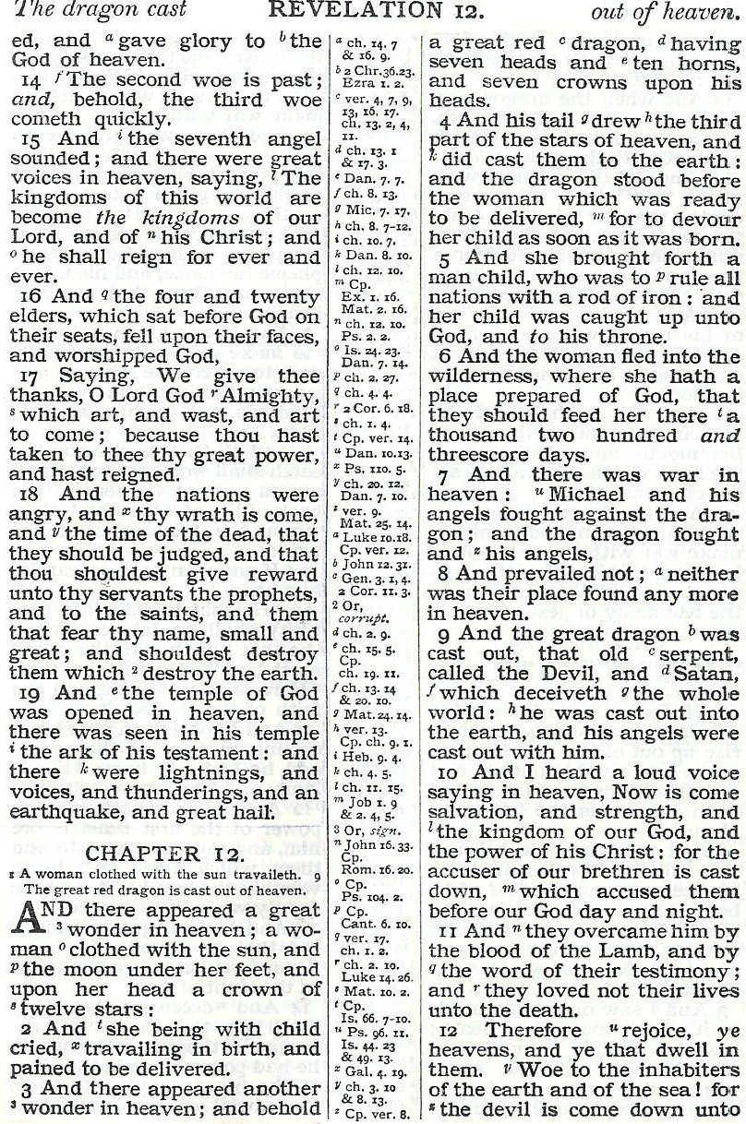
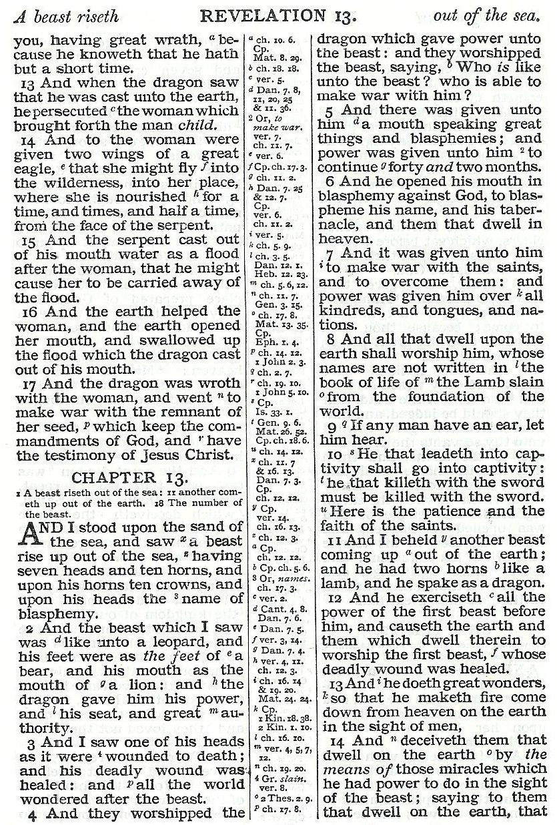
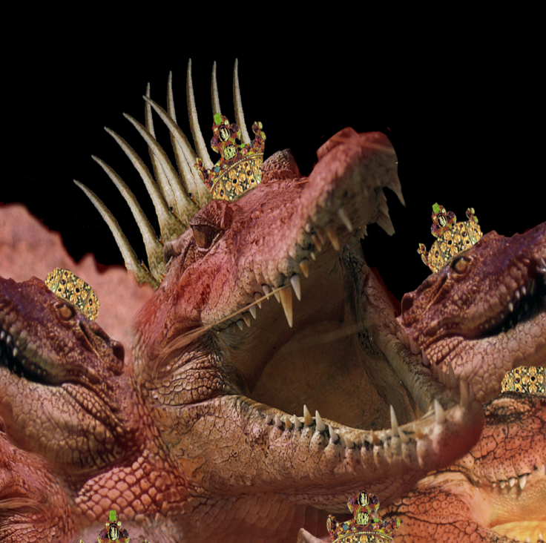
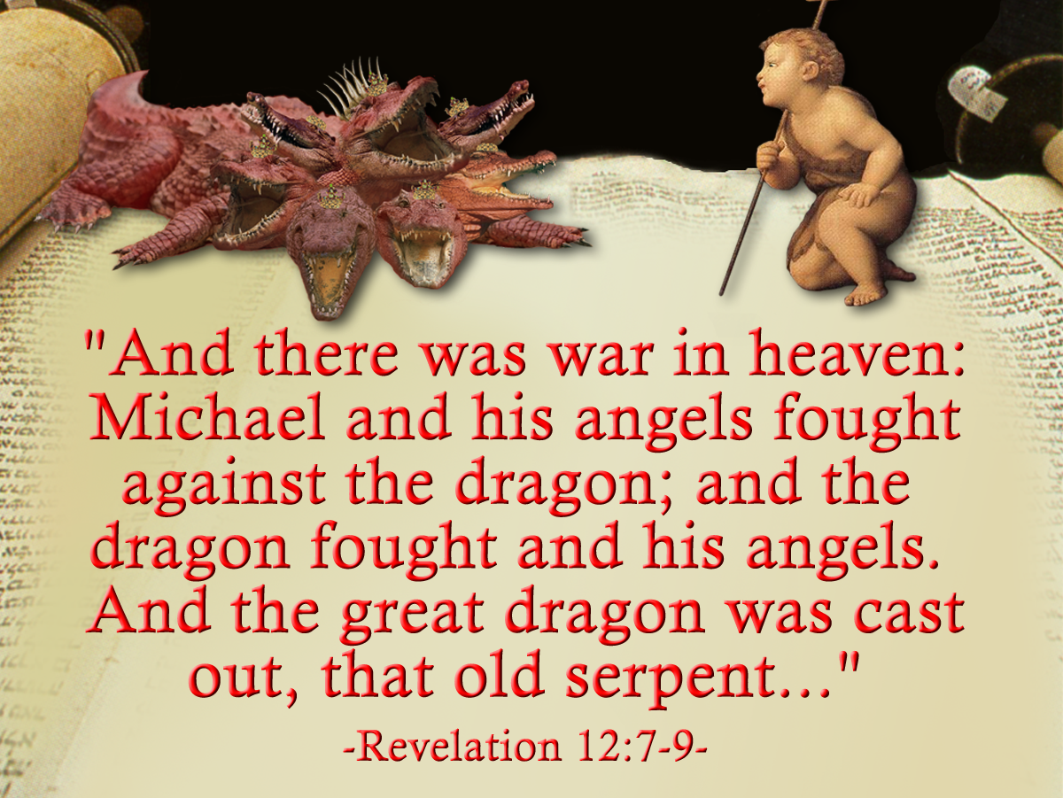
War in Political Heaven – War for Rome!
Pagan Dragon
Galerius
Maxentius
Licinius

Slide 13
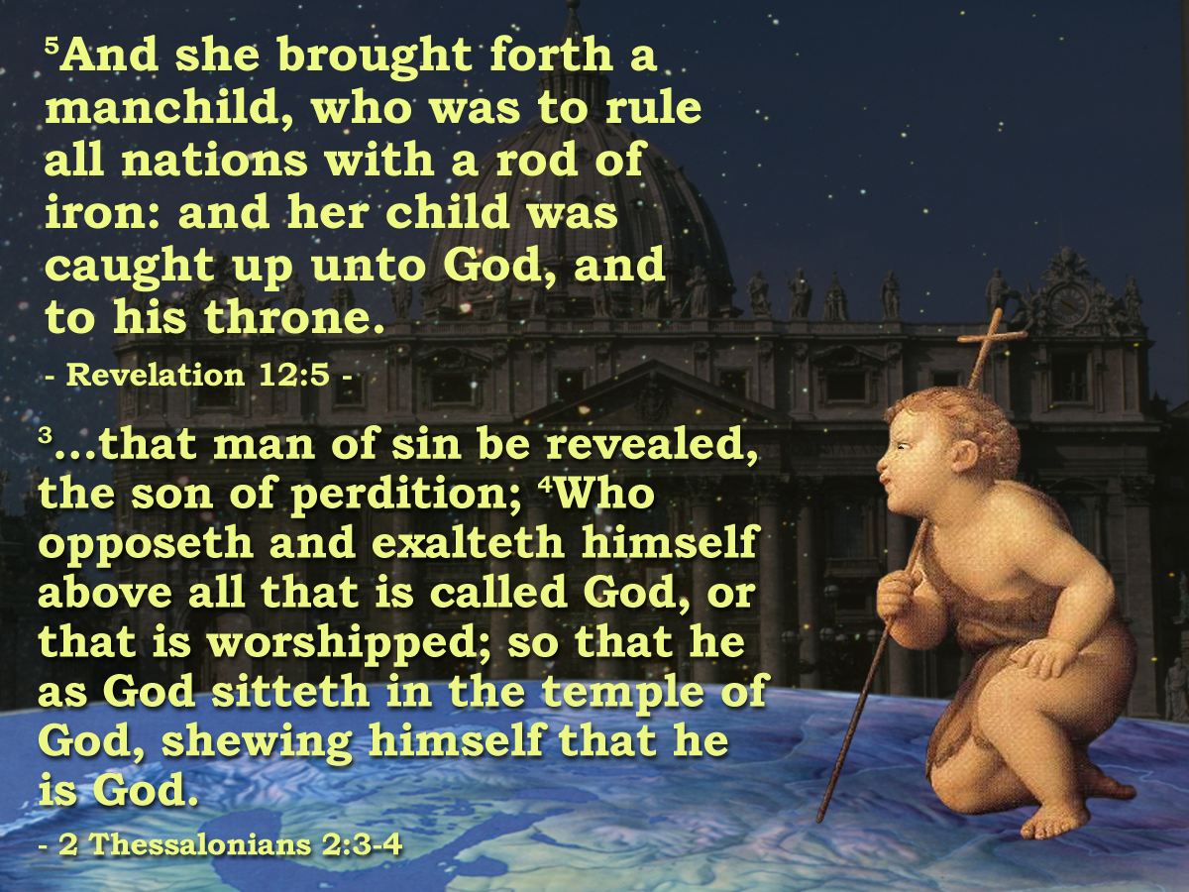
ROME?
Pagan Dragon
War for Rome!
Christian Dragon
Galerius
Maxentius
Licinius
Constantine and successors

Slide 14
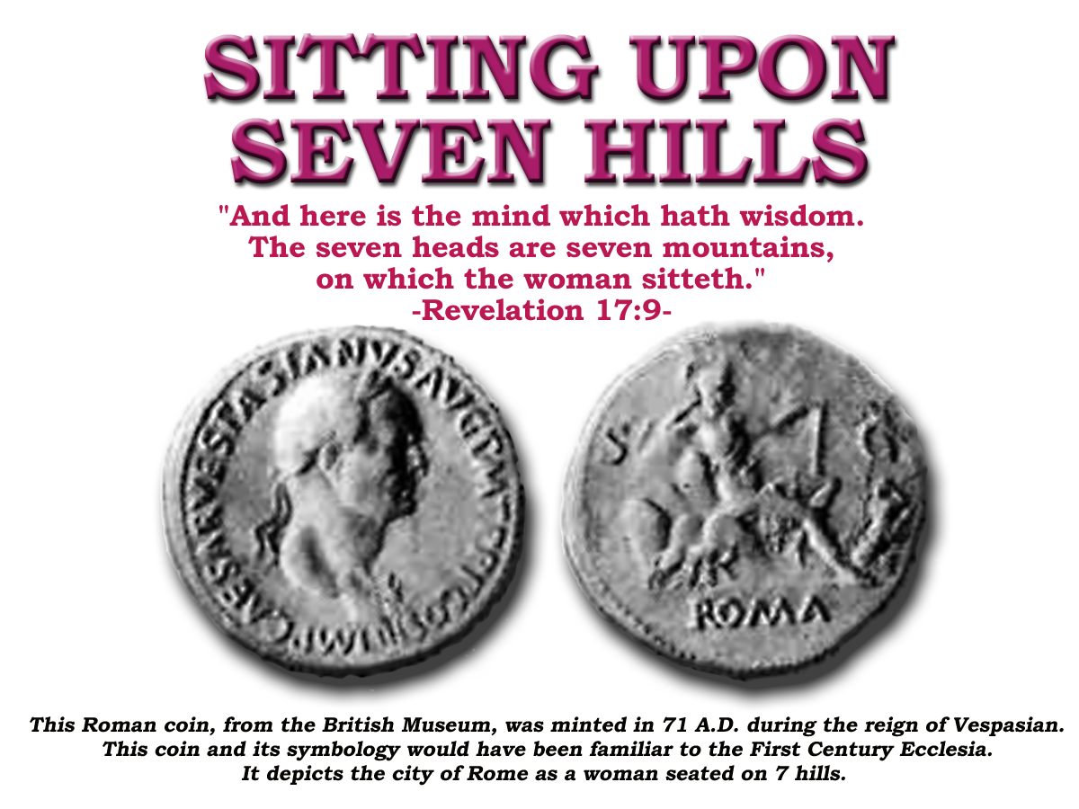
Revelation 17
v9 7 Heads = 7 Mountains (geographic identification)
v10 “and there are seven kings:” = 7 forms of Government (political identification)
“five are fallen”
“one is”
“the other is not yet come”
Regal
Consular
Dictatorial
Decemviral
Tribunitial
Imperial
Goths
‘and when he cometh he must continue a short space.’

Slide 15
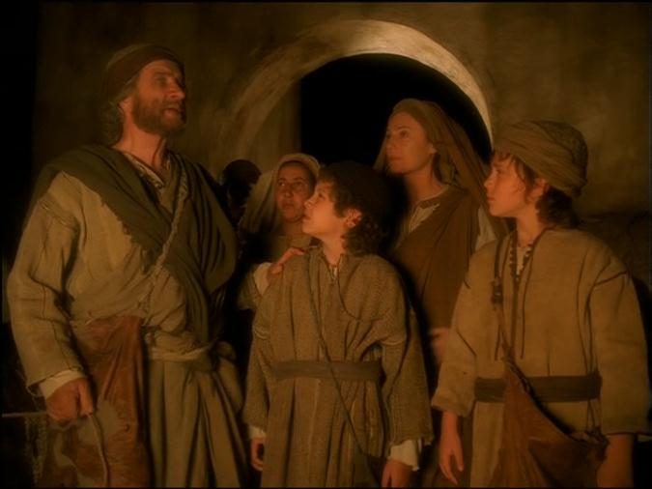
Revelation 17
v10 “and there are seven kings:” = 7 forms of Government
“.. not yet come, when he comes he must continue a short space”
“five are fallen”
“one is”
8th Head
“The one that was and is not”
Rev. 13:3

Slide 16
ROME!
Pagan Dragon
War in Political Heaven – War for Rome!
Galerius
Maxentius
Licinius

Slide 17
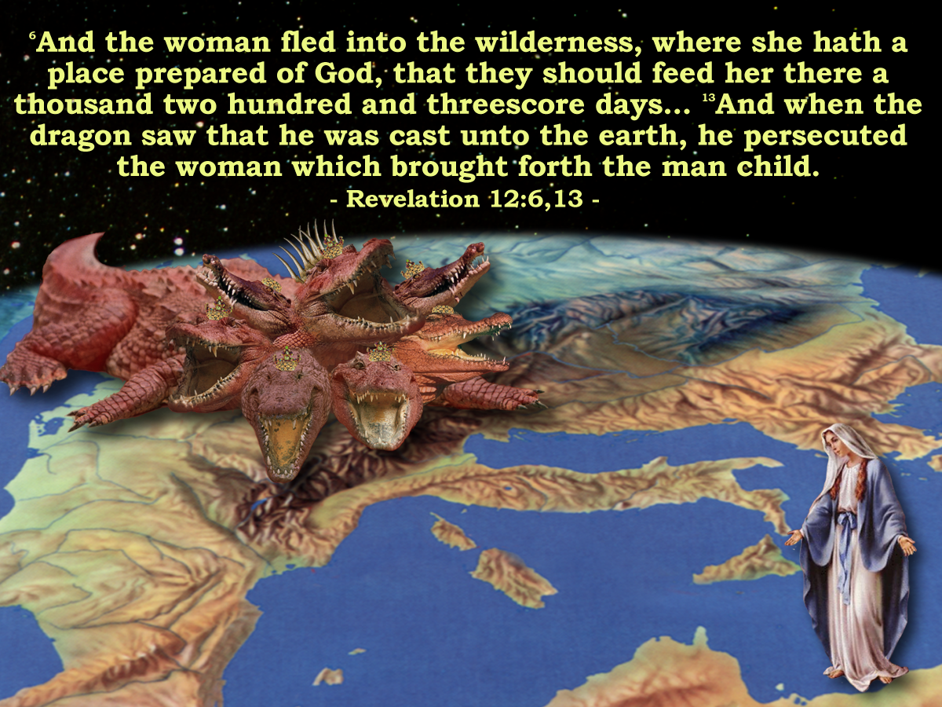
'And the Woman
Fled into the Wilderness'
Next session : (God Willing)
Notes:
The Book of Revelation describes the next phase in the drama:
READ PASSAGE
The ecclesia had been infested with the LAODICIAN APOSTACY for 200 years.
With the rise of Constantine to power the APOSTACY SEPARATED from the ecclesia – making a POLITICAL POWER UNION with the state
The woman – and the remnant of her seed had to flee into the wilderness to avoid persecution by this newly empowered APOSTACY.
Those who did not support this doctrine were eventually banished from the Roman society and had to move to the extremities of the empire.

Slide 19
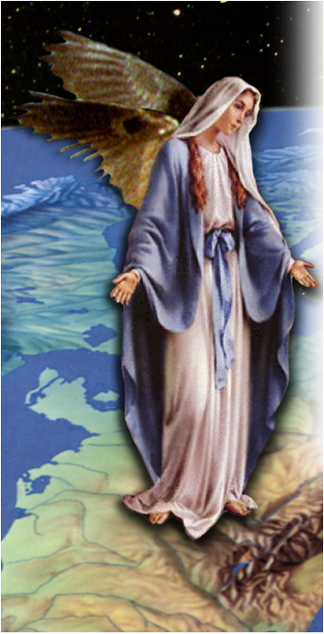
GK =“ho Michael”
the Michael
That is, the Michael of the situation.
Catholic Church
War in the Political Heaven
Pagan Dragon
“Lifted up forcibly.” The battles of force by his army allowed the inevitable lifting up to God. Rom. 13:1
Galerius
Maxentius
Licinius

Slide 20
Galerius / Maxentius
Rev.12:4
Notes:
The two characters are:
The woman (apostate ecclesia)
The dragon (pagan Rome)
Dragon Ready To Devour:
As Christianity increased in popularity it became increasingly more involved in politics it became a threat to the Roman State
The Christians had their own lands, their own “public purse”; system of taxation (called tithing); system of government
The more the ecclesia apostatized from the truth the more of a threat it became to the Roman Government of the day.
Consequently the emperor Diocletian attempted to destroy the political birth that was about to take place

Slide 21
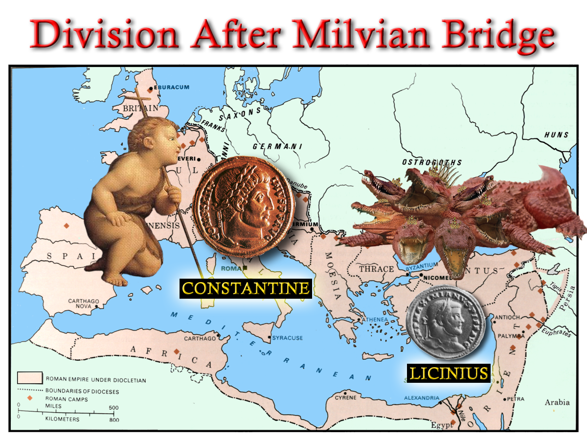
Struggle for Imperial Title
“And his tail drew the third part of the stars of heaven, and did cast them to the earth:”
Rev.12:4
Constantine
Licinius
Maximin
Notes:
The empire had grown substantially up until Diocletian
The Christian Religion had become very wide spread in the empire as a result of the fervent preaching campaign of the brethren (the first Seal)
This emperor enacted the role of the Dragon who “stood before the woman which was ready to be delivered, for to devour her child as son as it was born.”
The persecution of the 5th Trumpet time Period was to soon be avenged.
The divine finger had plotted a course that would see the Roman Dragon cast out of the political heavens – as recorded in Revelation 12.

Slide 22
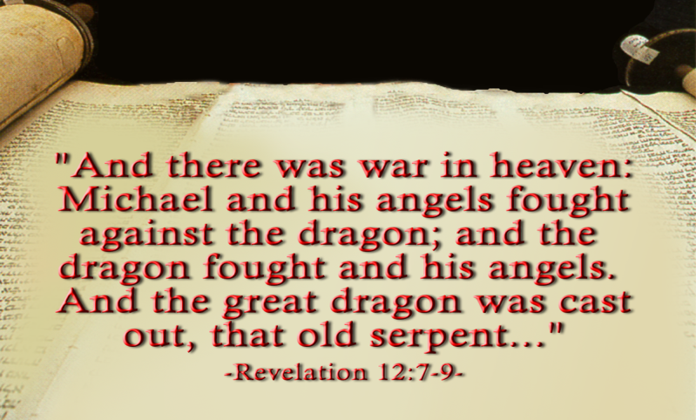
The Dragon and the Man Child
Notes:
In the mean time Licinus had defeated Galerius in an attempt to consolidate his own hold on power – and was emperor of the east.
Constantine issued an Edict throughout the Empire to restore all properties to the Christians that had been removed under Diocletian.
Licinius and Constantine held an 8 year truce that ended when Licinius conspired against Constantine.
The scripture demanded that the Pagan Dragon be cast out of the heaven – at this point only one half had been rid of the Dragon!
The Final battle took place place at ADRIANOPLE where 150.000 infantry; 15,000 cavalry; and 350 galleons had confronted Constantine’s measly 120,000 infantry with only 200 small vessels.
The Dragon (Licinius) was cast out!

Slide 23
'And the Woman
Fled into the Wilderness'
Next session : (God Willing)
Notes:
The Book of Revelation describes the next phase in the drama:
READ PASSAGE
The ecclesia had been infested with the LAODICIAN APOSTACY for 200 years.
With the rise of Constantine to power the APOSTACY SEPARATED from the ecclesia – making a POLITICAL POWER UNION with the state
The woman – and the remnant of her seed had to flee into the wilderness to avoid persecution by this newly empowered APOSTACY.
Those who did not support this doctrine were eventually banished from the Roman society and had to move to the extremities of the empire.

Slide 25
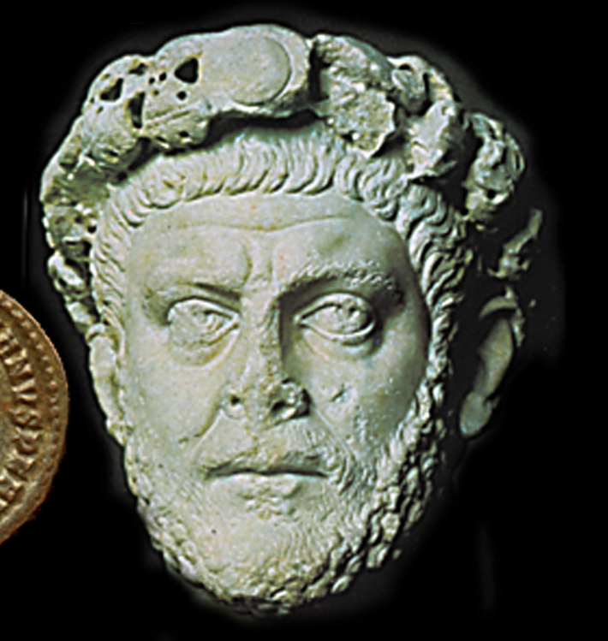
SOULS UNDER THE ALTAR
10
And they cried with a loud voice, saying, How long, O Lord, holy and true, dost thou not judge and avenge our blood on them that dwell on the earth?
Rev. 6:10
Rev.6:13-14
2 Thess. 2:7
“…only he who now restrains, will restrain, until he be taken out of the way.”
The Fifth Seal
303-311
8yrs

