Slide 1
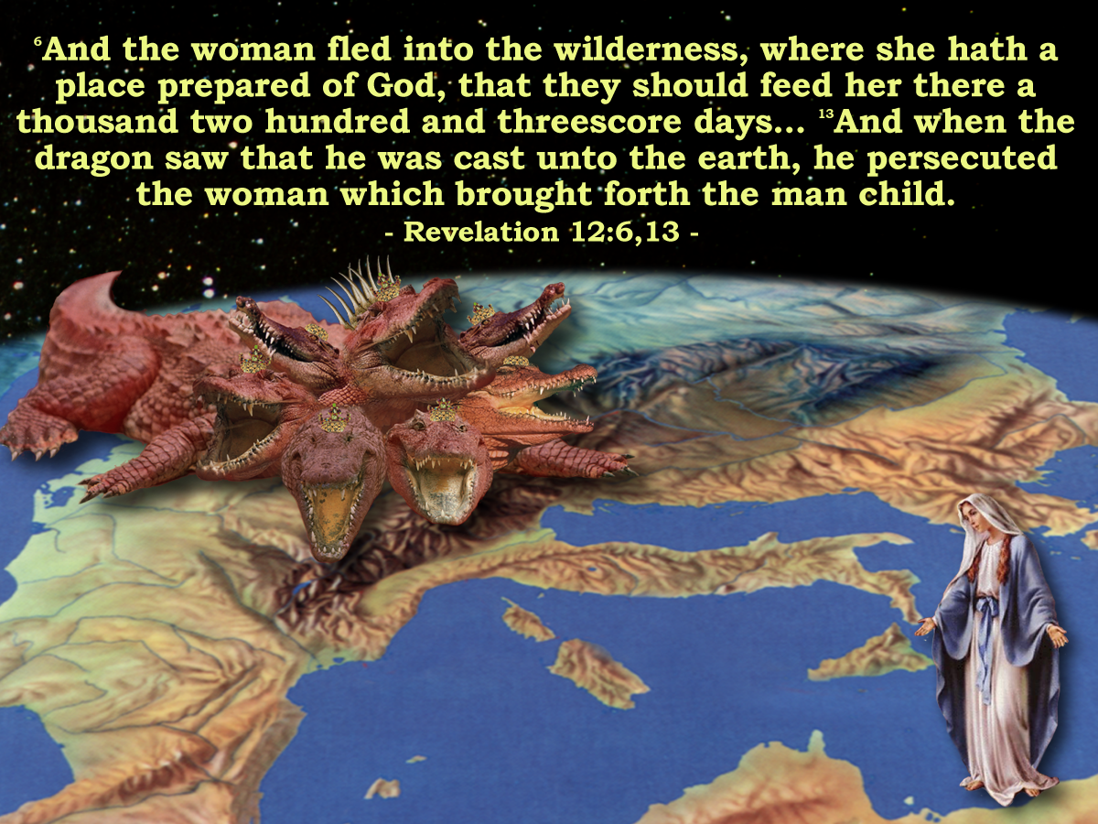
'And the Woman
Fled into the Wilderness'
Manitoulin Family Camp 2024
Notes:
The Book of Revelation describes the next phase in the drama:
READ PASSAGE
The ecclesia had been infested with the LAODICIAN APOSTACY for 200 years.
With the rise of Constantine to power the APOSTACY SEPARATED from the ecclesia – making a POLITICAL POWER UNION with the state
The woman – and the remnant of her seed had to flee into the wilderness to avoid persecution by this newly empowered APOSTACY.
Those who did not support this doctrine were eventually banished from the Roman society and had to move to the extremities of the empire.

Slide 2
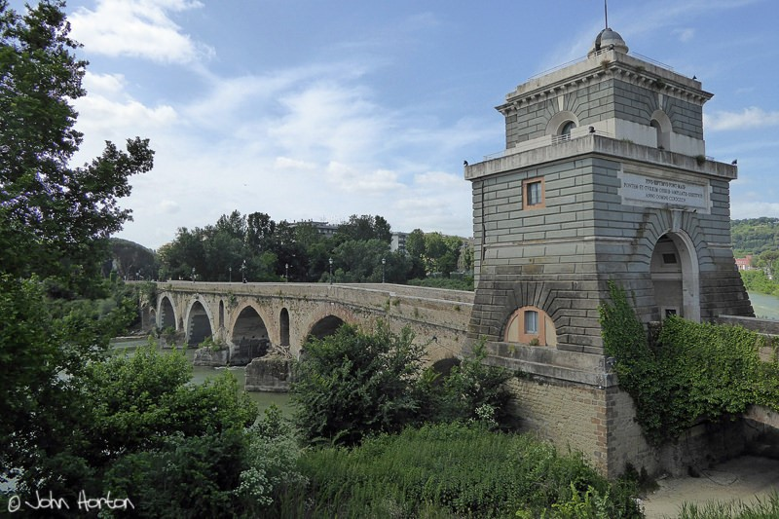
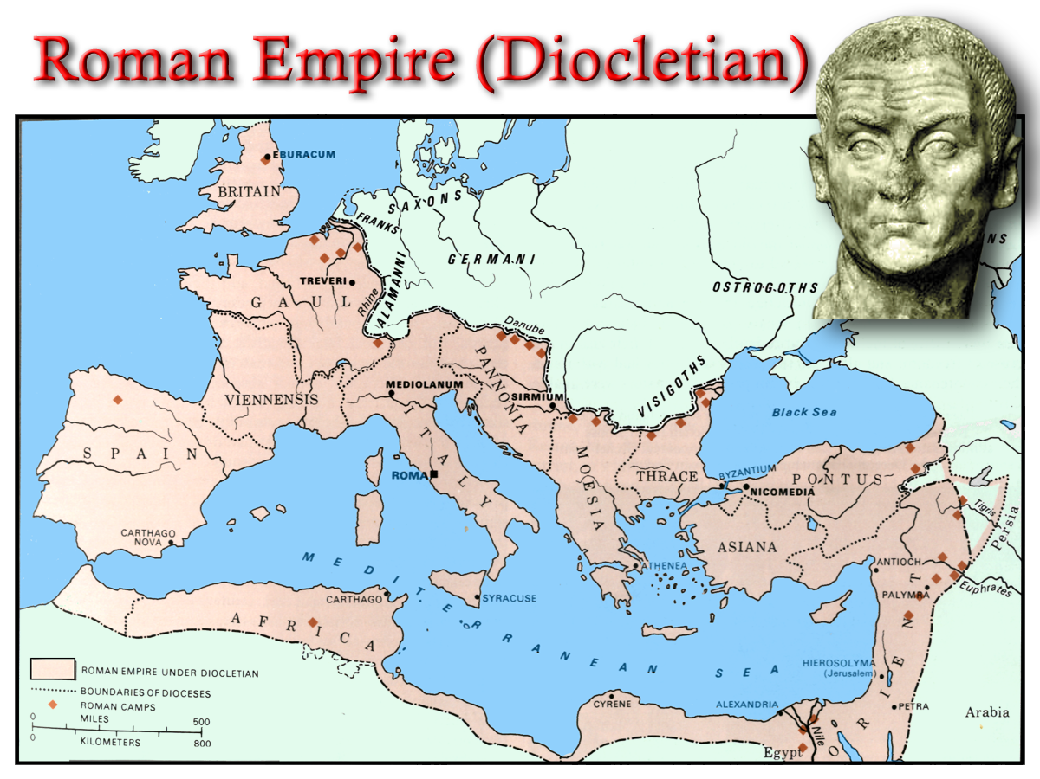

Struggle for Imperial Title
Chi - Rho
ΧΡΙΣΤΟΣ
Edict of Milan
Labarum
313 AD
Licinius
Constantine
Milvian Bridge
312 AD
“How long ,O Lord, holy and true dost thou not judge and avenge our blood on them that dwell on the earth”
Maximin
311 AD
305 AD
285 AD

Slide 3
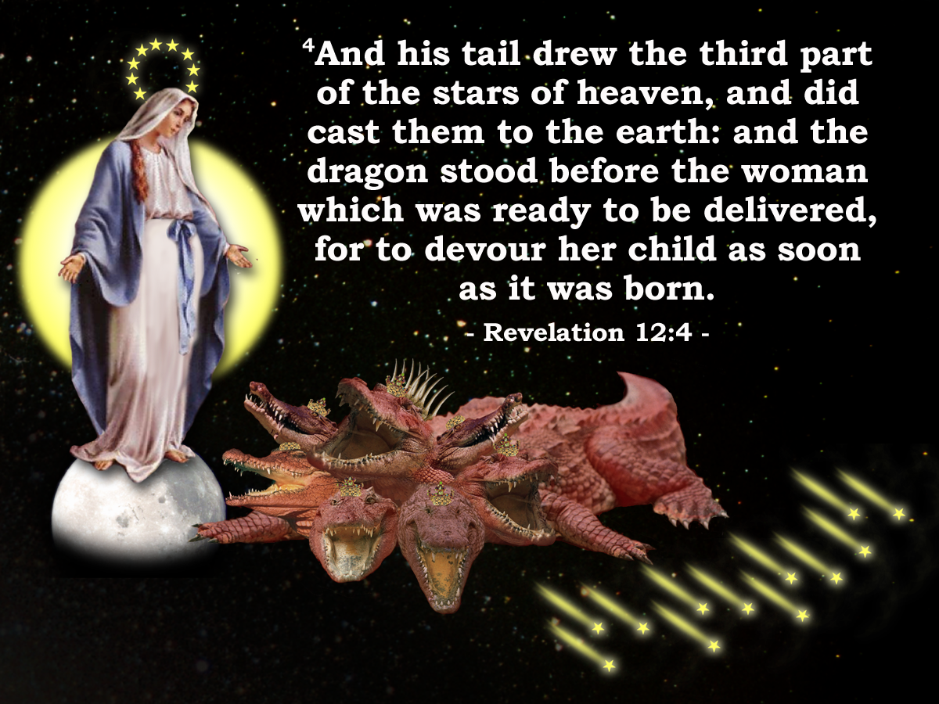
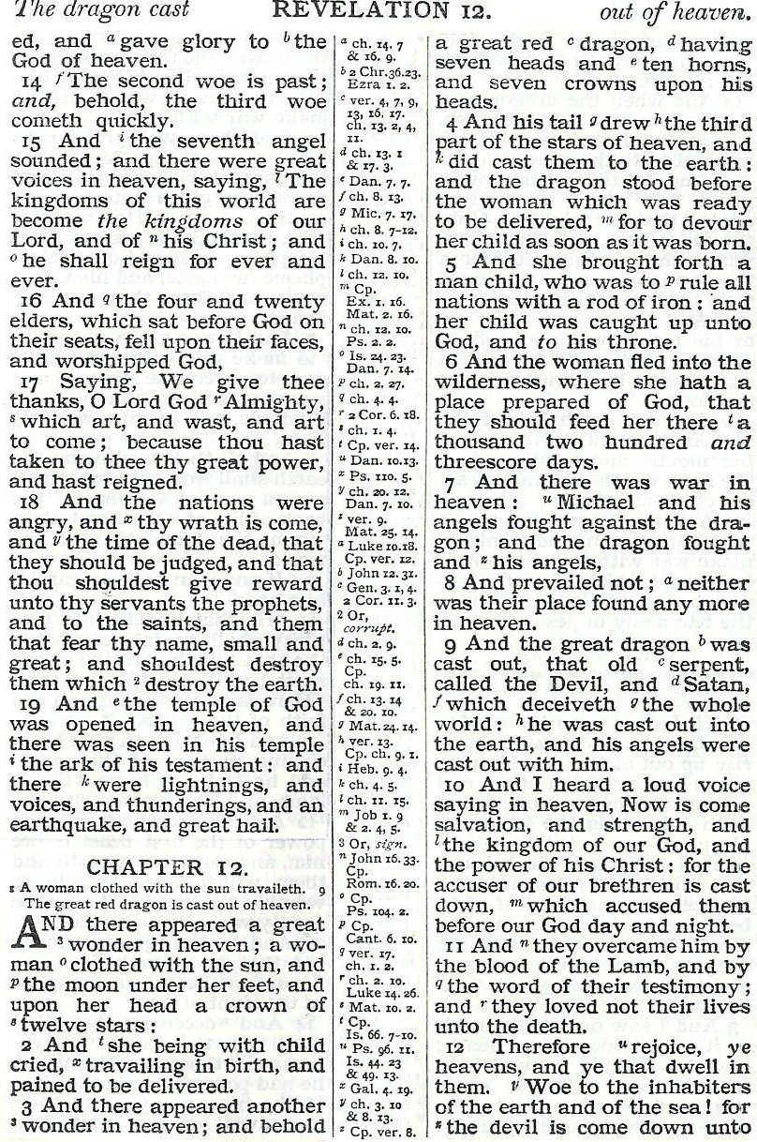
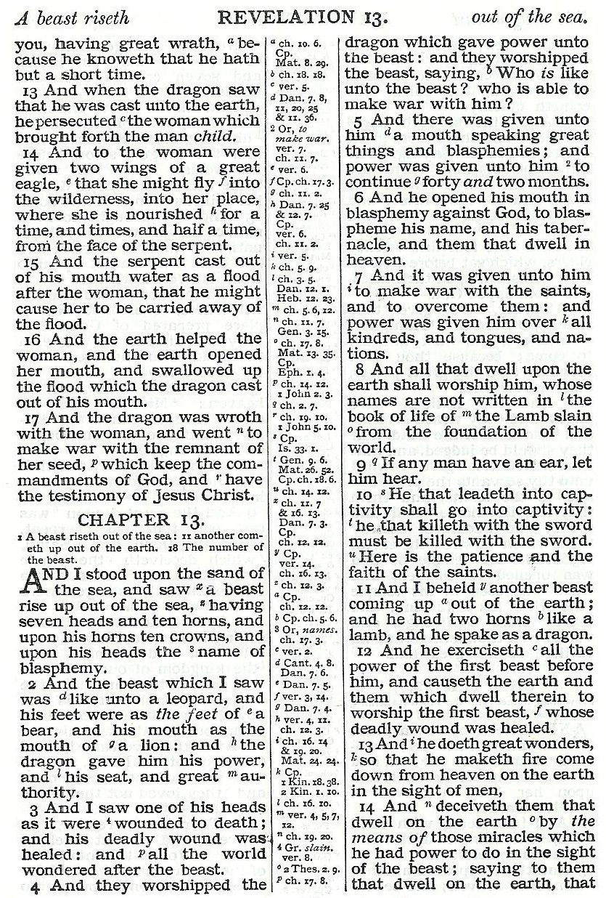
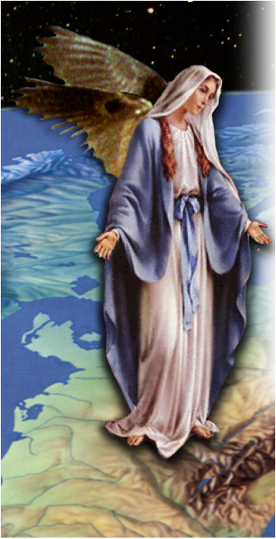
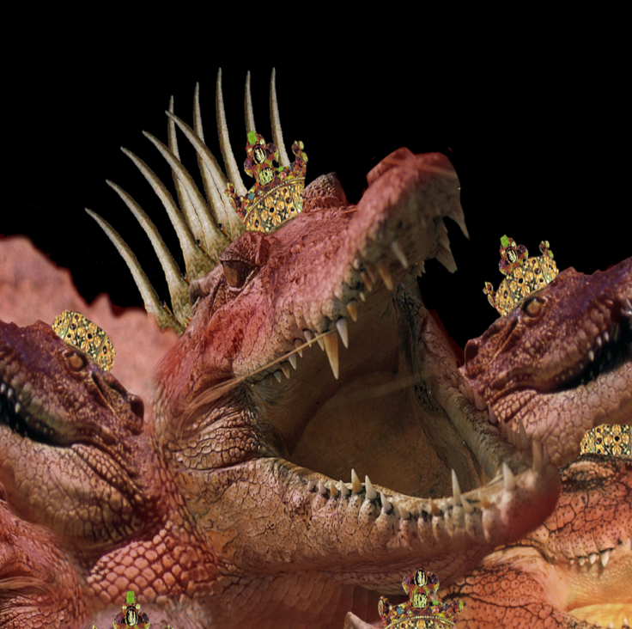
GK =“ho Michael”
the Michael
That is, the Michael of the situation.
Catholic Church
War in the Political Heaven
Pagan Dragon
“Lifted up forcibly.” The battles of force by his army allowed the inevitable lifting up to God. Rom. 13:1
Galerius
Maxentius
Licinius

Slide 4
Galerius / Maxentius / Licinius
Rev.12:4
Notes:
The two characters are:
The woman (apostate ecclesia)
The dragon (pagan Rome)
Dragon Ready To Devour:
As Christianity increased in popularity it became increasingly more involved in politics it became a threat to the Roman State
The Christians had their own lands, their own “public purse”; system of taxation (called tithing); system of government
The more the ecclesia apostatized from the truth the more of a threat it became to the Roman Government of the day.
Consequently the emperor Diocletian attempted to destroy the political birth that was about to take place

Slide 5
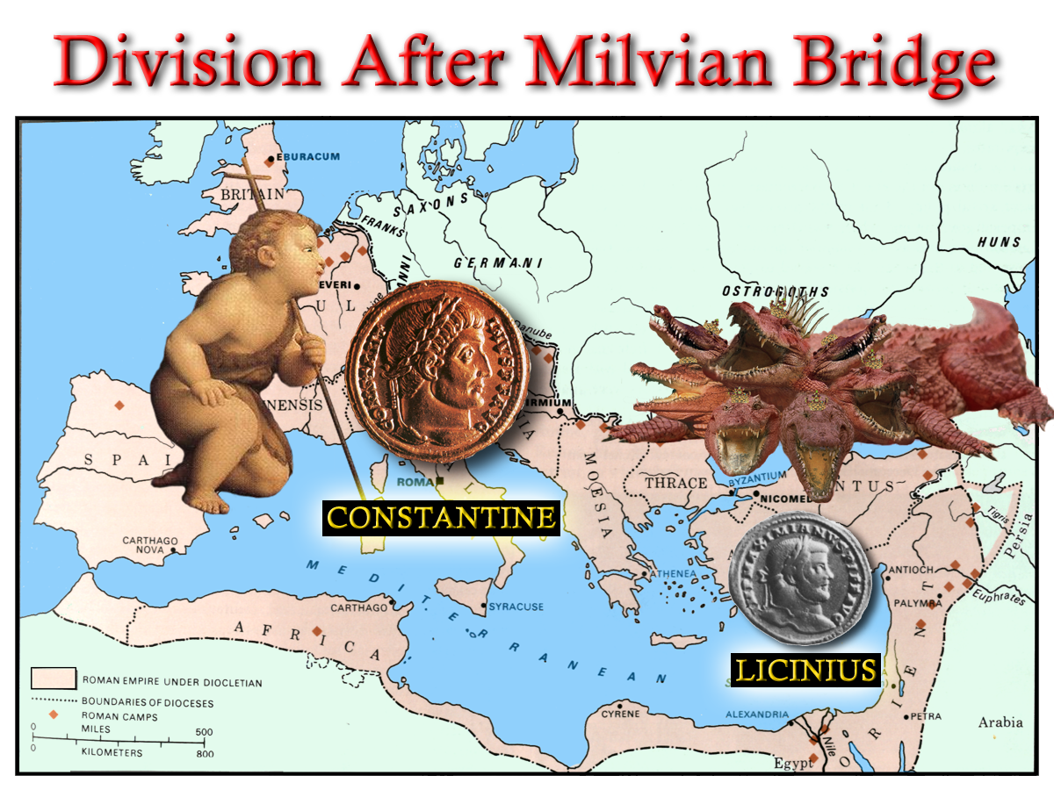
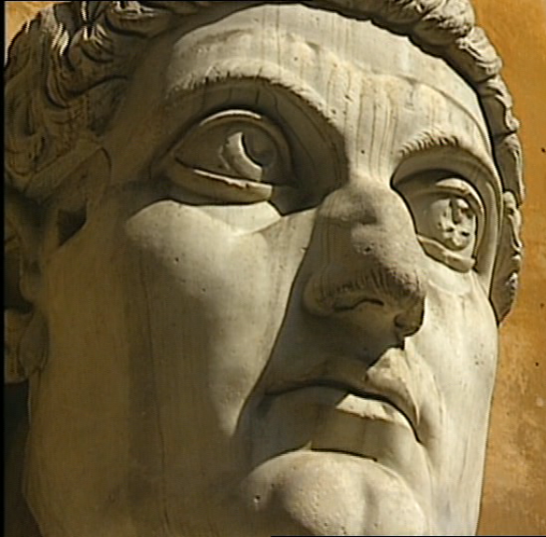
Struggle for Imperial Title
“And his tail drew the third part of the stars of heaven, and did cast them to the earth:”
Rev.12:4
Constantine
Licinius
Maximin
Notes:
The empire had grown substantially up until Diocletian
The Christian Religion had become very wide spread in the empire as a result of the fervent preaching campaign of the brethren (the first Seal)
This emperor enacted the role of the Dragon who “stood before the woman which was ready to be delivered, for to devour her child as son as it was born.”
The persecution of the 5th Trumpet time Period was to soon be avenged.
The divine finger had plotted a course that would see the Roman Dragon cast out of the political heavens – as recorded in Revelation 12.

Slide 6
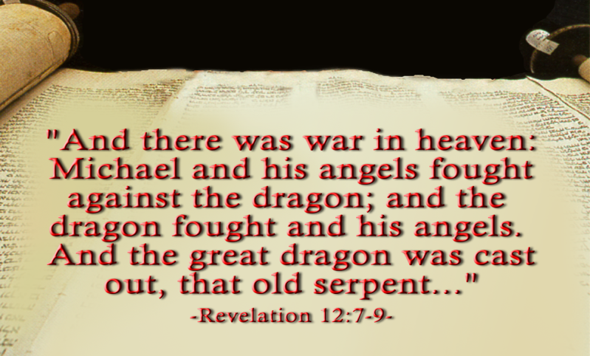
The Dragon and the Man Child
Note v8-9,12-13
Notes:
In the mean time Licinus had defeated Galerius in an attempt to consolidate his own hold on power – and was emperor of the east.
Constantine issued an Edict throughout the Empire to restore all properties to the Christians that had been removed under Diocletian.
Licinius and Constantine held an 8 year truce that ended when Licinius conspired against Constantine.
The scripture demanded that the Pagan Dragon be cast out of the heaven – at this point only one half had been rid of the Dragon!
The Final battle took place place at ADRIANOPLE where 150.000 infantry; 15,000 cavalry; and 350 galleons had confronted Constantine’s measly 120,000 infantry with only 200 small vessels.
The Dragon (Licinius) was cast out!

Slide 7
The Dragon and the man child
Just before the final battle, Licinius assembled friends in a sacred grove and offered sacrifices and said,
“Friends and fellow warriors. These are the gods of our ancestors, whom, received from our earliest predecessors as objects of worship, we honour; but he who commands the army that is drawn up against us, having adopted an atheistic opinion, violates the customs of the fathers, venerating a god from abroad, I know not whence, and disgraces his troops with his ignominious standard (the cross with the monogram of Christ) trusting in which he arms not so much against us as against the gods whom he offends…………If the foreign god whom we now deride, should appear the mightiest, we must acknowledge and honour him, and bid farewell to these to whom we have vainly lit wax tapers.”
“and there was war in heaven Michael and his angels fought against the dragon…….”
Rev.12:4

Slide 8
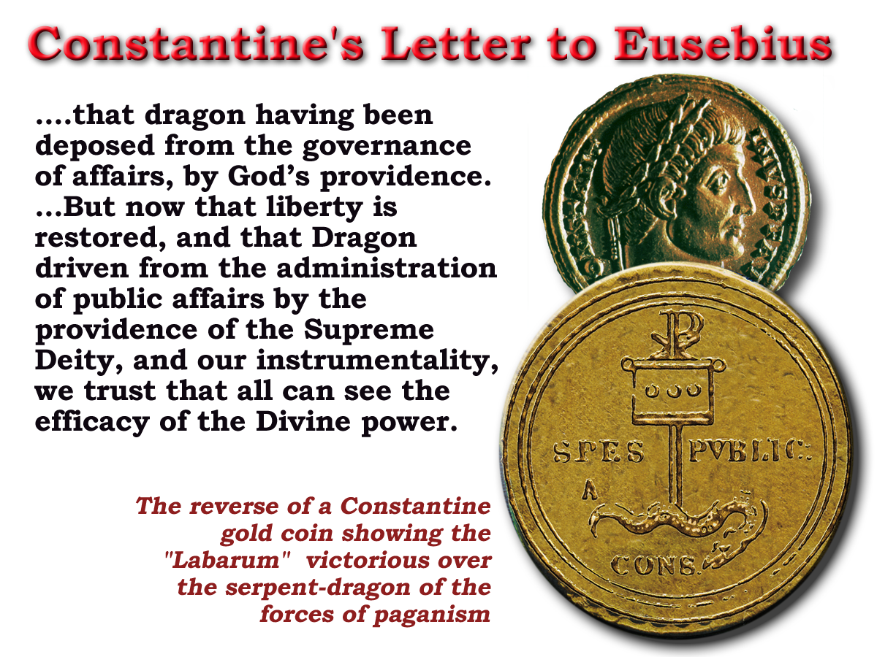
“ Now is come salvation and strength and the kingdom of our God and the power of his Christ”
Rev.12:10
Lactanius wrote:
“ Let us celebrate the triumph of God with gladness; let us commemorate His victory with praise; let us make mention in our prayers day and night of the peace which after ten years of persecution, He has conferred on his people.”
“ …and hide us from the face of him that sitteth upon the throne, and from the wrath of the Lamb:
For the great day of his wrath is come; and who shall be able to stand?”
Rev.6:16-17
Notes:
READ OVERHEAD – at end of notes
Constantine's close advisor – Eusebius was an apostate bishop who had supported the war effort.
He no doubt had an influence on Constantine’s mind – through the scripture
Constantine saw himself as a fulfillment of the prophecy of the book of Revelation
On his coins he depicted victory of the Labarum (Cross) over the Dragon
In a letter to Eusebius (which Eusebius records for us) he wrote the following:
READ OVERHEAD – at end of notes

Slide 9
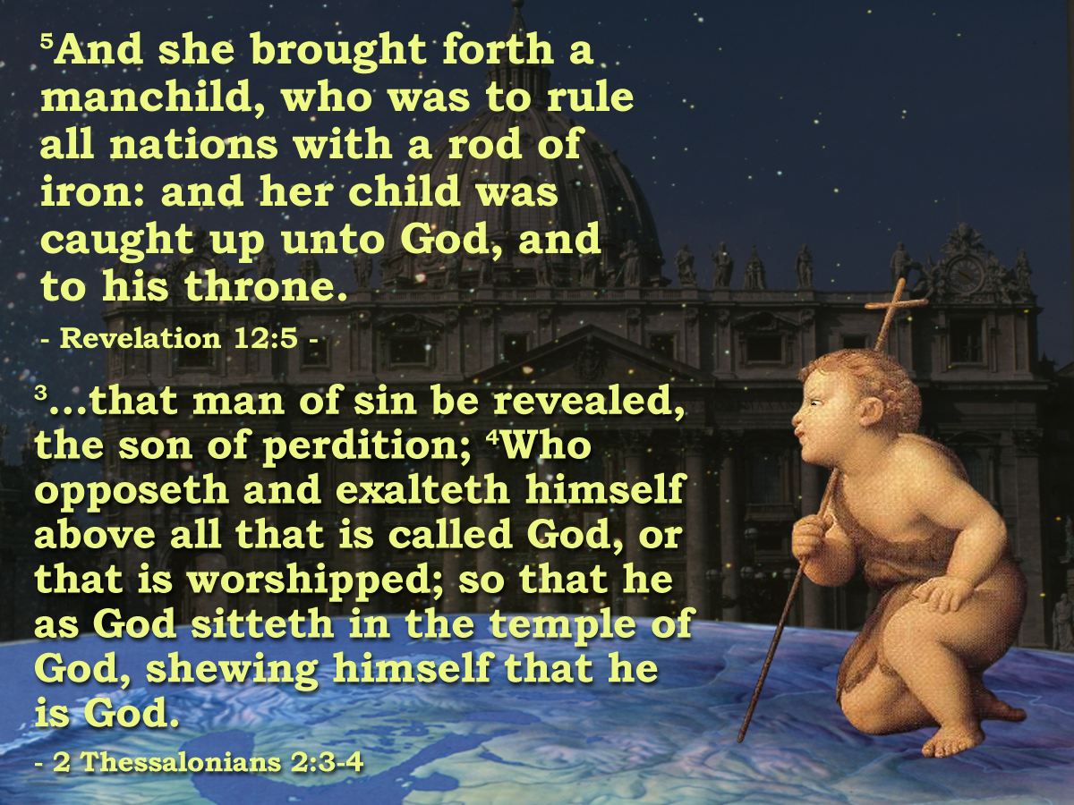
A Pagan Dragon becomes a Christian Dragon
“The edict of Milan, the great charter of toleration, had confirmed to each individual of the Roman world the privilege of choosing and professing his own religion. But this inestimable privilege was soon violated: with the knowledge of truth the emperor imbibed the maxims of persecution; and the sects which dissented from the catholic church were afflicted and oppressed by the triumph of Christianity.” Decline and fall of Roman Empire p.146 Abridged
Pagan Dragon
War for Rome!
Christian Dragon
Galerius
Maxentius
Licinius
Constantine and successors

Slide 11
'And the Woman
Fled into the Wilderness'
Notes:
The Book of Revelation describes the next phase in the drama:
READ PASSAGE
The ecclesia had been infested with the LAODICIAN APOSTACY for 200 years.
With the rise of Constantine to power the APOSTACY SEPARATED from the ecclesia – making a POLITICAL POWER UNION with the state
The woman – and the remnant of her seed had to flee into the wilderness to avoid persecution by this newly empowered APOSTACY.
Those who did not support this doctrine were eventually banished from the Roman society and had to move to the extremities of the empire.

Slide 12
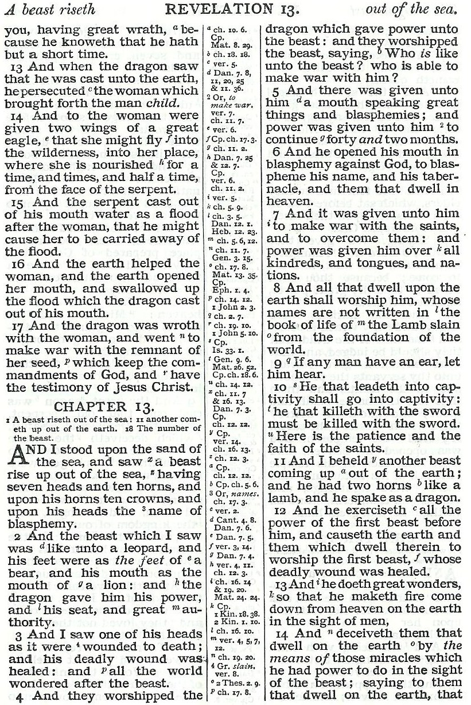
The woman minus the Catholic sect
Pagan Dragon
Catholic Church
Gr.=“Remnants of her seed” The First use in Revelation. = Rev. 2:24 cp v.20
Saints
Donatists.
First Christian movement to oppose the union of Church and State.

Slide 13
Rev.12:6
312 + 1260 =
1572
Rev.12:14
Rev.11:3
Notes:
The Book of Revelation describes the next phase in the drama:
READ PASSAGE
The ecclesia had been infested with the LAODICIAN APOSTACY for 200 years.
With the rise of Constantine to power the APOSTACY SEPARATED from the ecclesia – making a POLITICAL POWER UNION with the state
The woman – and the remnant of her seed had to flee into the wilderness to avoid persecution by this newly empowered APOSTACY.
Those who did not support this doctrine were eventually banished from the Roman society and had to move to the extremities of the empire.

Slide 14
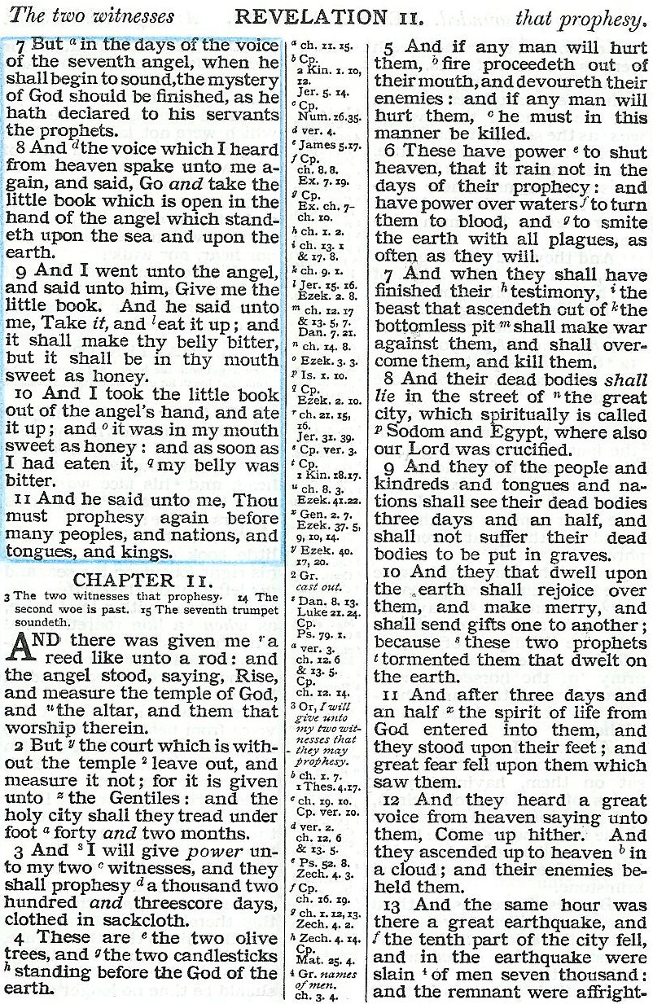
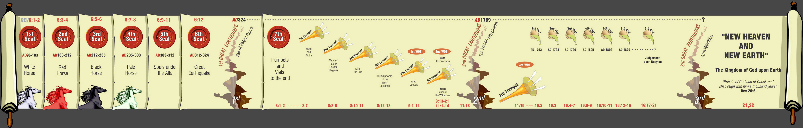
“That they should feed her there 1260 days" Rev. 12:6
Speak out!
Beginning 312 AD
4

Slide 15
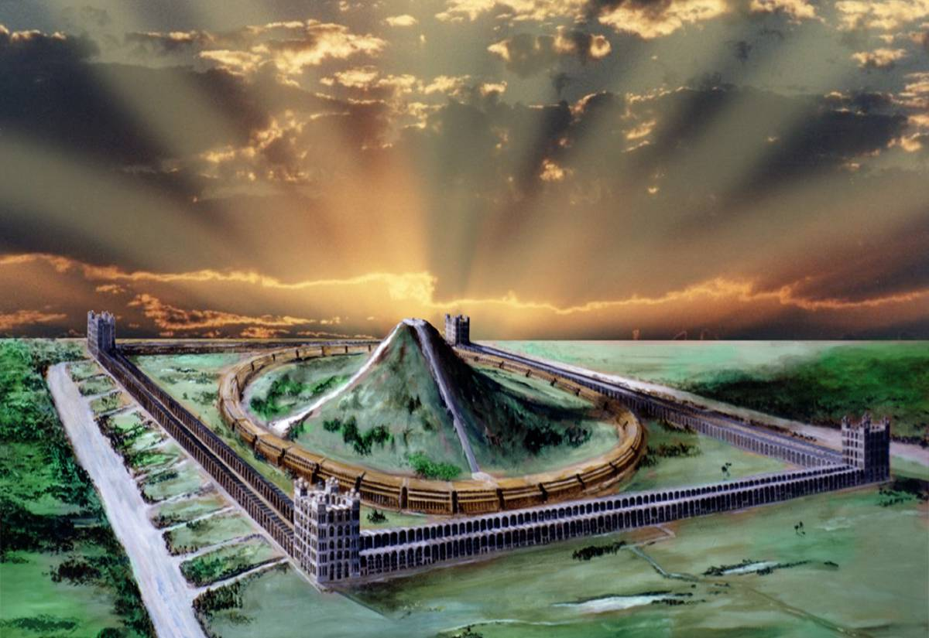
Fight!
Take away peace!
6 He shall come down like rain upon the mown grass: As showers that water the earth.
7 In his days shall the righteous flourish; and abundance of peace so as long as the moon endureth.
Psa. 72:6-7
Killed!
Come back to life!
Measured!
Speak out!
4

Slide 16
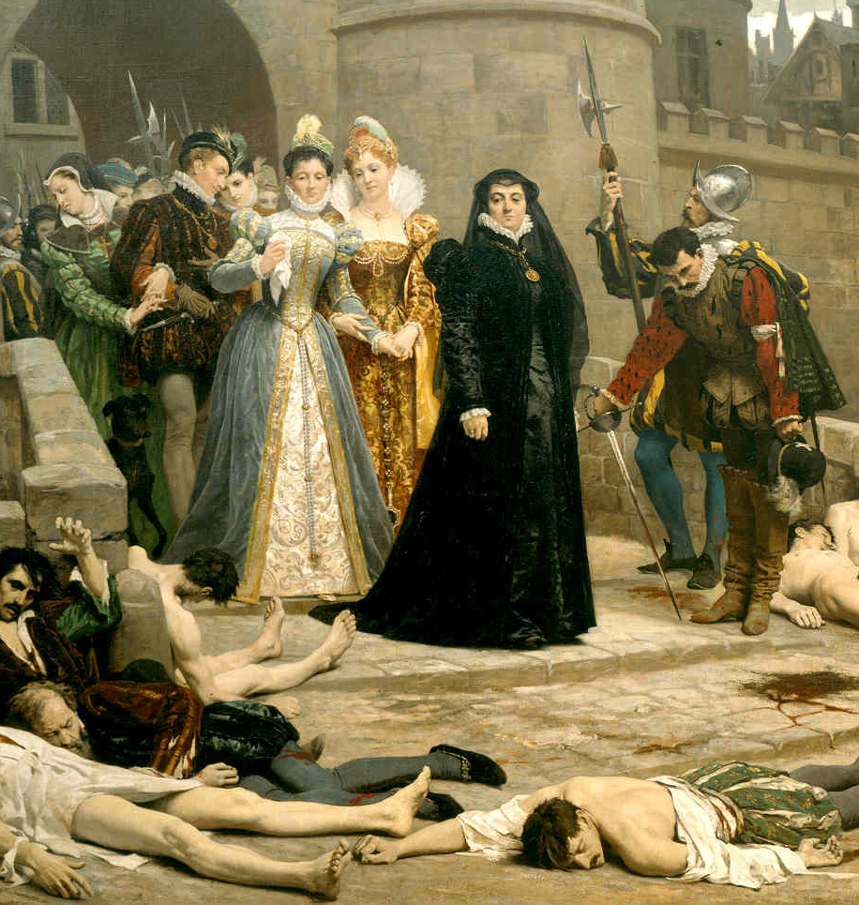
The 2 Witnesses
Rev.11
Secular/Religious (Anti-Papal)
312 AD
1572 AD
1260yrs
Woman & Earth
Rev.11:3
Rev.12:6, 14-17
Massacre St Bartholomew's day
(slaying of witnesses began) Rev.11:7

Slide 17
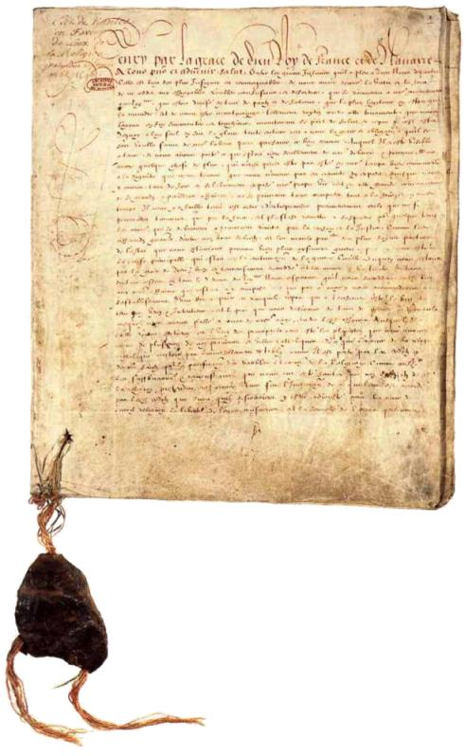
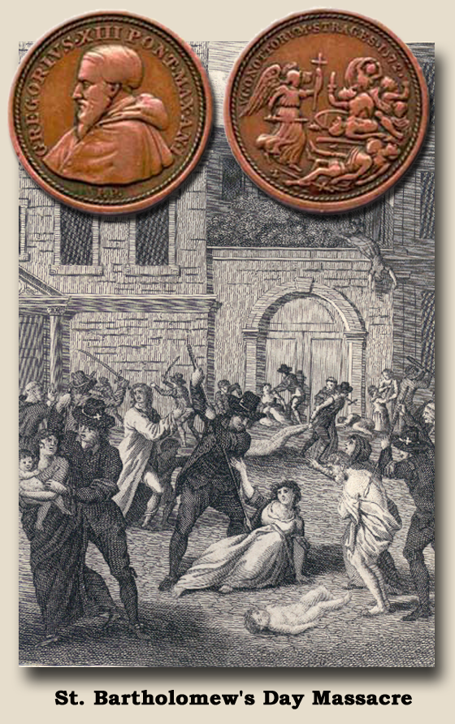
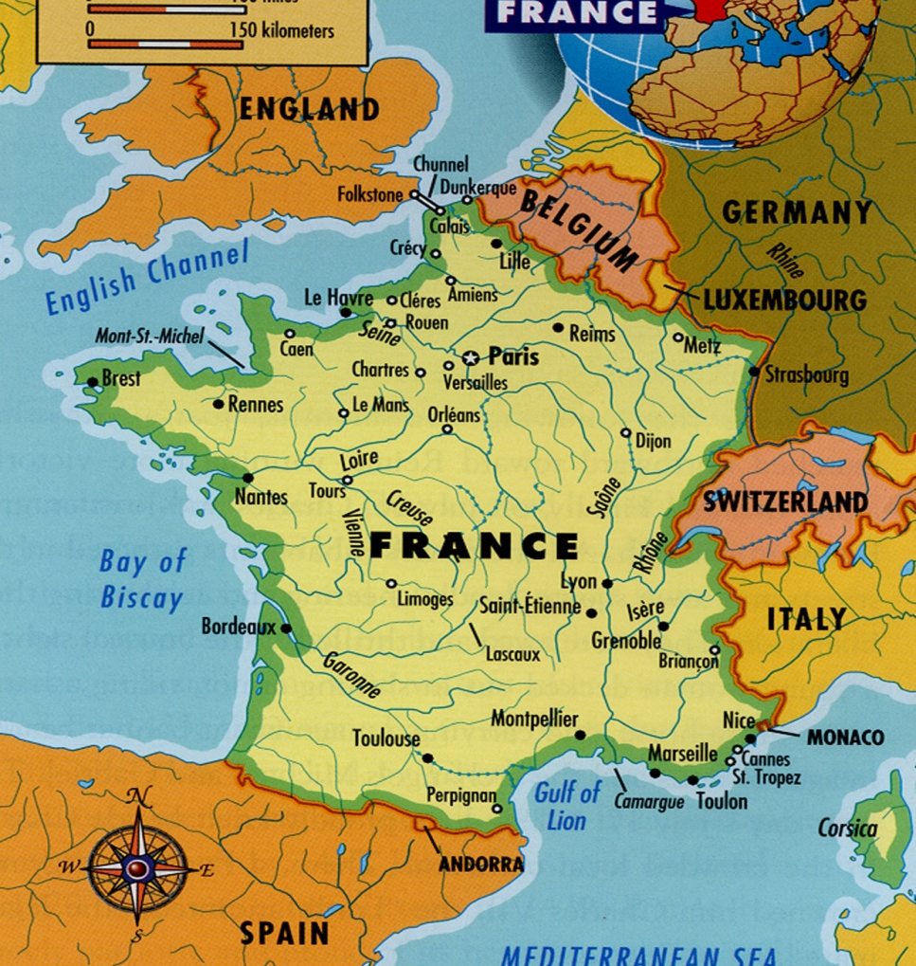

The 2 Witnesses
Rev.11
Secular/Religious (Anti-Papal)
Revocation of Edict of Nantes (Witnesses suffer extreme political death) Rev. 11:8-9
312
1572
1260yrs
Ch. 11:10
1598
1685
Edict of Nantes
Woman & Earth
Rev.11:3
Rev.12:6, 14-17
Massacre St Bartholomew's day (slaying of witnesses began) Rev.11:7

Slide 18
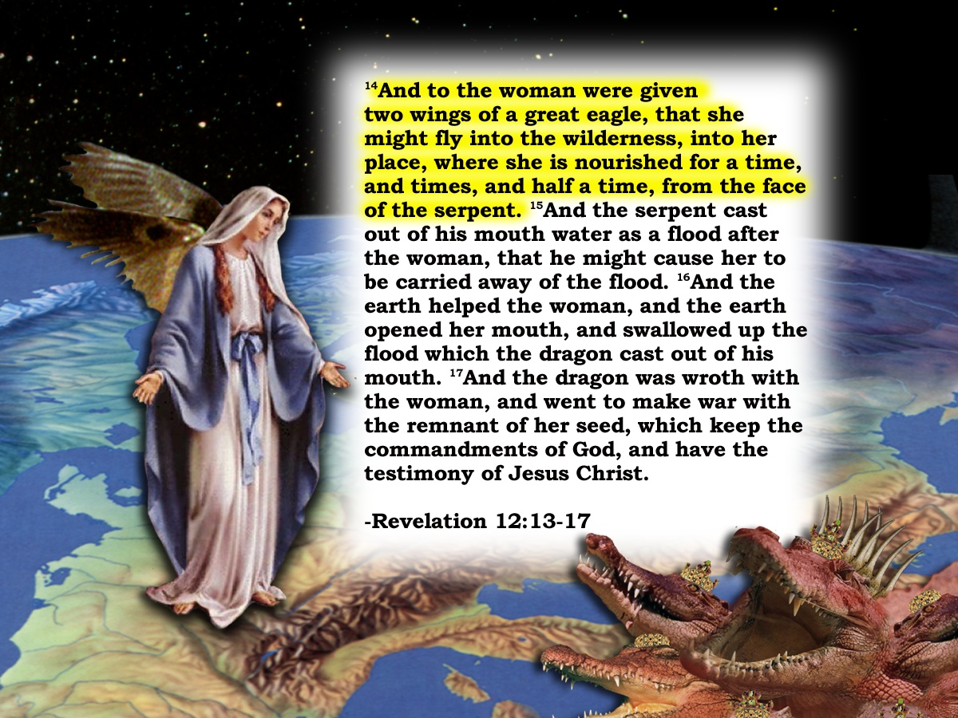
Two Witnesses
Rev.11
Two witnesses 1260 days Vv3-4
Rev.12
15
And the serpent cast out of his mouth water as a flood after the woman, that he might cause her to be carried away of the flood.
Starting point
16
And the earth helped the woman, and the earth opened her mouth, and swallowed up the flood
Woman fleeing – fed 1260 days Rev. 12:6
312 AD
6

Slide 19
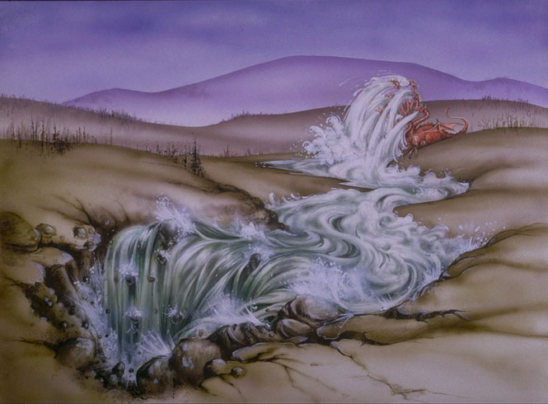
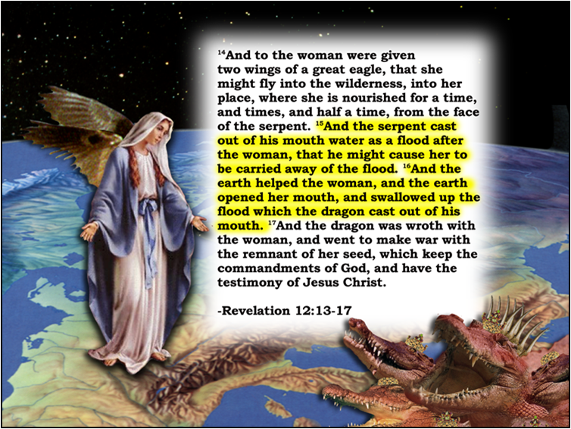
15
“And the serpent cast out of his mouth water as a flood after the woman, that he might cause her to be carried away of the flood.”
And the earth opened her mouth
and swallowed up the flood
The Circumcellions of North Africa
Isa.8:7
Jer.46:7-8
v16

Slide 20
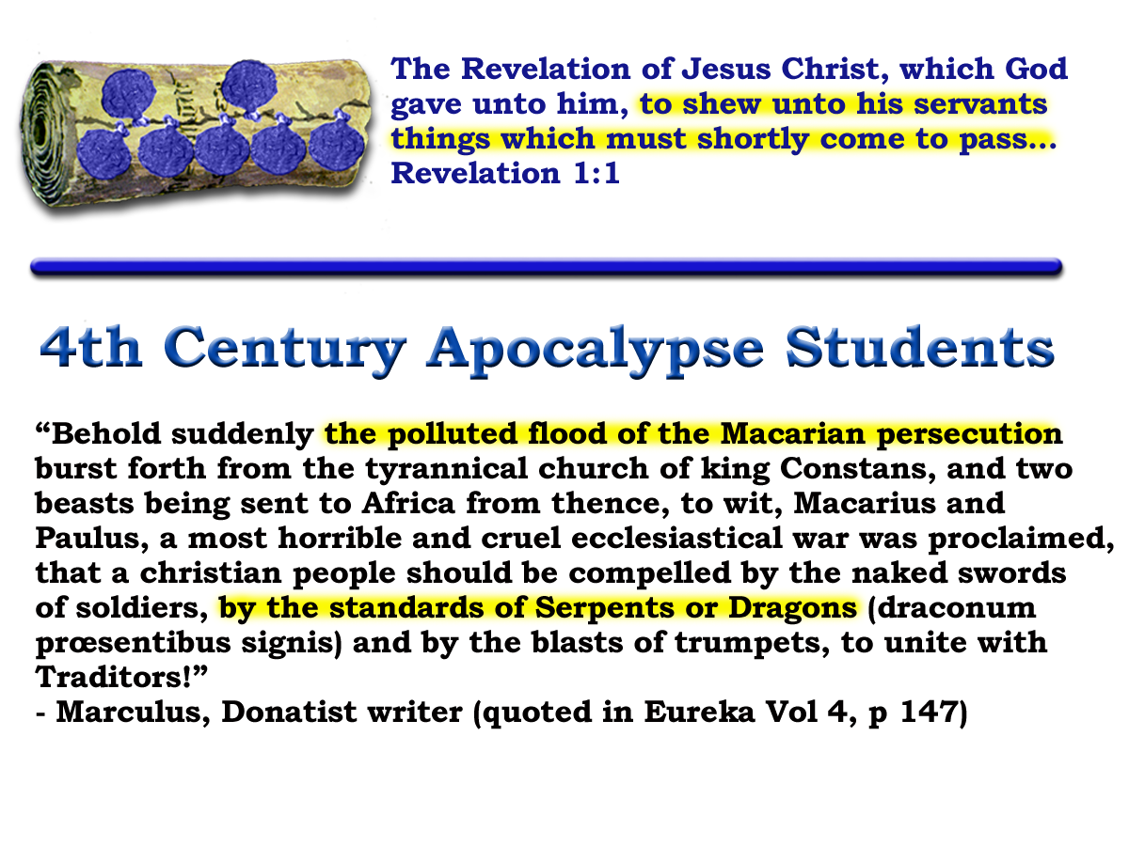
Notes:
BOOK OF REVELATION – GIVEN TO THE SERVANTS OF JESUS CHRIST – to show them things shortly to come
No surprise that Christians of the time understood what was coming.
Donatists of the day recognized the significance of the book of revelation in relation to themselves:
READ SECTION
In recognizing what was going on they were able to defend themselves from the doctrines of this system that was growing.
We do well to take heed to the lessons they provide us with.
Should be able to recognize where we stand to day – to be able to adequately witness against it and protect ourselves from it!
Tomorrow’s class we hope to continue the drama of the book – being exhorted by our brethren’s witness
Bringing us closer to a realization of the dangers we face today

Slide 22
Deut.28:49
Matt.24:27-28

Slide 23


Conquerors through Christ
7
Seals
7
1 2 3 4 5 6
Trumpets
7
1 2 3 4 5 6
Vials
Judgement - Pagan Rome
1 2 3 4 5 6
Judgement - Christian Rome
Rev.6
Judgement Holy Roman E.
T h u n d e r s
Rev.8 & 9
AD 96 – 324
Rev.16
AD 395 – 1685
AD 1789 – 1820
Armageddon

Slide 24
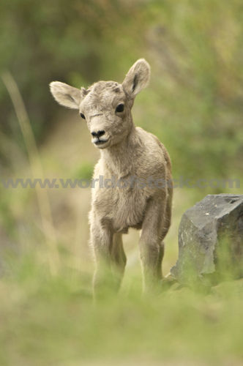

Conquerors through Christ
Next Session
(God willing)

Slide 25
“And she being with child cried, travailing in birth, and pained to be delivered.”
Rev.12:2
Galerius / Maxentius
“For I am jealous over you with Godly jealousy : for I have espoused you to one husband that I may present you as a chaste virgin to Christ.”
Woman with Child
2 Cor.11:2
“For the mystery of iniquity doth already work:”
2 Thess.2:7
280 days 280 yrs.
AD 33 AD 313
Notes:
The two characters are:
The woman (apostate ecclesia)
The dragon (pagan Rome)
Dragon Ready To Devour:
As Christianity increased in popularity it became increasingly more involved in politics it became a threat to the Roman State
The Christians had their own lands, their own “public purse”; system of taxation (called tithing); system of government
The more the ecclesia apostatized from the truth the more of a threat it became to the Roman Government of the day.
Consequently the emperor Diocletian attempted to destroy the political birth that was about to take place

Slide 26

“And there appeared a great wonder in heaven, a woman clothed with the sun, and the moon under her feet, and upon her head a crown of twelve stars.”
Division now occurs within in the ranks of the woman
Rev.12:6
Rev.12:1
Premature !
We remain separate from political involvement until invited to do so. Rev.4:1. 19:17
Emperors
“Under their rule, Rome was transformed from a republic to an empire, whose model of regal autocracy would survive in the west for more than a thousand years.”
Political authority
Psa.89:36
State religion
Notes:
The two characters are:
The woman (apostate ecclesia)
The dragon (pagan Rome)
Dragon Ready To Devour:
As Christianity increased in popularity it became increasingly more involved in politics it became a threat to the Roman State
The Christians had their own lands, their own “public purse”; system of taxation (called tithing); system of government
The more the ecclesia apostatized from the truth the more of a threat it became to the Roman Government of the day.
Consequently the emperor Diocletian attempted to destroy the political birth that was about to take place

Slide 27
Struggle for Imperial Title
Chi - Rho
ΧΡΙΣΤΟΣ
Labarum
Edict of Milan
313 AD
Licinius
Constantine
Milvian Bridge
312 AD
“How long ,O Lord, holy and true dost thou not judge and avenge our blood on them that dwell on the earth”
Maximin
311 AD
305 AD
285 AD

Slide 28
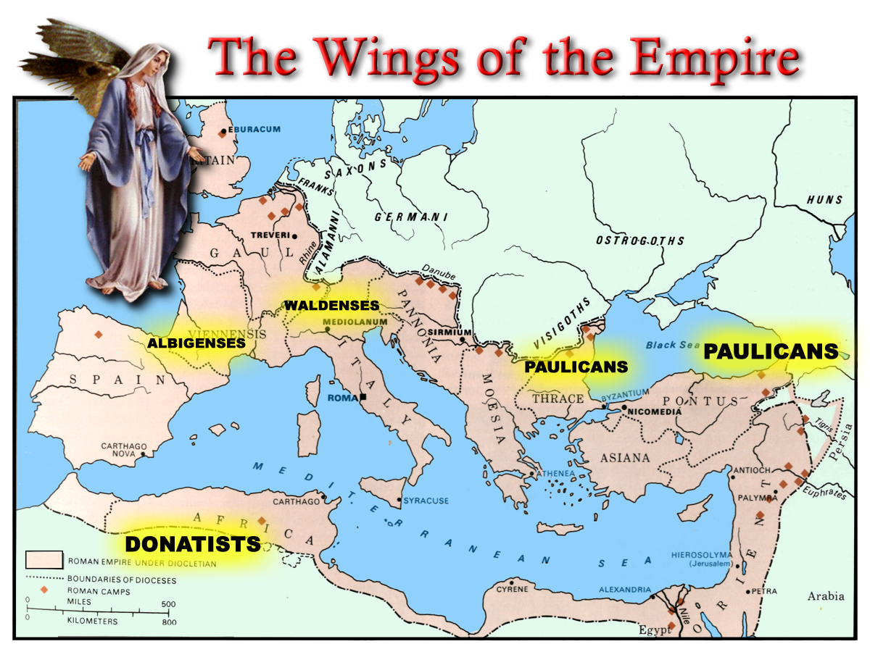
Notes:
The flight of the woman can be seen in the different SECTS that existed in the extremities of the empire – from this point and well into the future.
Perhaps the most famous of the time were the Donatists of North Africa – who refused to bow to a doctrine or religious assembly presided over by a pagan (Constantine not being baptized until shortly before his death).
They stood in opposition of many of the CHURCH doctrines that were evolving at this time.
The persecution against them was horrific.

