Slide 1
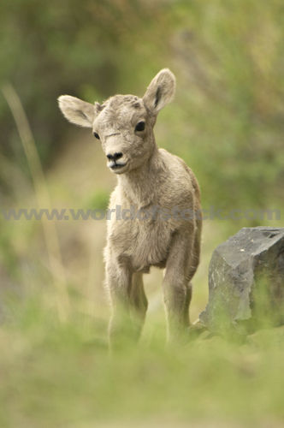
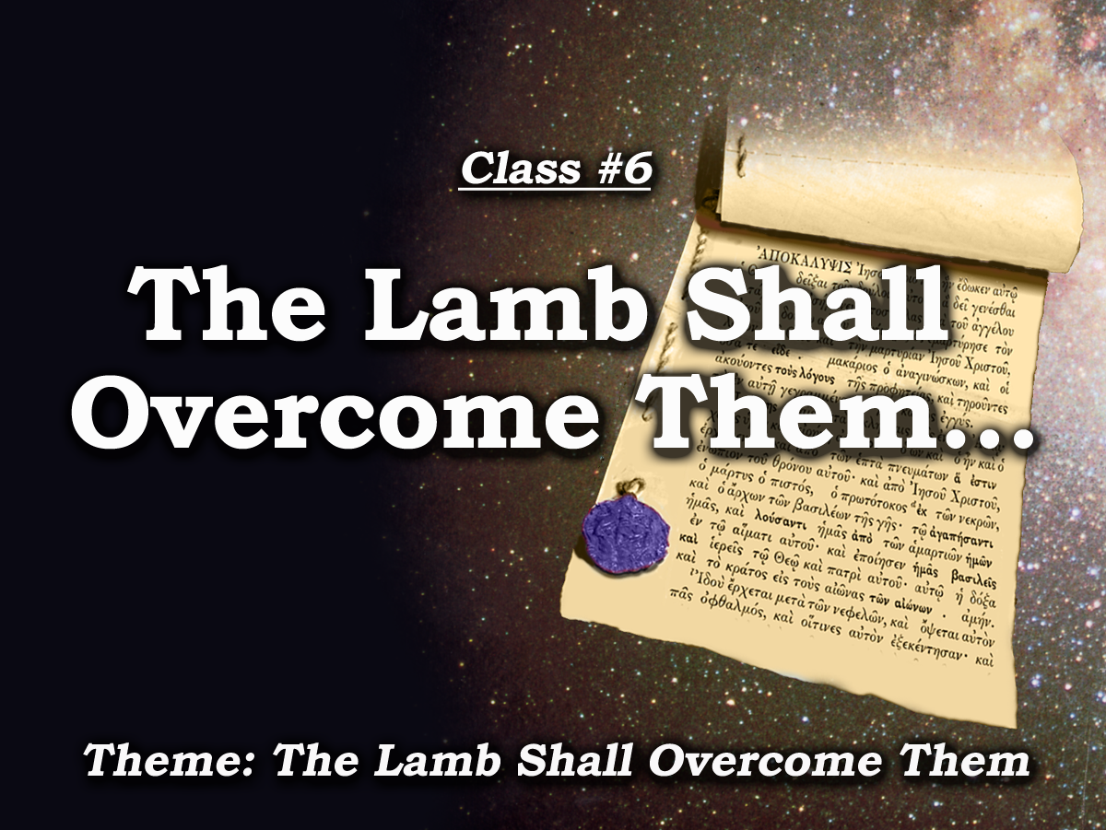
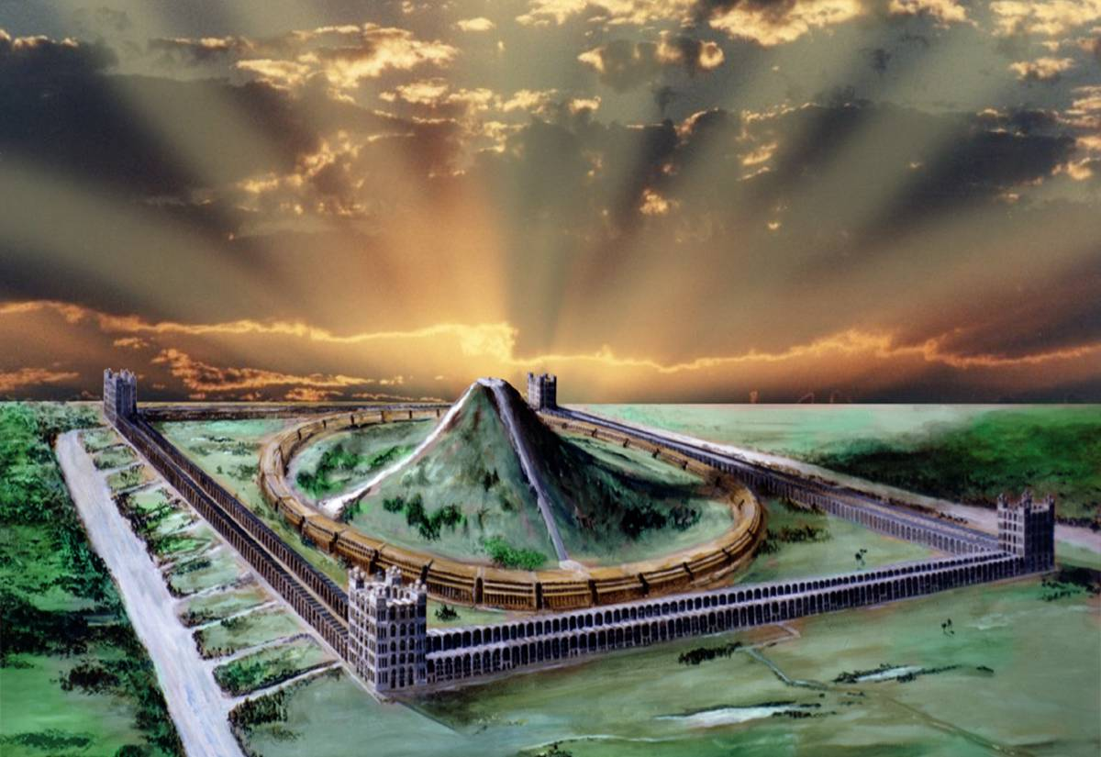
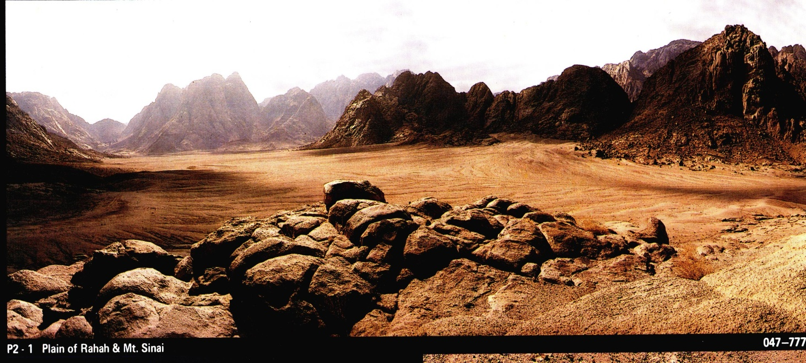
Behold I come !
Study 5
Manitoulin Family Camp 2024

Slide 2
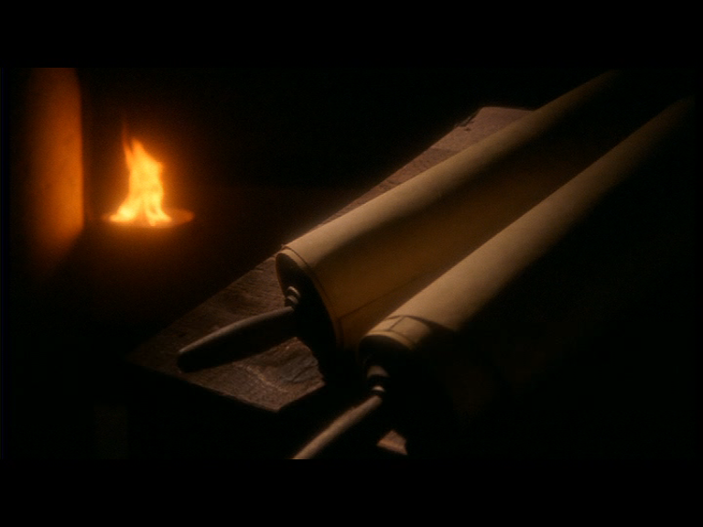
Prophecy
Prophecy
“The object of prophecy was always to reveal God to men and to
keep men with God.
It is an instrument in the
preparation of a people for the Lord
and is given primarily for the benefit of those
with whom God is working out His purpose of redemption.”
Bro. L. G. Sargent
2

Slide 3


The Seven sealed scroll
- and the little scroll
7
Seals
7
1 2 3 4 5 6
Trumpets
7
1 2 3 4 5 6
Vials
Judgement - Pagan Rome
1 2 3 4 5 6
Judgement - Christian Rome
Rev.6
Judgement Holy Roman E.
T h u n d e r s
Rev.8 & 9
AD 96 – 324
Rev.16
AD 395 – 1685
AD 1789 – 1820
Armageddon

Slide 4
Events of the Jubilee Period
50yrs
10yrs
40yrs
Mid Heaven procl-amation 10 yrs.
Marriage of the Lamb.
Catholic Europe Destroyed
30 yrs
Judgment Seat.
Marriage Supper.
Return of Christ
Rome Destroyed
Millennium Begins with Jubilee
Armageddon

Slide 5
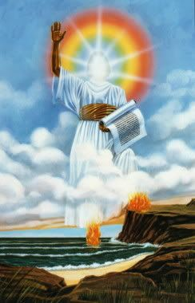
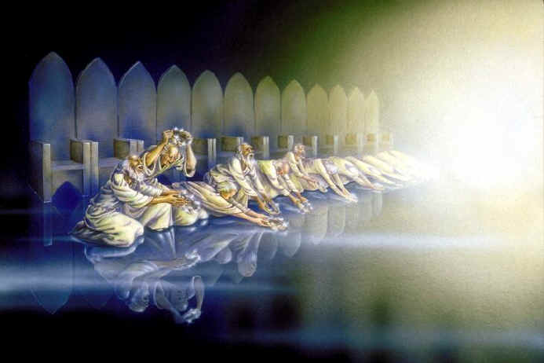
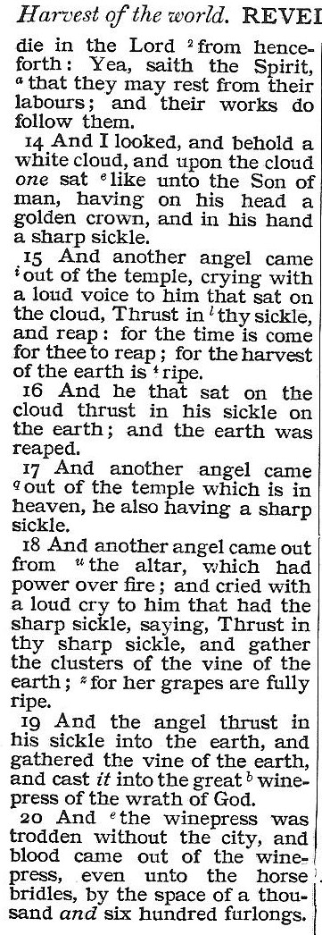
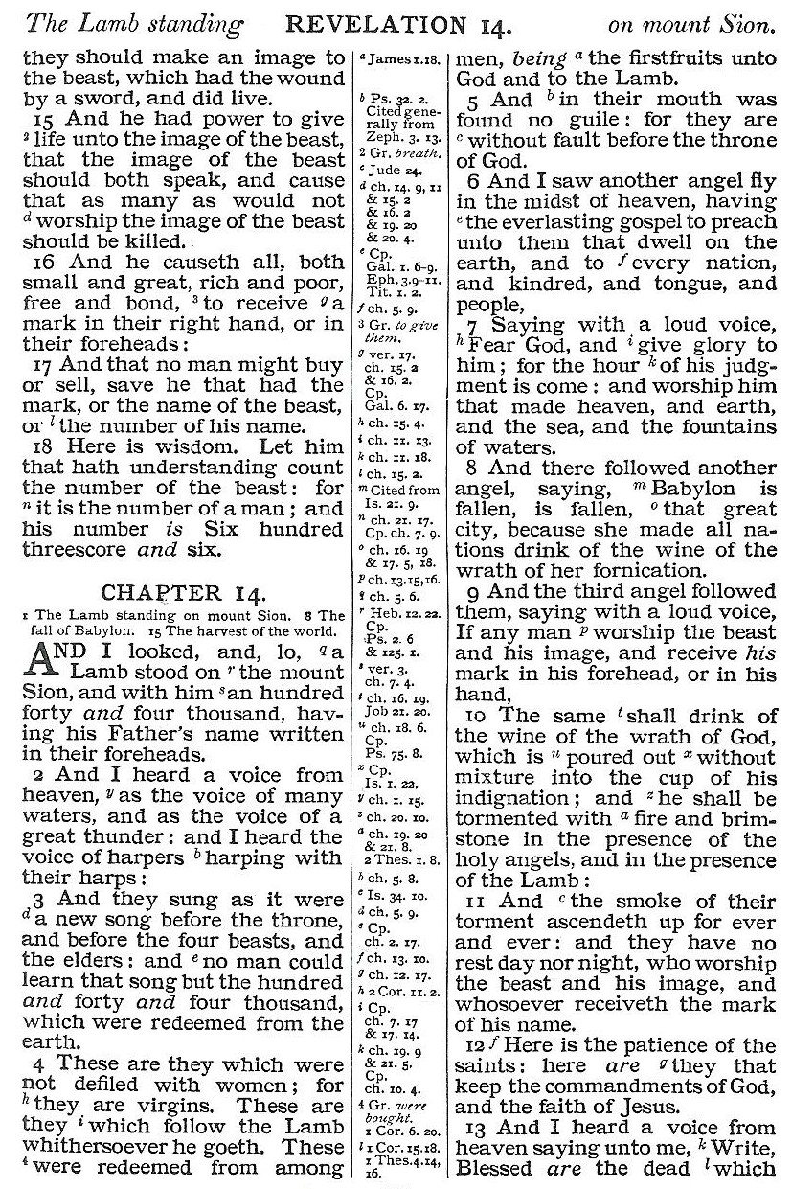
“come down from heaven,”
10:1-3
From heaven
4

Slide 6
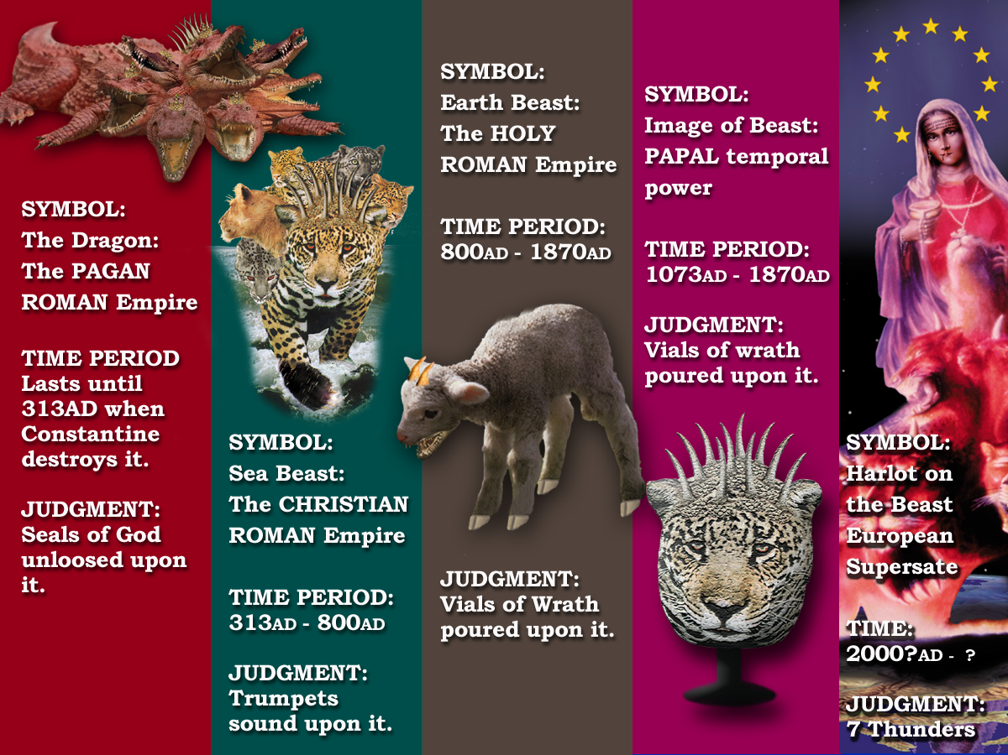
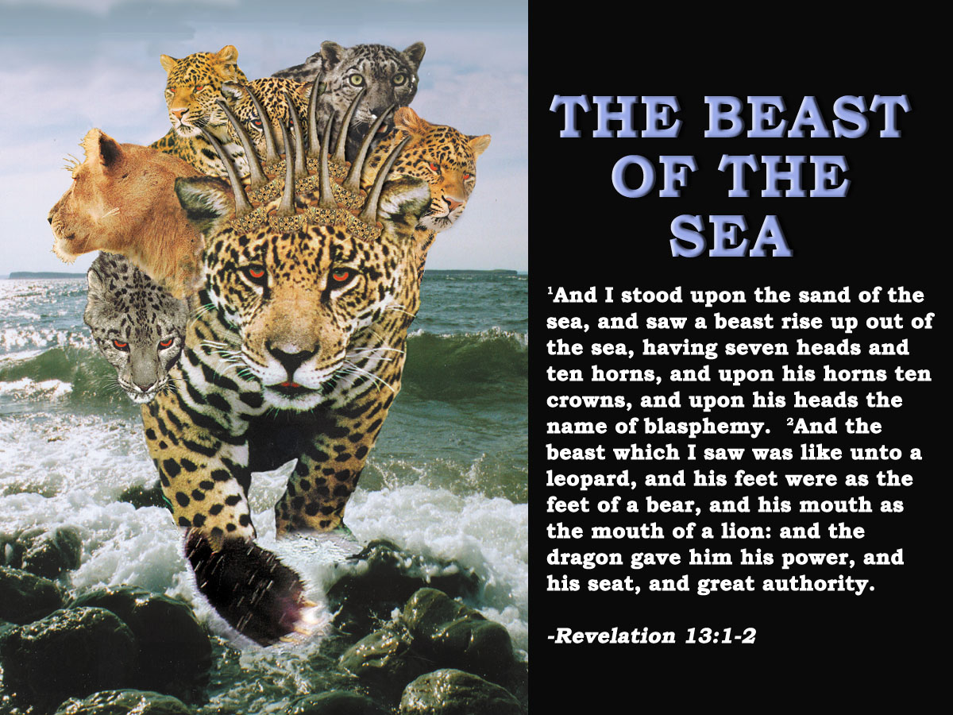
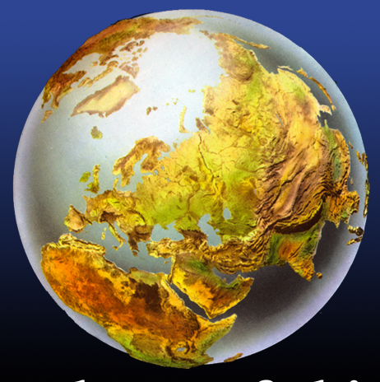
‘And I saw another mighty angel come down from heaven, .’
Rev.10:1
Earth
Rev.13:11
John turned his gaze from the coastal regions to the Roman land mass.
(Not a successor to the sea beast but a later addition in the Roman empire.)
Catholic Europe.
Sea
Rev.13:1-2
The Mediterranean powers, chief of which is the Gogian confederacy with its headquarters in Constantinople & Rome.
Beast of the sea symbolized the dominions of the Roman Eastern and Western Mediterranean world.
‘and he set his right foot upon the sea, and his left foot on the earth’
Rev.10:2
5

Slide 7
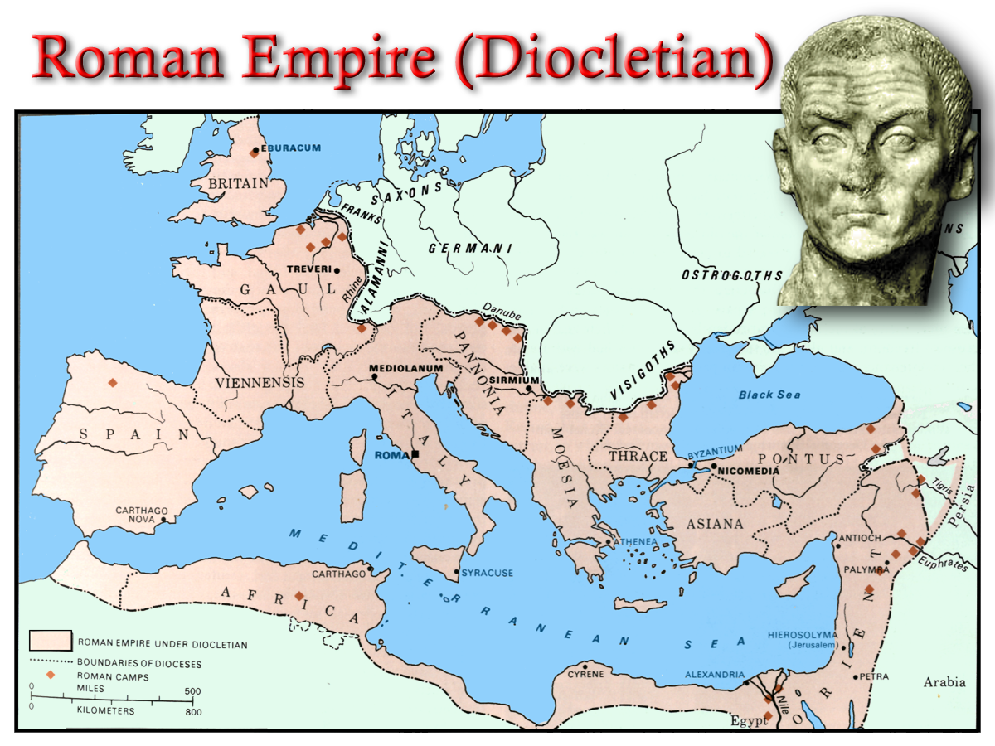
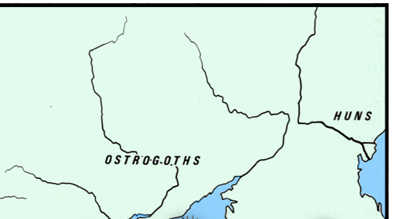
History Repeated!
Why Russia wants Constantinople!
(Mt Ida Chronicle Feb. 1917)
The third and last reason why we want Constantinople is that Constantinople is the cradle of our religion. We got our faith from Constantinople , when she was still Byzantium. A thousand years ago we called Constantinople “Czar-grad,” the Czar, the King, the Lord among towns, and all the Slavs and all the Russians know it under this name. For centuries we have fought with the Turks. The liberation of Constantinople will crown the secular efforts of Russia, of the Russian people, and it will bring them to the cradle of their faith.
Dragon
Earth Beast
Dragon
Sea Beast
6

Slide 8
40yrs
“come down from heaven,”
10:1-3
Mid Heaven proclam-ation 10 yrs.
Catholic Europe Destroyed
30 yrs
14:9-11
From heaven
14:6-8
Rome Destroyed
7

Slide 9
40yrs
‘And I saw an angel’ Diaglott.
Mid Heaven proclamation 10 yrs.
Catholic Europe Destroyed
30 yrs
10 yrs
‘And another a second’ Diaglott.
Rome Destroyed
2
12
Based on Rev.7:4-9
30 yrs
To Jews a thousand =‘family’ Jud.6:15
Here is perfected family of Israel
2
40
8

Slide 10
10 yrs
2
12
30 yrs
2
40
9

Slide 11
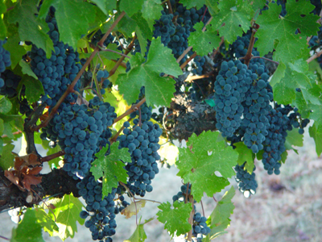
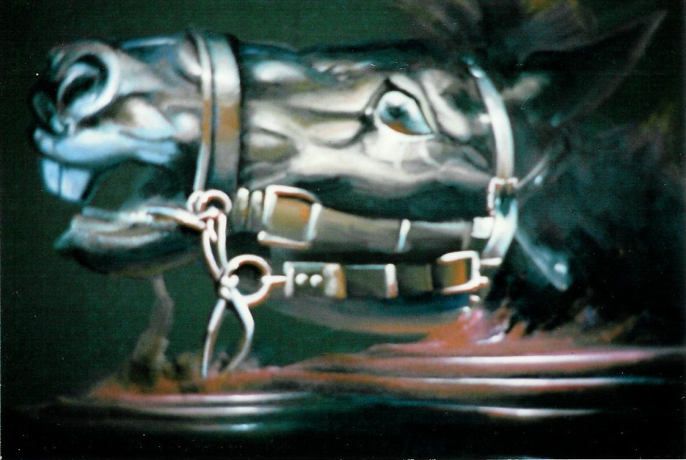
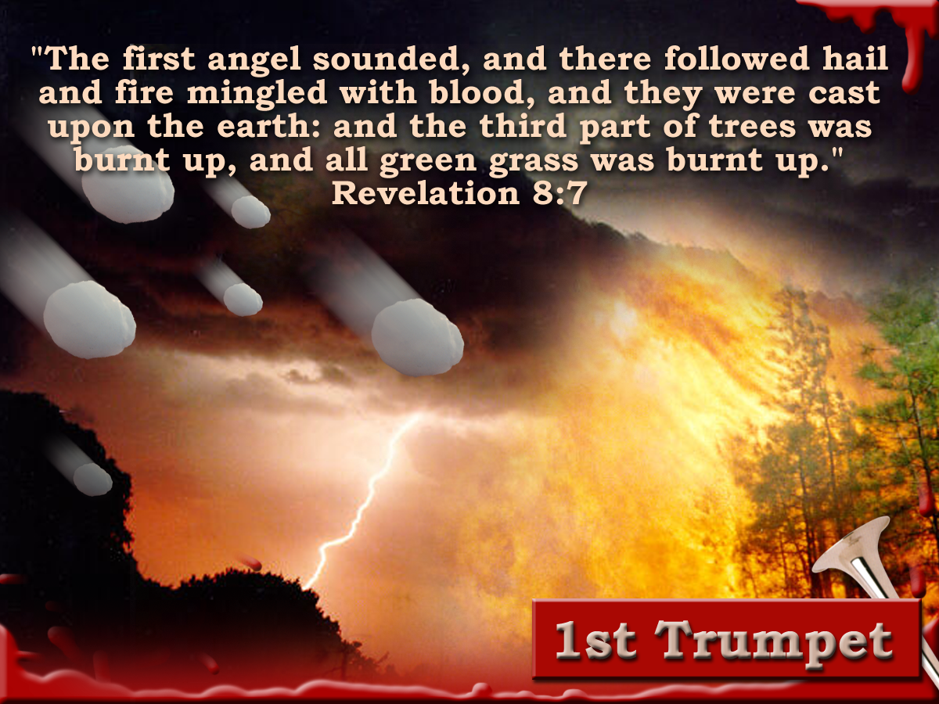
Blood and the
winepress
How long from the reaping of the Harvest by the Son of Man on the white cloud and the end of the vintage judgements when the Millennium begins?
Rev. 14
“And with thee will I break in pieces the horse and his rider;” Jer. 51:21
Judgement!
The length or space of that judgement would be 1600 “stadion.” Gk.– “certain measure of distance.”
The Rider The Bridle Men
The space of that judgement must fit the context of the chapter.
Ezek 20:33-36
20
Isa. 11:11,16
And the winepress was trodden without the city, and blood came
Micah 7:15
out of the winepress , even unto the horse bridles, by the space of a thousand and six hundred furlongs
2
40
The Seventh Vial
40yrs prior to and leading up to the Millennium
9
Notes:
The winepress is not an area, not a locality, covering approx. 280 K’s. i.e. from here to Port Augusta.
Its an area affecting all nations “without the city’.
The question is not how large the area is but how long is the blood going to flow from the winepress?

Slide 12
40yrs
Mid Heaven proclamation 10 yrs.
Catholic Europe Destroyed
30 yrs
10 yrs
Rome Destroyed
30 yrs
10

Slide 13
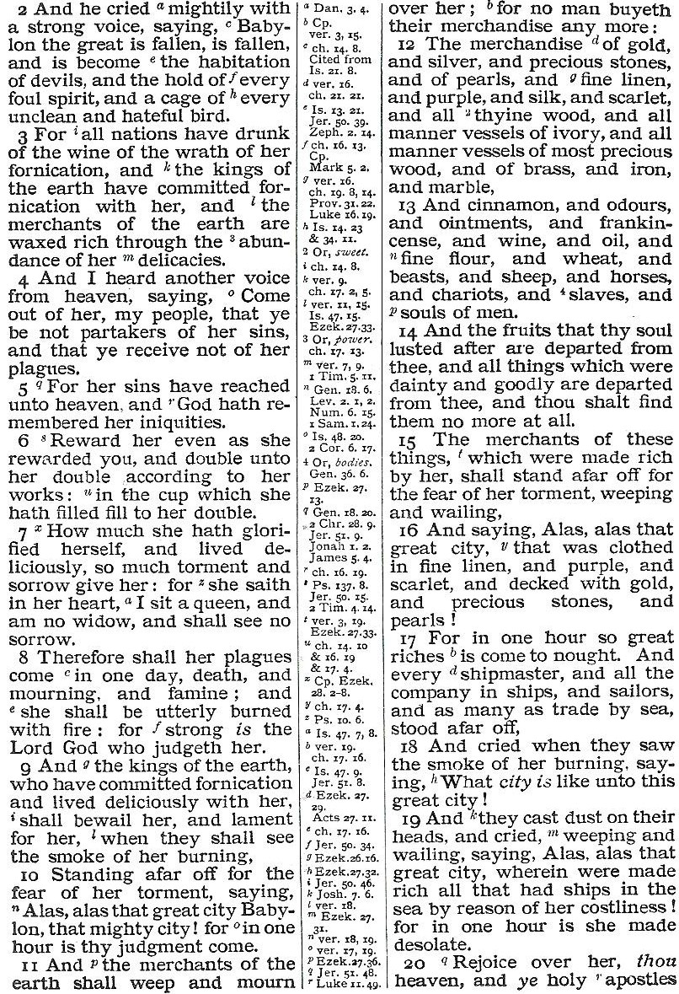
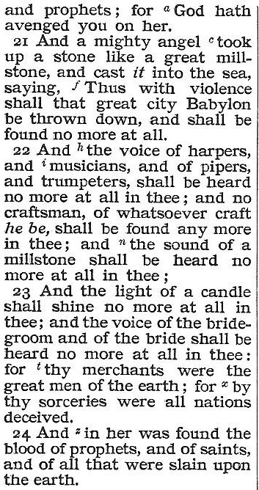
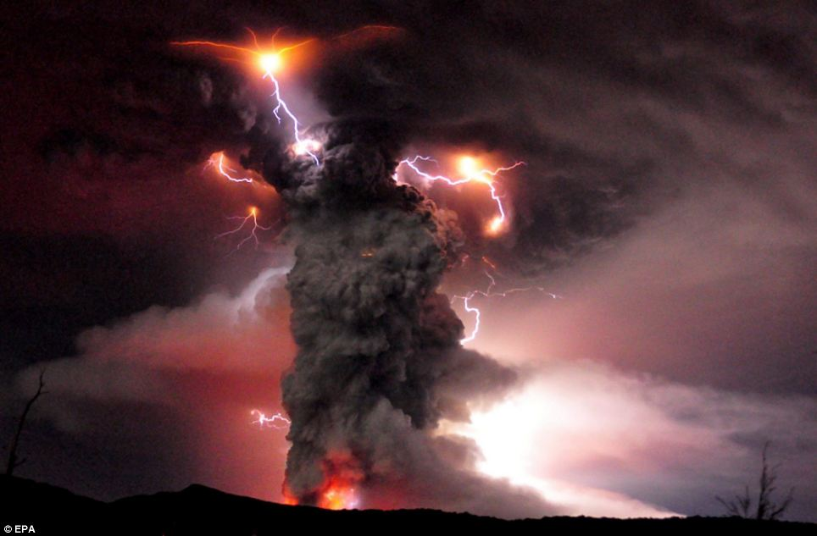
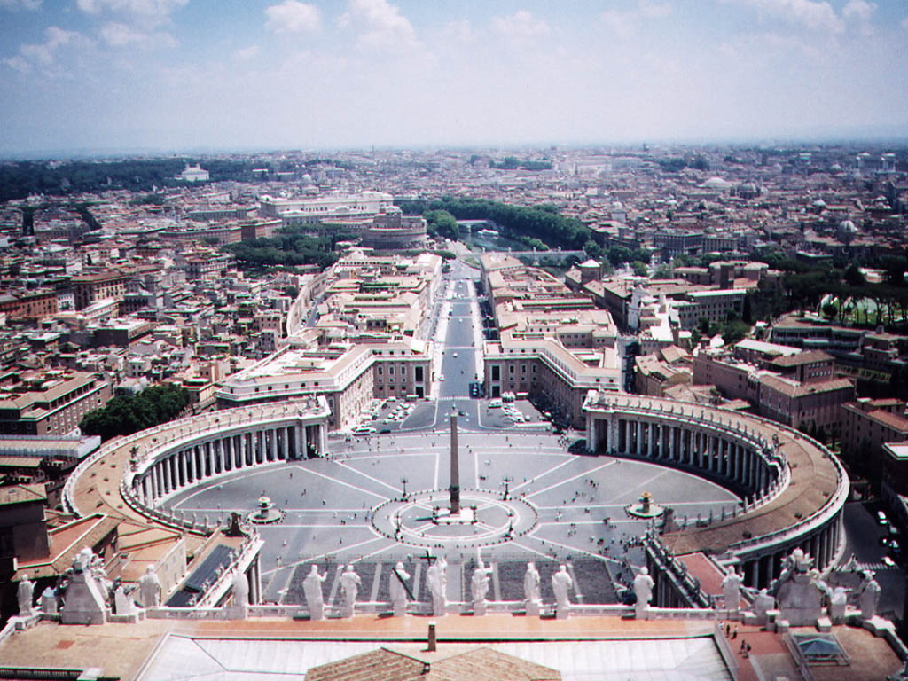
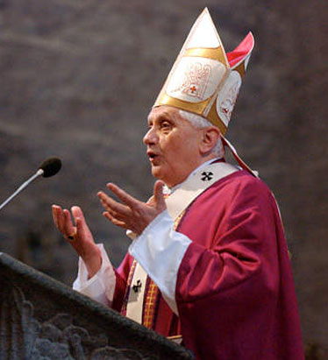
“One Hour”
Day for a Year. Gen.47:9, Num.14:34, Ezek. 4:4-6, Luke13:32
1/12 of a day = 1 hour. 1/12 of a year = 1month or 30days.
30 days = 30 years
Term used 8 times. 8:1.11:13. 14:7. 17:12. 18:10,17,19. 9:15
Twelve hours in a Jewish Day
John 11:9
“Jesus answered, are there not twelve hours in the day?”
Luke 23:44
“And it was about the sixth hour, and there was darkness over the earth until the ninth hour.”
Revelation 18
Rome Destroyed
Rev.14:8
11

Slide 14
10 yrs
Psa. 58:10-11
10 The righteous shall rejoice when he seeth the vengeance: he shall wash his feet in the blood of the wicked.
11 so that a man shall say, Verily there is a reward for the righteous: verily he is a God that judgeth the earth.
2
12
30 yrs
2
40
12

Slide 15
Will we be part of the 7th vial angel?
Humanism in the Churches
“ Among the many types of humanism that I have met in human history, I have found that of Jesus of Nazareth particularly attractive, although remote in time and open to completion by many more recent cultural elements. It is a humanism of universal, unselfish, brotherly love.”
J.Gomez Caffarena - Jesuit Priest.
The Argument!
The values of the 1st Century Christians , and of the Israelites before them, were relative values.
It is argued that if something becomes culturally acceptable, it becomes morally acceptable.
Humanism in the Churches
Increasing tolerance of divorce, feminism, political activism and homosexuality have made the Anglican Church a spearhead in humanism.
Revelation 14:1-5
“ Humanism has come to mean a reverence for man and a concern for his dignity, morality and happiness, linked with a belief that these ends are best served by the advance of scientific outlook”
Archbishop of Canterbury
Who are the women?
Rev.17:1-2, 5
Revelation 14
4
These are they which were not defiled with women; for they are virgins. These are they which follow the lamb withersoever he goeth. These were redeemed from among men, being the firstfruits unto God and to the lamb.
Humanism affects Moral Behaviour!
The Seventh Vial
40yrs prior to Millennium
13

Slide 16
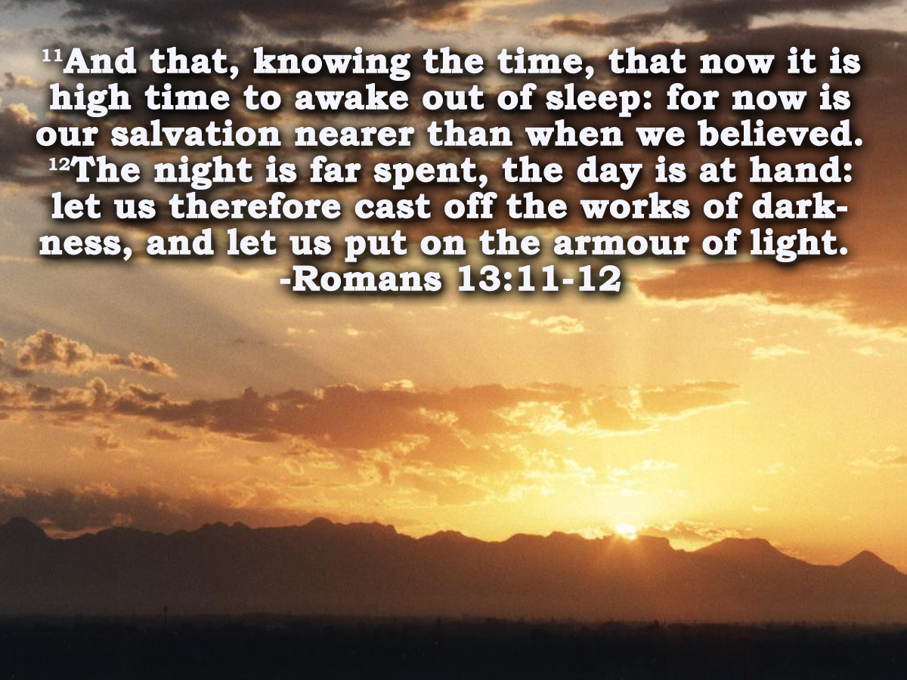
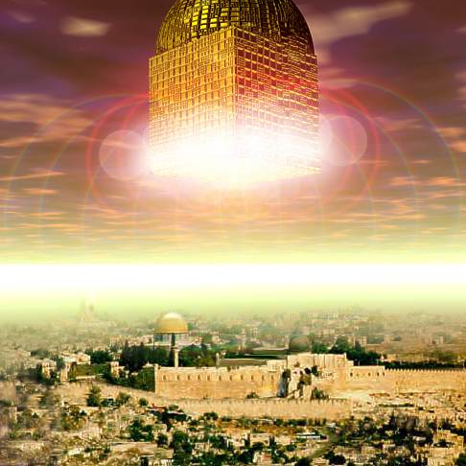
“Even so come Lord Jesus.”
Behold , I come. Blessed is he that watcheth

Slide 18
40yrs
‘And I saw an angel’ Diaglott.
Mid Heaven proclamation 10 yrs.
Catholic Europe Destroyed
30 yrs
10 yrs
‘And another a second’ Diaglott.
Rome Destroyed
2
12
Based on Rev.7:4-9
30 yrs
To Jews a thousand =‘family’ Jud.6:15
Here is perfected family of Israel
2
40
8

Slide 19
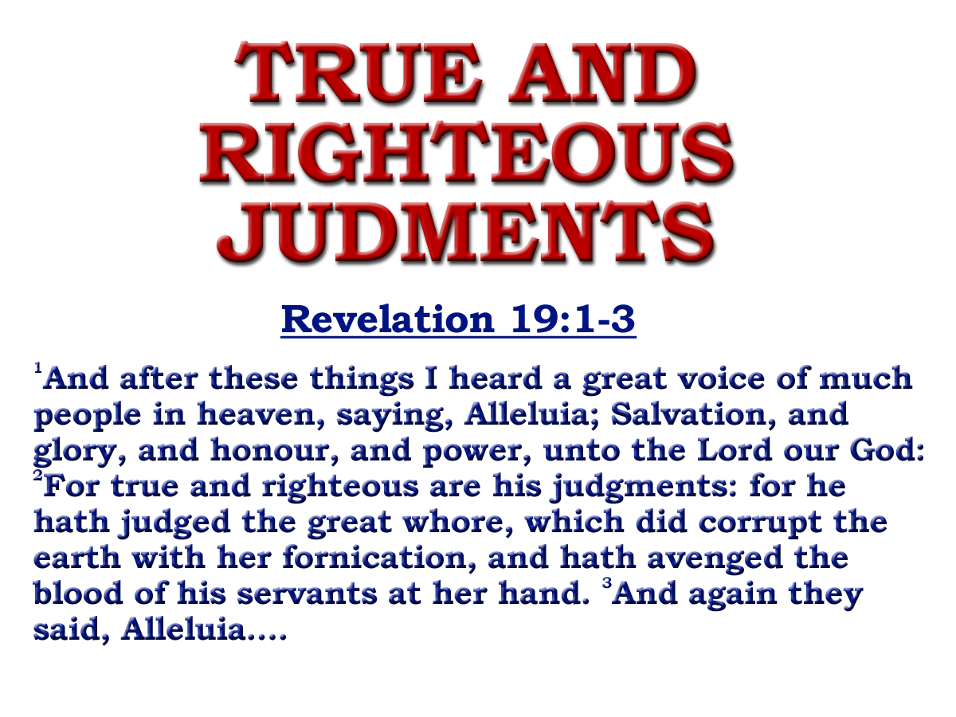
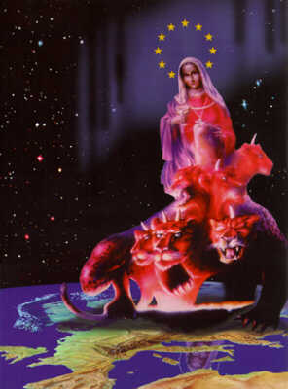
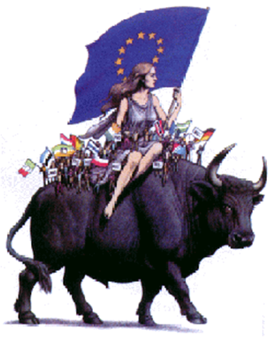
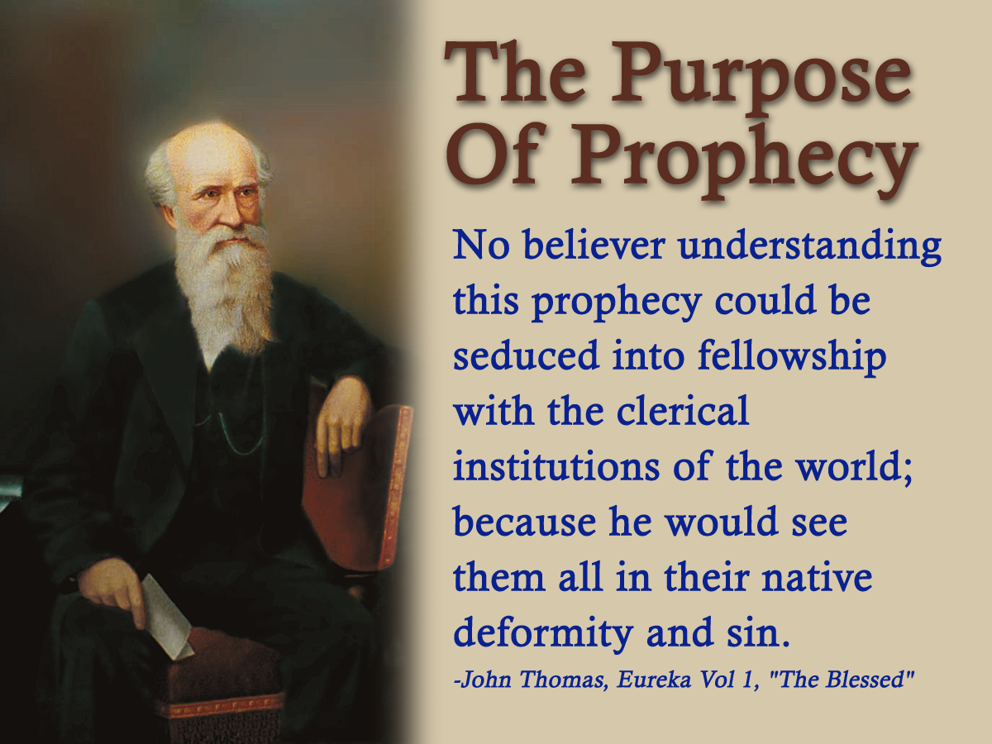
15
Notes:
The saints who have suffered through the ages will sing out “PRAISE BE TO YAH”
Because his judgment of this system will be true and righteous:
READ SLIDE

Slide 20
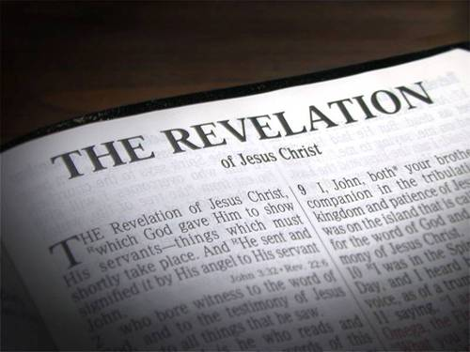
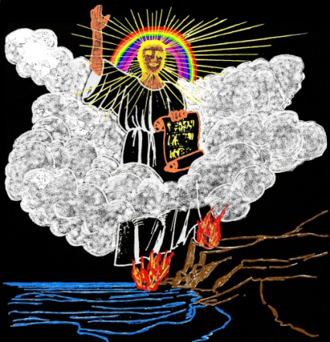
Prophecy
Where there is no vision the people perish
Prophecy
“The object of prophecy was always to reveal God to men and to
keep men with God.
It is an instrument in the
preparation of a people for the Lord
Vision
and is given primarily for the benefit of those
with whom God is working out His purpose of redemption.”
Rev.10:2,4,8-10
Bro. L. G. Sargent
2

Slide 21
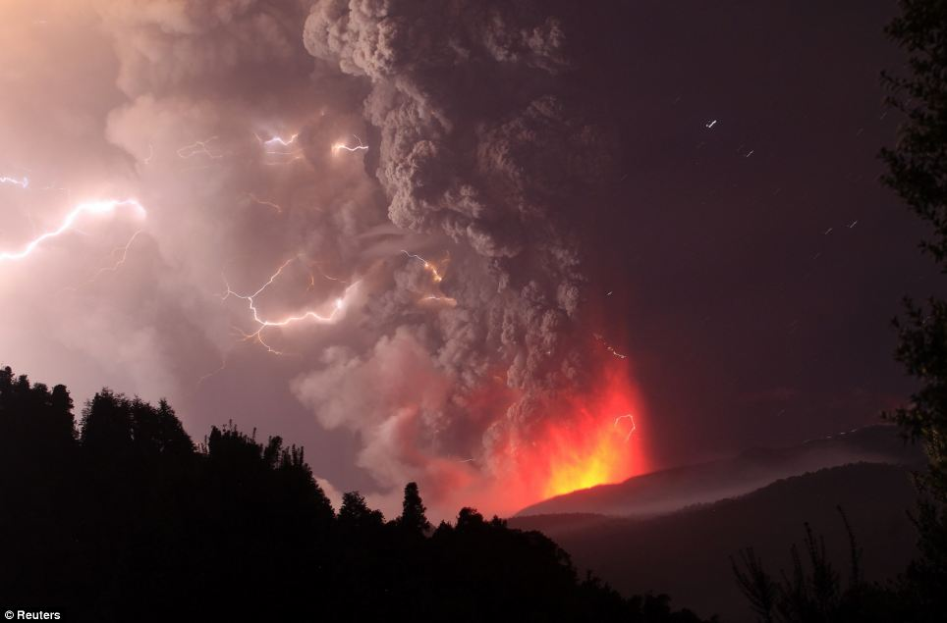
40yrs – The Most Important and Terrible in the Worlds History
The most noteworthy developments of this transition period are described in:
Ch.14, Part Ch.16 & 17, Ch.18, Ch.19, Part Ch.20
v. 17-21
v. 11-14
v. 1-2
7
Vials
1 2 3 4 5 6
T h u n d e r s
Rev.16
4

Slide 22
40yrs
‘And I saw an angel’ Diaglott.
Mid Heaven proclamation 10 yrs.
Catholic Europe Destroyed
30 yrs
10 yrs
‘And another a second’ Diaglott.
‘Alleluia!’ Rev.19:1-2
Rome Destroyed
2
12
Based on Rev.7:4-9
30 yrs
To Jews a thousand =‘family’ Jud.6:15
Here is perfected family of Israel
‘Alleluia!’ Rev.19:3
2
40
10

Slide 23
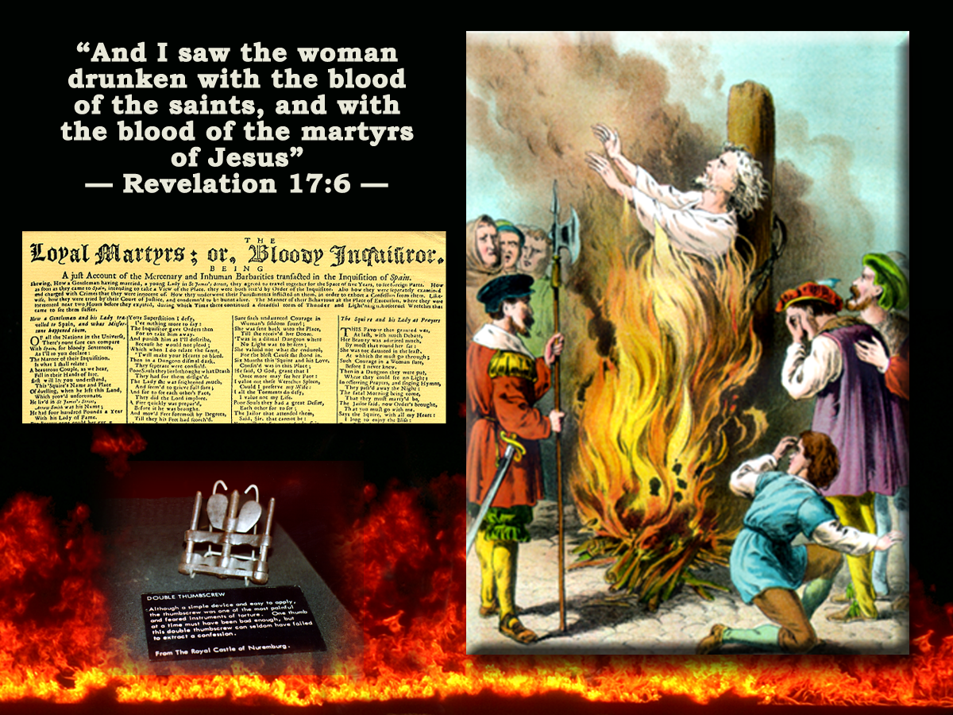
‘Blessed are the dead which
die in the lord..’
Revelation 14:13
13
And I heard a voice from heaven saying unto me, Write, Blessed are the dead which die in the lord from henceforth: Yea, saith the Spirit, that they may rest from their labours; and their works do follow them.
Isa.11:10
Heb.4:9-11
Rev. 2:26
From now! From this time!
Rev.14:11
Rev.15:8
‘That they may take rest from their labours and their works; He goeth in aid of with them.’
Bro Thomas Eureka
‘The time of blessedness is when the smoke has all cleared out of the temple; and the saints have fully executed the judgement committed to them.’ Eureka
The Seventh Vial
30yrs prior to and leading up to the Millennium
15
Notes:
‘Ye saith the spirit’ - emphatic endorsement
Note: the Spirit is their attendant in whatever capacity the circumstances of the situation may require them to act.
Without the spirit they could do nothing . But aided by the spirit there is nothing to difficult for them to accomplish.
“That they may take rest from their labours and their works.’
Their works are exhibited in the 14th chapter.
The harvest and vintage of the earth.
When that’s done then they along with the world will take their rest.

Slide 24
The Vintage of
The Earth
Revelation 14:17-20
The ruling place of authority
17
And another angel came out of the temple which is in heaven, he also having a sharp sickle.
18
And another angel came out from the altar, which had power over fire; and cried with a loud cry to him that had the sharp sickle, saying, Thrust in thy sharp sickle, and gather the clusters of the vine of the earth.
The Seventh Vial
30yrs prior to and leading up to the Millennium
12

Slide 25
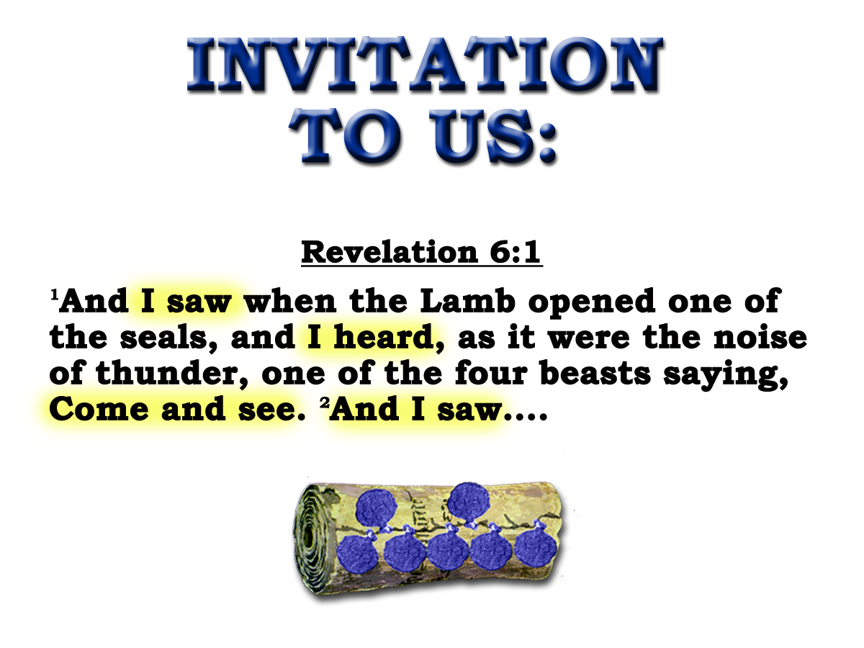
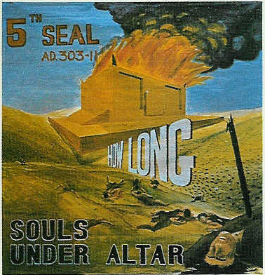
SOULS UNDER THE ALTAR
9
And when he had opened the fifth seal, I saw under the altar the souls of them that were slain for the word of God, and for the testimony which they held:
Heb.13:10
Lev.4:7
Gal.3:26-29
“When the faithful in Christ Jesus (those within the Altar) die, and return to their parent earth without violence, they are underneath the altar, sleeping in Jesus ……. But if they are made to lie underneath the altar by the blood- shedding cruelty of the enemy, their souls are said, as in the language of the fifth seal, to cry with a great or loud voice for the judicial vengeance on the murderers who poured out their soul-blood unto death
Eureka Vol. 2 p238
The Fifth Seal
303-311
8yrs
13

Slide 26
SOULS UNDER THE ALTAR
10
And they cried with a loud voice, saying, How long, O Lord, holy and true, dost thou not judge and avenge our blood on them that dwell on the earth?
Revelation 6:9-11
Rev.18:24, 20
The Fifth Seal
303-311
8yrs
14

Slide 27
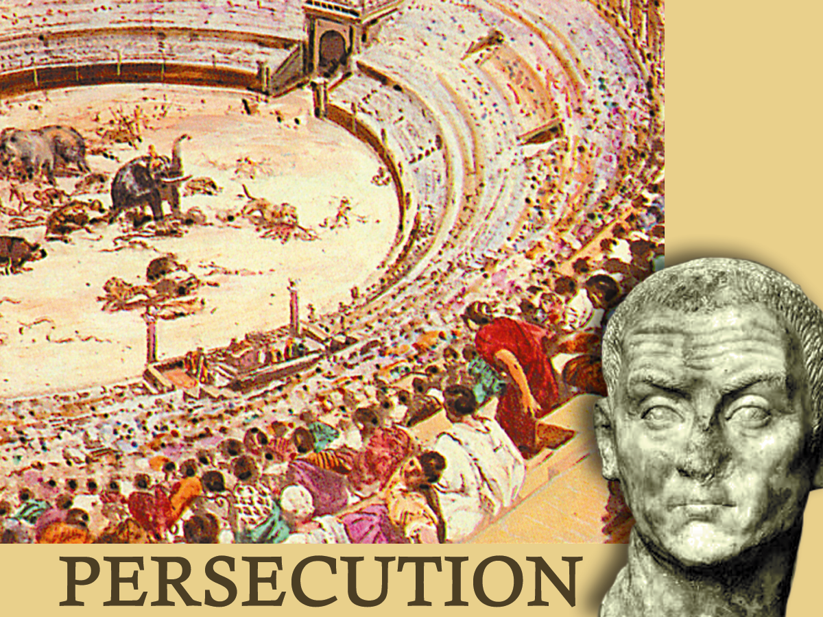
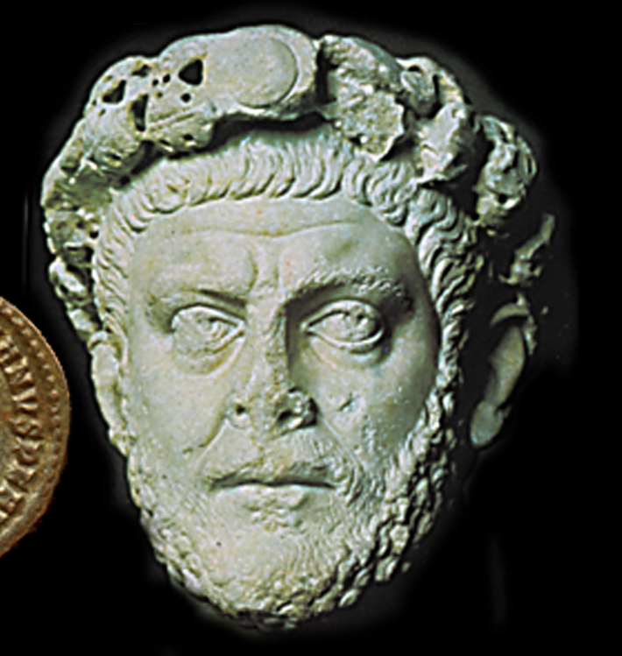
"THEY CRIED WITH A LOUD VOICE"
How would a man pray ?
How would a mother, a wife, pray ?

Slide 28
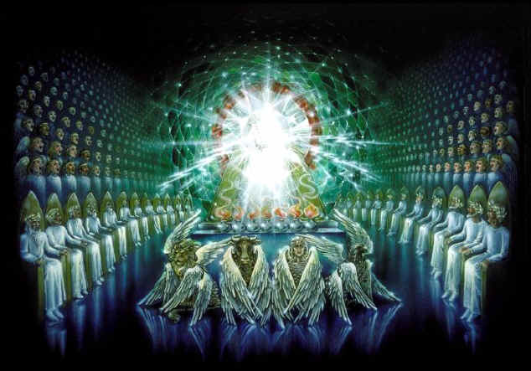
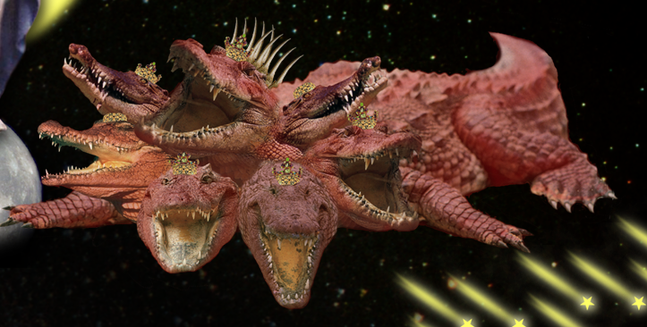
Rejoicing of the Redeemed
Revelation 14:1-5
Creature with a number!
Cp. Ch.12 & 13
1
And I looked, and, lo, a Lamb stood on the mount Sion, and
with him an hundred forty and four thousand, having his Fathers name written in their foreheads.
2
And I heard a voice from heaven, as the voice of many waters, and as the voice of a great thunder: and I heard the voice of harpers harping with their harps:
Dragon/Beast exercises power!
12:17. 13:7
Lamb/144,000 exercises power!
14:9-10. 17:14,12. 19:19
The Seventh Vial
40yrs prior to Millennium
6

Slide 29
Rejoicing of the Redeemed
Revelation 14:1-5
1
And I looked, and, lo, a Lamb stood on the mount Sion, and
with him an hundred forty and four thousand, having his Fathers name written in their foreheads.
Gr. “And I saw, and behold, the Lamb standing on mount Sion
And I heard a voice from heaven, as the voice of many waters, and as the voice of a great thunder: and I heard the voice of harpers harping with their harps:
NOTE: Lamb & 144,000 are Temple of Ch.11:19
Psa.122:2, 5
The Seventh Vial
40yrs prior to Millennium
7

Slide 30
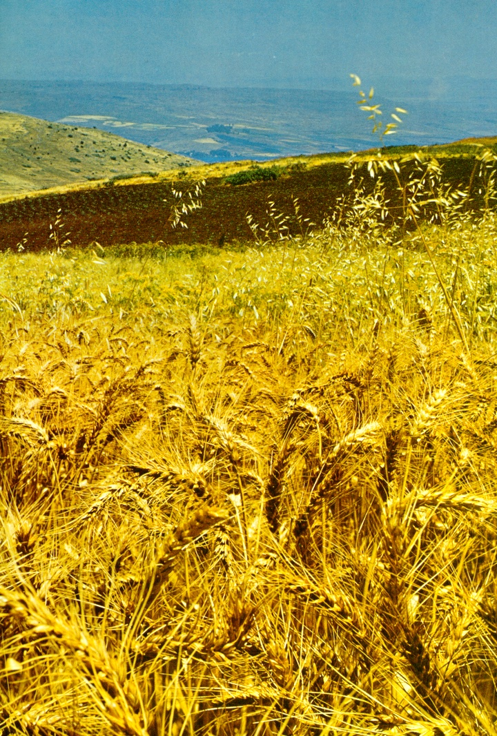
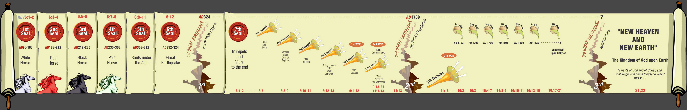
The Harvest & Vintage of the Earth
Armageddon
“Harvest of the Earth”
Temple?
10 yrs
2Cor.6:16 1Pet.2:5
?
Conquest of Europe & the World
“Vintage of the Earth”
30 yrs
4

Slide 31
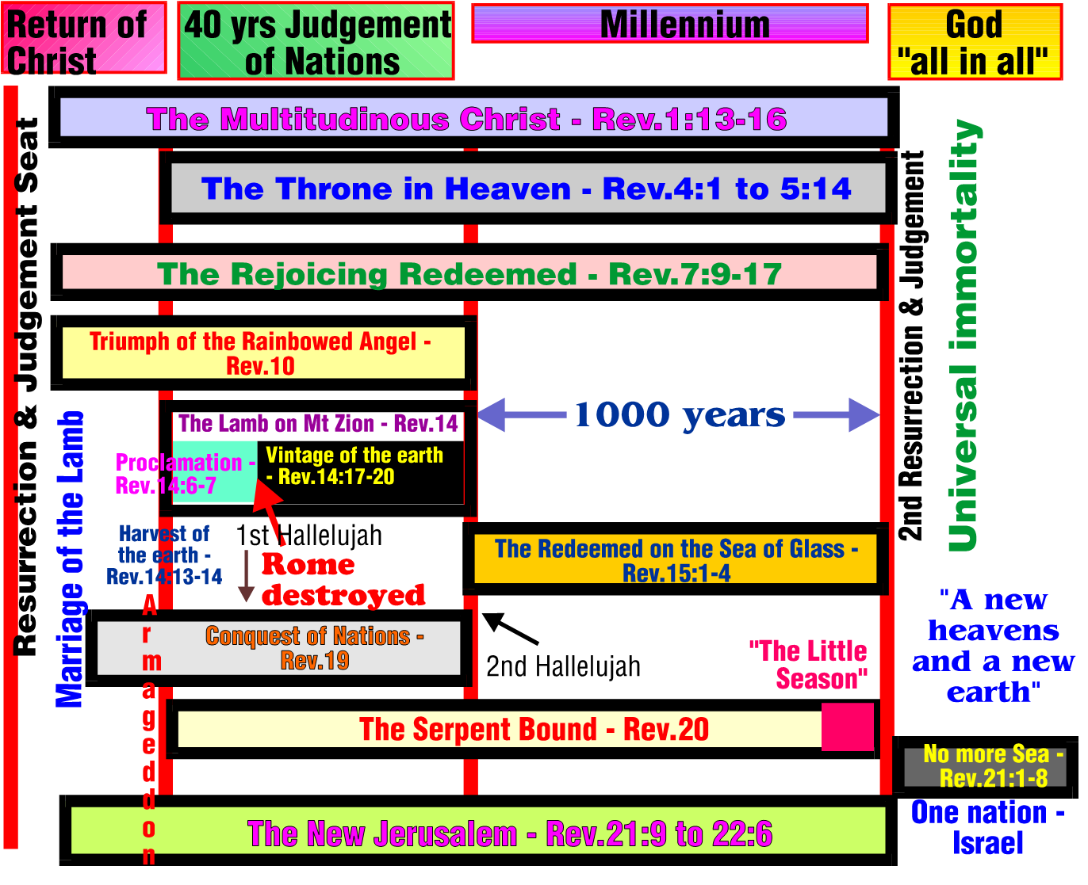
6

Slide 32
Session Outline
‘The Lamb on Mount Zion’.
  Rev.10 &14.
  The Lamb on Mt. Zion & the Angel of the Bow Ch.10 & 14.
  The Structure of Ch.14. - Angels and Times
  The 144 thousand & 1600 furlongs. Ch.14.
7

