Slide 1
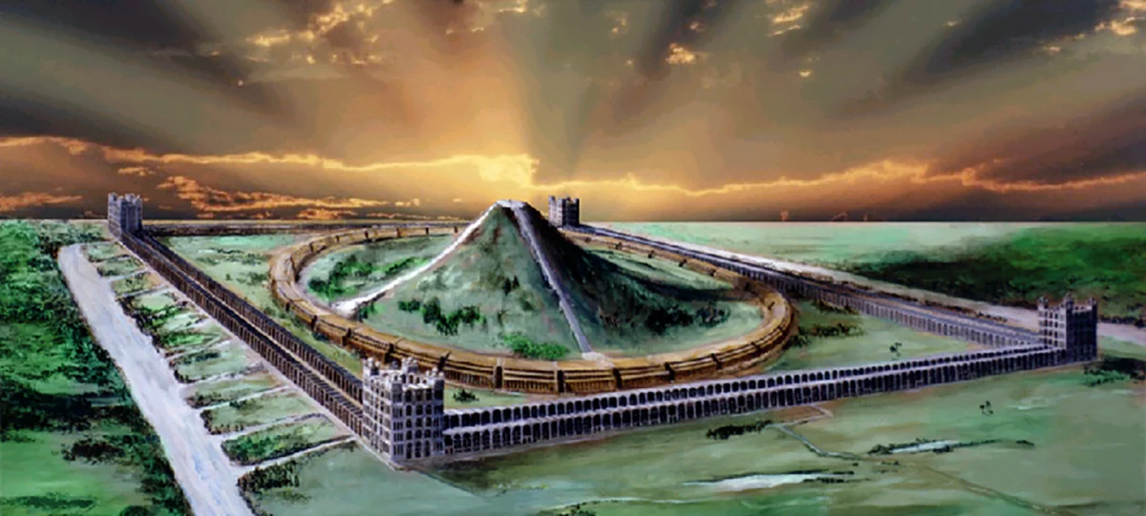
“Yahweh shall be King over all the earth”

Slide 2
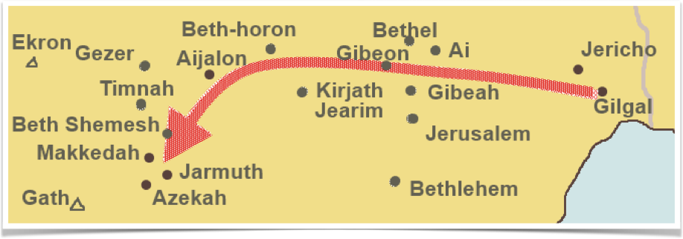
THE BATTLE OF BETH-HORON (JOSHUA 10)
Joshua led his army on a forced overnight march up into the hill country to defeat the Canaanitish kings at Beth-Horon, then chasing them down into the Valley of Aijalon

Slide 3
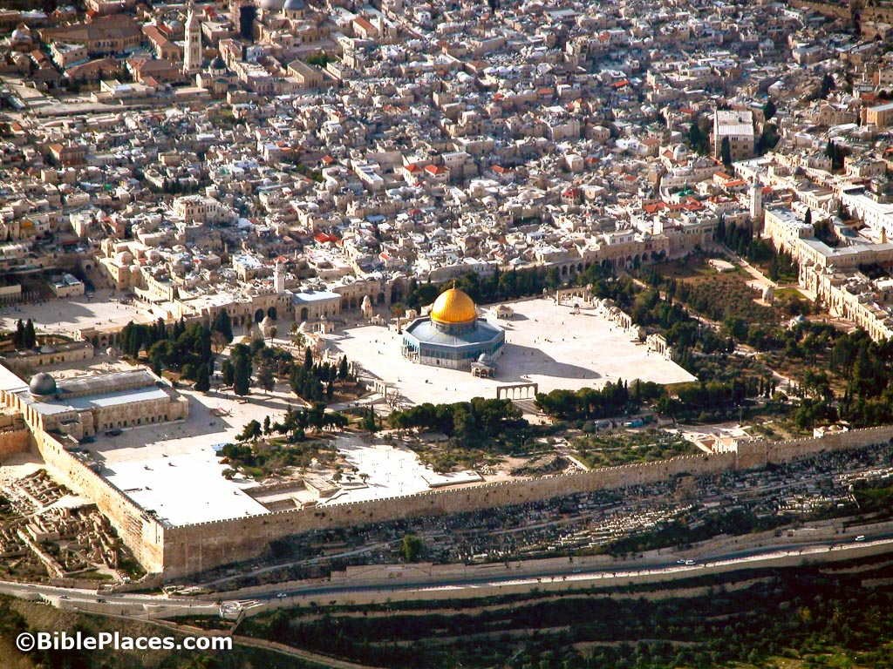

Slide 4
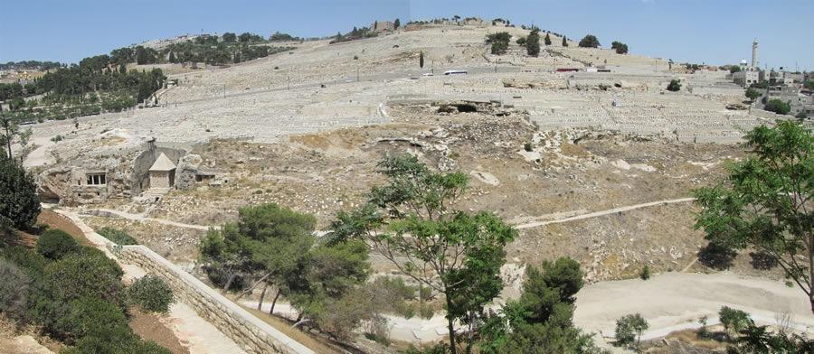

Slide 5
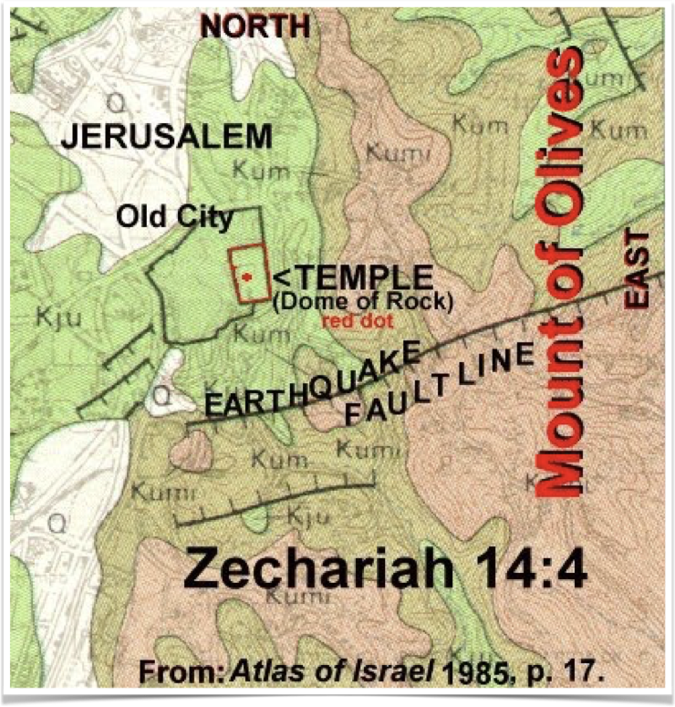

Slide 6
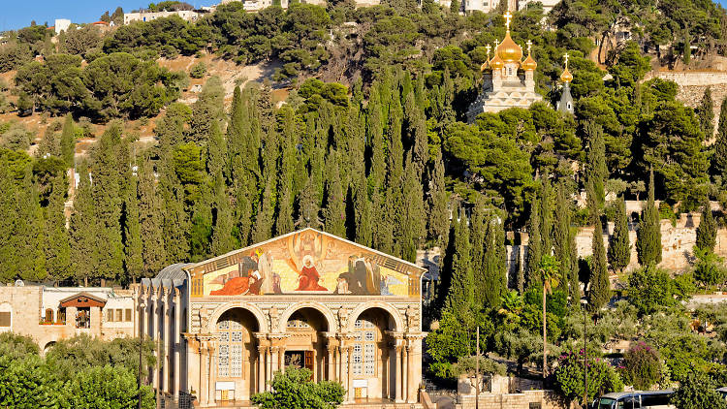

Slide 8
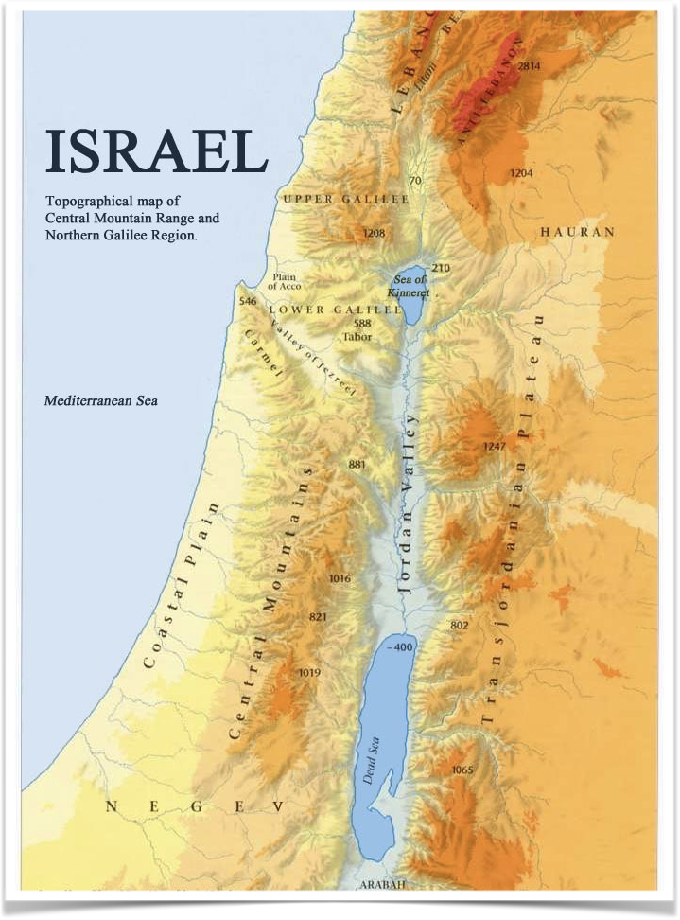
Plain of Sharon
(Isa.65:10;
1 Chr.5:16)
On either end of the “hump” there are two famous plains
The Arabah
(2 Kgs.14:25)

Slide 9
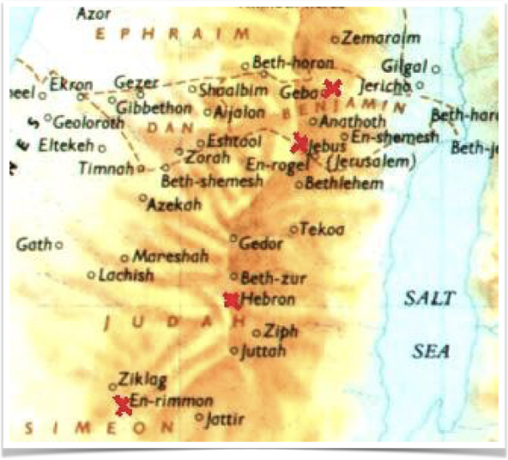
The land will be turned to a plain (Arabah) from Geba to Rimmon.
A distance of
roughly 60 km.

Slide 10
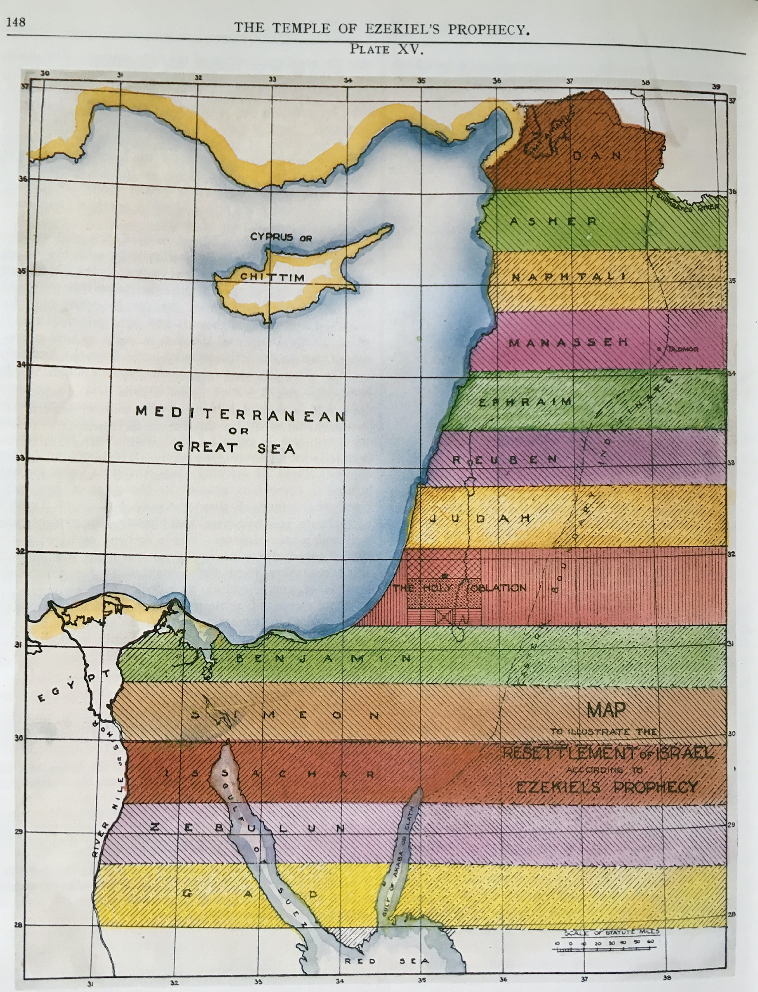
The distance from Geba to Rimmon essentially makes up the territory of the Holy Oblation.

Slide 11
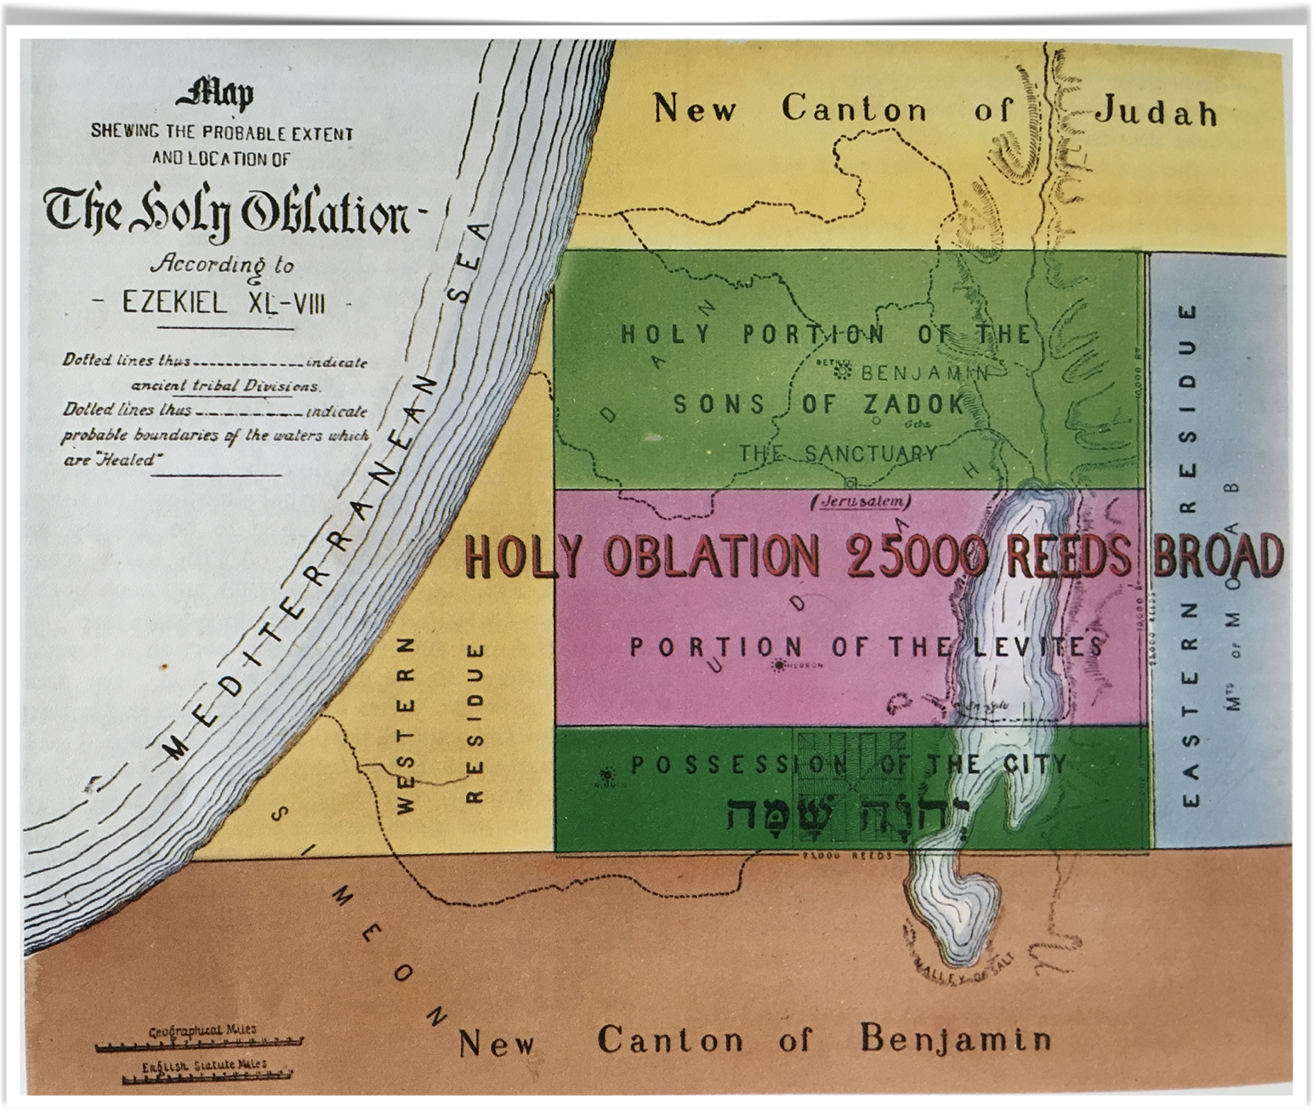
This explains why the land must be flattened for
this distance

Slide 12
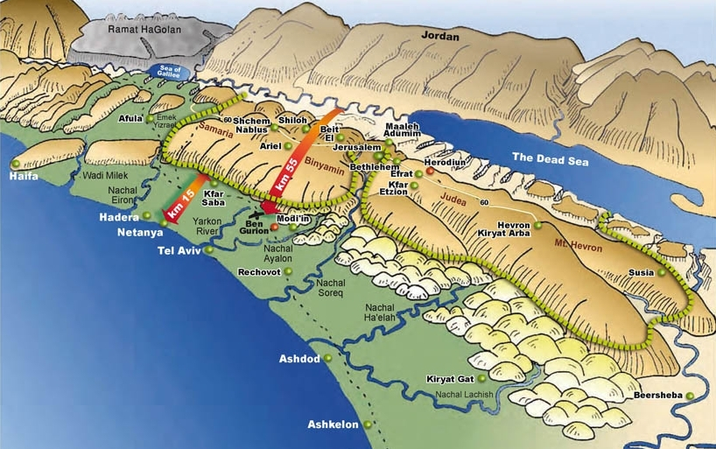

Slide 13
This explains why the land must be flattened for
this distance

Slide 14
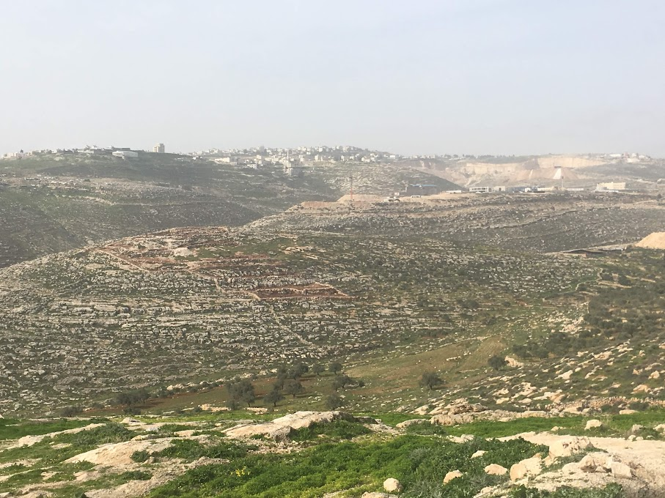

Slide 15
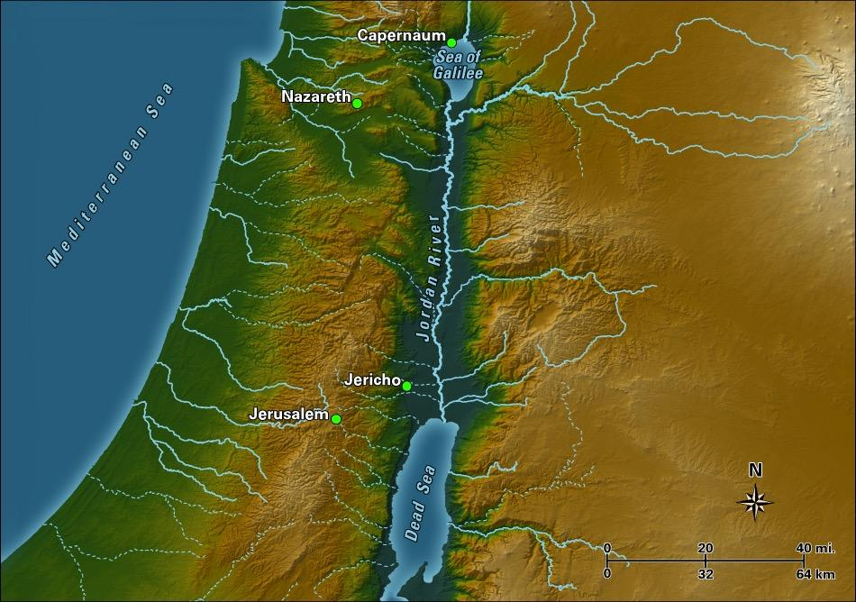

Slide 16
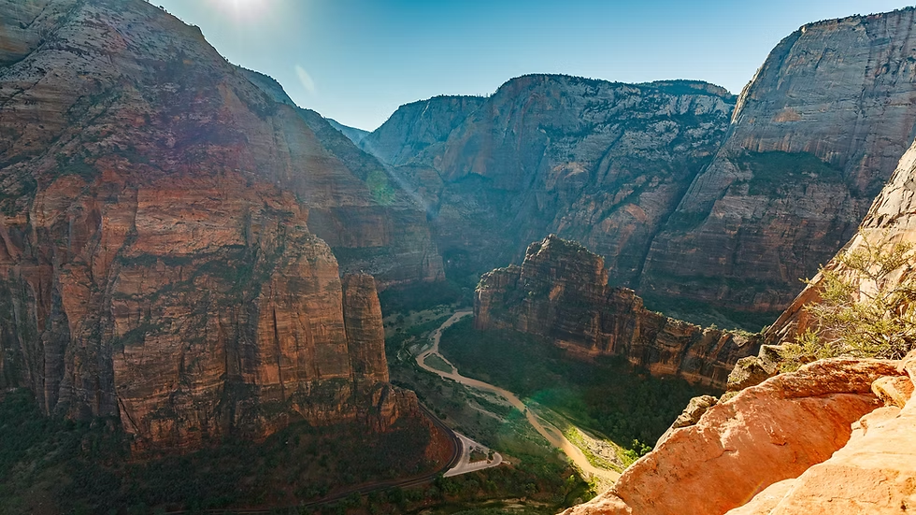

Slide 17
Plain of Sharon
(Isa.65:10;
1 Chr.5:16)
On either end of the “hump” there are two famous plains
The Arabah
(2 Kgs.14:25)

Slide 18
CHANGES AFFECTED BY EARTHQUAKE
Land flattened to pave way for Temple worship
Clear a path for Jews escaping the Land (v5)
Open a way for those returning with Elijah in the 2nd Exodus (Hosea 2:14-15, Isaiah 65:10)
Allow living waters to flow down from the altar into the Dead Sea, thus healing it (Ezekiel 47)

Slide 19
ZECHARIAH 14:6-7
“that the light shall not be clear nor dark” - Bro. Thomas translates, “it shall be in that day, there shall be no brightness, the splendid ones drawing in”. This is followed by the Revised Version. Christ and the Saints initially withdraw their full glory (Hab. 3:4) as a test to the world.
“but it shall come to pass that at evening time, there shall be light” - Once the day (40 years) of judgement is passed, the light of the glorified Saints will be seen in full radiance.

Slide 20
THE BATTLE OF BETH-HORON (JOSHUA 10)
Yahweh fought (Zech. 14:3, Josh. 10:14)
At evening time, shall be light (Zech. 14:6, Josh.10:13)
All the Saints with thee (Zech. 14:5, Josh. 10:7)
No more the Canaanite in the house of Yahweh (Zech. 14:21, Josh. 10:1)
The King (Zech. 14:9,16, Josh. 10:42)

Slide 21
