Slide 1
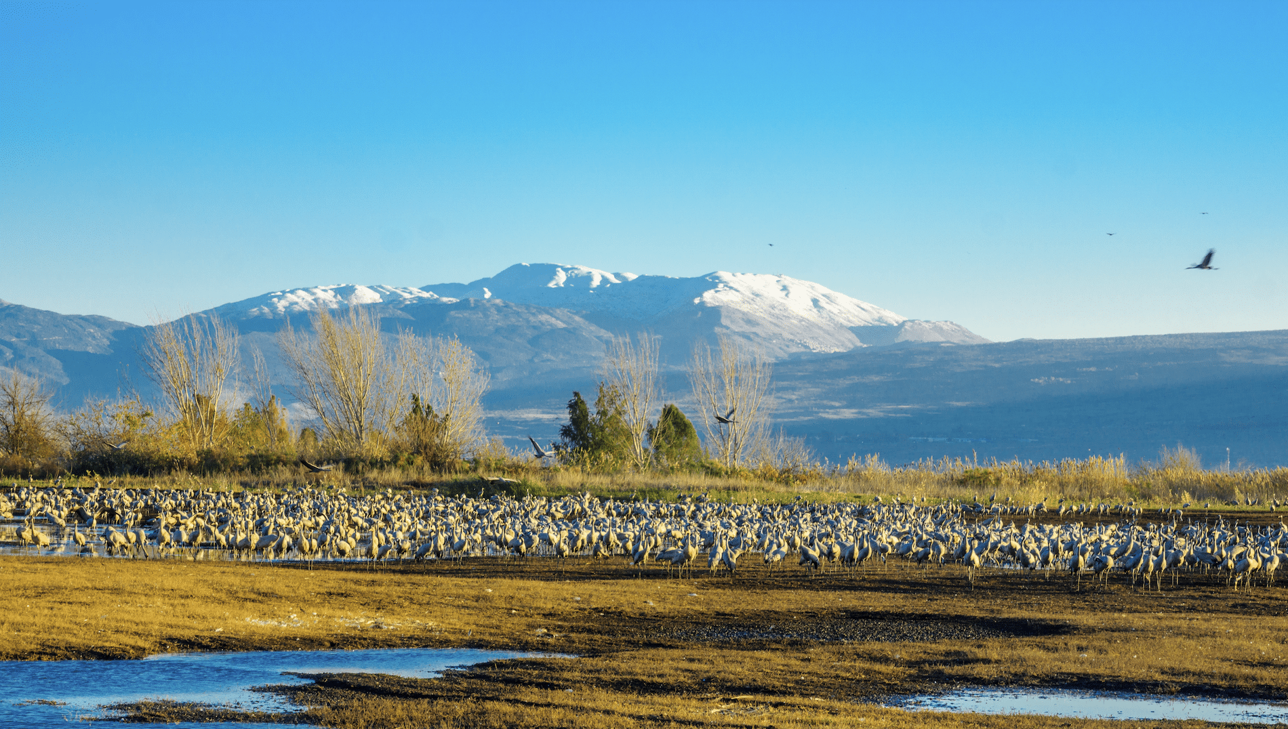
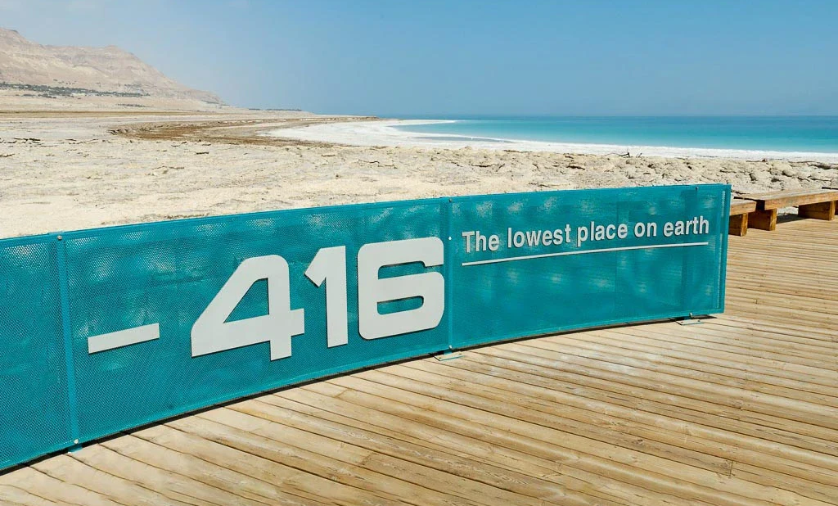
The Geography of the Holy Land
Class 4
Hermon to the Dead Sea

Slide 2
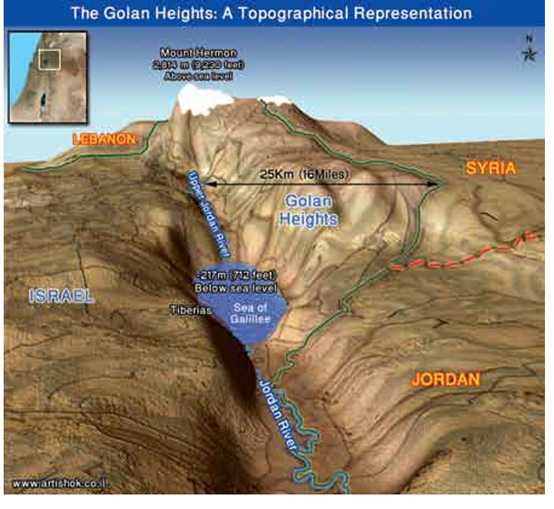

Slide 3
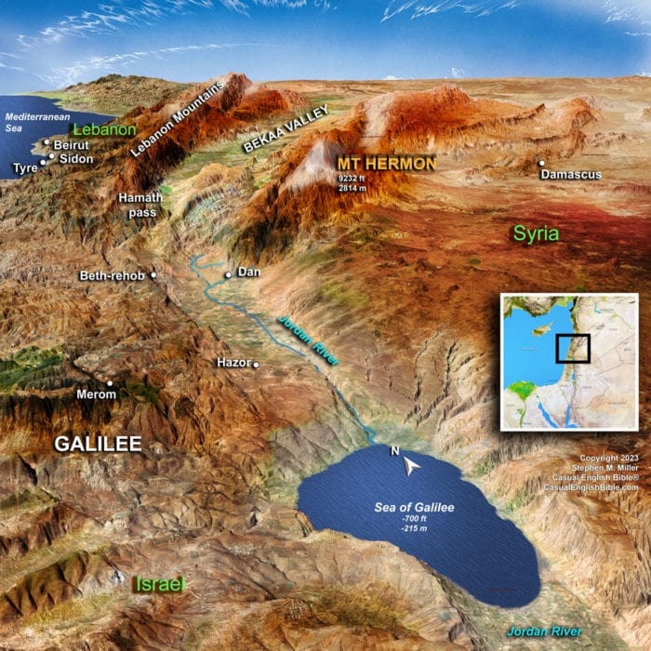

Slide 4
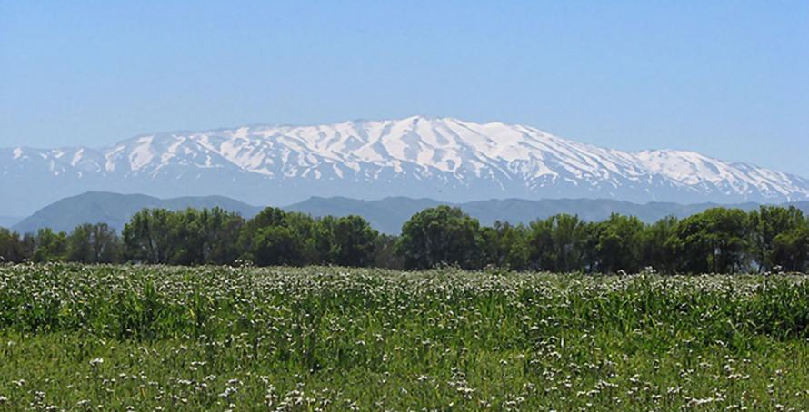
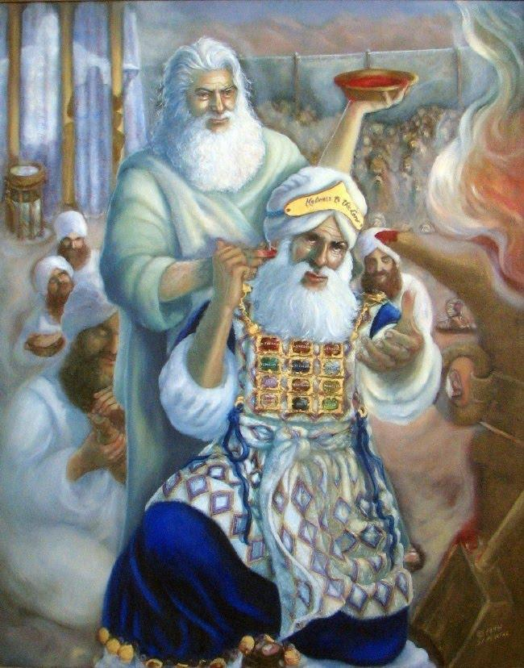
Hermon with its white head is likened to the high priest wearing his mitre, its blue lace is like the robe of the ephod.
Hermon’s triangular strips of snow give every appearance of the beard of maturity.

Slide 5
The other names for Hermon (Deut. 3:9) as given by the Gentiles were Sirion (“to glitter”) and Shenir (“to clatter”).
The word for Sirion is from the same root as “Habergeon” used in respect to the collar of the ephod (Exo. 28:31-32)

Slide 6
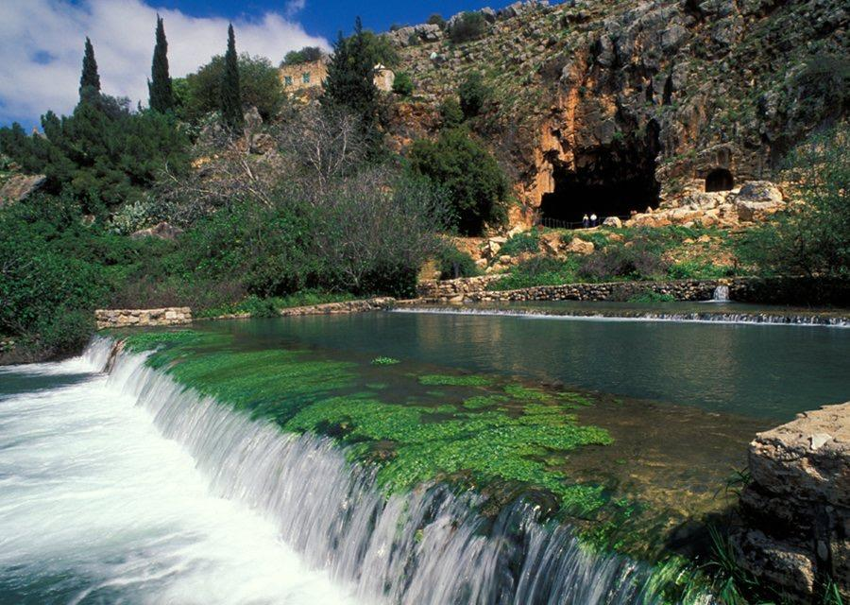

Slide 7
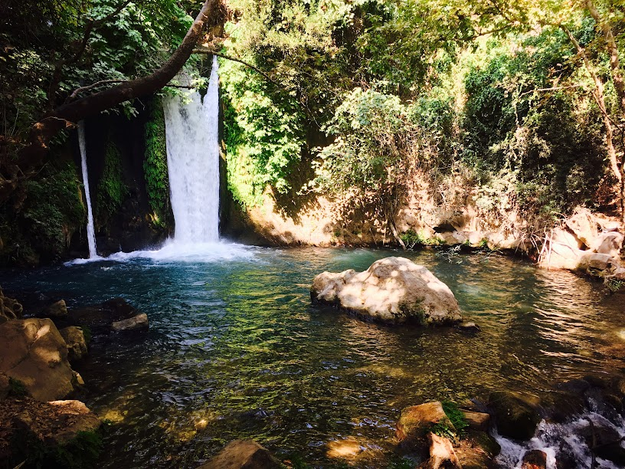

Slide 8
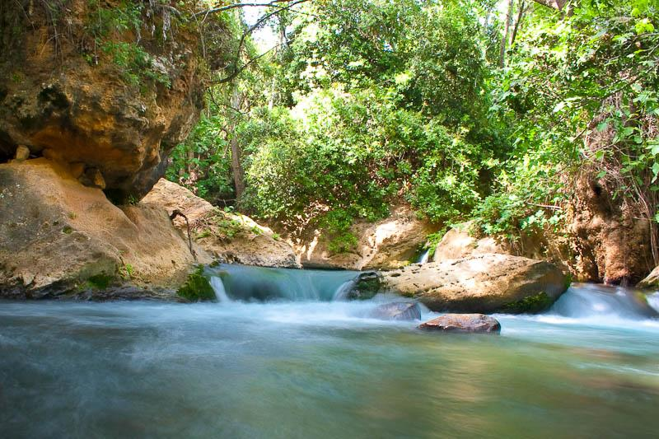

Slide 9

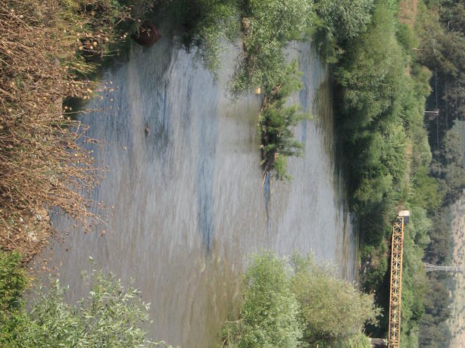
OVER A SHORT DISTANCE OF 30 MILES TO THE SOUTH THE WATER HAS TURNED BROWN AND MURKY INDICATING MAN’S RAPID DECLINE HENCE THE NAME JORDAN MEANS “DESCENDER”

Slide 10
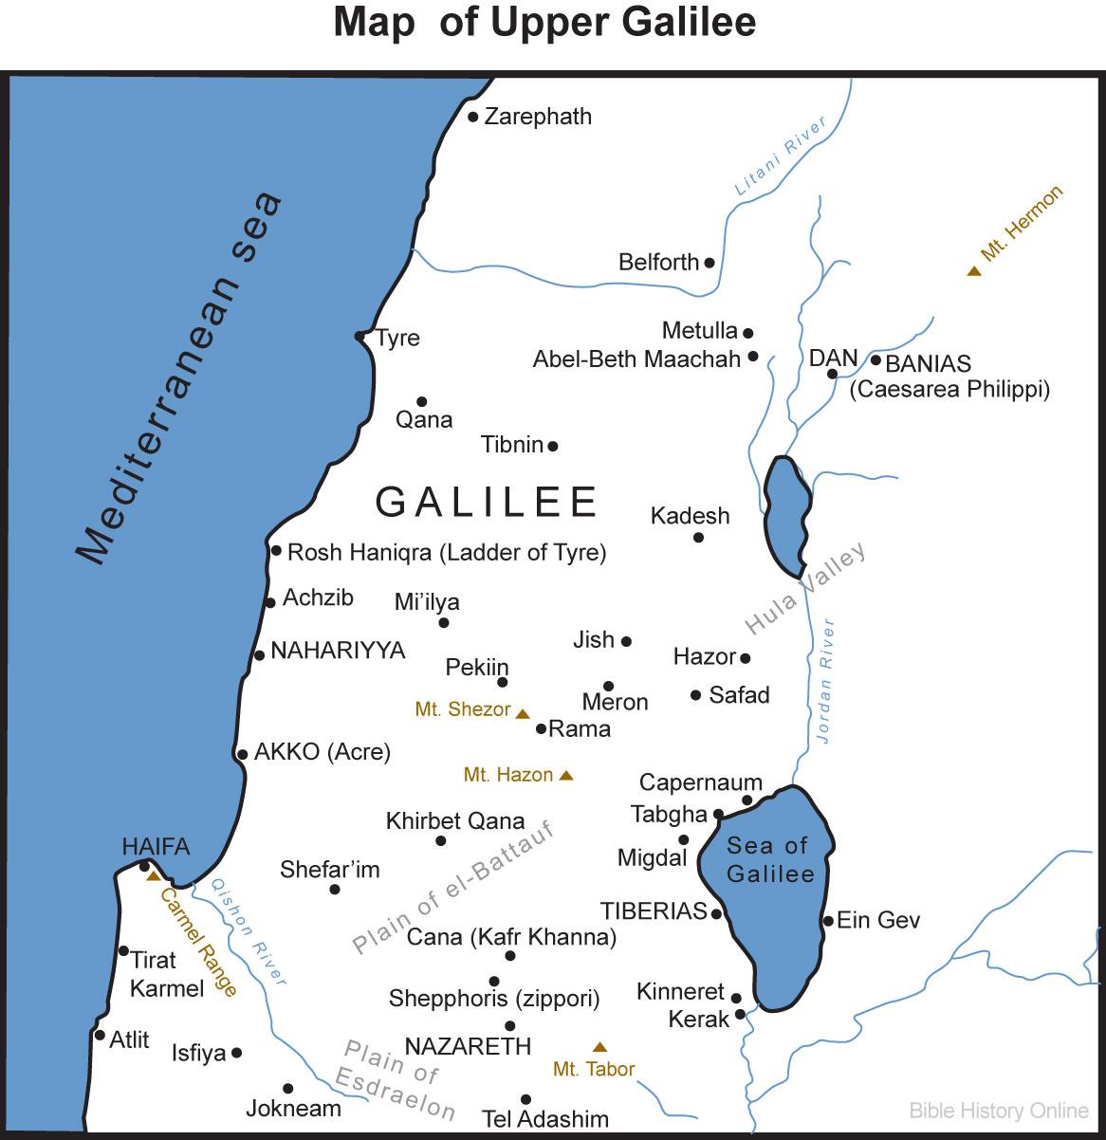

Slide 11
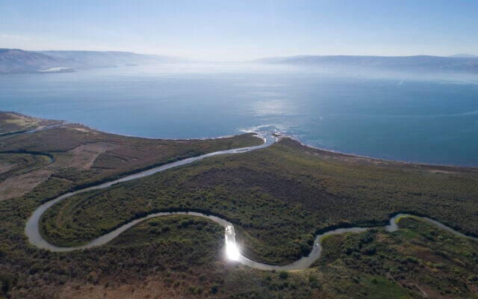

Slide 12
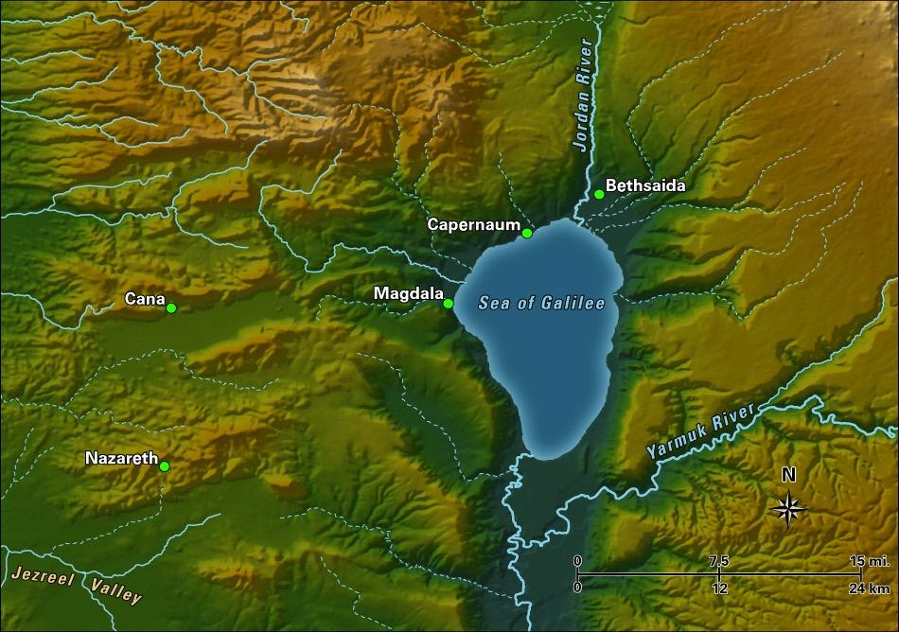

Slide 13
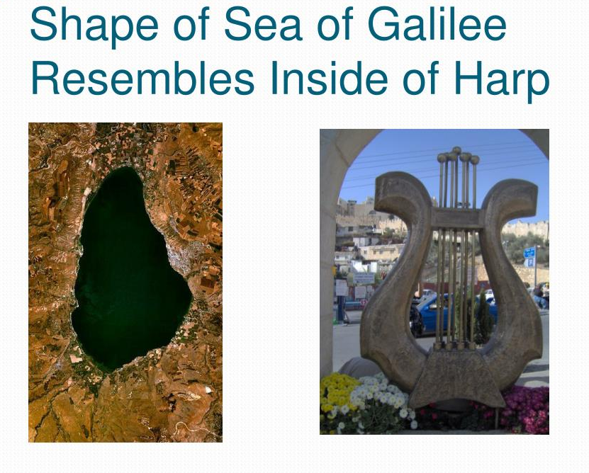
Galilee - The Ring
Gennesaret-
Harp shaped

Slide 14
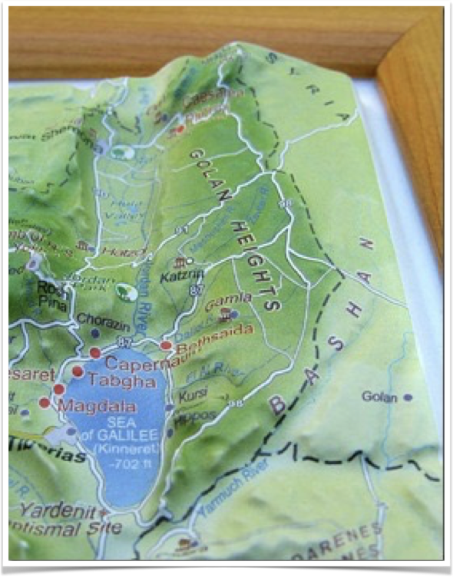
THE SEA OF GALILEE
(702 FT BELOW SEA LEVEL) IS ALSO REFERRED TO AS
“THE SEA OF TIBERIAS”
(JN. 21:1) AND REPRESENTS THE SEA OF THE NATIONS WHICH CAN ONLY BE CALMED BY CHRIST

Slide 15
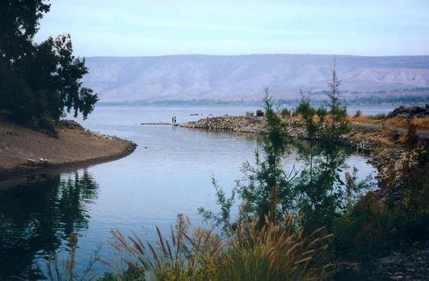

Slide 16
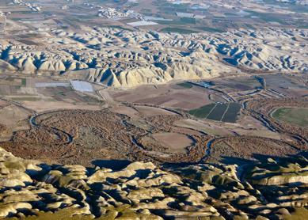

Slide 17
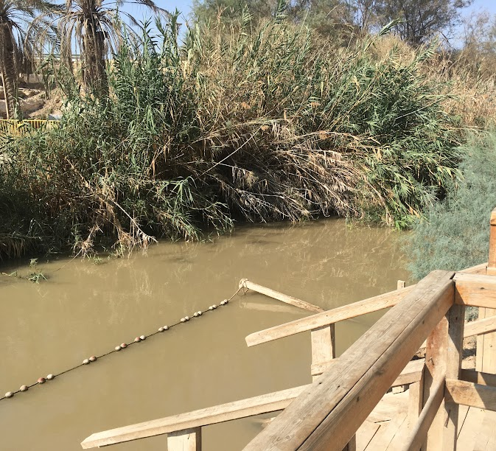
AS IT APPROACHES THE DEAD SEA THE WATER OF THE JORDAN BECOMES MORE STAGNANT AND TURGID DEMONSTRATING MAN’S INEVITABLE DESTINY

Slide 19
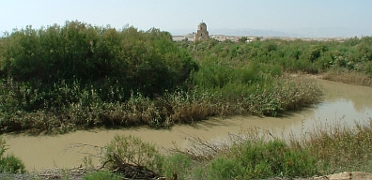

Slide 20

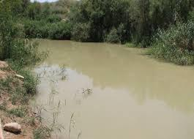
JORDAN WAS NOTED FOR DANGER, BEING A HABITATION FOR LIONS (JER. 49:19) AND SERPENTS (MATT 3:7)
THE PROPHETS WARNED THOSE WHO CAME IN CONTACT WITH IT (JER. 12:5,
ZECH. 11:3)

Slide 21
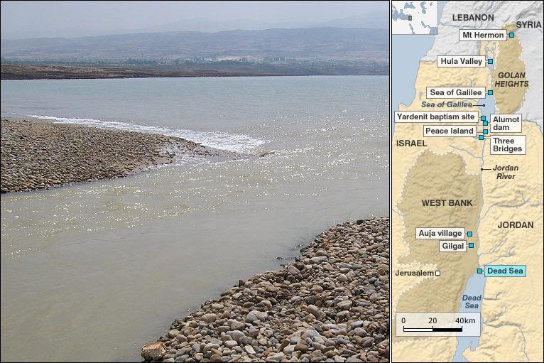

Slide 22
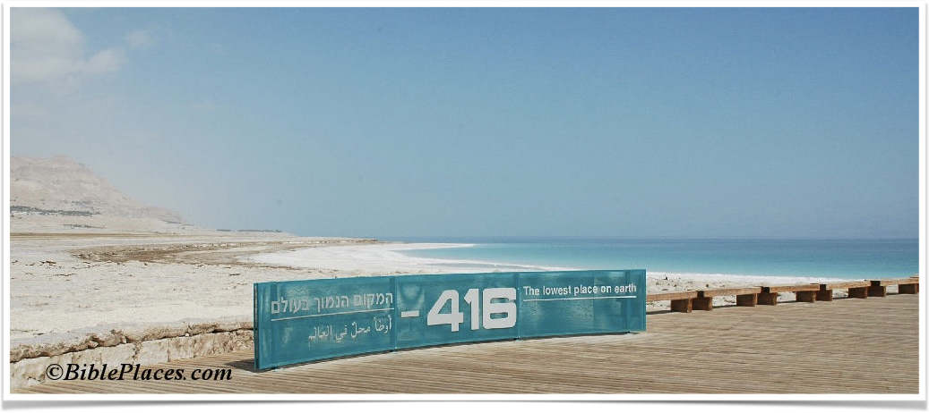
HAVING MADE ITS WAY TO THE DEAD SEA, MAN’S ULTIMATE END IS NOW REALIZED IN DEATH, IN THE LOWEST PART OF THE EARTH

Slide 23
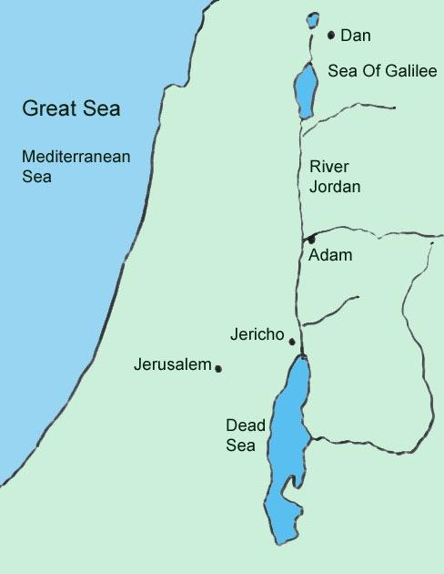
ONLY BY OUR IDENTIFICATION WITH CHRIST CAN THE SURE SENTENCE OF DEATH INHERITED FROM ADAM BE REVERSED
(JOSH. 3:14-17)

