Slide 1
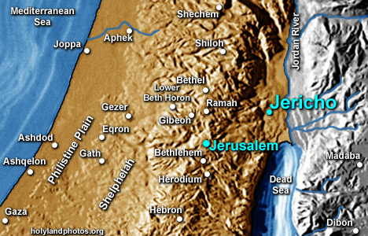
The Geography of the
Holy Land
Class 5
Jericho to Jerusalem

Slide 2
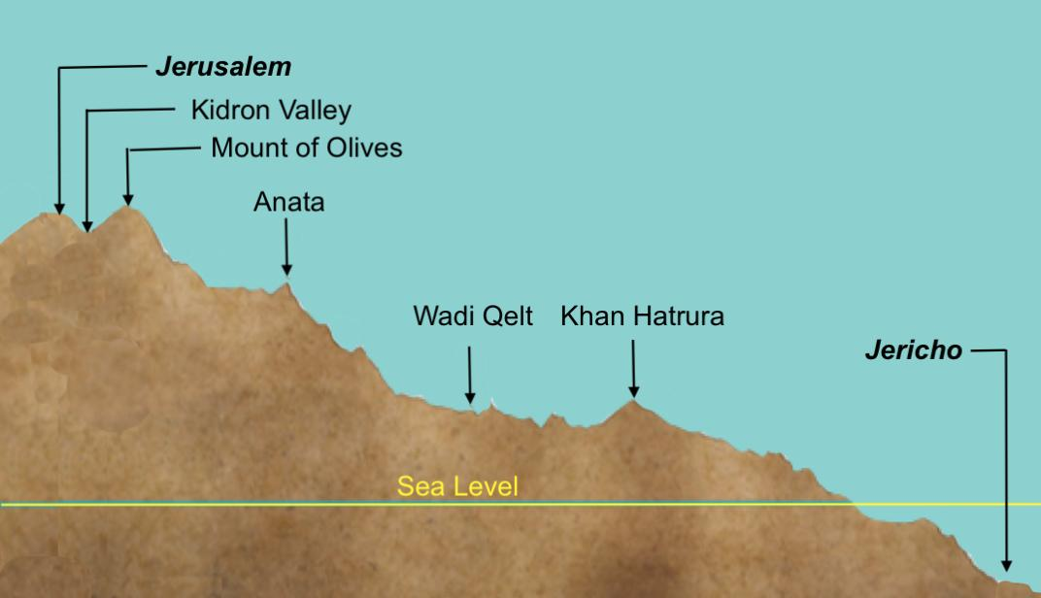

Slide 3
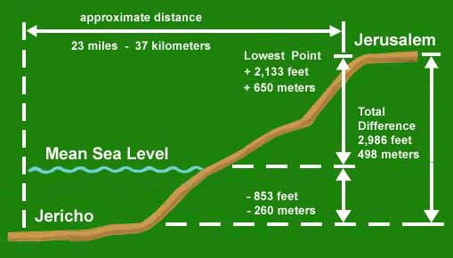
City of the Curse to the City of God

Slide 4
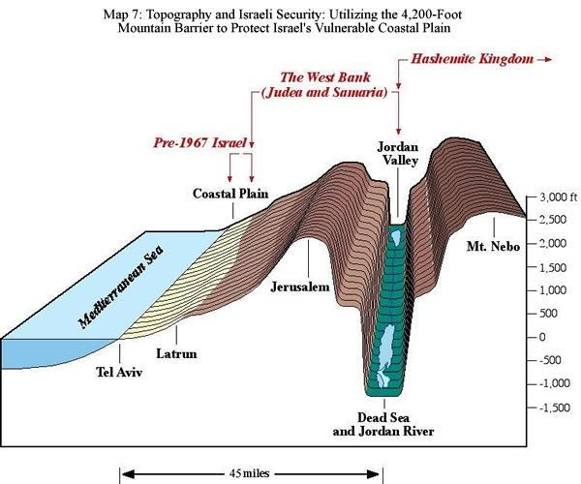

Slide 5
City of the Curse to the City of God

Slide 6
FACTS ABOUT JERICHO
Typified whole land of Canaan (Josh. 24:11)
A curse was placed upon it (Josh. 6:17)
Signifies “fragrance”
Noted for palm trees (Deut. 34:3, Gentiles)
Bitter waters made sweet by Elisha (2 Kgs. 2:19-22)
Blind Bartimaeus, the son of Timaeus (Mk. 10:46)

Slide 7
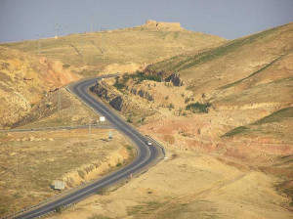
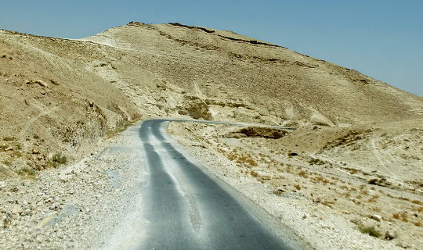

Slide 8
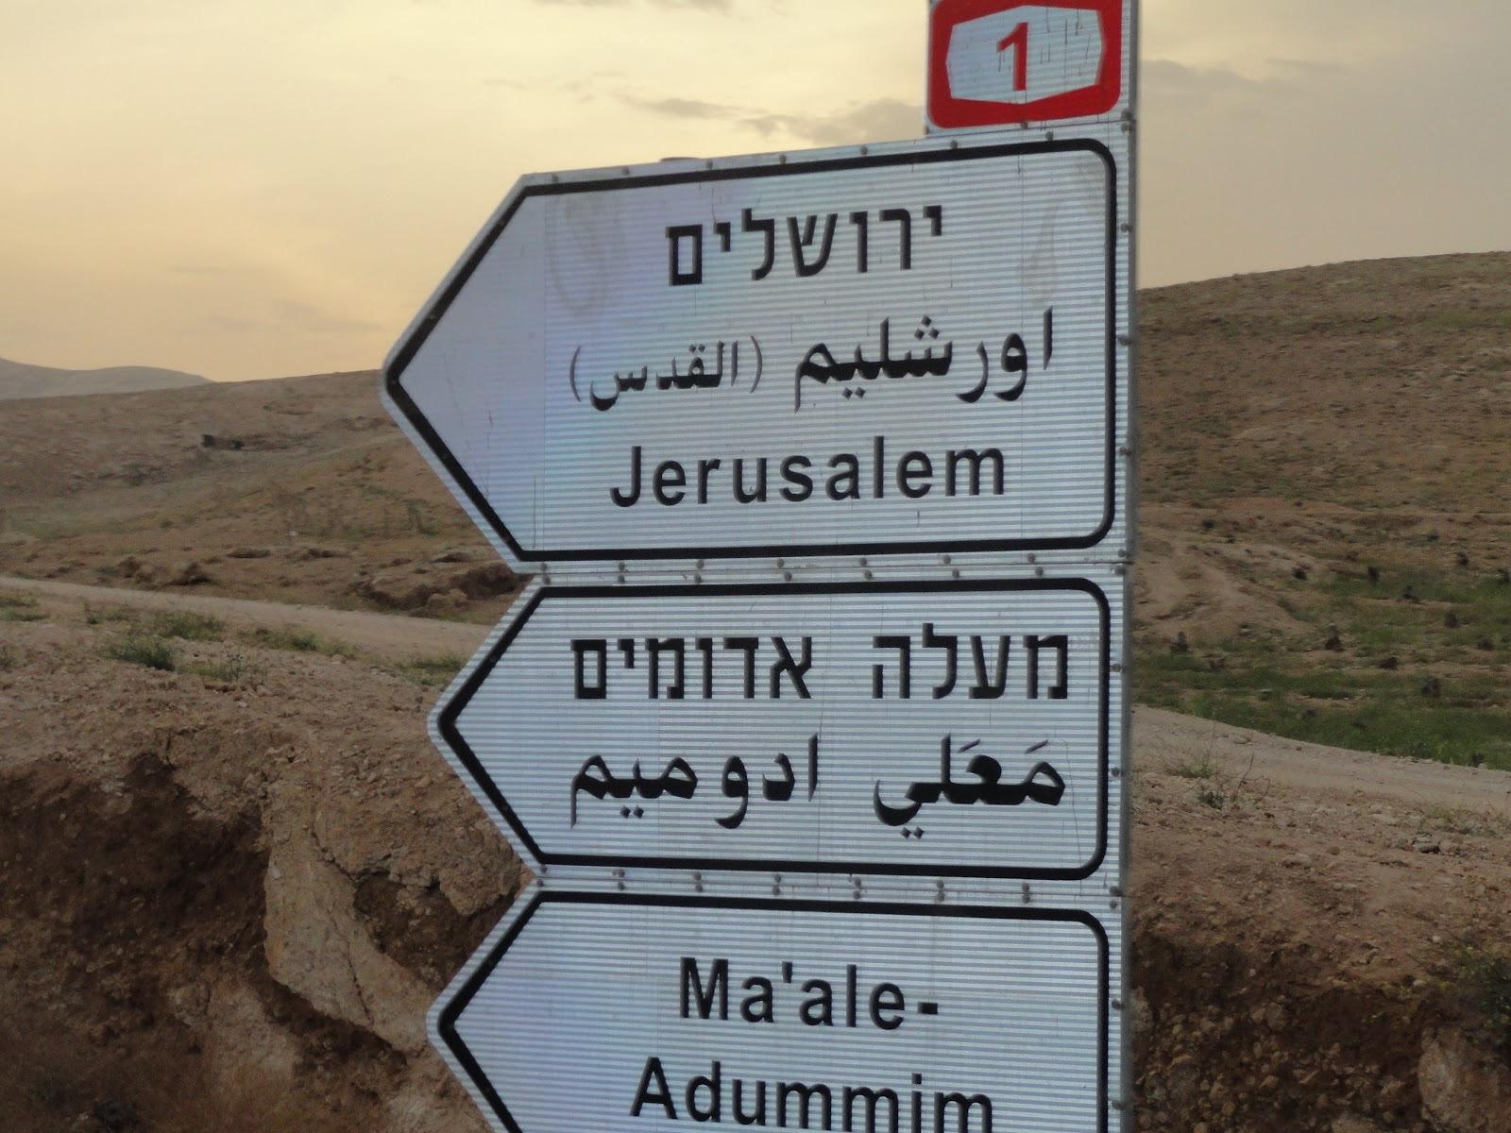

Slide 9
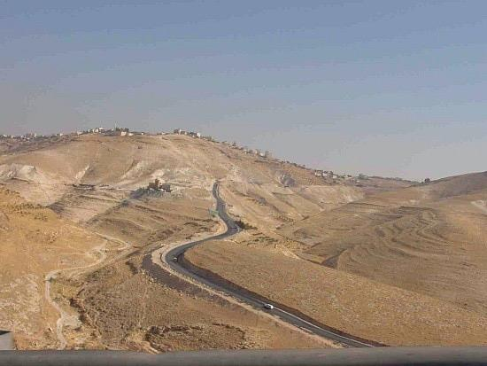

Slide 10
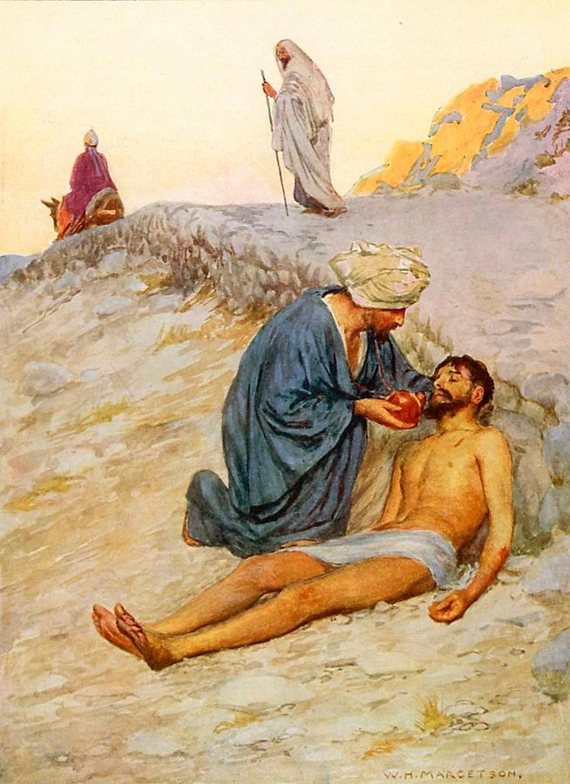
Samaritan - Our Lord
(Jn. 8:48)
Journeyed - took the same road as us (Heb. 2:14)
Bound up - forgiveness
(Isa. 61:1)
Inn - Ecclesia
On the morrow he departed - Spent the evening (death)
Two pence - Approximate value of a 1/2 shekel
(Ex. 30:13, Redemption)
When I come again, I will repay - 2nd Coming

Slide 11
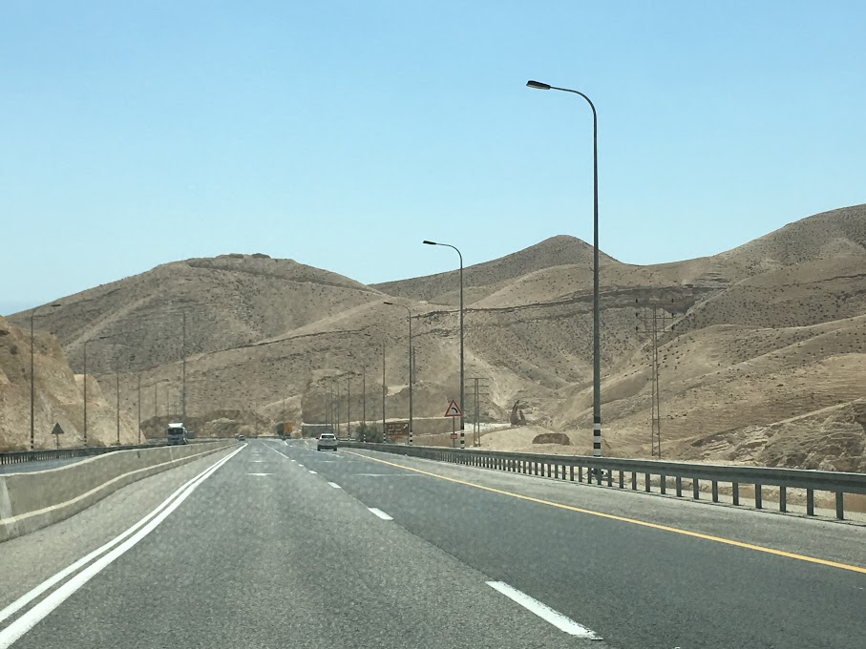

Slide 12
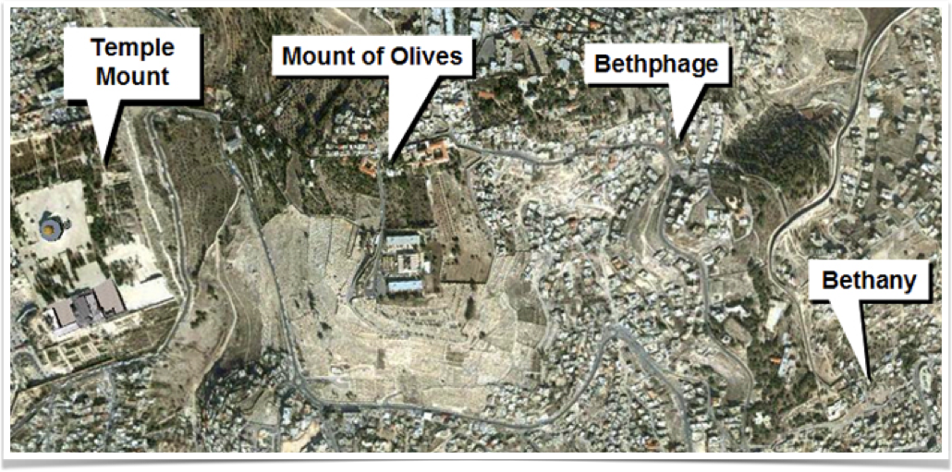

Slide 13

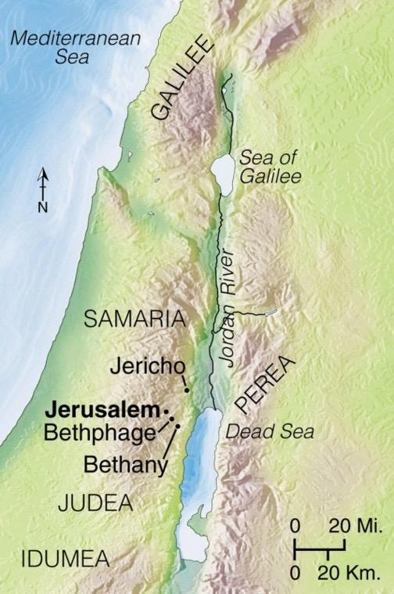
In the Lord’s final week he set his face towards Jerusalem seeking to unite all men on the basis of his sacrifice
Coming first to Beth-phage (house of figs, the Jews)
Then to Bethany (house of dates, the Gentiles)
Sends forth two disciples to find two animals in a place where two ways met
Spreading palm branches (Feast of Tabernacles)
Promise of a House of Prayer for all nations

Slide 14
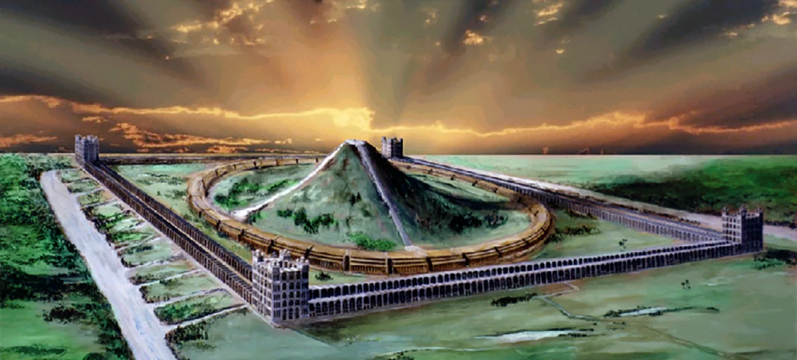
Even so Come, Lord Jesus!

